Slide 1




PARTICIPANT PRESENTATION
Participant Details
Qiskit
Fall Fest
2026
PROJECT TITLE
Integrated Dynamical Decoupling & Error Mitigation Pipeline for NISQ Workflows
TRACK
DD + Error Mitigation Pipeline
TEAM NAME
QubitCrew · VTU-QFF-HC-0184
TEAM LEADER
Prisha Bharti
EMAIL / CONTACT
[add team lead email]
Hackathon · Team Details
TEAM MEMBERS
Aarti Singla · Angel Garg
INSTITUTION / ORGANISATION
[add college name]
COUNTRY
India

Slide 2
Problem Statement
Track: Integrated Dynamical Decoupling and Error Mitigation Pipeline for NISQ Workflows.
The problem: on today’s noisy devices, qubits sit idle while others run gates. Idle qubits dephase and pick up coherent ZZ crosstalk from their neighbours, so fidelity collapses long before the algorithm finishes.
The gap: dynamical decoupling (DD) and error mitigation (ZNE, readout) are usually applied separately and by hand, with one fixed pulse sequence that ignores what kind of idle window it is protecting.
Our goal: one automated, hardware-aware pipeline: schedule the circuit, find and classify idle windows, choose and place DD, layer mitigation on top, and benchmark against Qiskit’s own DD and IBM Runtime.
Deliverable: an open-source Python package (ddpipe), a drop-in Qiskit transpiler pass and a Streamlit app, validated on real IBM Heron r2 hardware.

Slide 3
Objectives & Novelty
Objectives
Detect idle windows directly from a scheduled circuit and label each as idle-idle or crosstalk-idle.
Insert DD trains that compose to the identity and fit inside each window (XY4, uniform or staggered).
Combine DD with ZNE (CX folding) and readout-error mitigation in one pipeline.
Benchmark fairly against Qiskit PadDynamicalDecoupling and IBM Runtime DD, in simulation and on hardware.
Novelty
Staggered DD: pulse timing is offset between coupled neighbours so their ZZ interaction does not accumulate.
Auto mode: chooses pulse family and spacing per window by minimising a ZZ-frame cost, with “no DD” always a candidate.
IdleAwareDD: all of it packaged as a standard Qiskit transpiler pass, one line in a PassManager.

Slide 4
Solution & Quantum Advantage
Pipeline: 1 Schedule (ALAP, real gate durations) → 2 Analyse idle windows → 3 Protect with DD → 4 Mitigate (ZNE + readout) → 5 Benchmark.
Where the benefit comes from: long synchronous idle periods, e.g. spectator qubits waiting while a GHZ chain runs, and larger circuits such as a 6-qubit QAOA ring.
Hardware (spectator test): mean idle-qubit ⟨X⟩ rises from −0.05 (no DD) to 0.78 with staggered DD on ibm_fez, and from 0.28 to 0.82 on ibm_kingston (ideal = 1).
Simulation: auto-DD cuts mean infidelity from 0.281 to 0.129, a 54% reduction; Qiskit’s DD reaches 0.142.
What “advantage” means here: we do not claim a computational speed-up. The advantage is fidelity: keeping idle-heavy circuits usable on today’s noisy devices, at no extra qubits.

Slide 5
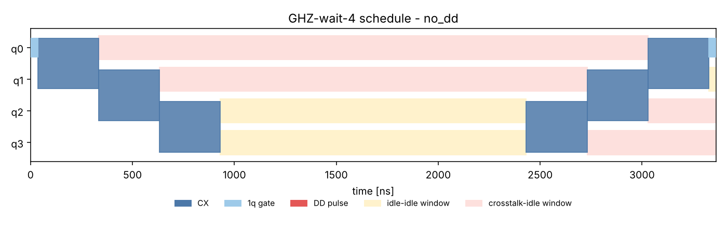
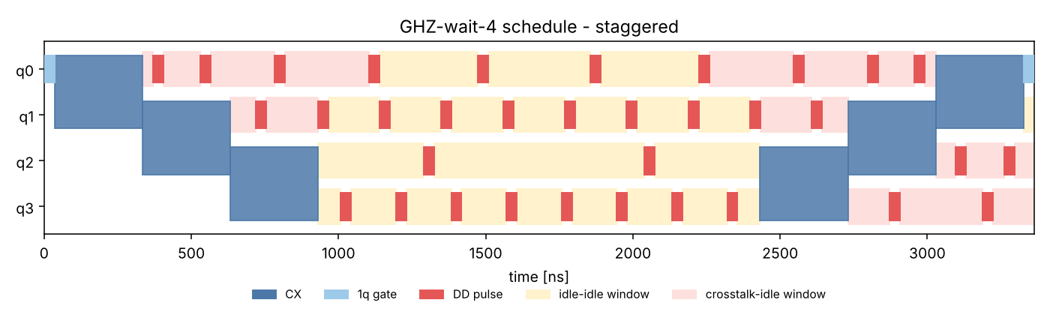
Algorithm & Circuit Design
Circuits: GHZ-wait-4, QAOA-ring-6, VQE-TFIM-4.
Schedule: transpile, ALAP schedule, PadDelay.
IdleAwareDD pass: XY4, τ = 600 ns, windows ≥ 250 ns, ≤ 16 pulses, uniform or staggered.
Mitigation: ZNE by CX folding (G G† G, scales 1, 2, 3) plus readout correction.
Figure: red = DD pulse, yellow = idle-idle window, pink = crosstalk-idle window. Top: before DD. Bottom: staggered DD.

Slide 6
Implementation & Tech Stack
Core: Python, Qiskit ≥ 2.1 (circuits, PassManager, ALAPScheduleAnalysis, PadDelay, custom TransformationPass), NumPy, SciPy, pandas, Matplotlib, Plotly.
Simulation: Qiskit Aer and an exact density-matrix model with drift, ZZ crosstalk and imperfect pulses.
Hardware: qiskit-ibm-runtime EstimatorV2 on IBM Heron r2 devices: ibm_fez, ibm_kingston, ibm_marrakesh (Open Plan).
Package ddpipe: scheduler, idle-window analyser, DD injector, mitigation (ZNE, readout) and passes.py with IdleAwareDD.
Interface: Streamlit app with four tabs: schedule explorer, live benchmark, hardware evidence, about.
Quality: 37 pytest tests (including that every DD train composes to the identity), committed results, scripts to reproduce every hardware run.

Slide 7
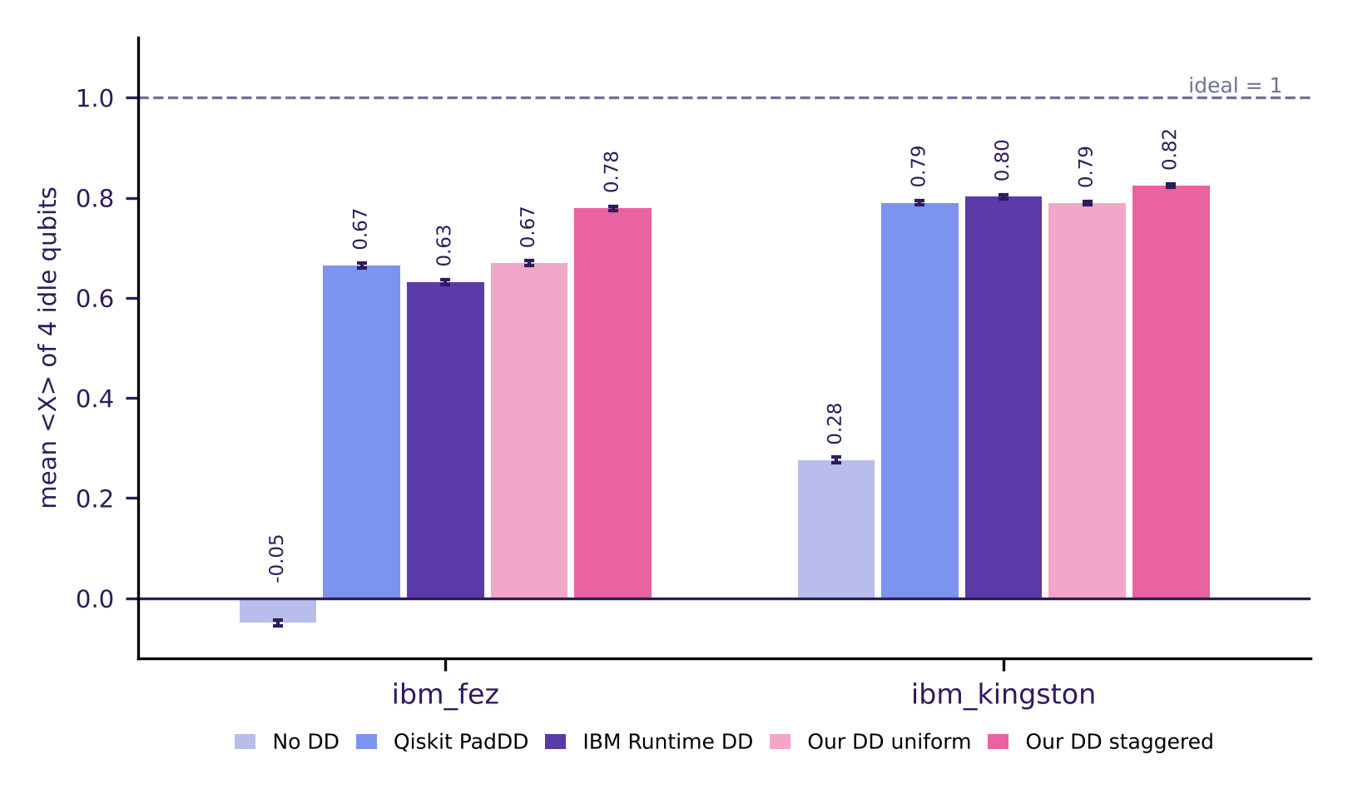
Results & Analysis
Staggered DD is best on both devices, in all 3 interleaved repeats.
ibm_fez: 0.78 vs Qiskit 0.67, IBM Runtime 0.63, our uniform 0.67, no DD −0.05.
ibm_kingston: 0.82 vs 0.79, 0.80, 0.79; no DD 0.28. Margin over IBM’s DD is small.
Crosstalk test (fez): staggered 0.82 vs uniform 0.72.
Simulation: mean infidelity 0.281 → 0.129 (−54%); Qiskit DD 0.142.
Metric: mean ⟨X⟩ of 4 idle qubits, ideal = 1; error bars are standard errors.

Slide 8
Impact & Real-World Applications
Who benefits: anyone running circuits with idle time on NISQ hardware: variational algorithms (VQE, QAOA), state preparation and circuits with mid-circuit waits.
Lower barrier: IdleAwareDD drops into an existing Qiskit PassManager, so DD no longer needs hand-built sequences.
Fair benchmarking: one tool that compares no DD, Qiskit DD, IBM Runtime DD and ours on the same circuits, with the raw hardware job results committed.
Useful today: better fidelity from existing devices, with no extra qubits or hardware changes, which helps near-term chemistry and optimisation experiments reach deeper circuits.
Education and research: the schedule explorer shows exactly which windows get which pulses, making DD behaviour easy to teach and inspect.

Slide 9
Challenges & Future Scope
Challenges
Free-plan QPU time limits repeats; hardware baselines drift between sessions, so we compare only within a run.
Our DD plus ZNE did not beat Runtime’s ZNE alone on ibm_marrakesh (0.74 vs 0.80), and the margin over IBM’s DD on ibm_kingston is small.
Every spectator-circuit window was classified idle-idle, so results support the injector and staggering more than the crosstalk-idle label itself. Busy-qubit fidelity is dominated by CZ errors.
Future scope
More repeats and devices; per-qubit ZZ rates read from backend calibration; richer sequences (UDD, CDD); dynamic circuits; tighter integration with Runtime resilience options.

Slide 10
CLOSING
Thank You
Questions?
Inspiring Minds. Shaping Tomorrow.
GITHUB REPOSITORY
github.com/vtu-qiskit-fall-fest-2026/vtu-hc-qubitcrew
DEMO VIDEO LINK
[add YouTube link]
PROJECT SITE
[add site link]

