Slide 1




PARTICIPANT PRESENTATION
Participant Details
Qiskit
PROJECT TITLE
Q-Charge Fair
Fall Fest
TEAM NAME
Qubits Nexus
TEAM ID
VTU-QFF-HC-0029
TEAM LEADER
Aliya Mulla
EMAIL / CONTACT
aliyamulla098@gmail.com
2026
TRACK
Quantum Applications for Climate Change and Sustainability
Hackathon · Team Details
EVENT
VTU-Qiskit Fall Fest 2026
TIER
Online
TEAM MEMBERS · GITHUB ID
Aliya Mulla — Team Leader · aliyamulla098-spec
Arsin Imtiyaz Karadagi · Arsinkaradagi
Zaveerya Mulla · ZaveeryaMulla
INSTITUTION / ORGANISATION
Visvesvaraya Technological University
COUNTRY
India

Slide 2
The Challenge
EV charging stations operate under limited grid capacity and must serve vehicles with different energy requirements and departure deadlines.
Conventional scheduling can create peak electricity demand, leave charging needs unmet, and distribute available charging capacity unfairly.
Finding a schedule that balances grid constraints, energy demand, deadlines, and fairness is a constrained optimization problem.
WHAT WE BUILT
A Streamlit prototype pairs an interactive classical greedy scheduler with a separate QAOA demonstration. The QAOA example uses a fixed two-EV, one-slot model and a local statevector simulator.

Slide 3
Objectives & Novelty
Objectives Addressed
What Makes Q-Charge Fair Different?
Demonstrate a binary charging model with a grid cap.
Reward charging for higher-priority EVs.
Compare the app’s classical scheduler with a separate, fixed QAOA example.
Report metrics available in the prototype.
Treat quantum advantage as an open research question.
Pairs an interactive Streamlit scheduler with a small Qiskit QAOA demonstration.
The QAOA example uses a fixed two-EV, one-slot scenario.
Presents prototype outputs as an experiment without claiming quantum advantage.

Slide 4
Our Solution
BENCHMARKING SCOPE
1 MODEL
Represented EV charging decisions as binary variables.
A controlled comparison on identical inputs remains future work. Benchmarking should measure:
2 OPTIMIZE
Formulated a constrained binary optimization problem and converted it into a QUBO/Ising representation.
Candidate schedule quality
Execution time
Scaling
Constraint satisfaction
3 SOLVE
Implemented QAOA with Qiskit to generate candidate charging schedules.
4 COMPARE
The interactive app uses the classical scheduler; its scenario is separate from the fixed QAOA example.
5 EXPLAIN
Streamlit presents scenario inputs, schedules, and the performance metrics available in the prototype.
Quantum advantage is reported only if supported by measurements. None is claimed in this presentation.

Slide 5
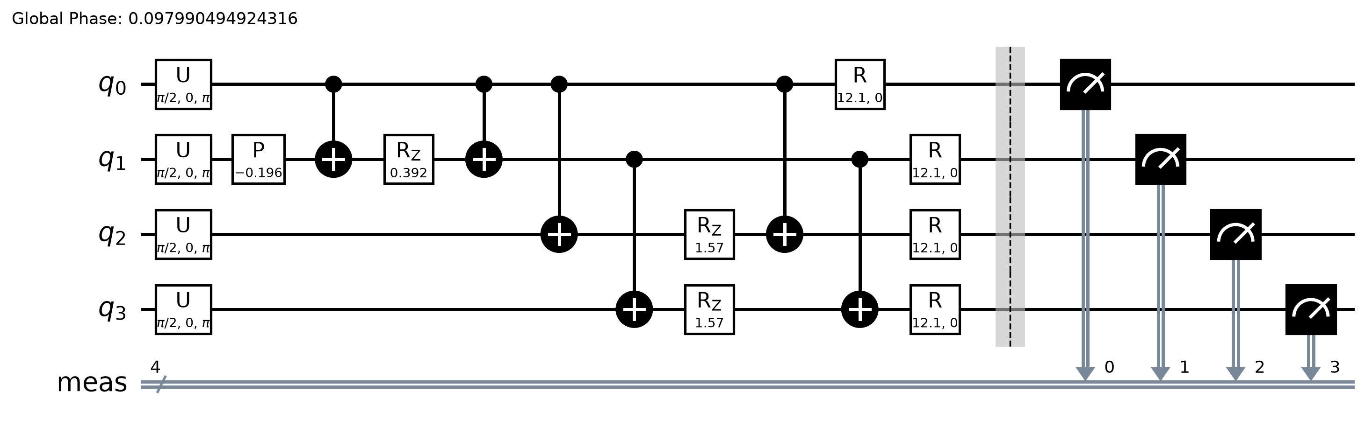
Algorithm: Quantum Approximate Optimization Algorithm (QAOA)
Implemented Workflow
Implemented QAOA Circuit
Key Components
Variables: Binary 1-kWh EV-slot charging assignments.
Objective: Reward charging higher-priority EVs.
Constraints: EV energy requests and per-slot grid limit.
QAOA: One layer (p=1), COBYLA (5 iterations), 64 simulator shots.
Measurement: Decode bitstrings as schedule candidates.
EV charging inputs
Binary optimization model
QUBO/Ising Hamiltonian
QAOA circuit
Measurement
4 qubits, measured on all qubits
Candidate schedule
Evaluation
Performance evaluation
The small QAOA output is examined alongside classical baseline results.

Slide 6
Technology Stack
What We Used
Implementation Pipeline
Programming Language | Python
Quantum Framework | Qiskit
Optimization | QUBO / Ising formulation and QAOA
Classical Baselines | Greedy scheduling and a classical optimization baseline
Data Analysis | NumPy, pandas, Matplotlib
User Interaction | Interactive web application with an AI planning agent for scenario inputs and trade-off explanations
1
Defined a small, reproducible EV charging scenario.
2
Formulated the optimization model.
3
Implemented and ran QAOA with Qiskit.
4
Generated classical baseline schedules.
5
Calculated and visualized performance metrics in the web application.

Slide 7
Results & Analysis
Methods Evaluated
Implemented Evaluation Metrics
Classical optimization baseline
Peak Load: Maximum total charging demand in a time slot.
Unmet Demand: Energy requirements not satisfied before departure.
Grid Violations: Magnitude of grid-capacity breaches.
Fairness: How equitably charging is distributed (Jain index).
Execution Time: Time required to obtain a schedule.
QAOA
Greedy scheduling
Same test scenarios for every method
OBSERVED OUTPUT — DEMO SCENARIO IN THE APPLICATION
Unmet energy
3.0 kWh
Peak load
3.0 kW
Grid-limit violation
0.0 kWh
Fairness (Jain index)
0.933
Limitations
Grid limit 10 kW · 4 time slots · 60 min per slot
Benchmark measurements (runtime, scaling, QAOA run variability) are not reported here.
No quantum advantage is claimed.
Conclusion: The working system generates schedules, reports peak load, unmet energy, grid violations and fairness, and supports QAOA-versus-classical comparison.

Slide 8
Impact & Real-World Applications
Impact
Potential Applications
Grid Sustainability: Schedules are evaluated against peak demand and grid limits.
Fair Access: Fairness (Jain index) quantifies how limited capacity is shared among EV users.
User Convenience: Schedules account for energy needs, departure deadlines and priorities.
Infrastructure Planning: Shows operators the trade-offs between capacity, demand, and fairness.
Quantum Research: Provides a testbed for hybrid quantum-classical optimization in energy management.
Public EV charging hubs
Commercial parking facilities
Workplace charging
Fleet depots
Smart-grid planning

Slide 9
Challenges & Future Scope
Challenges & Limitations
Future Improvements
SUMMARY
We built, implemented, tested and demonstrated Q-Charge Fair: a transparent, grid-aware scheduling system whose quantum-advantage claims are reserved for measured evidence.
Encoding charging constraints into a compact binary optimization model.
Managing QAOA circuit depth, parameter tuning, and sampling variability.
Ensuring fair comparison with classical optimization methods.
Scaling beyond small demonstration scenarios.
Balancing multiple objectives without violating hard grid constraints.
Test larger and more diverse EV charging scenarios.
Explore adaptive QAOA parameters and alternative quantum optimization methods.
Incorporate renewable energy availability and time-of-use electricity prices.
Support real-time charging decisions from changing demand forecasts.
Evaluate performance on available quantum hardware.

Slide 10
CLOSING
Thank You
Questions?
Inspiring Minds. Shaping Tomorrow.
TEAM
Qubits Nexus
TEAM ID
VTU-QFF-HC-0029
TEAM LEADER
Aliya Mulla
TEAM MEMBERS
Arsin Imtiyaz Karadagi, Zaveerya Mulla
GITHUB IDS
aliyamulla098-spec · Arsinkaradagi · ZaveeryaMulla
EMAIL
aliyamulla098@gmail.com
INSTITUTION · COUNTRY
Visvesvaraya Technological University, India

