Slide 1




PARTICIPANT PRESENTATION
Participant Details
Qiskit
Fall Fest
2026
PROJECT TITLE
GreenQ: quantum scheduling for less carbon and water
TRACK
TEAM NAME
Track 6 · Climate & Sustainability
Response200 · VTU-QFF-HC-0137
TEAM LEADER
EMAIL / CONTACT
Jagpreet Singh
jagpreet.singh2060@gmail.com
Hackathon · Team Details
TEAM MEMBERS
Jagpreet Singh (Team Lead) · Ramandeep Singh (Developer)
INSTITUTION / ORGANISATION
COUNTRY
SRMIST and GTBIT
India
Notes:
We are Team Response200. Our project is GreenQ: it decides where and when to run flexible data-centre jobs so they use less carbon and less water. The optimiser is QAOA written in Qiskit, and we ran it on a real IBM quantum computer.

Slide 2



Problem Statement
Where and when a job runs changes its carbon and its water.
THE CONFLICT
Site A
Evaporative cooling
Site B
Air-cooled chillers
Many jobs can move: ML training, analytics, video rendering.
Electricity
▼ less
Electricity
▲ more
0.710
2.6 L
Water
▲ more
Water
▼ almost none
kg CO₂ per kWh on India's grid
water per kWh at coal plants
4 jobs × 2 sites × 2 time slots = 256 possible plans
Sources: CEA CO₂ Baseline Database FY 2024-25 · Macknick et al. 2012 (NREL)
Notes:
Data centres burn electricity, which means carbon, and they use water for cooling. Many jobs, like model training or analytics, are flexible: they can run at another site or at another time. The catch is that the two goals conflict. Evaporative cooling saves electricity but evaporates water; air cooling saves water but uses more electricity. So there is no single best site, and even four jobs give 256 possible plans. The grid and power-plant water figures are cited; site and job figures are illustrative.

Slide 3



Objectives & Novelty
OBJECTIVES
NOVELTY: A SMARTER ENCODING
Cut carbon and water together
 | Textbook one-hot | GreenQ
Qubits | 16 | 8
Valid answers | 0.39% | 100%
Two-qubit gates | ≈227 | 114
Penalty tuning | Needed | None
One slider sets which matters more
Decide where + when with QAOA
Built in Qiskit, run on real IBM hardware
Prove every answer
Graded against the true best of all 256 plans
2 qubits per job, a where bit and a when bit, so every measured answer is a valid plan. Gate counts are for ibm_marrakesh.
Notes:
Three objectives: cut carbon and water together with one priority slider; decide where and when with QAOA in Qiskit on real IBM hardware; and prove every answer against the true best. Our main design decision is the encoding. The textbook one-hot form needs 16 qubits and only 0.39 percent of its outputs are valid schedules. We give each job one 'where' qubit and one 'when' qubit: 8 qubits, every output valid, no penalty tuning, and half the two-qubit gates on the real chip.

Slide 4

Solution & Quantum Advantage
01
02
03
04
05
Jobs · sites · slots
Cost model
Hamiltonian
QAOA on IBM
Best plan
4 × 2 × 2 = 256 plans
kg CO₂ + litres, one slider
8 qubits · 31 terms
trained on a simulator
checked against all 256
≈2×
Quantum advantage
Path to scale
Not claimed at this size. A laptop checks all 256 plans in about 1 ms, so it is our referee.
more shots in the best 10% of plans than random guessing on ibm_marrakesh (18–23% vs 10%)
Qubits grow linearly: 2 per job. Bigger fleets need better hardware.
Notes:
The pipeline: we model the carbon and water of every plan, turn that cost into an 8-qubit Hamiltonian with 31 terms, train QAOA's two angles on a simulator, run the trained circuit on IBM hardware, and check the result against brute force over all 256 plans. On quantum advantage we are explicit: we do not claim it. At this size a laptop solves the problem instantly, and we use it as the referee. What the real quantum computer does show is a clear shift toward cheap plans: about twice as many shots land in the best 10 percent as with random guessing. Because each job needs only two qubits, the formulation scales linearly; what limits us today is hardware noise.

Slide 5
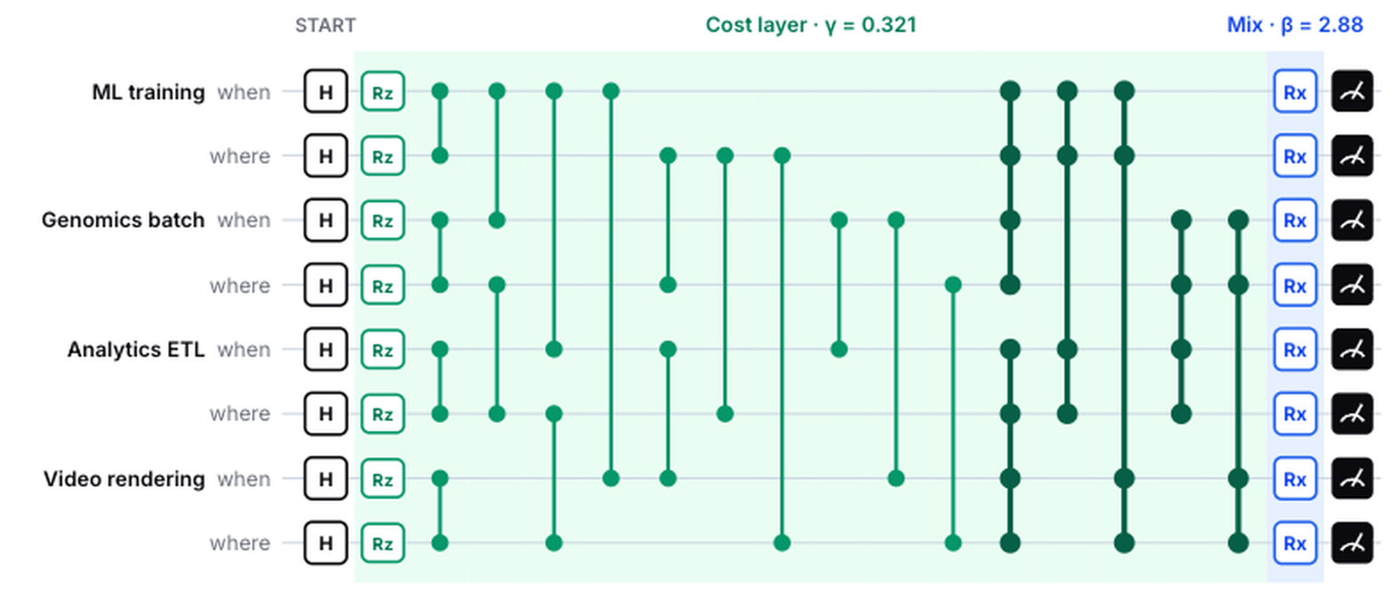
Algorithm & Circuit Design
QUBITS
8 · a where + when bit per job
COST HAMILTONIAN
31 Pauli terms, tested on all 256
TRAINING
CVaR + COBYLA on a simulator
ANGLES (BALANCED)
γ = 0.321 · β = 2.877
ON IBM_MARRAKESH
114 two-qubit gates · depth 247
The real 8-qubit QAOA circuit (p = 1): Hadamards → cost layer e^(−iγH) → mixer Rx(2β) → measure. Two qubits per job.
SHOTS
4,000 per run · 7 runs
Notes:
This is the real circuit we ran. Each job has two qubits, a 'when' and a 'where' qubit. Hadamards create an equal superposition of all 256 plans. The cost layer adds a phase proportional to each plan's carbon-and-water cost, using Z, ZZ and ZZZZ terms; a test checks that this Hamiltonian equals the classical cost on all 256 plans. The mixer then makes cheap plans interfere constructively. We train the two angles with CVaR and COBYLA on a simulator, because the free IBM plan gives about 10 minutes of quantum time a month, and send only the trained circuit to hardware. After transpiling for ibm_marrakesh it has 114 two-qubit gates.

Slide 6
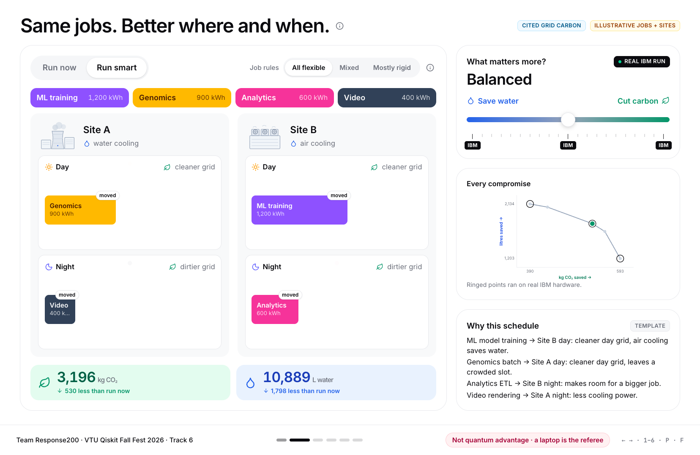

Implementation & Tech Stack
HOW IT IS BUILT
Web app
React + Vite · Motion · Dewy, the guide
API + AI layer
FastAPI · Groq LLM explains, never decides
Quantum core
IBM
marrakesh
Qiskit 2.6 · QAOAAnsatz · Aer · Runtime
The demo app: six screens, real saved results, an AI guide
One command: python -m server · runs offline from saved results · pytest suite
Notes:
Three layers. The quantum core is plain Python with Qiskit 2.6: the cost model, the encoding, QAOA, and the IBM Runtime SamplerV2 runs on ibm_marrakesh. Every hardware result is saved with its job ID, so the demo never depends on the queue. A FastAPI server serves the saved results and an AI layer on Groq that only explains results; it never chooses a schedule. The web app is React with a mascot, Dewy, that guides the viewer. One command starts everything, and an automated test suite checks the model, the Hamiltonian and the AI guard-rails.

Slide 7
Results & Analysis
SAVED VS RUN-NOW (ILLUSTRATIVE)
−530 kg
CO₂ · −14%
−1,798 L
water · −14%
7 runs on ibm_marrakesh · 21 s QPU
Beats random by 14–19 std. errors
Error mitigation: no consistent gain
Greedy and annealing also find the best here
Notes:
Left: where the 4,000 shots landed. Random guessing puts 10 percent of its shots in the best tenth of plans. The real IBM computer put 18 to 23 percent there, about twice as many, and a perfect simulator about a third. All hardware runs beat random by 14 to 19 standard errors. Error mitigation, dynamical decoupling plus twirling, helped in one setting and hurt in another, so we report no consistent gain. Right: in the balanced setting the best plan saves 530 kg of CO2 and 1,798 litres of water against running every job at home immediately, about 14 percent each. The site and job data are illustrative. And honestly: greedy and simulated annealing also find the best plan at this size, faster. Our claim is a validated formulation, not a speed-up.

Slide 8




Impact & Real-World Applications
WHO CAN USE IT
AI COPILOT (GROQ LLM)
WHAT IT COULD BE WORTH
Cloud and colocation providers
Ask GreenQ
≈3,420 t
Explains any plan in plain words
CO₂ saved per year
AI and HPC labs with batch jobs
Jobs in plain English
≈11.6 ML
Typed text becomes a plan
Enterprises with ESG targets
megalitres of water saved per year
Guard-railed
Assumed: 100 GWh/yr fleet, 20% flexible load, our measured 14% saving. An estimate, not a deployment.
AI never decides · every number checked · offline fallback
Water counts more in stressed cities (WRI Aqueduct weighting).
Notes:
Who would use this: cloud and colocation providers, AI and HPC labs that queue large batch jobs, and enterprises with carbon and water targets. Location matters too: a litre in a water-stressed state counts for more, which we model with WRI Aqueduct scores. The AI copilot runs on Groq. Operators can ask why a plan was chosen and get a short plain-language answer, or type their jobs in plain English and get a plan. It is guard-railed: the AI never chooses the schedule, every number it writes is checked against our data, and the demo falls back to saved answers when offline. What could it be worth? For an assumed fleet of 100 GWh a year with 20 percent flexible load, our measured 14 percent saving would be about 3,420 tonnes of CO2 and 11.6 million litres of water a year. Those inputs are assumptions, shown as such.

Slide 9
Challenges & Future Scope
CHALLENGES
Noise: the real chip keeps 48–67% of the ideal gain
22 qubits already need 1,010 two-qubit gates
About 10 min of free quantum time a month
Site and job data are illustrative
FUTURE SCOPE
Split big fleets into small sub-problems
Live regional carbon and water data
Plug into schedulers like Kubernetes and Slurm
Qubits on the x-axis (2 per job). Pink: 8 qubits, run on real IBM hardware.
Deeper circuits as hardware improves
Notes:
We measured how the problem grows. From 4 to 11 jobs the qubits grow linearly, 2 per job, but the two-qubit gates grow from 114 to 1,010, because every pair of jobs that can share a slot adds gates. Today's hardware handles our 8-qubit case; the real chip kept roughly half to two thirds of the ideal simulator's gain. Our limits are clear: noise, circuit depth, about 10 minutes of free quantum time a month, and illustrative site data. Next: split large fleets into small sub-problems that fit the hardware, plug in live regional carbon and water data, connect to real job schedulers like Kubernetes or Slurm, and use deeper circuits as hardware improves.

Slide 10
CLOSING
Thank You
Questions?
Inspiring Minds. Shaping Tomorrow.
GITHUB REPOSITORY
DEMO VIDEO LINK
github.com/vtu-qiskit-fall-fest-2026/
vtu-hc-response200
youtu.be/WW4myHQ4JOg
LIVE APP
greenq-xi.vercel.app
Notes:
Everything is in the repository: the code, the tests, the saved IBM hardware results with job IDs, and a plain-language explainer. Thank you; we are happy to take questions.

