Slide 1




PARTICIPANT PRESENTATION
Participant Details
Qiskit
Fall Fest
2026
PROJECT TITLE
Q-MedLab: A Quantum-Powered Virtual Medical Laboratory
TRACK
Quantum Technology for Medical Application & Sensing
TEAM NAME
Team - CIS
TEAM LEADER
S. Abdul Razak
EMAIL / CONTACT
abdulrazakshaik87@gmail.com
Hackathon · Team Details
TEAM MEMBERS
S. Sreeja · L. Sindhuja
INSTITUTION / ORGANISATION
Chaitanya Deemed University
COUNTRY
Hyderabad, India

Slide 2
Problem Statement
Quantum computing is entering healthcare research, but medical students almost never get to use it.
Commercial suites such as Schrödinger cost USD 25,000–100,000 per user per year
IBM Quantum and Azure Quantum expect hand-written circuits and are not built for medical education
Labster-style virtual labs have no-code interfaces but no quantum content
No teaching tool exists yet for quantum-ML antibiotic resistance, a very recent research area
9.5%
of 169 reviewed studies ran on real quantum hardware (16 studies)
USD 25K–100K
per user per year for commercial molecular simulation
0
quantum modules in existing medical virtual labs

Slide 3
Objectives & Novelty
Objectives
Browser-based virtual lab that runs real quantum algorithms with no code
Four healthcare modules: Grover (diagnosis), VQE (docking), QSVM (resistance), QCNN (imaging)
AI layer that turns raw quantum output into clinical language with confidence scores
Four role-based portals: Student, Researcher, Clinician, Administrator
Novelty
First platform to combine real quantum computation, a healthcare curriculum and free student access
Automatic fallback to Qiskit Aer when the IBM queue is long, so users always get a result
Quantum-vs-classical comparison, NISQ noise sandbox, QGAN augmentation and a leaderboard
Honest scope: a teaching and research tool, not a clinical device

Slide 4
Solution & Quantum Advantage
Pick an experiment in the browser → FastAPI builds a Qiskit circuit → runs on IBM hardware or Qiskit Aer → AI layer explains the result.
MODULE 1
Disease Diagnosis
Grover's Search
Quadratic speed-up over the 84-symptom search space
MODULE 2
Drug–Protein Docking
VQE (UCCSD ansatz)
Estimates binding energy from the molecular Hamiltonian
MODULE 3
Antibiotic Resistance
QSVM
Quantum kernel in a high-dimensional feature space
MODULE 4
Medical Imaging
QCNN
Amplitude-encodes MRI / CT / X-ray images into 8 qubits
Quantum advantage: Grover gives a quadratic search speed-up; VQE, QSVM and QCNN use high-dimensional quantum state spaces. Our runs are simulator-based on small datasets, so we demonstrate the algorithms, not a proven advantage.

Slide 5
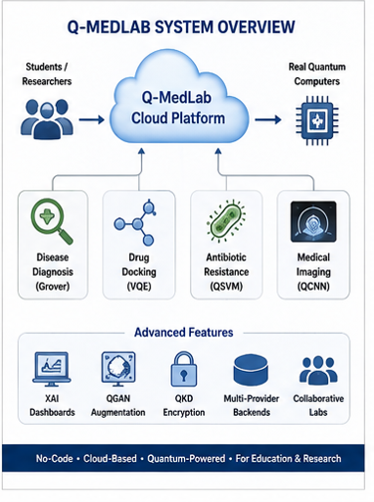
Algorithm & Circuit Design
Five-phase pipeline
1 Input encoding: symptoms, drug, bacteria or image mapped to datasets
2 Circuit build: Grover oracle + diffusion, Hamiltonian (Jordan–Wigner), ZZFeatureMap, amplitude encoding
3 Execution: Aer, IBM Eagle or other provider; Aer fallback if queue > 5 min
4 Post-processing: histograms, energies, kernels → medical metrics
5 Explanation: AI layer writes the clinical summary
Module configuration
M1 Grover + Amplitude Est.
5–6 qubits · 4–5 iterations
M2 VQE (UCCSD)
4–12 qubits · depth 1–5 · 2,048 shots
M3 QSVM
4–5 qubits · ZFeatureMap + ZZFeatureMap
M4 QCNN
8 qubits · 4 parameterised layers
Five layers: UI → AI layer → quantum modules → Qiskit execution → cloud.

Slide 6
Implementation & Tech Stack
Frontend
React.js 18, Three.js, WebGL
3D Bloch sphere and molecule viewer
D3.js, Plotly, Tailwind CSS
Drag-and-drop circuit builder
Four role-based portals
Backend
Python 3.10+ with FastAPI
One module per algorithm (Grover, VQE, QSVM, QCNN)
AI explainer via LLM API
PostgreSQL 16 and Redis
Docker, Git, Postman
Quantum & Chemistry
Qiskit 1.x and Qiskit Aer
PySCF, OpenFermion, PennyLane
IBM Quantum (Eagle 127Q)
Auto-fallback to Aer simulator
PubChem and RCSB PDB data
Server: multi-core CPU, 8 GB RAM (16 GB for 8+ qubit Aer simulation) Client: any modern WebGL browser

Slide 7
Results & Analysis
Module | Run | Observed result
M1 Diagnosis | Fever + cough → Influenza | 55.3% conf. (6 qubits, 5 iter.)
M1 Diagnosis | Age 58, headache → Migraine with aura | 92.4% conf., urgency Amber
M2 Docking | Sildenafil → PDE5A (PDB 3N55) | −6.32 kcal/mol, affinity 42/100
M3 Resistance | S. pyogenes → Ethambutol | SUSCEPTIBLE, 89.9% conf.
M4 Imaging | Brain MRI → Meningioma | QCNN 92.9% vs CNN 87.6%, 3.5× faster
Key observations
Grover: correct disease state dominates the output
VQE: Sildenafil–PDE5A matches a known drug–target pair
QSVM: matches known clinical susceptibility
QCNN: higher accuracy and faster training than CNN
Simulator runs on small datasets: no quantum advantage is claimed.

Slide 8
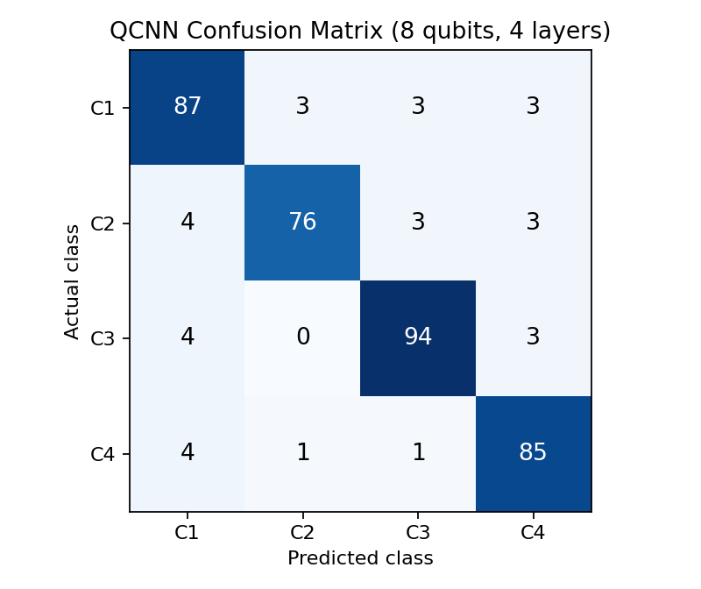
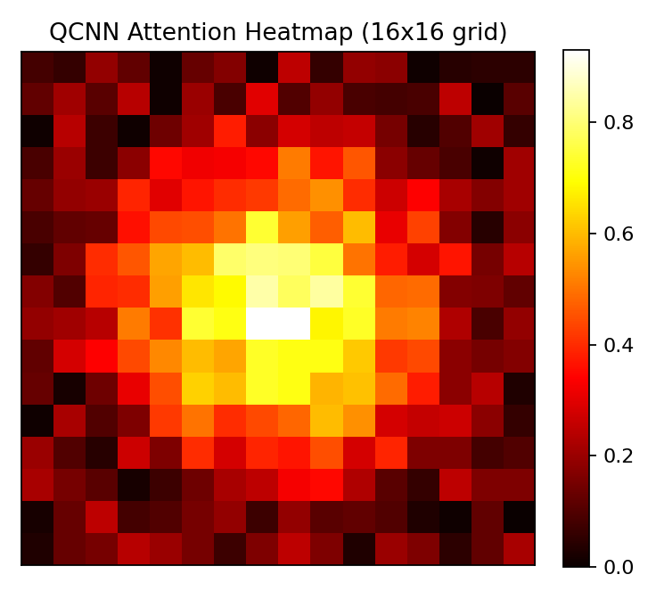
Results: QCNN Imaging Analysis
QCNN setup
8 qubits, 4 parameterised layers
Amplitude-encoded MRI / CT / X-ray
Heatmap shows which region drives the prediction
Simulator result on a small dataset, not clinically validated
Confusion matrix (CT-scan run)
Attention heatmap (16×16)

Slide 9
Impact & Real-World Applications
Medical Education
MBBS, BPharm and CSE students learn quantum algorithms through healthcare problems, not abstract circuits
Pharmacology Research
Run VQE-based docking without paying for hardware or commercial software
Clinical Microbiology
QSVM resistance predictor as a teaching tool for antibiotic susceptibility
Radiology Training
QCNN shows how quantum models handle imaging anomalies in MRI, CT and X-ray
Classroom Instruction
Instructors set shared quantum exercises for a whole cohort
Quantum Research
Common healthcare benchmark for comparing different hardware backends

Slide 10
Challenges & Future Scope
Challenges
Most runs are simulator-based; real hardware is limited by queue time and noise
Small datasets: 84 symptoms, 30 drug–protein pairs, 22 pathogens
VQE on current hardware handles only small molecules
Classical baselines stay competitive, so quantum advantage is conditional
Not a certified medical device; AI layer depends on a paid LLM API
Future Scope
Real-hardware execution with queue-time and cost estimates
Azure Quantum and Amazon Braket for gate-based vs annealing comparison
Noise-aware sandbox with error mitigation
Automated PDF / Word reports and a public benchmark leaderboard
Multi-target docking, Q-BAFNet-style hybrid model, collaborative sessions, mobile / VR-AR

Slide 11
CLOSING
Thank You
Questions?
Inspiring Minds. Shaping Tomorrow.
GITHUB REPOSITORY
GitHub - vtu-qiskit-fall-fest-2026/vtu-hc-team-cis: VTU-QFF-HC-0118 | Team - CIS | Tier: Both · GitHub
DEMO VIDEO LINK
https://youtu.be/Lfiy4g3N-Mo?si=_hdOXJs-LKXFHCs8
DEEPLOYMENT LINK
https://q-med-lab-project-rh6g1y0su-abdulrazak5764s-projects.vercel.app/

