Slide 1




PARTICIPANT PRESENTATION
Participant Details
Qiskit
Fall Fest
2026
PROJECT TITLE
Hybrid Quantum-Classical Urban Mobility Analysis
TRACK
Track 4: Quantum + AI & ML
TEAM NAME
Team Zen · VTU-QFF-HC-0080
TEAM LEADER
Channaveer (Channaveer06)
EMAIL / CONTACT
channaveer06@gmail.com
8073790832
Hackathon · Team Details
TEAM MEMBERS
Mallikarjun (mallugze) · Akhilesh (akhilesh488-byte)
INSTITUTION / ORGANISATION
Poojya Doddappa Appa College of Engineering
COUNTRY
India

Slide 2
Problem Statement
The Core Challenge: High-resolution satellite imagery segmentation for road network extraction demands massive computational overhead, creating severe parameter bottlenecks in classical deep learning models.
Why It Matters: These computational bottlenecks limit real-time processing capabilities for urban disaster management and Earth observation, restricting scalability on standard GPU hardware.
Domain: Urban Mobility & Disaster Route Resilience using Satellite Intelligence.

Slide 3
Objectives & Novelty
Primary Objective: Build a hybrid architecture combining deep learning spatial encoders with quantum computing principles to process satellite imagery efficiently.
Key Innovation: Replacing heavy classical bottleneck layers with Variational Quantum Circuits (VQCs) to compress spatial feature dimensions without losing semantic road segmentation accuracy.
Novelty: Bridges quantum computing with practical computer vision for civil infrastructure mapping and emergency logistics.

Slide 4
Solution & Quantum Advantage
The Solution: A Hybrid Quantum-Classical U-Net architecture built using Qiskit and PyTorch.
User Workflow: Users upload raw satellite imagery via our Streamlit web interface (app.py) → Model processes features through quantum layers → Generates precise road extraction masks.
Quantum Advantage: Leveraging quantum superposition and entanglement properties in the VQC bottleneck to map high-dimensional spatial data into compact quantum states, drastically reducing parameter counts while maintaining high Dice evaluation scores.

Slide 5
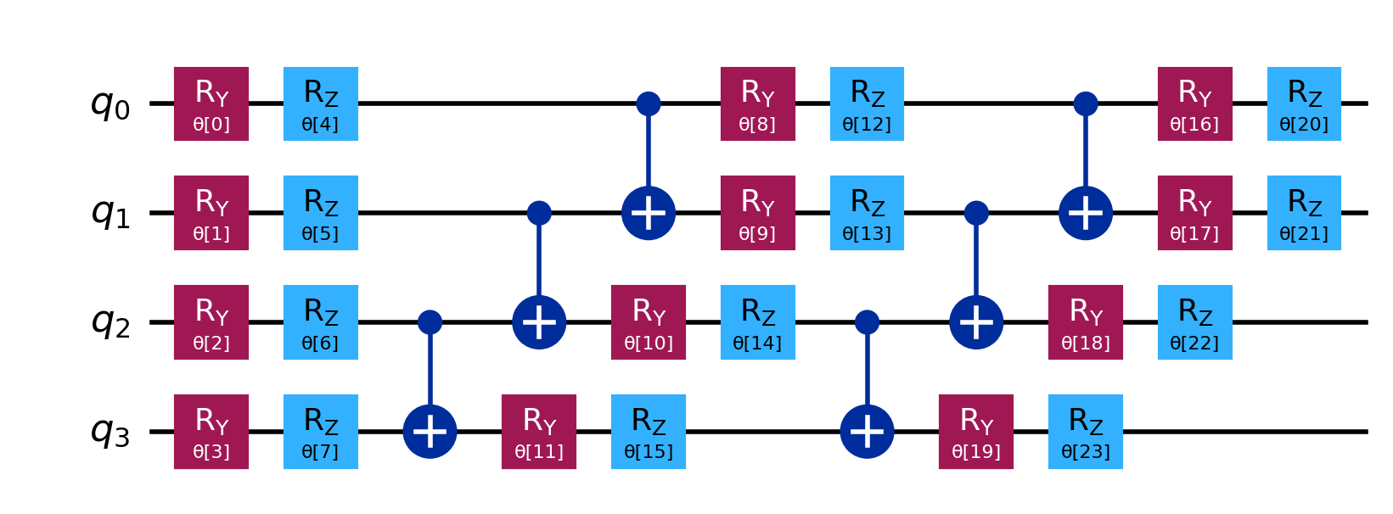
Algorithm & Circuit Design
Architecture Design
Encoder: Classical convolutional layers extracting spatial feature maps.
Quantum Bottleneck: Parameterized Quantum Circuit (PQC) utilizing Qiskit (EfficientSU2 / RealAmplitudes ansatz) with angle encoding.
Decoder: Dual-attention skip connections reconstructing the segmentation mask.
# Core Quantum Circuit Ansatz Integration
num_qubits = 4
ansatz = EfficientSU2(num_qubits, reps=2)
qc = QuantumCircuit(num_qubits)
qc.compose(ansatz, inplace=True)

Slide 6
Implementation & Tech Stack
Language & Core Frameworks: Python 3.11+, PyTorch, Torchvision
Quantum SDK: Qiskit >=1.0, Qiskit Machine Learning (TorchConnector), Qiskit Aer
Frontend & Visualization: Streamlit (Light-themed dashboard matching ISRO project design standards)
Optimization & Training: Adam optimizer, Binary Cross-Entropy Loss, executed on local/cloud GPU environments
Version Control: Git & GitHub (vtu-hc-team-zen)

Slide 7
Results & Analysis
Average Training Loss
Training Performance: Stable convergence across ISRO satellite image datasets, with average training loss dropping efficiently from 0.1835 (Epoch 1) down to 0.0702 (Epoch 3).
Evaluation Metrics: High overlap accuracy measured via the Dice similarity coefficient and Intersection over Union (IoU).
Visual Output: Successfully outputs clean binary road masks separating complex background noise from actual transit paths.
0.1835
Epoch 1
→
0.0702
Epoch 3
Stable convergence achieved across ISRO satellite image datasets.

Slide 8
Impact & Real-World Applications
Emergency Response: Accelerates route recovery planning during natural disasters (e.g., floods or earthquakes) by instantly mapping passable roads from post-disaster satellite feeds.
Smart Infrastructure: Powers automated geographic information system (GIS) updates and municipal urban planning without requiring expensive supercomputing infrastructure.

Slide 9
Challenges & Future Scope
Challenges Overcome: Managing tensor-to-quantum state conversions and ensuring stable gradient backpropagation through the hybrid PyTorch-Qiskit connector.
Future Scope:
Scaling the quantum circuit from local Qiskit Aer simulators to real IBM Quantum hardware processors via Qiskit Runtime primitives.
Integrating graph-theoretic routing engines to calculate cascading traffic delays upon road blockages.

Slide 10
CLOSING
Thank You
Questions?
Built with Qiskit for the VTU-QFF Hackathon
Team ID: VTU-QFF-HC-0080
GITHUB REPOSITORY
vtu-hc-team-zen (GitHub)
DEMO VIDEO LINK
Watch demo video

