Slide 1




PARTICIPANT PRESENTATION
Participant Details
Qiskit
Fall Fest
2026
PROJECT TITLE
Quantum ML-Based Software Bug Prediction
TRACK
Quantum + AI&ML
TEAM NAME
TrioByte
TEAM LEADER
Disha M V
EMAIL / CONTACT
dishamv72@gmai.com
Hackathon · Team Details
TEAM MEMBERS
1.Disha M V
2.Harshitha K P
3.Ishakrishna
INSTITUTION / ORGANISATION
Vivekananda College Of Engineering &Technology Puttur
COUNTRY
India

Slide 2
Problem Statement
Problem Statement
Software defects can cause system failures, security issues, higher maintenance costs, and delays.
Early defect prediction helps developers improve software quality and prioritize testing.
Traditional machine learning may struggle with imbalanced data and complex patterns, while quantum machine learning offers an alternative approach using quantum feature maps and kernel methods.
Our Problem:
Predicting defective and non-defective software modules using a quantum-kernel-based classifier and the NASA CM1 dataset.
Goal:
To build and compare a classical Support Vector Machine (SVM) and a Quantum Support Vector Classifier (QSVC) using accuracy, precision, recall, and F1-score.

Slide 3
Objectives & Novelty
Objectives
Use the NASA CM1 dataset to predict defective and non-defective software modules.
Preprocess data and prepare target labels.
Build a classical SVM and a quantum-kernel-based QSVC using Qiskit.
Compare both models using accuracy, precision, recall, and F1-score.
Develop a Streamlit app to display predictions and results.
Novelty
Apply quantum machine learning to software defect prediction.
Compare classical and quantum-kernel classifiers in one workflow.
Use a quantum feature map to encode software metrics.
Present results through an interactive application.
Key Contribution: An experimental framework for evaluating quantum-kernel classification on software defect data.

Slide 4
Solution & Quantum Advantage
Proposed Solution
Our system uses NASA CM1 software metrics to predict whether a module is defective or non-defective.
Workflow
Load and preprocess the dataset.
Split data into training and testing sets.
Train classical SVM and quantum QSVC models.
Evaluate both models using performance metrics.
Display results through a Streamlit app.
Quantum Approach
Feature Map: ZZFeatureMap
Quantum Kernel: FidelityQuantumKernel
Classifier: QSVC
Execution: Quantum simulation on a classical computer.
Quantum Advantage
QSVC achieved slightly higher accuracy, while SVM performed better in precision, recall, and F1-score. Quantum advantage is not yet established

Slide 5
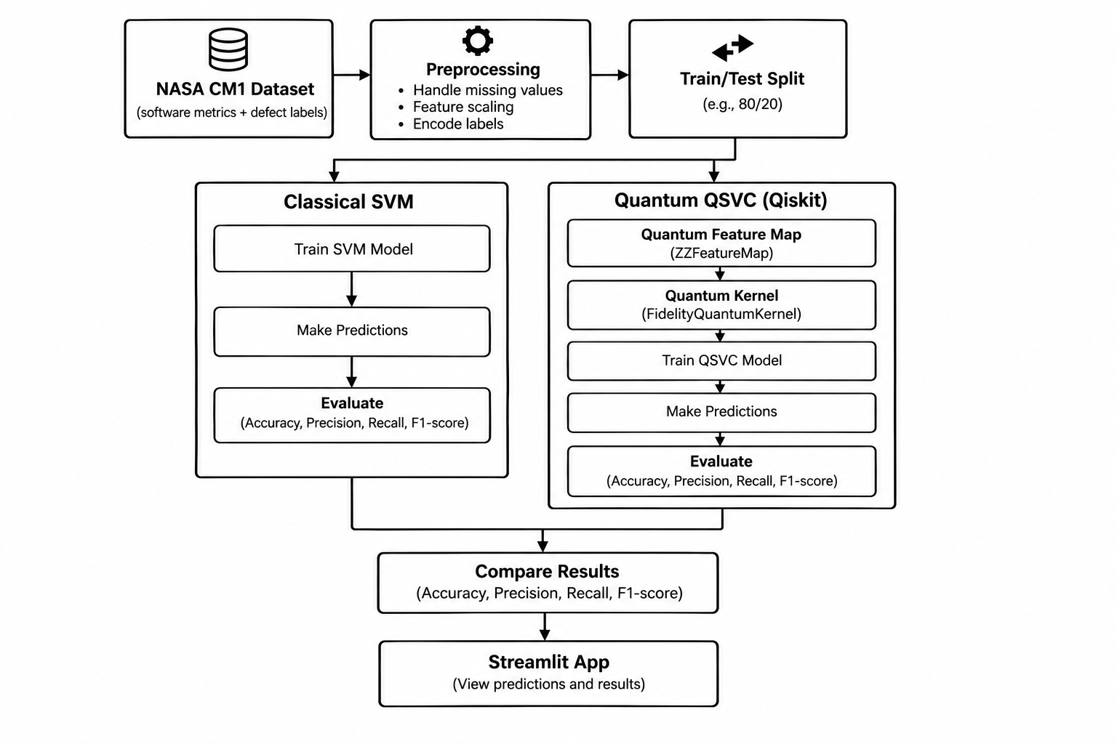
Algorithm & Circuit Design
Key Details
Algorithm: Quantum Support Vector Classifier (QSVC)
Feature Map: ZZFeatureMap
Quantum Kernel: FidelityQuantumKernel
Framework: Qiskit
Process: Feature Encoding → Kernel Calculation → Classification
Output: Defective or Non-defective
Execution: Quantum simulation on a classical computer
Quantum Advantage: Not yet established

Slide 6
Implementation & Tech Stack
Implementation
Language: Python
Dataset: NASA CM1
Models: Classical SVM (RBF) and Quantum QSVC
Quantum: ZZFeatureMap, FidelityQuantumKernel, Qiskit
Libraries: Pandas, NumPy, scikit-learn
Interface: Streamlit
IDE: Visual Studio Code
Application Features
Trains and compares SVM and QSVC.
Evaluates accuracy, precision, recall, and F1-score.
Displays predictions and exports results to CSV.
Execution
Run using:python -m streamlit run app.py
The application displays predictions and experimental results in a web browser.

Slide 7
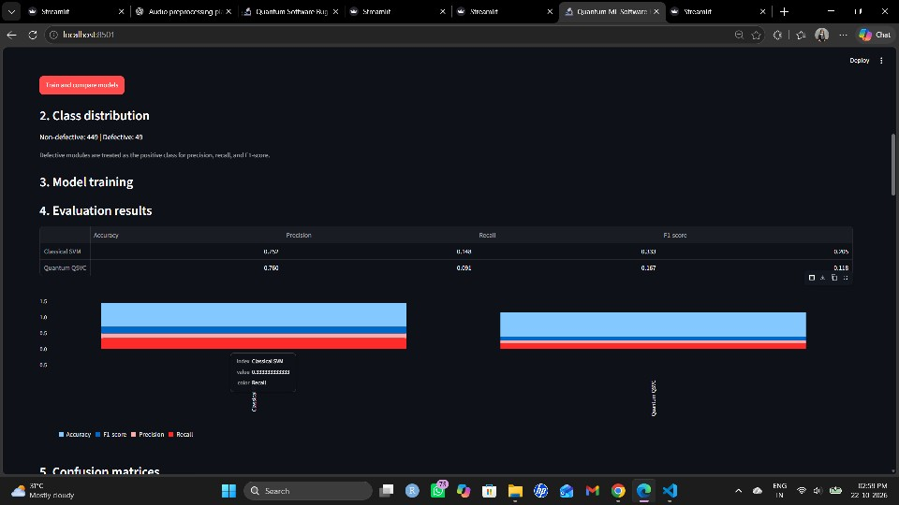
Results & Analysis
Key Details
QSVC achieved slightly higher accuracy (76.0%).
SVM performed better in precision, recall, and F1-score.
Both models need improvement in detecting defective modules.
Results are based on one test split; quantum advantage is not established.

Slide 8
Impact & Real-World Applications
Potential Impact
Identifies potentially defect-prone software modules.
Helps prioritize testing and code reviews.
Supports software quality improvement.
Demonstrates quantum ML for software defect prediction.
Real-World Applications
Software Testing: Focus testing on high-risk modules.
Quality Assurance: Support defect-risk assessment.
Software Maintenance: Prioritize code reviews and debugging.
Research and Education: Compare classical SVM and quantum QSVC.

Slide 9
Challenges & Future Scope
Challenges
Class Imbalance: Fewer defective modules in the dataset.
Model Performance: Low precision and recall for defect detection.
Quantum Cost: Kernel calculations can be computationally expensive.
Evaluation: Results are based on one test split.
Quantum Advantage: Not yet established.
Future Scope
Apply class balancing techniques.
Use cross-validation for reliable evaluation.
Improve feature selection and model tuning.
Test on additional datasets like NASA KC1.
Explore quantum hardware and scalability.
Long-Term Goal
Develop a reliable software defect prediction system combining classical and quantum machine learning.

Slide 10
CLOSING
Thank You
Questions?
Inspiring Minds. Shaping Tomorrow.
GITHUB REPOSITORY
https://github.com/vtu-qiskit-fall-fest-2026/vtu-hc-triobyte
DEMO VIDEO LINK
https://youtu.be/qWoJreXOV0s

