Slide 1




PARTICIPANT PRESENTATION
Participant Details
Qiskit
Fall Fest
2026
PROJECT TITLE
Green Quanta – AI-Powered Quantum Learning Platform
TRACK
Track 4: Quantum + AI & ML
TEAM NAME
Veda
TEAM LEADER
Darshan naik
EMAIL / CONTACT
darshannaik0915@gmail.com
Hackathon · Team Details
TEAM MEMBERS
Darshan .Amol .Payal
INSTITUTION / ORGANISATION
Vishveshvaraya Technological University, Belagavi
COUNTRY
India

Slide 2
Problem Statement
Quantum computing is difficult for beginners to learn because concepts such as qubits, superposition, quantum gates, and measurement are often taught theoretically, with limited opportunities for hands-on experimentation.

Slide 3
Objectives & Novelty
Objectives
- Simplify quantum learning through interactive lessons.
- Build and simulate quantum circuits.
- Visualize quantum states and measurement results.
Novelty
- AI-powered quantum tutor.
- Step-by-step circuit simulation.
- Integrated lessons, algorithms, and quizzes.
Impact: Make quantum computing practical and beginner-friendly.

Slide 4
Solution & Quantum Advantage
Our Solution – Green Quanta
- Interactive quantum lessons and algorithms.
- Circuit builder with quantum gates.
- Qiskit-powered circuit simulation and measurement results.
- AI Tutor and interactive quizzes.
Quantum Advantage
- Demonstrates superposition and quantum gate operations.
- Visualizes circuit outputs and quantum states.
- Makes quantum concepts easier to explore through hands-on learning.

Slide 5
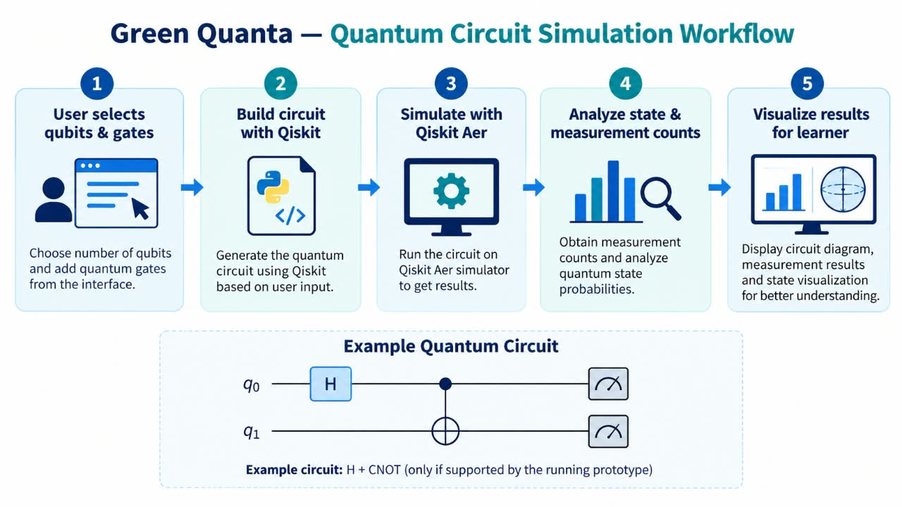
Algorithm & Circuit Design
Key Features
- Interactive quantum circuit builder
- Qiskit-based circuit construction
- Qiskit Aer simulation
- Measurement counts and state probabilities
- Step-by-step quantum state visualization
- AI Tutor, lessons, and quizzes
- Interactive learning dashboard

Slide 6
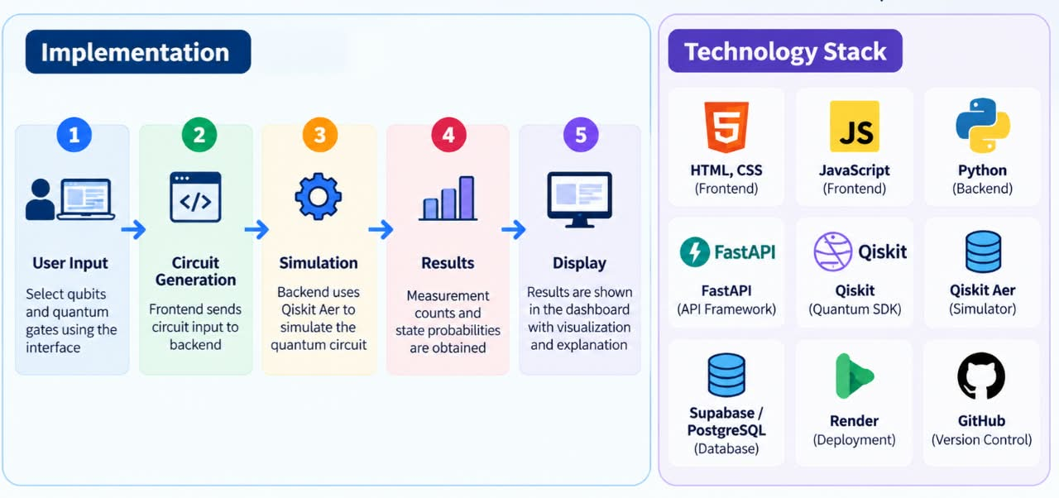
Implementation & Tech Stack

Slide 7
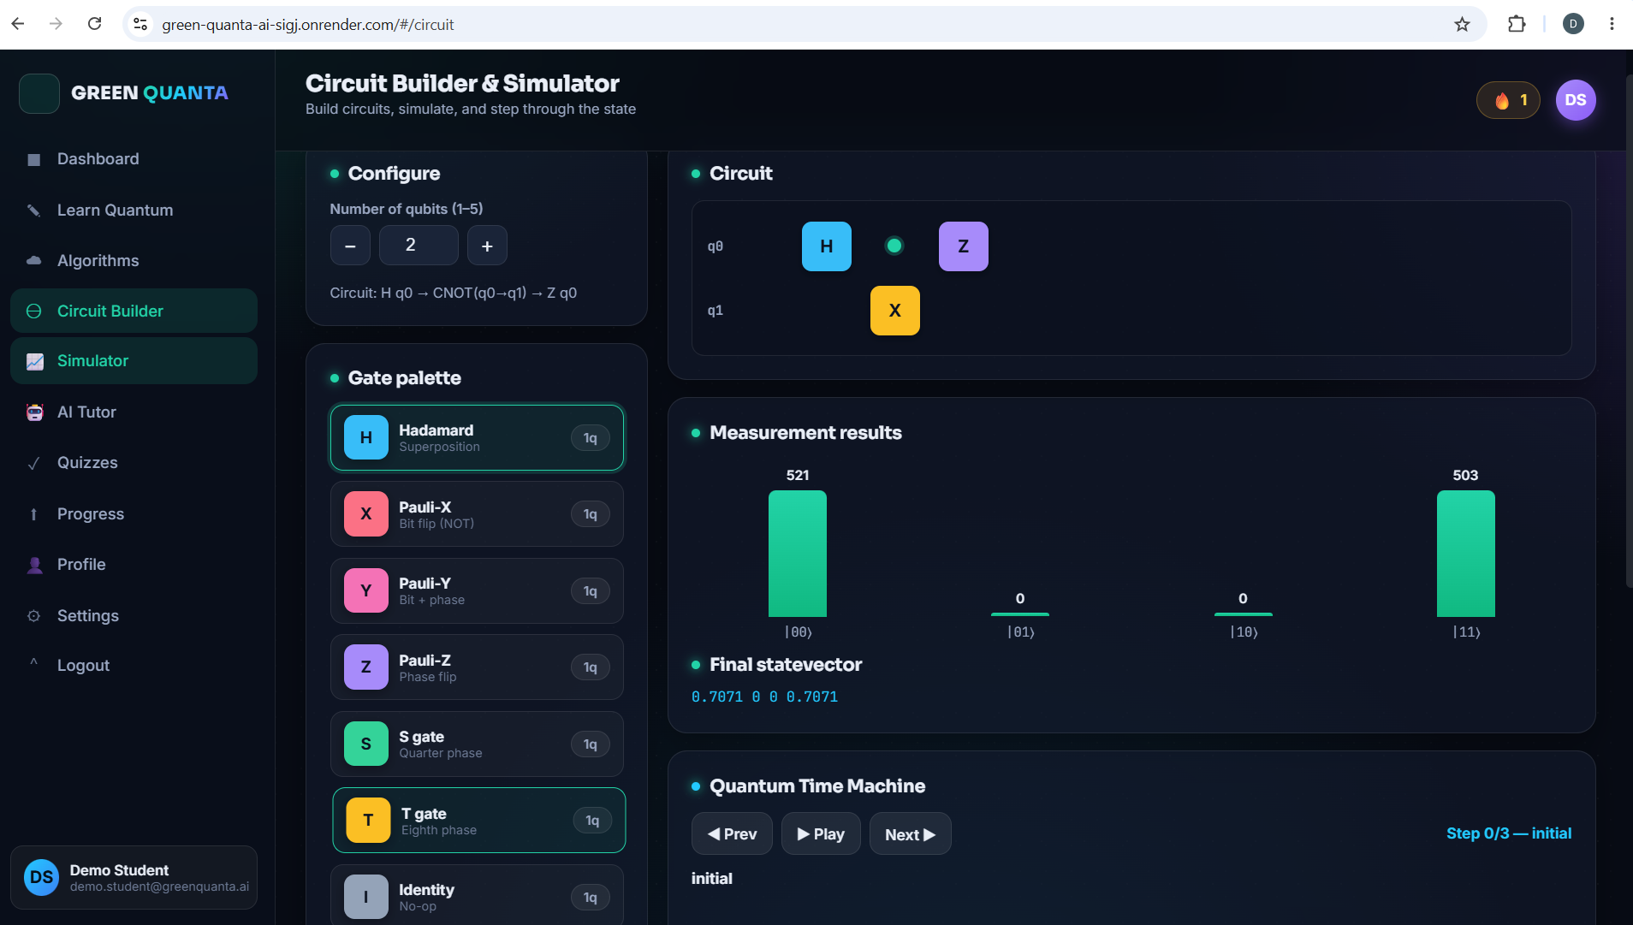
Results & Analysis
Insert results
Histogram, plot or table
Results & Analysis
- Quantum circuits simulated using Qiskit Aer.
- Measurement counts and state probabilities visualized.
- Gate-by-gate state changes demonstrated.
- Interactive quizzes and AI Tutor support learning.

Slide 8
Impact & Real-World Applications
- Makes quantum computing easier for beginners to learn.
- Supports hands-on circuit building and simulation.
- Helps students understand quantum algorithms visually.
- Useful for education, research, and future quantum developers.

Slide 9
Challenges & Future Scope
Challenges
- Quantum concepts are difficult for beginners.
- Simulation results may be complex to understand.
- Limited access to real quantum hardware.
Future Scope
- Integrate real quantum computers.
- Add more quantum algorithms and experiments.
- Improve AI Tutor and personalized learning.

Slide 10
CLOSING
Thank You
Questions?
Inspiring Minds. Shaping Tomorrow.
GITHUB REPOSITORY
https://github.com/vtu-qiskit-fall-fest-2026/vtu-hc-veda
DEMO VIDEO LINK
https://youtu.be/0YJ-GzHXsSI

