Slide 1
24 HOUR HACKTHON 2020
NIDHI RANI VTU-10447
SHRAWAN KUMAR VTU-10454
ABHISHEK KUMAR VTU-10370
BATCH NO: 21
PRESENTED DATE:-18/05/2020

Slide 2
ABSTRACT
Chatbots have become almost commonplace in e-commerce, but they have recently started to emerge in the healthcare sector, as well. Chatbots are services that people interact with through a messenger. Instead of having a conversation with another person, the user talks with a bot that’s either powered by basic rules or machine learning. Every chatbot serves a specific purpose-health bot are designed to help with health-related issues. Health chatbots could potentially provide many different services. They might give the user health-related information. If you tell them your symptoms, they can give you a likely diagnosis. While everyone seems interested in these bots’ potential, So, how much confidence should we put in health chatbots? They certainly have some limitations compared to human doctors but also provide some benefits, such as the convenience of quick responses. However, the field is also very young, so many of the apps haven’t yet undergone rigorous testing. While chatbots can be useful for preliminary information.
BATCH NO: 15 PRESENTED DATE: 08-FEB-2020

Slide 3
INTRODUCTION
A chatbot is a computer program which hosts a conversation through speech or textual method.
It interact with user in natural language. It acts as a conversational partner rather than humans.
Chatbots work basically on Artificial Intelligence, so using this capability we have decided to add some contribution to the Health Informatics.
Various surveys have proved that chatbot can provide healthcare in low costs and improved treatment if the doctors and the patient keep in touch after consultation.
The bot then ask a series of questions about their symptoms to diagnose the disease. Our bot’s best application would be it acts as a preliminary diagnosis tool that patients could use to assess their symptoms before going to the doctor.
BATCH NO: 15 PRESENTED DATE: 08-FEB-2020

Slide 4
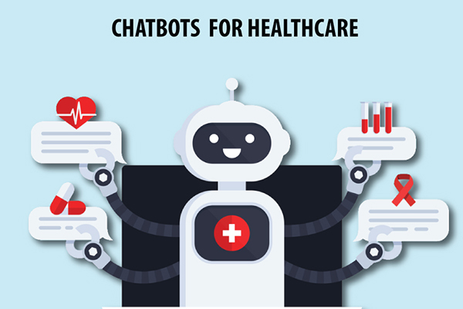
BATCH NO: PRESENTED DATE:

Slide 5
OBJECTIVES
Aim of the Project:
To develop a software that acts as a virtual assistant that plays a vital role if there is an urgent need of medical attention.
It helps in providing the information fast when there is not a moment to lose.
Scope of the Project:
The medical details are more important and should not be disclosed to anyone. No one should have any access medical details of the user. So, the database which stores the medical details of the user should be encrypted.
BATCH NO: 15 PRESENTED DATE: 08-FEB-2020

Slide 6
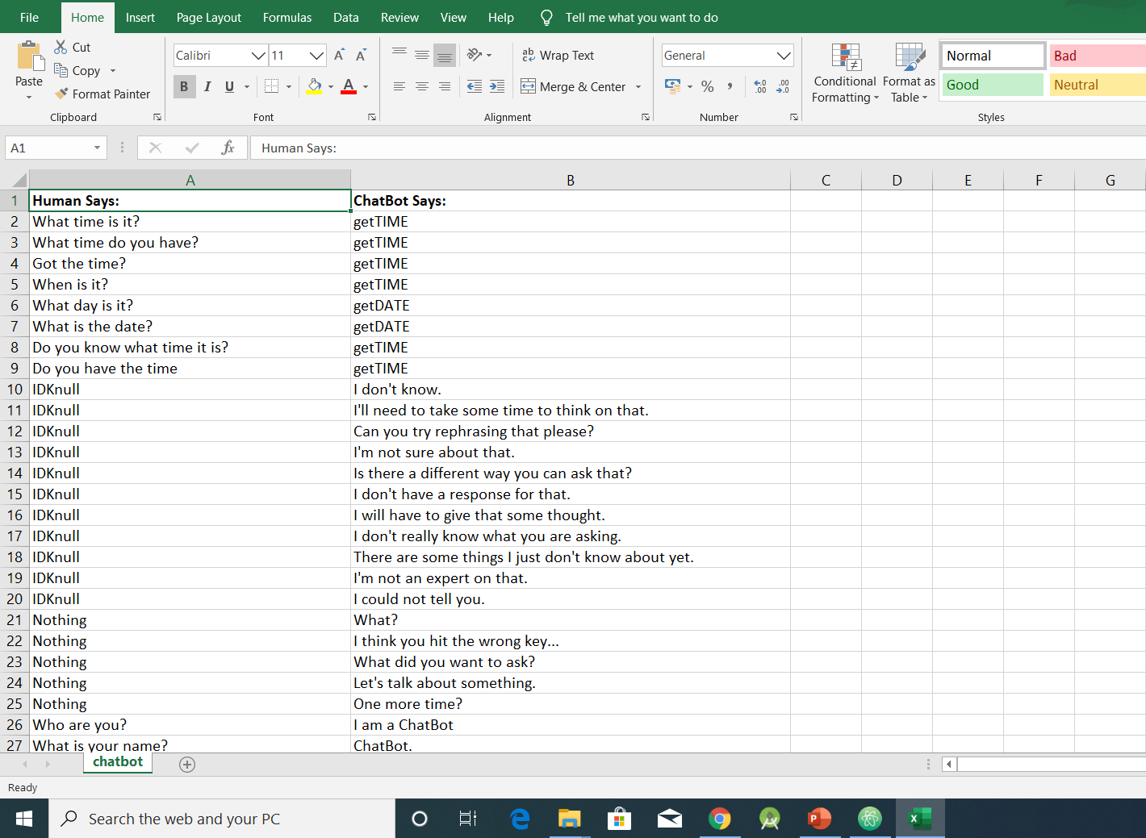
MODULE:1
Data Collection and training using Machine Learning Algorithms
Step:1 Collection of data
BATCH NO: PRESENTED DATE:

Slide 7
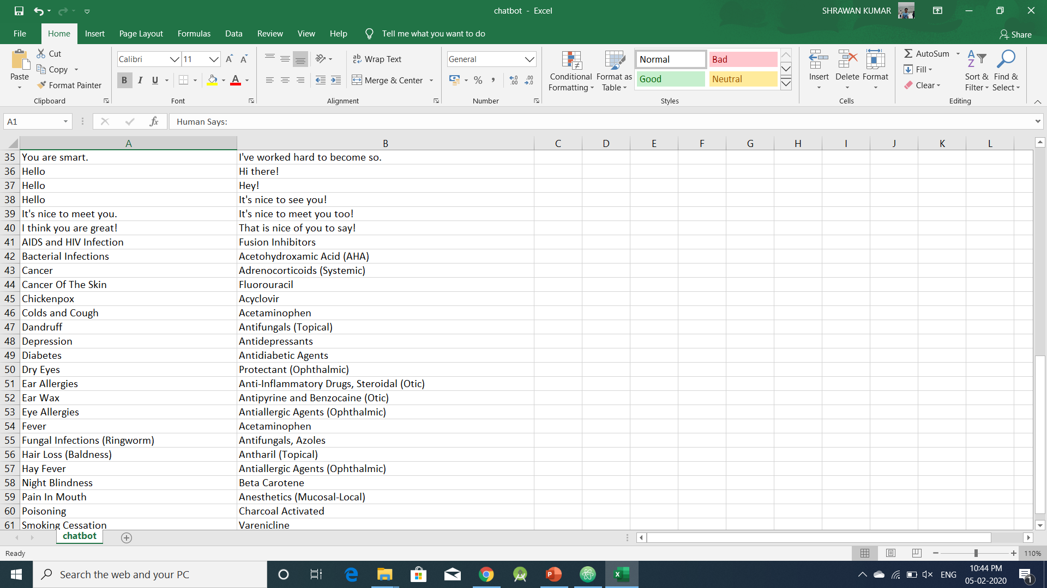
Step 2: Processing of data
BATCH NO: 15 PRESENTED DATE: 08-FEB-2020

Slide 8
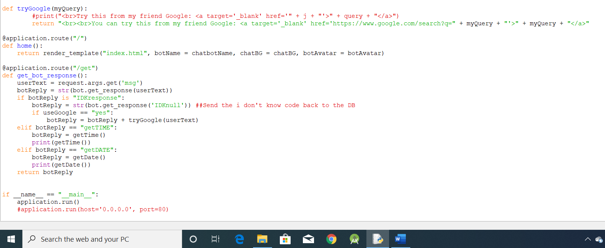
Step 3: Apply Machine Learning Algorithms
BATCH NO: PRESENTED DATE:

Slide 9
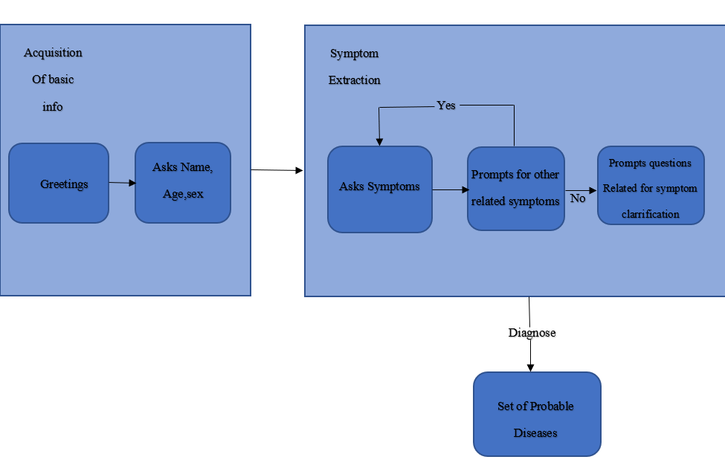
DATA FLOW DIAGRAM
BATCH NO: 15 PRESENTED DATE: 08-FEB-2020

Slide 10
DESIGN AND METHOLOGIES
MODULE 1:
Data Collection and training using Machine Learning Algorithms
MODULE 2:
A quick introduction on the context of the proper use of complex prescription drugs as well as the perception of digital health tools and chatbot by physicians.
This was followed by a presentation of the test version of the conversational agent with a first demonstration by the investigator ,then role playing by the physician.
The third stage ivolved disscussion and feedback.
BATCH NO: 15 PRESENTED DATE: 08-FEB-2020

Slide 11
CONCLUSION
A chatbot ia a great tool for conversation. Here the application is developed to provide quality of answers ina short period of time.
It removes the burden from the answer provider by directly delivering the answer to the user using an expert system.
The project is developed to save the user their time in consulting the doctors or experts for the healthcare solution.
In this project we have presented a system for the patients to get instant help in an emergency situation using medical chatbot.
Finally a successful execution of customized medicine would save many lives and perfect medical line of work.
BATCH NO:15 PRESENTED DATE: 08-FEB-2020

Slide 12
THANK YOU
BATCH NO: 15 PRESENTED DATE: 08-FEB-2020

