Slide 1



DEPARTMENT OF COMPUTER SCIENCE & ENGINEERING
SCHOOL OF COMPUTING
10214CS602 MINOR PROJECT -2
WINTER SEMESTER(2023-2024)
REVIEW-1
“IoT-Enabled Cardiac Attack Detection and Intervention”
SUPERVISED BY
PRESENTED BY
Dr. M. Saravana Karthikeyan
1. Pitta Rahul (VTU19191) (21UECT0062)
2.Thota Rushitha (VTU19357) (21UECT0042)
3. Bhavanam Sarath Chandra Reddy (VTU19151) (21UECT0052)

Slide 2
OVERVIEW
ABSTRACT
OBJECTIVES
TIMELINE OF THE PROJECT
INTRODUCTION
LITERATURE REVIEW
DESIGN AND METHODOLOGIES
IMPLEMENTATION
CONCLUSION
REFERENCES

Slide 3
ABSTRACT
Cardiovascular diseases (CVDs) remain one of the leading causes of mortality globally, accounting for millions of deaths each year. Among the various manifestations of CVDs, cardiac attacks, including heart attacks and sudden cardiac arrests, pose significant threats to human life due to their sudden onset and often fatal consequences. Timely detection and intervention are critical in mitigating the severity of cardiac attacks and improving patient outcomes.
In recent years, the Internet of Things (IoT) has emerged as a promising technology for healthcare applications, offering innovative solutions to improve patient monitoring, diagnosis, and treatment. Leveraging IoT in cardiac attack detection and intervention presents a transformative approach to addressing this pressing healthcare challenge.
At the core of the proposed system are wearable biosensors equipped with advanced physiological monitoring capabilities. These sensors continuously collect vital signs and biometric data, including heart rate, blood pressure, i2c signals from pulse sensor and activity levels, in real-time.

Slide 4
OBJECTIVES
Aim of the project:
The aim of this project is to develop an IoT-enabled system for the early detection and intervention of cardiac attack. And to continually monitor vital signs, evaluate data in real-time, and send timely notifications to patients and healthcare providers.
Scope of the project:
The scope of this project encompasses the design, development, and implementation of an IoT-enabled system for cardiac attack detection and intervention. It includes the integration of wearable biosensors, data analytics algorithms, and intervention mechanisms to enable real-time monitoring, early detection of cardiac events, and timely intervention to mitigate their impact.

Slide 5
TIMELINE OF THE PROJECT
JANUARY | FEBRUARY | MARCH | APRIL
Planning and Preparation | System Development | Testing and Optimization | Validation and Deployment

Slide 6
INTRODUCTION
The initiative to use IoT technology to monitor and identify heart attacks is extremely important to society. It promises to transform cardiac healthcare and maybe save countless lives by utilizing IoT sensors and real-time data processing. For those suffering from cardiovascular disorders, early diagnosis of heart attacks can lower death rates, save healthcare expenses, and enhance overall quality of life. Moreover, proactive self-care practices are encouraged when patients are equipped with real-time insights regarding their cardiac health condition. In addition to improving access to healthcare, especially for marginalized communities, the project provides important data for medical research, which advances the development of cardiovascular disease prevention and treatment methods. In the end, this research has the potential to significantly influence society by advancing patient outcomes, encouraging early intervention.

Slide 7
LITERATURE REVIEW
Author’s Name | Paper name and publication details | Year of publication | Main content of the paper
M. A. Oktay, C. E. Celebi, and M. K. Ozer | An IoT-Based Real-Time Cardiac Monitoring System | 2019 | To know the heart beat and the pulse Realtime
S. A. M. Ali, T. M. Z. Aung, and M. M. Htwe | Design and Implementation of IoT-Based Cardiac Health Monitoring System | 2020 | Open system on to monitoring using IO the card
M. H. Rostamian, A. M. Ghadimi, and H. R. Hassani | Design and Implementation of a Smart IoT-based Cardiac Monitoring System | 2020 | Design of IoT device to monitor heartbeat
J. Alshehri and A. Aljahdali | A Secure and Privacy-Preserving IoT-based Heart Disease Monitoring System | 2020 | Heartbeat monitoring withsecure and privacy prevention.

Slide 8
DESIGN AND METHODOLOGIES
MODULE 1: System Architecture
MODULE 2: Data Processing and analysis
MODULE 3: Realtime Monitoring System
MODULE 4: User Interface Design
MODULE 5: Integration with Healthcare System

Slide 9
MODULE 1: System Architecture
Hardware components include sensors such as the BMP180 barometric pressure sensor, Ublox NEO-6M GPS module, and heart rate pulse sensor, as well as the Arduino Pro Mini microcontroller and display.
- Software components encompass algorithms for data processing, analysis, and real-time monitoring, as well as communication protocols for transmitting data between components.
- This module provides an overview of how these components work together to enable continuous monitoring of cardiac health parameters and timely intervention in case of abnormalities.

Slide 10
MODULE 2: Data Processing and analysis
Algorithms are employed to extract relevant features from the data streams, such as heart rate, blood pressure, and GPS coordinates.
- Sophisticated signal processing techniques, including filtering and pattern recognition, are utilized to identify patterns indicative of cardiac anomalies.
- The processed data is analyzed in real-time to detect abnormal cardiac events and trigger appropriate alerts or interventions.

Slide 11
MODULE 3: Real-time Monitoring and Alerts
Continuous data collection from sensors allows for real-time monitoring of vital signs such as heart rate and blood pressure.
- Algorithms continuously analyze the data streams, comparing them against predefined thresholds or patterns to detect anomalies.
- Upon detection of abnormal cardiac events, the system generates alerts, notifying the user or healthcare providers through visual or audible cues.

Slide 12
MODULE 4: User Interface Design
The user interface provides visualizations of cardiac health data, such as heart rate trends, GPS location, and alert notifications.
- Design considerations include intuitive navigation, clear presentation of information, and customization options to suit individual user preferences.
- The interface enables users to interpret their cardiac health status, view historical data, and take appropriate actions based on alerts or recommendations provided by the system.

Slide 13
MODULE 5: Integration with Healthcare Systems
Integration with electronic medical records (EMR) systems allows healthcare providers to access patient data and monitor their cardiac health remotely.
- The system may also communicate with hospital networks or emergency response services to provide timely assistance in case of cardiac emergencies.
- Compliance with regulatory standards, such as FDA regulations for medical devices, ensures the system meets quality and safety requirements for healthcare applications.

Slide 14
IMPLEMENTATION
Architecture Diagram
Data –Flow Diagram
Use Case Diagram
Class Diagram
Activity Diagram
Sequence Diagram

Slide 15
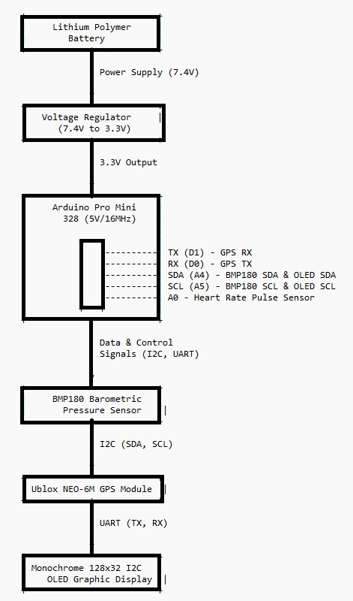
Architecture Diagram
This diagram illustrates the interconnected components of the system, including power supply, microcontroller (Arduino Pro Mini), sensors (BMP180 pressure sensor, Ublox NEO-6M GPS module, and heart rate pulse sensor), and display (monochrome 128x32 I2C OLED graphic display). Arrows indicate the flow of power, data, and control signals between the components.

Slide 16
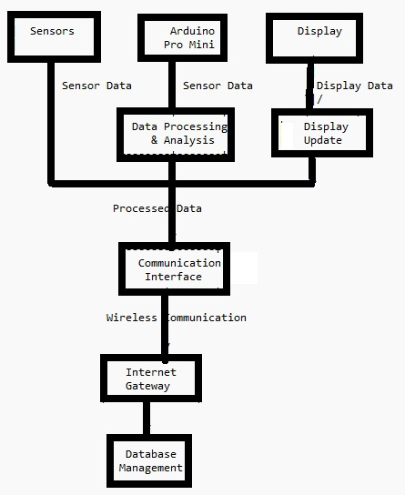
Data –Flow Diagram
Sensors: Capture physiological data such as heart rate, blood pressure, and GPS coordinates.
Arduino Pro Mini: Receives sensor data, processes and analyzes it.
Display: Receives processed data from Arduino for visualization.
Data Processing & Analysis: In the Arduino, algorithms process sensor data, detect patterns, and analyze cardiac health status.
Communication Interface: Manages the communication between Arduino and the internet gateway.
Internet Gateway: Facilitates communication between the IoT device and the database management system over the internet.
Database Management: Stores and manages the collected data for further analysis, retrieval, and integration with other systems.

Slide 17
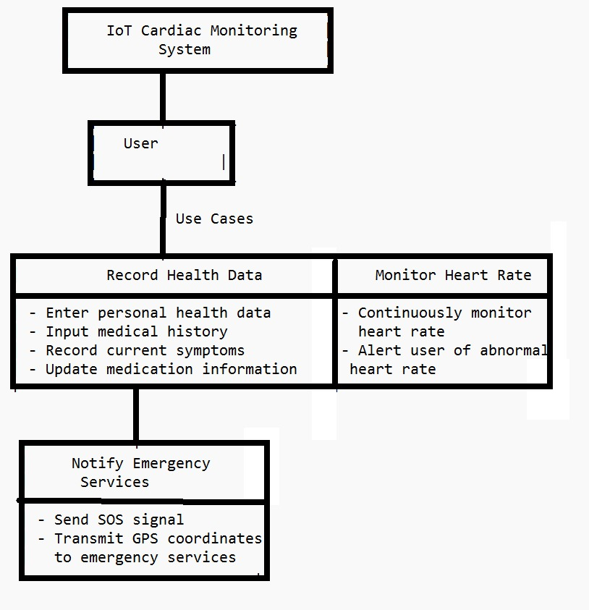
Use Case Diagram
Record Health Data: Users can input and update personal health information, medical history, symptoms, and medication details into the system.
Monitor Heart Rate: The system continuously monitors the user's heart rate in real-time and alerts them in case of abnormal heart rates.
Notify Emergency Services: In case of a cardiac emergency, the user can trigger an SOS signal, and the system transmits their GPS coordinates to emergency services for immediate assistance.

Slide 18
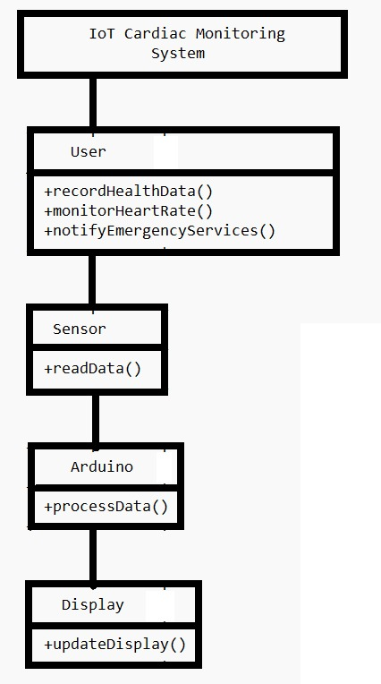
Class Diagram
Eg,
User: Represents the user interacting with the system. They can record health data, monitor heart rate, and notify emergency services.
Sensor: Abstract class representing various sensors (e.g., heart rate sensor, GPS module) used to collect physiological data.
Arduino: Represents the microcontroller responsible for processing the sensor data and managing system operations.
Display: Represents the display component used to visualize information for the user.
readData(): Method to read data from sensors.
processData(): Method to process sensor data and perform analysis.
updateDisplay(): Method to update the display with relevant information for the user.

Slide 19
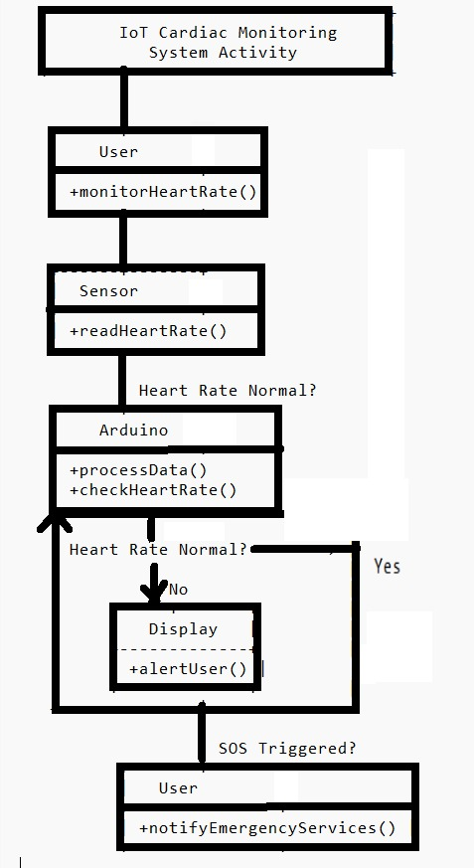
Activity Diagram
The user initiates heart rate monitoring. The sensor reads the heart rate data. The Arduino processes the data and checks if the heart rate is normal. If the heart rate is normal, the system proceeds with normal operations. If the heart rate is abnormal, the system alerts the user through the display. If the user triggers an SOS signal, the system notifies emergency services.

Slide 20
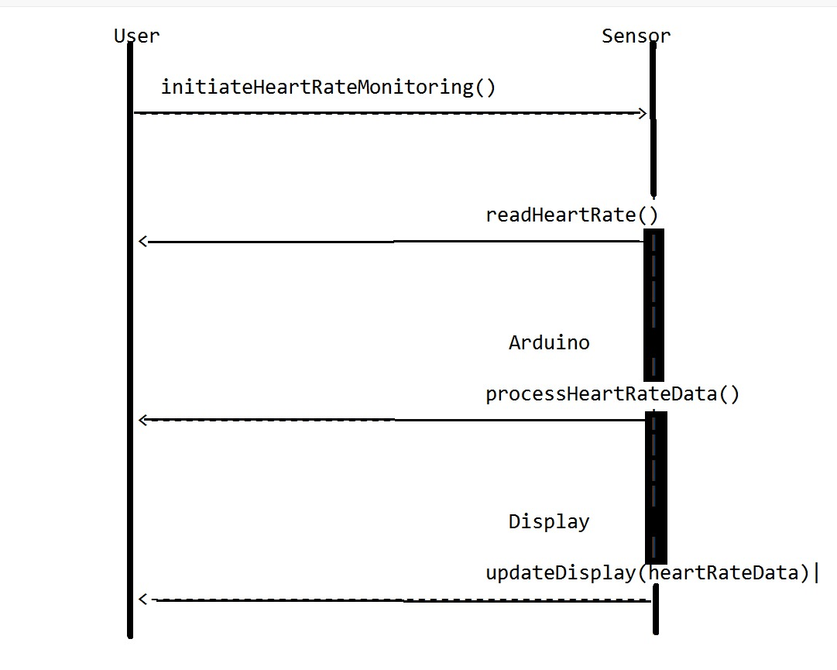
Sequence Diagram
The sequence diagram depicts interactions between the user, sensor, Arduino, and display components. The User lifeline initiates heart rate monitoring. Concurrently, the Sensor reads the heart rate data. Once the heart rate data is read, the Arduino processes it. Concurrently, the Display updates with the processed heart rate data. Each lifeline represents a parallel process occurring independently in the system.

Slide 21
REFERENCES
M. A. Oktay, C. E. Celebi, and M. K. Ozer, "An IoT-Based Real-Time Cardiac Monitoring System," 2019 IEEE 8th Global Conference on Consumer Electronics (GCCE), Osaka, Japan, 2019, pp. 891-892, doi: 10.1109/GCCE46687.2019.9015267.
S. A. M. Ali, T. M. Z. Aung, and M. M. Htwe, "Design and Implementation of IoT-Based Cardiac Health Monitoring System," 2020 IEEE Conference on Open Systems (ICOS), Melaka, Malaysia, 2020, pp. 141-145, doi: 10.1109/ICOS48703.2020.9274296.
M. H. Rostamian, A. M. Ghadimi, and H. R. Hassani, "Design and Implementation of a Smart IoT-based Cardiac Monitoring System," 2020 IEEE 10th Annual Computing and Communication Workshop and Conference (CCWC), Las Vegas, NV, USA, 2020, pp. 0595-0600, doi: 10.1109/CCWC47524.2020.9031004.
J. Alshehri and A. Aljahdali, "A Secure and Privacy-Preserving IoT-based Heart Disease Monitoring System," 2020 IEEE International Conference on Electro Information Technology (EIT), Grand Forks, ND, USA, 2020, pp. 403-407, doi: 10.1109/EIT47822.2020.9150285.
A. D. N. Siñel, N. C. O. Lleno, and J. A. A. Lao, "Development of an IoT-Based Cardiac Monitoring and Alert System for Atrial Fibrillation Detection," 2020 IEEE 12th International Conference on Humanoid, Nanotechnology, Information Technology, Communication and Control, Environment, and Management (HNICEM), Baguio City, Philippines, 2020, pp. 1-5, doi: 10.1109/HNICEM51425.2020.9395688.
M. S. Khan, A. U. Qazi, and A. Zeb, "An IoT-enabled Cardiac Health Monitoring and Management System," 2019 IEEE 3rd International Conference on Sustainable Information Engineering and Technology (SIET), Malang, Indonesia, 2019, pp. 380-385, doi: 10.1109/SIET48337.2019.8945880.

Slide 22
THANK YOU

