Slide 1



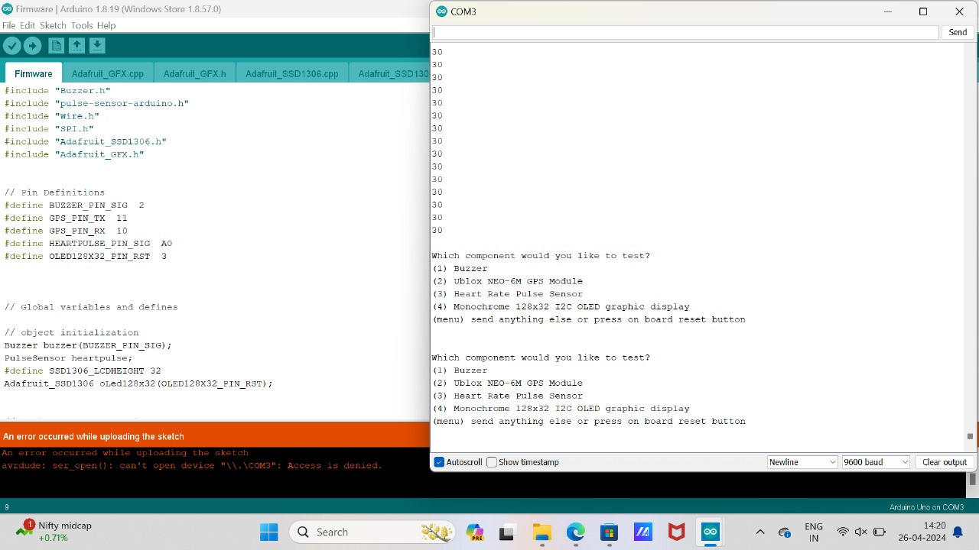
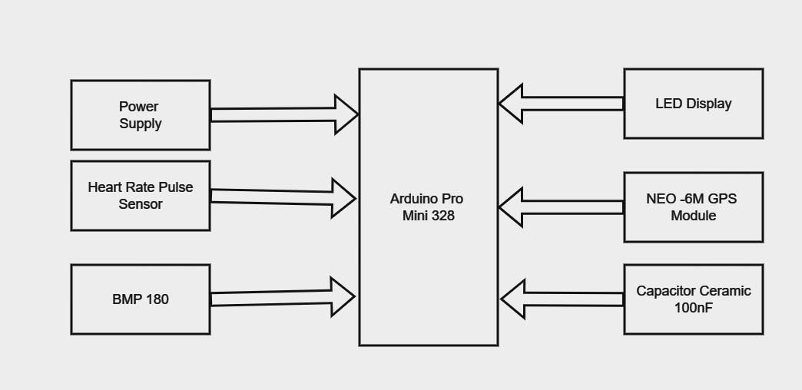
CARDIAC ATTACK DETECTION AND INTERVENTION BASED ON IOT
Department of Computer Science & Engineering
School of Computing
10214CS602– MINOR PROJECT-2
WINTER SEMESTER 2023-2024
ABSTRACT
INTRODUCTION
RESULTS
STANDARDS AND POLICIES
In recent years, the Internet of Things (IoT) has emerged as a promising technology for healthcare applications, offering innovative solutions to improve patient monitoring, diagnosis, and treatment. Leveraging IoT in cardiac attack detection and intervention presents a transformative approach to addressing this pressing healthcare challenge. At the core of the proposed system are wearable biosensors equipped with advanced physiological monitoring capabilities. These sensors continuously collect vital signs and biometric data, including heart rate, blood pressure, i2c signals from pulse sensor and activity levels, in real-time. The LED display module provides visual feedback to the user, displaying vital information and alerts. The collected sensor data is transmitted wirelessly to a central server or cloud platform via IoT connectivity, facilitating remote monitoring and data analysis
The initiative to use IoT technology to monitor and identify heart attacks is extremely important to society. It promises to transform cardiac healthcare and maybe save countless lives by utilizing IoT sensors and real-time data processing. For those suffering from cardiovascular disorders, early diagnosis of heart attacks can lower death rates, save healthcare expenses, and enhance overall quality of life. Moreover, proactive self-care practices are encouraged when patients are equipped with real-time insights regarding their cardiac health condition. In addition to improving access to healthcare, especially for marginalized communities, the project provides important data for medical research, which advances the development of cardiovascular disease prevention and treatment methods. In the end, this research has the potential to significantly influence society by advancing patient outcomes, encouraging early intervention. Advancements in sensor technology have played a crucial role in enhancing the capabilities of IoT-enabled cardiac monitoring systems.
The Arduino Integrated Development Environment (IDE) is a software platform used to write, compile and upload code to Arduino microcontrollers like the Arduino UNO. It provides an easy-to-use interface for programming and developing projects for various Arduino-compatible boards. Standard Used: ISO 5667-11. Machine learning algorithms, trained on historical cardiac data, analyze the sensor data in real-time to detect anomalies indicative of a cardiac attack. The proposed system offers several advantages, including early detection of cardiac abnormalities, remote monitoring capabilities, and prompt emergency response.
CONCLUSIONS
The social feasibility of a cardiac attack detection and intervention system using IoT technology involves several critical aspects that impact its acceptance and adoption within society. Public awareness campaigns and educational initiatives are essential to highlight the benefits of early detection and intervention, fostering a proactive approach to cardiovascular health.
User acceptance is pivotal, requiring a deep understanding of user needs and preferences to develop intuitive and user-friendly interfaces. Incorporating user feedback through testing and iterative design processes can enhance the system’s usability and overall satisfaction. The system notifies the doctor and appropriate relatives of the patient’s condition using IoT if it detects any sud den changes in the patient’s heartbeat or bodily functions. Additionally, it stores the patient’s information in the cloud for future reference.
METHODOLOGIES
Architecture Diagram
Our methodology involved a systematic approach to designing and implementing a robust system for cardiac attack detection and intervention leveraging IoT technology. Initially, we conducted an extensive review of existing literature and technologies related to cardiac monitoring, IoT devices, and medical intervention systems. Based on this research, we designed a wearable IoT device capable of continuously monitoring cardiac activity in real-time. The device utilizes sensors to capture vital signs and transmit data securely to an IoT gateway for further processing.
To evaluate the effectiveness of our system, we conducted comprehensive simulation studies and real-world trials involving patients at risk of cardiac events. We assessed the system's accuracy in detecting cardiac anomalies, its responsiveness in issuing timely alerts, and the efficacy of medical interventions initiated by healthcare providers. Feedback from both patients and healthcare professionals was collected to refine the system's performance and usability.
TEAM MEMBER DETAILS
ACKNOWLEDGEMENT
1. Vtu19191 P. Rahul
2. Vtu19151 B. Sarath Chandra Reddy
1. 8106177376
2. 9676526446
1. vtu19191@veltech.edu.in
2. vtu19151@veltech.edu.in
Dr.M. Saravana Karthikeyan, M.E., PH.D.,
Assistant Professor
9443852472

