Slide 1


GAS LEAKAGE DETECTOR USING ARDUINO
THEME:PUBLIC SAFETY
Vel Tech Rangarajan Dr.Sagunthala R & D Institute of Science & Technology

Slide 2
ABSTRACT
Home fires have been taking place frequently and the threat to human lives and properties is growing in recent years. Liquid petroleum gas (LPG) is highly inflammable and can burn even at some distance from the source of leakage. Most fire accidents are caused because of a poor-quality rubber tube or the regulator is not turned off when not in use. Therefore, developing the gas leakage alert system is very essential. Hence, this paper presents a gas leakage alert system to detect the gas leakage and to alarm the people onboard. Keywords: Liquid petroleum gas, Gas sensor, Leakage

Slide 3
SELECTED THEME : PUBLIC SAFETY
Gas Leak Detection System:
Gas leak detection is the process of identifying potentially hazardous gas leaks by sensors. These sensors usually employ an audible alarm to alert people when a dangerous gas has been detected. Exposure to toxic gases can also occur in operations such as painting, fumigation, fuel filling, construction, excavation of contaminated soils, landfill operations, entering confined spaces, etc.

Slide 4
LIST OF THEMES:
AGRICULTURE
PUBLIC SAFETY
WASTE TO WEALTH
ENERGY CONSERVATION
ENVIRONMENTAL CONSERVATION
ROBOTICS
INFRASTRUCTURE
TRANSPORTATION
BIO ENGINEERING
RENEWABLE ENERGY

Slide 5
EXISTING METHOD
Gas leakage is sensed using MQ-2 sensor, when it is more than threshold value given which is interfaced by Arduino UNO. The buzzer will be on to notify the surrounding people. Using the relay on, the power supply will be off and then there will a display on the LCD for detection of the alert message like LPG gas detected!.

Slide 6
PROBLEM IDENTIFICATION
PROBLEM :
In recent days as usage of gas is flexible and cheaper, it has been increased from home to hotels, industries, office etc. Besides its advantageous, gas leakage is becoming a major concern at all the places wherever it is being used as it may lead to a small accident or sometimes major disaster causing a great loss of infrastructures and lives of people.
SOLUTION:
The sensors are widely used to detect essence of propane, iso-butane, LPG and even smoke. Arduino UNO is used in the project; low signals are overlooked by the Arduino and gas leakage is been noticed by the Arduino. The Arduino UNO turns on the LCD and buzzer.

Slide 7
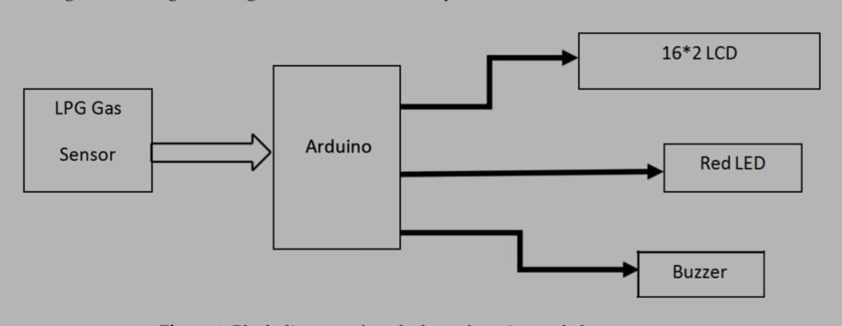

BLOCK DIAGRAM:

Slide 8
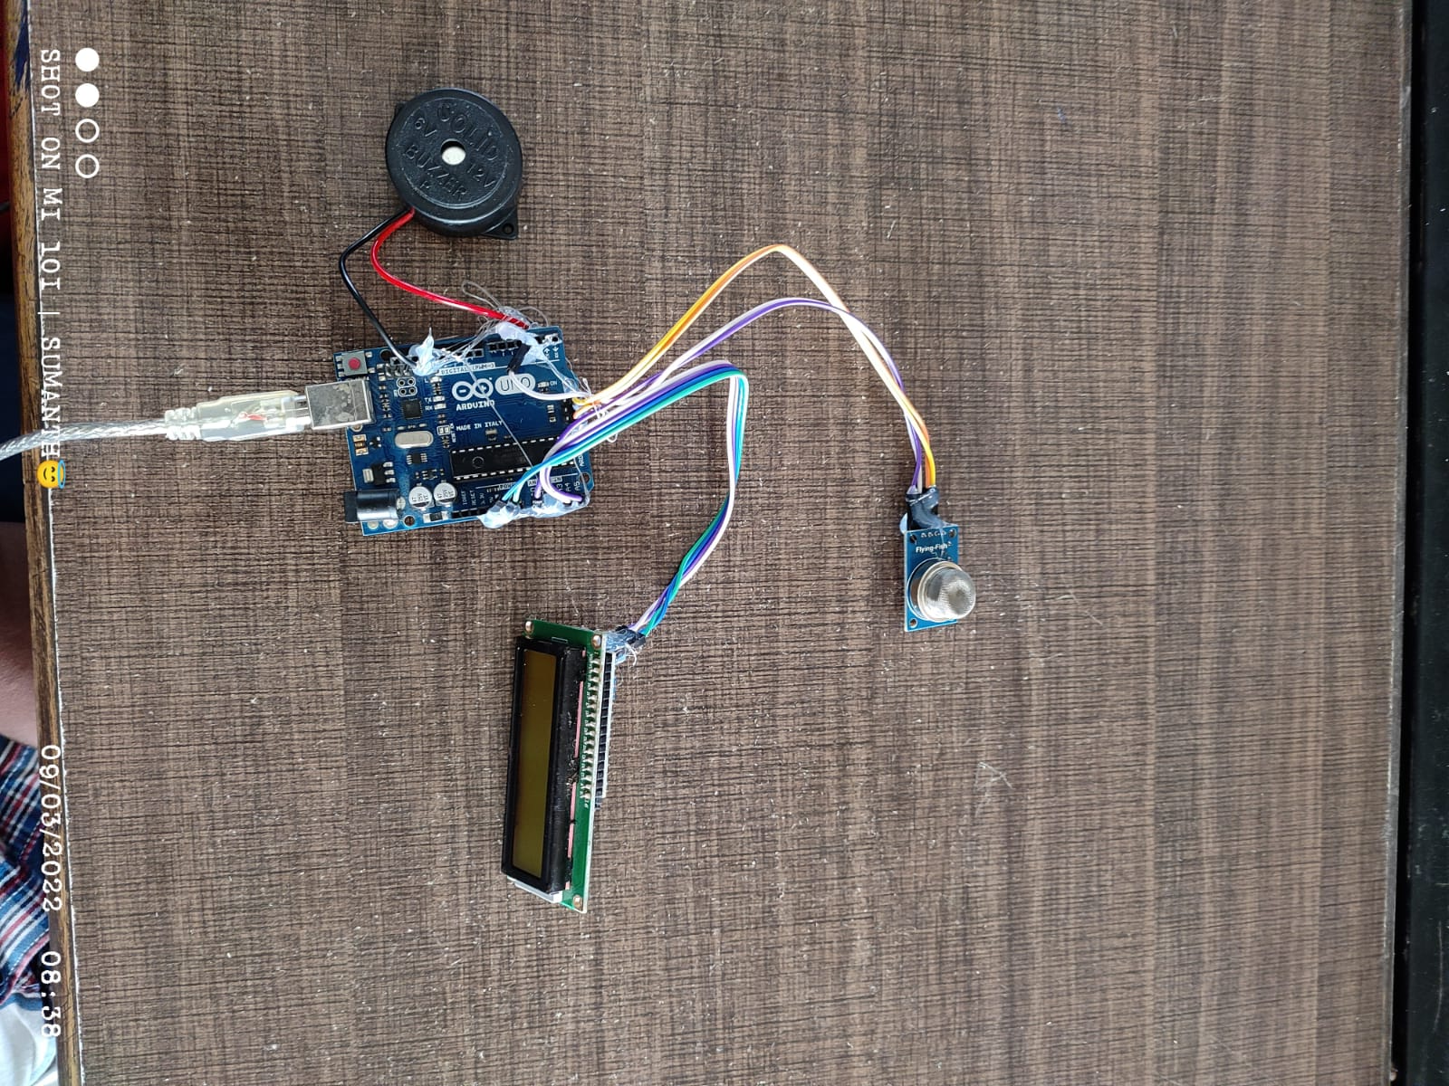

Slide 9
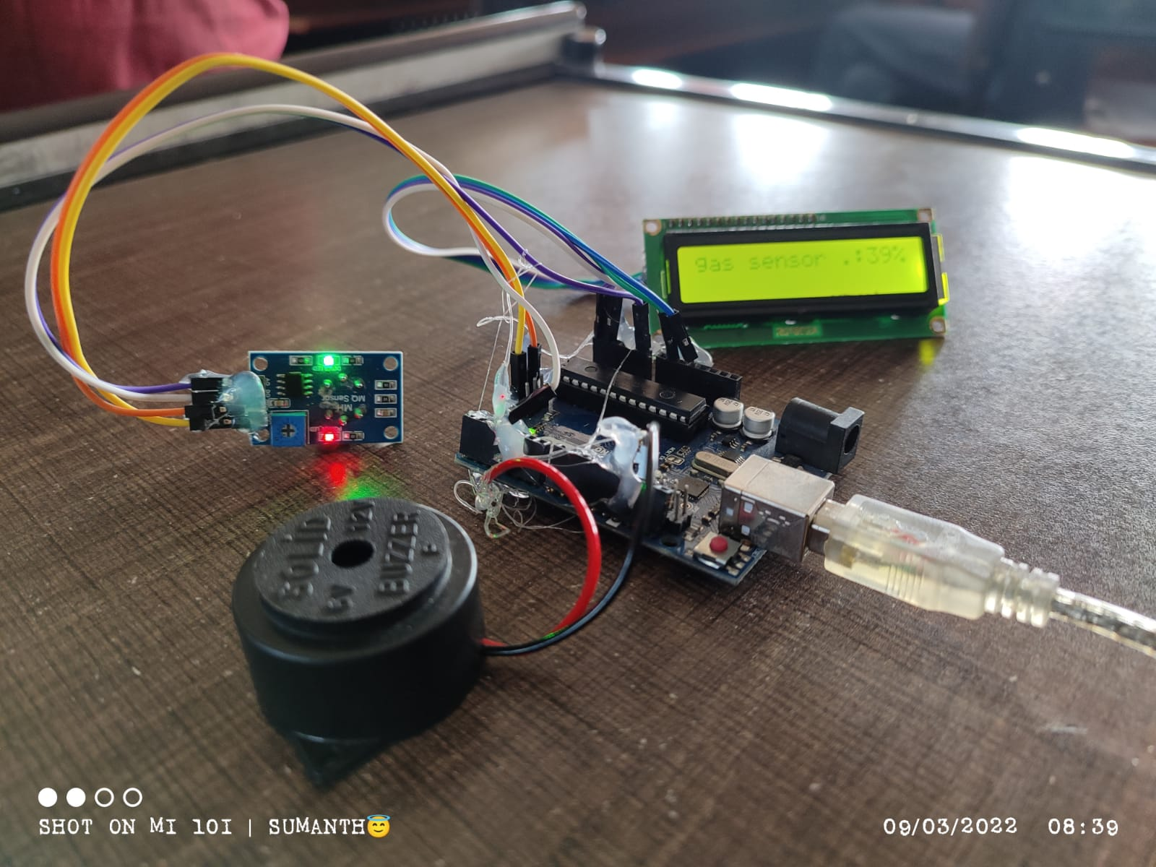
HARDWARE PROTOTYPE

Slide 10
MATERIALS
Arduino Uno R3
MQ2 SENSOR
3. LCD DISPLAY
4. BUZZER

Slide 11
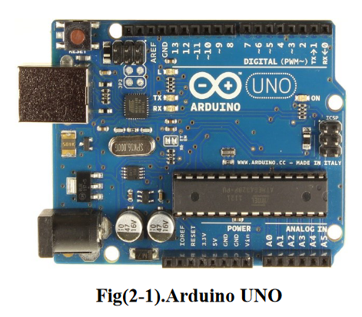
Arduino UNO: Arduino Uno is a microcontroller board based on the ATmega328P. It has 14 digital input/output pins (of which 6 can be used as PWM outputs), 6 analog inputs, a 16 MHz quartz crystal, a USB connection, a power jack, an ICSP header and a reset button. It contains everything needed to support the microcontroller; simply connect it to a computer with a USB cable or power it with a AC-to-DC adapter or battery to get started. It can be powered by the USB cable or by an external 9-volt battery, though it accepts voltages between 7 and 20 volts.

Slide 12
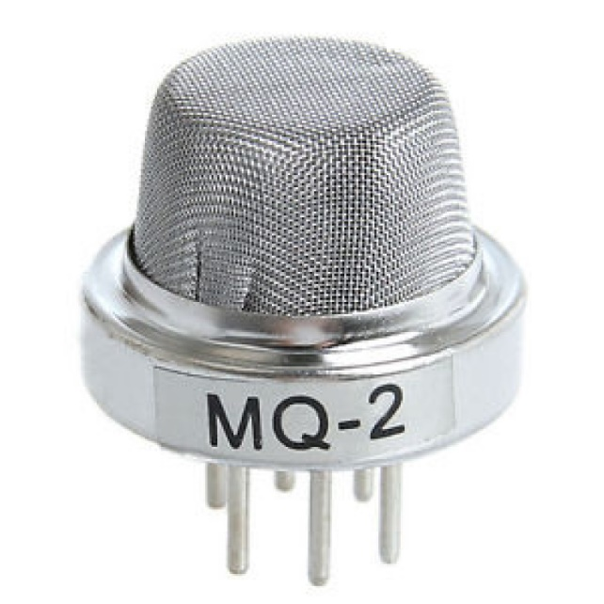
MQ2 Sensor: MQ-2 gas sensor module is shown in fig.3. It is a sensor detector used to detects the flammable gas and smoke concentration of the combustible gas in the air, and output is read in the analog voltage and digital value output. Supply input voltage is 5v. it is very sensitive to H2, LPG, CH4, CO, SMOKE, PROPANE. It has three pins for transmitter, receiver, ground and sensitivity can be adjust by the potentiometer. Detects LPG from 200ppm to 10000ppm.

Slide 13
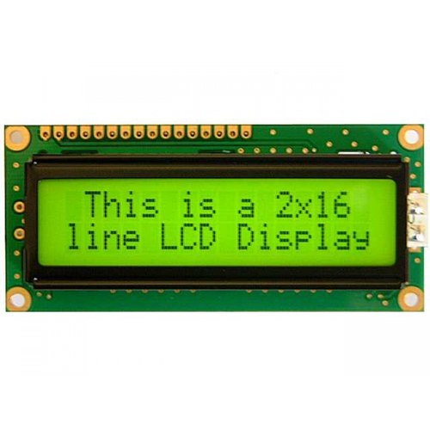
LCD DISPLAY: LCD is employed for displaying the message indicating that” gas detected at zone” into the display, which is initially coded in program to display the danger. The message been displayed on the LCD, data and command both are register of LCD and it's shown in fig.5. The register selects is employed to modify the registers. data register RS=1, whereas for the command register RS=0 is employed.

Slide 14
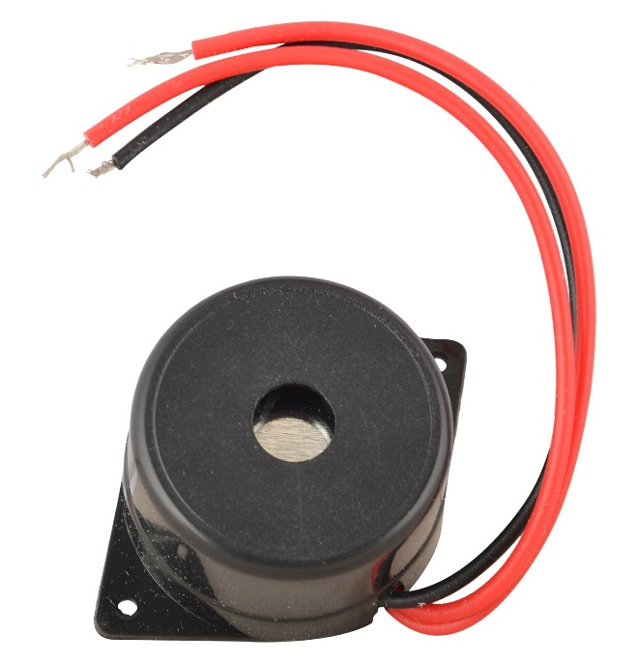
Buzzer : Buzzer is used to alarm the beep sound to indicate and warn the danger to the people working around. The buzzer is the output of the system. The sound of the buzzer is beep-beep, which indicates the danger.

Slide 15
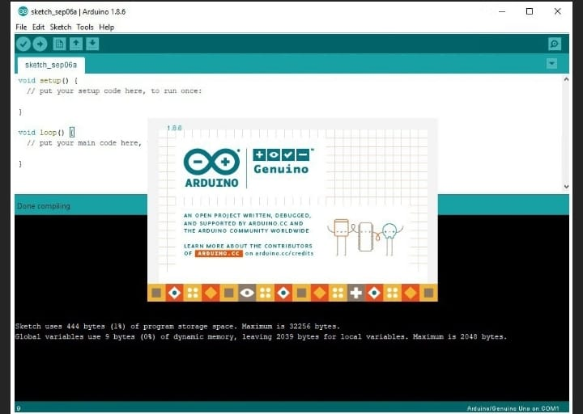
SOFTWARE DETAILS
I have used Arduino software in my project. The Arduino Integrated Development Environment a cross-platform application (for Windows, macOS, Linux) that is written in functions from C and C++. It is used to write and upload programs to Arduino compatible boards, but also, with the help of third-party cores, other vendor development boards. The Arduino IDE also supplies a software library from the Wiring project, which provides many common input and output procedures.

Slide 16
PROGRAM
CODE:
#include <LiquidCrystal.h>
LiquidCrystal lcd(12, 11, 5, 4, 3, 2);
#define lpg_sensor 7
#define buzzer 13
void setup()
{
pinMode(lpg_sensor, INPUT);
pinMode(buzzer, OUTPUT);
lcd.begin(16, 2);
lcd.print("LPG Gas Detector");
lcd.setCursor(0,1);
lcd.print("Techno Review 85");
delay(2000);

Slide 17
}
void loop()
{
if(digitalRead(lpg_sensor))
{
digitalWrite(buzzer, LOW);
lcd.clear();
lcd.print(" NO LPG GAS ");
lcd.setCursor(0, 1);
lcd.print(" LEAKAGE ");
delay(400);
digitalWrite(buzzer, LOW);
delay(500);
}
else
{

Slide 18
digitalWrite(buzzer, HIGH);
lcd.clear();
lcd.print(" LPG Gas Leakage ");
lcd.setCursor(0,1);
lcd.print(" Alert ");
delay(1000);
}
}

Slide 19
WORKING PRINCIPLE
Gas leakage is sensed using MQ-2 sensor, when it is more than threshold value given which is interfaced by Arduino UNO. The buzzer will be on to notify the surrounding people. Using the relay on, the power supply will be off and then there will a display on the LCD for detection of the alert message like LPG gas detected!.

Slide 20
ADVANTAGES & DISADVANTAGES
ADVANTAGES :
USED IN HOUSE AS A LPG GAS DETECTOR.
IT ALSO DETECT ALCOHOL SO IT IS USED AS LIQUOR TESTER.
THE SENSOR HAS EXCELLENT SENSITIVITY COMBINED WITH A QUICK RESPONCE TIME.
DISADVANTAGES :
IT IS LITTLE SENSITIVE TO SMOKE THEN IT IS NOT PERFECTLY RESPONSE FOR
LPG GAS DETECTION
2. ITS SENSITIVITY DEPENDS ON HUMIDITY AND TEMPERATURE.

Slide 21
CONCLUSION
After this project performance, can conclude that detection of the LPG gas leakage is incredible in the project system. Applicable usefully in the industrial and domestic purpose. In danger situations we are able to save the life by using this system. A sensor node senses gas like CO2, oxygen, propane. The estimated range of transmission and consumption of power is obtained. The simple procedures and Arduino UNO Micro controller area used to build the sensor.

Slide 22
REFERENCE
https://youtu.be/FAwek1hV7ww

Slide 23
Thank YOU

