Slide 1



DEPARTMENT OF COMPUTER SCIENCE & ENGINEERING
SCHOOL OF COMPUTING
10214CS602 MINOR PROJECT -2
WINTER SEMESTER(2023-2024)
REVIEW-1
“SIGN SAVVY RECOGNITION USING MACHINE LEARNING”
SUPERVISED BY
PRESENTED BY
MRS.S.KIRUTHIGA
Assistent Professor.
1.PARRA VARSHITH (VTU20508)(21UECS0437)
2.SAMPATH PARUPALLI (VTU20359)(21UECS0714)
3.HEMA SUNDHAR VEGI (VTU20416)(21UECS0718)

Slide 2
OVERVIEW
ABSTRACT
OBJECTIVES
TIMELINE OF THE PROJECT
INTRODUCTION
LITERATURE REVIEW
DESIGN AND METHODOLOGIES
IMPLEMENTATION
CONCLUSION
REFERENCES

Slide 3
ABSTRACT
The project title "Sign Language Recognition System Using Machine Learning" is quite self-explanatory, as it describes the essence of the project.The "Sign Language Recognition System Using Machine Learning" project holds immense societal, technological, and educational significance, addressing the needs of a marginalized community while pushing the boundaries of AI and fostering inclusivity and accessibility.An Sign Language is one of the way to communicate with deaf people. In this work sets, included features and variation in the language with locality have been the major barriers which has led to little research being done in ISL. One should learn sign language to interact with them. Learning usually takes place in peer groups. There are very few study materials available for sign learning. Because of this, the process of learning sign language learning is a very difficult task. The initial stage of isign learning is Finger spelled signi learning and moreover, are used when no corresponding sign exists or signer is not aware of it. Most of the existing tools for sign language learning use external sensors which are costly. Our project aims at extending a step forward in this field by collecting a dataset and then use various feature extraction techniques to extract useful information which is then input into various supervised learning techniques. Currently, we have reported four fold cross validated results for the different approaches, and the difference from the previous work done can be attributed to the fact that in our four fold i cross validation, the validation set Correspond to images of a iperson different from the persons in the training set.

Slide 4
OBJECTIVES
1.Aim of the project:The aim of the project "Sign Language Recognition System Using Machine Learning" is to develop a robust and accurate system capable of interpreting sign language gestures from videos or images.Sign language recognition systems bridge the communication gap between the deaf community and the hearing population, enabling seamless interaction and understanding.Sign language recognition empowers the deaf community by providing them with tools to express themselves and engage more effectively in a predominantly spoken language society.
2.Scope of the project:The objective and scope of the project "Sign Language Recognition System Using Machine Learning" are crucial for defining its goals and boundaries.Sign language involves intricate hand movements, facial expressions, and body language, making it a challenging task for machines to accurately interpret and recognize.the scope of a Sign Language Recognition System using Machine Learning extends beyond technical development to encompass practical implementation and societal impact, with the ultimate goal of fostering inclusion, accessibility, and empowerment for individuals with communication disabilities.

Slide 5
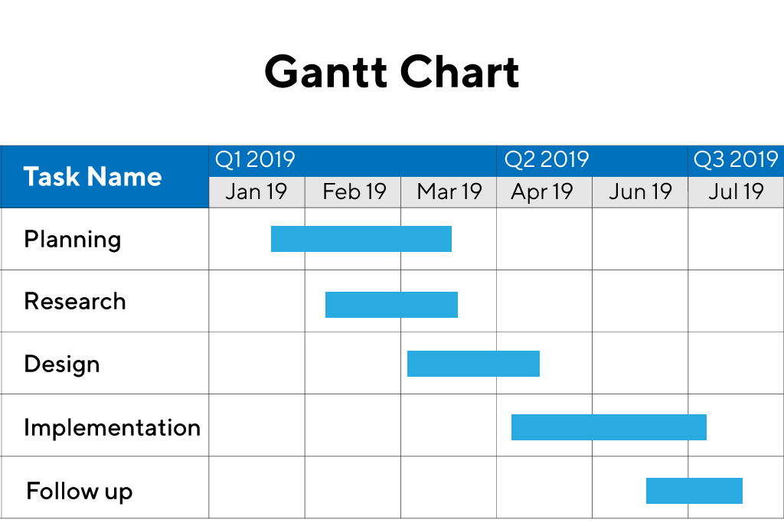
TIMELINE OF THE PROJECT

Slide 6
INTRODUCTION
Sign language guides this part of the community and empowers smooth communication in the community of people with trouble talking and hearing (deaf and dumb). They use hand signals along with facial expressions and body activities to cooperate.
Sign language has an extra advantage as it can be used to communicate efficiently. Many techniques have been developed using image processing, sensor data processing, and motion detection by applying different dynamic algorithms and methods like machine learning and deep learning.
Depending on methodologies, researchers have proposed their way of classifying sign languages. As technologies develop, we can explore the limitations of previous works and improve accuracy.
Machine Learning Techniques for Sign Language Recognition:
Feature Extraction: Extracting meaningful features from sign language images, such as hand shape, orientation, and motion, is fundamental for training recognition models.
Supervised Learning: Utilizing labeled datasets for training supervised learning models, which learn to map input sign language images to corresponding gestures.
Unsupervised Learning: Exploring unsupervised learning techniques for clustering and pattern discovery in sign language data, enabling the system to identify similarities and differences in gestures.The sign language is used widely by people who are deaf-dumb these are used as a medium for communication.
A sign language is nothing but composed of various gestures formed by different shapes of hand, its movements,orientations as well as the facial expressions.
There are around 466 million people worldwide with hearing loss and 34 million ofthese are children. `Deaf' people have very little or no hearing ability .They use sign language for communication. People use different sign languages in different parts of the world. Comparedtospokenlanguages they are very less in number

Slide 7
LITERATURE REVIEW
Author’s Name | Paper name and publication details | Year of publication | Main content of the paper
E. Abraham | Published in: 2019 Global Conference for Advancement in Technology (GCAT) | 20 October 2019 | Real-time translation of indian sign language using LSTM
Rahib H.Abiyev | KSII Transactions on Internet and Information Systems Monthly Online Journal (eISSN: 1976-7277) | February 29, 2020 | Sign Language Translation Using Deep Convolutional Neural Networks

Slide 8
Subhash Chand Agrawal | Published in: 2012 4th International Conference on Intelligent Human Computer Interaction (IHCI) | 21 March 2013 | Recognition of Indian sign language using feature fusion
V. Adithya | Published in: 2013 IEEE Conference on Information & Communication Technologies | 15 July 2013 | Artificial neural network based method for Indian sign language recognition

Slide 9
DESIGN AND METHODOLOGIES
MODULE 1: Mention name of the module 1(Data acquisition)
MODULE 2:Mention the name of the module 2(Mention the algorithm)

Slide 10
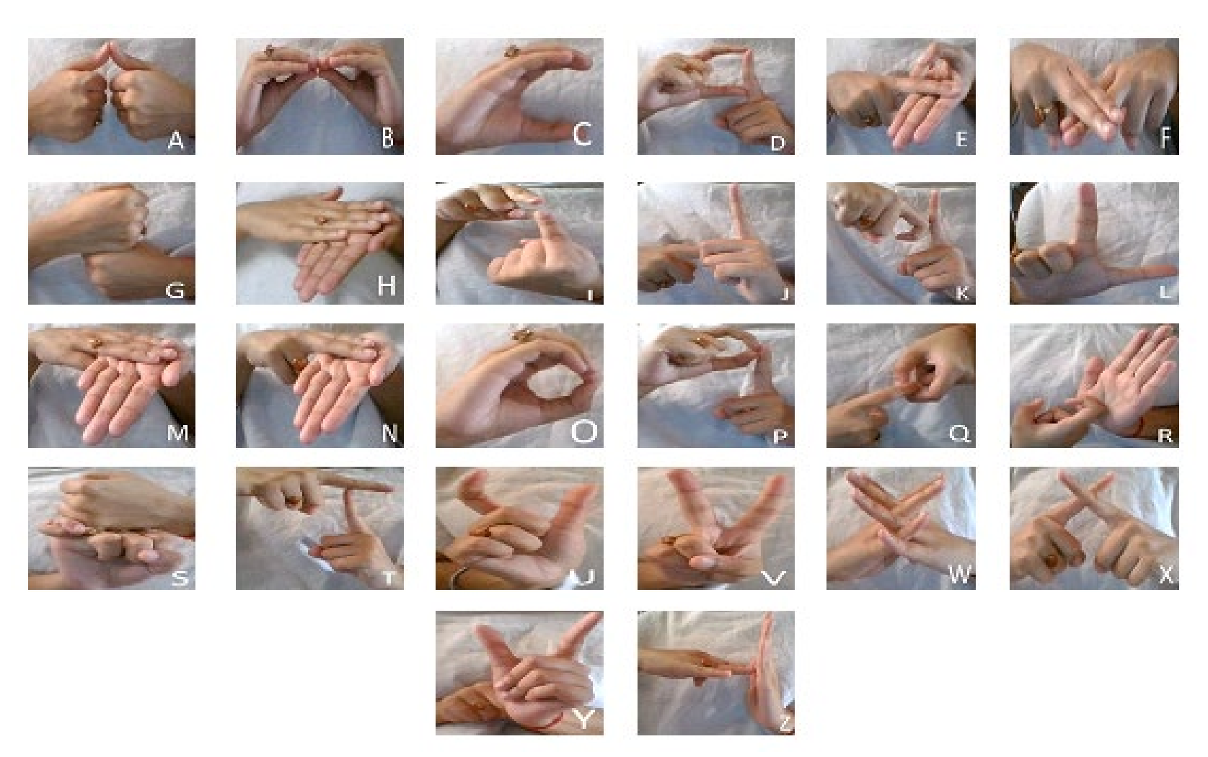
MODULE 1: Data acquisition
A real-time sign language detection system is being developed for Sign Language. For data acquisition, images are captured by webcam using Python and OpenCV. OpenCV provides functions which are primarily aimed at the real-time computer vision

Slide 11
Step 2: Processing the data
System Modules
• DATA COLLECTION
• PREPROCESSING
• MODEL TRAINING
• MODEL TESTING
• PERFORMANCE EVALUATION
• OUTPUT PREDICTION

Slide 12
Module 2- Mention the algorithm
Sign Language Recognition (SLR) System using Machine Learning, several algorithms can be employed depending on the specific requirements of the system and the nature of the input data. Here are some commonly used algorithms:
Convolutional Neural Networks (CNNs):
CNNs are widely used for image-based recognition tasks, making them suitable for SLR systems that operate on image or video data of sign language gestures.
They are effective in learning hierarchical features directly from raw pixel values, enabling them to capture spatial patterns and variations in hand gestures.
Recurrent Neural Networks (RNNs):
RNNs are suitable for sequence modeling tasks, making them ideal for capturing temporal dependencies in sign language sequences.
Architectures like Long Short-Term Memory (LSTM) networks or Gated Recurrent Units (GRUs) are commonly used within RNN frameworks to address the vanishing gradient problem and model long-range dependencies effectively.
Hidden Markov Models (HMMs):
HMMs are probabilistic models often used for sequential data modeling and have been applied to SLR systems for recognizing sequential patterns in sign language gestures.They model the temporal evolution of sign language sequences and estimate the most likely sequence of states corresponding to observed gestures.
Support Vector Machines (SVMs):
SVMs are effective for classification tasks and have been used in SLR systems for recognizing static hand shapes or gestures.They work well with high-dimensional feature vectors extracted from sign language images or videos and are known for their ability to handle non-linear decision boundaries.
Hidden Conditional Random Fields (HCRFs):
HCRFs extend traditional Conditional Random Fields (HCRFs) by incorporating hidden states, making them suitable for sequential labeling tasks like SLR.
They model dependencies between observed features and output labels, capturing both spatial and temporal relationships in sign language sequences.

Slide 13
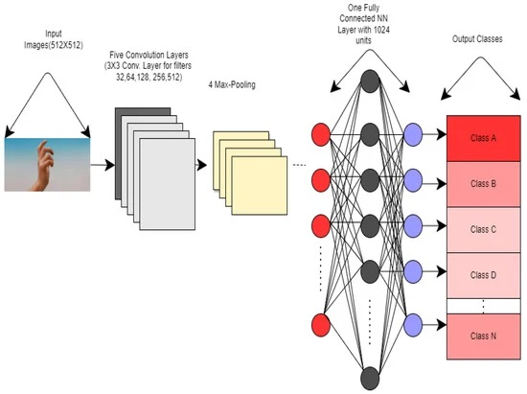
Step 3: Using algorithm’s name algorithm
An Experimental Analysis of Various Machine Learning Algorithm

Slide 14
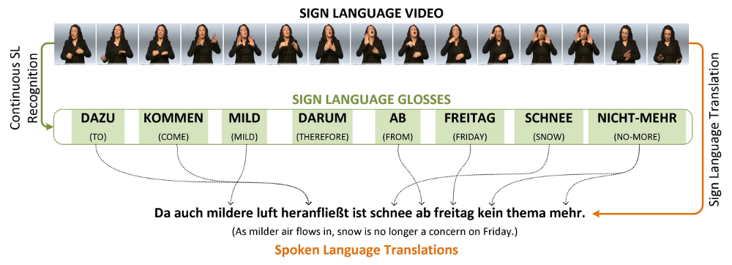
Step 4: The output

Slide 15
IMPLEMENTATION
Architecture Diagram
Data –Flow Diagram
Use Case Diagram
Class Diagram
Activity Diagram
Sequence Diagram
Collaboration Diagram(If applicable)
E-R Diagram

Slide 16
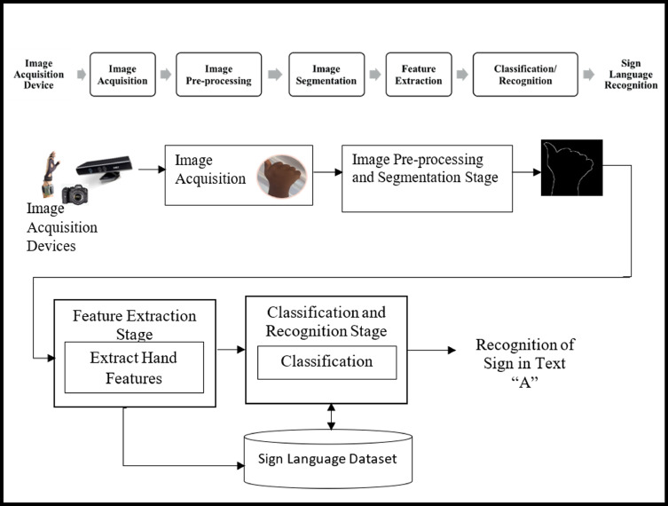
Architecture Diagram

Slide 17
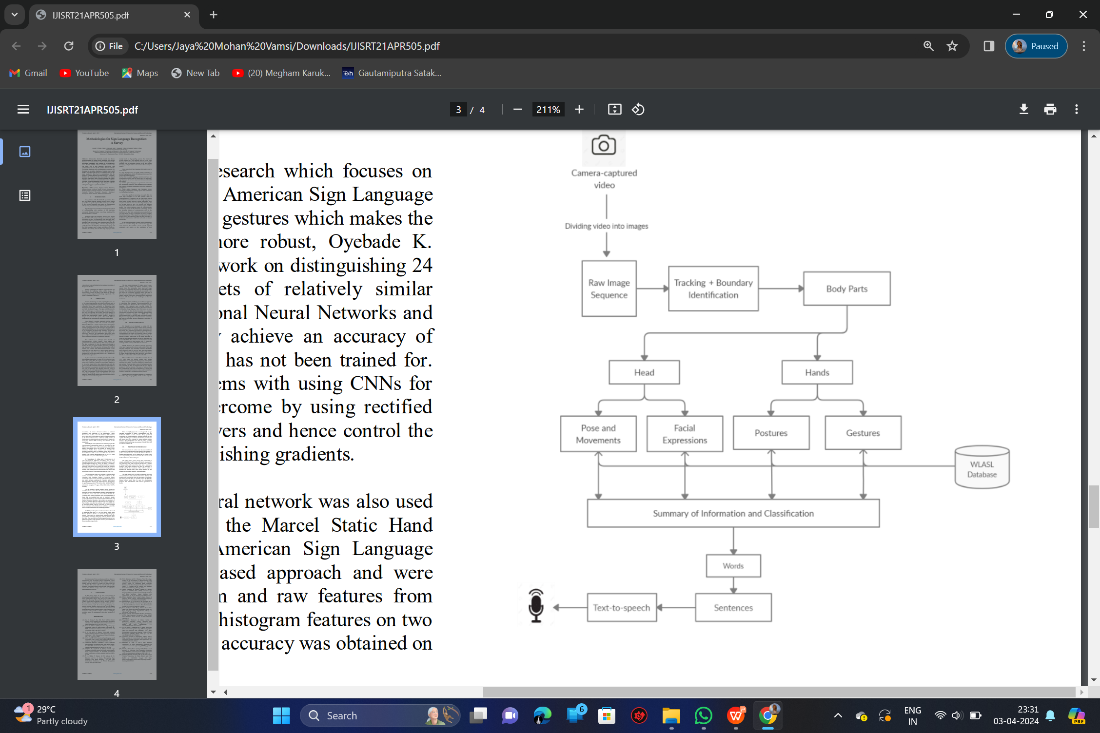
Data –Flow Diagram

Slide 18
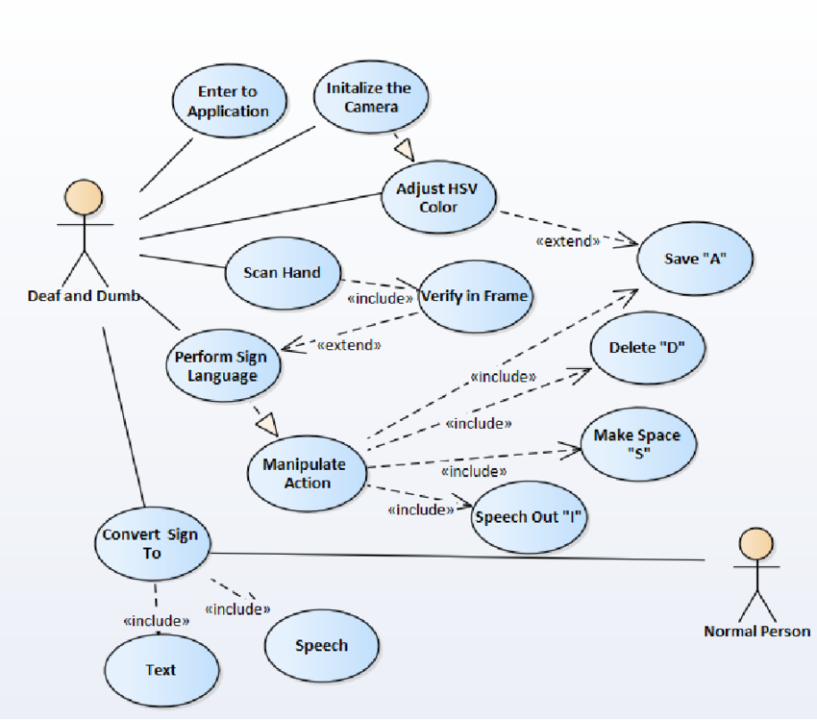
Use Case Diagram

Slide 19
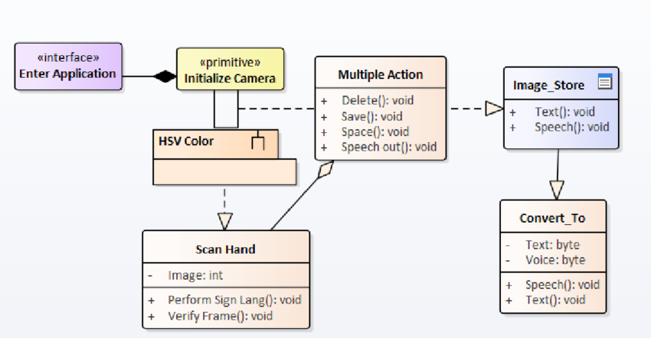
Class Diagram

Slide 20
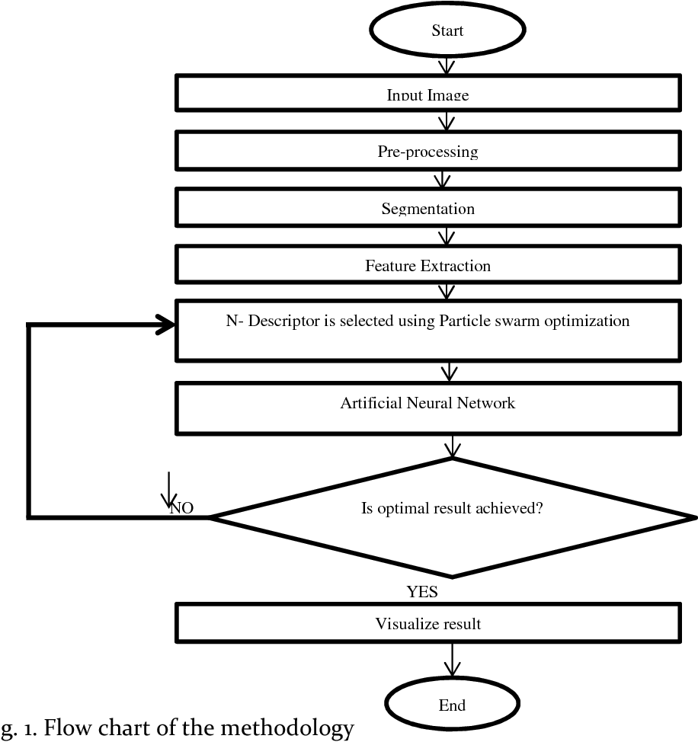
Activity Diagram

Slide 21
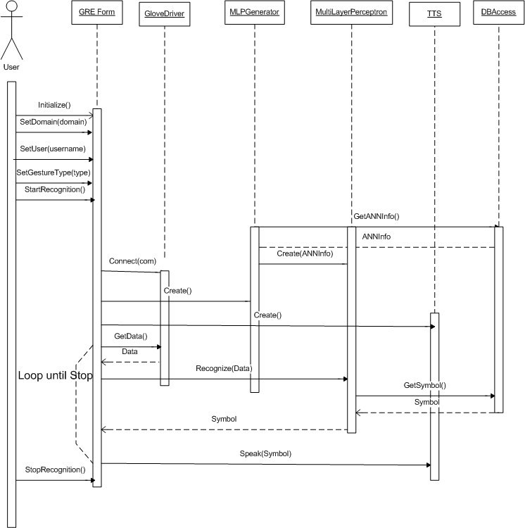
Sequence Diagram

Slide 22
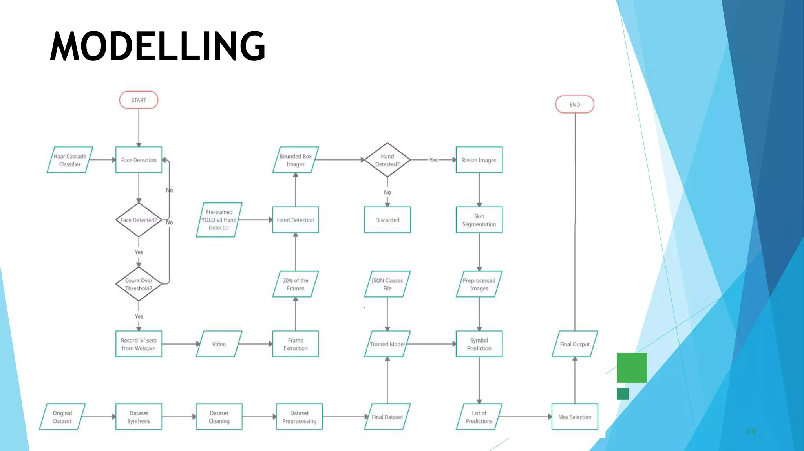
E-R Diagram

Slide 23
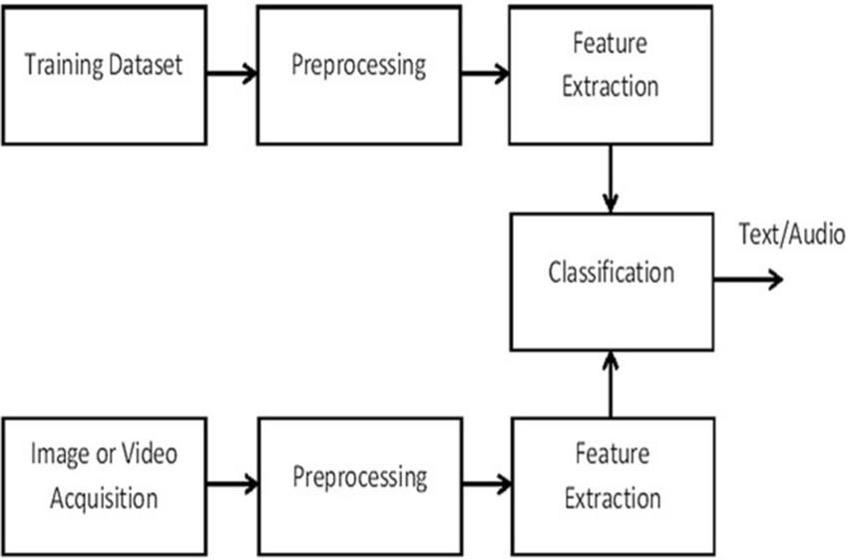
Collaboration Diagram(If applicable)

Slide 24
REFERENCES
Enikeev, D.G., Mustafina, S.A.: Sign language recognition through Leap Motion controller and input prediction algorithm. J. Phys. Conf. Ser. 1715, 012008 (2021).
Zhang, W.; Wang, J.; Lan, F. Dynamic hand gesture recognition based on short-term sampling neural networks. IEEE/CAA J. Autom. Sin. 2021, 8, 110–120.
Kapur, R.: The Types of Communication. MIJ. 6, (2020).
Pan T, Lo L, Yeh C, Li J, Liu H, Hu M (2016) Real-time sign language recognition in complex background scene based on a hierarchical clustering and support vector machine. In: 2016 IEEE second conference on multimedia big data, pp 64–67
Masood S, Thuwal H, Srivastava A (2017) American sign language character recognition using convolution neural network. Smart Comput Inform, 403–412.
Kumar P, Gauba H, Roy P, Dogra D (2017) Coupled HMM-based multi-sensor data fusion for sign language recognition. Pattern Recogn Lett 86:1–8.
Hore, S., Chatterjee, S., Santhi, V., Dey, N., Ashour, A.S., Balas, V.E., Shi, F.: Indian Sign Language Recognition Using Optimized Neural Networks. Adv. Intell. Syst. Comput.
Bragg, D., Koller, O., Bellard, M., Berke, L., Boudreault, P., Braffort, A., Caselli, N.,Huenerfauth, M., Kacorri, H., Verhoef, T., Vogler, C., Morris, M.R.: Sign Language Recognition, Generation, and Translation: An Interdisciplinary Perspective. 21st Int. ACM SIGACCESS Conf. Comput. Access. (2019).

Slide 25
THANK YOU

