Slide 1

Vel Tech Rangarajan Dr. Sagunthala R&D Institute of Science and Technology
School of Computing
Department of Computer Science and Engineering
10211CS224 / FULL STACK APPLICATION DEVELOPMENT (JAVA)
PROJECT REVIEW : MILESTONE PROJECT – 1
Date: 04-03-2026
RELATIONAL INVENTORY CONTROL & STOCK TRACKING SYSTEM
SDG: SDG No – SDG 12: (Responsible Consumption and Production).
Presented By:
JITHEESWAR.S– VTU24418 – 23UECS1251.
Courses Handling Faculty:
Dr.M MAGESHWARI

Slide 2
INTRODUCTION
1
Traditional manual inventory methods often lead to significant data inaccuracies, resulting in overstocking and unnecessary waste. This project is vital for modernizing supply chains to ensure resource efficiency and minimize environmental impact. By providing real-world transparency, the system helps businesses meet global sustainability targets through reduced spoilage. This Relational Inventory Control & Stock Tracking System utilizes a structured database to monitor stock levels in real-time. It automates replenishment alerts to prevent excess accumulation and optimizes the distribution of goods. Ultimately, the system serves as a bridge between operational profitability and responsible resource management.
2
3
4
5
6
7
8
9

Slide 3
PROBLEM STATEMENT
1
2
A Relational Inventory Control System improves this by linking suppliers, products, and transactions through a structured database, ensuring 100% data integrity. By utilizing real-time tracking and automated reorder points, the system prevents overstocking and ensures a "First-In,First-Out" (FIFO) flow to minimize spoilage. This transition from reactive to proactive management optimizes resource use and provides the transparency needed for a sustainable supply chain.
Ultimately, it bridges the gap between operational profitability and global sustainability by reducing the environmental footprint of production.
3
4
5
6
7
8
9

Slide 4
OBJECTIVE(S)
1
Manual inventory management often leads to data silos and inaccurate stock records, resulting in significant resource waste and over-ordering. This project is vital for aligning business operations with SDG 12: Responsible Consumption and Production by ensuring efficient resource use. In a real-world context, transparency in the supply chain prevents product spoilage and reduces the environmental footprint of excess production. The proposed system is a Relational Inventory Control and Stock Tracking solution designed to centralize data. By linking suppliers, products, and real-time transactions, it eliminates "phantom inventory" and human error. Automated alerts ensure optimal stock levels are maintained through proactive monitoring. Ultimately, the system serves as a bridge between operational profitability and global sustainability goals.
2
3
4
5
6
7
8
9

Slide 5
PROPOSED SYSTEM
1
2
By utilizing primary and foreign keys, the system eliminates data redundancy, ensuring that a stock update in one table instantly reflects across all related modules like billing and procurement. This connectivity provides high data integrity and allows for complex querying, enabling managers to identify trends or pinpoint "dead stock" with surgical precision. Furthermore, the relational model supports scalability and multi-user access, maintaining strict concurrency controls so that two sales of the same item don't result in overselling. Ultimately, it transforms raw counts into actionable insights, streamlining the supply chain while reducing manual entry errors.
3
4
5
6
7
8
9

Slide 6
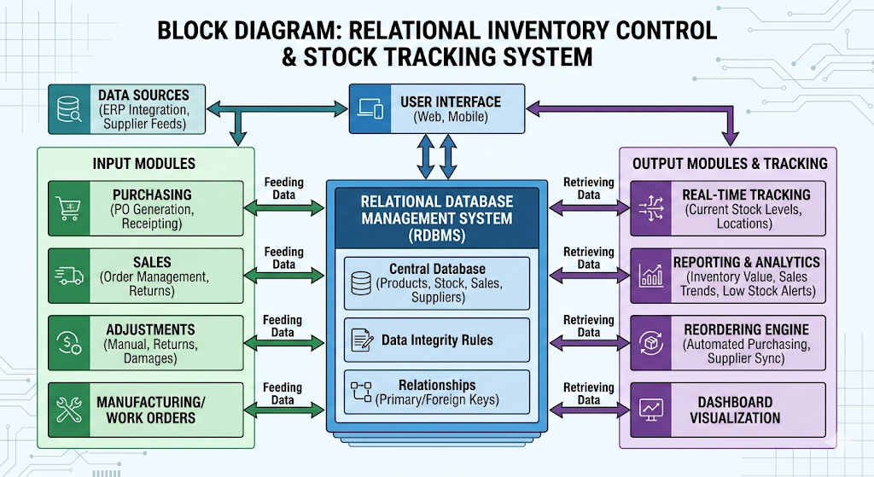
PROPOSED SYSTEM ARCHITECTURE
1
2
3
4
5
6
7
8
9

Slide 7
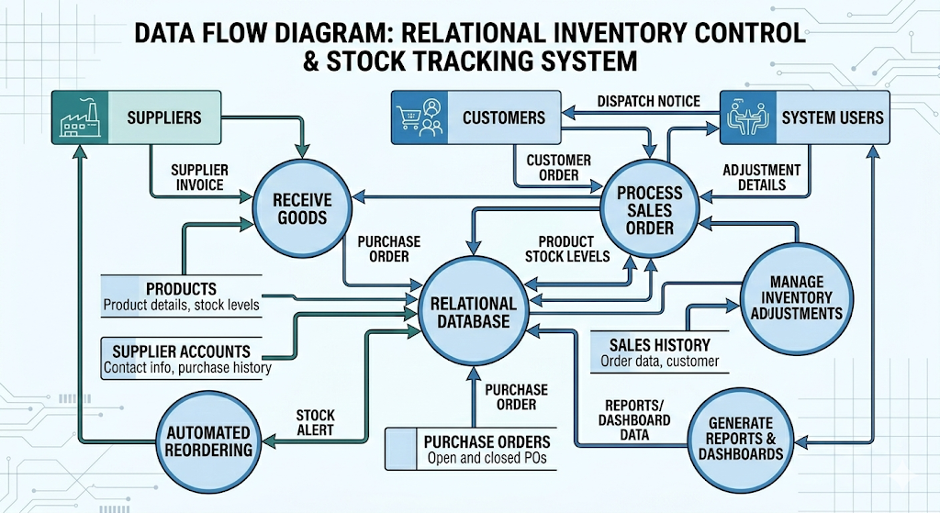
WORKFLOW
1
2
3
4
5
6
7
8
9

Slide 8
TECHNOLOGIES USED
Frontend:
React.js or Angular: For building a dynamic, single-page application (SPA) that handles real- time stock updates without refreshing.
Backend: RESTful API or GraphQL: To facilitate clean communication between the frontend and the database.
Database: PostgreSQL or MySQL: These are the industry standard for relational systems, providing ACID compliance to ensure that stock counts are never "lost" during a crash.
Tools used: Visual Studio Code: The primary Integrated Development Environment (IDE). Postman: For testing API endpoints before they are integrated into the frontend. Git/GitHub: For version control and collaborative coding.
1
2
3
4
5
6
7
8
9

Slide 9
MODULE DESCRIPTION
Project Modules:
Module 1: User & Role Management Handles secure authentication (login/registration) and defines access levels, such as distinguishing between a Warehouse Clerk (who updates stock) and a Manager (who views financial reports).
Module 2: Inventory & Stock Tracking The heart of the system that processes real-time stock levels, handles incoming shipments, manages barcode scanning, and updates "quantity on hand" automatically.
Module 3: Supplier & Purchase Management Manages relational data for vendors, tracks pending purchase orders (POs), and links specific products to their primary and secondary suppliers for streamlined reordering.
Module 4: Analytics & Low-Stock Alerts Generates visual dashboards and automated notifications when stock dips below defined thresholds, ensuring the business never runs out of critical items.
1
2
3
4
5
6
7
8
9

Slide 10
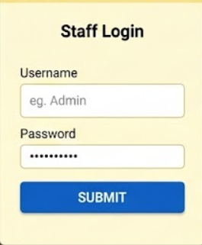
IMPLEMENTATION SCREENSHOTS
1
2
3
4
5
6
7
8(A)
9

Slide 11
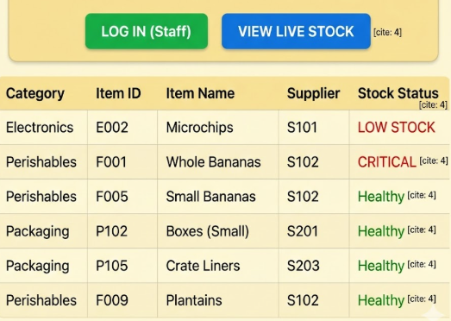
IMPLEMENTATION SCREENSHOTS
1
2
3
4
5
6
7
8(B)
9

Slide 12
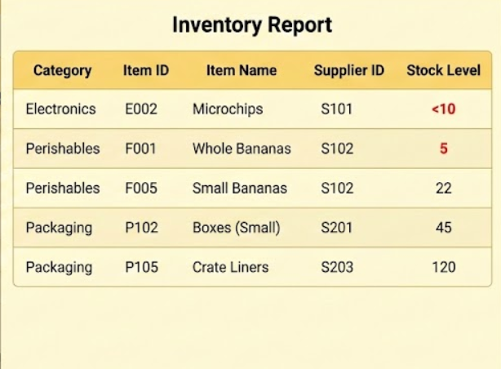
IMPLEMENTATION SCREENSHOTS
1
2
3
4
5
6
7
8(C)
9

Slide 13
ADVANTAGES & LIMITATIONS
1
2
The primary advantage of this Relational Inventory Control System is its ability to maintain data integrity through structured relationships, ensuring that every product is strictly mapped to a specific category. This eliminates data redundancy and allows for complex querying and real-time stock monitoring, which is critical for preventing overselling. By using a Flask-SQLAlchemy stack, the system remains highly scalable and lightweight, making it easy to deploy or integrate with larger enterprise databases later. However, the disadvantages include a steeper initial setup curve compared to simple spreadsheets and a reliance on consistent database connectivity. Without a robust frontend validation layer, the system could also be vulnerable to human entry errors, and as the dataset grows into the millions of rows, performance may lag unless advanced indexing and caching strategies are implemented.
3
4
5
6
7
8
9

Slide 14
Thank you

