Slide 1

Vel Tech Rangarajan Dr. Sagunthala R&D Institute of Science and Technology
School of Computing
Department of Computer Science and Engineering
10211CS224 / FULL STACK APPLICATION DEVELOPMENT (JAVA)
PROJECT REVIEW : MILESTONE PROJECT – 1
Date: 27-03-2026
Full-Stack Skill Learning Academy Marketplace with Secure Authentication
SDG: SDG No – SDG Title(Example: SDG 4 – Quality Education)
Presented By:
K. SUJITH REDDY – VTU24787 – 23UECS1097
Courses Handling Faculty:
Dr.Hafizur Rahman -Assistant Professor

Slide 2
INTRODUCTION
The rapid growth of online learning has created a need for platforms that connect learners with quality skill-based courses in one place.
Many existing systems focus only on video hosting and ignore smooth dashboards for students, instructors, and admins.
This project is important because it provides a full-stack solution with secure authentication and role-based access for all users.
It is relevant in the real world for colleges, training institutes, and individual tutors who want to run their own mini “Udemy-like” platform.
The system allows instructors to create courses, admins to approve them, and students to enroll, learn, track progress, and post reviews.
It focuses on clean UI, smooth navigation, and secure handling of user data and course operations
1
2
3
4
5
6
7
8
9

Slide 3
PROBLEM STATEMENT
Learners struggle to find a single platform that offers structured, skill-focused courses with clear progress tracking.
Many platforms lack separate, well-designed dashboards for students, instructors, and admins, causing confusion and poor workflow.
Instructors often do not have simple tools to create, manage, and publish courses with proper approval from administrators.
Existing systems may not enforce secure authentication and role-based access, risking unauthorized access to sensitive data.
There is a need for an integrated, secure full-stack system that manages courses, enrollments, lessons, and reviews in one place.
1
2
3
4
5
6
7
8
9

Slide 4
OBJECTIVE(S)
1
2
To design and develop a full-stack Skill Learning Academy Marketplace with secure, role-based authentication for students, instructors, and admins.
To implement course creation, approval, enrollment, lesson tracking, and review features in a single, smooth and user-friendly web platform.
To improve the overall learning experience with a modern UI, clear dashboards, and structured navigation for all user roles.
3
4
5
6
7
8
9

Slide 5
PROPOSED SYSTEM
1
A full-stack web application called “Skill Learning Academy Marketplace” built with PHP, MySQL, HTML, CSS, and role-based authentication.
Students can register, browse published courses, enroll, access lessons, track progress, and submit reviews from a dedicated dashboard.
Instructors get their own panel to create courses, add structured lessons (video/PDF/text), and see enrollments.
Admins can review instructor courses, approve or reject them, manage users, and control which content is visible to students.
Secure login with hashed passwords and role checks prevents unauthorized access to admin/instructor/student features.
The system solves fragmentation by handling courses, enrollments, lessons, and reviews in a single integrated platform.
It improves usability compared to many basic systems by providing clean dashboards and smooth navigation for each role.
It is flexible enough to be used by colleges, coaching centers, or individual trainers as their own mini learning marketplace.
2
3
4
5
6
7
8
9

Slide 6
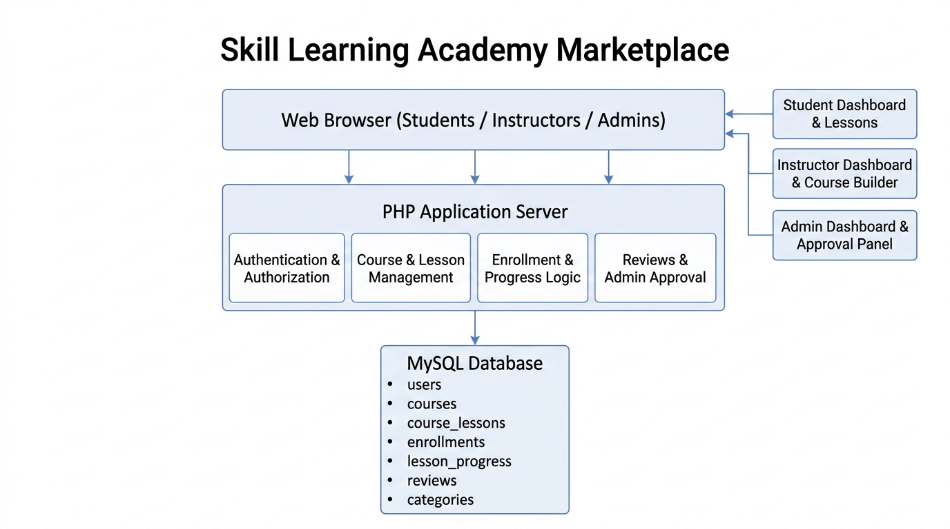
PROPOSED SYSTEM ARCHITECTURE
Input: Users enter data through web pages (registration, login, course creation, lesson creation, enroll, reviews) using HTML forms in browser.
Processing: PHP backend validates input, applies business logic (auth checks, role checks, course approval, enrollment, progress update), and prepares responses.
Database: MySQL stores users, roles, courses, lessons, enrollments, lesson progress, and reviews in relational tables with foreign keys.
Output: The system returns dynamic web
pages like dashboards, course lists, course
details, lesson player, admin panels, and
confirmation messages back to the browser.
1
2
3
4
5
6
7
8
9

Slide 7
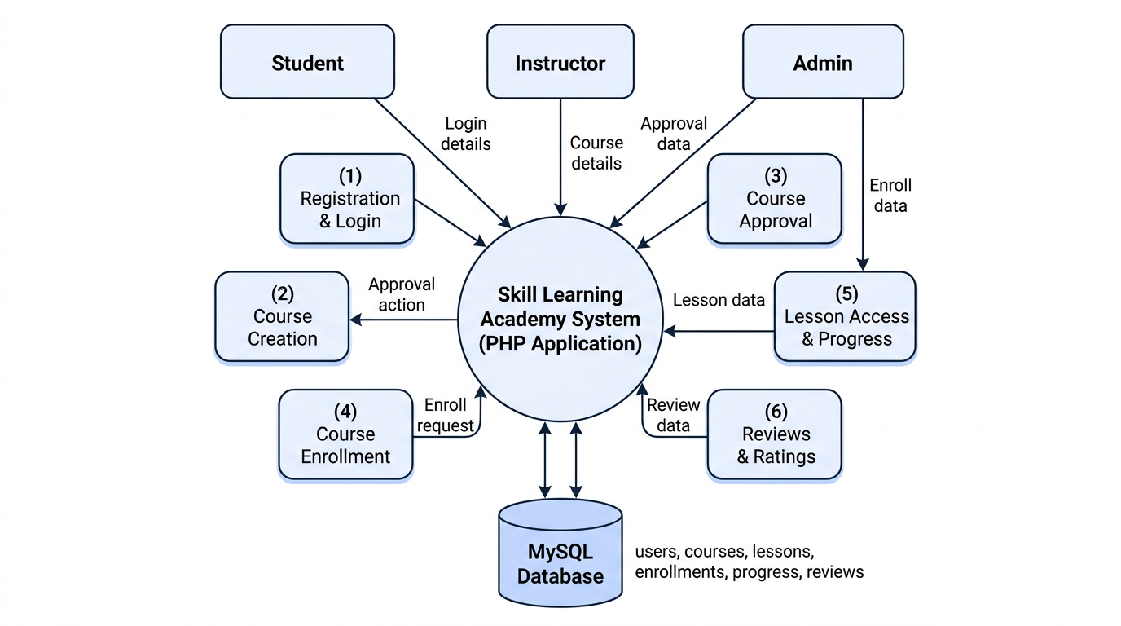
WORKFLOW
1
2
3
4
5
6
7
8
9

Slide 8
TECHNOLOGIES USED
1
Frontend: HTML5, CSS3, JavaScript for responsive UI and dashboards.
Backend: PHP 8 (core PHP) for business logic, authentication, and role-based access.
Database: MySQL for storing users, courses, lessons, enrollments, progress, and reviews.
Tools: XAMPP (Apache, PHP, MySQL), phpMyAdmin for DB management, VS Code for coding, browser dev tools for testing UI.
Hardware Requirements: Standard PC or laptop with at least 4 GB RAM, modern web browser, and local server environment.
Software Requirements: Windows OS, XAMPP stack installed, modern browser (Chrome/Edge), and code editor (VS Code/ Sublime)
2
3
4
5
6
7
8
9

Slide 9
MODULE DESCRIPTION
Module 1: Authentication & User Management
Handles registration, secure login, role-based access (student/instructor/admin), and basic profile handling using hashed passwords and sessions.
Module 2: Course & Lesson Management
Allows instructors to create courses, add structured lessons (video/PDF/text), and lets admins approve or reject courses before publishing.
Module 3: Enrollment & Progress Tracking
Manages student enrollments into published courses and records lesson completion to show learning progress on the dashboard.
Module 4: Reviews & Admin Control Panel
Enables students to rate and review courses, and provides admins with dashboards to monitor users, courses, and overall platform activity.
1
2
3
4
5
6
7
8
9

Slide 10
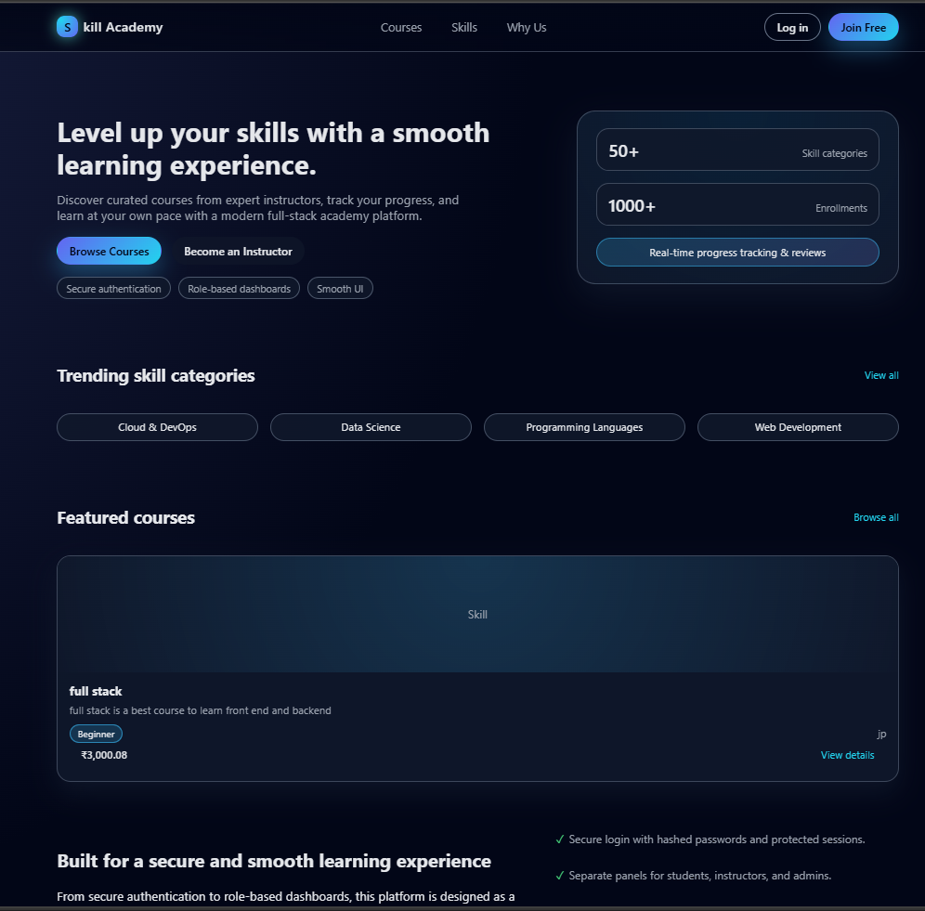
IMPLEMENTATION SCREENSHOTS
Home Page:
Displays featured courses, trending categories, and a modern hero section that introduces the Skill Learning Academy platform to users.
1
2
3
4
5
6
7
8(A)
9

Slide 11
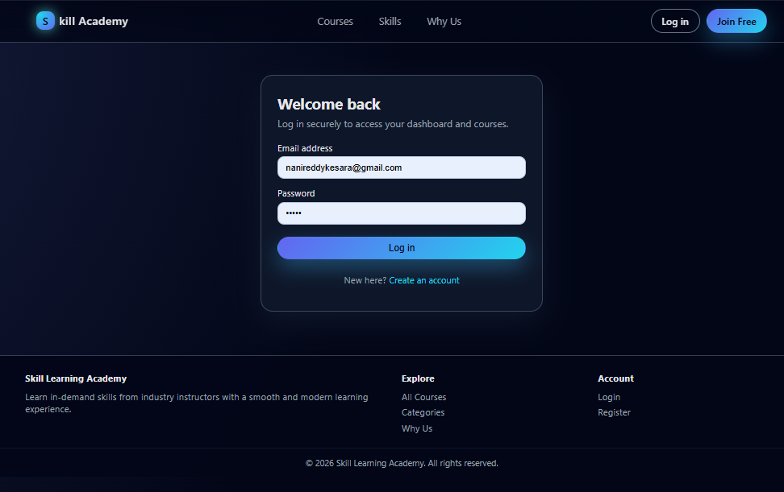
IMPLEMENTATION SCREENSHOTS
Login Page:
Provides secure login for students, instructors, and admins with clean input forms and role-based redirection after successful authentication
1
2
3
4
5
6
7
8(B)
9

Slide 12
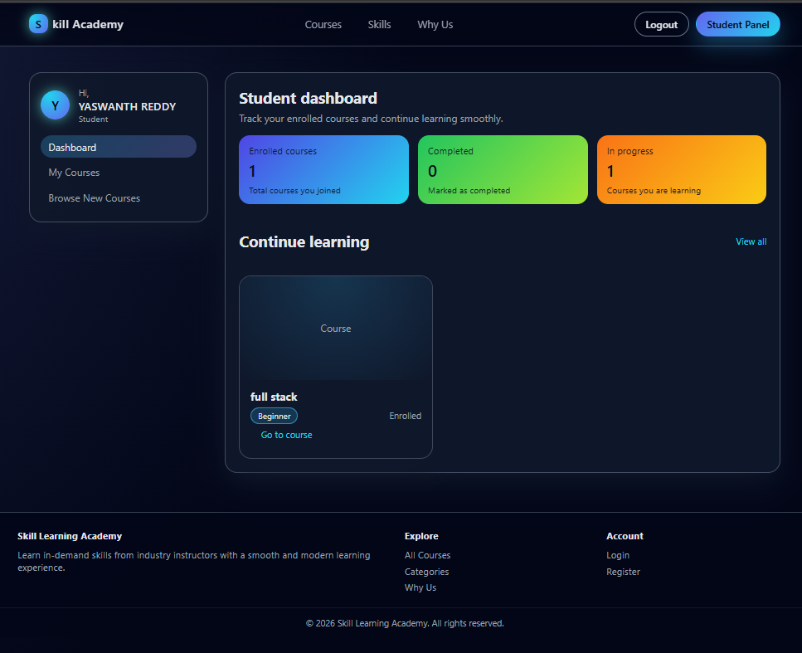
IMPLEMENTATION SCREENSHOTS
Main Module – Student Dashboard:
Shows enrolled courses, basic stats (enrolled, completed, in-progress), and quick links to continue lessons in a structured layout.
1
2
3
4
5
6
7
8(C)
9

Slide 13
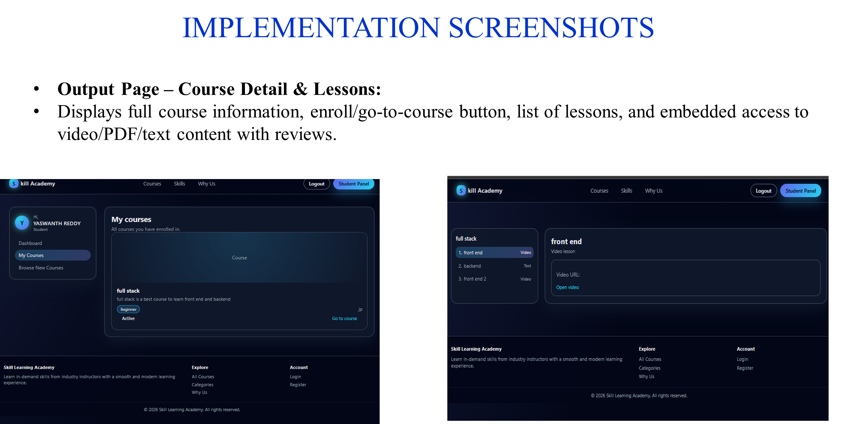
1
2
3
4
5
6
7
8
9

Slide 14
ADVANTAGES & LIMITATIONS
Advantages:
Provides a complete end‑to‑end learning marketplace in one integrated system (auth, courses, lessons, enrollments, reviews).
Role-based dashboards for students, instructors, and admins improve clarity, usability, and workflow.
Uses secure authentication with hashed passwords and basic CSRF protection to reduce common security risks.
Built with widely used technologies (PHP, MySQL, HTML, CSS) that are easy to deploy on shared hosting or local servers.
Limitations:
Does not yet include payment gateway integration for real paid course transactions.
Basic UI only; no advanced front-end framework (like React/Vue) or mobile app version is included.
Limited analytics and reporting; only simple stats are provided on dashboards.
1
2
3
4
5
6
7
8
9

Slide 15
Thank you

