Slide 1

Vel Tech Rangarajan Dr. Sagunthala R&D Institute of Science and Technology
School of Computing
Department of Computer Science and Engineering
10211CS224 / FULL STACK APPLICATION DEVELOPMENT (JAVA)
PROJECT REVIEW
Date: 18-05-2026
Smart Campus Event Management System
SDG:SDG 4 – Quality Education
Presented By:
KETHA SUJITH REDDY – VTU24784 – 23UECS1097
Courses Handling Faculty:
Dr. Hafizur Rahman

Slide 2

INTRODUCTION
1
The Smart Campus Event Management System is used to manage college events digitally.
It allows students, organizers, and admins to interact on one platform.
Organizers can create and update event details بسهولة.
Students can view and register for events online.
The system stores all event and user data in a database.
Admin can approve, edit, or delete events and users.
It reduces manual work and paperwork in colleges.
Notifications can be sent to users about event updates.
It provides a simple and user-friendly interface.
2
3
4
5
6
7
8
9

Slide 3
PROBLEM STATEMENT
1
2
Managing campus events manually leads to confusion and inefficiency.
Students often miss important event updates and registration deadlines.
Event information is scattered across notice boards and social media.
There is no centralized system to handle event scheduling and participation.
Tracking registrations and attendance becomes difficult for organizers.
Communication gaps exist between students, organizers, and administration.
Manual processes increase paperwork and chances of errors.
Therefore, a smart system is needed to automate and streamline event management.
3
4
5
6
7
8
9

Slide 4
OBJECTIVE(S)
1
2
To develop a centralized system for managing and organizing campus events efficiently.
To provide an easy platform for students to view and register for events with real-time updates.
3
4
5
6
7
8
9

Slide 5
PROPOSED SYSTEM
1
The proposed system is a web-based application that automates the management of campus events.
It provides a centralized platform for students, organizers, and administrators.
Organizers can create, update, and manage event details بسهولة.
Students can easily browse and register for events online.
Admin has full control to monitor and manage users and events.
The system stores all data securely in a database.
It sends notifications and updates to users about upcoming events.
Overall, the system improves efficiency, reduces manual work, and ensures better coordination.
2
3
4
5
6
7
8
9

Slide 6
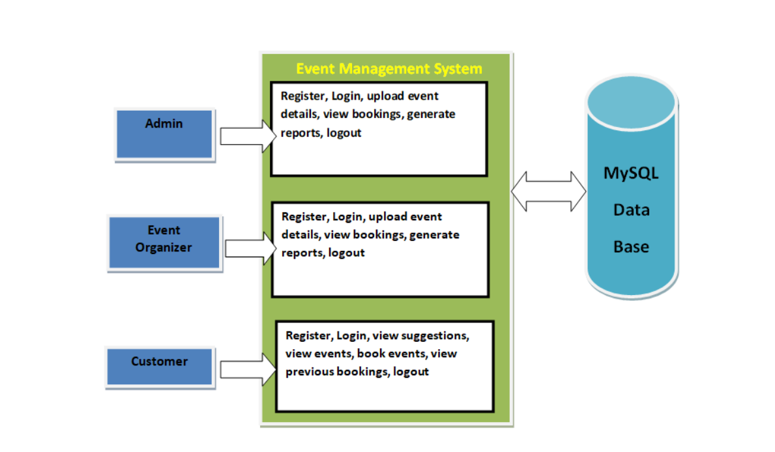
PROPOSED SYSTEM ARCHITECTURE
1
2
3
4
5
6
7
8
9

Slide 7
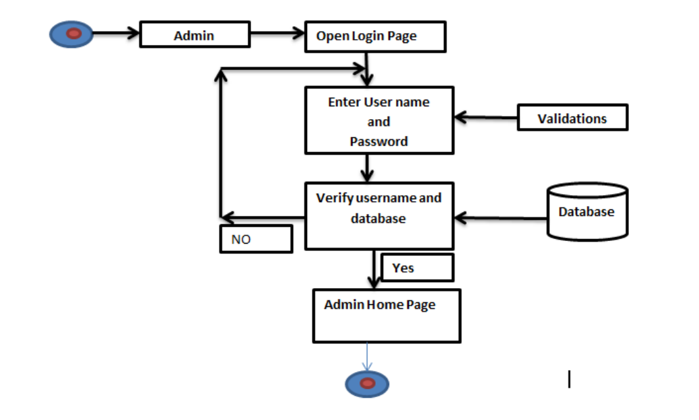
WORKFLOW
1
2
3
4
5
6
7
8
9

Slide 8
TECHNOLOGIES USED
1
Frontend: HTML, CSS, JavaScript (for designing user interface)
Backend: Java (Spring Boot) for handling business logic and APIs
Database: MySQL for storing users, events, and registrations data
IDE/Tools: Eclipse or IntelliJ IDEA for development
Server: Apache Tomcat or embedded Spring Boot server for deployment
2
3
4
5
6
7
8
9

Slide 9
MODULE DESCRIPTION
1
2
Admin Module: Manages users and events, and has full control over approving, editing, or deleting event details.
Organizer Module: Allows organizers to create and manage events and view the list of registered participants.
Student/User Module: Enables students to browse available events and register for them easily.
Authentication Module: Handles secure login and registration for all users in the system.
3
4
5
6
7
8
9

Slide 10
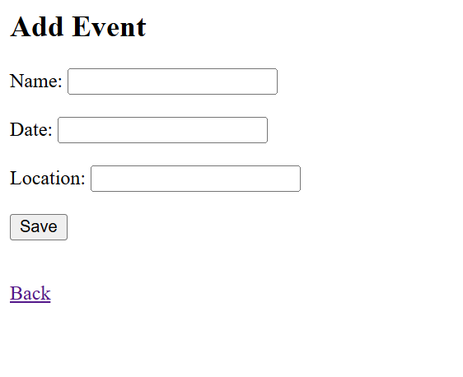
IMPLEMENTATION SCREENSHOTS
1
2
3
4
5
6
7
8
9

Slide 11
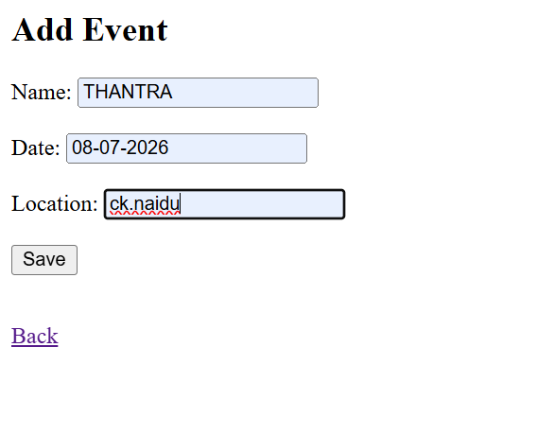
IMPLEMENTATION SCREENSHOTS
1
2
3
4
5
6
7
8(A)
9

Slide 12
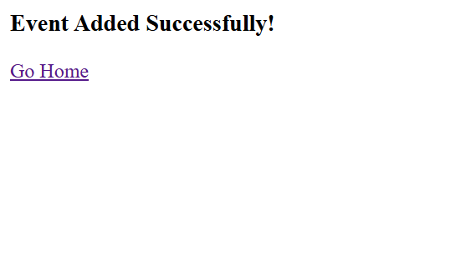
IMPLEMENTATION SCREENSHOTS
1
2
3
4
5
6
7
8(B)
9

Slide 13
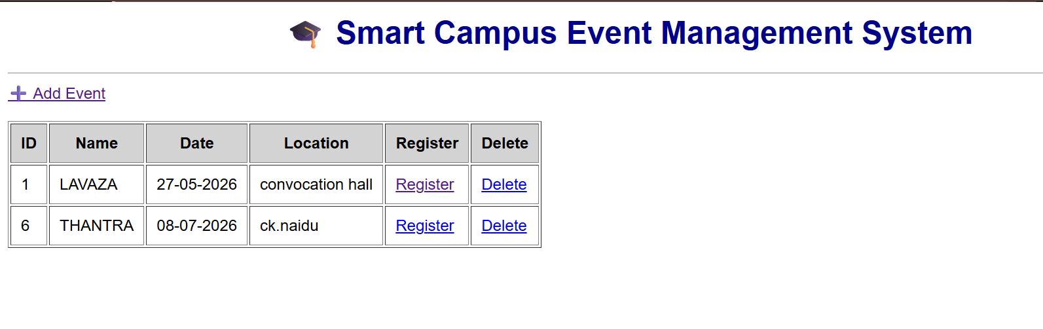
IMPLEMENTATION SCREENSHOTS
1
2
3
4
5
6
7
8(C)
9

Slide 14
ADVANTAGES & LIMITATIONS
1
✅ Advantages
Reduces manual work and paperwork in managing campus events.
Provides a centralized platform for all event-related activities.
Makes event registration quick and easy for students.
Improves communication through notifications and updates.
Ensures better organization and tracking of events and participants.
❌ Disadvantages
Requires internet connectivity to access the system.
Initial development and maintenance cost can be high.
Technical issues or server downtime may affect usability.
Users may need training to use the system effectively.
Data security risks if proper protection measures are not implemented.
2
3
4
5
6
7
8
9

Slide 15
Thank you

