Slide 1

Vel Tech Rangarajan Dr. Sagunthala R&D Institute of Science and Technology
School of Computing
Department of Computer Science and Engineering
10211CS224 / FULL STACK APPLICATION DEVELOPMENT
END SEMESTER PROJECT REVIEW
Date:06/05/2026
A FULL-STACK PLATFORM FOR RECRUITMENT AND APPLICATION MANAGEMENT
SDG: 9-Industry , Innovation and Infrastructure
Presented By:
K.B.NITHISH KUMAR REDDY – VTU24854 – 23UECS0776
Dr. S. Hemamalini,Assistant.Professor
(Sr Grade)-M.E,ph.D

Slide 2
INTRODUCTION
1
The recruitment process in many organizations is still handled manually or through scattered systems, leading to inefficiencies, delays, and poor communication. This creates difficulties for both recruiters and job seekers in managing applications and tracking progress. Therefore, there is a need for a centralized digital platform to streamline the hiring process. This project is important as it reduces manual effort, improves accuracy, and enhances transparency in recruitment activities. In real-world scenarios, such platforms are widely used by companies to manage job postings and candidate applications effectively. The proposed system is a full-stack web application that allows administrators to post and manage jobs, while users can search, apply, and track their application status. Additionally, the system provides automated email notifications to keep users updated throughout the recruitment process.
2
3
4
5
6
7
8
9

Slide 3
PROBLEM STATEMENT
1
2
The recruitment process in many organizations is often handled through manual or fragmented digital systems, leading to inefficiencies and delays. Recruiters face challenges in managing large volumes of applications, while candidates lack proper visibility into their application status. This results in poor communication, data inconsistency, and difficulty in tracking progress. Additionally, the absence of a centralized platform makes it hard to maintain accurate records and streamline workflows. These limitations reduce the overall efficiency of the hiring process. Therefore, there is a need for a reliable and integrated system that can simplify recruitment and application management.
3
4
5
6
7
8
9

Slide 4
OBJECTIVE(S)
1
Develop a centralized platform to manage job postings and applications efficiently
Enable users to search, apply, and track job applications easily
Provide administrators with tools to manage recruitment and communicate with candidates
2
3
4
5
6
7
8
9

Slide 5
PROPOSED SYSTEM
1
Develops a centralized full-stack web platform for recruitment and application management
Provides separate interfaces for administrators and job seekers
Allows admins to post, update, and manage job listings efficiently
Enables users to search jobs, apply online, and track application status
Automates notifications through email for application updates
Reduces manual errors and improves data consistency
Enhances communication between recruiters and candidates
More efficient, scalable, and user-friendly compared to traditional systems
2
3
4
5
6
7
8
9

Slide 6
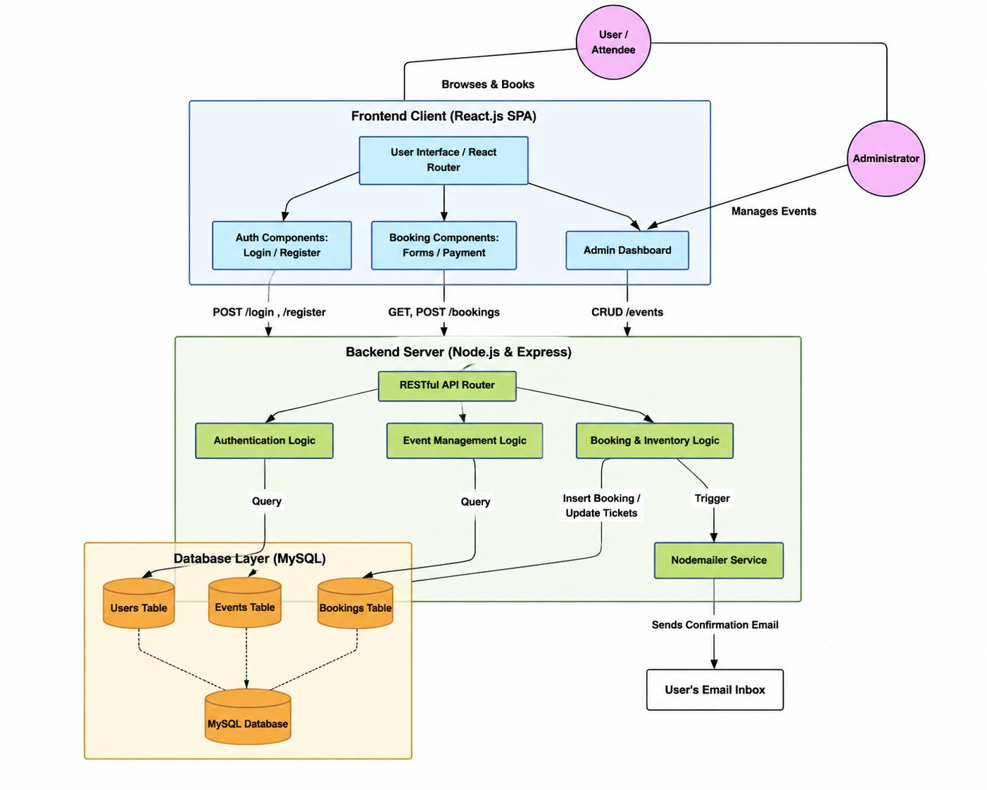
PROPOSED SYSTEM ARCHITECTURE
1
2
3
4
5
6
7
8
9

Slide 7
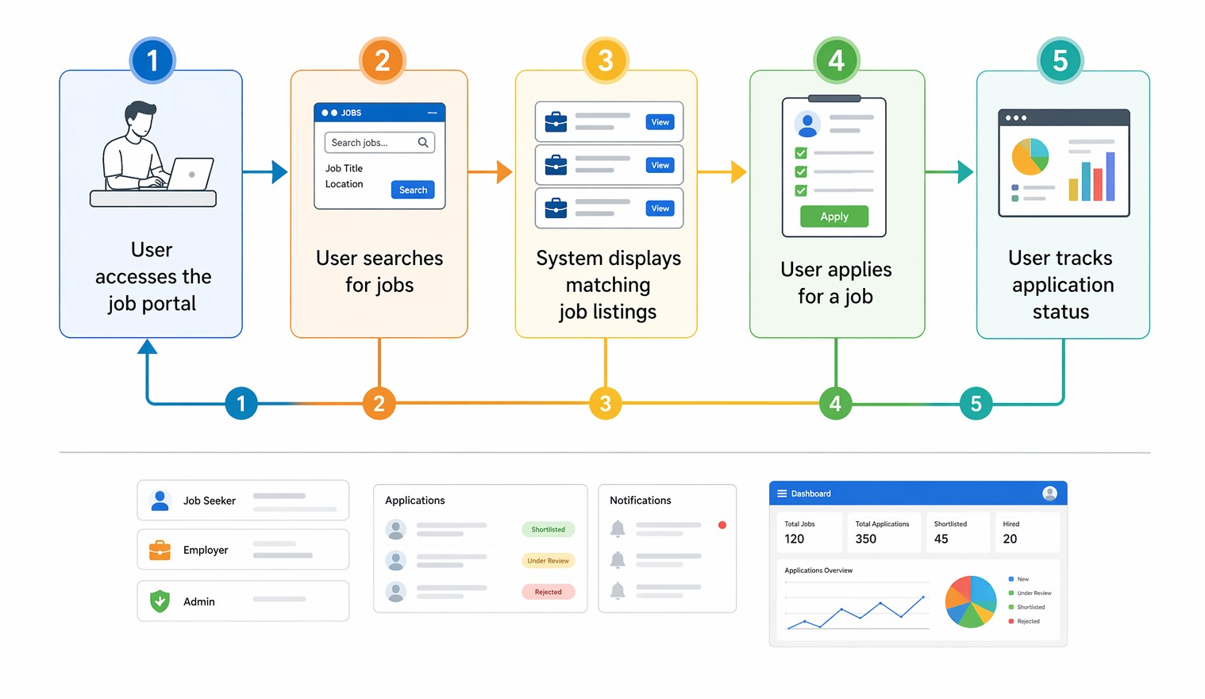
WORKFLOW
1
2
3
4
5
6
7
8
9

Slide 8
TECHNOLOGIES USED
1
Frontend:
• HTML, CSS, JavaScript, Thymeleaf
Backend:
• Java, Spring Boot, Spring Security
Database:
• H2 / MySQL
Tools:
• VS Code
• Maven
• Jsp
Other:
• Spring Mail (Email notifications)
2
3
4
5
6
7
8
9

Slide 9
MODULE DESCRIPTION
1
Module 1: User Authentication & Role Management
• Secure login and registration
• Role-based access (Admin / Student)
Module 2: Job Listing & Search
• Admin can add/manage jobs
• Students can search and filter jobs
Module 3: Application & File Management
• Resume upload system
• Application tracking
Module 4: Email Notification System
• Sends confirmation and status updates
2
3
4
5
6
7
8
9

Slide 10
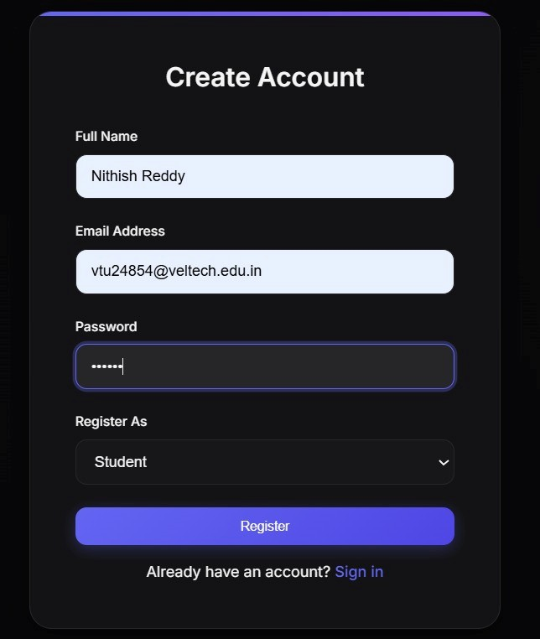
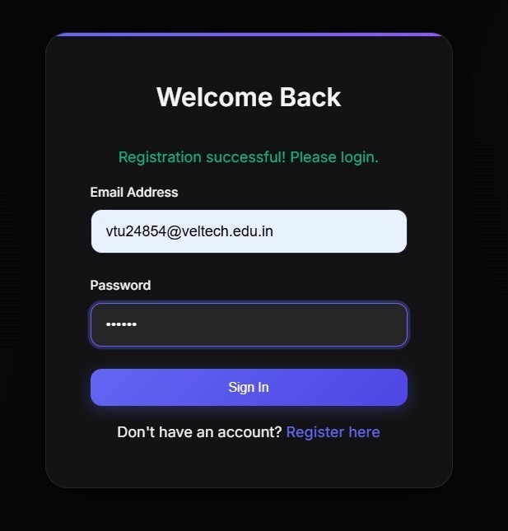
IMPLEMENTATION SCREENSHOTS
1
2
3
4
5
6
7
8
9
Figure : Secure Login Page
Figure : User Registration Interface

Slide 11
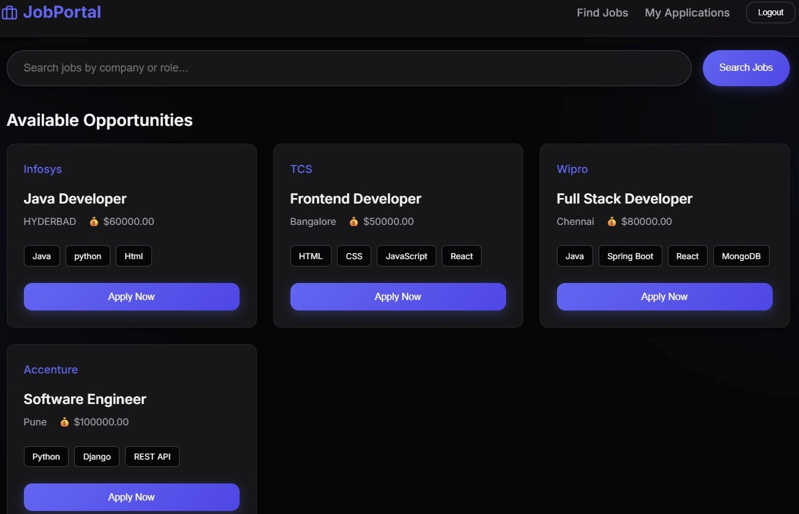
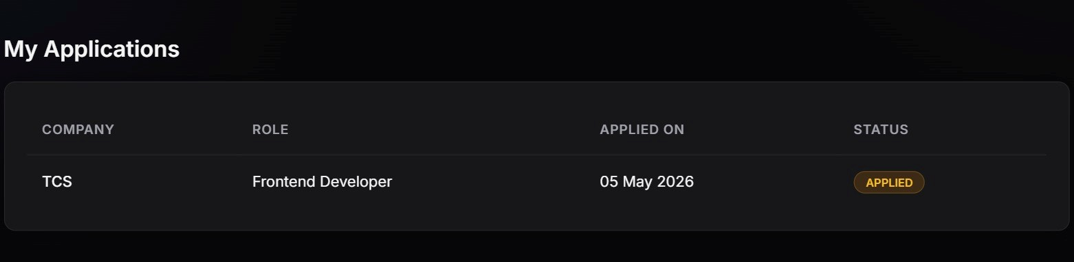
IMPLEMENTATION SCREENSHOTS
1
2
3
4
5
6
7
Figure : Student Job Search and Apply
Interface
8(A)
9
Figure : Student Application Status Page

Slide 12
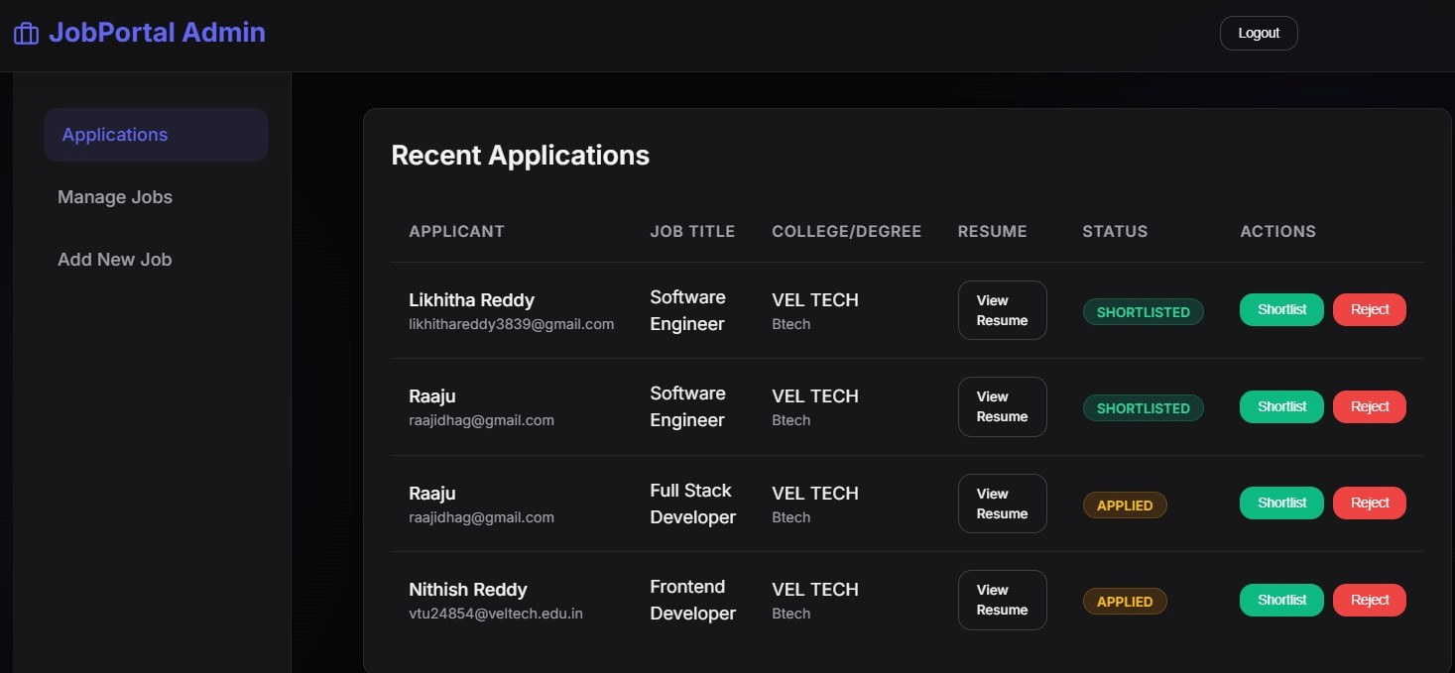
IMPLEMENTATION SCREENSHOTS
1
2
3
4
5
6
7
8(B)
9
Figure : Admin Dashboard for Managing Applications

Slide 13
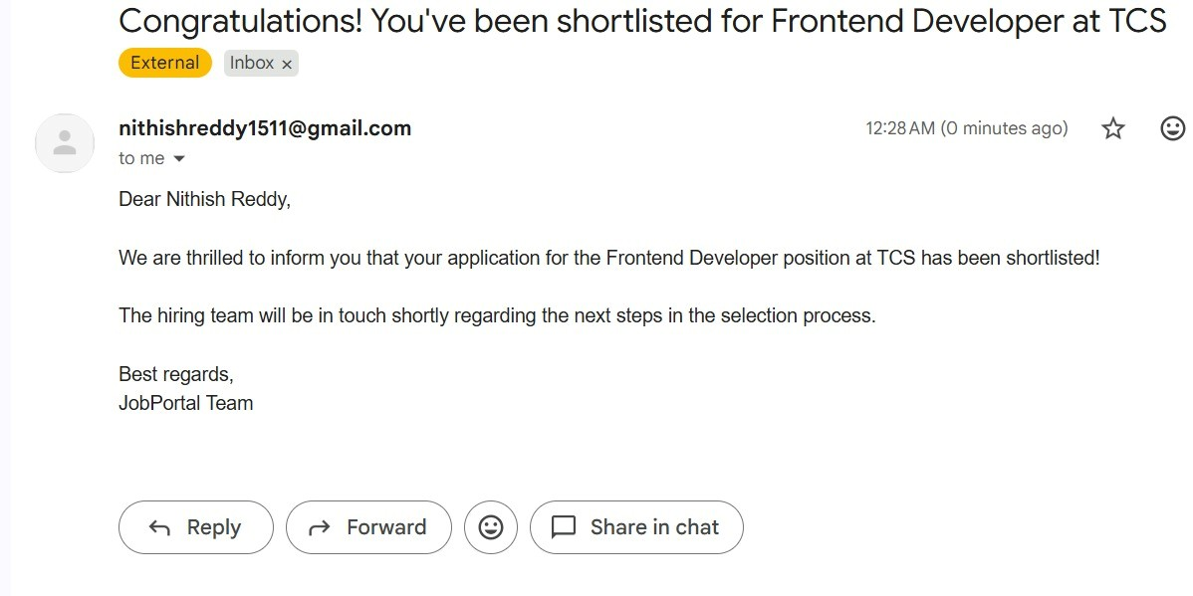
IMPLEMENTATION SCREENSHOTS
1
2
3
4
5
6
7
8(C)
9
Figure : Shortlisting Email Notification

Slide 14
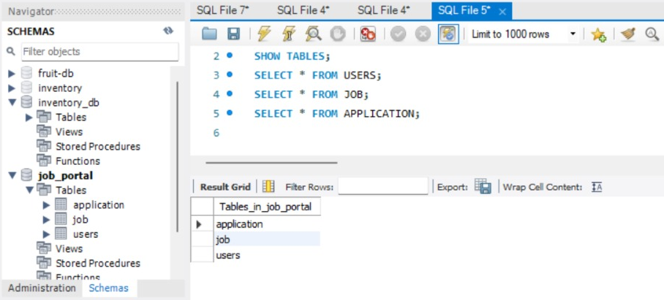
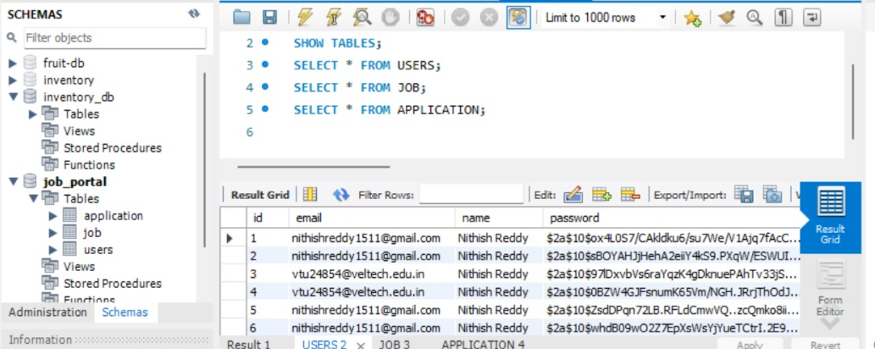
IMPLEMENTATION SCREENSHOTS
1
2
3
4
5
6
7
8(B)
9

Slide 15
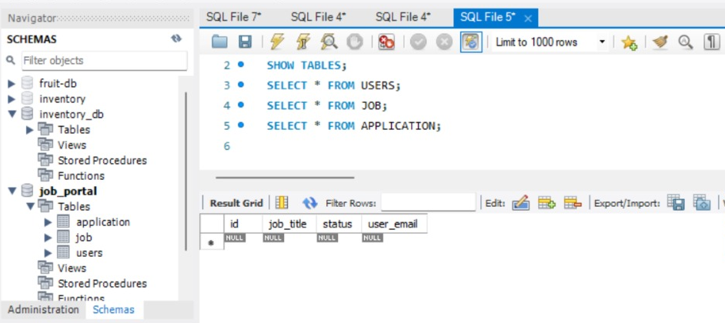
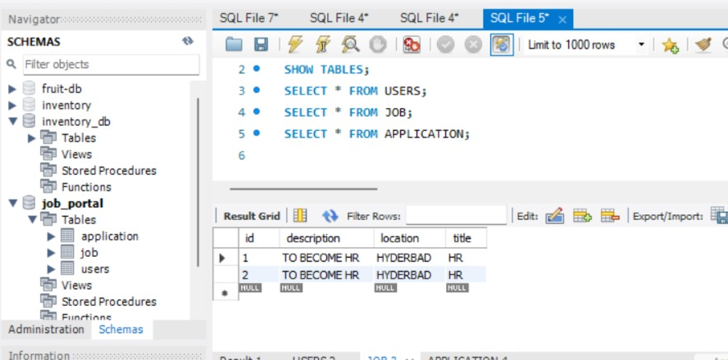
IMPLEMENTATION SCREENSHOTS
1
2
3
4
5
6
7
8(B)
9

Slide 16
ADVANTAGES & LIMITATIONS
1
Advantages
• High security using Spring Security
• Automated email notifications
• Easy job search and application
• Modular and scalable system
• Centralized data management
Limitations
• Uses local storage (not cloud)
• Limited advanced search features
• Requires internet connection
2
3
4
5
6
7
8
9

Slide 17
Thank you

