Slide 1

Vel Tech Rangarajan Dr. Sagunthala R&D Institute of Science and Technology
School of Computing
Department of Computer Science and Engineering
10211CS224 / FULL STACK APPLICATION DEVELOPMENT (JAVA)
PROJECT REVIEW : MILESTONE PROJECT – 1
Date: 03-03-2026
Relational Inventory Control & Stock Tracking System
SDG: SDG 9 – Industry, Innovation and Infrastructure
Courses Handling Faculty:
Dr.S.Hemamalini – Asst.Professor(Sr Grade)
-M.E,P.hD
Presented By:
KB. NITHISH KUMAR REDDY – VTU24854 –23UECS0776

Slide 2
INTRODUCTION
Inventory management plays a vital role in businesses to maintain proper stock levels and avoid losses.
Many small and medium enterprises still rely on manual record-keeping methods.
Manual systems often lead to stock mismanagement, data redundancy, and errors.
A relational database-based system ensures structured and efficient data handling.
This project focuses on developing a web-based inventory control system.
It tracks stock availability, product details, and transaction history.
The system ensures data accuracy, real-time updates, and secure access.
It helps organizations improve operational efficiency and decision-making.
1
2
3
4
5
6
7
8
9

Slide 3
PROBLEM STATEMENT
Many organizations manage inventory using spreadsheets or manual registers.
This approach leads to duplicate records and inaccurate stock updates.
Stock shortages or overstocking result in financial losses.
Tracking supplier and product relationships becomes difficult.
Generating reports is time-consuming and error-prone.
There is no centralized system for monitoring stock movement.
Security and data consistency are not guaranteed.
Hence, a reliable relational inventory system is required.
1
2
3
4
5
6
7
8
9

Slide 4
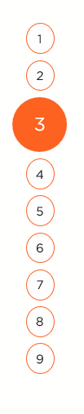
OBJECTIVE(S)
To design and develop a relational database-driven inventory control system for efficient stock tracking.
To implement real-time stock updates, reporting and secure user management.
1
2
3
4
5
6
7
8
9

Slide 5
PROPOSED SYSTEM
Web-based inventory management application
Relational database to maintain product, supplier, and stock tables
Secure login and role-based access
Add, update, delete product records
Automatic stock quantity updates
Supplier management module
Report generation (stock summary, low-stock alert)
Improved data accuracy and reduced manual errors
1
2
3
4
5
6
7
8
9

Slide 6
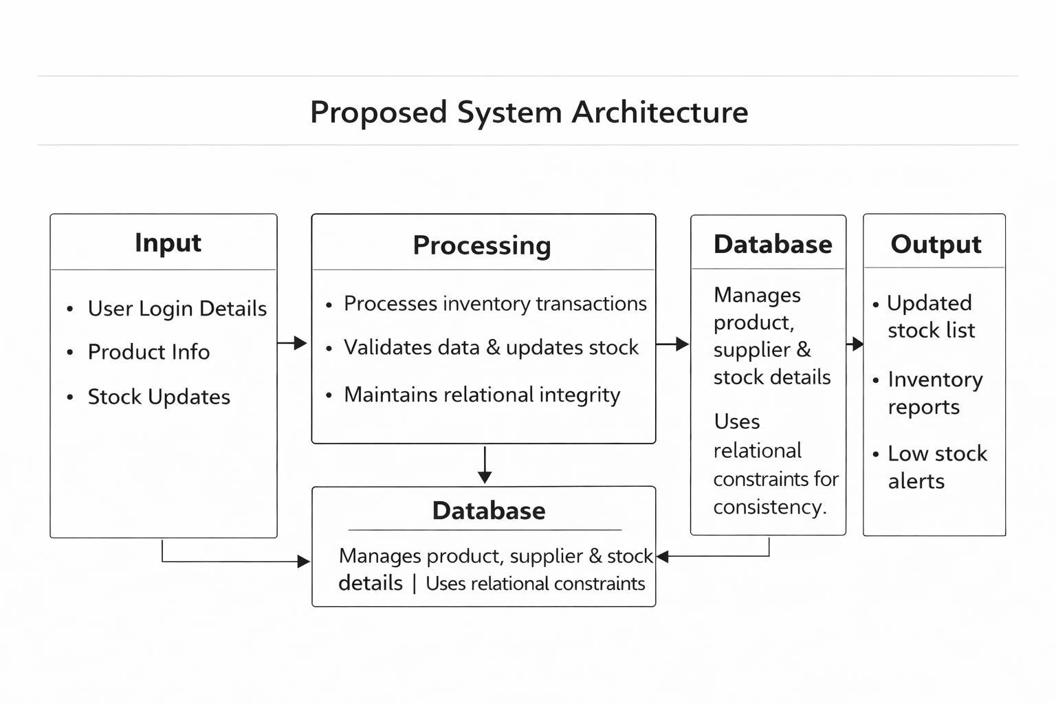
PROPOSED SYSTEM ARCHITECTURE
1
2
3
4
5
6
7
8
9

Slide 7
PROPOSED SYSTEM ARCHITECTURE
Input:
Input includes user login details, product information, supplier data, and stock updates entered through the web interface. This data is provided by the user to perform inventory operations.
Processing:
Processing validates the input data and updates stock quantities automatically. It handles business logic and maintains relationships between inventory tables
Database:
The database stores product, supplier, stock, and transaction details. It ensures data consistency using relational constraints.
Output:
Output displays updated stock lists, reports, and low-stock alerts. The results are shown on the dashboard for user reference.
1
2
3
4
5
6
7
8
9

Slide 8
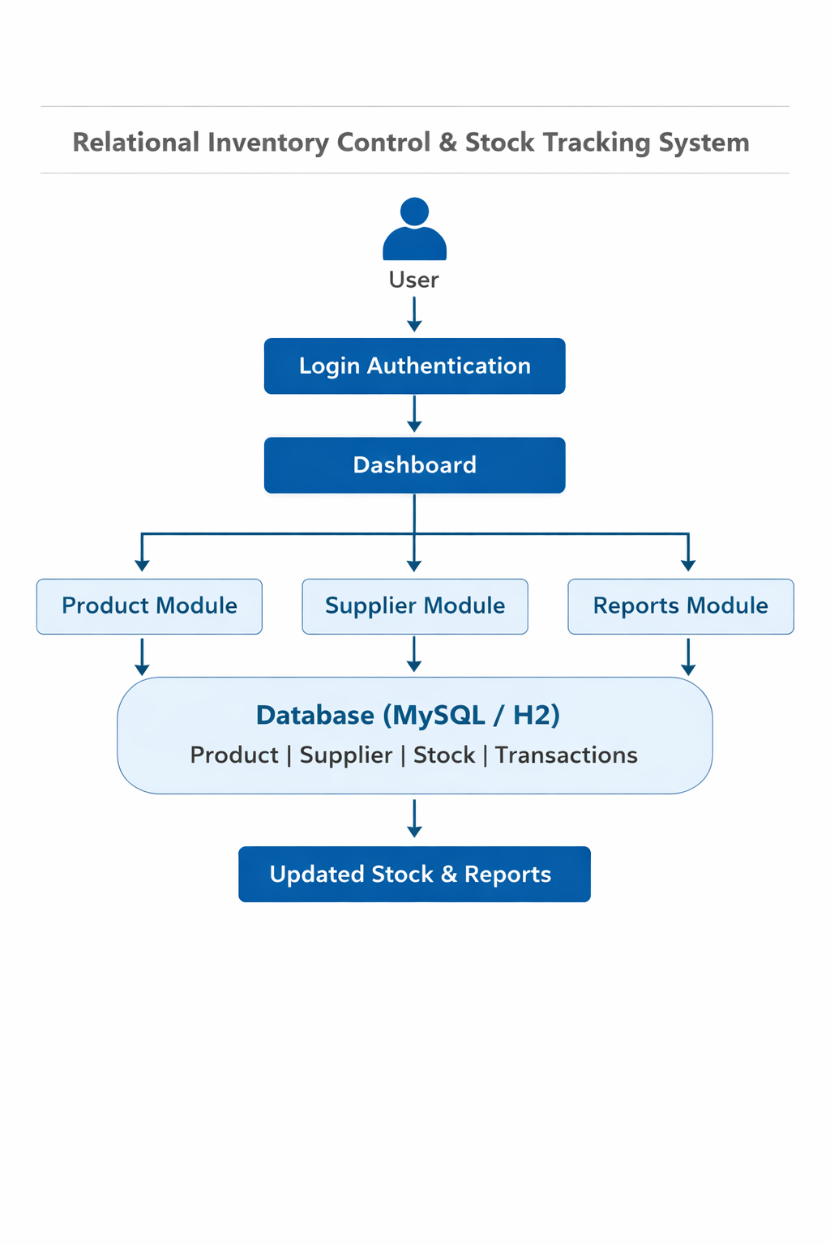
WORKFLOW
1
2
3
4
5
6
7
8
9

Slide 9
TECHNOLOGIES USED
1
Frontend: HTML, CSS
Backend: Java, Spring Boot
Database: MySQL
Tools: Eclipse IDE
Hardware/Software Requirements: Minimum 4GB RAM, JDK 17+, Web Browser
2
3
4
5
6
7
8
9

Slide 10
MODULE DESCRIPTION
1
Module 1: User Management
Handles secure login, authentication, and role-based access control.
Module 2: Product Management
Manages product details including name, category, price, and stock quantity.
Module 3: Supplier & Stock Management
Maintains supplier details and updates stock levels based on transactions.
Module 4: Reporting & Analytics
Generates stock reports, low-stock alerts, and transaction history.
2
3
4
5
6
7
8
9

Slide 11
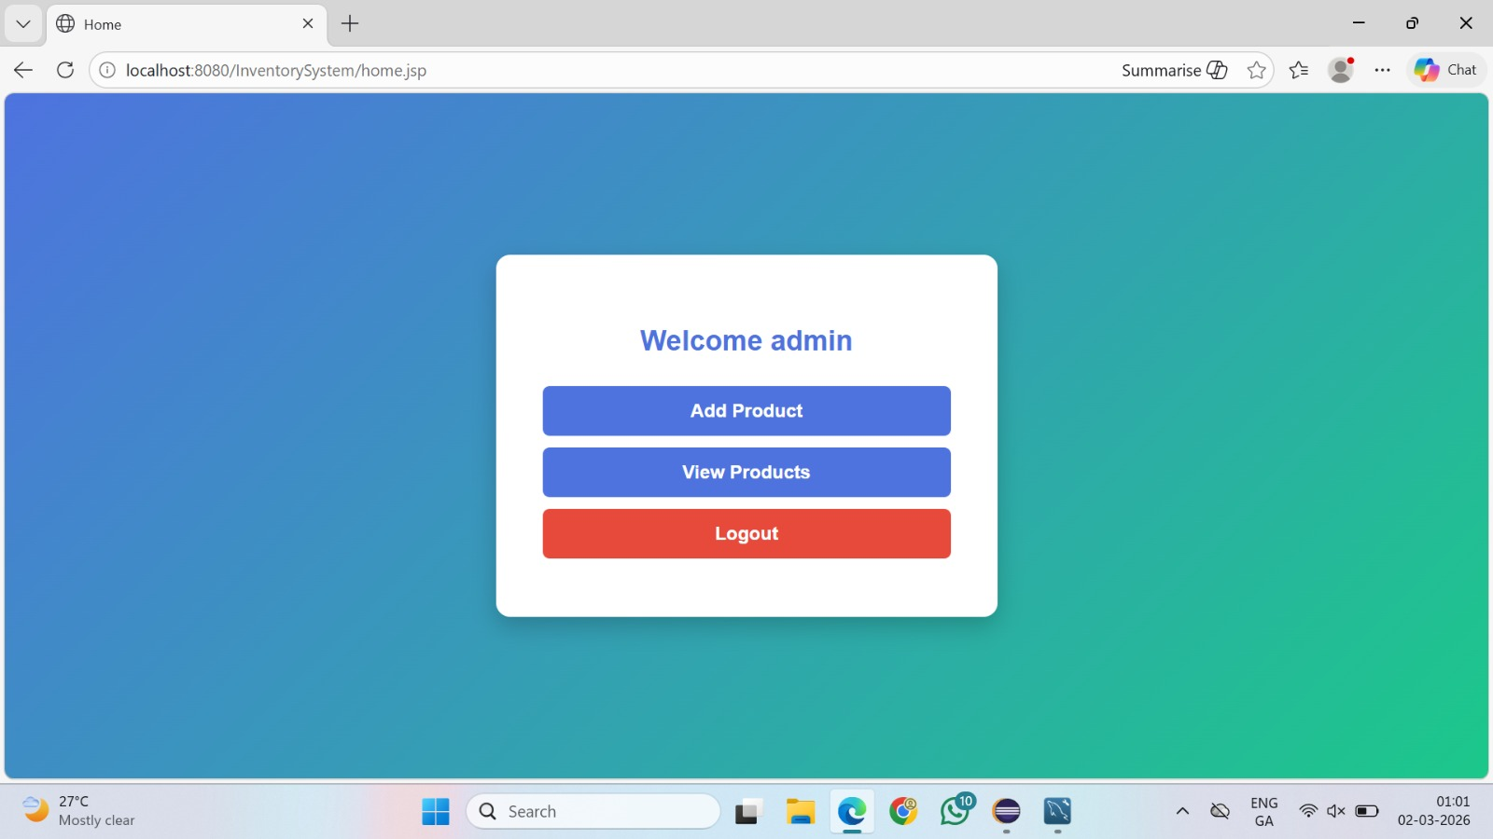
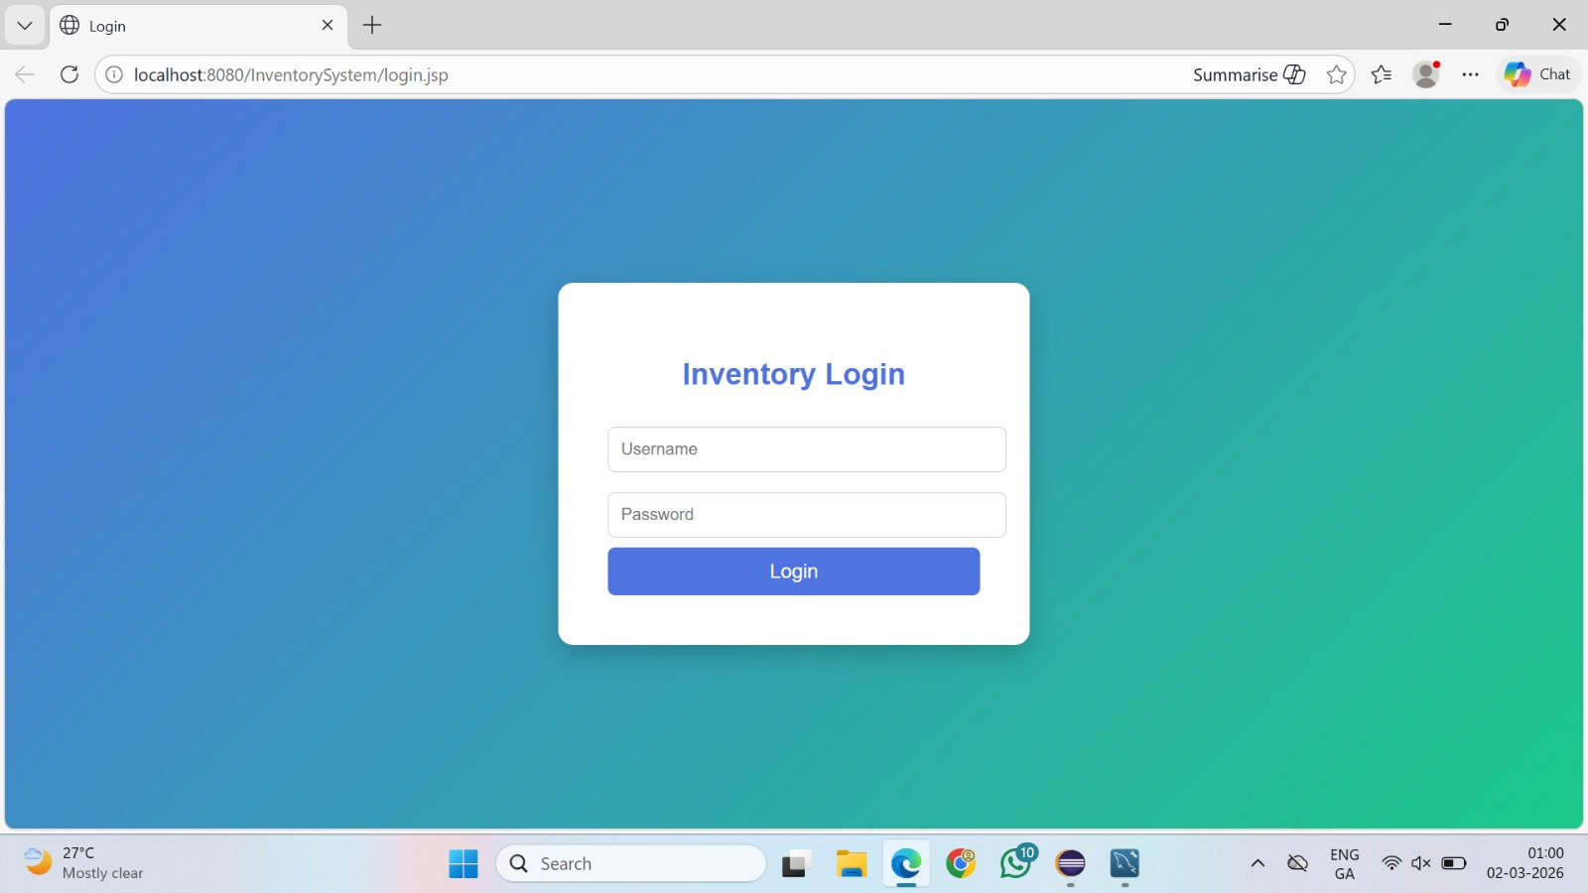
IMPLEMENTATION SCREENSHOTS
Home Page: Displays system dashboard with navigation to modules.
Login Page: Secure authentication page for admin/user access.
1
2
3
4
5
6
7
8(A)
9

Slide 12
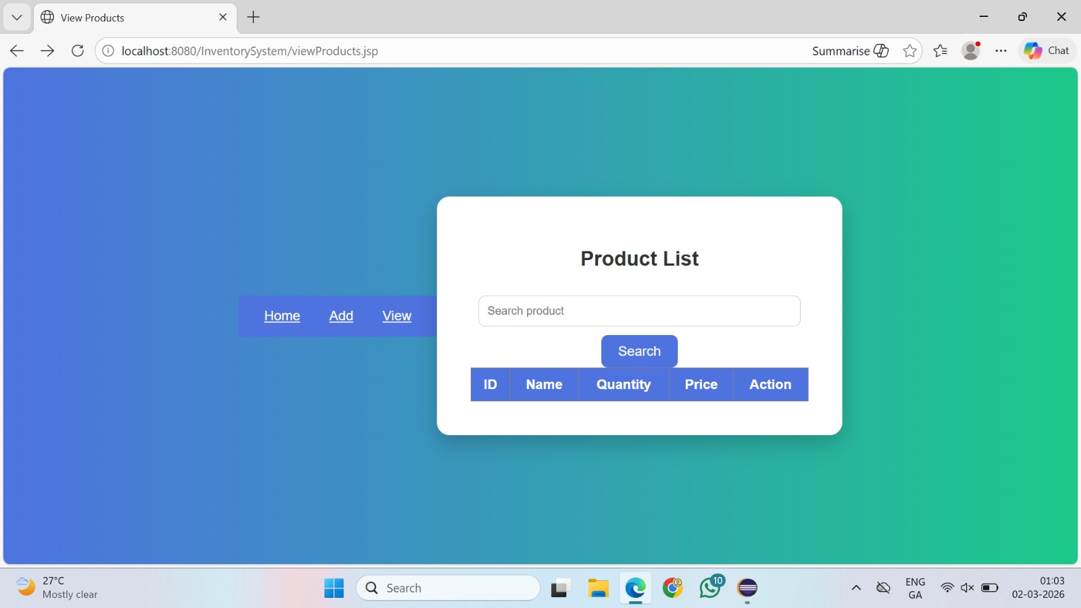
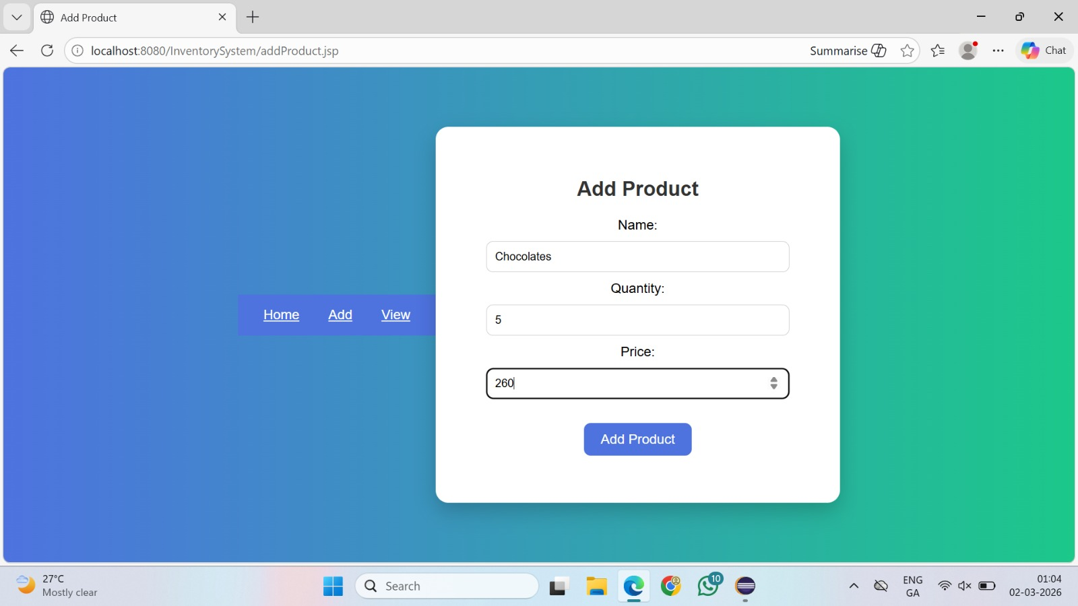
IMPLEMENTATION SCREENSHOTS
Main Module: Product and stock management interface to add/update inventory.
1
2
3
4
5
6
7
8
9

Slide 13
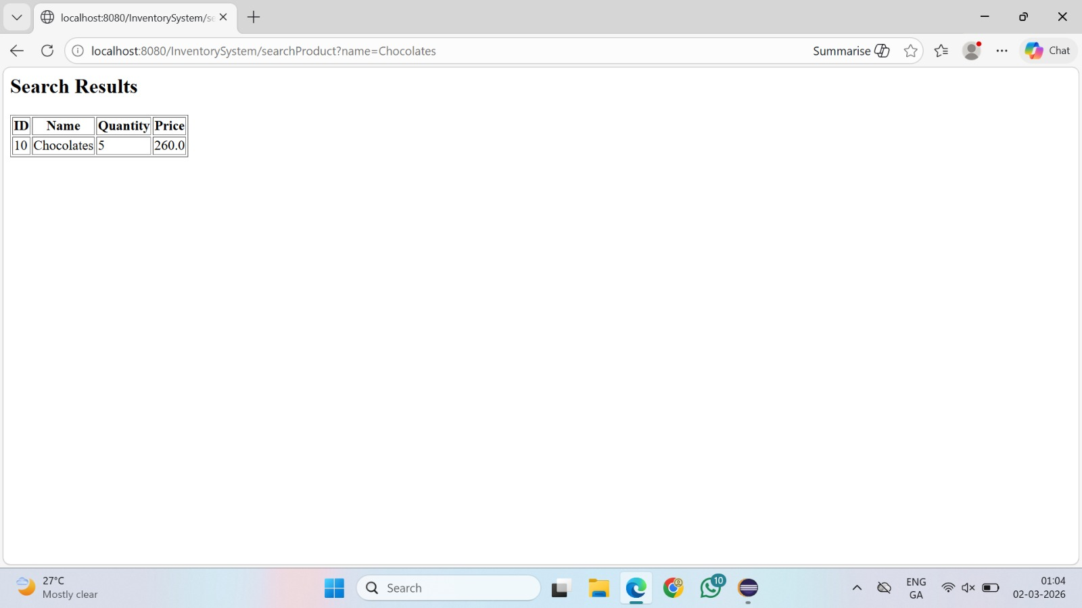
IMPLEMENTATION SCREENSHOTS
Output Page: Displays stock reports and updated inventory details.
1
2
3
4
5
6
7
8(C)
9

Slide 14
ADVANTAGES & LIMITATIONS
ADVANTAGES:
Reduces manual errors
Real-time stock tracking
Secure data management
Easy report generation
LIMITATIONS:
Requires internet/server availability
Limited scalability in basic version
Initial setup cost
Requires technical knowledge for maintenance
1
2
3
4
5
6
7
8
9

Slide 15
Thank you

