Slide 1

Vel Tech Rangarajan Dr. Sagunthala R&D Institute of Science and Technology
School of Computing
Department of Computer Science and Engineering
10211CS224 / FULL STACK APPLICATION DEVELOPMENT (JAVA)
PROJECT REVIEW : MILESTONE PROJECT – 1
Date:23-03-2026
DYNAMIC ONLINE EXAINATION & RESULT PROCESSING SYSTEM
SDG: SDG 4 – ( Quality Education)
Presented By:
P.VIVEK VARDHAN REDDY – VTU(24989) – 23UECS0855
Courses Handling Faculty:
Dr .S. HEMAMALINI-ASST PROFESSOR(SR. GRADE)

Slide 2
INTRODUCTION
The Dynamic Online Examination & Result Processing System is a web-based platform designed to conduct exams digitally and efficiently.
Traditional examination methods are time-consuming, paper-based, and prone to human errors in evaluation.
This project aims to automate the entire examination process, from question paper generation to result publication.
It ensures accuracy, transparency, and quick result processing.
The system provides secure login access for students, administrators, and examiners.
It supports objective-type tests with automatic evaluation and instant score generation.
The platform reduces paperwork and administrative workload.
This system is highly useful for schools, colleges, and competitive exam organizations in the digital era.
1
2
3
4
5
6
7
8
9

Slide 3
PROBLEM STATEMENT
1
Traditional examination systems are manual, time-consuming, and prone to errors in evaluation and result processing.
Managing large numbers of students, question papers, and answer sheets requires significant effort and resources.
Delays in result publication create inconvenience for students and institutions.
There is also a lack of transparency and security in paper-based examinations.
Hence, there is a need for a secure, automated, and efficient online examination system that can conduct exams and process results dynamically with accuracy and speed.
2
3
4
5
6
7
8
9

Slide 4
OBJECTIVE(S)
1
To design and develop a secure online examination platform.
To automate question paper generation and exam scheduling.
To enable students to take exams anytime and anywhere through login authentication.
To implement automatic evaluation and instant result processing.
To maintain accurate records of student performance.
To reduce paperwork and administrative workload.
To ensure data security and transparency in the examination process.
2
3
4
5
6
7
8
9

Slide 5
PROPOSED SYSTEM
1
The system is a web-based application that conducts examinations online and processes results automatically.
It provides secure login access for Admin, Faculty, and Students.
Admin can create exams, manage question banks, and schedule tests.
Questions are dynamically generated and displayed to reduce malpractice.
The system automatically evaluates objective-type answers instantly.
Results are generated immediately after exam submission with detailed score reports.
All student data and exam records are securely stored in a centralized database.
The system reduces manual work, saves time, ensures accuracy, and improves transparency compared to traditional methods.
2
3
4
5
6
7
8
9

Slide 6
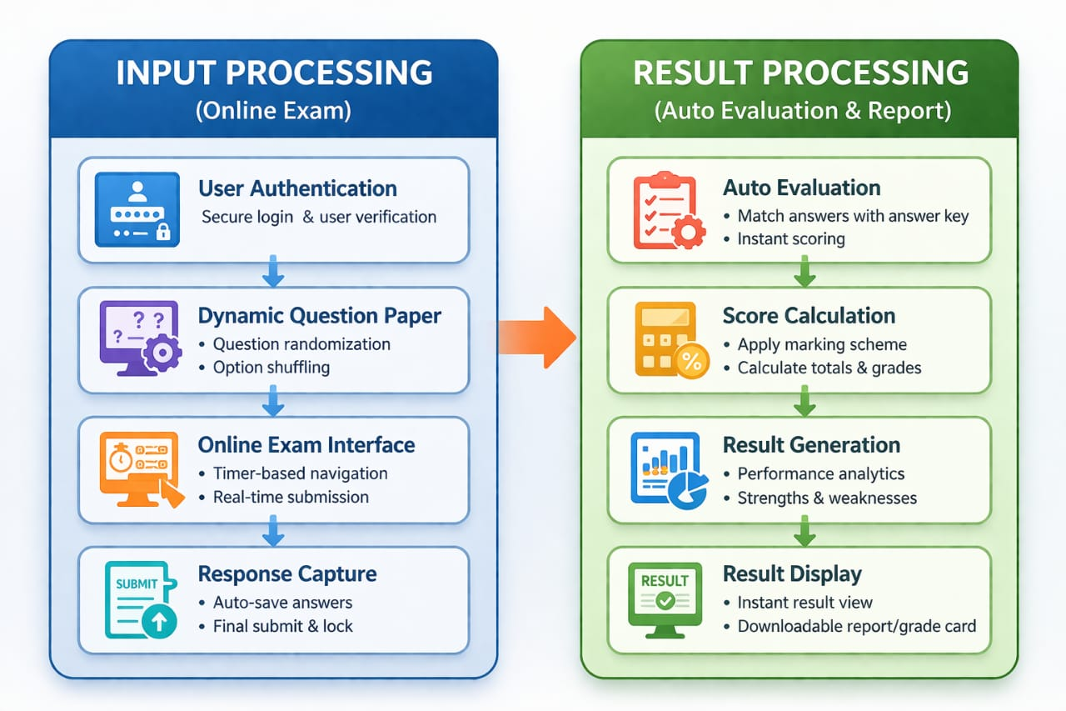
PROPOSED SYSTEM ARCHITECTURE
1
2
3
4
5
6
7
8
9

Slide 7
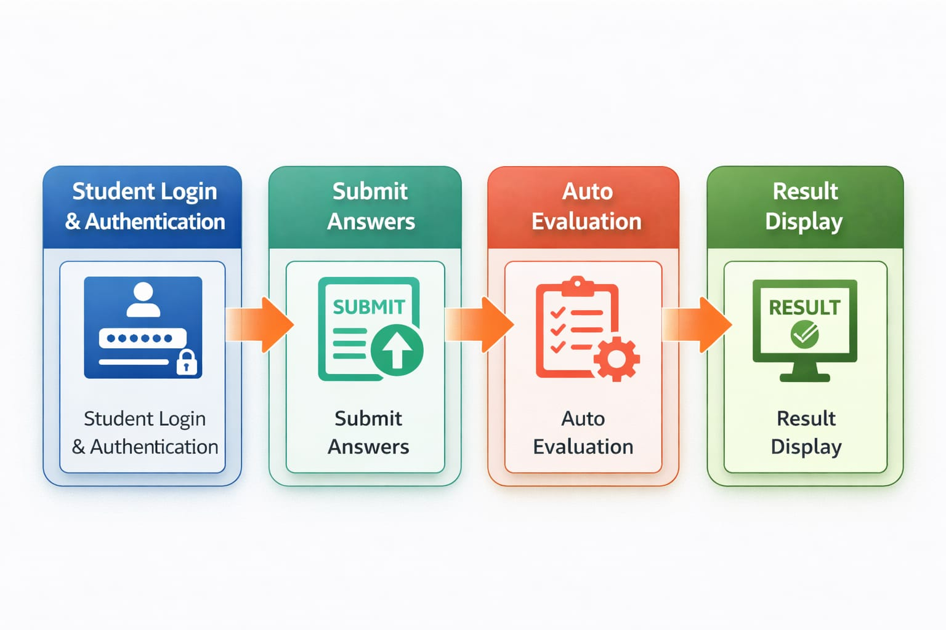
WORKFLOW
1
2
3
4
5
6
7
8
9

Slide 8
TECHNOLOGIES USED
1
Frontend: HTML, CSS, JavaScript
Backend: PHP / Python for handling server-side logic and Exam processing
Database: MySQL or PostgreSQL for storing student details, question bank, exam data, and results.
Tools: VS Code / Eclipse IDE, XAMPP or Apache Tomcat Server, Git for version control.
Hardware/Software Requirements: Minimum 4GB RAM, Dual-Core Processor, Windows/Linux OS, Web Browser (Chrome/Edge/Firefox), Stable Internet Connection.
2
3
4
5
6
7
8
9

Slide 9
MODULE DESCRIPTION
1
Module 1: User Management Handles student, faculty, and admin registration, login, and role-based authentication to ensure secure system access.
Module 2: Examination Management Manages exam creation, scheduling, dynamic question paper generation, and timer-based online test conduction.
Module 3: Evaluation & Result Processing Automatically evaluates objective answers, calculates marks, and generates instant results with performance analysis.
Module 4: Database & Reporting Management Stores student data, question banks, and result records securely, and generates detailed reports and analytical summaries for administrators.
2
3
4
5
6
7
8
9

Slide 10

IMPLEMENTATION SCREENSHOTS
1
2
3
4
5
6
7
8
This screenshot shows the login interface of a Dynamic Online Examination and Result Processing System, where users enter their username and password to securely access the platform. It ensures authorized access for students and administrators to login.
9

Slide 11

IMPLEMENTATION SCREENSHOTS
1
2
3
4
5
6
7
8(A)
This screenshot shows the main dashboard of the Dynamic Online Examination System, where users can start the exam by clicking the “Start Exam” button.It provides a simple interface for students to access and begin their test smoothly within the system. And we a history of result analysis.
9

Slide 12
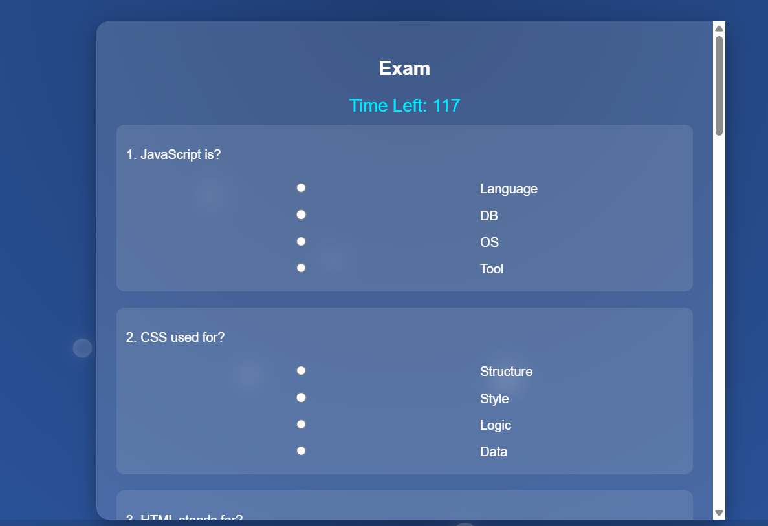
IMPLEMENTATION SCREENSHOTS
1
2
3
4
5
6
7
8(B)
9
This screenshot shows the examination question paper interface of the Dynamic Online Examination System, where students can view and answer questions.It allows users to navigate through questions and submit their responses efficiently during the exam.

Slide 13

IMPLEMENTATION SCREENSHOTS
1
2
3
4
5
6
7
8(C)
This screenshot shows the result view of the Dynamic Online Examination and Result Processing System, where students can see their scores and performance. It provides instant evaluation results, helping users easily analyze their exam outcome
9

Slide 14
ADVANTAGES & LIMITATIONS
1
Advantages:
Reduces manual work and paperwork through full automation.
Provides instant result generation with high accuracy.
Ensures secure login and minimizes chances of paper leakage.
Saves time for students, faculty, and administrators.
Stores data centrally for easy access and performance analysis.
Limitations:
Requires stable internet connection for smooth operation.
Technical issues or server failure may affect exam conduction.
Limited evaluation for descriptive/subjective answers (if fully automated).
Initial setup and maintenance cost may be high.
2
3
4
5
6
7
8
9

Slide 15
Thank you

