Slide 1

Vel Tech Rangarajan Dr. Sagunthala R&D Institute of Science and Technology
School of Computing
Department of Computer Science and Engineering
10211CS224 / FULL STACK APPLICATION DEVELOPMENT (JAVA)
PROJECT REVIEW : MILESTONE PROJECT – 2
Date: 16-04-2026
SMART CAMPUS EVENT MANAGEMENT SYSTEM
Presented By:
P.VIVEK VARDHAN REDDY – VTU24989– 23UECS0855
Courses Handling Faculty:
Dr. S . HEMAMALINI , M.E , Ph.D.,

Slide 2
INTRODUCTION
A Smart Campus Event Management System is a web-based application designed to simplify the planning, organization, and management of events within a campus.
In many institutions, event coordination is done manually, which leads to miscommunication, scheduling conflicts, and inefficiencies.
This system provides a centralized platform where students, faculty, and administrators can create, manage, and participate in events.
It enables real-time updates, online registrations, and seamless communication.
The application improves coordination, reduces manual work, and enhances overall event experience within the campus.

Slide 3
PROBLEM STATEMENT
In traditional campus environments, event management is often handled manually or through scattered platforms. This leads to:
Difficulty in tracking event schedules
Lack of centralized communication
Manual registration and attendance issues
Overlapping events due to poor coordination
Limited awareness among students
There is a need for a smart, automated system that can efficiently handle event planning, registration, and notifications in a centralized manner.

Slide 4
OBJECTIVE(S)
To develop a centralized platform for managing campus events
To allow users to create, update, and delete events
To enable online event registration for students
To provide real-time notifications and updates
To avoid scheduling conflicts using proper event management
To maintain event records and attendance data
To improve communication between organizers and participants
To ensure a user-friendly interface

Slide 5
PROPOSED SYSTEM
The proposed system is a web application that allows users to:
Create and manage events
Register for events online
Receive notifications about upcoming events
View event schedules in a structured format
Track participation and attendance
Admins can monitor all events, approve requests, and manage users efficiently.

Slide 6
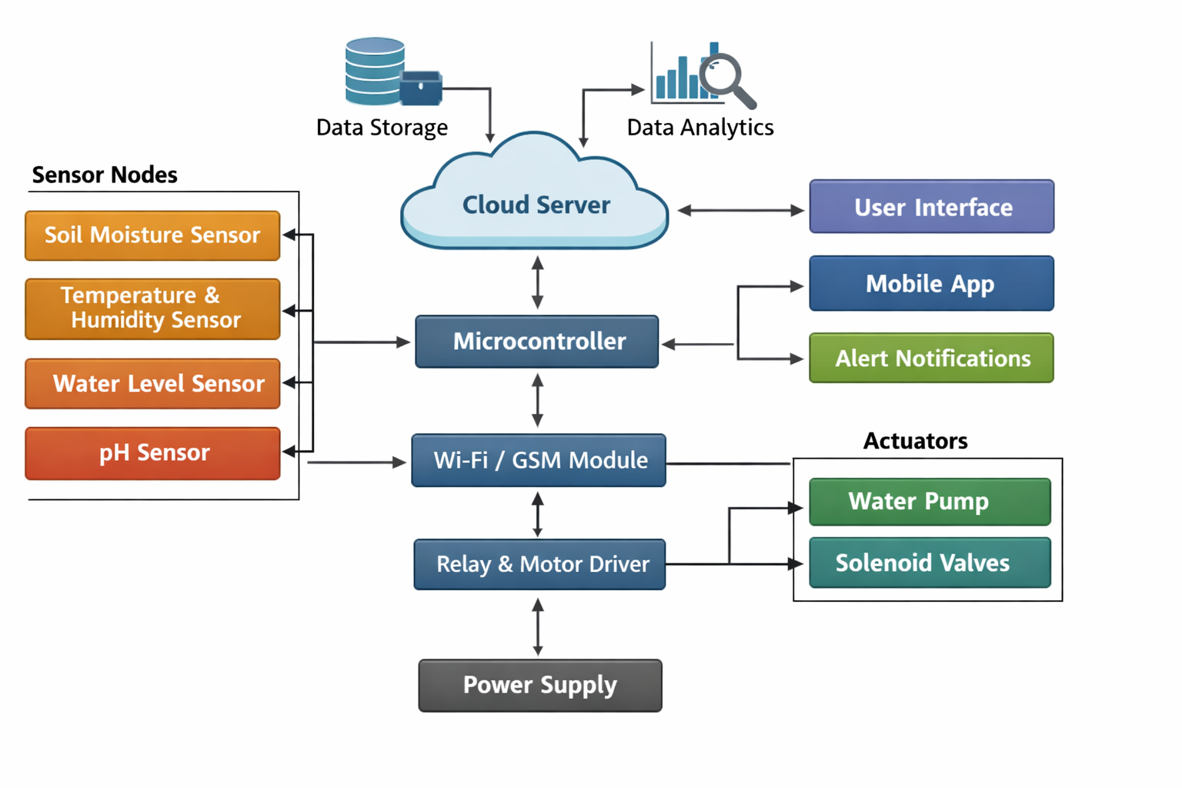
PROPOSED SYSTEM ARCHITECTURE
Input: User enters event details or registers for an event through the interface.
Processing: Frontend sends request → Backend processes using APIs → Validates data.
Database: Stores event details, user data, and registrations.
Output: Displays event list, confirmations, and notifications to users.

Slide 7
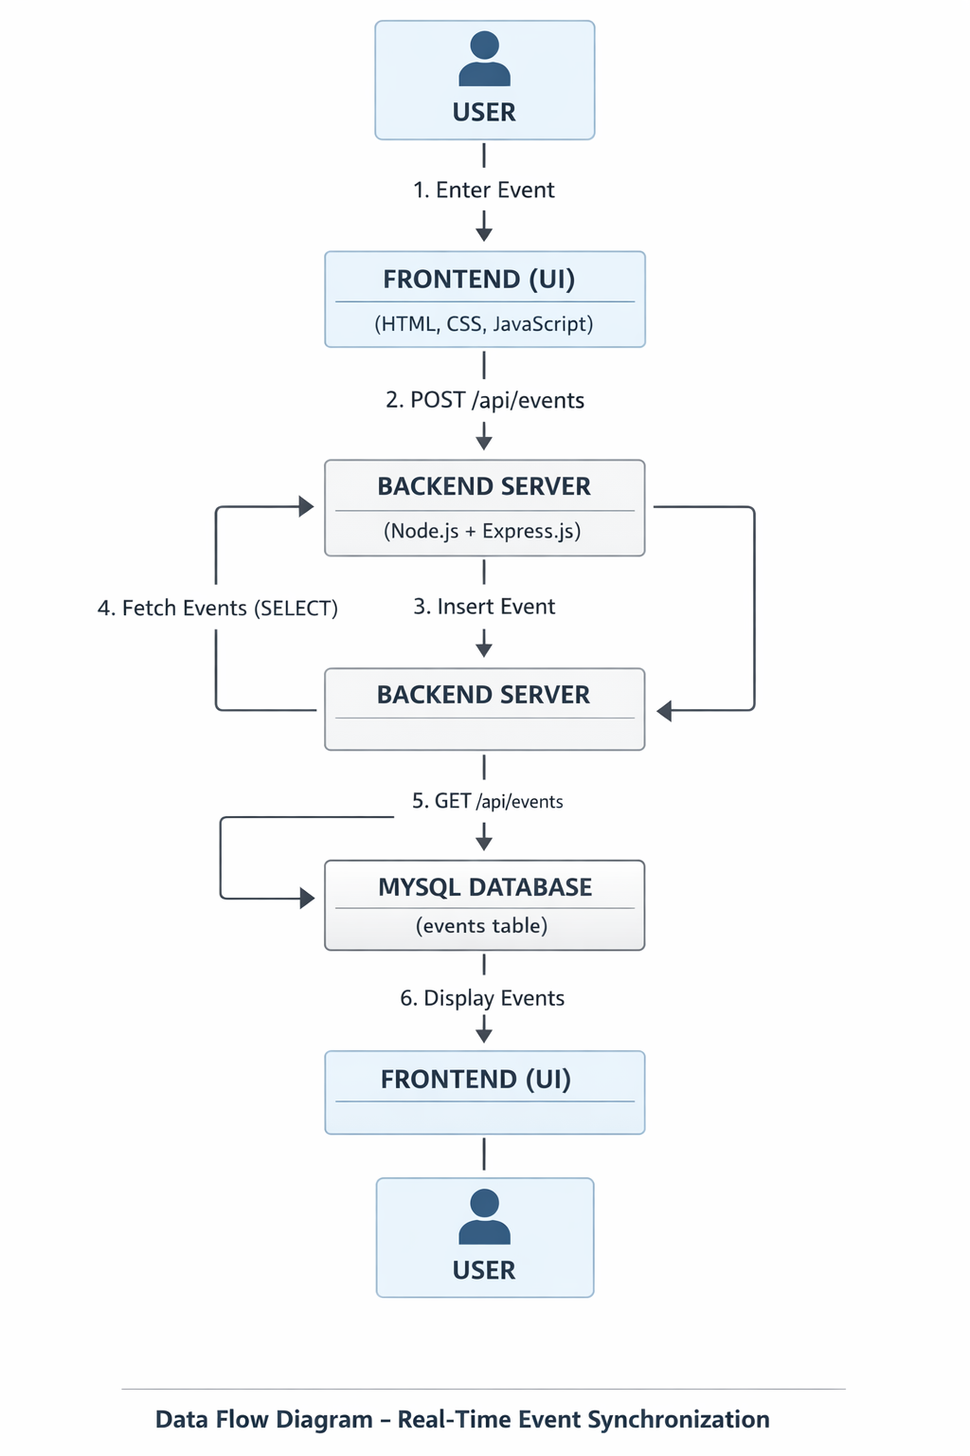
WORKFLOW
Admin/Organizer logs into the system
Creates a new event with details (date, time, venue)
Event is stored in the database
Students view available events
Students register for events
System sends confirmation/notification
Admin tracks registrations and attendance
Event updates are reflected in real time

Slide 8
TECHNOLOGIES USED
Frontend:
HTML, CSS, JavaScript Backend:
Node.js, Python(Flask or Django) Database:
MySQL, MangoDB Tools:
VS Code, Web Browser Hardware/Software Requirements: Firebase for notifications

Slide 9
MODULE DESCRIPTION
Module 1:User Management Module Handles login, registration, and user roles (Admin/Student)
Module 2: Event Management Module Allows creation, updating, and deletion of events
Module 3: Registration Module Enables students to register for events
Module 4: Notification Module Sends alerts and updates about events
Module 5: Dashboard Module Displays event details, schedules, and statistics

Slide 10
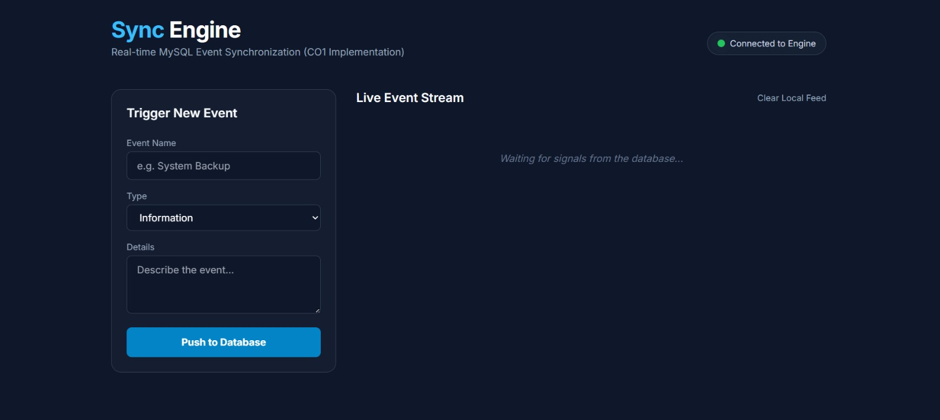
IMPLEMENTATION SCREENSHOTS
Home Page: Displays event submission form and navigation interface.

Slide 11
IMPLEMENTATION SCREENSHOTS
Main Dashboard: Shows live event feed with dynamically generated event cards.

Slide 12
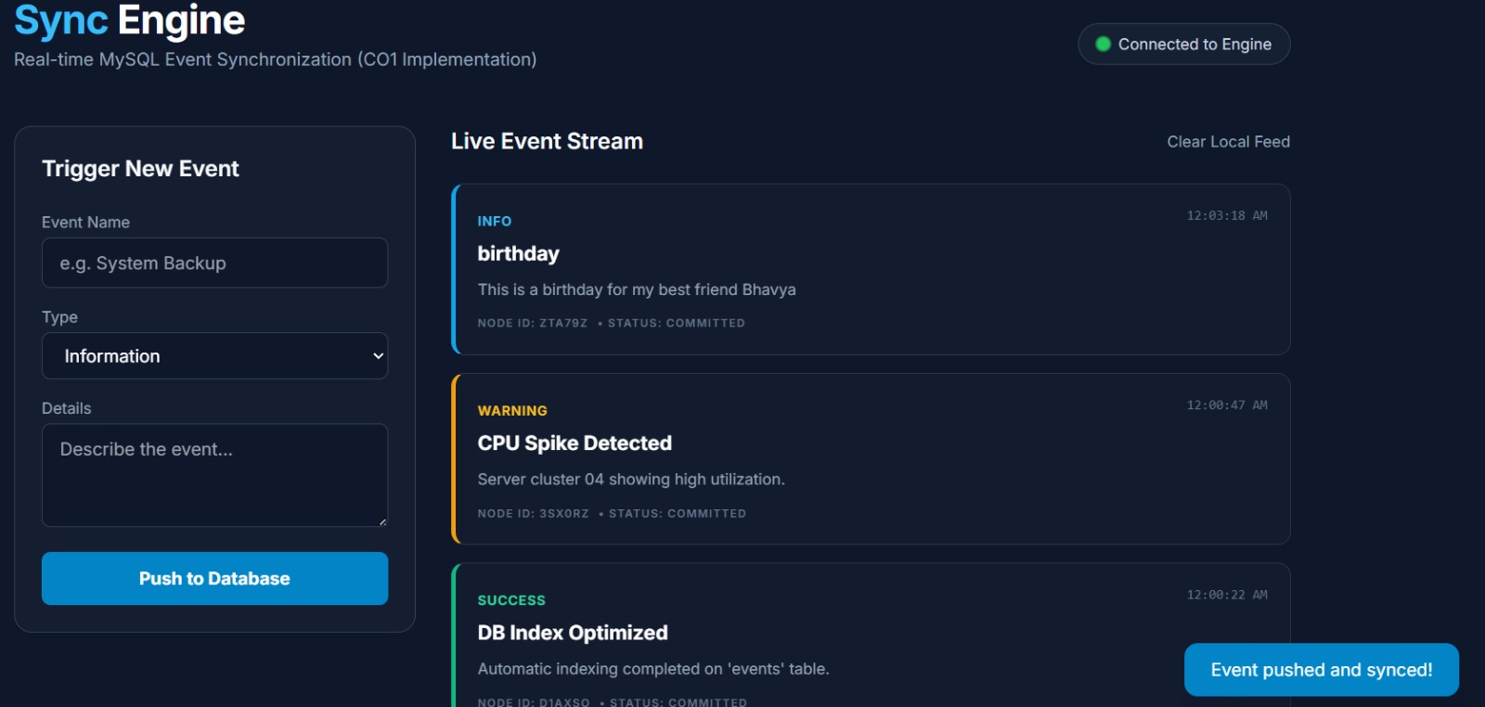
IMPLEMENTATION SCREENSHOTS
Event Submission: User enters event message and system logs it successfully

Slide 13
IMPLEMENTATION SCREENSHOTS
Output Page: Latest events are displayed in real time without refreshing.

Slide 14
ADVANTAGES & LIMITATIONS
ADVANTAGES
Centralized event management
Reduces manual work
Real-time updates and notifications
Easy registration process
Avoids scheduling conflicts
Improves communication
LIMITATIONS
Requires internet access
Basic security may need improvement
Limited features without advanced integrations
Depends on system maintenance

Slide 15
Thank you

