Slide 1

Vel Tech Rangarajan Dr. Sagunthala R&D Institute of Science and Technology
School of Computing
Department of Computer Science and Engineering
10211CS224 / FULL STACK APPLICATION DEVELOPMENT (JAVA)
PROJECT REVIEW : MILESTONE PROJECT – 2
Date: 20-04-2026
JOB PORTAL MANAGEMENT SYSTEM
SDG 8: DECENT WORK AND ECONOMIC GROWTH
Presented By:
K.Amar – VTU25055 – 23UECS1099
Courses Handling Faculty:
Dr. S. Hemamalini., M.E., Ph.D.
Assistant Professor (Senior Grade)

Slide 2
INTRODUCTION
The JOB PORTAL MANAGEMENT SYSTEM is designed to simplify and organize the recruitment process.
It acts as a bridge between job seekers and employers, providing a centralized platform for job postings and applications.
The system helps in reducing manual effort and ensures transparency in the hiring process.
Job seekers can explore opportunities, apply efficiently, and track their progress through the portal.
Employers benefit from streamlined hiring, organized candidate data, and faster decision-making.
Overall, the system enhances communication, accessibility, and efficiency in recruitment management.
1
2
3
4
5
6
7
8
9

Slide 3
PROBLEM STATEMENT
Traditional recruitment processes are time-consuming and inefficient, often involving manual paperwork and scattered communication.
Job seekers face difficulty in accessing opportunities, as postings are spread across multiple platforms without a centralized system.
Employers struggle with managing large volumes of applications, leading to delays in shortlisting and hiring.
Lack of transparency in the process causes confusion for candidates, who cannot track the status of their applications.
Communication gaps between recruiters and applicants result in missed opportunities and slower hiring decisions.
There is a need for a digital solution that streamlines job postings, applications, and candidate management in one platform.
1
2
3
4
5
6
7
8
9

Slide 4
OBJECTIVE(S)
To develop a centralized platform that connects job seekers with employers efficiently.
To simplify the recruitment process by reducing manual effort and paperwork.
1
2
3
4
5
6
7
8
9

Slide 5
PROPOSED SYSTEM
The proposed JOB PORTAL MANAGEMENT SYSTEM will serve as a unified platform for employers and job seekers.
It will allow employers to post job vacancies and manage applications in a structured manner.
Job seekers will be able to create profiles, search for jobs, and apply online with ease.
The system will provide real-time updates on application status to ensure transparency.
A secure database will be implemented to store candidate and employer information safely.
The portal will include filters and search options to help users find relevant opportunities quickly.
Communication between recruiters and applicants will be streamlined through notifications and messaging features.
1
2
3
4
5
6
7
8
9

Slide 6
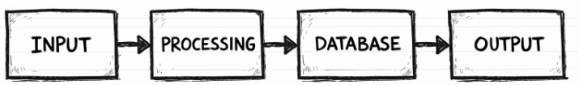
PROPOSED SYSTEM ARCHITECTURE
Input:
Employer job details, job seeker profiles, login credentials, and applications submitted.
Processing:
System processes employer job postings, candidate applications, and matches profiles with requirements.
Database:
Stores employer details, job seeker profiles, resumes, applications, and recruitment records securely.
Output:
Job listings, candidate profiles, application status updates, and notifications.
1
2
3
4
5
6
7
8
9

Slide 7
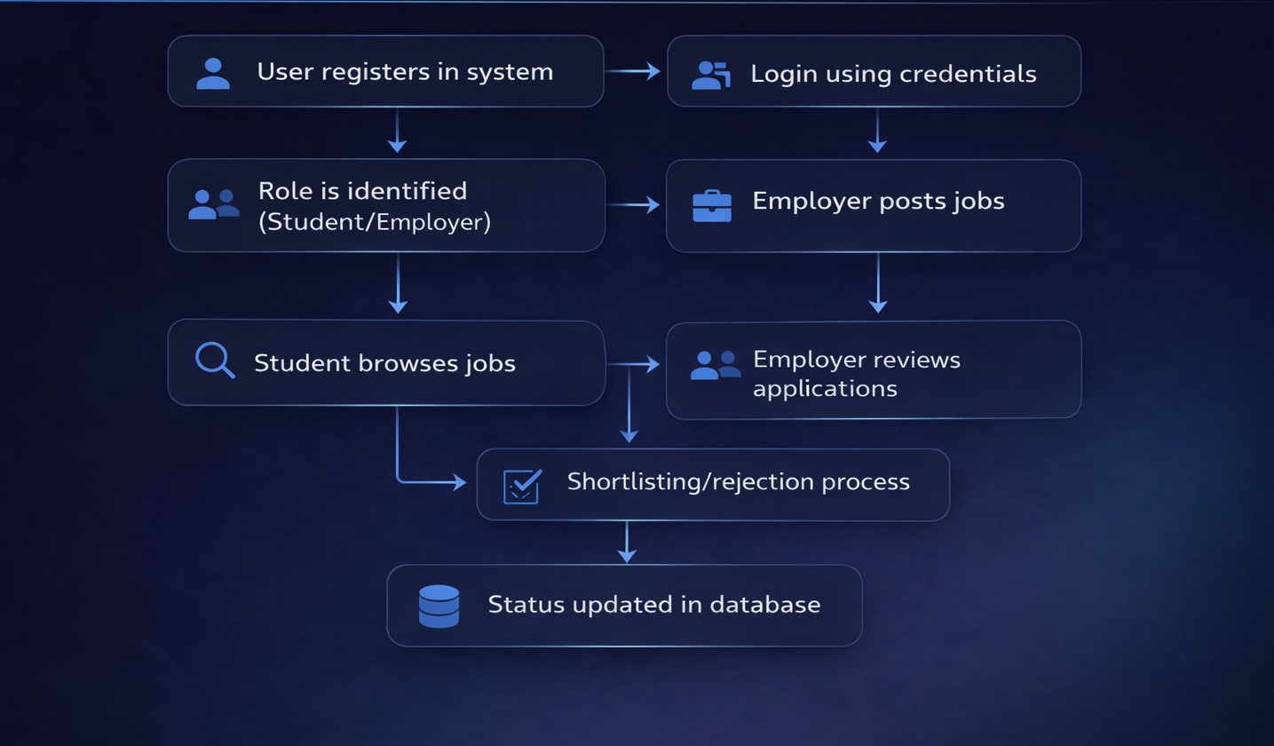
WORKFLOW
1
2
3
4
5
6
7
8
9

Slide 8
TECHNOLOGIES USED
Frontend: HTML, CSS, JavaScript
Backend: Java, Node.js (Express.js)
Database: MySQL workbench
Security: Spring Security
Tools: Visual Studio Code
Hardware/Software Requirements: Minimum 4GB RAM, JDK 17+, Web Browser
1
2
3
4
5
6
7
8
9

Slide 9
MODULE DESCRIPTION
Module 1: User Authentication:
Secure login and registration
Handles secure login by verifying username and password
Role-based access (Student / Employer / Admin)
Module 2: Job Management:
Employers can post, edit, delete jobs
Module 3: Application Management:
Students apply for jobs, Track application status
Module 4: Search & Filter:
Filter jobs by:
Location
Skills
Experience
1
2
3
4
5
6
7
8
9

Slide 10
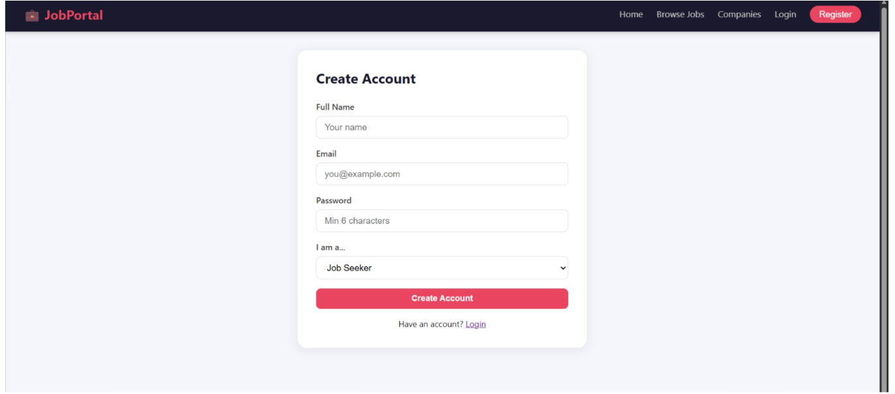
IMPLEMENTATION SCREENSHOTS
1
2
3
4
5
6
7
8
9
Explanation:
This picture shows a registration form interface where a job seeker can create an account by entering their name, email, password, and selecting their role before clicking “Create Account.”

Slide 11
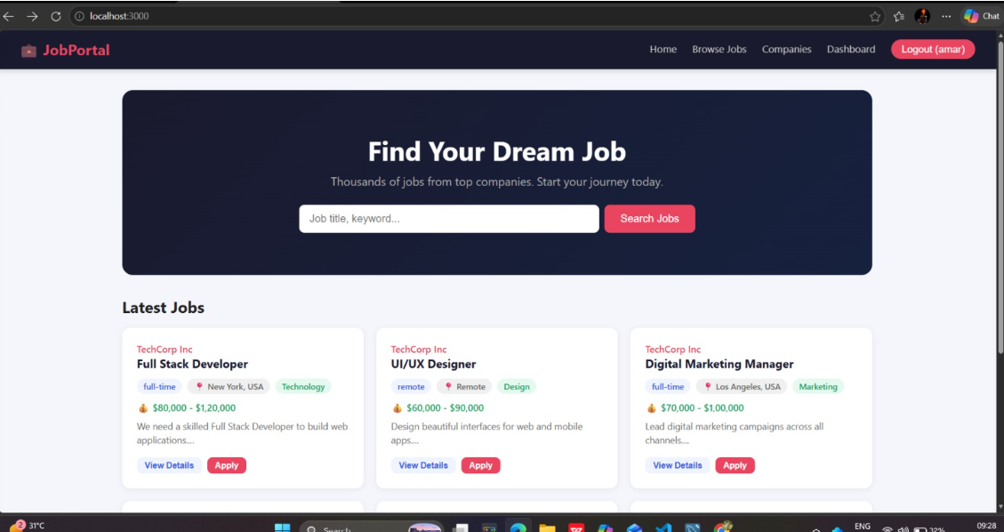
IMPLEMENTATION SCREENSHOTS
1
2
3
4
5
6
7
8(A)
9
Explanation:
This picture shows a job portal homepage interface where users can search for jobs using keywords, view the latest job listings, and apply directly through options like “View Details” and “Apply.”

Slide 12
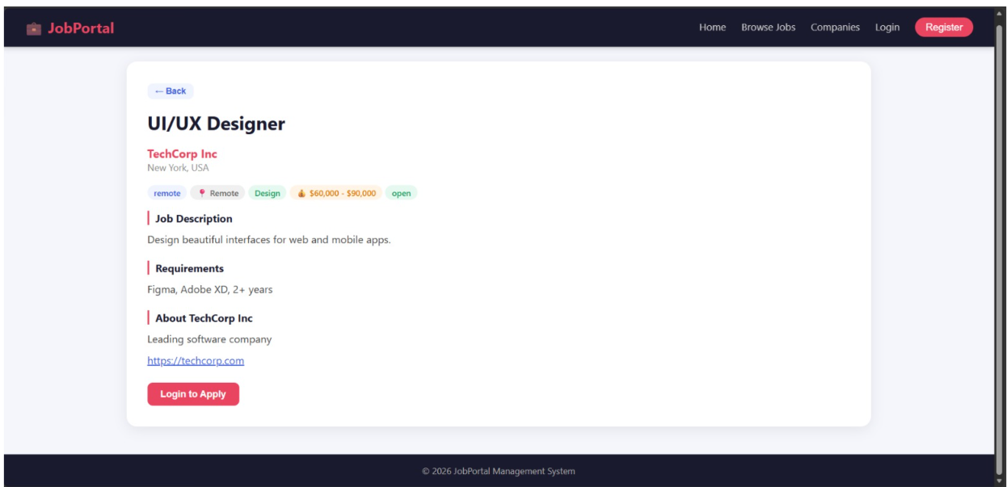
IMPLEMENTATION SCREENSHOTS
1
2
3
4
5
6
7
8(B)
9
Explanation:
This picture shows a job listing page where details of a UI/UX Designer role at TechCorp Inc are displayed, including job description, requirements, company info, and an option to log in to apply.

Slide 13
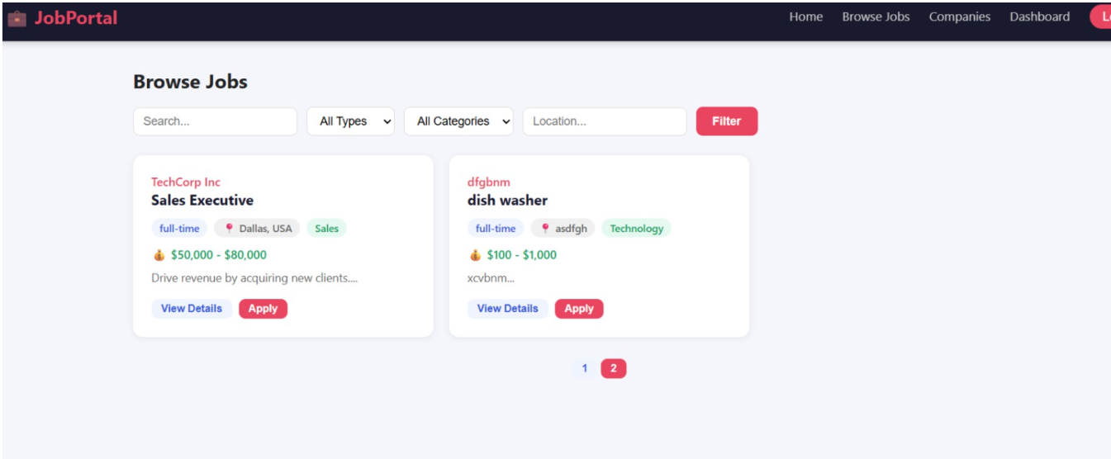
IMPLEMENTATION SCREENSHOTS
1
2
3
4
5
6
7
8(C)
9
Explanation:
This picture shows a Browse Jobs page where users can search and filter job listings by type, category, and location, then view details or apply directly from the displayed results.

Slide 14
ADVANTAGES & LIMITATIONS
1
Advantages:
Centralized platform for employers and job seekers.
Easy access to job opportunities and applications.
Transparent process with real-time updates.
Limitations:
Requires internet access for usage.
Data security risks if not managed properly.
Limited to registered users only.
May face technical issues or downtime.
2
3
4
5
6
7
8
9

Slide 15
Thank you

