Slide 1

Vel Tech Rangarajan Dr. Sagunthala R&D Institute of Science and Technology
School of Computing
Department of Computer Science and Engineering
10211CS224 / FULL STACK APPLICATION DEVELOPMENT (JAVA)
PROJECT REVIEW : MILESTONE PROJECT – 1
Date: 23-03-2026
End-to-End Event Lifecycle & Ticketing Platform
SDG 9 – Industry, Innovation and Infrastructure
Presented By:
K.Amar – VTU25055 – 23UECS1099
Courses Handling Faculty:
Dr. S. Hemamalini., M.E., Ph.D.
Assistant Professor (Senior Grade)

Slide 2
INTRODUCTION
Event management today is fragmented, using multiple tools for planning, promotion, and ticketing.
This leads to inefficiency, errors, and poor coordination among organizers.
This project is important as it provides a single integrated platform for the entire event lifecycle.
It reduces manual effort and improves efficiency for both organizers and users.
In real-world scenarios, it is useful for concerts, seminars, college events, and workshops.
The platform supports online ticket booking with secure payment options.
It includes features like event creation, user management, notifications, and analytics.
Overall, it ensures a smooth, organized, and user-friendly event management experience.
1
2
3
4
5
6
7
8
9

Slide 3
PROBLEM STATEMENT
In many cases, event management processes are handled using multiple disconnected systems or manual methods.
This leads to inefficiency in planning, ticketing, and communication between organizers and participants.
Manual handling increases the chances of errors, data loss, and delays in event execution.
There is a lack of a centralized system to manage the complete event lifecycle effectively.
Ticket booking and payment processes are often not streamlined or user-friendly.
Organizers face difficulty in tracking attendance, managing schedules, and analyzing event performance.
Users also experience inconvenience in accessing event details and booking tickets.
Therefore, there is a need for a unified, automated, and reliable platform to manage end-to-end event lifecycle and ticketing efficiently.
1
2
3
4
5
6
7
8
9

Slide 4
OBJECTIVE(S)
To design and develop an End-to-End Event Lifecycle & Ticketing Platform for managing events, ticket booking, and user interactions in a single system.
To implement and evaluate a secure and efficient system that improves event management, reduces manual effort, and enhances user experience.
1
2
3
4
5
6
7
8
9

Slide 5
PROPOSED SYSTEM
The system provides a centralized platform to manage the complete event lifecycle from creation to post-event analysis.
It integrates modules like event creation, ticket booking, payment processing, user management, and notifications.
The platform automates manual tasks, reducing errors and saving time for organizers.
It offers a user-friendly interface for easy event browsing and ticket booking.
Real-time updates and notifications improve communication between organizers and attendees.
Secure payment integration ensures safe and reliable ticket transactions.
Analytics and reporting features help organizers evaluate event performance effectively.
Compared to existing systems, it is more efficient, scalable, and cost-effective, providing an all-in-one solution.
1
2
3
4
5
6
7
8
9

Slide 6
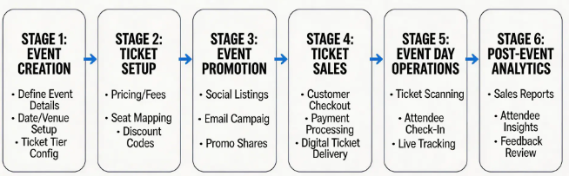
PROPOSED SYSTEM ARCHITECTURE
Input:
User enters login details, event information, and booking requests. Includes payment details and user interactions with the system.
Processing:
System verifies users, manages events, and processes ticket bookings. Handles payment confirmation and sends notifications.
Database:
Stores user data, event details, and booking records securely. Maintains transaction history and system data for retrieval.
Output:
Displays booking confirmation, e-tickets, and event details. Generates reports, receipts, and notifications for users and organizers.
1
2
3
4
5
6
7
8
9

Slide 7
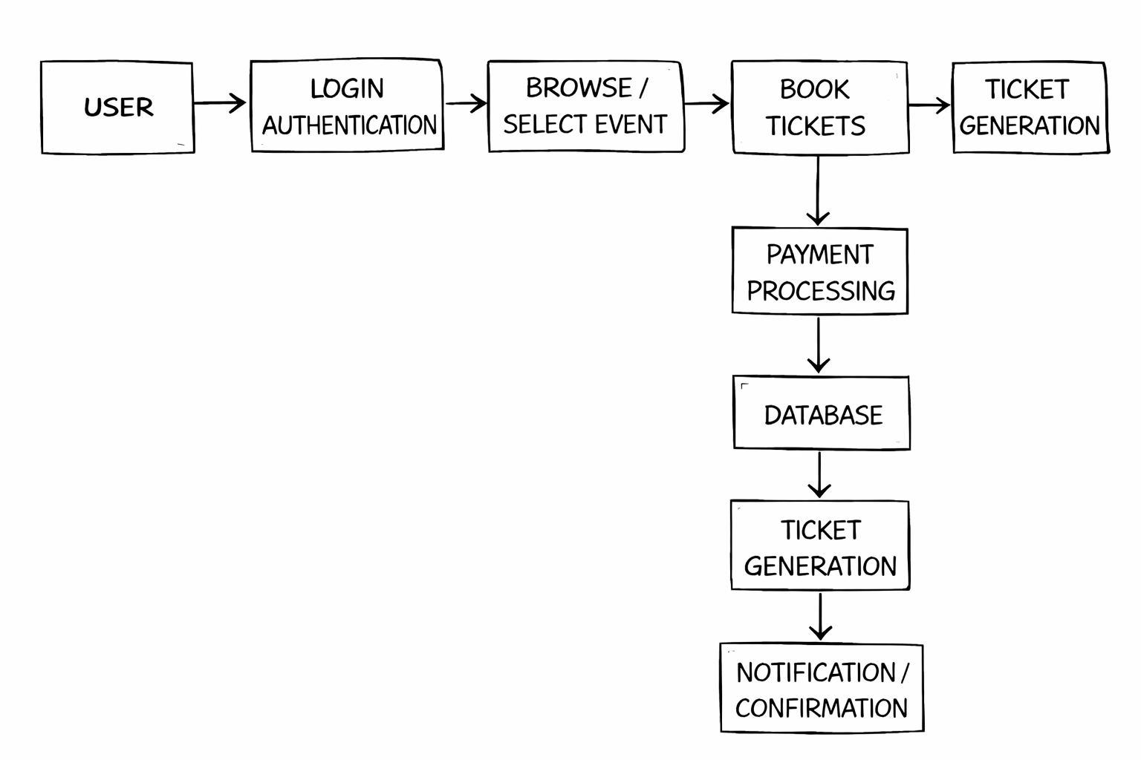
WORKFLOW
1
2
3
4
5
6
7
8
9

Slide 8
TECHNOLOGIES USED
🔹 Frontend:
HTML, CSS, JavaScript
🔹 Backend:
Java (Spring Boot)
🔹 Database:
MySQL
🔹 Tools:
VS Code
🔹 Hardware/Software Requirements:
Laptop (4GB RAM)
Web Browser (Chrome) MySQL Server
1
2
3
4
5
6
7
8
9

Slide 9
MODULE DESCRIPTION
Module 1: User Management
Handles user registration, login, and authentication for both organizers and attendees.
Module 2: Event Management
Allows organizers to create, update, and manage event details like date, venue, and pricing.
Module 3: Ticket Booking & Payment
Manages ticket selection, booking process, and secure payment transactions.
Module 4: Database & Reporting
Stores all data and generates reports on bookings, users, and event performance.
1
2
3
4
5
6
7
8
9

Slide 10
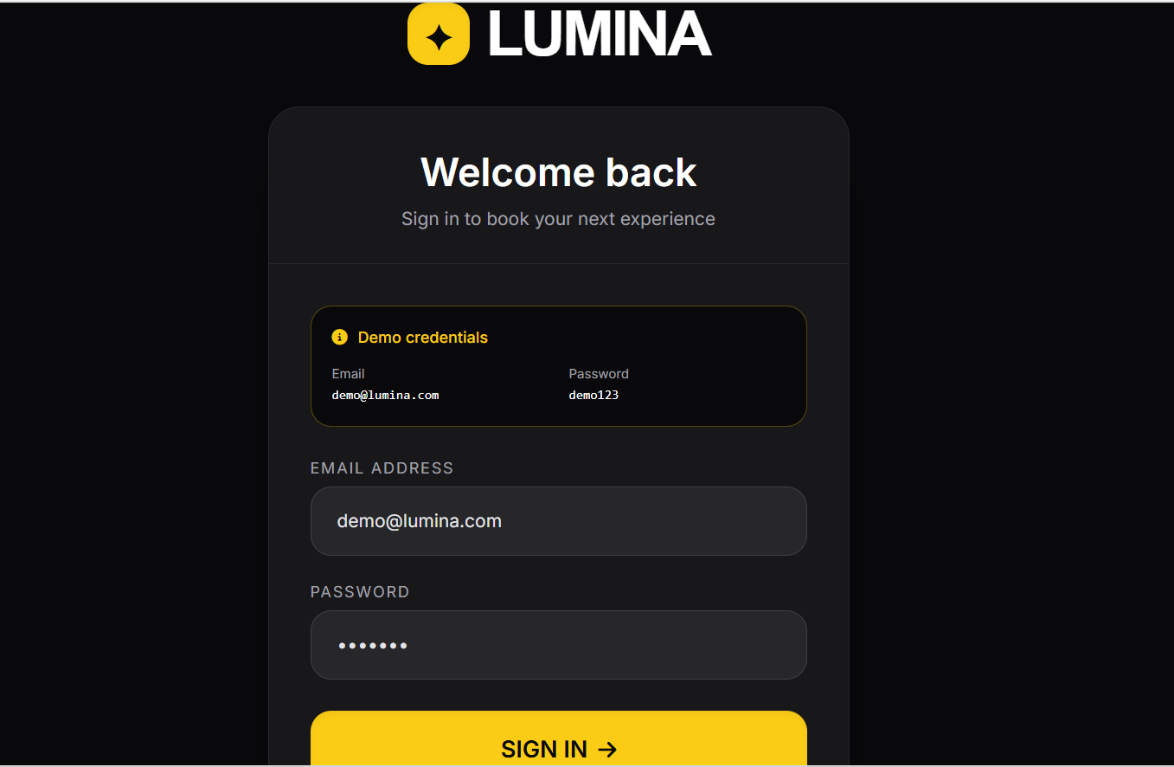
IMPLEMENTATION SCREENSHOTS
1
2
3
4
5
6
7
8
9
Explanation:
This is a login page UI where users enter their email and password to access their account.

Slide 11
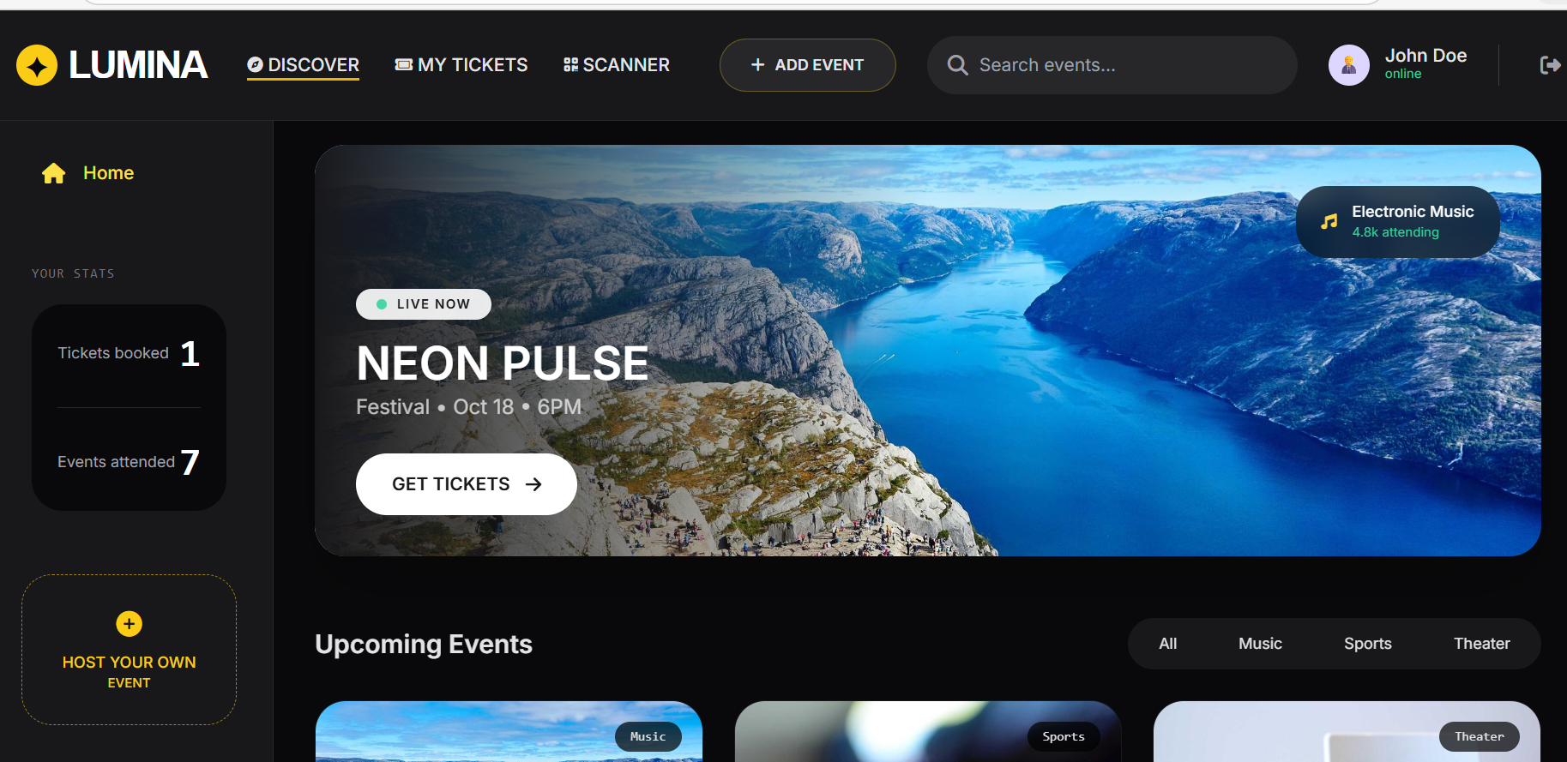
IMPLEMENTATION SCREENSHOTS
1
2
3
4
5
6
7
8(A)
9
Explanation:
This screen displays the All Events page, where users can view and browse different events with details like date, location, and booking status.

Slide 12
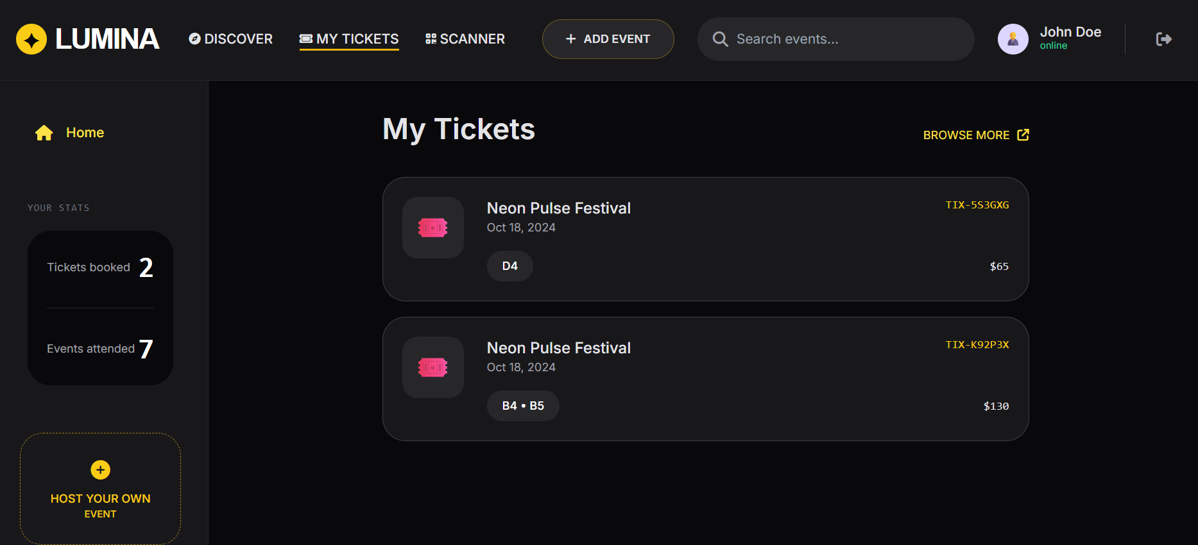
IMPLEMENTATION SCREENSHOTS
1
2
3
4
5
6
7
8(B)
9
Explanation:
This screen shows the ticket management dashboard, displaying real-time ticket sales for different categories like General, VIP, and Backstage.

Slide 13
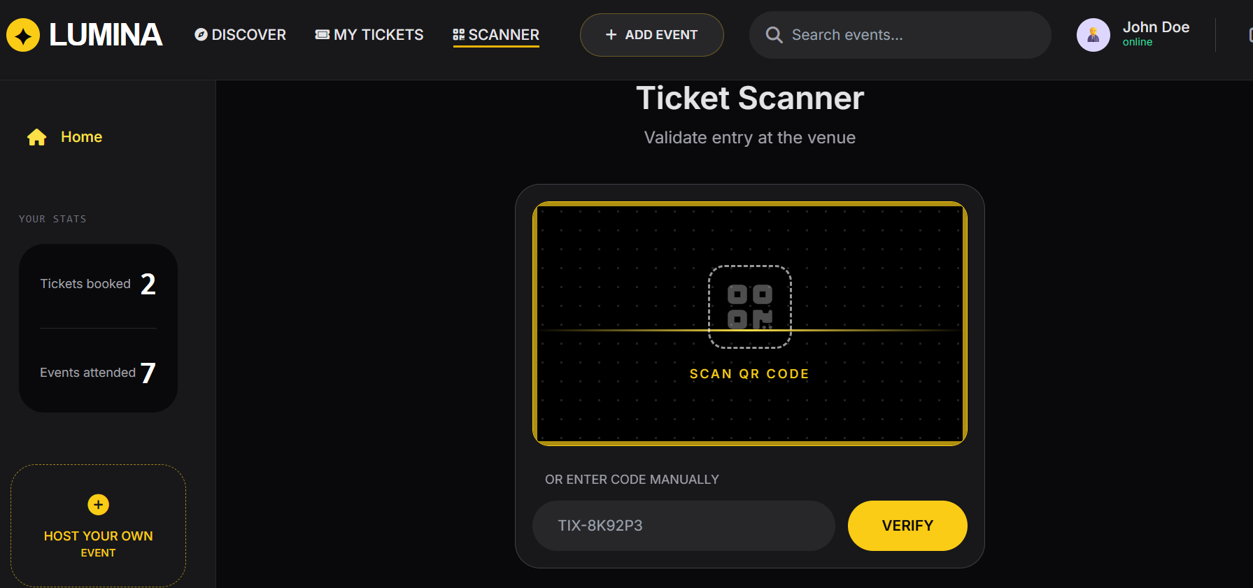
IMPLEMENTATION SCREENSHOTS
1
2
3
4
5
6
7
8(C)
9
Explanation:
This is a ticket scanner interface used to validate event entry by scanning a QR code or entering a code manually.

Slide 14
ADVANTAGES & LIMITATIONS
1
Advantages:
Reduces manual work by automating event management and ticket booking processes.
Provides real-time updates on ticket availability and event status.
Ensures secure transactions and user authentication.
Saves time for both organizers and users through an easy-to-use platform.
Stores all event and booking data centrally for quick access and analysis.
Limitations:
Requires a stable internet connection for proper functioning.
System downtime or server issues may affect bookings and access.
Security risks like data breaches if not properly managed.
Initial development and maintenance cost may be high.
2
3
4
5
6
7
8
9

Slide 15
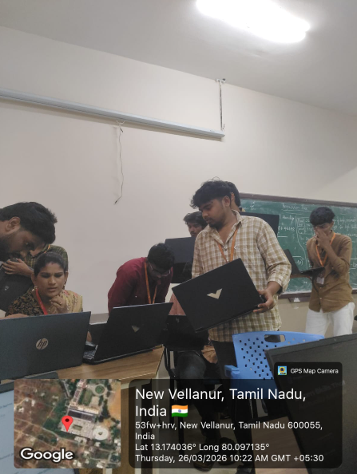

Slide 16
Thank you

