Slide 1

Vel Tech Rangarajan Dr. Sagunthala R&D Institute of Science and Technology
School of Computing
Department of Computer Science and Engineering
10211CS224 / FULL STACK APPLICATION DEVELOPMENT (JAVA)
PROJECT REVIEW : MILESTONE PROJECT – 1
Date: 30 – 03 – 2026
Full-Stack Skill Learning Academy Marketplace with Secure Authentication
SDG: SDG 4 – Quality Education
Presented By:
Courses Handling Faculty:
P. SREE MANJUNATH REDDY– VTU25479 – 23UECS0261
Dr. ANGELINE LYDIA

Slide 2
INTRODUCTION
1
- SkillAcademy is a full-stack web-based online learning marketplace built using PHP, MySQL, HTML5, CSS3, and JavaScript, hosted on a local XAMPP server.
- The platform connects learners who want to develop new skills with instructors who want to share their expertise through structured courses.
- Existing learning resources online are fragmented and hard to navigate — SkillAcademy brings them together into one simple, organised platform.
- The system supports three user roles — Admin, Instructor, and Student — each with their own access and functionality.
- Students can browse courses across 6 categories, view course details, enroll with one click, and track their learning from a personal dashboard.
- The project is built as a Milestone 1 prototype demonstrating core functionality: authentication, course listing, enrollment, and a basic dashboard.
- It directly supports SDG 4 (Quality Education) by making structured learning freely accessible to anyone with internet access.
2
3
4
5
6
7
8
9

Slide 3
PROBLEM STATEMENT
1
- Learners who want to improve their skills have no single, easy-to-use platform to find, enroll in, and track structured courses.
- Most existing systems are either too complex, too expensive, or require separate tools for browsing, enrolling, and tracking progress.
- Instructors have no simple way to list and manage their courses without technical expertise or costly infrastructure.
- There is no unified role-based system where students, instructors, and admins can each perform their tasks from one platform.
- Manual enrollment and tracking processes lead to disorganised records and poor learning outcomes.
- SkillAcademy solves this by providing a straightforward PHP/MySQL web application that automates user registration, course browsing, enrollment, and dashboard tracking.
2
3
4
5
6
7
8
9

Slide 4
OBJECTIVES
1
Objective 1
2
To design and develop a role-based online learning platform using PHP and MySQL where students can register, browse courses, and enroll — while instructors can manage their published courses — all from a clean, simple web interface.
3
4
5
Objective 2
To implement a secure PHP backend with session-based authentication, a 6-table MySQL database, and a basic student dashboard that displays enrolled courses and simple learning statistics.
6
7
8
9

Slide 5
PROPOSED SYSTEM
1
- SkillAcademy is a multi-role web application where students can discover and enroll in courses, and instructors can publish and manage their content.
- The system uses a clean PHP backend with a 6-table MySQL database covering users, categories, courses, enrollments, reviews, and contact messages.
- Students get a personal dashboard that shows their enrolled courses, basic progress stats, and course recommendations.
- Course browsing includes search by keyword, filter by category and level, giving students an easy way to find relevant content.
- Enrollment is a single click — the system checks authentication, records the enrollment, and reflects it instantly on the dashboard.
- Secure session-based login protects all user data, with password hashing and basic rate-limiting to prevent misuse.
- The entire application runs on XAMPP (Apache + PHP + MySQL) — free, open-source, and easy to set up on any local machine.
2
3
4
5
6
7
8
9

Slide 6
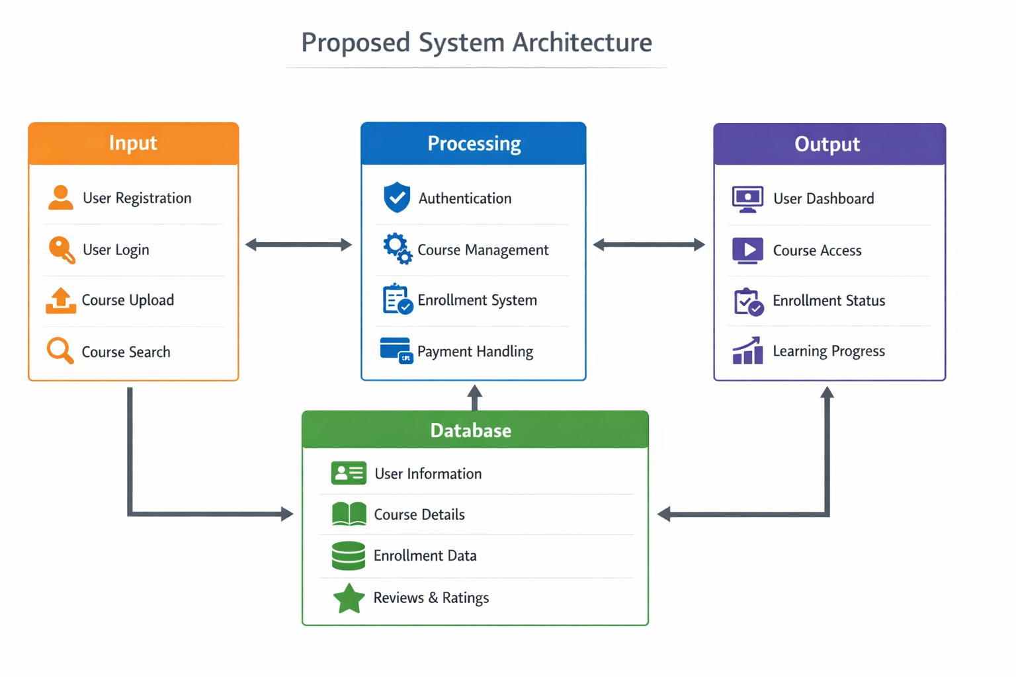
PROPOSED SYSTEM ARCHITECTURE
1
2
3
4
5
6
7
8
9

Slide 7
WORKFLOW
1
1
Register
2
Login
3
Browse Courses
2
3
User signs up as Student or Instructor
→
Session-based authentication via PHP
→
Search and filter by category / level
4
5
6
4
View Detail
5
Enroll
6
Dashboard
7
Course info, instructor, student reviews
→
One-click enroll, saved to DB instantly
→
View enrolled courses and basic stats
8
9

Slide 8
TECHNOLOGIES USED
1
Frontend: HTML5, CSS3, JavaScript (ES6) – clean responsive UI with no external frameworks
2
3
Backend: PHP 8 – custom session-based authentication and API endpoints using PDO
4
Database: MySQL – 6 tables: users, categories, courses, enrollments, reviews, contact_messages
5
6
Tools: XAMPP (Apache + MySQL), Pycharm, phpMyAdmin, Git
7
Hardware / Software Requirements: Any PC running Windows / macOS / Linux with XAMPP 8.x installed
8
9

Slide 9
MODULE DESCRIPTION
1
01
User Authentication Module
03
Enrollment Module
2
Handles registration, login, and logout using PHP sessions. Passwords are hashed with bcrypt. Includes basic rate-limiting and role-based redirects for Student, Instructor, and Admin.
Students can enroll in a course with one click. The system checks for duplicate enrollments, records the entry in the enrollments table, and updates the student count on the course.
3
4
5
6
02
Course Management Module
04
Student Dashboard Module
7
PHP endpoints serve course listings with keyword search and filters (category, level). Courses are stored in MySQL and displayed dynamically on the courses page.
Displays a summary of enrolled courses, basic stats (total enrolled, in-progress), and course recommendations for courses not yet enrolled in.
8
9

Slide 10
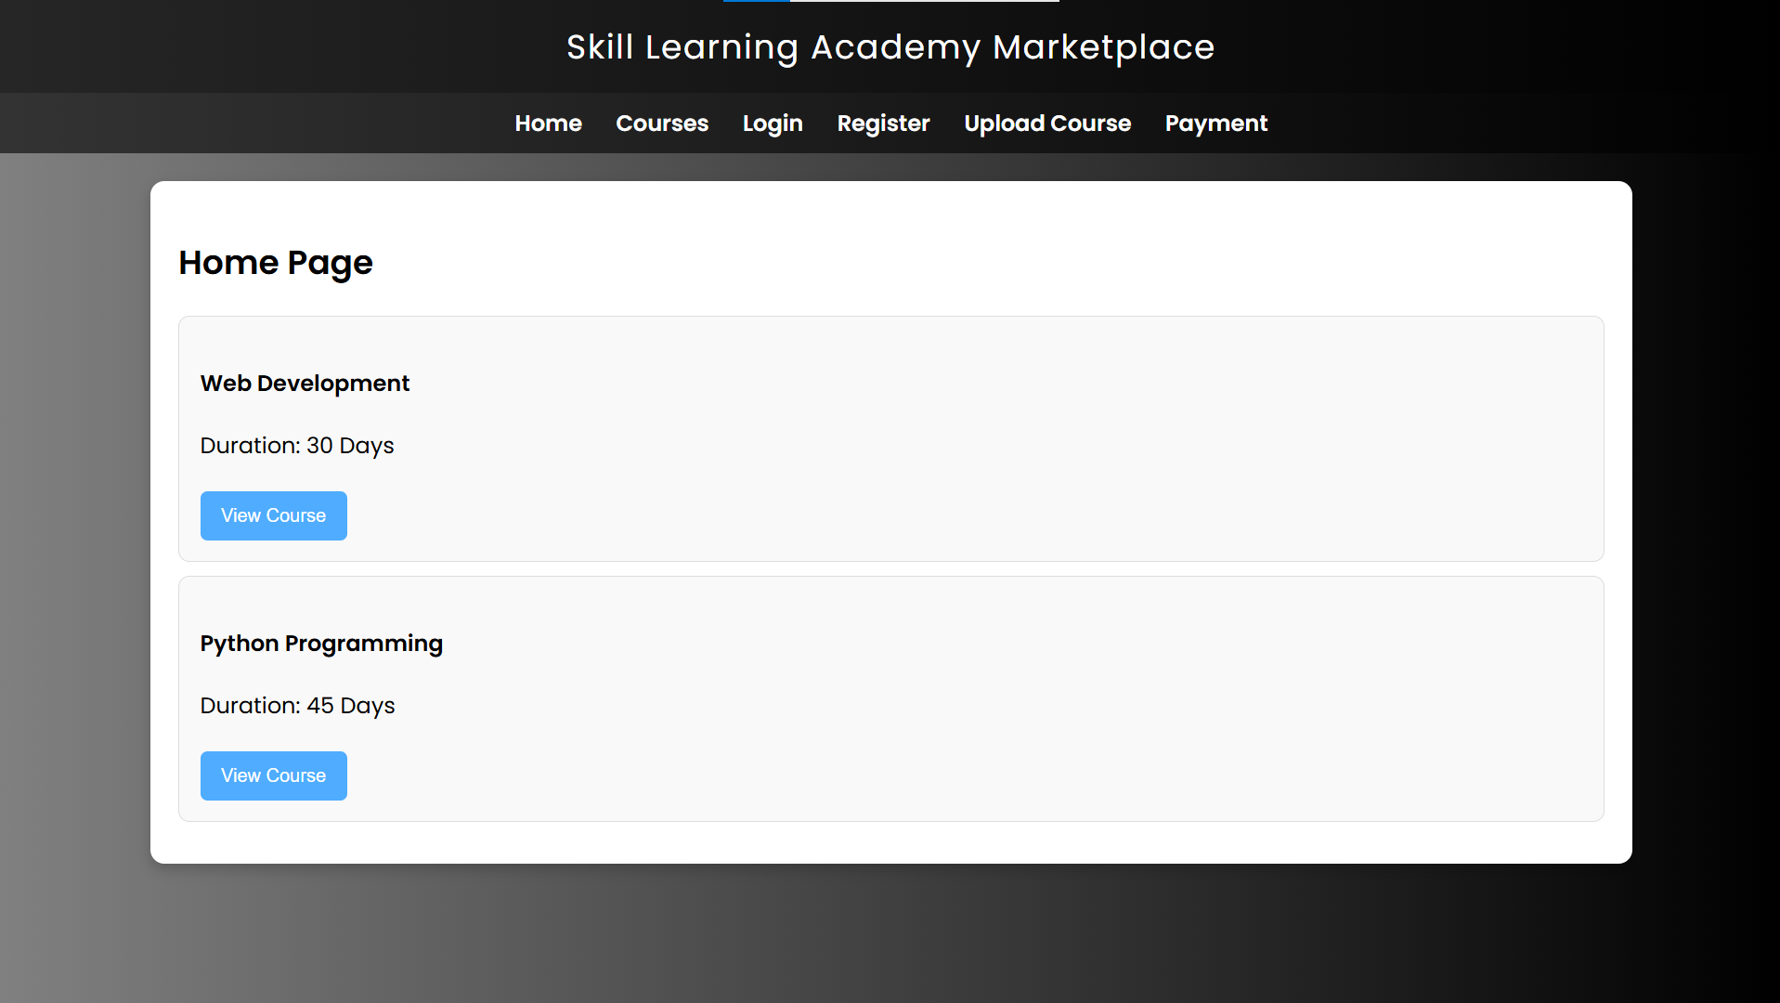
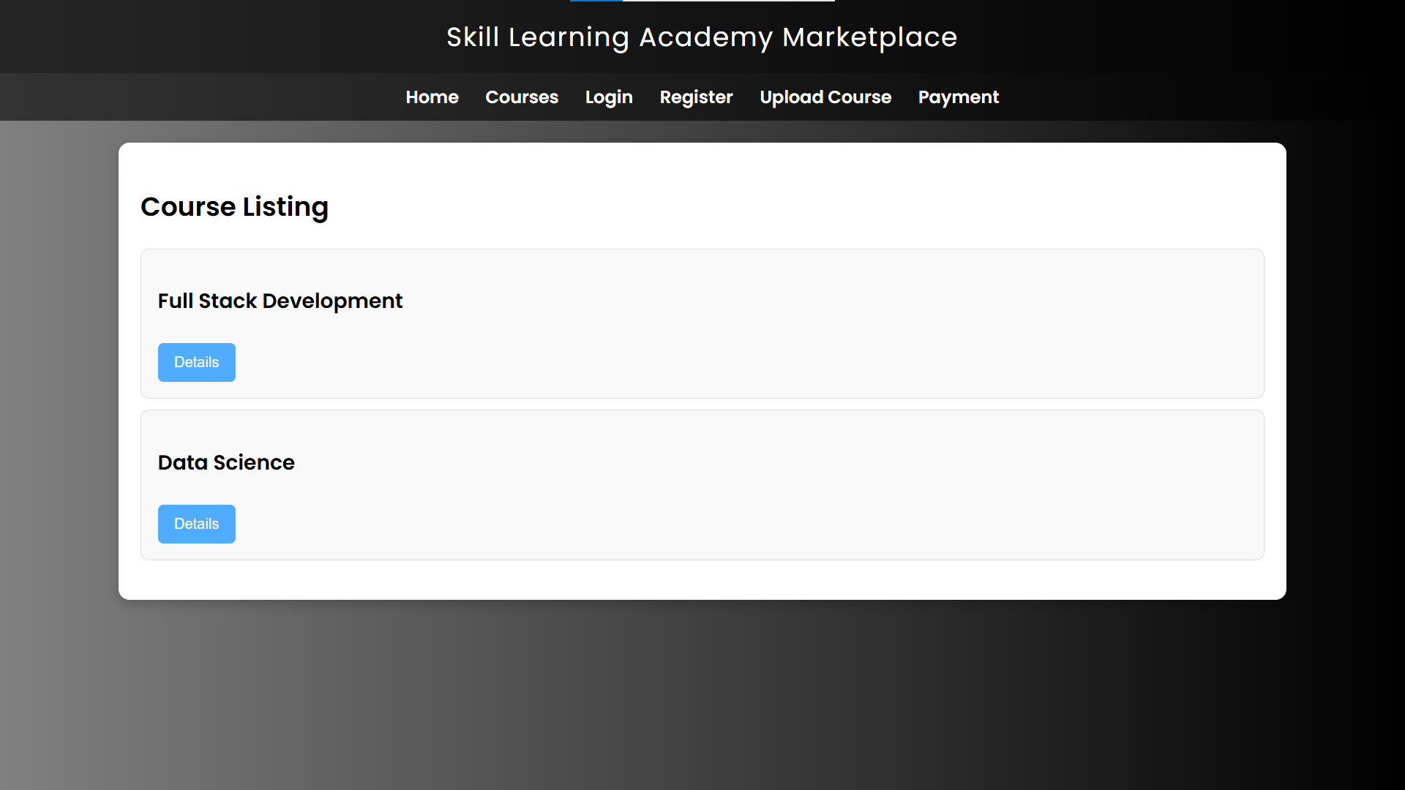
IMPLEMENTATION SCREENSHOTS
1
[Screenshot Placeholder]
[Screenshot Placeholder]
2
3
4
5
6
Home Page (index.php)
Courses Page (courses.php)
7
Hero section with category pills, featured course grid, and Why SkillAcademy features. Fully responsive, clean blue/white design.
All courses shown as cards with keyword search, level filter, category filter, and category pills for one-click browsing.
8
9

Slide 11
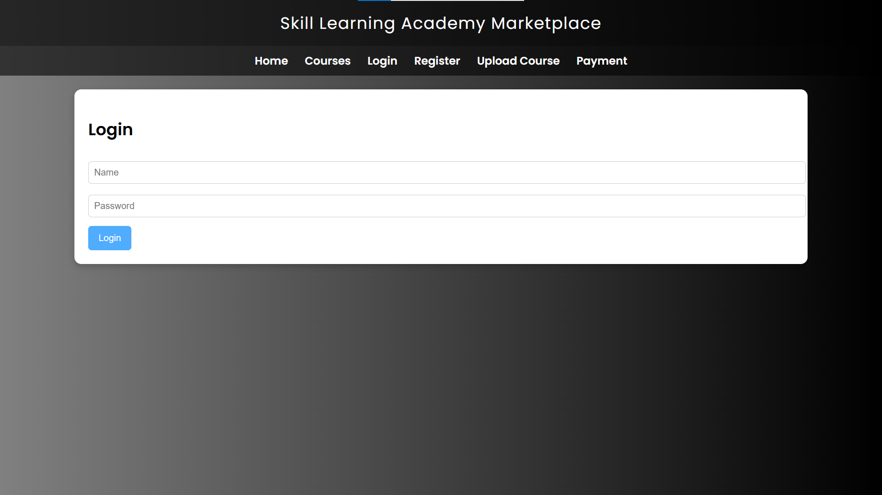
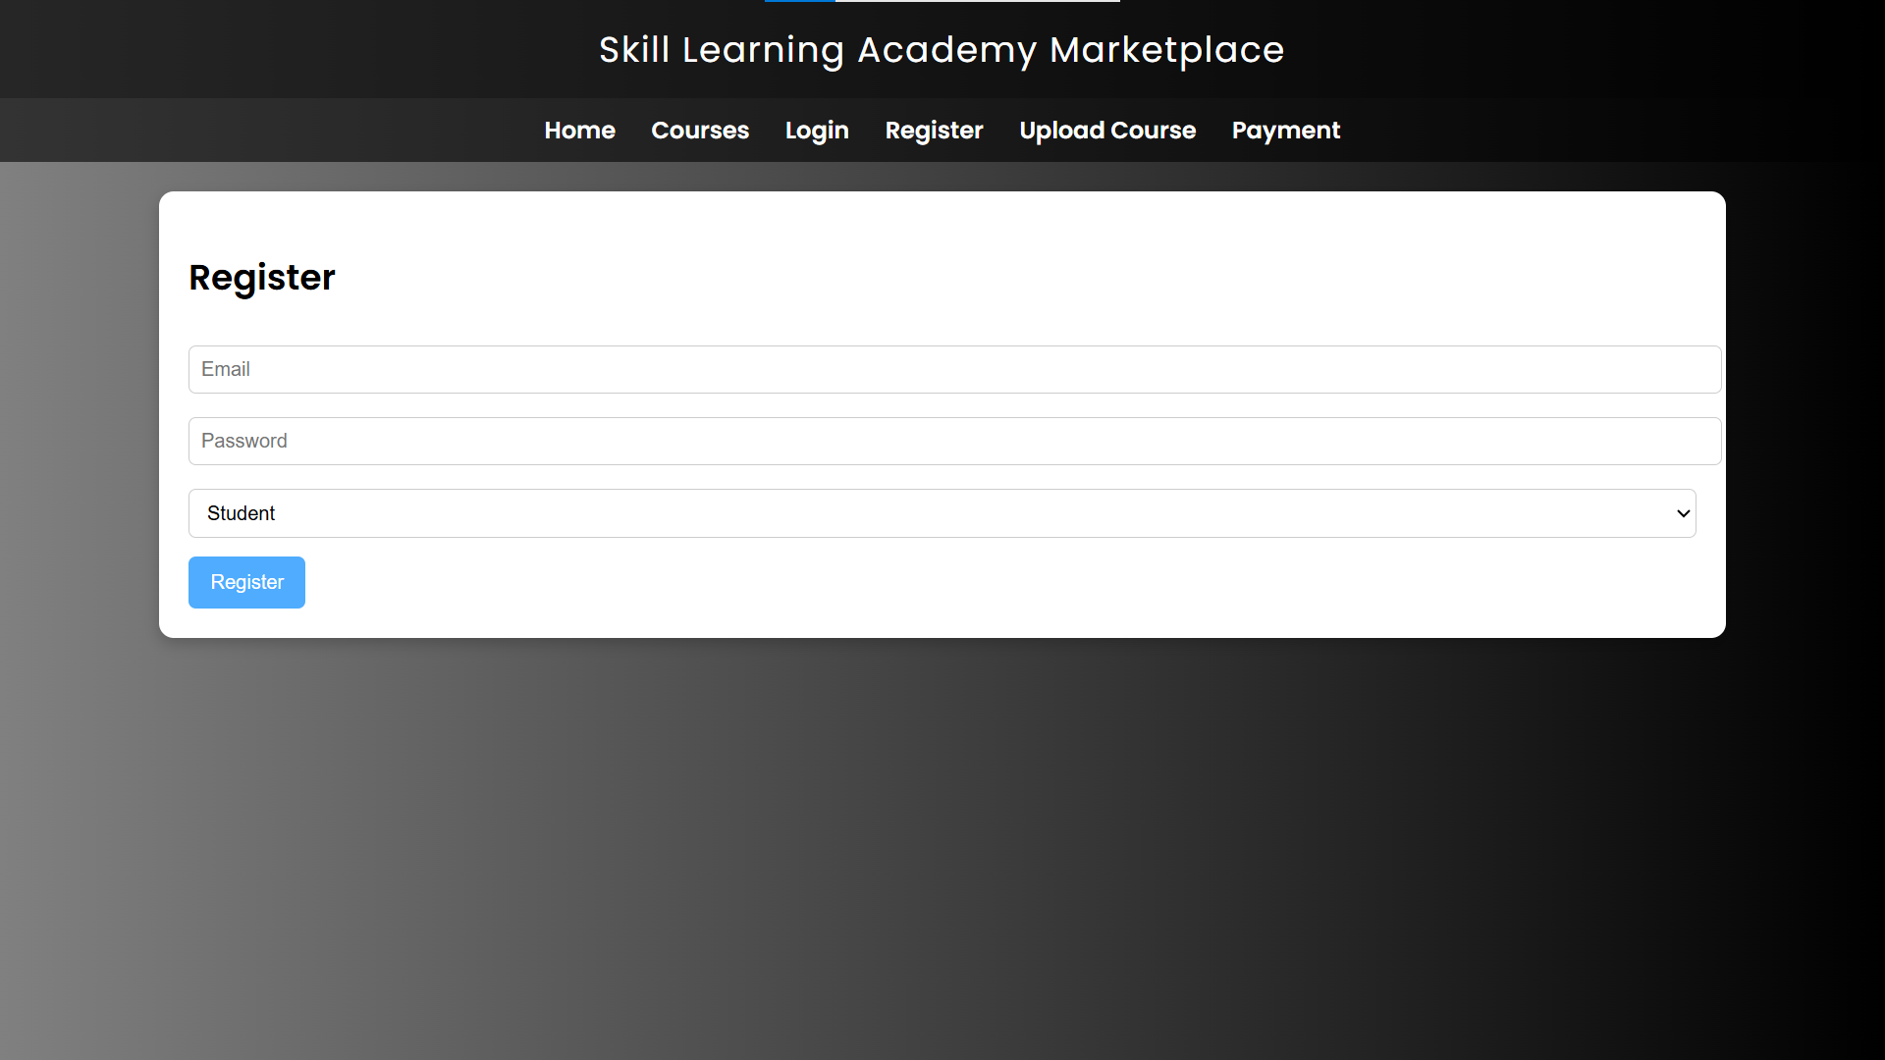
IMPLEMENTATION SCREENSHOTS
1
[Screenshot Placeholder]
[Screenshot Placeholder]
2
3
4
5
6
Login Page (login.php)
Register Page (register.php)
7
Simple sign-in form with password toggle, demo credential hint box, and redirect to dashboard on successful authentication.
Account creation form with name, email, role selector (Student/Instructor), password with confirmation, and validation.
8
9

Slide 12
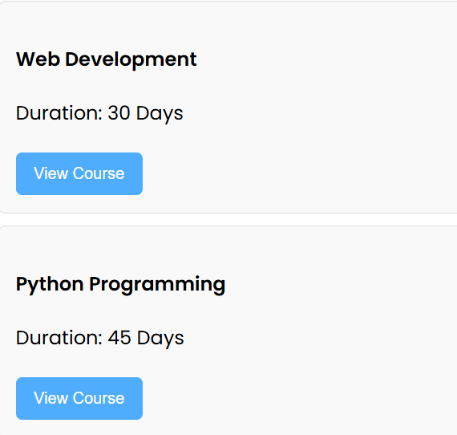
IMPLEMENTATION SCREENSHOTS
1
[Screenshot Placeholder]
[Screenshot Placeholder]
2
3
4
5
6
Dashboard (dashboard.php)
Course Detail (course-detail.php)
7
Greeting header, 3 stat cards (enrolled/completed/in-progress), enrolled course list, and recommended courses section.
Course hero, details table, about the instructor, student reviews, and sticky enroll card with one-click enrollment.
8
9

Slide 13
ADVANTAGES & LIMITATIONS
1
✔ ADVANTAGES
✖ LIMITATIONS
2
→ Clean, simple UI suitable for students and first-time users
→ No payment gateway — all courses are currently free only
3
→ Secure login with bcrypt password hashing and rate-limited login
→ Video content not supported; courses are text-description only
4
→ Role-based access — Student, Instructor, and Admin accounts
→ No mobile app — web platform only (though UI is responsive)
5
6
→ Course search and filter by keyword, category, and level
→ No real-time features; page must be refreshed for updates
7
→ One-click enrollment with dashboard progress tracking
→ Certificate generation not yet implemented in this milestone
8
→ Lightweight stack — runs on free XAMPP, no paid services needed
9

Slide 14
Thank you

