Slide 1

Vel Tech Rangarajan Dr. Sagunthala R&D Institute of Science and Technology
School of Computing
Department of Computer Science and Engineering
10211CS224 / FULL STACK APPLICATION DEVELOPMENT (JAVA)
PROJECT REVIEW : MILESTONE PROJECT – 1
Date: 24-03-2026
Relational Inventory Control & Stock Tracking System
SDG: SDG 9 – Industry, Innovation and Infrastructure
Presented By:
J.PRUDHVI RAJ – VTU25575– 23UECS0231
Courses Handling Faculty:
Dr. Hafizur Rahman

Slide 2
INTRODUCTION
- Inventory management is essential for businesses to track stock and avoid losses.
- Manual systems are time-consuming and prone to human errors.
- This project provides a digital solution for managing inventory efficiently.
- It helps in tracking stock levels, sales, and product details in real time.
- The system improves accuracy, reduces wastage, and saves time.
- It is useful for small and medium-scale businesses.
- The application is built using web technologies with a relational database.
- Overall, it simplifies inventory control and enhances decision-making.
1
2
3
4
5
6
7
8
9

Slide 3
PROBLEM STATEMENT
Many businesses still rely on manual or outdated systems to manage their inventory, which often leads to errors in stock tracking and data inconsistency. The lack of real-time updates results in issues such as overstocking or stock shortages. Manual record-keeping is time-consuming and inefficient, making it difficult to maintain accurate sales and product information. This poor inventory control negatively impacts business decision-making and overall efficiency. Additionally, there is no centralized system to handle all inventory operations effectively. Therefore, there is a need for a reliable and automated system to improve accuracy, efficiency, and overall inventory management.
1
2
3
4
5
6
7
8
9

Slide 4
OBJECTIVE(S)
The main objective of this project is to design and develop a web-based Relational Inventory Control and Stock Tracking System for efficient management of inventory operations. The system aims to reduce manual effort, improve accuracy, and provide real-time updates of stock levels. It also focuses on enhancing data organization, minimizing errors, and supporting better decision-making for businesses.
1
2
3
4
5
6
7
8
9

Slide 5
PROPOSED SYSTEM
The proposed system is a web-based Relational Inventory Control and Stock Tracking System designed to automate and simplify inventory management processes. It provides a centralized platform to manage product details, stock levels, and sales information efficiently. The system offers real-time updates, ensuring accurate tracking of inventory and reducing the chances of overstocking or shortages. It eliminates manual errors by maintaining organized digital records and improves overall efficiency. Additionally, the system enhances decision-making by providing reliable data and offers significant advantages over traditional manual systems in terms of speed, accuracy, and ease of use.
1
2
3
4
5
6
7
8
9

Slide 6
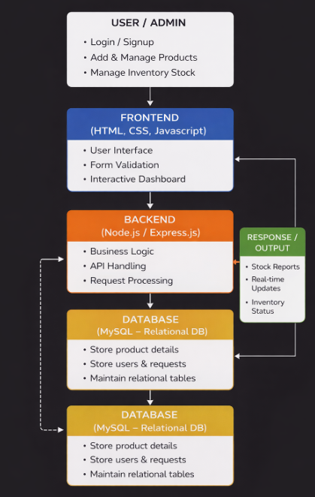
PROPOSED SYSTEM ARCHITECTURE
The proposed system architecture is designed as a web-based application consisting of input, processing, database, and output components. The input module allows users to enter product details, stock information, and sales data through a user-friendly interface. The processing unit handles data validation, updates stock levels, and manages inventory operations efficiently. All data is stored in a relational database, ensuring consistency, security, and easy retrieval of information. The output module provides real-time reports, stock status, and analysis, helping users make informed decisions. This architecture ensures smooth communication between components and enhances system performance and reliability.
1
2
3
4
5
6
7
8
9

Slide 7
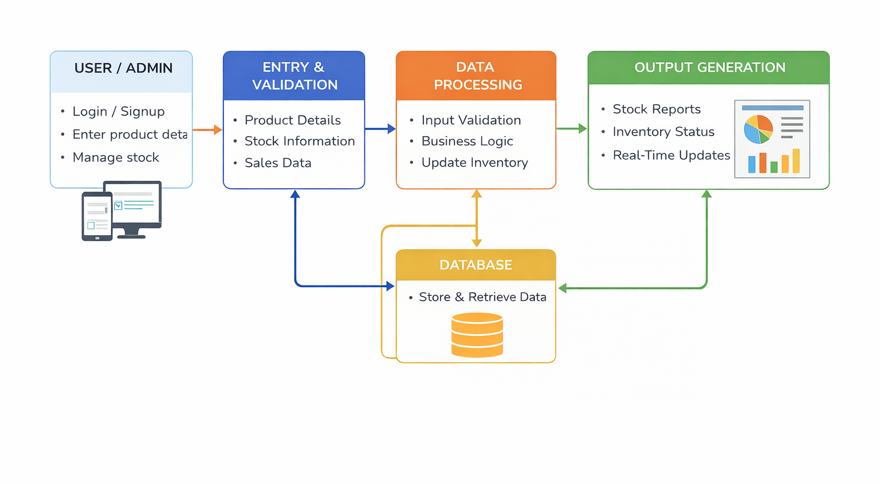
WORKFLOW
1
2
3
4
5
6
7
8
9

Slide 8
TECHNOLOGIES USED
TECHNOLOGIES USED
- Frontend: HTML, CSS, JavaScript
- Backend: node js
- Database: MySQL (Relational Database)
- Tools: VS Code, Web Browser (Chrome)
1
2
3
4
5
6
7
8
9

Slide 9
MODULE DESCRIPTION
MODULE DESCRIPTION
Module 1: User Management
Handles user registration, login, and authentication for admin and users, ensuring secure access to the system.
Module 2: Inventory Management
Manages product details, stock levels, adding, updating, and deleting items in the inventory.
Module 3: Stock Tracking
Monitors stock availability in real time and updates inventory based on sales and purchases.
Module 4: Database Management
Stores and retrieves data efficiently using a relational database while maintaining data integrity.
Module 5: Reporting & Analysis
Generates reports on stock status, sales, and inventory performance to support decision-making.
1
2
3
4
5
6
7
8
9

Slide 10
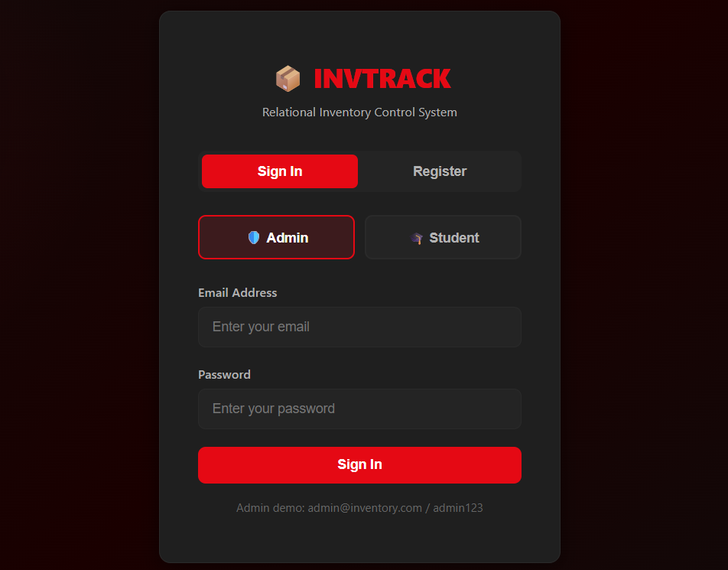
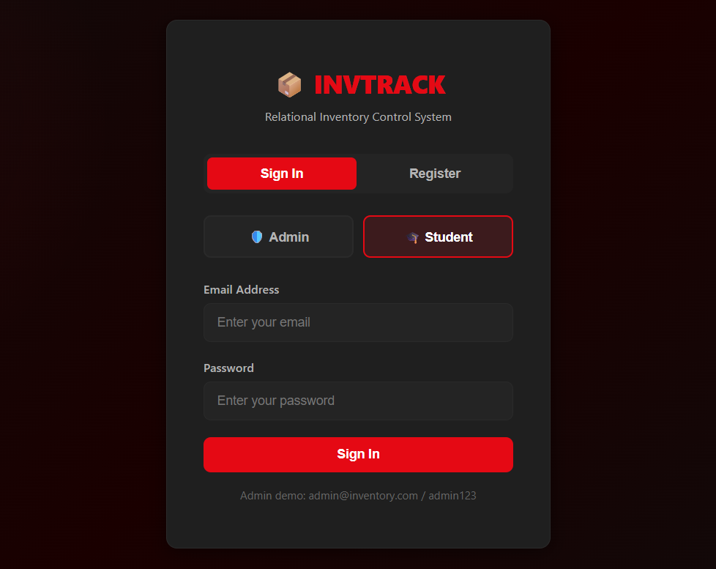
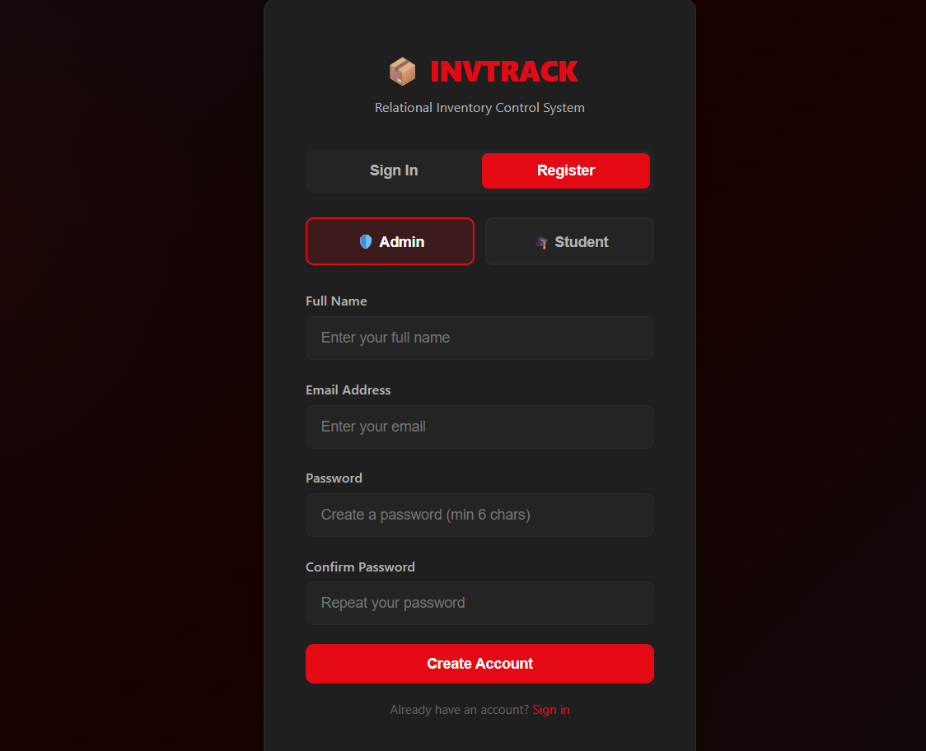
IMPLEMENTATION SCREENSHOTS
1
2
3
4
5
6
Admin Sign In:
Allows admin users to log in using email and password.
After successful authentication, admin can manage inventory, users, and system data.
Student Sign In:
Allows student users to log in using email and password.
After successful login, students can view and access inventory-related data based on their permissions.
7
8
9
Admin Register Page:
Allows admin users to create a new account by entering full name, email, and password.
After registration, admin can securely log in and manage inventory and system data.

Slide 11
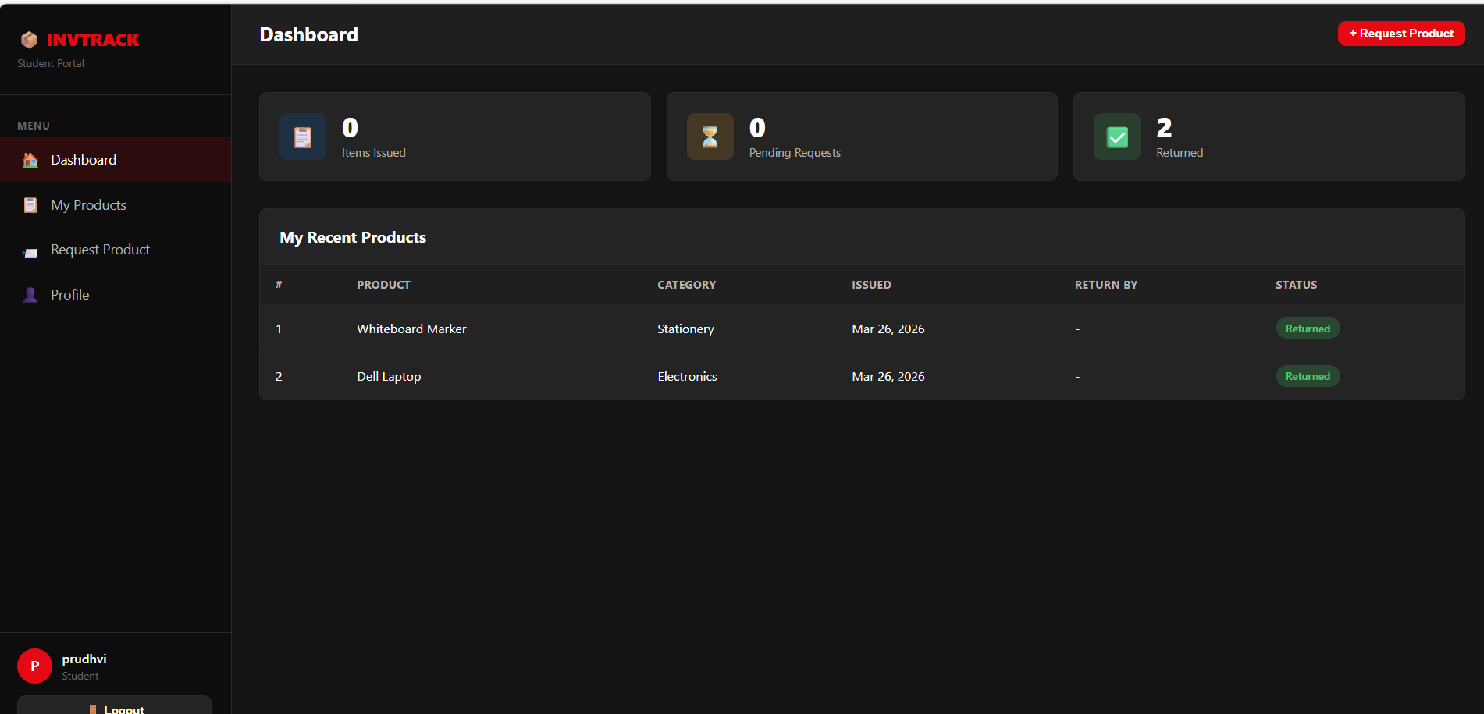
IMPLEMENTATION SCREENSHOTS
1
2
3
4
5
6
7
8(A)
Student Dashboard (Home Page):
Displays an overview of issued items, pending requests, and returned products.
Allows students to view recent products, request new items, and track their inventory activity.
9

Slide 12
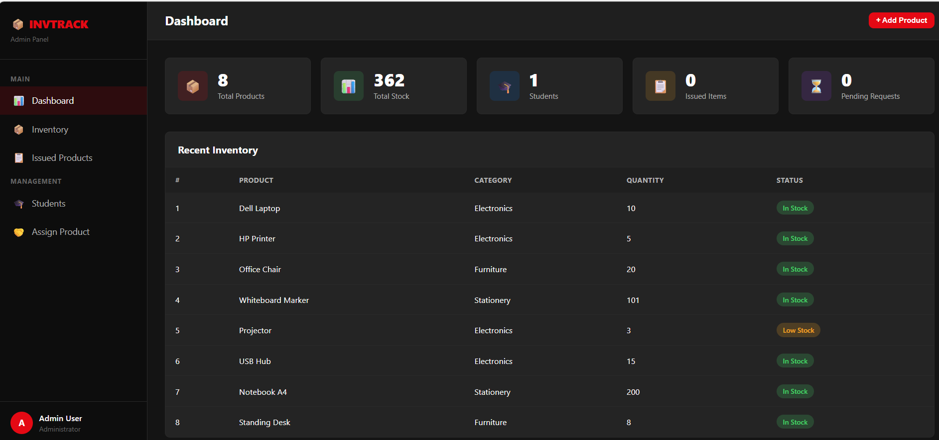
IMPLEMENTATION SCREENSHOTS
1
2
3
4
5
6
7
8(B)
9
Admin Dashboard:
Displays overall inventory details including total products, stock, students, and issued items.
Allows admin to manage inventory, assign products, and monitor stock status.
Provides real-time updates and easy access to recent inventory data for better decision making.

Slide 13
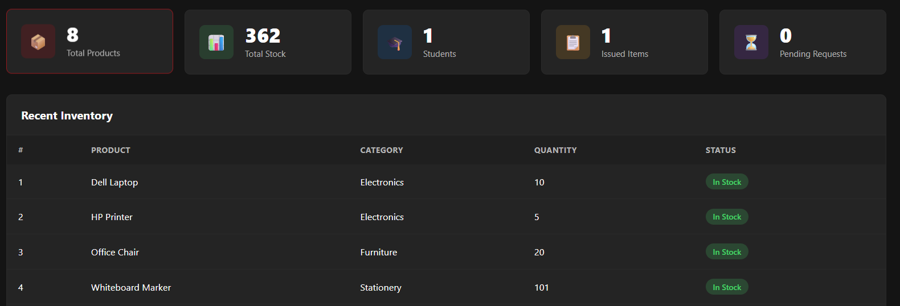
IMPLEMENTATION SCREENSHOTS
1
2
3
4
5
6
7
8(C)
Recent Inventory Section:
Displays recently added products with category, quantity, and stock status.
Helps admin quickly monitor available items and low stock levels.
Provides an organized view of inventory for easy tracking and management.
9

Slide 14
ADVANTAGES & LIMITATIONS
ADVANTAGES
- Reduces manual work and human errors
- Provides real-time stock updates
- Improves accuracy and efficiency
- Easy to use and manage
- Centralized data management system
LIMITATIONS
- Requires internet or local server setup
- Initial setup and configuration needed
- Limited scalability for very large businesses
- Depends on system maintenance and updates
1
2
3
4
5
6
7
8
9

Slide 15
Thank you

