Slide 1

Vel Tech Rangarajan Dr. Sagunthala R&D Institute of Science and Technology
School of Computing
Department of Computer Science and Engineering
10211CS224 / FULL STACK APPLICATION DEVELOPMENT (JAVA)
PROJECT REVIEW : MILESTONE PROJECT – 1
Date: 23-03-2026
Dynamic Online Examination & Result Processing System
SDG: SDG No –4 ( Quality Education)
Presented By:
D.CHINMAYI – VTU26449– Reg.No.23UECS0153
Courses Handling Faculty:
Dr. S. Hemamalini., M.E., Ph.D.
Assistant Professor (Senior Grade)

Slide 2
INTRODUCTION
Traditional examination systems are manual, time-consuming, and prone to errors in evaluation and result processing.
Managing large numbers of students, question papers, and results becomes difficult without automation.
This project is important because it ensures faster, accurate, and secure examination management.
It reduces paperwork, minimizes human errors, and saves time for institutions and students.
In the real world, schools, colleges, and competitive exam bodies require efficient online assessment platforms.
The system supports automated question generation, online test conduction, and instant result calculation.
It provides secure login, performance analysis, and result storage in a centralized database.
Overall, it improves transparency, efficiency, and reliability in the examination process.
1
2
3
4
5
6
7
8
9

Slide 3
PROBLEM STATEMENT
In many educational institutions, examination and result processing are still handled manually or through semi-automated systems.
This leads to delays in conducting exams, evaluating answer sheets, and publishing results.
Manual data entry increases the chances of errors, data loss, and lack of transparency.
Managing large numbers of students, question banks, and performance records becomes complex and time-consuming.
There is limited flexibility in generating dynamic question papers and analyzing student performance instantly.
Security issues such as paper leaks and unauthorized access also affect the reliability of exams.
Hence, there is a need for a secure, automated, and efficient online examination system.
The proposed system aims to conduct exams dynamically and process results quickly with accuracy and transparency.
1
2
3
4
5
6
7
8
9

Slide 4
OBJECTIVE(S)
To design and develop a secure web-based system for conducting dynamic online examinations and automated result processing.
To implement real-time evaluation and instant result generation with accurate performance analysis for students.
To improve the efficiency and accuracy of exam management by reducing manual work and minimizing errors.
To evaluate the performance of students through automated reports and analytical dashboards.
1
2
3
4
5
6
7
8
9

Slide 5
PROPOSED SYSTEM
The proposed system is a web-based platform that conducts online examinations and automatically processes results.
It provides secure login access for administrators, faculty, and students with role-based permissions.
The system generates dynamic question papers from a centralized question bank to reduce repetition and malpractice.
It performs automatic evaluation of objective-type answers and instantly calculates results.
The system stores all exam data, marks, and reports in a centralized database for easy access and management.
It solves existing issues such as manual errors, delayed result publication, and paper leakage risks.
Compared to traditional systems, it saves time, reduces paperwork, and improves transparency.
Overall, it offers higher accuracy, better security, real-time performance analysis, and efficient exam management.
1
2
3
4
5
6
7
8
9

Slide 6

PROPOSED SYSTEM ARCHITECTURE
Input: Student registration details, login credentials, exam information, question bank data, and student answers during the exam.
Processing: User authentication, dynamic question paper generation, automatic answer evaluation, marks calculation, and performance analysis.
Database: Stores student data, question bank, exam details, responses, and result records securely in a centralized system.
Output: Instant result display, mark sheets, performance reports, and administrative analysis reports.
1
2
3
4
5
6
7
8
9

Slide 7
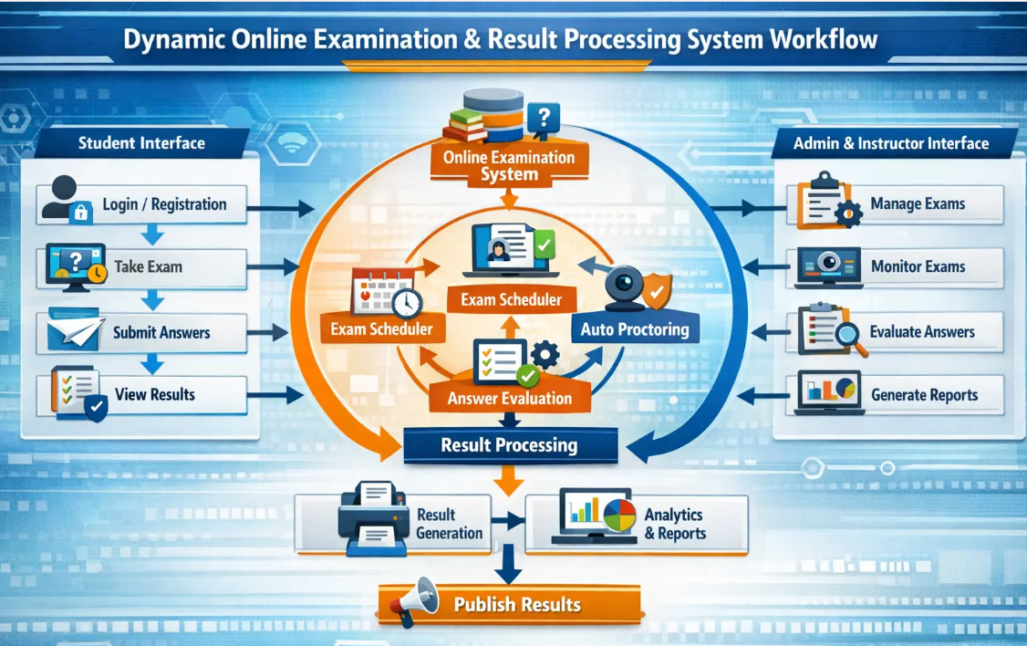
WORKFLOW
1
2
3
4
5
6
7
8
9

Slide 8
TECHNOLOGIES USED
Frontend: HTML, CSS, JavaScript (for user interface and responsive design).
Backend: Java for handling server-side logic and exam processing.
Database: MySQL for storing student details, question bank, exam data, and results.
Tools: VS Code for version control.
Hardware/Software Requirements: Minimum 4GB RAM, Windows/Linux OS, Web Browser (Chrome/Edge/Firefox), Stable Internet Connection.
1
2
3
4
5
6
7
8
9

Slide 9
MODULE DESCRIPTION
Module 1: User Management Handles student, faculty, and admin registration, login, and role-based authentication to ensure secure system access.
Module 2: Examination Management Manages exam creation, scheduling, dynamic question paper generation, and timer-based online test conduction.
Module 3: Evaluation & Result Processing Automatically evaluates objective answers, calculates marks, and generates instant results with performance analysis.
Module 4: Database & Reporting Management Stores student data, question banks, and result records securely, and generates detailed reports and analytical summaries for administrators.
1
2
3
4
5
6
7
8
9

Slide 10
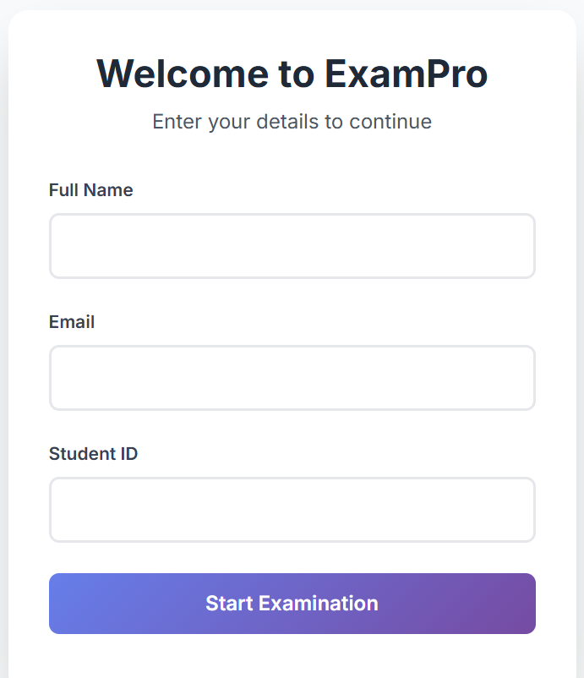
IMPLEMENTATION SCREENSHOTS
1
2
3
4
5
6
7
8
9
Explanation: The home page provides an overview of the system with navigation options like Login, Register, and Exam Information. It offers a user-friendly interface for easy access.

Slide 11
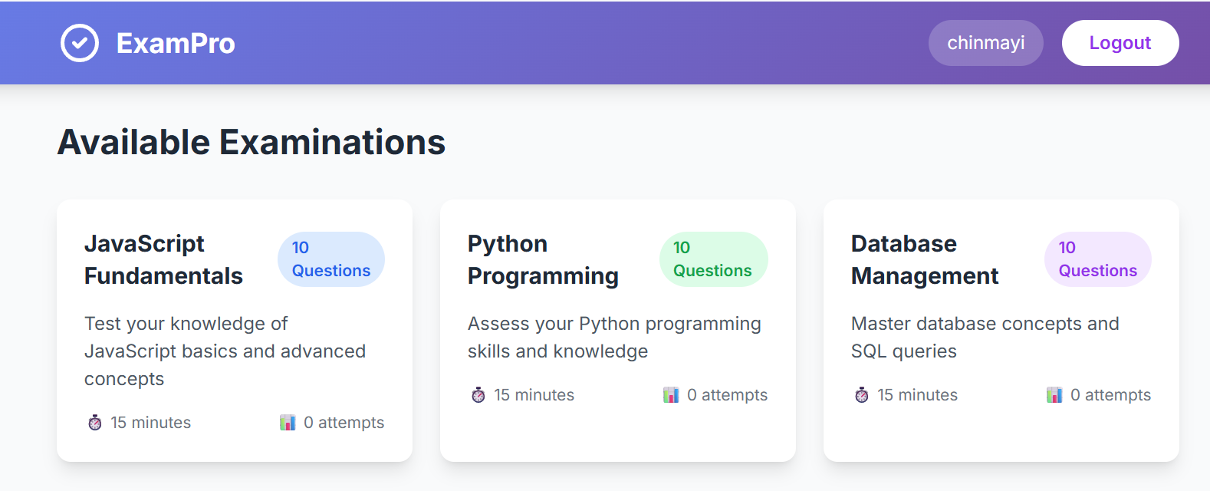
IMPLEMENTATION SCREENSHOTS
1
2
3
4
5
6
7
8(A)
9
Explanation:
This screenshot shows the Available Examinations dashboard where the student can choose a subject to start the online test.Each exam card displays details like number of questions, duration, and difficulty level with a secure logout option.

Slide 12
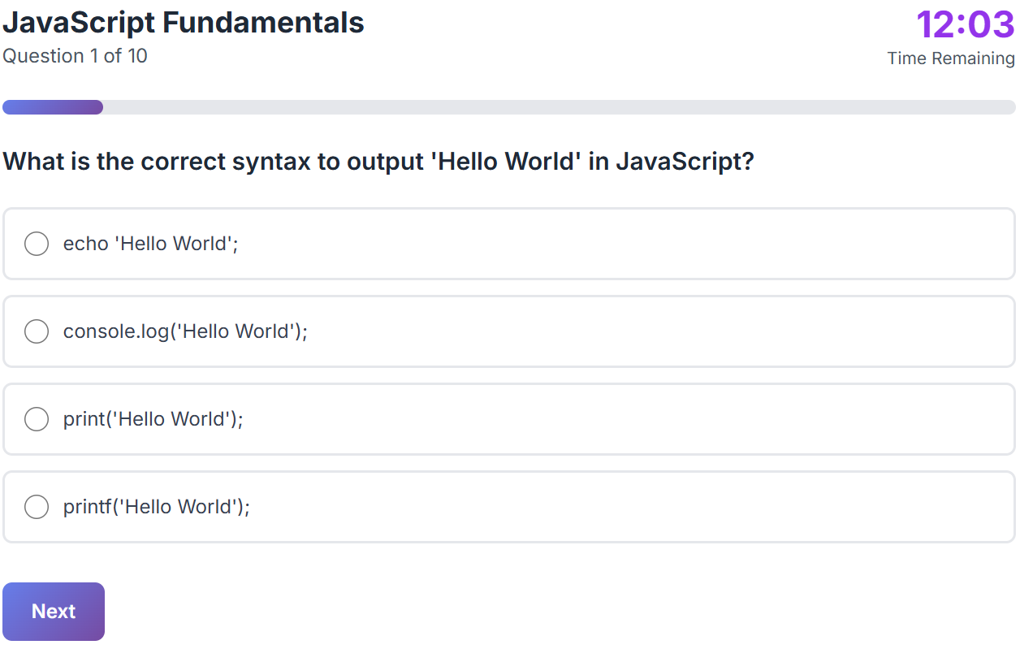
IMPLEMENTATION SCREENSHOTS
1
2
3
4
5
6
7
8(B)
9
Explanation: This page displays exam questions dynamically with options, a timer, and navigation controls for submitting answers.

Slide 13
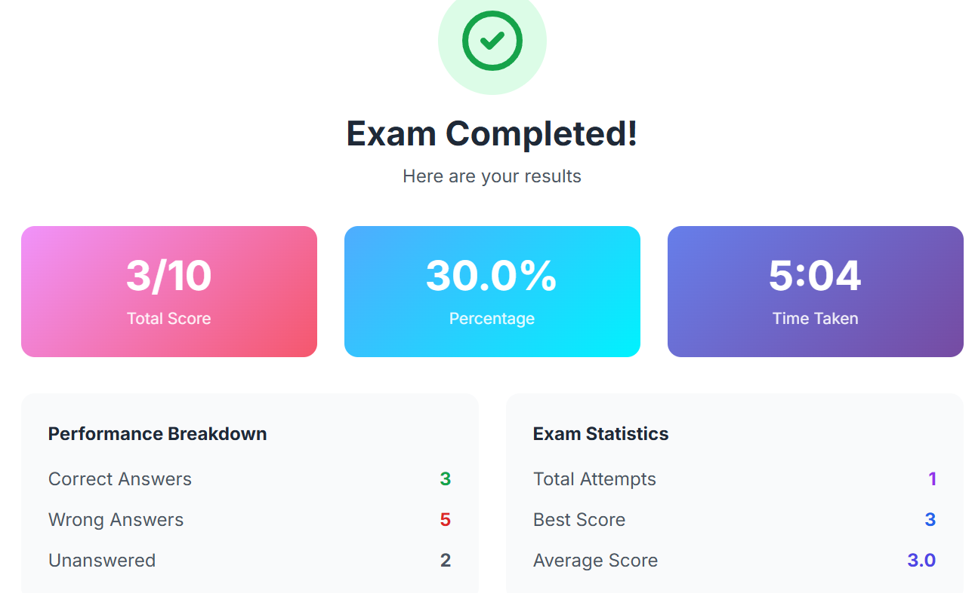
IMPLEMENTATION SCREENSHOTS
1
2
3
4
5
6
7
8(C)
9
Explanation: The output page shows instant results after submission, including total marks, performance summary, and detailed score analysis.

Slide 14
ADVANTAGES & LIMITATIONS
1
Advantages:
Reduces manual work and paperwork through full automation.
Provides instant result generation with high accuracy.
Ensures secure login and minimizes chances of paper leakage.
Saves time for students, faculty, and administrators.
Stores data centrally for easy access and performance analysis.
Limitations:
Requires stable internet connection for smooth operation.
Technical issues or server failure may affect exam conduction.
Limited evaluation for descriptive/subjective answers (if fully automated).
Initial setup and maintenance cost may be high.
2
3
4
5
6
7
8
9

Slide 15
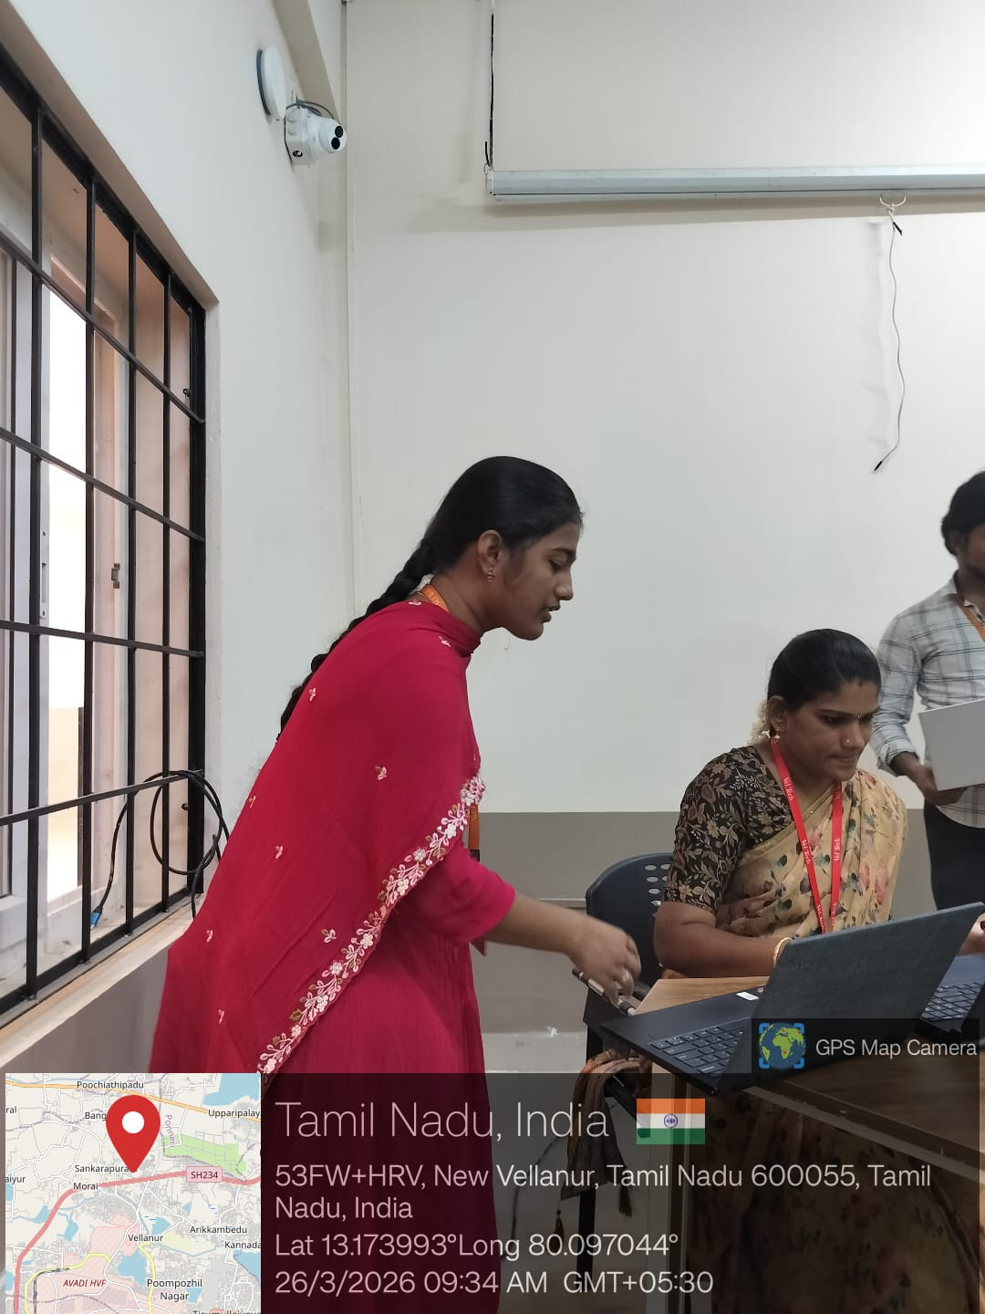

Slide 16
Thank you

