Slide 1

Vel Tech Rangarajan Dr. Sagunthala R&D Institute of Science and Technology
School of Computing
Department of Computer Science and Engineering
10211CS224 / FULL STACK APPLICATION DEVELOPMENT (JAVA)
PROJECT REVIEW : MILESTONE PROJECT – 2
Date: 20-04-2026
Smart Campus Event Management System
SDG: SDG 9: INDUSTRY, INNOVATION, AND INFRASTRUCTURE 🏗️
SDG 4 – Quality Education 🎓
Presented By:
D.CHINMAYI – VTU26449– Reg.No.23UECS0153
Courses Handling Faculty:
Dr. S. Hemamalini., M.E., Ph.D.
Assistant Professor (Senior Grade)

Slide 2
INTRODUCTION
The SMART CAMPUS MANAGEMENT SYSTEM is designed to digitally manage and automate campus operations.
It provides a centralized platform for students, faculty, and administrators to access services.
The system ensures efficient handling of academic, administrative, and resource management tasks.
It integrates modules like attendance, timetable, examination, library, and communication tools.
By reducing manual effort, it enhances accuracy, transparency, and real-time information sharing.
The system supports data-driven decision-making and improves overall campus productivity.
It creates a smart, connected environment that fosters innovation and smooth campus functioning.
1
2
3
4
5
6
7
8
9

Slide 3
PROBLEM STATEMENT
Traditional campus operations rely heavily on manual processes, leading to delays and inefficiencies.
Students face difficulties in accessing academic information and services in a unified manner.
Faculty and administrators struggle with managing attendance, examinations, and communication effectively.
Lack of integration between different campus modules results in data redundancy and poor transparency.
There is a need for a smart, centralized system that automates campus activities, ensures accuracy, and improves overall management efficiency.
1
2
3
4
5
6
7
8
9

Slide 4
OBJECTIVE(S)
To digitize and automate campus operations for improved efficiency and transparency.
To provide a centralized platform for students, faculty, and administrators.
To enable real-time access to academic and administrative information.
1
2
3
4
5
6
7
8
9

Slide 5
PROPOSED SYSTEM
The proposed SMART CAMPUS MANAGEMENT SYSTEM will serve as a centralized digital platform for managing campus activities.
It will automate academic, administrative, and resource management tasks to reduce manual effort.
Students will be able to access attendance, timetables, exam schedules, and library services in real time.
Faculty can manage classes, monitor student performance, and communicate efficiently through integrated tools.
Administrators will gain transparent access to data for decision-making and campus resource allocation.
The system will provide real-time notifications and updates to ensure smooth communication across the campus.
By integrating all modules, it will enhance efficiency, accuracy, and transparency in campus operations.
1
2
3
4
5
6
7
8
9

Slide 6
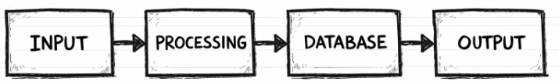
PROPOSED SYSTEM ARCHITECTURE
Input: Student details, faculty data, academic records, and administrative information
Processing: System automates attendance, timetables, exams, communication, and resource management.
Database: Stores student profiles, faculty records, course data, schedules, and campus resources securely.
Output: Real-time access to attendance, timetables, exam results, notifications, and reports.
1
2
3
4
5
6
7
8
9

Slide 7
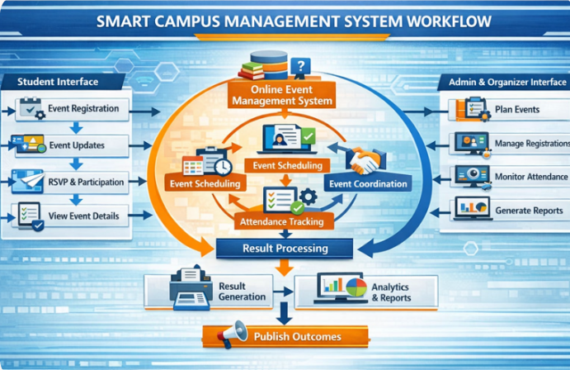
WORKFLOW
1
2
3
4
5
6
7
8
9

Slide 8
TECHNOLOGIES USED
Frontend: HTML, CSS, JavaScript (developed using Visual Studio Code).
Backend: PHP (for server‑side scripting and event management logic).
Database: MySQL (managed through MySQL Workbench).
Software Requirements: Visual Studio Code, MySQL Workbench, Web Browser.
1
2
3
4
5
6
7
8
9

Slide 9
MODULE DESCRIPTION
User Management: Handles student, faculty, and admin profiles with secure login and role-based access.
Event Management: Automates event creation, scheduling, registration, and participation tracking.
Attendance Management: Records and monitors event attendance in real time.
Communication Module: Sends notifications, updates, and reminders to participants and organizers.
Feedback & Evaluation: Collects participant feedback and generates reports for event improvement.
Report Generation: Provides analytics and summaries of events, attendance, and feedback data.
1
2
3
4
5
6
7
8
9

Slide 10
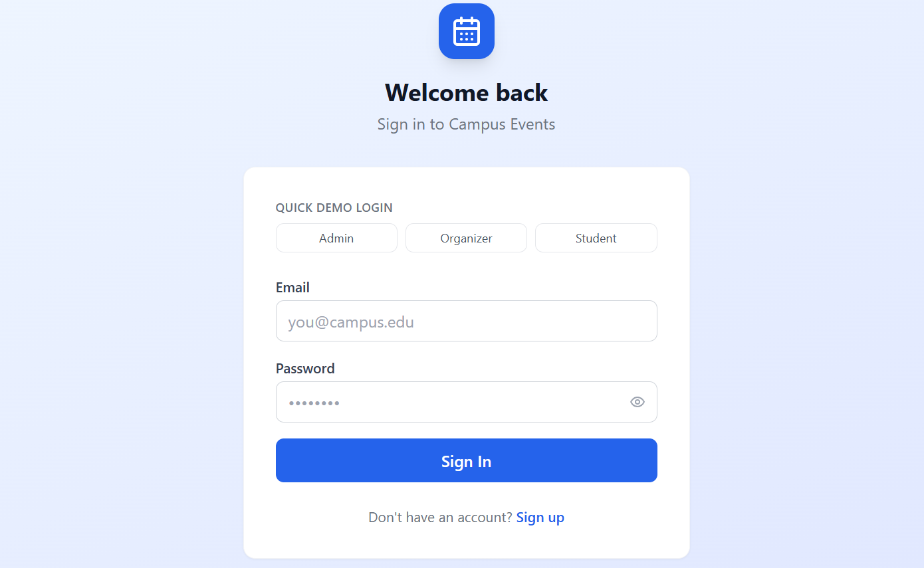
IMPLEMENTATION SCREENSHOTS
1
2
3
4
5
6
7
8
9
Explanation: This picture shows a Campus Events login page where users (Admin, Organizer, or Student) can sign in with their email and password to access event management features.

Slide 11
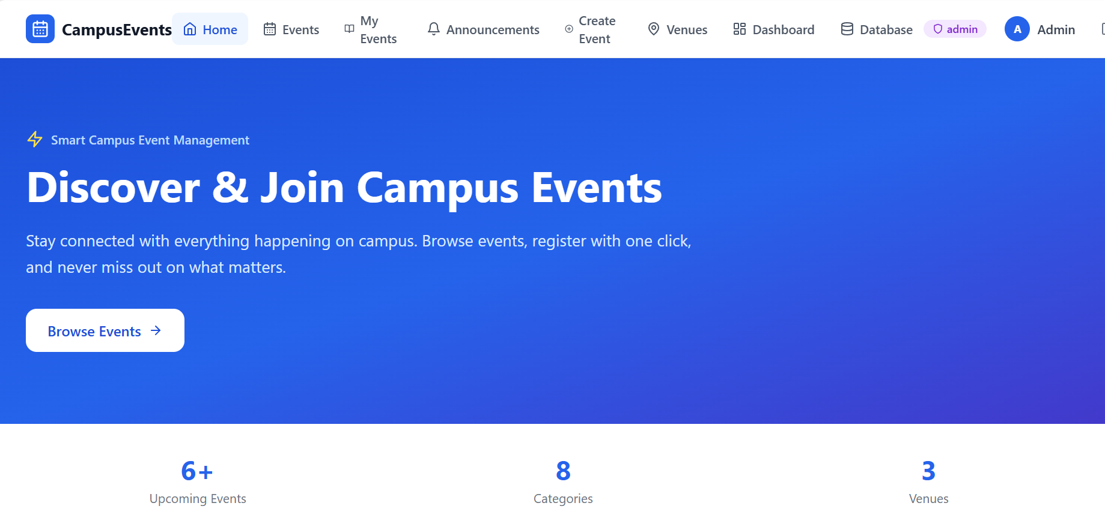
IMPLEMENTATION SCREENSHOTS
1
2
3
4
5
6
7
8(A)
9
Explanation:
This picture shows the Campus Events homepage where users can browse, register, and join upcoming campus events with real‑time details.

Slide 12
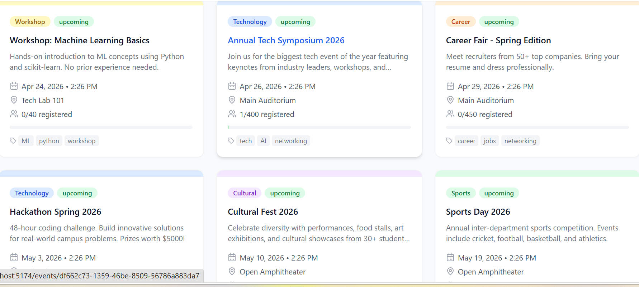
IMPLEMENTATION SCREENSHOTS
1
2
3
4
5
6
7
8(B)
9
Explanation: This picture shows a Campus Events dashboard displaying upcoming workshops, symposiums, career fairs, hackathons, cultural fests, and sports events with details like date, time, venue, registration count, and tags.

Slide 13
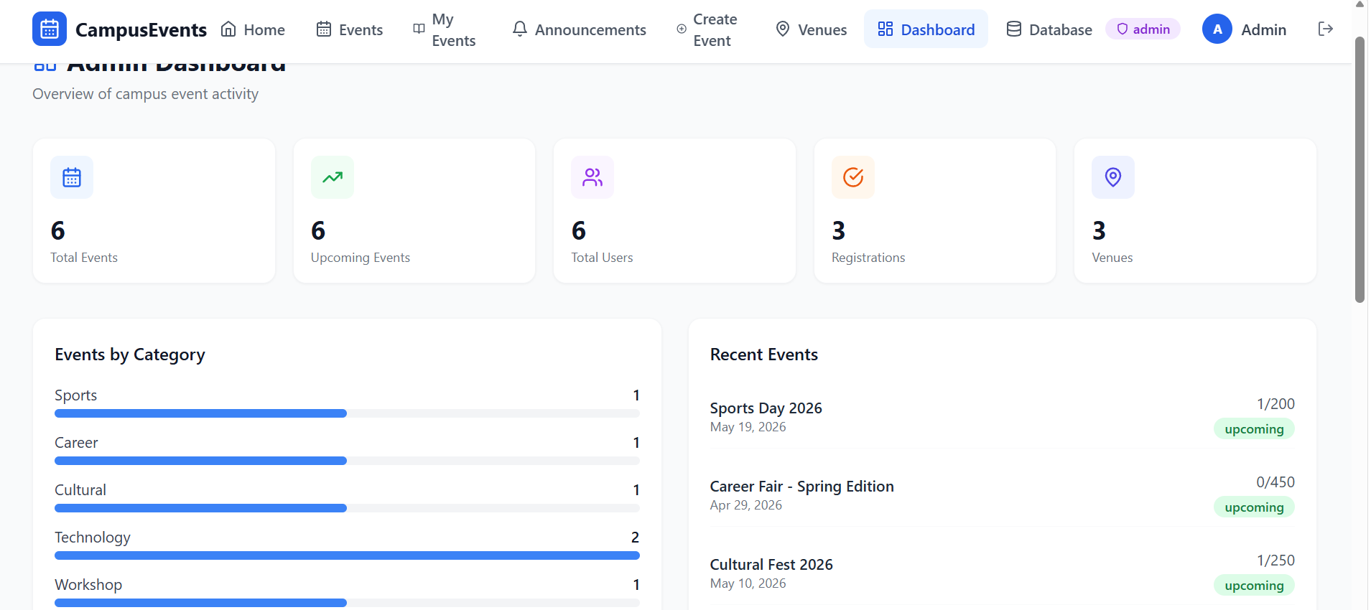
IMPLEMENTATION SCREENSHOTS
1
2
3
4
5
6
7
8(C)
9
Explanation: This picture shows the Campus Events admin dashboard, summarizing total events, users, registrations, venues, and categorizing upcoming events with real‑time statistics and recent activity.

Slide 14
ADVANTAGES & LIMITATIONS
Advantages:
Centralized platform for managing all campus events.
Easy registration and participation tracking for students.
Real‑time notifications and updates for organizers and participants.
Transparent attendance monitoring and feedback collection.
Saves time and reduces manual effort in event coordination.
Limitations:
Requires stable internet connectivity for smooth functioning.
Data security risks if not properly managed.
Limited to registered users only.
May face technical issues or downtime during peak usage.
Initial setup and training may require extra effort.
1
2
3
4
5
6
7
8
9

Slide 15
Thank you

