Slide 1

Vel Tech Rangarajan Dr. Sagunthala R&D Institute of Science and Technology
School of Computing
Department of Computer Science and Engineering
10211CS224 / FULL STACK APPLICATION DEVELOPMENT (JAVA)
PROJECT REVIEW : MILESTONE PROJECT – 2
Date: 21-04-2026
Job Portal Management System
SDG:SDG 8 – Decent Work and Economic Growth
Presented By:
A.Reshmitha – VTU26450 – Reg.No.23UECS0057
Courses Handling Faculty:
Dr. K. Seethalakshmi,M.E,ph.D.,
Associate Professor

Slide 2
INTRODUCTION
1
A Job Portal Management System is a web-based application designed to connect job seekers and employers on a single platform. In today’s digital world, recruitment processes are shifting online for faster and more efficient hiring. This system allows students to create profiles, upload resumes, and apply for jobs easily. Employers can post job openings and manage applications efficiently. The platform reduces manual effort and improves accessibility. It provides a centralized system for job searching and recruitment. This project is important for simplifying hiring workflows. It has real-world relevance in education institutions and companies.
2
3
4
5
6
7
8
9

Slide 3
PROBLEM STATEMENT
1
2
Many existing job application systems are either manual or poorly organized, making it difficult for students to find relevant job opportunities. Employers also face challenges in managing large numbers of applications efficiently. Lack of automation leads to time-consuming processes and errors. There is no centralized platform for students and employers to interact easily. Tracking application status is also difficult. Hence, there is a need for a simple, automated, and efficient job portal system.
3
4
5
6
7
8
9

Slide 4
OBJECTIVE(S)
1
To design and develop a web-based Job Portal Management System
To implement secure login with role-based access
To enable job posting and management for employers
To provide job search and filtering options for students
2
3
4
5
6
7
8
9

Slide 5
PROPOSED SYSTEM
1
Provides a centralized platform for job seekers and employers
Enables students to register, upload resumes, and apply for jobs
Allows employers to post, update, and delete job listings
Supports job filtering based on skills, location, and experience
Tracks application status (Applied, Shortlisted, Rejected)
Ensures secure login with role-based access
Reduces manual work and improves efficiency
Provides better communication between users
2
3
4
5
6
7
8
9

Slide 6
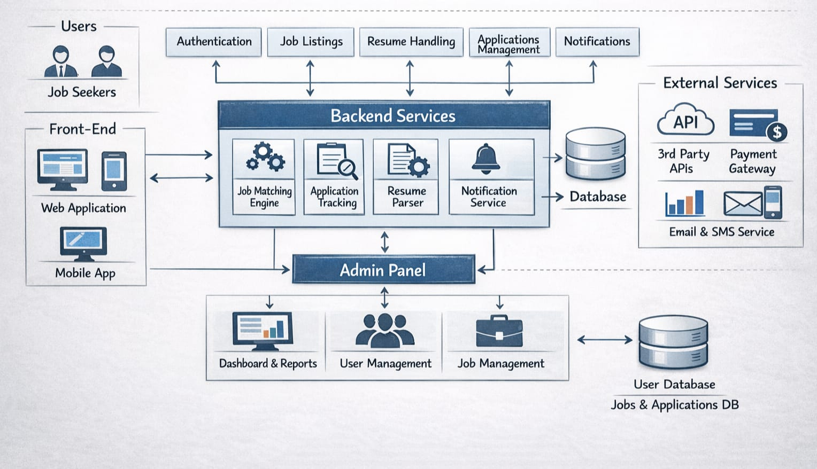
PROPOSED SYSTEM ARCHITECTURE
1
2
3
4
5
6
7
8
9

Slide 7
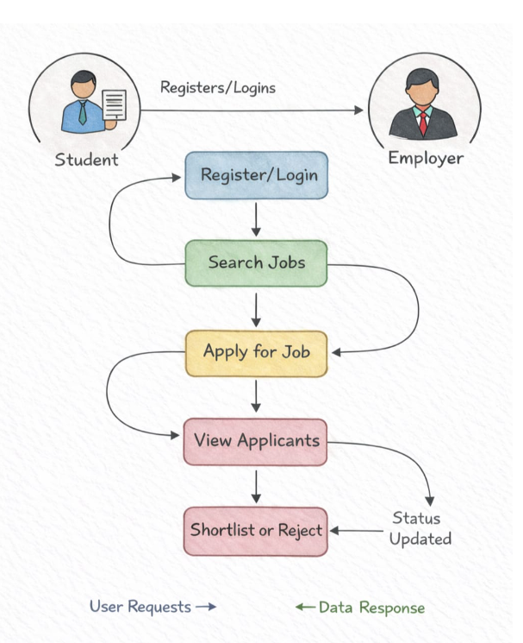
WORKFLOW
1
2
3
4
5
6
7
8
9

Slide 8
TECHNOLOGIES USED
1
Frontend: HTML5, CSS3, Thymeleaf, JavaScript
Backend: Spring Boot, Spring MVC
Database: MySQL / H2
Tools: Eclipse/ Maven
Server: Apache Tomcat (embedded)
2
3
4
5
6
7
8
9

Slide 9
MODULE DESCRIPTION
1
Module 1: User Management
Handles user registration, login, and profile management for students and employers. Provides secure authentication and role-based access. Students can upload resumes, and employers can manage their profiles.
Module 2: Job Management
Allows employers to post, update, and delete job listings. Job seekers can browse and filter jobs based on skills, location, and experience.
Module 3: Application Management
Manages job applications and tracks status (Applied, Shortlisted, Rejected). Employers can view applicants and shortlist or reject candidates.
2
3
4
5
6
7
8
9

Slide 10
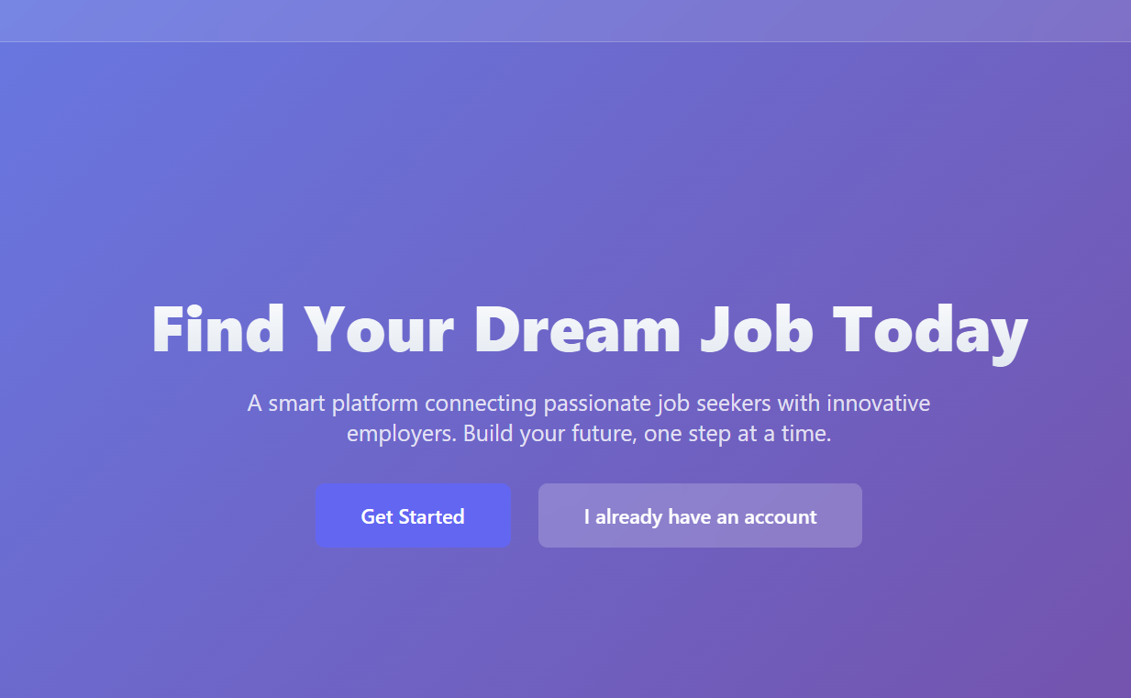
IMPLEMENTATION SCREENSHOTS
1
2
3
4
5
6
7
8
9

Slide 11
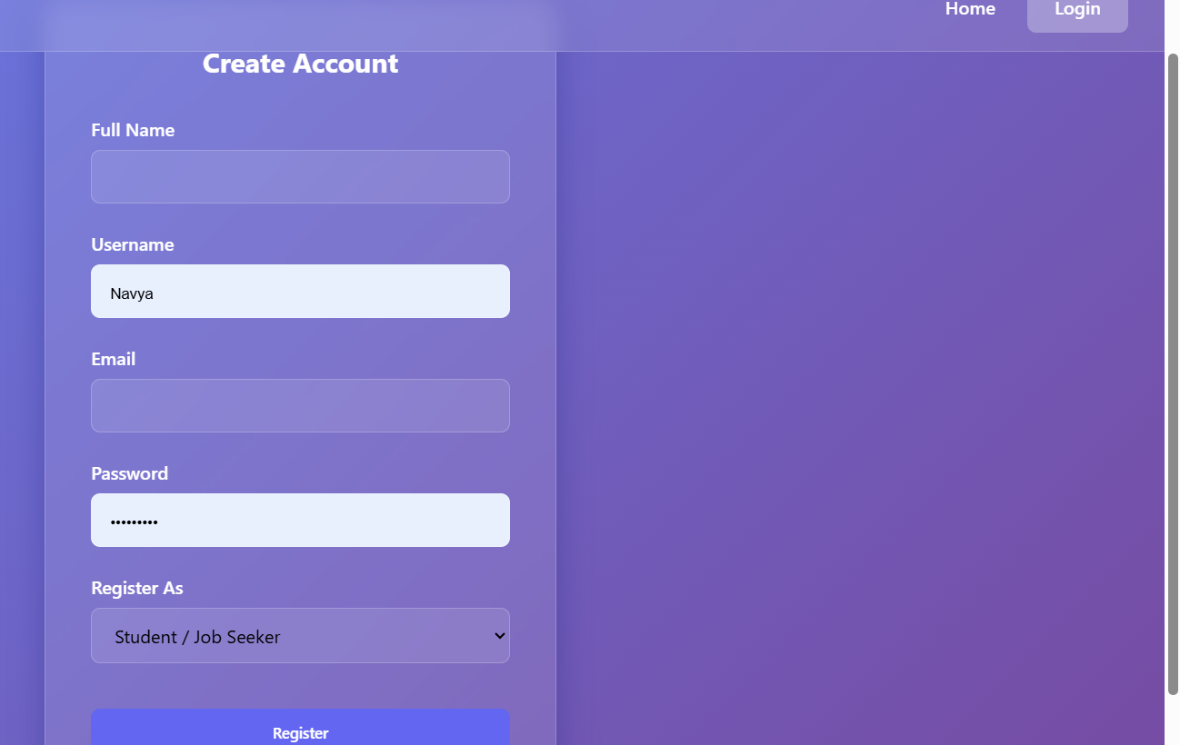
IMPLEMENTATION SCREENSHOTS
1
2
3
4
5
6
7
8(A)
9

Slide 12
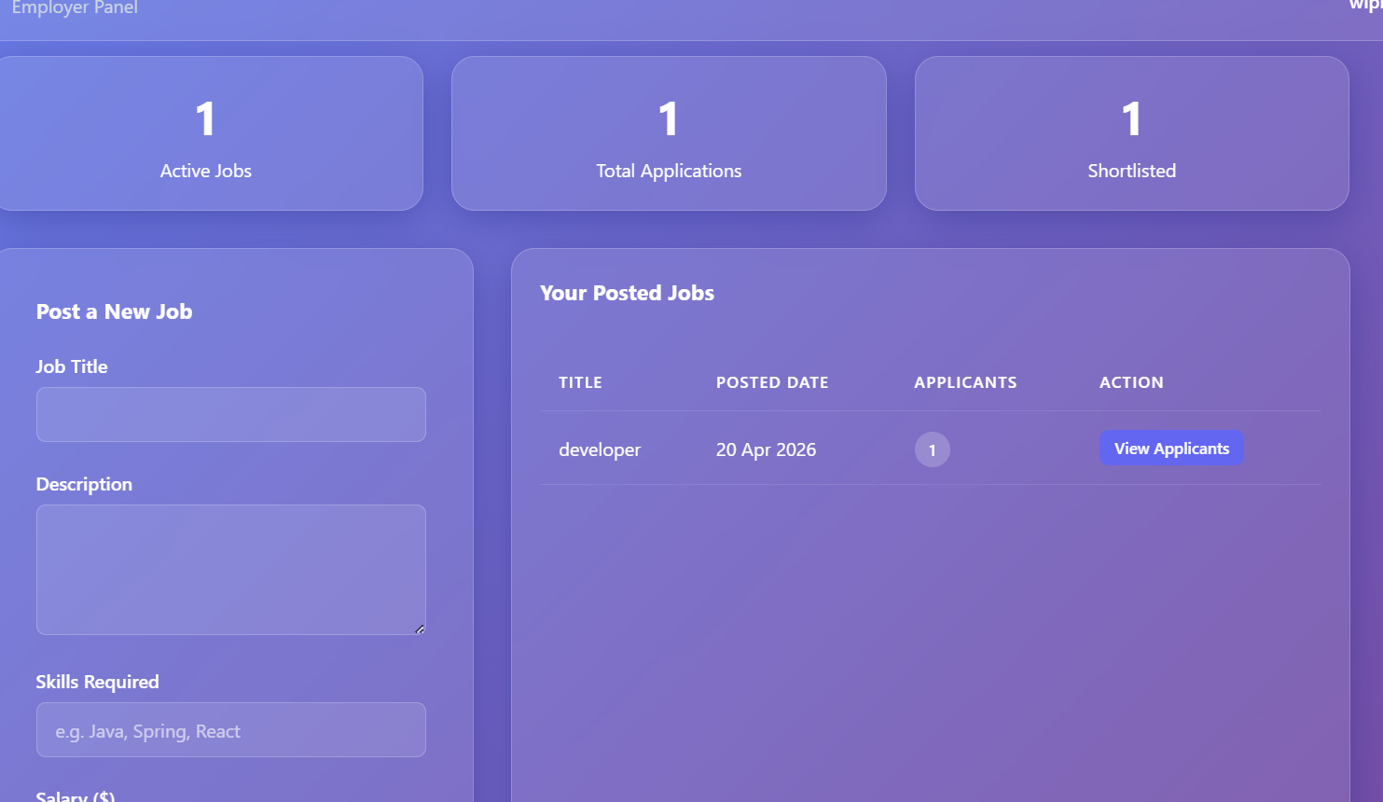
IMPLEMENTATION SCREENSHOTS
1
2
3
4
5
6
7
8(B)
9

Slide 13
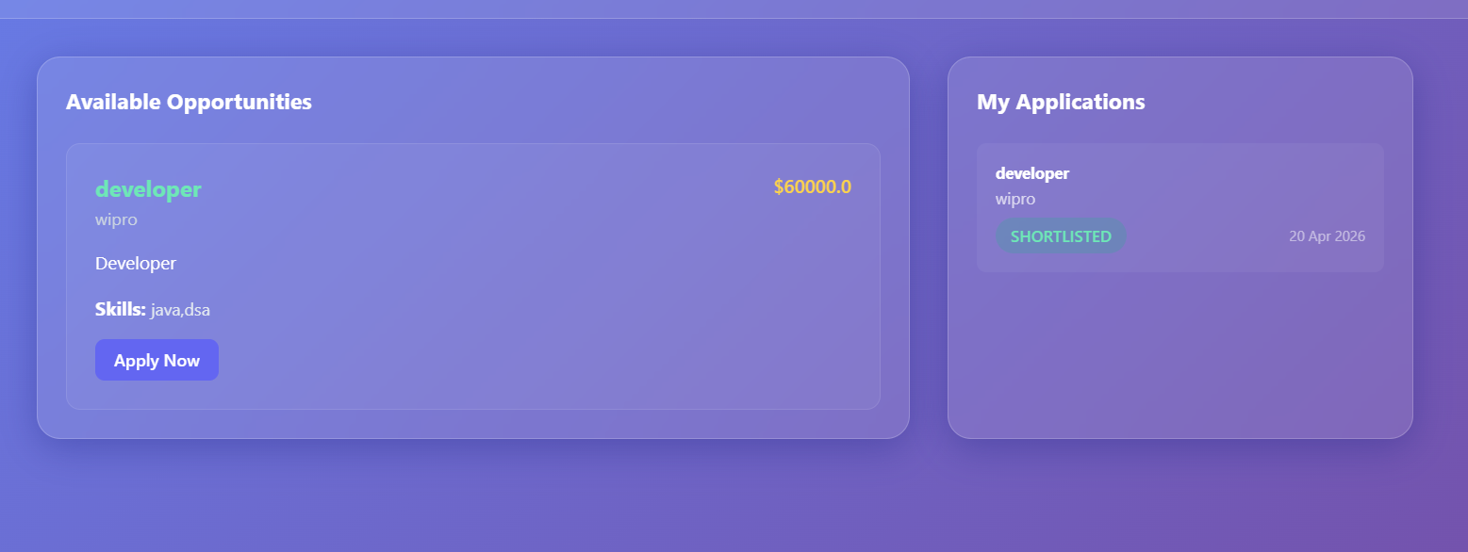
IMPLEMENTATION SCREENSHOTS
1
2
3
4
5
6
7
8(C)
9

Slide 14
ADVANTAGES & LIMITATIONS
1
Advantages:
Easy job search and application
Saves time for both students and employers
Centralized system for recruitment
Secure and role-based access
Scalable and user-friendly
Limitations:
Requires internet connection
Basic version may not include advanced analytics
Email notifications may require additional setup
2
3
4
5
6
7
8
9

Slide 15
Thank you

