Slide 1

Vel Tech Rangarajan Dr. Sagunthala R&D Institute of Science and Technology
School of Computing
Department of Computer Science and Engineering
10211CS224 / FULL STACK APPLICATION DEVELOPMENT (JAVA)
PROJECT REVIEW : MILESTONE PROJECT – 1
Date: 23-03-2026
End-to-End Event Lifecycle & Ticketing Platform
SDG: SDG No – SDG: SDG 9 – Industry, Innovation and Infrastructure
Presented By:
LAMBU SESHASAI– VTU26580 – Reg.No:23UECS0307
Courses Handling Faculty:
Dr.HAFIZUR RAHMAN - Designation

Slide 2
INTRODUCTION
The increasing number of events such as concerts, seminars, and workshops has made event management more complex, highlighting the limitations of traditional manual systems. These methods often lead to inefficiencies, errors, and lack of proper coordination. This project is important as it introduces a centralized digital platform that simplifies event planning, ticketing, and management processes. In real-world applications, it benefits event organizers, businesses, and participants by saving time and improving accessibility. The system provides an end-to-end solution including event creation, online ticket booking, secure payment integration, and real-time notifications. It ensures transparency, better organization, and user convenience. Overall, the platform addresses modern event management challenges through technology-driven innovation.
1
2
3
4
5
6
7
8
9

Slide 3
PROBLEM STATEMENT
In many event management scenarios, existing systems rely heavily on manual processes for organizing events, selling tickets, and maintaining records. This often results in inefficiencies, data errors, lack of coordination, and poor user experience. Additionally, there is limited transparency in ticket availability and payment handling. These challenges make it difficult for organizers to manage events smoothly and for users to access reliable information. Therefore, there is a need for a centralized, automated, and user-friendly platform. Such a system can improve accuracy, reduce manual effort, and enhance overall efficiency. It should provide seamless event lifecycle management from planning to ticketing and execution. Overall, the problem highlights the necessity for a modern digital solution in event management.
1
2
3
4
5
6
7
8
9

Slide 4
OBJECTIVE(S)
1
2
1. To design and develop an end-to-end event lifecycle and ticketing platform for efficient event management.
2. To implement a secure and user-friendly system for online ticket booking, payment processing, and real-time updates.
3
4
5
6
7
8
9

Slide 5
PROPOSED SYSTEM
1. The proposed solution is an end-to-end event lifecycle and ticketing platform that manages event creation, promotion, ticket booking, and execution in a single system.
2. It replaces manual processes with automation, reducing errors and improving efficiency in managing events and user data.
3. The system provides real-time ticket availability and instant booking confirmation, solving issues of overbooking and delays.
4. Secure online payment integration ensures safe and transparent financial transactions for both organizers and users.
5. It offers centralized data management, making it easier to track attendees, sales, and event performance.
6. The platform improves communication through notifications and updates, enhancing user experience.
7. Compared to existing systems, it is more scalable, user-friendly, and accessible from anywhere.
8. Overall, it saves time, reduces operational costs, and provides a reliable digital solution for modern event management.
1
2
3
4
5
6
7
8
9

Slide 6
PROPOSED SYSTEM ARCHITECTURE
+-------------------+
| Users |
| (Attendees/Admin) |
+---------+---------+
|
v
+------------------------+
| User Interface (UI) |
| (Web / Mobile App) |
+---------+--------------+
|
v
+------------------------+
| Authentication & |
| User Management |
+---------+--------------+
|
v
+------------------------+
| Event Management |
| (Create, Update Event) |
+---------+--------------+
|
v
+------------------------+
| Ticketing System |
| (Booking, Pricing, QR) |
+---------+--------------+
|
v
+------------------------+
| Payment Gateway |
| (UPI / Card / Wallet) |
+---------+--------------+
|
v
+------------------------+
| Database |
| (Users, Events, Tickets|
| Transactions) |
+---------+--------------+
|
v
+------------------------+
| Notifications System |
| (Email / SMS Alerts) |
+---------+--------------+
|
v
+------------------------+
| Reporting & Analytics |
| (Sales, Attendance) |
+------------------------+
1
2
3
4
5
6
7
8
9

Slide 7
WORKFLOW
+----------------------+
| USER |
| (Attendee / Host) |
+----------+-----------+
|
v
+--------------------------+
| Registration / Login |
+-----------+--------------+
|
v
+--------------------------+
| Event Browsing |
+-----------+--------------+
|
v
+--------------------------+
| Booking System |
+-----------+--------------+
|
v
+----------------------+
| DATABASE |
| (Users, Events, |
| Bookings) |
+----------+-----------+
^
|
+------------+-------------+
| Event Management |
+------------+-------------+
^
|
+----------------------+
| ADMIN |
+----------------------+
1
2
3
4
5
6
7
8
9

Slide 8
TECHNOLOGIES USED
Frontend:
HTML, CSS, JavaScript
React.js / Angular (for dynamic UI)
Backend:
Node.js with Express.js / Django / Spring Boot
Database:
MySQL / PostgreSQL (Relational Database)
MongoDB (for flexible data storage)
Tools:
VS Code / IntelliJ IDEA (Development IDE)
Hardware/Software Requirements:
Database Server (MySQL / MongoDB)
Operating System: Windows / Linux / macOS
1
2
3
4
5
6
7
8
9

Slide 9
MODULE DESCRIPTION
Module 1: User Management
Handles registration, login, and secure authentication..
Module 2: Core Processing
Implements the main business logic and processes user inputs efficiently.
Module 3: Database Management
Manages data storage, retrieval, and ensures data integrity.
Module 4: Reporting & Analytics
Generates reports and visual insights for better decision-making.
1
2
3
4
5
6
7
8
9

Slide 10
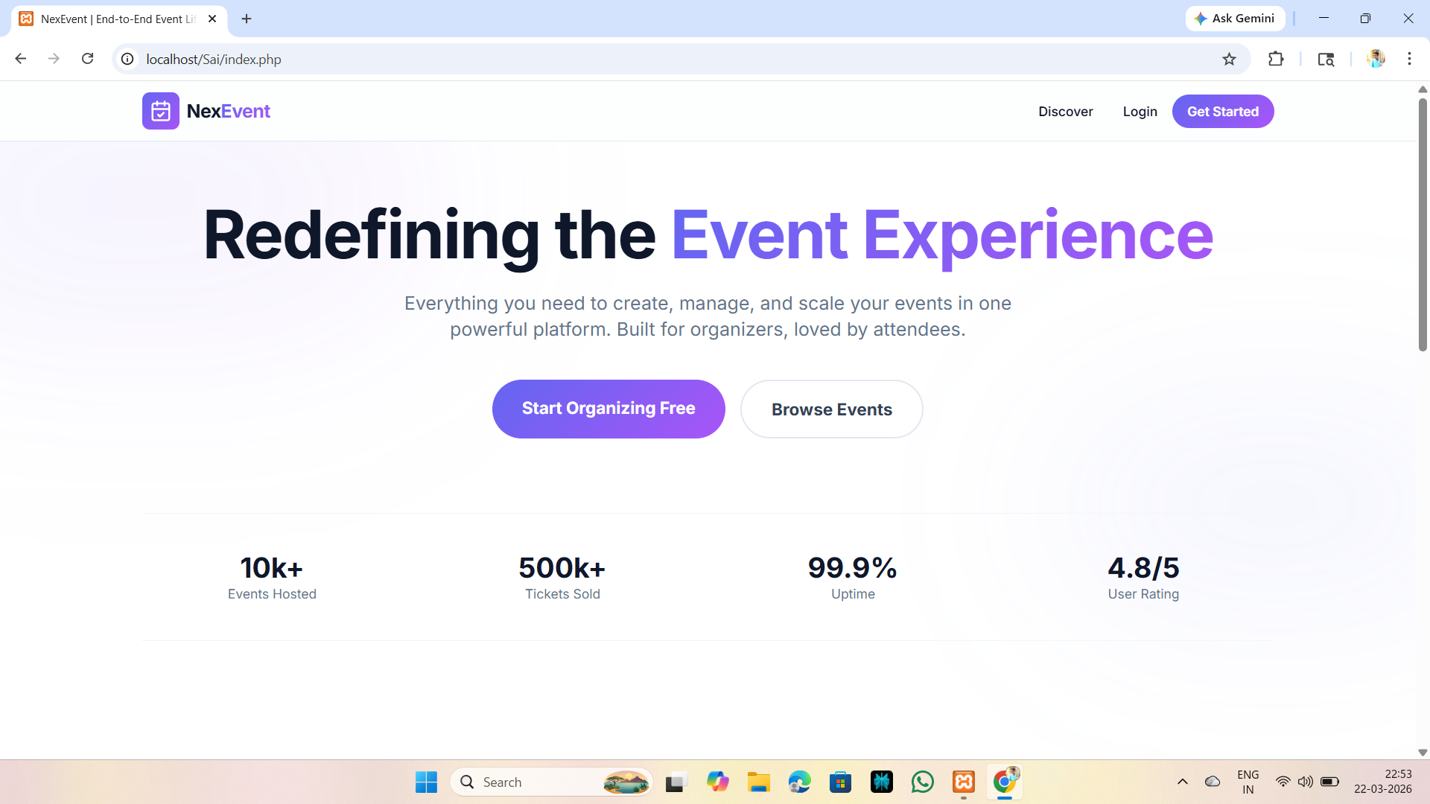
IMPLEMENTATION SCREENSHOTS
1
Home page:
2
3
4
5
6
7
8
9

Slide 11
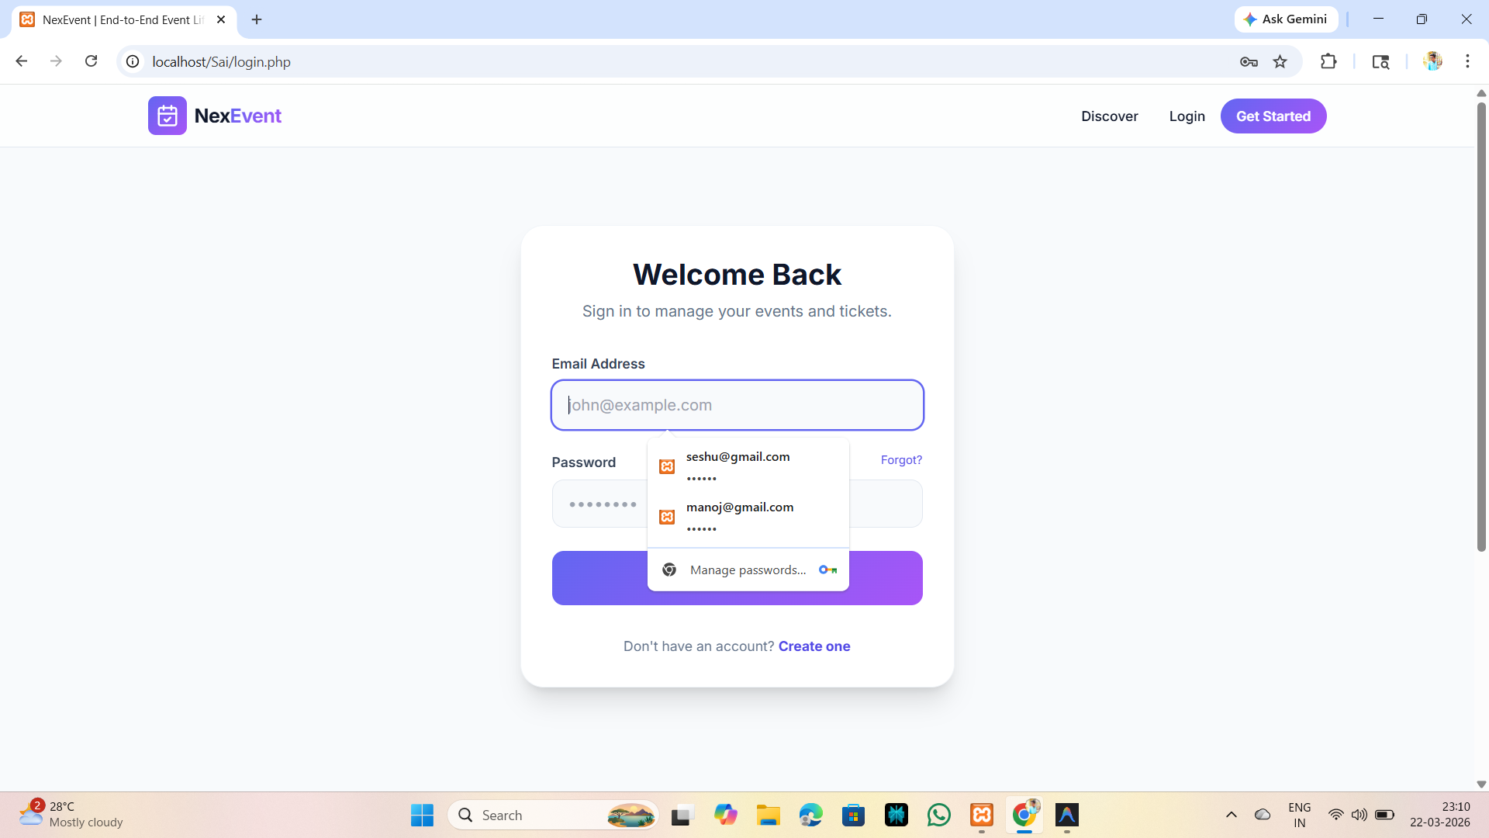
IMPLEMENTATION SCREENSHOTS
Login page:
1
2
3
4
5
6
7
8(A)
9

Slide 12
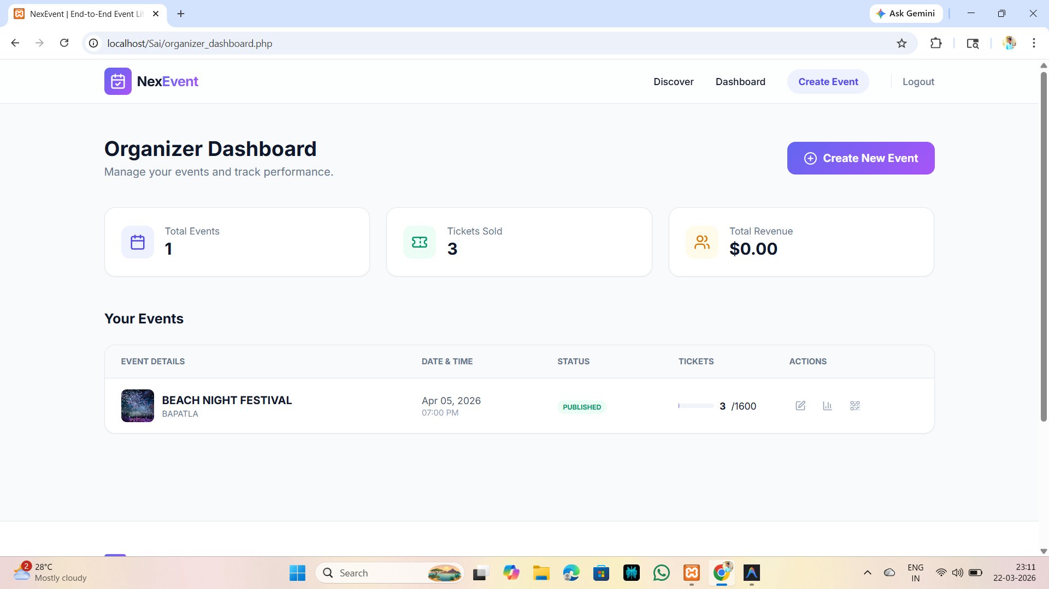
IMPLEMENTATION SCREENSHOTS
Main module:
1
2
3
4
5
6
7
8(B)
9

Slide 13
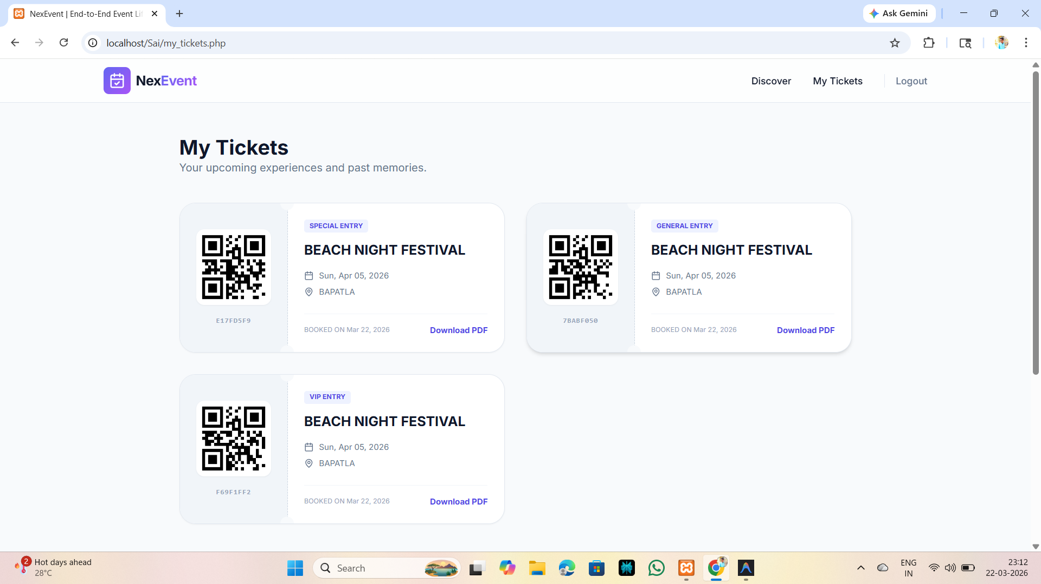
IMPLEMENTATION SCREENSHOTS
Output page:
1
2
3
4
5
6
7
8(C)
9

Slide 14
ADVANTAGES & LIMITATIONS
1
Advantages:
* Simplifies event management from creation to ticket sales in one system
* Provides real-time booking and instant ticket confirmation
* Reduces manual work and human errors
* Offers secure online payment options
* Generates reports and analytics for better decision-making
Limitations:
* Requires stable internet connectivity
* Initial development and maintenance cost can be high
* Security risks if data is not properly protected
* System failures may affect ticket booking process
* Requires technical knowledge for setup and managemen
2
3
4
5
6
7
8
9

Slide 15
Thank you

