Slide 1

Vel Tech Rangarajan Dr. Sagunthala R&D Institute of Science and Technology
School of Computing
Department of Computer Science and Engineering
10211CS224 / FULL STACK APPLICATION DEVELOPMENT
END SEMESTER PROJECT REVIEW
Date: 06-05-2026
TICKET BOOKING WEB APPLICATION FOR TECHNICAL FEST
SDG: 9 – Industry, Innovation and Infrastructure
Presented By:
AVVARU AISHWARYA– VTU26635 – 23UECS0669
Courses Handling Faculty:
Dr. Hafizur Rahman-Assistant Professor

Slide 2
INTRODUCTION
Background of the problem:
Manual ticket booking systems lack automation and real-time seat management.
Why this project is important:
It simplifies ticket booking and provides instant confirmation with reduced errors.
Real-world relevance:
Useful for managing departmental events like technical fests, seminars, and workshops.
Brief overview of the system:
Useful for managing departmental events like technical fests, seminars, and workshops
1
2
3
4
5
6
7
8
9

Slide 3
PROBLEM STATEMENT
In many educational institutions and organizations, ticket booking for internal events such as technical fests, seminars, and workshops is often handled manually or through basic systems that lack proper automation. This creates difficulties in managing participants, tracking ticket availability and ensuring smooth registration. Manual processes can lead to overbooking, data errors and delays in confirmation. Additionally, there is no centralized system to monitor bookings and generate reports efficiently. Therefore, there is a need for a secure, reliable and fully automated ticket booking system that allows users to book tickets easily, provides real-time updates, and enables administrators to manage events effectively. Such a system improves accuracy, saves time, and enhances the overall event management experience.
1
2
3
4
5
6
7
8
9

Slide 4
OBJECTIVES
1
To Design and develop a React JS-based web application for efficient event ticket booking.
To provide real-time ticket availability and instant booking confirmation.
To design an application that sends OTP for booking tickets for users.
To develop application that sends Email for booking confirmation after successfully booking.
2
3
4
5
6
7
8
9

Slide 5
PROPOSED SYSTEM
The proposed system is a React JS-based web application for managing event ticket booking in a single platform.
It allows users to register, view events, and book tickets.
Admin can create and manage events.
It provides real-time ticket availability and instant booking confirmation.
The system stores booking details securely and generates reports.
It reduces manual work and saves time.
It avoids mistakes in Money calculation.
It is faster and more efficient than manual systems.
1
2
3
4
5
6
7
8
9

Slide 6
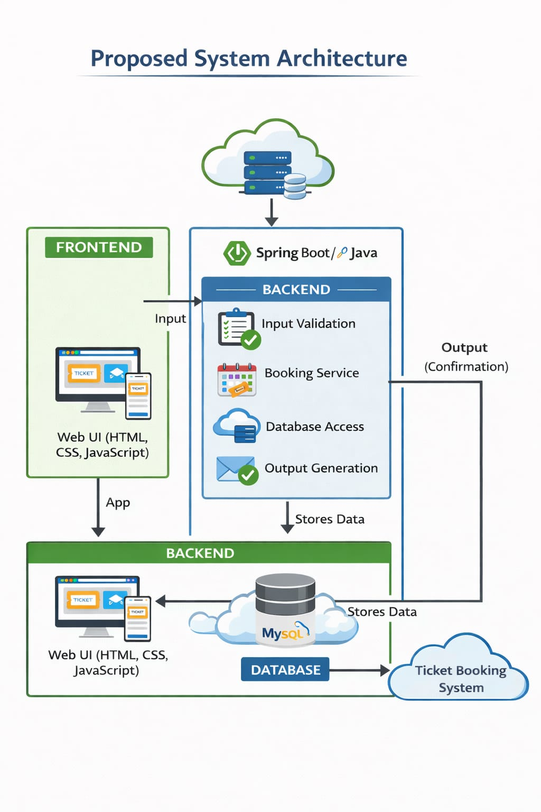
PROPOSED SYSTEM ARCHITECTURE
1
Input: The user interaction and data entered via the Web UI (HTML, CSS, JavaScript) which is then sent to the backend for processing.
Processing: Java backend logic that performs input validation, executes the booking service, and handles data access.
Database: The MySQL storage layer where application data is permanently stored .
Output: The confirmation or ticket generation sent back to the user or an external system after the request is successfully handled.
2
3
4
5
6
7
8
9

Slide 7
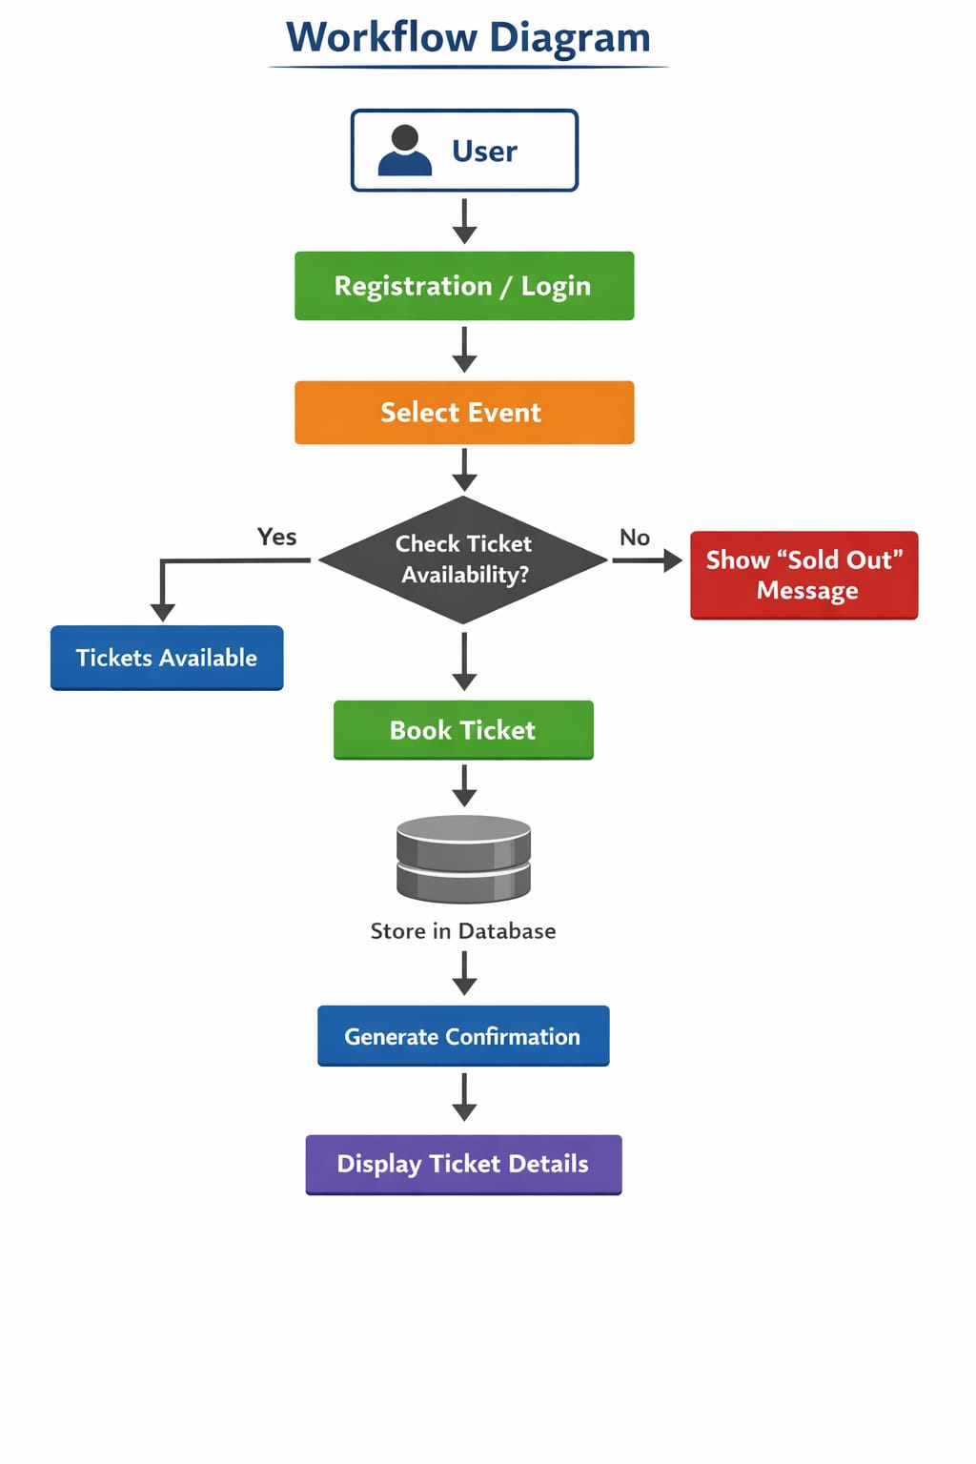
WORKFLOW
1
2
3
4
5
6
7
8
9

Slide 8
TECHNOLOGIES USED
1
Frontend:
1.HTML
2.CSS3
3.Javascript
4.React JS
Backend:
1.Node Js
Data Base / Tools:
1.Vs code
Software Requirements:
1.Windows / Mac
2. Web Browser
2
3
4
5
6
7
8
9

Slide 9
MODULE DESCRIPTION
Module 1: User Management
Handles user registration, login, and profile management with secure authentication.
Module 2: Event Management
Allows admin to create, update, and delete events and manage event details.
Module 3: Ticket Booking System
Enables users to view events, select tickets, and complete the booking process.
Module 4: Payment & Confirmation
Generates booking confirmation and allows users to receive tickets.
Module 5: Notification Module
Sends reminders about upcoming events, booking confirmations through email .
1
2
3
4
5
6
7
8
9

Slide 10
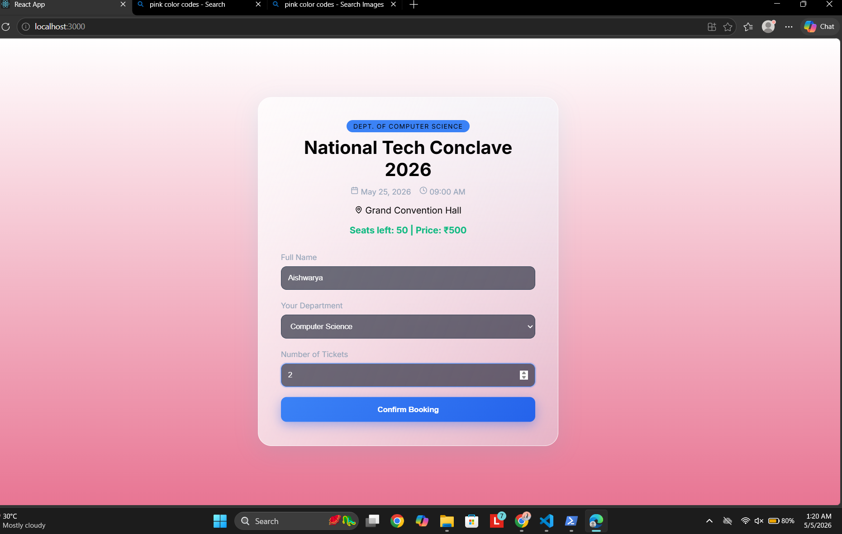
IMPLEMENTATION SCREENSHOTS
1
2
3
4
5
6
7
8
9
This is the booking interface for the National Tech Conclave 2026 organized by the Department of Computer Science, where users can enter their details to secure tickets.

Slide 11
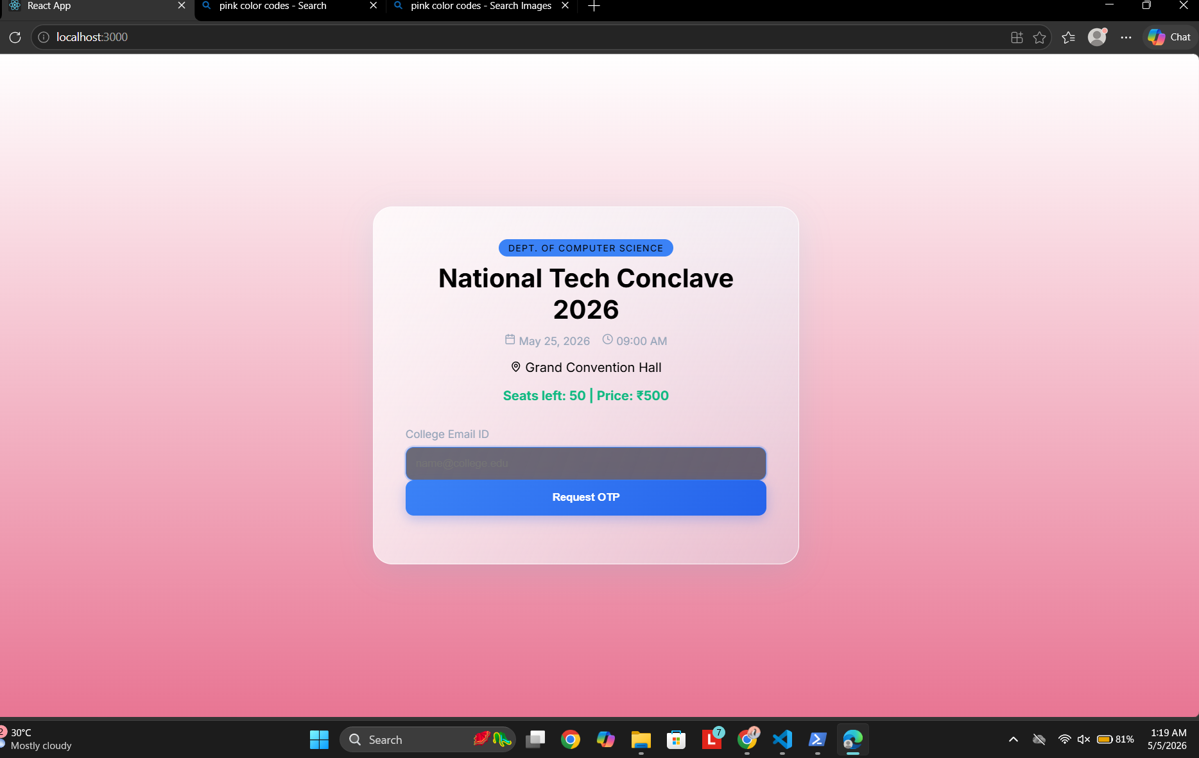
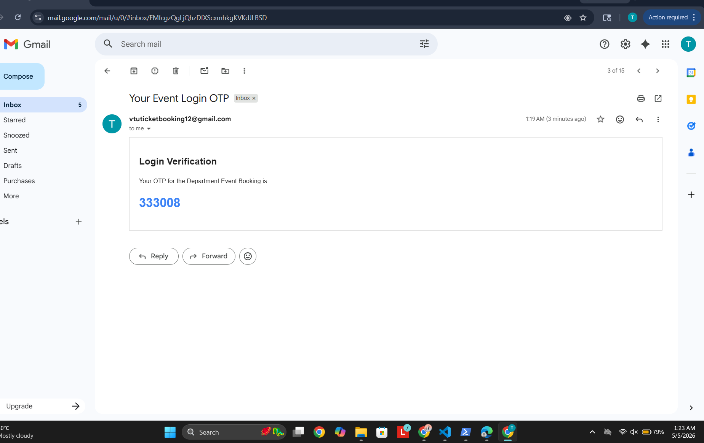
IMPLEMENTATION SCREENSHOTS
1
2
3
4
5
6
7
8
9

Slide 12
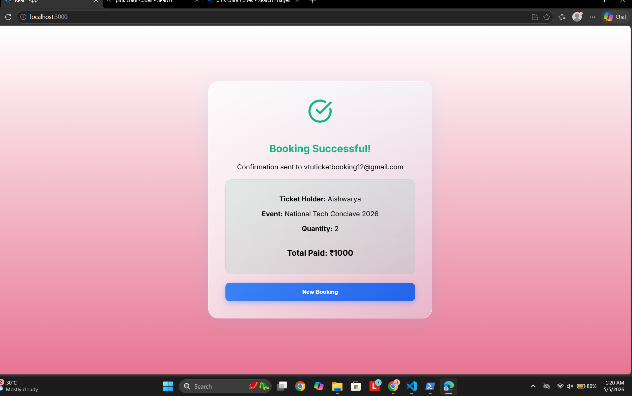
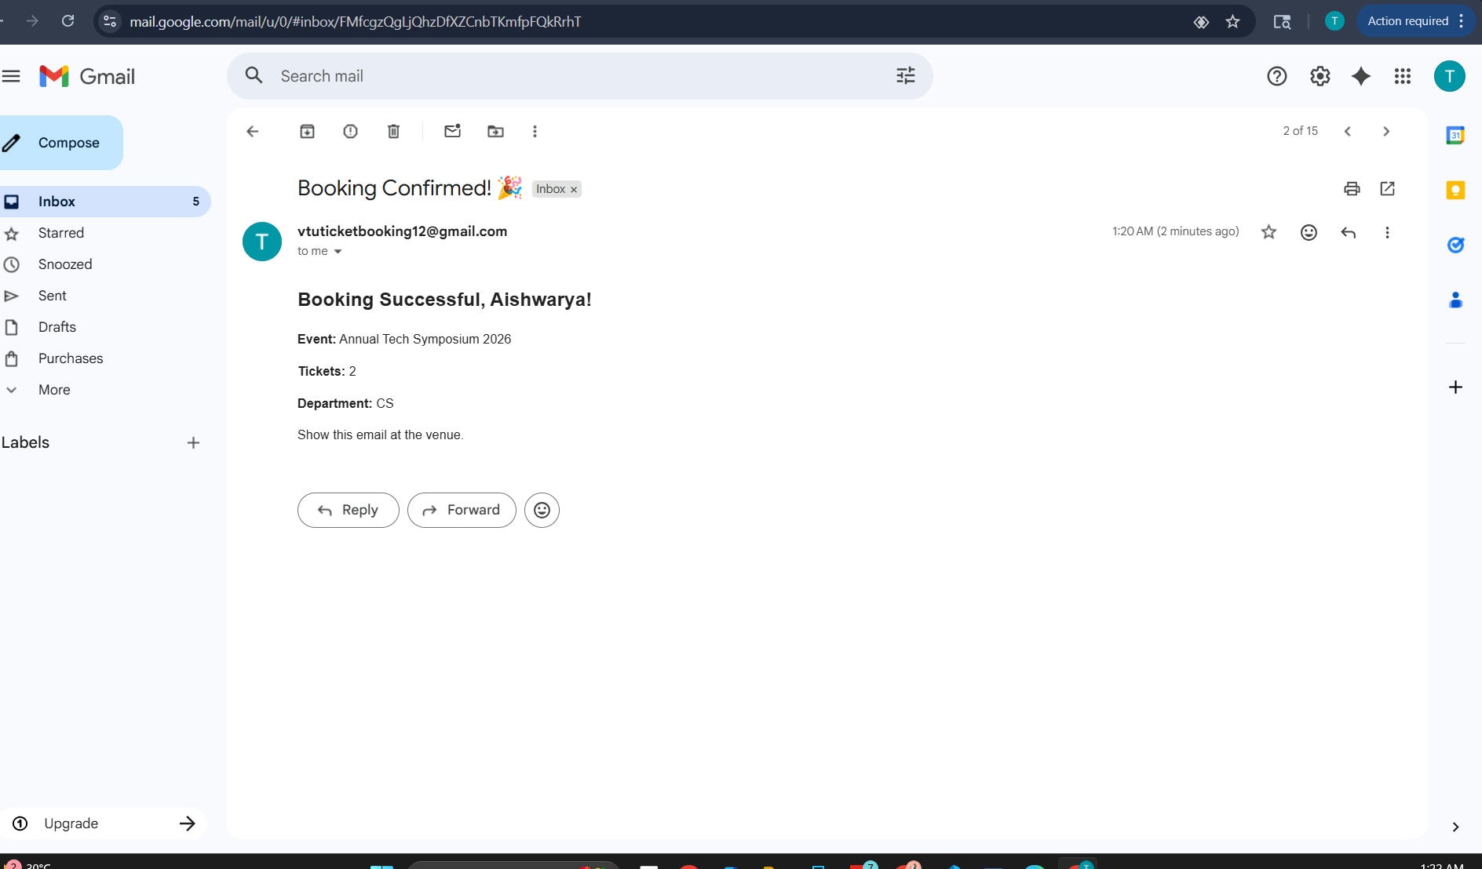
IMPLEMENTATION SCREENSHOTS
1
2
3
4
5
6
7
8(B)
9
It displays a successful booking confirmation for the event and sends automated gmail to the user.

Slide 13
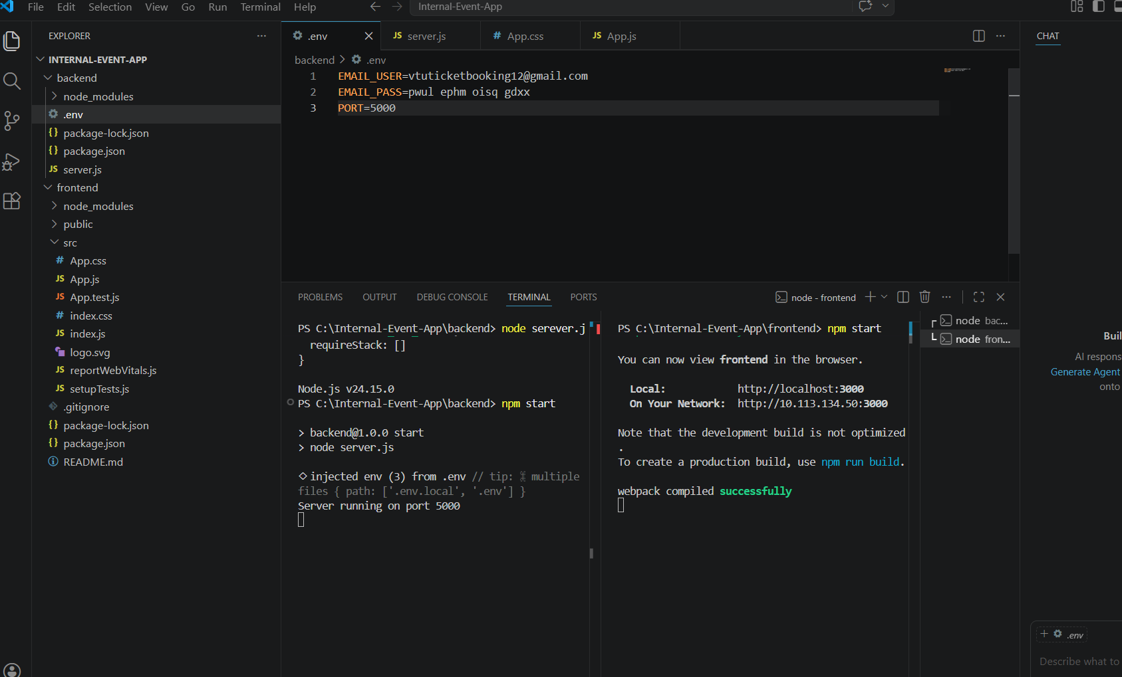
IMPLEMENTATION SCREENSHOTS
1
2
3
4
5
6
7
8(C)
9
It confirms the application is working locally, allowing users to access the internal event ticket booking system through the browser.

Slide 14
ADVANTAGES & LIMITATIONS
Advantages:
1.Time saving and Fully Automated.
2. Real-time ticket availability and instant confirmation.
3. Easy access and user-friendly interface.
Limitations:
1. Initial setup and development complexity.
2.Internet Dependency(Stable Internet connection is Required).
3. Depends on system/server availability.
1
2
3
4
5
6
7
8
9

Slide 15
Thank you

