Slide 1

Vel Tech Rangarajan Dr. Sagunthala R&D Institute of Science and Technology
School of Computing
Department of Computer Science and Engineering
10211CS224 / FULL STACK APPLICATION DEVELOPMENT (JAVA)
END SEMESTER PROJECT REVIEW
Date: 06-05-2026
React JS Based Web Application for Ticket Booking of an Internal Departement Event
SDG: SDG No – SDG 4 – Quality Education
Presented By:
Mullangi Nagasiri – VTU26655 – 23UECS0376.
Courses Handling Faculty:
Dr. S . HEMAMALINI – M.E., Ph.D.,
(Senior Grade)

Slide 2
INTRODUCTION
Ticket Booking System is a web-based application developed using React that allows users to view event details and book tickets online.
It simplifies the process of event registration by providing:
Real-time ticket availability
Easy booking interface
Instant confirmation
This system is designed for internal department events such as:
Technical fests
Seminars
Workshops
1
2
3
4
5
6
7
8
9

Slide 3
PROBLEM STATEMENT
1
Traditional ticket booking methods face several issues:
Manual registration is time-consuming
No real-time tracking of ticket availability
Chances of overbooking
Lack of proper validation
Poor user experience
There is a need for a digital, efficient, and user-friendly system to handle event ticket booking.
2
3
4
5
6
7
8
9

Slide 4
OBJECTIVES
1
To develop a user-friendly ticket booking interface
To display event details clearly
To implement real-time ticket availability
To ensure proper input validation
To prevent booking errors
To provide instant booking confirmation
2
3
4
5
6
7
8
9

Slide 5
PROPOSED SYSTEM
1
The proposed system is a React-based web application
Displays complete event details
Allows users to book tickets online
Validates user input
Prevents overbooking
Updates ticket count dynamically
It ensures a smooth and error-free booking experience
2
3
4
5
6
7
8
9

Slide 6
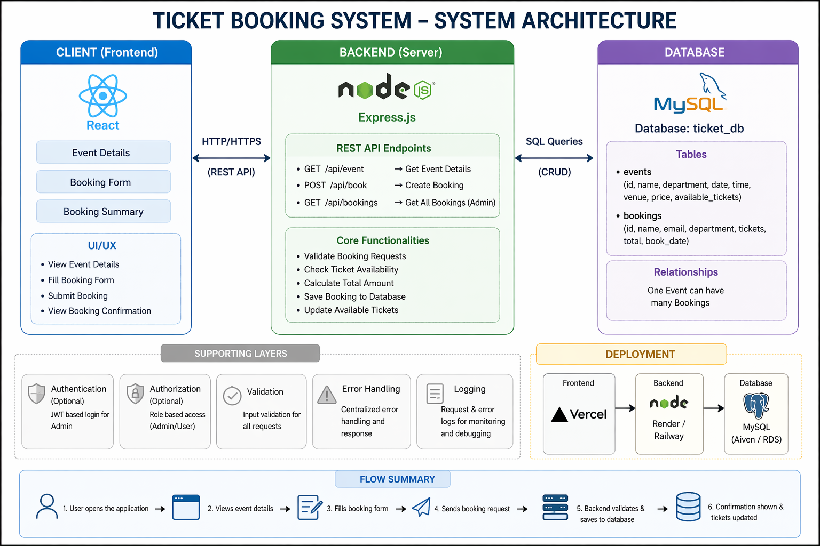
PROPOSED SYSTEM ARCHITECTURE
1
2
3
4
5
6
7
8
9

Slide 7
WORKFLOW
start
1
User Registers / Logs In
2
3
View Events List
4
Select Event
5
Enter Booking Details
6
Confirm Booking
7
Store in Database(MySQL)
8
Show Confirmation
9
End
Notes:
Start

Slide 8
TECHNOLOGIES USED
1
React – Frontend framework
JavaScript (ES6) – Logic handling
HTML5 – Structure
CSS3 – Styling and UI design
Vite – Fast development environment
MySQL - Database
2
3
4
5
6
7
8
9

Slide 9
MODULE DESCRIPTION
Module 1: User Authentication Module
The User Authentication Module is responsible for verifying users before they access the system. In this project, users enter basic details such as name, email, and
department, followed by an OTP verification process.
Module 2: Dashboard and Event Display Module
The Dashboard and Event Display Module acts as the central interface of the application where users can view all available technical events. It displays important
information such as event name, available seats, venue, and registration fee.
Module 3: Payment Module
The Payment Module enables users to complete their event registration by making
payments through a QR code system. Users scan the displayed QR code using UPIbased payment applications and confirm the payment within the system
1
2
3
4
5
6
7
8
9

Slide 10
MODULE DESCRIPTION
Module 4: Registration Management Module
The Registration Management Module is responsible for storing and organizing all
user registrations for different events. It maintains a structured record that maps
users to the events they have registered for. This module allows organizers to view
participant details for each event, making it easier to manage attendance.
Module 5: Ticket Generation Module
The Ticket Generation Module is responsible for creating a downloadable ticket in
PDF format after successful registration. The ticket contains important details such
as user information, registered events, and a unique ticket ID.
1
2
3
4
5
6
7
8a
9

Slide 11
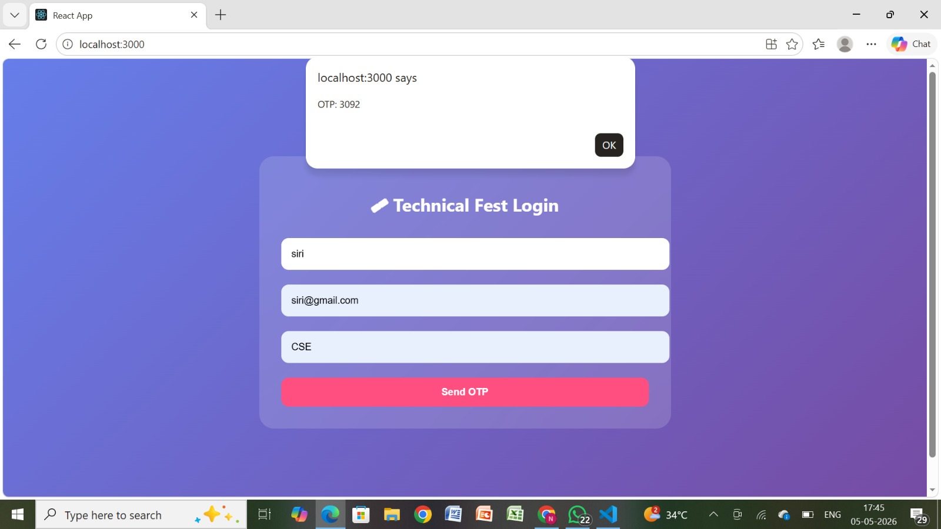
IMPLEMENTATION SCREENSHOTS
1
2
3
4
5
6
7
8c
9
This page shows login interface. It allows users to securely access the platform by entering their name, email and department. It also provides an OTP to verfiy.

Slide 12
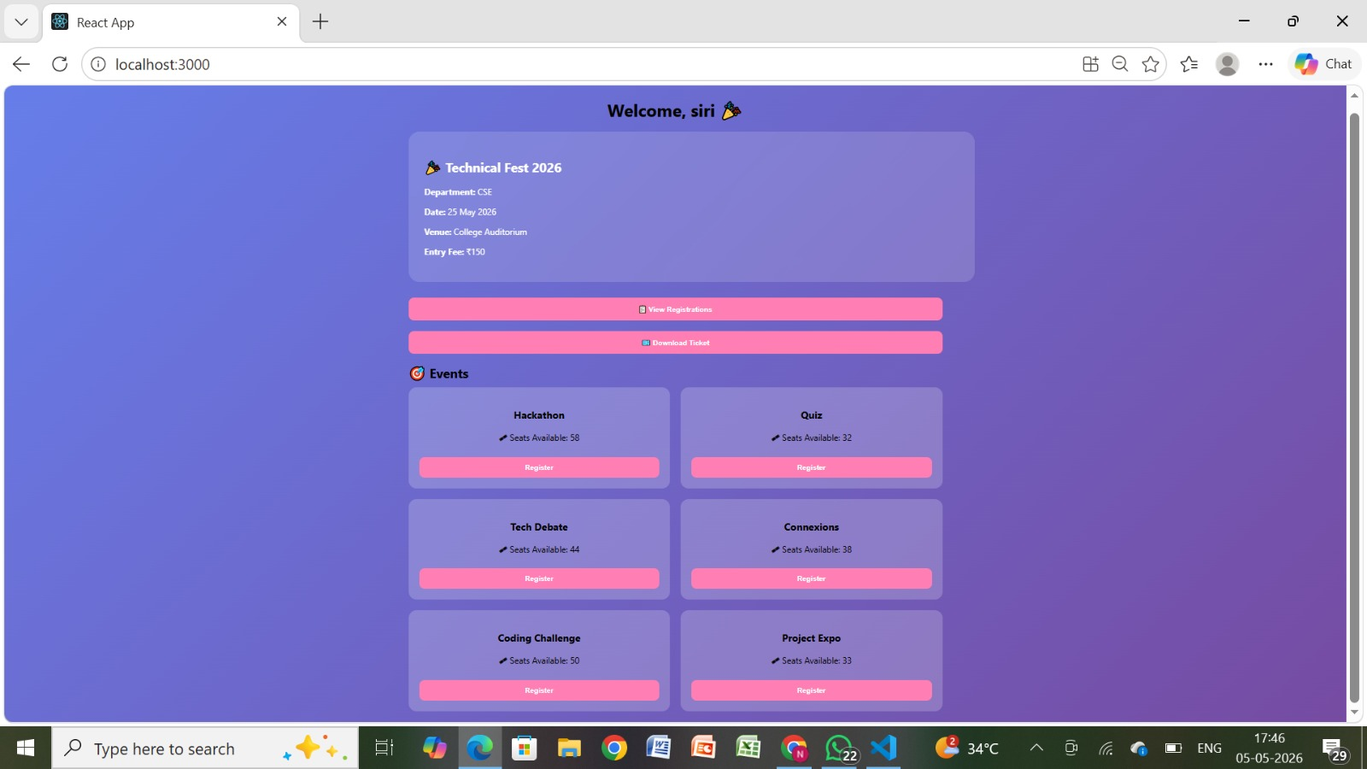
IMPLEMENTATION SCREENSHOTS
1
2
3
4
5
6
7
8d
9
It shows the dashboard that displays all upcoming events with details like date, time, venue, available slots, and price. Users can filter events by category such as technology, hackathon, or workshop. It helps users easily browse and select events.

Slide 13
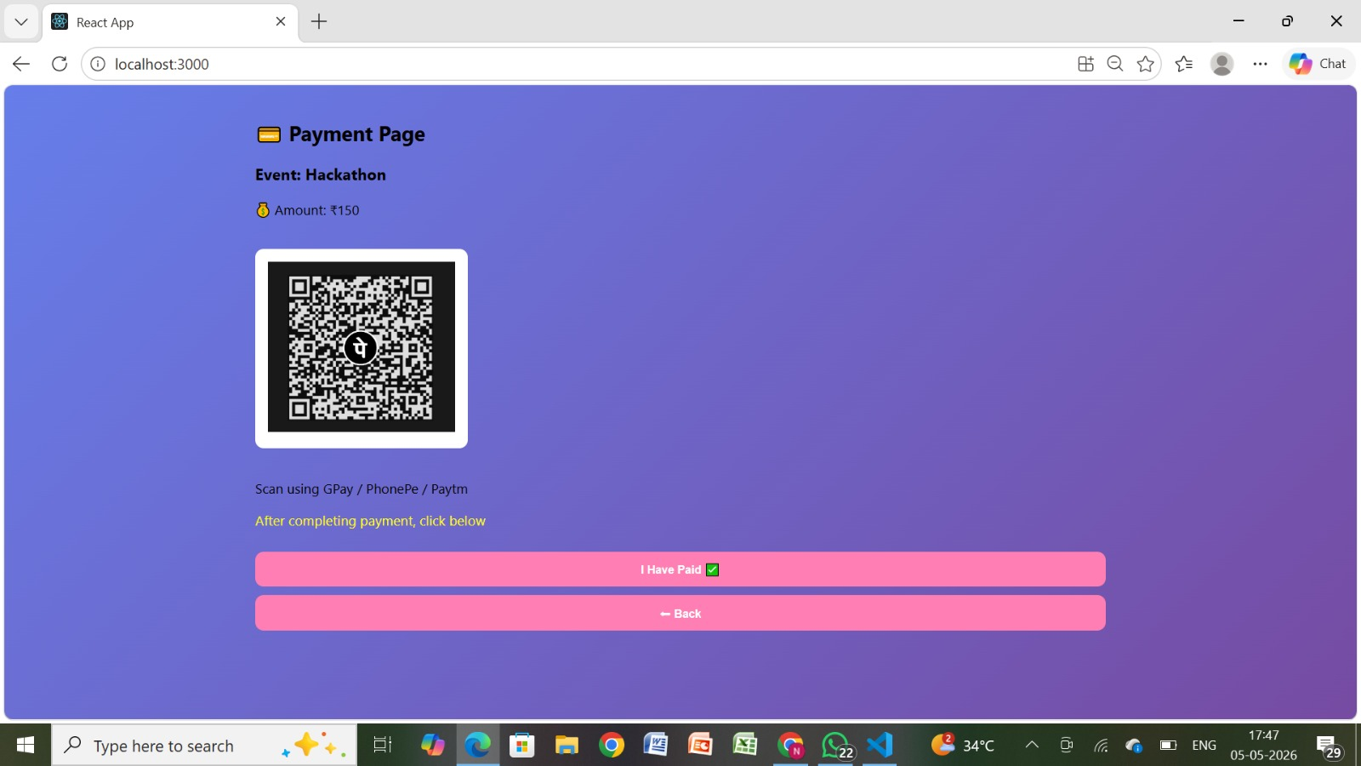
IMPLEMENTATION SCREENSHOTS
1
2
3
4
5
6
7
8e
9
.
It shows the Payment Interface. It enables users to complete ticket booking using methods like UPI, card, or net banking. It provides a QR code and UPI ID option for payment. This ensures a secure and flexible payment process.

Slide 14
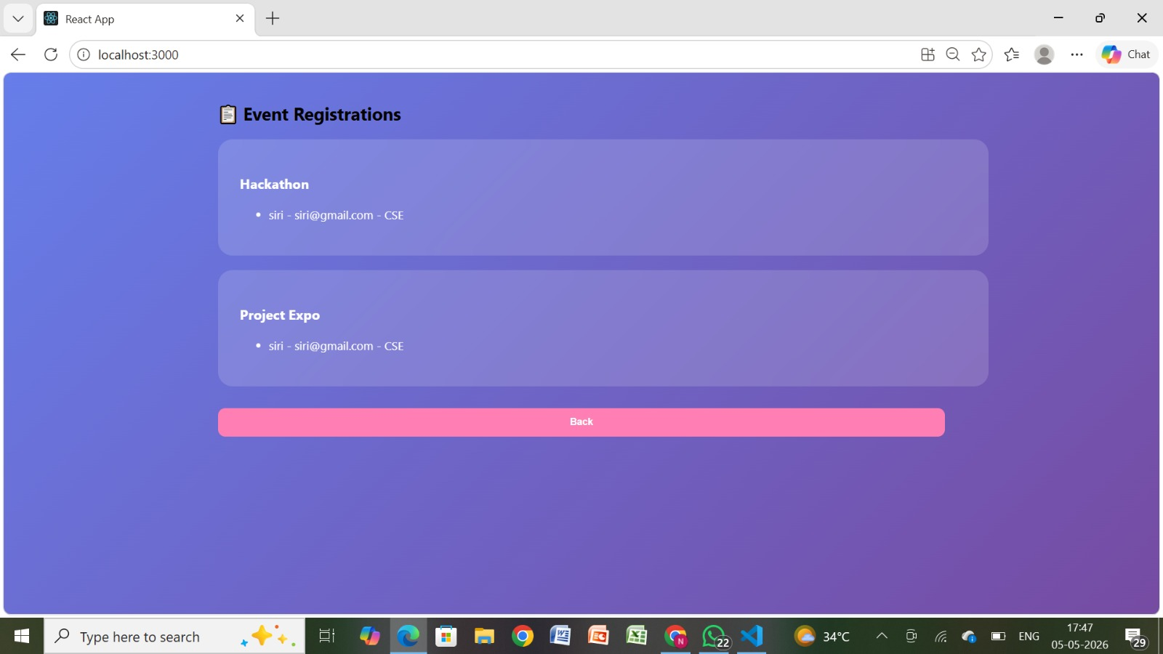
IMPLEMENTATION SCREENSHOTS
1
2
3
4
5
6
7
8f
9
.
This image shows the Registration details of the particular user about the registrations that have done for clarification..

Slide 15
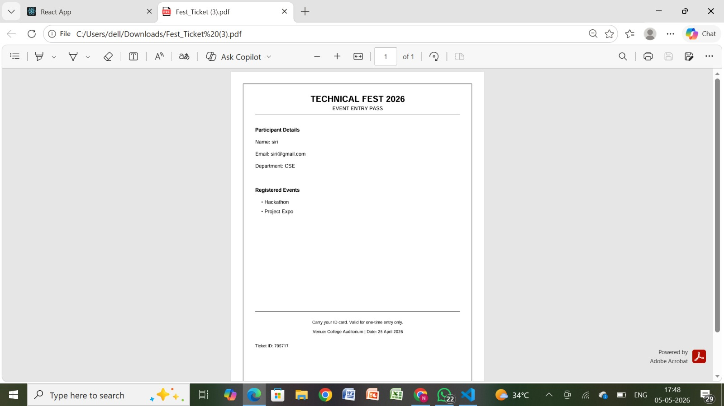
IMPLEMENTATION SCREENSHOTS
1
2
3
4
5
6
7
8g
9
.
This image shows the confirmation ticket download that is sent after successful booking as proof of purchase. It includes booking details like ID, email, and event information.

Slide 16
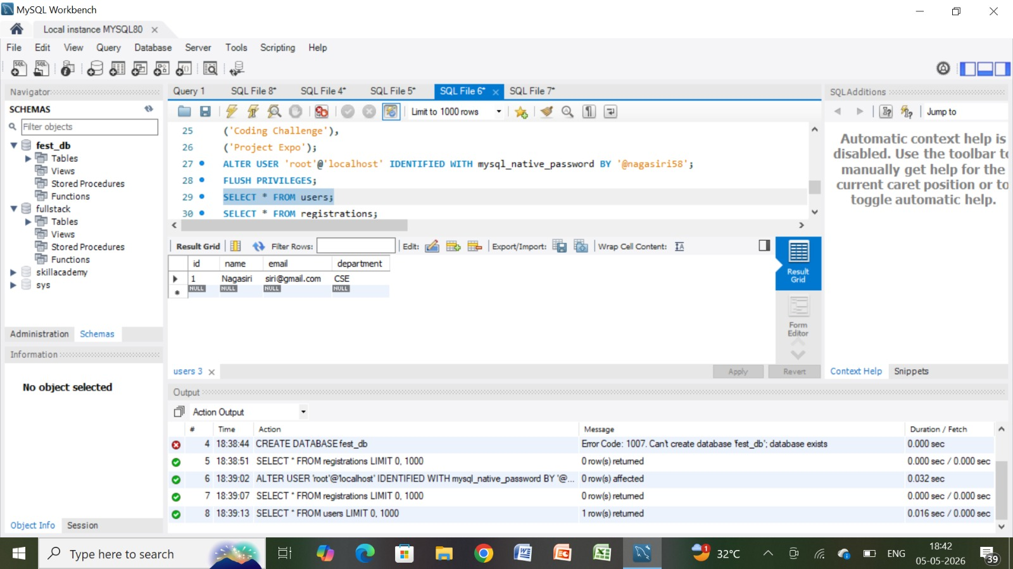
IMPLEMENTATION SCREENSHOTS
1
2
3
4
5
6
7
8h
9
.

Slide 17
ADVANTAGES & LIMITATIONS
1
Advantages
2
Real-time ticket availability updates
User-friendly interface (simple and clean UI)
Reduces manual work and errors
Data stored securely in database
3
4
5
6
Limitations
7
Depends on internet connection
Basic security (no login/auth system yet)
Limited to single event (not scalable fully)
Backend must run continuously (no cloud deployment yet)
8
9

Slide 18
Thank you

