Slide 1

Vel Tech Rangarajan Dr. Sagunthala R&D Institute of Science and Technology
School of Computing
Department of Computer Science and Engineering
10211CS224 / FULL STACK APPLICATION DEVELOPMENT (JAVA)
PROJECT REVIEW : MILESTONE PROJECT – 1
Date: DD-MM-YYYY
Automated Quiz Engine with PDF Certification Generation
SDG: SDG 4 – Quality Education
Presented By:
Pantangi Gowtham Siva Santhosh – VTU26659 – Reg.No: 23UECS0429
Courses Handling Faculty:
Dr. S. HEMAMALINI – M.E., Ph.D.,

Slide 2
INTRODUCTION
Traditional quiz systems rely on manual paper-based evaluation, causing delays, errors, and lack of instant feedback for students.
The Automated Quiz Engine is a web-based platform that allows students to take timed multiple-choice quizzes fully online with real-time evaluation.
Students authenticate using their Name, VTU Number, Slot Number, and Batch Code, ensuring a unique and secure quiz session for each individual.
Upon quiz completion, the system automatically calculates the score and generates a personalized, downloadable PDF certificate for the student.
The project is deployed live on Netlify and aligns with SDG 4 (Quality Education) by enabling accessible, automated, and technology-driven assessment.
1
2
3
4
5
6
7
8
9

Slide 3
PROBLEM STATEMENT
Existing educational assessment methods are largely paper-based and manual, leading to significant inefficiencies in grading and result declaration.
Students do not receive instant feedback on their performance, which delays learning and hampers timely improvement in understanding concepts.
There is no automated mechanism to validate student identity, assign unique quiz slots, or prevent question repetition across different student batches.
Issuing certificates manually is time-consuming, prone to errors, and lacks personalization, reducing student motivation and engagement.
A need exists for a reliable, web-accessible quiz platform that automates evaluation, ensures academic integrity, and generates certificates instantly upon completion.
1
2
3
4
5
6
7
8
9

Slide 4
OBJECTIVE(S)
To design and develop a fully automated, web-based quiz engine that supports timed multiple-choice question evaluation with secure student authentication via Name, VTU Number, Slot Number, and Batch Code.
To implement an automatic PDF certificate generation module that personalizes and issues downloadable certificates to students upon successful quiz completion, completely eliminating manual effort.
1
2
3
4
5
6
7
8
9

Slide 5
PROPOSED SYSTEM
A fully web-based Automated Quiz Engine hosted at fsadquizengine.netlify.app, accessible from any device with a modern browser without requiring any software installation.
Student authentication via Name, VTU Number, Slot Number, and Batch Code ensures a unique and secure session for every student attempting the quiz.
The quiz engine dynamically loads 25 multiple-choice questions based on the student's slot, with a live countdown timer, progress bar, and Back/Next navigation.
Automatic grading evaluates all submitted answers against the answer key and instantly displays the student's final score without any manual intervention.
A personalized PDF certificate is auto-generated and made available for download, containing the student's name, VTU number, score, batch code, and date of completion.
1
2
3
4
5
6
7
8
9

Slide 6
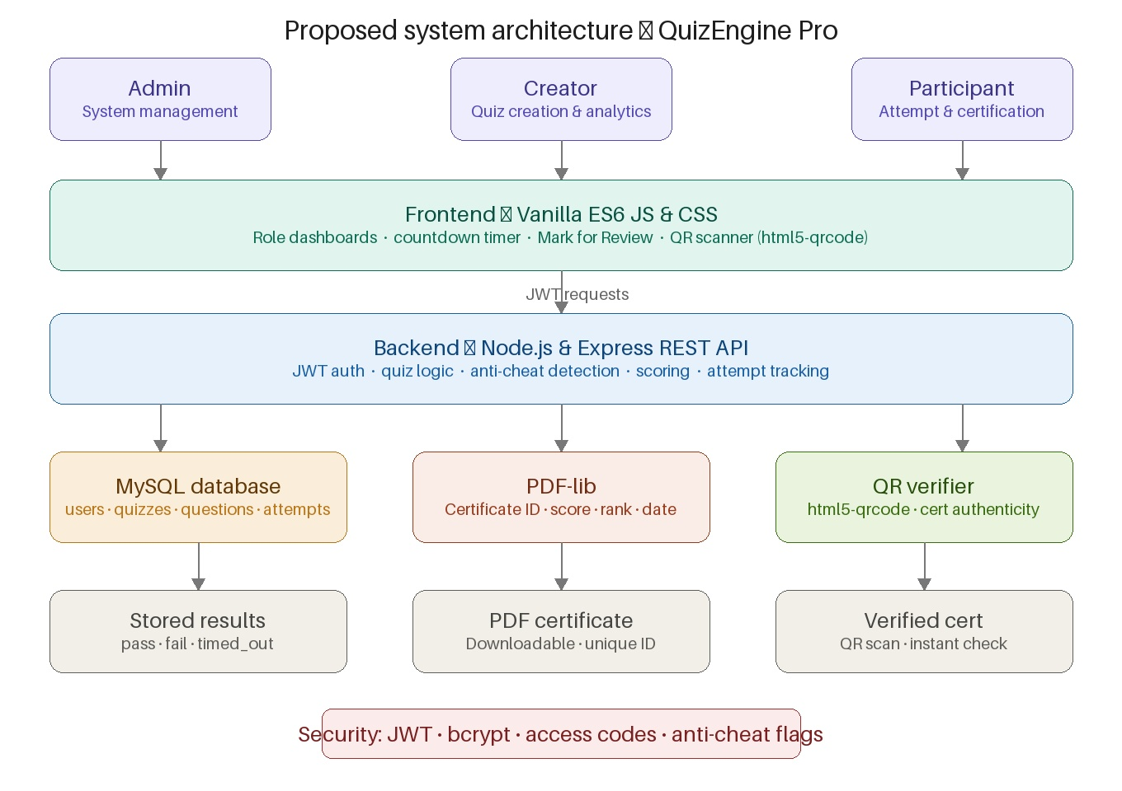
PROPOSED SYSTEM ARCHITECTURE
1
2
3
4
5
6
7
8
9

Slide 7
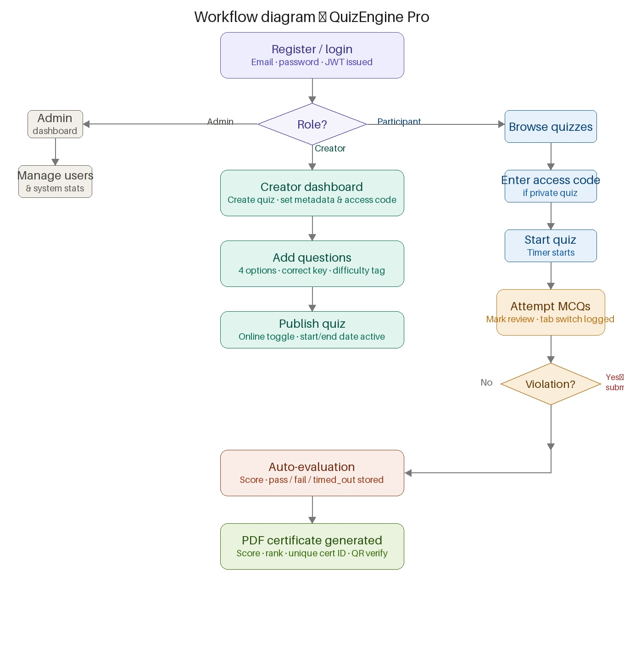
WORKFLOW
1
2
3
4
5
6
7
8
9

Slide 8
TECHNOLOGIES USED
Frontend: HTML5, CSS3, and Vanilla JavaScript — used for building the user interface, quiz rendering, timer logic, progress bar, and all interactive elements.
Backend: Client-side JavaScript only — all quiz logic, evaluation, and session management run entirely within the browser with no server-side processing required.
Database: Static JSON question bank — slot-wise MCQ data is stored in JavaScript/JSON files and loaded dynamically based on the student's slot number.
PDF Library: jsPDF and html2canvas — used to auto-generate and render the personalized PDF certificate with student details, score, and date of completion.
Tools: Visual Studio Code (IDE), Git and GitHub (version control and repository), and Netlify (CI/CD pipeline and live deployment hosting).
Hardware/Software Requirements: Any device running a modern web browser such as Chrome, Firefox, or Edge; a stable internet connection for accessing the deployed application.
1
2
3
4
5
6
7
8
9

Slide 9
MODULE DESCRIPTION
Module 1 — Student Authentication: Validates all student login inputs including Name, VTU Number, Slot Number, and Batch Code, and initiates a unique quiz session for each student.
Module 2 — Quiz Engine: Dynamically loads 25 MCQs for the assigned slot, manages the countdown timer, handles Back/Next navigation, and records all selected answers.
Module 3 — Evaluation and Scoring: Automatically evaluates all submitted answers against the stored answer key, computes the total score, and displays the result instantly.
Module 4 — PDF Certificate Generation: Generates a personalized, downloadable PDF certificate containing the student's name, VTU number, batch code, score, and completion date.
1
2
3
4
5
6
7
8
9

Slide 10
IMPLEMENTATION SCREENSHOTS
1
2
3
4
5
6
7
8
9

Slide 11
IMPLEMENTATION SCREENSHOTS
1
2
3
4
5
6
7
8(A)
9

Slide 12
IMPLEMENTATION SCREENSHOTS
1
2
3
4
5
6
7
8(B)
9

Slide 13
1
2
3
4
5
6
7
8(C)
9

Slide 14
ADVANTAGES
Fully automated evaluation eliminates manual grading effort entirely, saving significant time and reducing administrative burden for both students and faculty.
Instant score display and auto-generated PDF certificate provide immediate feedback and recognition to students right after quiz completion.
Slot-based question assignment ensures academic integrity by providing a different question set to each student batch, effectively preventing sharing of answers.
Web-based and device-independent — the application is accessible from any browser on any device without requiring any software installation or setup.
Zero infrastructure cost — deployed on Netlify with no server-side backend required, making the system lightweight, scalable, and easy to maintain.
1
2
3
4
5
6
7
8
9

Slide 15
LIMITATIONS
No persistent backend database — student results and session data are not stored permanently and are lost once the quiz session ends in the browser.
Internet dependency — the application requires a stable internet connection and cannot be accessed or used in completely offline environments.
Static question bank — adding or updating questions requires manual editing of the source JSON/JS files, as there is no admin dashboard for content management.
No anti-cheating mechanism — features such as full-screen lock enforcement or tab-switch detection are not implemented in the current version of the project.
1
2
3
4
5
6
7
8
9

Slide 16
Thank you

