Slide 1

Vel Tech Rangarajan Dr. Sagunthala R&D Institute of Science and Technology
School of Computing
Department of Computer Science and Engineering
10211CS224 / FULL STACK APPLICATION DEVELOPMENT (JAVA)
END SEMESTER PROJECT REVIEW
Date: 06-05-2026
SMART CAMPUS EVENT MANAGEMENT AND SYSTEM
SDG: 4 – Quality Education
Presented By:
B. MANOJ– VTU26671 – 23UECS0067
Courses Handling Faculty:
Dr. S . HEMAMALINI – M.E., Ph.D

Slide 2






INTRODUCTION
The Smart Campus Event Management System is a web-based application designed to manage college events efficiently.
1
In many institutions, event management is handled manually, leading to errors and delays.
2
3
This project aims to digitalize the process of event creation, registration, and management.
4
Students can view upcoming events and register online.
5
Administrators can manage event details and track registrations.
6
The system improves accuracy, reduces paperwork, and saves time.
7
8
It provides a user-friendly interface for both students and admins.
9
Overall, it enhances campus event coordination and participation.

Slide 3




PROBLEM STATEMENT
In many colleges, event management is not fully automated and depends on manual processes.
1
This leads to inefficiency, data loss, and difficulty in tracking registrations.
2
Students face issues in knowing event details and registering on time.
3
Administrators struggle to manage large volumes of data manually.
4
5
There is no centralized system to monitor event participation.
6
This results in poor coordination and reduced efficiency.
7
Hence, a need arises for a reliable and automated system.
8
The system should simplify event management and improve accuracy.
9

Slide 4
OBJECTIVE(S)
1
2
To design and develop a web-based system for managing campus events and registrations.
3
To implement an efficient platform for event creation, registration, and tracking.
4
5
6
7
8
9

Slide 5
PROPOSED SYSTEM
1
Provides an online platform for event management
2
3
Enables admin to add, update, and delete events
4
Stores data securely in a database
5
Reduces manual work and errors
6
Improves communication between students and admin
7
Tracks registrations and available seats
8
Ensures better organization and efficiency
9

Slide 6
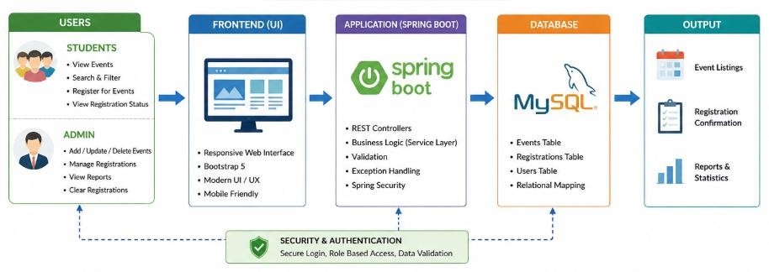
PROPOSED SYSTEM ARCHITECTURE
1
2
3
4
5
6
Explaination:
Input: Student details, event details
Processing: Validation, registration, seat management
Database: MySQL stores events and registrations
Output: Event list, registration confirmation, admin reports
7
8
9

Slide 7

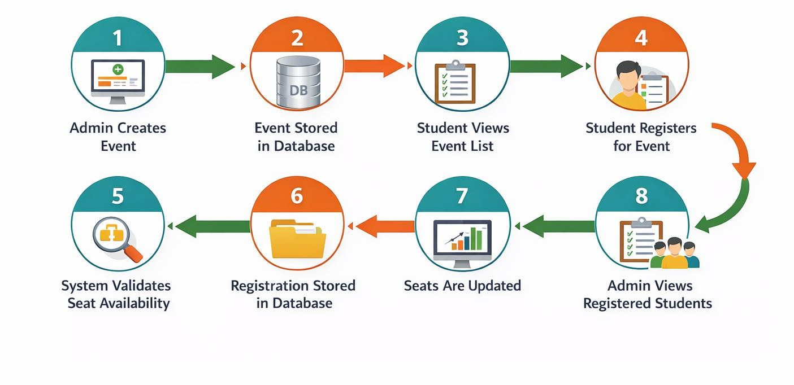



WORKFLOW
1
2
3
4
5
6
7
8
9

Slide 8

TECHNOLOGIES USED
Frontend: HTML, CSS, Thymeleaf Backend: Spring Boot (Java) Database: MySQL
Tools: VS Code, Maven
Hardware Requirements: Minimum 4GB RAM, i3 Processor
Software Requirements: JDK 8+, MySQL Server, Web Browser
1
2
3
4
5
6
7
8
9

Slide 9
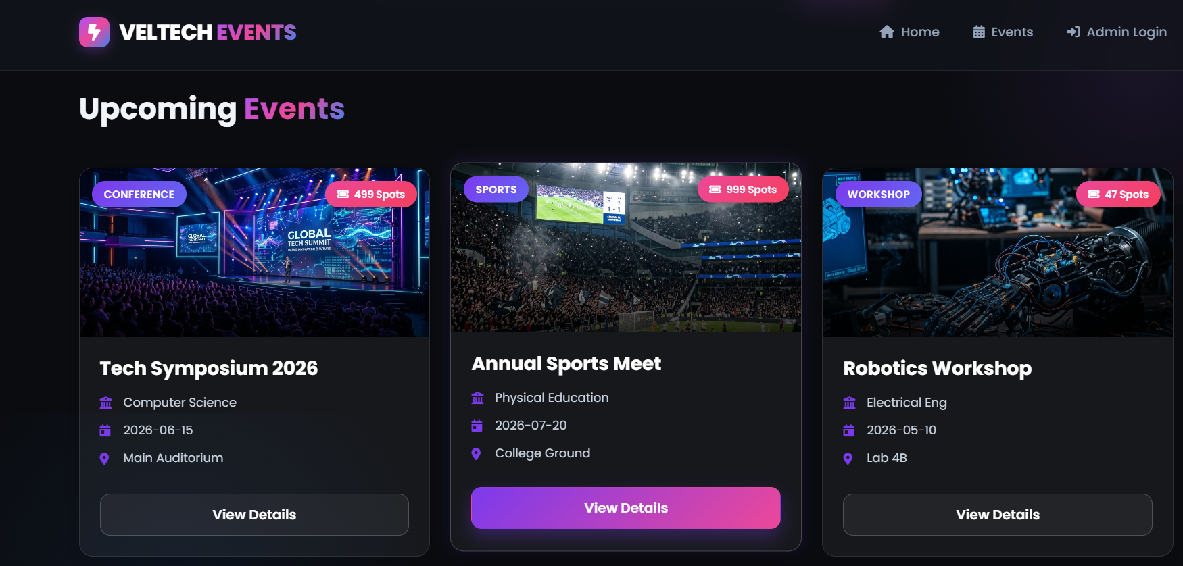
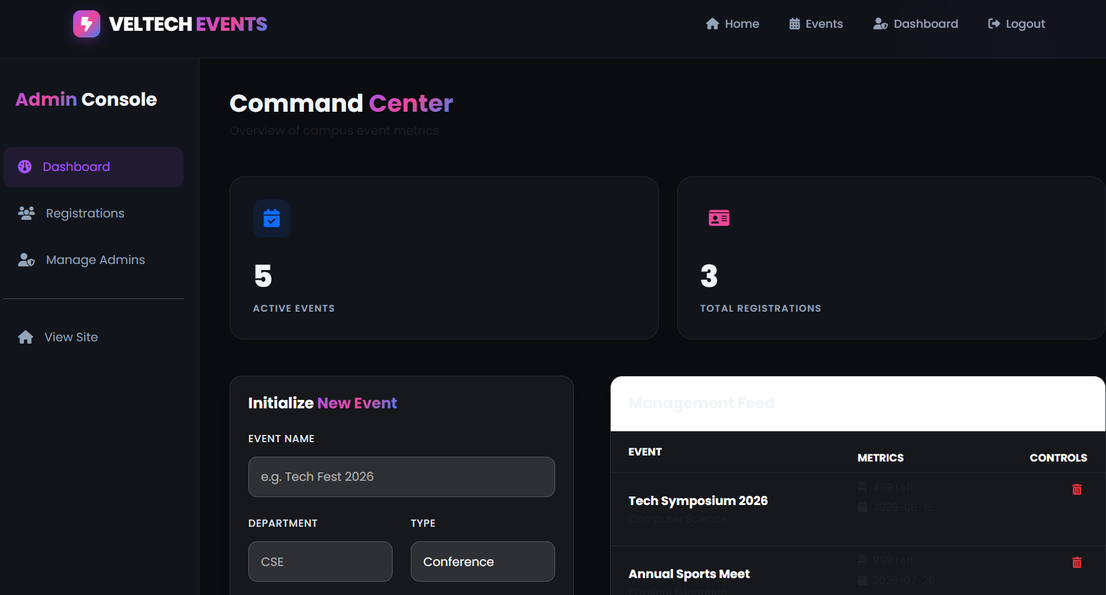

IMPLEMENTATION SCREENSHOTS
Home Page:
- Displays list of events available for students.
1
2
3
4
5
6
Admin Page:
- Allows admin to add and manage events.
7
8(A)
9

Slide 10
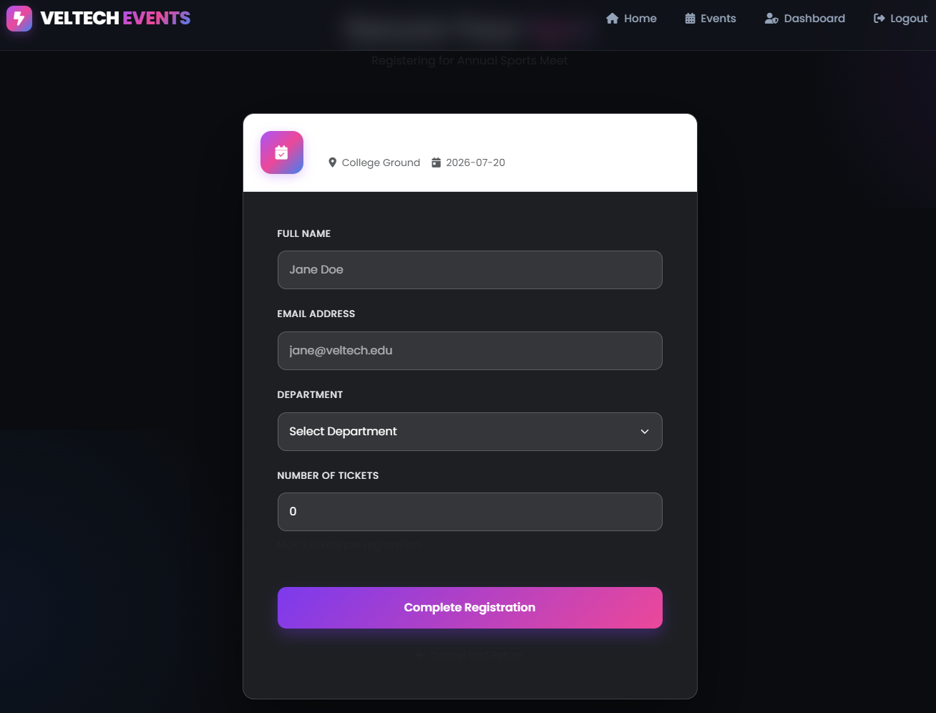
IMPLEMENTATION SCREENSHOTS
Registration Page:
- Students fill details to register for events.
1
2
3
4
5
6
7
8(B)
9

Slide 11
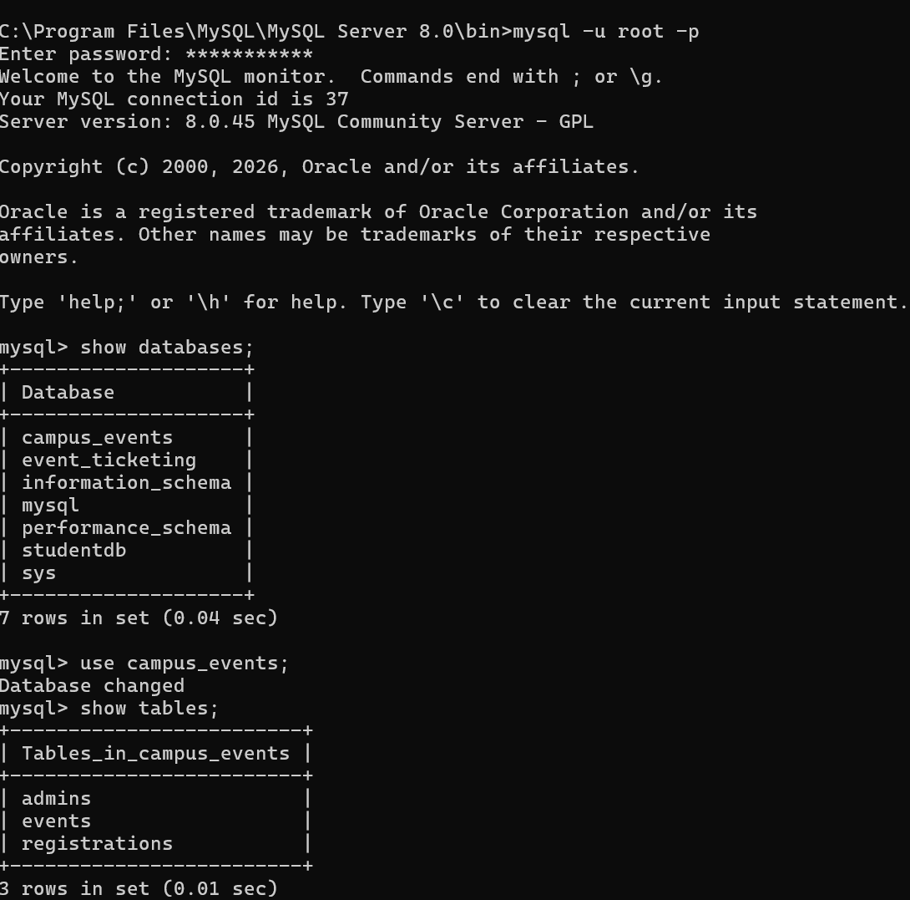
IMPLEMENTATION SCREENSHOTS
1
2
3
4
5
6
7
8(C)
9

Slide 12
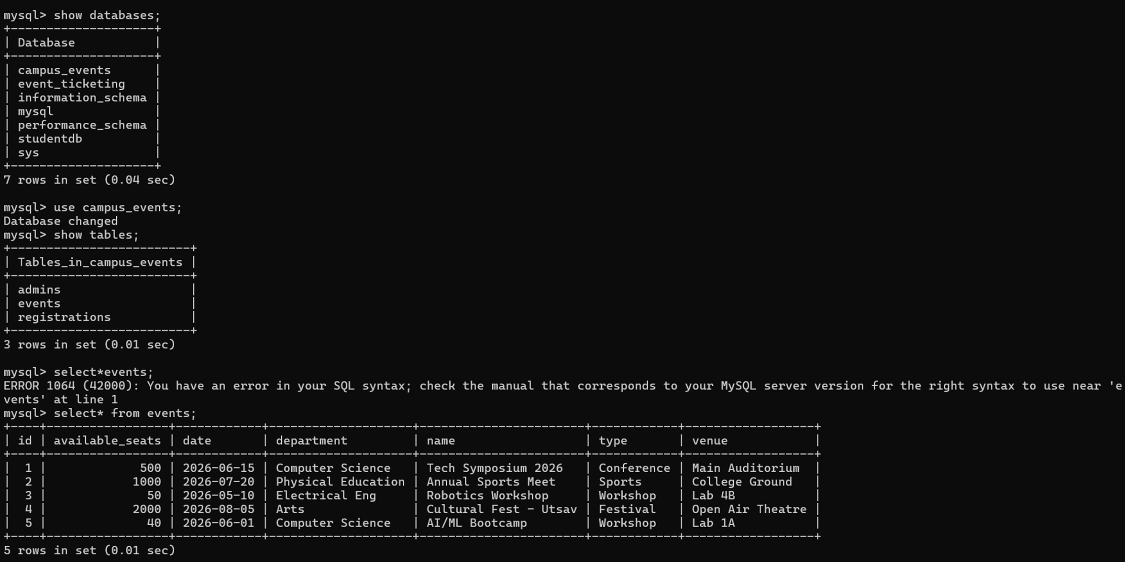
IMPLEMENTATION SCREENSHOTS
1
2
3
4
5
6
7
8(C)
9

Slide 13
ADVANTAGES & LIMITATIONS
Advantages:
1
Reduces manual work
Improves accuracy
Easy to use interface
Centralized system
Saves time
2
3
4
5
Limitations:
Requires internet connection
Basic security (can be improved)
Limited to campus-level usage
6
7
8
9

Slide 14
Thank you

