Slide 1

School of Computing
Vel Tech Rangarajan Dr. Sagunthala R&D Institute of Science and Technology
Department of Computer Science and Engineering
10211CS224 / FULL STACK APPLICATION DEVELOPMENT (JAVA)
PROJECT REVIEW : MILESTONE PROJECT – 1
Date: 23-03-2026
END TO END EVENT LIFE CYCLE & TICKETING PLATFORM
SDG: SDG No –4 ( Quality Education)
Presented By:
B.MANOJ – VTU26671– Reg.No.23UECS0067
Courses Handling Faculty: Dr. S . HEMAMALINI – M.E., Ph.D.,

Slide 2
INTRODUCTION
Event management and ticket booking are commonly handled manually or through separate systems.
This leads to inefficiency, data inconsistency, and poor user experience.
With increasing demand for online services, there is a need for a centralized platform.
This project provides a digital solution for managing events and booking tickets.
Users can view events, book tickets, and make payments easily.
Admin can manage events, users, and bookings efficiently.
The system ensures accuracy, speed, and better organization.
It improves accessibility and reduces manual workload.
1
2
3
4
5
6
7
8
9

Slide 3
PROBLEM STATEMENT
1
Existing event management systems are not fully integrated and often rely on manual processes.
Users face difficulties in discovering events and booking tickets efficiently.
Event organizers struggle with managing bookings and tracking data.
Lack of automation leads to errors, delays, and poor user experience.
There is a need for a reliable and automated system.
The system should handle event creation, ticket booking, and data management.
It should improve efficiency, accuracy, and user satisfaction.
2
3
4
5
6
7
8
9

Slide 4
OBJECTIVES
1
To design and develop a web-based event ticketing system for efficient event management.
To implement a secure and user-friendly platform for booking and managing tickets.
2
3
4
5
6
7
8
9

Slide 5
PROPOSED SYSTEM
1
The system is a web-based application for managing events and ticket bookings.
Users can register, login, view events, and book tickets.
Admin can add, update, and delete events.
The system stores all data in a centralized database.
It provides real-time updates on ticket availability.
The platform ensures secure login and transaction handling.
It reduces manual work and increases efficiency.
It improves user experience and system reliability.
2
3
4
5
6
7
8
9

Slide 6
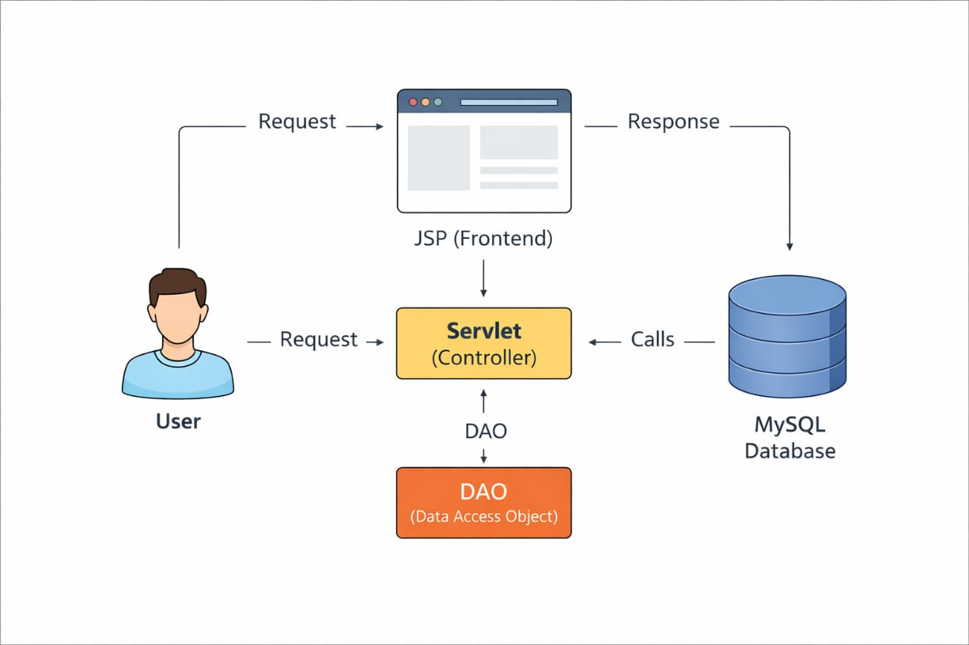
PROPOSED SYSTEM ARCHITECTURE
1
2
3
4
5
6
7
8
9

Slide 7
WORKFLOW
start
1
User Registers / Logs In
2
3
View Events List
4
Select Event
5
Enter Booking Details
6
Confirm Booking
7
Store in Database(MySQL)
8
Show Confirmation
9
End
Notes:
Start

Slide 8
TECHNOLOGIES USED
1
Frontend: HTML, CSS3, JavaScript (for user interface and responsive design).
Backend: The backend of an end-to-end ticketing platform handles business logic, ticket processing, user management, integrations processing.
Database: tickets, users, workflows, communications, and analytics data for efficient management and reporting.
Tools: VS Code / Eclipse IDE, XAMPP or Apache Tomcat Server, Git for version control.
Hardware/Software:Minimum 4GB RAM, Dual-Core Processor, Windows/Linux OS, Web Browser (Chrome/Edge/Firefox), Stable Internet Connection.
2
3
4
5
6
7
8
9

Slide 9
MODULE DESCRIPTION
1
User Management: Handles registration, login, and profile
Event Management: Admin creates and manages events
Booking System: Users book tickets and view bookings
Database Management: Stores and retrieves data securely
2
3
4
5
6
7
8
9

Slide 10
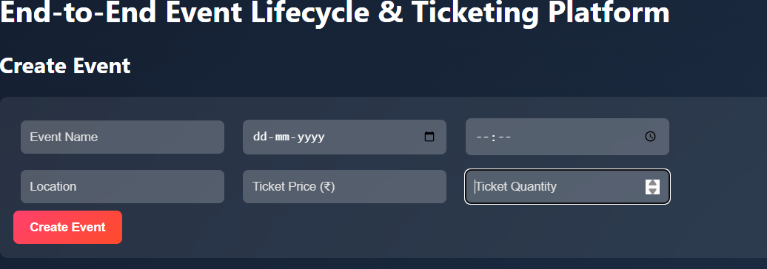
IMPLEMENTATION SCREENSHOTS
1
2
3
4
5
6
7
8
Explanation:
The home page provides an overview of the system with navigation options like Login, Register, and Information. It offers a user-friendly interface for easy access.
9

Slide 11
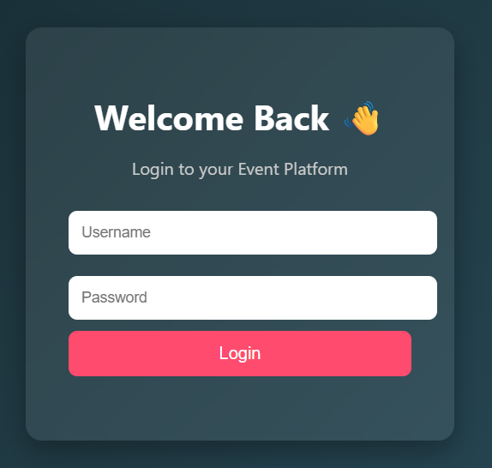
IMPLEMENTATION SCREENSHOTS
1
2
3
4
5
6
7
8(A)
9
.
Explanation:
Login page lets existing users log in using their registered email and password. Validates credentials and redirects to the events dashboard on success

Slide 12
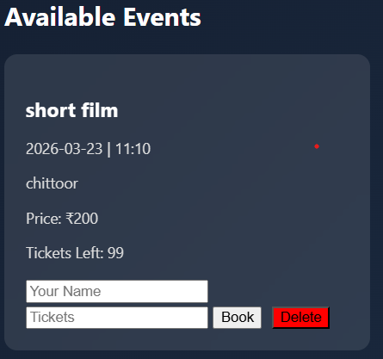
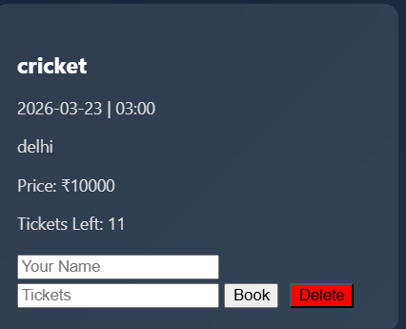
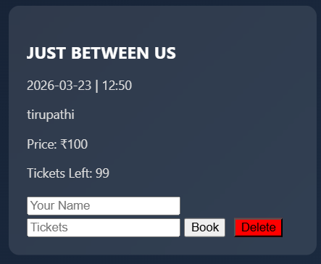
IMPLEMENTATION SCREENSHOTS
1
2
3
4
5
6
7
8(B)
9
Explanation:
Displays a list of available events with date, venue, and ticket price. Users can select quantity and click “Book” to reserve tickets.

Slide 13
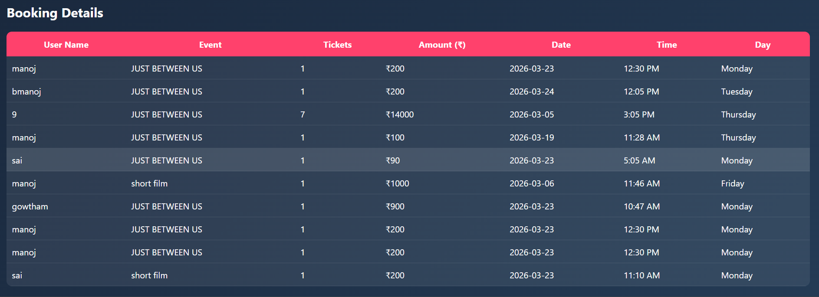
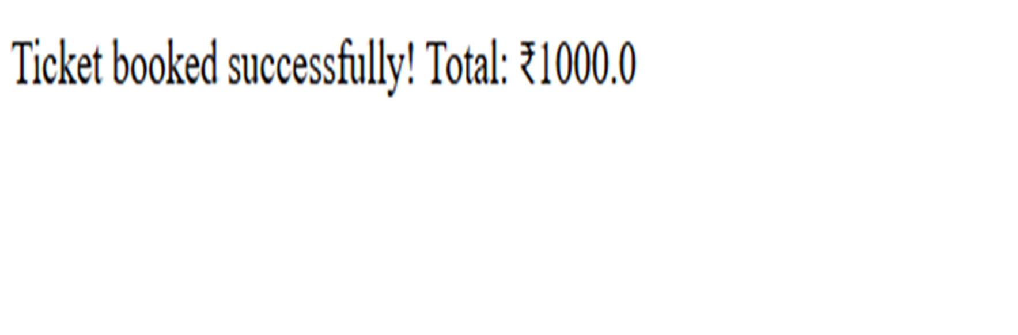
IMPLEMENTATION SCREENSHOTS
1
2
3
4
5
6
7
8(C)
Explanation:
This page displays dynamically with options organizer dashroad. And scanner to access the app defauls and navigation controls for submitting answers.
9

Slide 14
ADVANTAGES & LIMITATIONS
1
Advantages
Easy and convenient for users to book tickets online
Reduces manual work and paperwork
Faster event management and ticket processing
Centralized database for storing all information
Real-time updates on event availability
2
3
4
5
6
7
Limitations
Requires internet connection to access the system
Basic security (can be improved with advanced features)
Limited scalability for very large number of users
Payment integration may be basic or simulated
Requires regular maintenance and updates
8
9

Slide 15
Thank you

