Slide 1



School of Computing
Department of Computer Science and Engineering
ACADEMIC YEAR 2025 – 26 (Winter Semester)
BONAFIDE CERTIFICATE
NAME: Arava Saisnikitha
VTU NO: VTU28387
REG.NO: 23UECS2023
BRANCH: COMPUTER SCIENCE & ENGINEERING
YEAR/SEM: III/VI
SLOT: E3
Certified that this is a bonafide record of work done by above student in the "10211CS224 – Full Stack Application Development" during the year 2025 - 26.
SIGNATURE OF FACULTY INCHARGE SIGNATURE OF INCHARGE
Submitted for the Semester Model Examination held on at Vel Tech
06-05-2026
Rangarajan Dr. Sagunthala R & D Institute of Science and Technology.
EXAMINER 1
EXAMINER 2

Slide 3
Task-1: Student Registration & Data Storage System
AIM: To develop a Student Registration System that allows users to enter, store, and manage student details efficiently using a web interface and a MySQL database.
ALGORITHM:
Step 1: Start
Step 2: Open the web application (index page)
Step 3: Display home page with option to go to registration page Step 4: User navigates to the registration form
Step 5: User enters student details (like name, ID, course, etc.)
Step 6: Validate input fields
Check if fields are empty
Ensure correct data format
Step 7: Submit the form data to the server
Step 8: Server receives the data using Node.js
Step 9: Establish connection with MySQL database
If connection fails → display error
Else → proceed
Step 10: Insert student data into database table Step 11: Confirm successful storage of data
Step 12: Display success message to user
Step 13: Allow user to view/manage stored data (if implemented) Step 14: Stop
PROGRAM: INDEX.HTML:
<!DOCTYPE html>

Slide 4
<html>
<head>
<title>Student Portal</title>
<link rel="stylesheet" href="style.css">
</head>
<body>
<div class="home-container">
<h1>Welcome to Student Portal</h1>
<p>Register and manage student information easily.</p>
<a href="registration.html" class="start-btn">Go to Registration</a>
</div>
</body>
</html>
REGISTRATION.HTML:
<!DOCTYPE html>
<html>
<head>
<title>Student Registration</title>
<link rel="stylesheet" href="style.css">
</head>
<body>
<div class="container">
<h1>Student Registration</h1>
<button onclick="goHome()" class="home-btn">Home</button>
<form id="studentForm">
<label>Name</label>

Slide 5
<input type="text" id="name" placeholder="Enter your name" required>
<label>Email</label>
<input type="email" id="email" placeholder="Enter your email" required>
<label>Date of Birth</label>
<input type="date" id="dob" required>
<label>Department</label>
<select id="department" required>
<option value="">Select Department</option>
<option>CSE</option> <option>IT</option>
<option>ECE</option>
<option>MECH</option>
</select>
<label>Phone</label>
<input type="text" id="phone" placeholder="Enter phone number" required>
<button type="submit">Register</button>
</form>
</div>
<script src="script.js"></script>
</body>
</html> STYLE.CSS: body{ font-family: 'Segoe UI', sans-serif;
background: linear-gradient(135deg,#0f2027,#203a43,#2c5364); height:100vh;
display:flex; justify- content:center; align-
items:center; margin:0;
}

Slide 6
.container{ width:420px; padding:35px;
background:rgba(255,255,255,0.08); border-radius:18px; backdrop-filter: blur(10px); box-shadow:0 10px 35px rgba(0,0,0,0.6);
}
h1{ text-align:center; color:white; margin- bottom:25px;
}
h2{ text-align:center; color:white; margin- top:30px;
}
form{ display:flex;
flex-direction:column;
}
label{ color:#ddd; font-size:14px;
margin-bottom:5px; margin-top:10px;
}
input,select{ width:100%; padding:12px;
border:none; border- radius:8px;

Slide 7
background:#27496d;
color:white; font-
size:14px; outline:none; margin-bottom:5px;
}
input:focus,select:focus{ box-shadow:0 0 8px #00eaff; background:#2c5d8a;
}
button{ margin-top:15px; padding:12px;
border:none; border- radius:10px;
background:linear-
gradient(45deg,#ff4b2b, #ff416c); color:white;
font-size:16px; font- weight:bold;
cursor:pointer; transition:0.3s;
}
button:hover{ transform:scale(1.05); box-shadow:0 0 15px #ff416c;
}
#studentList{ margin-
top:15px; text-align:center; color:white; font-size:15px;

Slide 8
}
.home-container{ text-align:center; color:white;
background:rgba(255,255,255,0.08); padding:50px; border-radius:20px; backdrop-filter: blur(10px); box- shadow:0 10px 35px rgba(0,0,0,0.6); width:420px;
}
.home-container h1{ font-size:32px; margin-bottom:15px;
}
.home-container p{ margin- bottom:30px; color:#ddd;
}
.start-btn{ text-decoration:none; padding:12px 25px; border-radius:10px; background:linear-
gradient(45deg,#ff4b2b,#ff416c); color:white; font- weight:bold; transition:0.3s;
}
.start-btn:hover{
transform:scale(1.05); box-shadow:0 0 15px #ff416c;
}
SCRIPT.JS:

Slide 9
const form = document.getElementById("studentForm") form.addEventListener("submit", async
(e) => {
e.preventDefault() const student = { name: document.getElementById("name").value, email: document.getElementById("email").value, dob:
document.getElementById("dob").value, department: document.getElementById("department").value, phone: document.getElementById("phone").value
} try{ const res = await
fetch("http://localhost:3000/addStudent",{ method:"POST", headers:{
"Content-Type":"application/json"
},
body:JSON.stringify(student)
})
const data = await res.text() alert(data) // clear form
form.reset() }catch(error){ console.log("Error:",error)
} })
function goHome(){
window.location.href="index.html"
}
SERVER.JS: const express = require("express") const cors =

Slide 10
require("cors") const path =
require("path") const db = require("./db") const app = express() app.use(cors()) app.use(express.json())
// Serve static files (HTML, CSS, JS)
app.use(express.static( dirname)) // Redirect root link to index.html app.get("/", (req, res) => { res.sendFile(path.join( dirname, "index.html"))
})
// Insert student data app.post("/addStudent", (req, res) => { const
{name,email,dob,department,phone} = req.body const sql = "INSERT INTO students(name,email,dob,department,phone) VALUES (?,?,?,?,?)"
db.query(sql,[name,email,dob,department,phone],(err,result)=>{ if(err){ res.send(err) }else{
res.send("Student Added Successfully")
}
})
})
// Get student data
app.get("/students",(req,res)=>{ db.query("SELECT
* FROM students",(err,result)=>{ if(err){
res.send(err) }else{ res.json(result)

Slide 11
}
})
})
// Start server app.listen(3000,()=>{
console.log("Server running at: http://localhost:3000")
})
DB.JS:
const mysql = require("mysql") const db = mysql.createConnection({ host: "localhost", user: "root", password: "fahi",
database: "studentdb"
})
db.connect((err)=>{
if(err){ console.log("Database Error:", err)
}else{ console.log("MySQL Connected Successfully")
} })
module.exports = db
OUTPUTS:

Slide 12
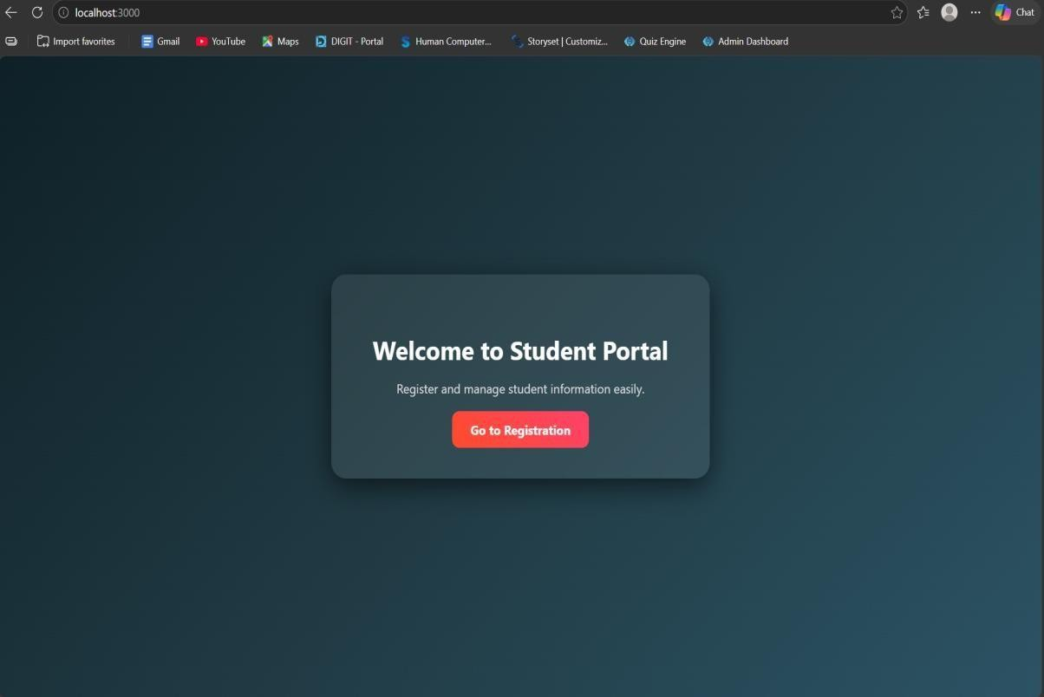
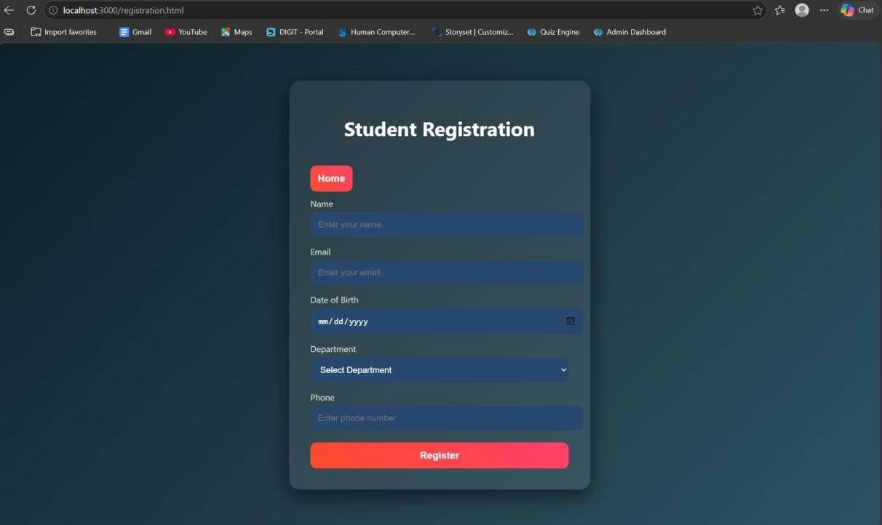
RESULT: The student registration system was successfully developed to store and manage student data using a web interface and MySQL database.
TASK2: Data Retrieval & Sorting Dashboard

Slide 13
AIM: To develop a web-based dashboard that allows users to store, retrieve, and display student data efficiently from a database, and present it in a structured format for easy access and
management.
ALGORITHM:
Start the application
Initialize the server using Express framework
Establish database connection using MySQL 4. Load frontend pages (HTML, CSS, JS) in browser
➤ Data Insertion Process:
User enters student details (Name, Email, DOB, Department, Phone)
Send data to backend using POST request (/addStudent)
Execute SQL query to insert data into database
Display success message after insertion
➤ Data Retrieval Process:
Send GET request to server (/students)
Fetch all student records from database
Convert data into JSON format
Display data dynamically in dashboard table.
Arrange data in structured format (table/grid)
Allow better readability and management
Stop.
PROGRAM: INDEX.HTML:
<!DOCTYPE html>
<html>
<head>

Slide 14
<title>Student Portal</title>
<link rel="stylesheet" href="style.css">
</head>
<body>
<div class="home-container">
<h1>Welcome to Student Portal</h1>
<p>Register and manage student information easily.</p>
<a href="registration.html" class="start-btn">Go to Registration</a>
<a href="dashboard.html" class="start-btn">View Dashboard</a>
</div>
</body>
</html>
REGISTRATION.HTML:
<!DOCTYPE html>
<html>
<head>
<title>Student Registration</title>
<link rel="stylesheet" href="style.css">
</head>
<body>
<div class="container">
<h1>Student Registration</h1>
<button onclick="goHome()" class="home-btn">Home</button>
<form id="studentForm">
<label>Name</label>

Slide 15
<input type="text" id="name" placeholder="Enter your name" required>
<label>Email</label>
<input type="email" id="email" placeholder="Enter your email" required>
<label>Date of Birth</label>
<input type="date" id="dob" required>
<label>Department</label>
<select id="department" required>
<option value="">Select Department</option>
<option>CSE</option> <option>IT</option>
<option>ECE</option>
<option>MECH</option>
</select>
<label>Phone</label>
<input type="text" id="phone" placeholder="Enter phone number" required>
<button type="submit">Register</button>
</form>
</div>
<script src="script.js"></script>
</body>
</html>
DASHBOARD.HTML:
<!DOCTYPE html>
<html>
<head>
<title>Student Dashboard</title>

Slide 16
<link rel="stylesheet" href="dashboard.css">
</head>
<body>
<div class="container">
<button onclick="goHome()" class="home-btn">Home</button>
<h1>Student Dashboard</h1>
<div class="controls">
<select id="sortSelect">
<option value="">Sort By</option>
<option value="name">Name</option>
<option value="dob">Date of Birth</option>
</select>
<select id="departmentFilter">
<option value="">Filter by Department</option>
<option value="CSE">CSE</option> <option value="IT">IT</option>
<option value="ECE">ECE</option>
<option value="MECH">MECH</option>
</select>
<button onclick="loadStudents()">Apply</button>
</div>
<table>
<thead>
<tr>
<th>ID</th>
<th>Name</th>

Slide 17
<th>Email</th>
<th>DOB</th>
<th>Department</th>
<th>Phone</th>
</tr>
</thead>
<tbody id="studentTable"></tbody>
</table>
<h2>Department Count</h2>
<div id="deptCount"></div>
</div>
<script src="dashboard.js"></script>
<script> function goHome(){ window.location.href = "index.html"
}
</script>
</body>
</html>
STYLE.CSS: body{ font-family: 'Segoe UI', sans-serif; background: linear-gradient(135deg,#0f2027,#203a43,#2c5364);
height:100vh; display:flex; justify-content:center; align- items:center; margin:0;
}

Slide 18
.container{ width:420px; padding:35px;
background:rgba(255,255,255,0.08); border-radius:18px; backdrop-filter: blur(10px); box-shadow:0 10px 35px rgba(0,0,0,0.6);
}
h1{ text-align:center; color:white; margin- bottom:25px;
}
h2{ text-align:center; color:white; margin- top:30px; }
form{ display:flex;
flex-direction:column;
}
label{ color:#ddd; font-size:14px;
margin-bottom:5px; margin-top:10px;
}

Slide 19
input,select{ width:100%;
padding:12px;
border:none; border- radius:8px;
background:#27496d; color:white; font-
size:14px; outline:none; margin-bottom:5px;
} input:focus,select:focus{ box-shadow:0 0 8px #00eaff; background:#2c5d8a;
}
button{ margin-top:15px; padding:12px; border:none; border-radius:10px;
background:linear-gradient(45deg,#ff4b2b,#ff416c); color:white; font-size:16px; font-weight:bold;
cursor:pointer; transition:0.3s;
}
button:hover{ transform:scale(1.05); box-shadow:0 0 15px #ff416c;
}
#studentList{ margin-top:15px; text-align:center; color:white; font-size:15px;
}

Slide 20
.home-container{ text-align:center;
color:white;
background:rgba(255,255,255,0.08); padding:50px; border-radius:20px; backdrop-filter: blur(10px); box- shadow:0 10px 35px rgba(0,0,0,0.6); width:420px;
}
.home-container h1{ font-size:32px; margin-bottom:15px;
}
.home-container p{ margin- bottom:30px; color:#ddd;
}
.start-btn{ text-decoration:none; padding:12px 25px; border- radius:10px; background:linear- gradient(45deg,#ff4b2b,#ff416c)
; color:white; font-weight:bold; transition:0.3s;
}

Slide 21
.start-btn:hover{
transform:scale(1.05); box-shadow:0 0 15px #ff416c;
}
DASHBOARD.CSS: body{ font-family:Segoe UI;
background:linear-gradient(135deg,#0f2027,#203a43,#2c5364); margin:0; padding:0; display:flex; justify-content:center;
}
.container{ width:900px; margin-top:40px;
background:rgba(255,25 5,255,0.08);
padding:30px; border-
radius:15px; backdrop- filter:blur(10px);
color:white;
}
h1{ text-align:center; margin-bottom:20px;
}

Slide 22
.controls{ display:flex;
gap:10px; margin- bottom:20px;
}
select,button{
padding:10px; border:none; border-radius:6px;
}
button{ background:#ff416c; color:white; cursor:pointer;
}
table{ width:100%; border- collapse:collapse;
background:rgba(255,255,255,0.1);
}
th,td{ padding:10px; text-align:center;
}
th{
background:#1f4068;
}

Slide 23
tr:nth-child(even){ background:rgba(255,255,255,0.05);
}
#deptCount{ margin-top:15px; font-size:16px;
}
.home-btn{ padding:8px 16px; border:none;
border-radius:6px; background:#00c6ff; color:white;
cursor:pointer; margin- bottom:10px;
}
SCRIPT.JS:
const form = document.getElementById("studentForm") form.addEventListener("submit", async (e) => {
e.preventDefault() const student = { name:
document.getElementById("name").value, email: document.getElementById("email").value, dob: document.getElementById("dob").value, department:
document.getElementById("department").value, phone: document.getElementById("phone").value

Slide 24
} try{ const res = await
fetch("http://localhost:3000/addStudent",{ method:"POST", headers:{
"Content-Type":"application/json"
},
body:JSON.stringify(student)
})
const data = await res.text() alert(data) // clear form
form.reset() }catch(error){ console.log("Error:",error)
} })
function goHome(){ window.location.href="index.html"
}
SERVER.JS:
const express = require("express") const cors = require("cors") const path = require("path") const db = require("./db") const app = express() app.use(cors()) app.use(express.json()) // Serve static files (HTML, CSS, JS)
app.use(express.static( dirname))
// Redirect root link to index.html app.get("/", (req, res) => {

Slide 25
res.sendFile(path.join( dirname,
"index.html"))
})
// Insert student data app.post("/addStudent", (req, res) => { const
{name,email,dob,department,phone} = req.body const sql = "INSERT INTO students(name,email,dob,department,phone) VALUES (?,?,?,?,?)"
db.query(sql,[name,email,dob,department,phone],(err,result)=>{ if(err){ res.send(err) }else{
res.send("Student Added Successfully")
}
})
})
// Get student data
app.get("/students",(req,res)=>{ db.query("SELECT
* FROM students",(err,result)=>{ if(err){
res.send(err) }else{ res.json(result)
}
})
})
// Start server app.listen(3000,()=>{
console.log("Server running at: http://localhost:3000")
})

Slide 26
DB.JS:
const mysql = require("mysql") const db = mysql.createConnection({ host: "localhost", user: "root",
password: "fahi", database: "studentdb"
})
db.connect((err)=>{
if(err){ console.log("Database Error:", err)
}else{ console.log("MySQL Connected Successfully")
} })
module.exports = db
OUTPUTS:

Slide 27
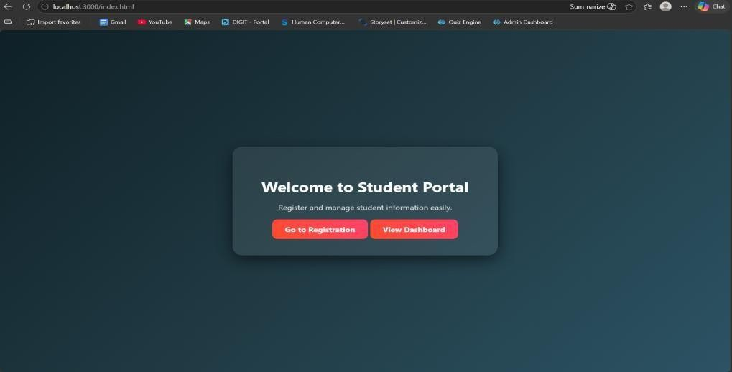
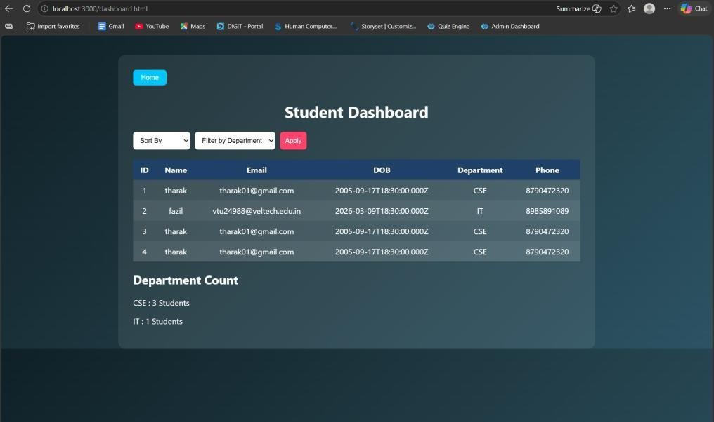
RESULT: The system successfully stores, retrieves, and displays student data efficiently through a user-friendly dashboard.
TASK3: : Login System with Validation

Slide 28
AIM: To develop a secure login system that validates user credentials (username and password) and allows access only to authorized users.
ALGORITHM:
Start the application
Display login form (Username & Password fields)
User enters login credentials
Perform input validation:
o Check if fields are empty o Validate email format (if applicable) o Ensure password meets required criteria
Send login data to backend server
Server receives request and processes input 7. Compare entered credentials with database records
If credentials match:
Grant access and redirect to dashboard
Else:
Display error message (“Invalid Username/Password”)
End process
PROGRAM: INDEX.HTML:
<!DOCTYPE html>
<html>
<head>
<title>Student Portal</title>

Slide 29
<link rel="stylesheet" href="style.css">
</head>
<body>
<div class="home-container">
<h1>Welcome to Student Portal</h1>
<p>Register and manage student information easily.</p>
<a href="registration.html" class="start-btn">Go to Registration</a>
<a href="dashboard.html" class="start-btn">View Dashboard</a>
</div>
</body>
</html>
DASHBOARD.HTML:
<!DOCTYPE html>
<html>
<head>
<title>Student Dashboard</title>
<link rel="stylesheet" href="dashboard.css">
</head>
<body>
<div class="container">
<button onclick="goHome()" class="home-btn">Home</button>
<h1>Student Dashboard</h1>
<div class="controls">
<select id="sortSelect">
<option value="">Sort By</option>

Slide 30
<option value="name">Name</option>
<option value="dob">Date of Birth</option>
</select>
<select id="departmentFilter">
<option value="">Filter by Department</option>
<option value="CSE">CSE</option> <option value="IT">IT</option>
<option value="ECE">ECE</option>
<option value="MECH">MECH</option>
</select>
<button onclick="loadStudents()">Apply</button>
</div>
<table>
<thead>
<tr>
<th>ID</th>
<th>Name</th>
<th>Email</th>
<th>DOB</th>
<th>Department</th>
<th>Phone</th>
</tr>
</thead>
<tbody id="studentTable"></tbody>
</table>
<h2>Department Count</h2>

Slide 31
<div id="deptCount"></div>
</div>
<script src="dashboard.js"></script>
<script> function goHome(){ window.location.href = "index.html"
}
</script>
</body>
</html>
LOGIN.HTML:
<!DOCTYPE html>
<html>
<head>
<title>Login</title>
<link rel="stylesheet" href="login.css">
</head>
<body>
<div class="login-container">
<h1>Login</h1>
<form id="loginForm">
<label>Username</label>
<input type="text" id="username"> <label>Password</label>
<input type="password" id="password">
<p id="errorMsg"></p>

Slide 32
<button type="submit">Login</button>
</form>
</div>
<script src="login.js"></script>
</body>
</html>
REGISTRATION.HTML:
<!DOCTYPE html>
<html>
<head>
<title>Student Registration</title>
<link rel="stylesheet" href="style.css">
</head>
<body>
<div class="container">
<h1>Student Registration</h1>
<button onclick="goHome()" class="home-btn">Home</button>
<form id="studentForm">
<label>Name</label>
<input type="text" id="name" placeholder="Enter your name" required>
<label>Email</label>
<input type="email" id="email" placeholder="Enter your email" required> <label>Date of Birth</label>
<input type="date" id="dob" required>
<label>Department</label>

Slide 33
<select id="department" required>
<option value="">Select Department</option>
<option>CSE</option> <option>IT</option>
<option>ECE</option>
<option>MECH</option>
</select>
<label>Phone</label>
<input type="text" id="phone" placeholder="Enter phone number" required>
<button type="submit">Register</button>
</form>
</div>
<script src="script.js"></script>
</body>
</html>
STYLE.CSS: body{ font-family: 'Segoe UI', sans-serif; background: linear-gradient(135deg,#0f2027,#203a43,#2c5364);
height:100vh; display:flex; justify-content:center;
align-items:center; margin:0;
}
.container{ width:420px; padding:35px; background:rgba(255,255,255,0.08); border-radius:18px; backdrop-filter: blur(10px); box-shadow:0 10px 35px rgba(0,0,0,0.6);

Slide 34
}
h1{ text-align:center; color:white; margin- bottom:25px;
}
h2{ text-align:center; color:white; margin- top:30px;
}
form{
display:flex; flex-direction:column;
}
label{ color:#ddd; font-size:14px;
margin- bottom:5px;
margin-top:10px;
}
input,select{ width:100%; padding:12px;
border:none; border-

Slide 35
radius:8px;
background:#27496d; color:white; font-
size:14px; outline:none; margin-bottom:5px;
}
input:focus,select:focus{ box-shadow:0 0 8px #00eaff; background:#2c5d8a;
}
button{ margin-top:15px; padding:12px; border:none; border-radius:10px;
background:linear-
gradient(45deg,#ff4b2b,#ff416c); color:white; font- size:16px; font-weight:bold; cursor:pointer; transition:0.3s;
}
button:hover{ transform:scale(1.05); box-shadow:0 0 15px #ff416c;
}
#studentList{ margin- top:15px; text-

Slide 36
align:center; color:white;
font-size:15px;
}
.home-container{ text-align:center; color:white;
background:rgba(255,255,255,0.08); padding:50px; border-radius:20px; backdrop-filter: blur(10px); box- shadow:0 10px 35px rgba(0,0,0,0.6); width:420px;
}
.home-container h1{ font-size:32px; margin-bottom:15px;
}
.home-container p{ margin- bottom:30px; color:#ddd;
}
.start-btn{ text-decoration:none; padding:12px 25px; border-radius:10px; background:linear-
gradient(45deg,#ff4b2b,#ff416c); color:white; font- weight:bold; transition:0.3s;
}

Slide 37
.start-btn:hover{
transform:scale(1.05); box- shadow:0 0 15px #ff416c;
}
SERVER.JS:
const express = require("express") const cors = require("cors") const path = require("path") const db = require("./db") const app = express()
app.use(cors()) app.use(express.json())
app.use(express.urlencoded({ extended: true }))
// Disable default index.html loading
app.use(express.static( dirname, { index: false
}))
// ==========================
// OPEN LOGIN PAGE FIRST //
==========================
app.get("/", (req, res) => { res.sendFile(path.join( dirname, "login.html")) })
// ==========================
// LOGIN SYSTEM
// ========================== app.post("/login",(req,res)=>{ const
{username,password} = req.body const sql = "SELECT * FROM users WHERE username=? AND password=?"
db.query(sql,[username,password],(err,result)=>{

Slide 38
if(err){
res.send("error") return
}
if(result.length > 0){ res.send("success")
}else{ res.send("fail")
}
})
})
// ==========================
// STUDENT REGISTRATION
// ========================== app.post("/addStudent",(req,res)=>{ const
{name,email,dob,department,phone} = req.body const sql = "INSERT INTO students(name,email,dob,department,phone) VALUES (?,?,?,?,?)"
db.query(sql,[name,email,dob,department,phone],(err,result)=>{
if(err){ res.send(err) }else{ res.send("Student Added Successfully")
}
})
})
// ==========================
// GET STUDENTS (Dashboard)
// ==========================

Slide 39
app.get("/students",(req,res)=>{
db.query("SELECT * FROM students",(err,result)=>{
if(err){ res.send(err)
}else{
res.json(result)
}
})
})
// ==========================
// START SERVER
// ==========================
app.listen(3000,()=>{ console.log("Server running at: http://localhost:3000")
})
OUTPUTS:

Slide 40
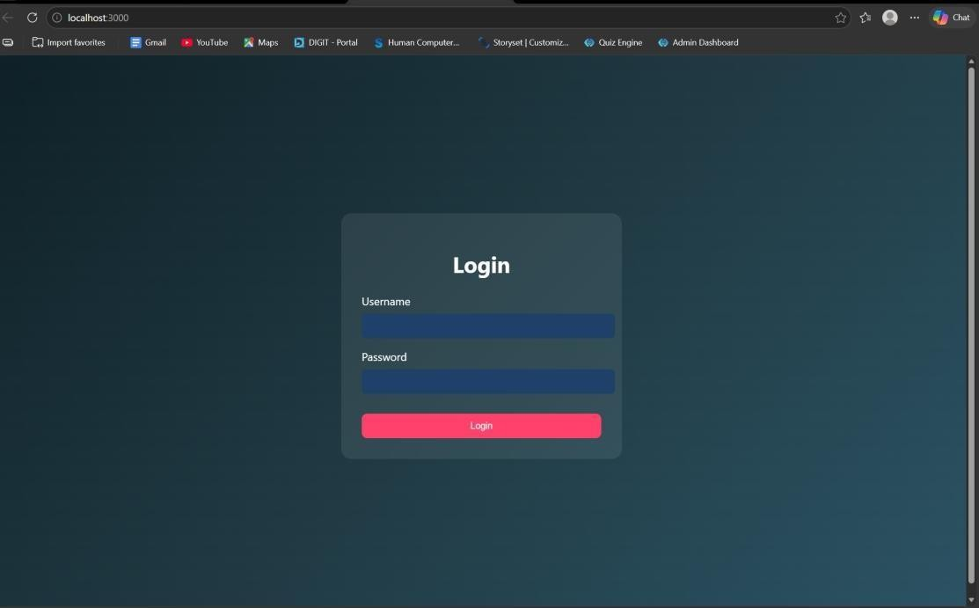
RESULT: The system successfully validates user credentials and grants access only to authorized users while preventing invalid logins.
TASK4: Order Management using Joins
AIM: To design and implement an order management system using SQL joins and subqueries to efficiently retrieve and analyze customer, product, and order data.
ALGORITHM:
Start the process
Create database tables:

Slide 41
o Customers (CustomerID, Name, etc.) o Products
(ProductID, ProductName, Price) o Orders (OrderID, CustomerID, ProductID, Quantity, TotalAmount)
Insert sample data into all tables
➤ Data Retrieval using Joins:
Use SQL JOIN queries to combine data from Customers, Orders, and Products 5. Display customer order history with details (Name, Product, Quantity, Total Amount)
➤ Subquery for Analysis:
Use subquery to find the highest value order
Use subquery with GROUP BY to find the most active customer (maximum number of orders)
➤ Sorting:
Apply ORDER BY clause to sort results (e.g., highest order value first)
Display results in structured format (table/UI with CSS if frontend used) 10. Stop
PROGRAM:
INDEX.HTML:
<!DOCTYPE html>
<html>
<head>
<title>Login</title>
<link rel="stylesheet" href="style.css">
</head>
<body>

Slide 42
<div class="login">
<h2>Admin Login</h2>
<input type="text" id="username" placeholder="Username">
<input type="password" id="password" placeholder="Password">
<button onclick="login()">Login</button>
</div>
<script src="script.js"></script>
</body>
</html>
ADMINDASHBOARD.HTML:
<!DOCTYPE html>
<html>
<head>
<title>Order Dashboard</title>
<link rel="stylesheet" href="style.css">
</head>
<body>
<!-- NAVBAR -->
<div class="navbar">
<h2>Order Management</h2>
<a href="index.html">
<button class="logout-btn">Logout</button>
</a>
</div>

Slide 43
<h1>Order Management Dashboard</h1>
<!-- CARDS SECTION -->
<div class="grid">
<!-- Add Customer -->
<div class="card">
<h3>Add Customer</h3>
<input id="cname" placeholder="Customer Name">
<input id="cemail" placeholder="Email">
<button onclick="addCustomer()">Add Customer</button>
</div>
<!-- Add Product -->
<div class="card">
<h3>Add Product</h3>
<input id="pname" placeholder="Product Name">
<input id="pprice" placeholder="Price">
<button onclick="addProduct()">Add Product</button>
</div>
<!-- Place Order -->
<div class="card">
<h3>Place Order</h3>
<select id="customerSelect">
<option value="">Select Customer</option>
</select>
<select id="productSelect">
<option value="">Select Product</option>
</select>

Slide 44
<input id="qty" placeholder="Quantity">
<button onclick="placeOrder()">Place Order</button>
</div>
</div>
<!-- ACTION BUTTONS -->
<div class="actions">
<button onclick="loadOrders()">Order History</button>
<button onclick="highestOrder()">Highest Order</button>
<button onclick="activeCustomer()">Most Active Customer</button>
</div>
<!-- RESULT AREA -->
<div id="result"></div>
<script src="script.js"></script>
</body>
</html>
STYLE.CSS:
*{ margin:0; padding:0; box-sizing:border-box; font-family: 'Segoe UI', Tahoma, Geneva, Verdana, sans-serif;
}
body{ background: linear-
gradient(135deg,#5f6caf,#9a6bff); min-height:100vh; display:flex; flex-direction:column; align-
items:center;
}

Slide 45
/* LOGIN PAGE */
.login{ width:350px; padding:40px;
margin-top:120px; background:white;
border-radius:15px; box-shadow:0 10px 25px rgba(0,0,0,0.2); text-align:center;
}
.login h2{ margin-bottom:20px; color:#333;
}
.login input{ width:100%; padding:12px;
margin:10px 0;
border:1px solid #ccc; border-radius:8px; outline:none;
}
.login button{ width:100%; padding:12px;
border:none;
background:#5f6caf; color:white; font-

Slide 46
weight:bold; border-
radius:8px; cursor:pointer; transition:0.3s;
}
.login button:hover{ background:#7c4dff;
}
/* DASHBOARD TITLE */
h1{ margin-top:30px; margin-bottom:25px; color:white;
}
/* CARD GRID */
.grid{ display:flex; gap:25px; flex- wrap:wrap; justify- content:center;
margin-bottom:20px;
}
/* CARDS */
.card{

Slide 47
width:260px; padding:22px; border-
radius:15px; box-shadow:0 8px 20px rgba(0,0,0,0.2); text-align:center; transition:0.3s; color:white;
}
/* Different card colors */
.card:nth-child(1){ background:linear-gradient(135deg,#ff7a18,#ffb347);
}
.card:nth-child(2){ background:linear-gradient(135deg,#00c6ff,#0072ff);
}
.card:nth-child(3){ background:linear-
gradient(135deg,#43e97b,#38f9d7); color:#222;
}
.card:hover{ transform:translateY(-6px);
}
.card h3{ margin-bottom:10px;
}
/* INPUTS */

Slide 48
.card input{ width:90%;
padding:10px;
margin:6px; border- radius:6px;
border:none;
}
/* CARD BUTTON */
.card button{ padding:10px 15px; border:none;
background:white; color:#333; border-
radius:6px; cursor:pointer; font-weight:bold; transition:0.3s;
}
.card button:hover{ background:#f1f1f1;
}
/* ACTION BUTTONS */
button{ margin:10px; padding:12px 18px; border:none;

Slide 49
border-radius:6px;
background:#ffffff; color:#333; font- weight:bold;
cursor:pointer; transition:0.3s;
}
button:hover{ background:#eaeaea;
}
/* TABLE */
table{ width:85%; margin:auto; margin- top:30px; border-collapse:collapse;
background:white; border-radius:12px; overflow:hidden; box-shadow:0 5px
15px rgba(0,0,0,0.2);
}
th{ background:#5f6caf; color:white;
padding:14px; font- size:18px;
}

Slide 50
td{ padding:12px; text-
align:center; border- bottom:1px solid #ddd;
color:#222; font-weight:500;
}
tr:nth-child(even){ background:#f7f7f7;
}
tr:hover{ background:#eef1ff;
}
/* RESULT TEXT */
#result{ margin-top:20px; color:white; font-
size:18px; text- align:center;
}
/* NAVBAR */
.navbar{
width:100%; display:flex; justify-
content:space-between; align- items:center; padding:15px

Slide 51
40px; background:#2c2f5c;
color:white; box-shadow:0 4px 10px rgba(0,0,0,0.2);
}
.navbar h2{ font-weight:600;
}
.logout-btn{
background:#ff5252; color:white; border:none; padding:10px 16px;
border-radius:6px; cursor:pointer; font- weight:bold;
}
.logout-btn:hover{ background:#ff1744;
}
.actions{

Slide 52
display:flex; justify-
content:center; gap:20px; margin-top:30px; flex- wrap:wrap;
}
.actions button{
padding:12px 20px; font- size:16px; border:none; border-radius:8px;
background:#5f6caf;
color:white; cursor:pointer; transition:0.3s;
}
.actions button:hover{
background:#7c4dff; transform:scale(1.05);
}
SCRIPT.JS:
// LOGIN FUNCTION
function login(){

Slide 53
const username=document.getElementById("username").value const
password=document.getElementById("password").value
fetch("/login",{
method:"POST", headers:{"Content-Type":"application/json"}, body:JSON.stringify({username,password})
})
.then(res=>res.json())
.then(data=>{ if(data.success){
window.location="admindashboard.html"
}else{ alert("Invalid login") }
})
}
// ADD CUSTOMER
function addCustomer(){

Slide 54
fetch("/add-customer",{
method:"POST", headers:{"Content-Type":"application/json"}, body:JSON.stringify({
name:document.getElementById("cname").value, email:document.getElementById("cemail").value
})
})
.then(res=>res.text())
.then(alert)
}
// ADD PRODUCT
function addProduct(){ fetch("/add-product",{
method:"POST", headers:{"Content-Type":"application/json"},

Slide 55
body:JSON.stringify({
product:document.getElementById("pname").value, price:document.getElementById("pprice").value
})
})
.then(res=>res.text())
.then(alert)
}
// LOAD CUSTOMERS INTO DROPDOWN
async function loadCustomers(){
const res = await fetch("/customers") const data = await res.json()
let select=document.getElementById("customerSelect") if(!select) return

Slide 56
select.innerHTML='<option value="">Select Customer</option>'
data.forEach(c=>{
select.innerHTML+=`<option value="${c.id}">${c.name}</option>`
})
}
// LOAD PRODUCTS INTO DROPDOWN
async function loadProducts(){
const res = await fetch("/products") const data = await res.json()
let select=document.getElementById("productSelect") if(!select) return
select.innerHTML='<option value="">Select Product</option>' data.forEach(p=>{

Slide 57
select.innerHTML+=`<option value="${p.id}">${p.product_name}</option>`
})
}
// PLACE ORDER
function placeOrder(){ fetch("/place-order",{
method:"POST", headers:{"Content-Type":"application/json"}, body:JSON.stringify({
customer_id:document.getElementById("customerSelect").value,
product_id:document.getElementById("productSelect").value, quantity:document.getElementById("qty").value
})
})
.then(res=>res.text())
.then(alert)

Slide 58
}
// ORDER HISTORY (JOIN)
async function loadOrders(){
const res=await fetch("/orders") const data=await res.json()
let
html="<table><tr><th>Customer</th><th>Product</th><th>Price</th><th>Qty</th><th>Total<
/th></tr>"
data.forEach(o=>{
html+=`
<tr>
<td>${o.name}</td>
<td>${o.product_name}</td>
<td>${o.price}</td>
<td>${o.quantity}</td>
<td>${o.total}</td>

Slide 59
</tr>
`
})
html+="</table>"
document.getElementById("result").innerHTML=html
}
// HIGHEST ORDER (SUBQUERY)
async function highestOrder(){
const res=await fetch("/highest-order") const data=await res.json()
document.getElementById("result").innerHTML=
`<h2>Highest Order</h2>
${data[0].name} - ₹${data[0].total}`
}

Slide 60
// MOST ACTIVE CUSTOMER
async function activeCustomer(){
const res=await fetch("/active-customer") const data=await res.json()
document.getElementById("result").innerHTML=
`<h2>Most Active Customer</h2> ${data[0].name} (${data[0].total_orders} orders)`
}
// AUTO LOAD DROPDOWNS WHEN PAGE LOADS
window.onload=function(){ loadCustomers() loadProducts()
}
SERVER.JS:
const express=require("express") const db=require("./db")

Slide 61
const app=express()
app.use(express.json()) app.use(express.static( dirname))
// LOGIN
app.post("/login",(req,res)=>{
const {username,password}=req.body
const sql="SELECT * FROM users WHERE username=? AND password=?" db.query(sql,[username,password],(err,result)=>{
if(err) throw err
if(result.length>0){ res.json({success:true})
}else{ res.json({success:false})
}
})
})
// ADD CUSTOMER

Slide 62
app.post("/add-customer",(req,res)=>{
const {name,email}=req.body
const sql="INSERT INTO customers(name,email) VALUES(?,?)"
db.query(sql,[name,email],(err)=>{ if(err) throw err
res.send("Customer Added Successfully")
})
})
// ADD PRODUCT
app.post("/add-product",(req,res)=>{ const {product,price}=req.body
const sql="INSERT INTO products(product_name,price) VALUES(?,?)" db.query(sql,[product,price],(err)=>{

Slide 63
if(err) throw err
res.send("Product Added Successfully")
})
})
// GET CUSTOMERS (for dropdown)
app.get("/customers",(req,res)=>{
const sql="SELECT * FROM customers" db.query(sql,(err,result)=>{
if(err) throw err res.json(result)
})
})
// GET PRODUCTS (for dropdown)

Slide 64
app.get("/products",(req,res)=>{
const sql="SELECT * FROM products"
db.query(sql,(err,result)=>{ if(err) throw err
res.json(result)
})
})
// PLACE ORDER
app.post("/place-order",(req,res)=>{
const {customer_id,product_id,quantity}=req.body
const sql="INSERT INTO orders(customer_id,product_id,quantity) VALUES(?,?,?)" db.query(sql,[customer_id,product_id,quantity],(err)=>{
if(err) throw err

Slide 65
res.send("Order Placed Successfully")
})
})
// ORDER HISTORY (JOIN)
app.get("/orders",(req,res)=>{ const sql=`
SELECT customers.name, products.product_name, products.price, orders.quantity,
(products.price * orders.quantity) AS total
FROM orders
JOIN customers
ON orders.customer_id = customers.id
JOIN products
ON orders.product_id = products.id
ORDER BY orders.order_date DESC

Slide 66
`
db.query(sql,(err,result)=>{
if(err) throw err res.json(result)
})
})
// HIGHEST VALUE ORDER (SUBQUERY)
app.get("/highest-order",(req,res)=>{ const sql=`
SELECT customers.name,
(products.price * orders.quantity) AS total
FROM orders
JOIN customers
ON orders.customer_id = customers.id
JOIN products

Slide 67
ON orders.product_id = products.id WHERE (products.price * orders.quantity) =
(
SELECT MAX(products.price * orders.quantity) FROM orders
JOIN products
ON orders.product_id = products.id
)
`
db.query(sql,(err,result)=>{ if(err) throw err
res.json(result)
})
})
// MOST ACTIVE CUSTOMER
app.get("/active-customer",(req,res)=>{ const sql=`

Slide 68
SELECT customers.name,
COUNT(orders.id) AS total_orders
FROM customers
JOIN orders
ON customers.id = orders.customer_id
GROUP BY customers.id
ORDER BY total_orders DESC LIMIT 1
`
db.query(sql,(err,result)=>{ if(err) throw err
res.json(result)
})
})

Slide 69
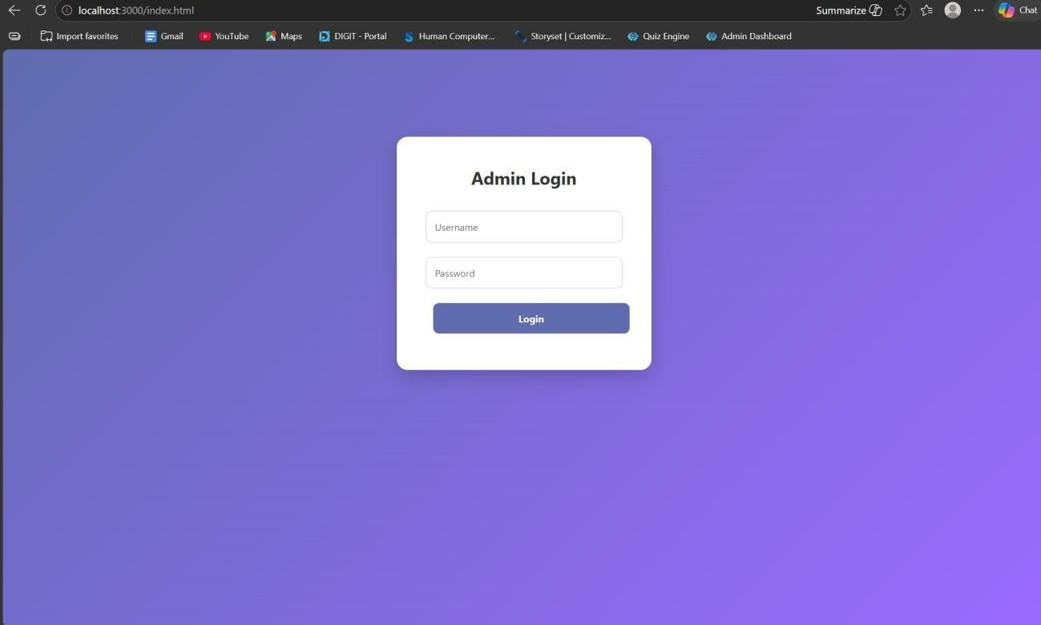
// START SERVER
app.listen(3000,()=>{
console.log("Server running at http://localhost:3000")
})
OUTPUTS:

Slide 70
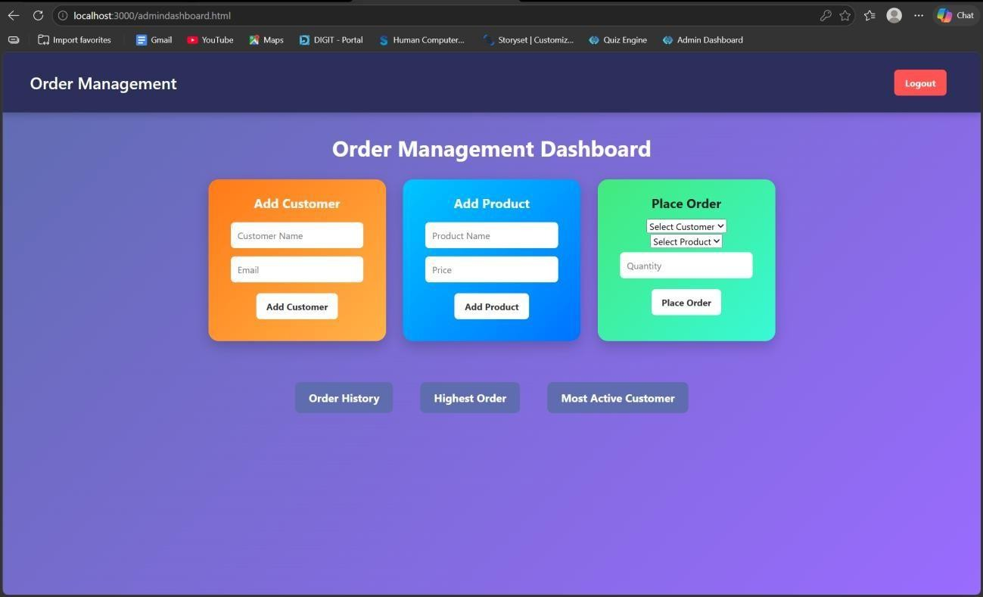
RESULT: The system successfully retrieves and analyzes customer order data using joins and subqueries, displaying meaningful insights like highest order value and most active customer.
TASK5: Transaction-Based Payment Simulation
AIM: To simulate an online payment system using database transactions that ensures safe and reliable fund transfer between user and merchant accounts using COMMIT and ROLLBACK operations.
ALGORITHM:
Start the process
Create database tables:
o User Account (UserID, Balance) o
Merchant Account (MerchantID, Balance) 3. Insert initial balance values for user and merchant

Slide 71
➤ Transaction Process:
Begin transaction (START TRANSACTION)
Deduct amount from user account
Add amount to merchant account
➤ Validation:
Check if user has sufficient balance o
If yes → proceed o
If no → go to rollback
➤ Commit / Rollback:
If all operations are successful → COMMIT transaction
If any error occurs → ROLLBACK transaction
Display transaction status (Success / Failed)
Stop
PROGRAM:
INDEX.HTML:
<!DOCTYPE html>
<html>
<head>
<title>Payment Simulation</title>
<link rel="stylesheet" href="style.css">
</head>
<body>
<div class="container">
<h2>Online Payment</h2>
<select id="user" onchange="updateBalances()"></select>
<select id="merchant" onchange="updateBalances()"></select>
<input type="number" id="amount" placeholder="Enter amount">

Slide 72
<button onclick="pay()">Pay</button>
<h3 id="userBalance"></h3>
<h3 id="merchantBalance"></h3>
<p id="result"></p>
</div>
<script src="script.js"></script>
</body>
</html>
STYLE.CSS: body{
font-family: Arial; background:
linear-
gradient(135deg,
#dfe9f3,#ffffff); display:flex; justify-
content:center; align-
items:center; height:100vh;
}
.container{ background:white;
padding:30px; border-radius:15px; box-

Slide 73
shadow:0 10px 25px rgba(0,0,0,0.2);
text-align:center; width:400px;
}
select, input{ padding:10px;
margin:10px; width:90%; border-radius:5px;
border:1px solid #ccc;
}
button{ padding:10px; width:95%;
background:green; color:white;
border:none; border-
radius:5px;
cursor:pointer; font- size:16px;
}
button:hover{ background:darkgreen;
}
h3{ margin:5px; color:#333;

Slide 74
}
SCRIPT.JS: let
usersData = [] let merchantsData = []
function loadData(){ fetch("/balances")
.then(res=>res.json())
.then(data=>{ usersData
= data.users
merchantsData = data.merchants let userSelect =
document.getElementB yId("user") let
merchantSelect =
document.getElementB yId("merchant")
userSelect.innerHTML= ""
merchantSelect.innerH TML=""
// fill users
usersData.forEach(u=>{ userSelect.innerHTML += `<option value="${u.id}">${u.name}</option>`
})

Slide 75
window.onload = loadData // fill merchants merchantsData.forEach(m=>{
merchantSelect.innerHTML += `<option value="${m.id}">${m.name}</option>`
})
// show initial balances updateBalances()
})
}
function updateBalances(){ let userId =
document.getElementById("user").value let merchantId = document.getElementById("merchant").value let user = usersData.find(u=>u.id == userId) let merchant =
merchantsData.find(m=>m.id == merchantId)
document.getElementById("userBalance").innerText =
"User Balance: ₹" + user.balance document.getElementById("merchantBalance").innerText
= "Shop Balance: ₹" + merchant.balance
}
function pay(){ let userId =
document.getElementById("user").value let merchantId = document.getElementById("merchant").value let amount = document.getElementById("amount").value fetch("/pay",{ method:"POST", headers:{
"Content-Type":"application/json"
},
body:JSON.stringify({ userId:userId, merchantId:merchantId, amount:amount
})

Slide 76
})
.then(res=>res.json()) .then(data=>{
document.getElementById("result").innerText = data.message loadData()
})
}
window.onload = loadData
SERVER.JS: const express = require("express") const db =
require("./db") const app = express() app.use(express.json())
app.use(express.static( dirname)) app.get("/", (req, res) => {
res.sendFile( dirname + "/index.html")
})
app.post("/pay", (req, res) => {
const { userId,
merchantId, amount } = req.body
const amt =
parseInt(amount) if (!amt || amt <= 0) {
res.json({ message: "Enter valid amount" })
return
}
db.beginTransaction(err => { if (err) return res.status(500).send("Transaction error")
// 1. Get user balance db.query("SELECT balance FROM users WHERE id=?", [userId], (err, result) => { if (err || result.length === 0) {
return db.rollback(() => res.send("User not found"))
}

Slide 77
let balance = result[0].balance
< amt) { return db.rollback(() => {
if (balance
res.json({ message: "Insufficient Balance" })
})
}
// 2. Deduct from user db.query(
"UPDATE users SET balance = balance - ? WHERE id=?", [amt, userId],
(err) => {
if (err)
{
return db.rollback(() => res.send("Deduction failed"))
}
// 3. Add to merchant
db.query(
"UPDATE merchants SET balance = balance + ? WHERE id=?", [amt, merchantId],
(err) => {
if (err)
{
return db.rollback(() => res.send("Merchant update failed"))
}

Slide 78
// 4. Commit
db.commit(err => {
if (err) {
return db.rollback(() => res.send("Commit failed"))
}
res.json({ message: "Payment Successful " })
})
}
)
}
)
})
})
})
app.get("/balances", (req, res) => {
db.query("SELECT * FROM users", (err, users) => { if (err) return res.send("Error fetching users")
db.query("SELECT * FROM merchants", (err, merchants) => { if (err) return res.send("Error fetching merchants")

Slide 79
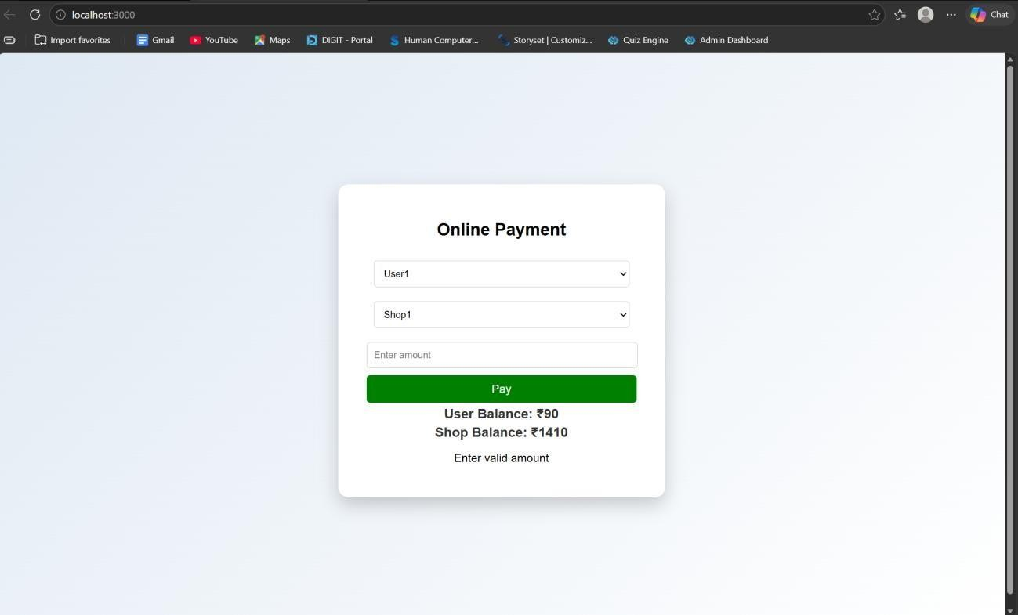
res.json({
users:
users,
merchants:
merchants
})
})
})
})
app.listen(3000, () => {
console.log("Server running on
http://localhost:3000")
})
OUTPUTS:
RESULT: The system successfully performs secure payment transactions by updating balances accurately using COMMIT on success and ROLLBACK on failure.
TASK6: Automated Logging using Triggers & Views

Slide 80
AIM: To develop a web-based application for automated logging of database activities using MySQL triggers and views, integrated with a Node.js backend and frontend interface, in order to track INSERT and UPDATE operations and generate daily activity reports.
ALGORITHM:
Start the program
Create database and required tables
Create triggers for INSERT and UPDATE operations
Store actions in log table automatically
Create a view for daily activity report
Develop backend using Node.js and Express
Connect backend with MySQL database
Create APIs for add, update, logs, and report
Design frontend using HTML, CSS, and JavaScript
Run the application and display results
Stop the program
PROGRAM:
INDEX.HTML:
<!DOCTYPE html>
<html>
<head>
<title>Employee Audit System</title>
<link rel="stylesheet" href="style.css">
</head>
<body>
<h2>Employee Management</h2>

Slide 81
<div class="form">
<input type="number" id="emp_id" placeholder="Employee ID">
<input type="text" id="name" placeholder="Name">
<input type="number" id="salary" placeholder="Salary">
<button onclick="addEmployee()">Add</button>
</div>
<div class="form">
<input type="number" id="update_id" placeholder="Employee ID">
<input type="number" id="new_salary" placeholder="New Salary">
<button onclick="updateEmployee()">Update</button>
</div>
<button onclick="loadLogs()">View Logs</button>
<button onclick="loadReport()">View Daily Report</button>
<h3>Output</h3>
<pre id="output"></pre>
<script src="script.js"></script>
</body>
</html>
STYLE.CSS: body {
font-family: Arial; text-align: center;
background: #f4f4f4;
}
.form {
margin: 15px;

Slide 82
}
input { padding: 8px; margin: 5px;
}
button { padding: 8px 15px;
background: blue; color: white;
border: none; cursor: pointer;
}
button:hover {
background: darkblue;
}
pre {
background:
white;
padding:
10px; width: 60%;
margin: auto; text- align: left;
}
SCRIPT.JS:
const BASE_URL = "http://localhost:3000"; // Add Employee function addEmployee() { const data = { emp_id:
document.getElementById("emp_id").value, name:

Slide 83
document.getElementById("name").value,
salary:
document.getElementById("salary").value
};
fetch(`${BASE_URL}/add`, { method: "POST", headers: { "Content-Type": "application/json" }, body: JSON.stringify(data)
})
.then(res => res.text())
.then(data => alert(data));
}
// Update Employee function updateEmployee() { const id = document.getElementById("update_id").value; const salary = document.getElementById("new_salary").value;
fetch(`${BASE_URL}/update/${id}`, {
"PUT", headers: { "Content-Type":
method:
"application/json" }, body: JSON.stringify({
salary })
})
.then(res => res.text())
.then(data => alert(data));
}
// Load Logs function loadLogs() {
fetch(`${BASE_URL}/logs`)

Slide 84
.then(res => res.json()) .then(data => {
document.getElementById("output").innerText = JSON.stringify(data, null, 2);
});
}
// Load Report function loadReport() {
fetch(`${BASE_URL}/report`)
.then(res => res.json()) .then(data => { document.getElementById("output").innerText =
JSON.stringify(data, null, 2);
});
}
DB.JS:
const mysql = require('mysql2'); const db = mysql.createConnection({
host: 'localhost', user: 'root',
password: 'fahi', database: 'audit_db'
});
db.connect((err) => { if (err) {
console.error('DB Connection Failed:', err);
} else {
console.log('Connected to MySQL');

Slide 85
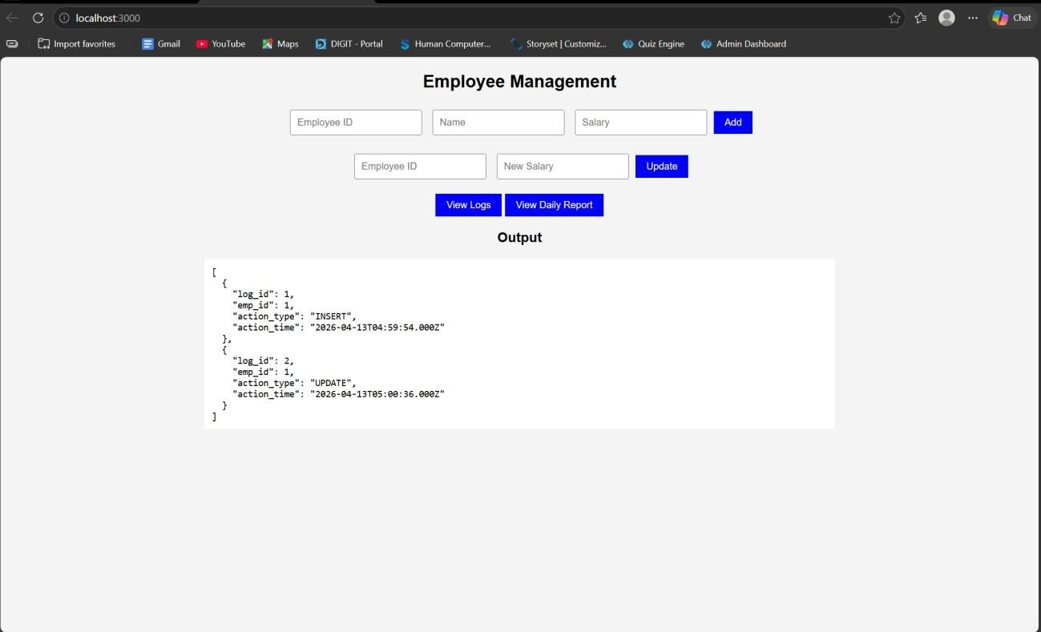
}
});
module.exports = db; OUTPUTS:
RESULT: The system successfully logs all INSERT and UPDATE operations automatically using triggers and displays daily activity reports through a web interface.
TASK7: Interactive Web Form with Events & Functions
AIM: To develop an interactive web-based feedback form with real-time validation, UI effects, and backend data storage using HTML, CSS, JavaScript, and Node.js.
ALGORITHM:
Start the program
Create project files (HTML, CSS, JS, server.js, db.js)
Design feedback form with input fields (name, email, message)
Apply CSS styling for layout and visual effects

Slide 86
Define reusable validation functions in JavaScript
Capture user input using DOM elements
Apply keyup event for real-time validation
Add hover effect to highlight input fields
Implement double-click event on submit button
Validate all fields before submission
Send data to server using fetch API (POST request)
Store data in database module and display success message
PROGRAM:
INDEX.HTML:
<!DOCTYPE html>
<html lang="en">
<head>
<title>Feedback Form</title>
<link rel="stylesheet" href="style.css">
</head>
<body>
<div class="container">
<h2> Customer Feedback</h2>
<form id="feedbackForm">
<input type="text" id="name" placeholder="Your Name" required>
<span class="error" id="nameError"></span>
<input type="email" id="email" placeholder="Your Email" required>
<span class="error" id="emailError"></span>
<textarea id="message" placeholder="Your Feedback" required></textarea>

Slide 87
<span class="error" id="msgError"></span>
<button type="button" id="submitBtn">Submit</button>
</form>
<p id="successMsg"></p>
</div>
<script src="script.js"></script>
</body>
</html> STYLE.CSS: body { font-family: 'Segoe UI', sans- serif; background: linear-gradient(135deg, #1f1c2c,
#928dab);
display: flex; justify- content: center; align- items: center; height:
100vh; color: white;
}
.container { background: rgba(255, 255, 255, 0.1); padding: 25px; border- radius: 15px; backdrop-filter: blur(10px); width: 320px; box-shadow: 0 10px 25px rgba(0,0,0,0.3);
}
h2 { text-align: center;
}
input, textarea { width: 100%;

Slide 88
padding: 10px;
margin: 8px 0;
border-radius: 8px; border: none; outline: none; transition: 0.3s;
}
input:hover, textarea:hover {
transform: scale(1.05); box-shadow: 0 0 8px #00f7ff;
}
button {
width: 100%; padding: 10px;
background: #00c6ff; border: none; border- radius: 10px; color: white; font-weight: bold; cursor: pointer;
}
button:hover {
background: #0072ff;
}
.error { color:
#ff6b6b; font- size: 12px;

Slide 89
}
#successMsg {
text-align: center;
margin-top: 10px;
color:
#00ffae;
}
SCRIPT.JS:
const nameInput = document.getElementById("name"); const emailInput = document.getElementById("email"); const
messageInput = document.getElementById("message"); const submitBtn = document.getElementById("submitBtn"); function validateName() { if (nameInput.value.length < 3) { document.getElementById("nameError").innerText = "Min 3 characters";
return false;
}
document.getElementById("nameError").innerText = ""; return true;
}
function validateEmail() { let pattern = /^[^ ]+@[^ ]+\.[a-z]{2,3}$/; if (!emailInput.value.match(pattern)) {
document.getElementById("emailError").innerText = "Invalid email"; return false;
}
document.getElementById("emailError").innerText = ""; return true;

Slide 90
}
function validateMessage() { if (messageInput.value.length < 5) { document.getElementById("msgError").innerText = "Too short";
return false;
}
document.getElementById("msgError").innerText = ""; return true;
}
nameInput.addEventListener("keyup", validateName); emailInput.addEventListener("keyup", validateEmail); messageInput.addEventListener("keyup", validateMessage);
submitBtn.addEventListener("dblclick", () => { if (validateName() && validateEmail() && validateMessage()) { sendData(); } else { alert("Fix errors before submitting!");
}
});
function sendData() {
fetch("http://localhost:3000/submit", { method: "POST", headers: {
"Content-Type": "application/json"
},
body: JSON.stringify({ name: nameInput.value, email: emailInput.value,
message: messageInput.value
})
})

Slide 91
.then(res => res.json()) .then(data => {
document.getElementById("successMsg").innerText = " Feedback Submitted!";
});
}
SERVER.JS: const express = require("express"); const cors = require("cors"); const bodyParser = require("body-parser"); const path =
require("path"); const db = require("./db"); const app = express(); app.use(cors());
app.use(bodyParser.json());
app.use(express.static( dirname)); app.get("/",
(req, res) => { res.sendFile(path.join( dirname, "index.html"));
});
app.post("/submit", (req, res) => {
const {
name, email, message } = req.body;
db.saveFeedback({ name, email, message }); res.json({ status: "success" });
});
app.listen(3000, () => { console.log("Server running on http://localhost:3000");
});
DB.JS:
let feedbacks = []; function saveFeedback(data) {

Slide 92
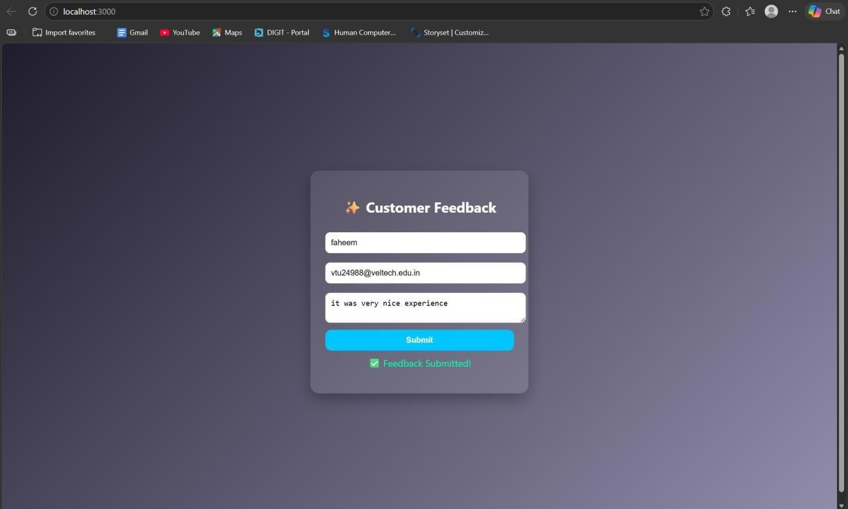
feedbacks.push(data);
console.log("Saved:", data); }
module.exports = { saveFeedback
};
OUTPUT:
RESULT: The interactive feedback form was successfully implemented with real-time validation, enhanced UI effects, and backend data handling.
TASK8: Employee Management
AIM: To develop a simple Employee Management system using HTML, CSS, JavaScript, and Node.js for adding and displaying employee data.

Slide 93
ALGORITHM:
Start the program
Create project files (HTML, CSS, JS, server.js, db.js)
Design the user interface with input fields (name, role)
Apply CSS styling for layout and centering
Capture user input using JavaScript
Create function to add employee data
Send data to server using fetch API (POST request)
Create backend using Node.js and Express
Receive and store employee data in memory (db.js)
Create API to fetch all employee records (GET request)
Display employee list dynamically on the webpage
Stop the program
PROGRAM:
INDEX.HTML:
<!DOCTYPE html>
<html>
<head>
<title>Employee Management</title>
<link rel="stylesheet" href="style.css">
</head>
<body>
<div class="container">
<h2>Employee Management</h2>
<input id="name" placeholder="Name">
<input id="role" placeholder="Role">

Slide 94
<button onclick="addEmployee()">Add</button>
<ul id="list"></ul>
</div>
<script src="script.js"></script>
</body>
</html>
STYLE.CSS: body {
font-family: Arial;
background: #1e1e2f; color: white; display: flex; justify-content: center; align-items: center; height:
100vh; margin: 0;
}
.container {
text-
align: center;
}
input { padding:
10px; margin: 5px; border-radius: 5px; border: none;
}

Slide 95
button {
padding:
10px;
background:
#00c6ff; border:
none; border-radius: 5px; cursor: pointer;
}
SCRIPT.JS:
function addEmployee() { const name = document.getElementById("name").value;
const role =
document.getElementById("role").value;
fetch("http://localhost:3000/add", {
method: "POST",
headers: {
"Content-Type": "application/json"
},
body: JSON.stringify({ name, role })
})
.then(res => res.json())
.then(() => loadEmployees());
}
function loadEmployees() { fetch("http://localhost:3000/all")
.then(res => res.json()) .then(data => { let list = document.getElementById("list"); list.innerHTML = "";

Slide 96
data.forEach(emp => {
let li =
document.createElement("li");
li.innerText
= emp.name + " - " + emp.role;
list.appendChild(li);
});
});
}
loadEmployees();
SERVER.JS:
const express = require("express"); const cors = require("cors"); const path = require("path"); const db = require("./db"); const app = express(); app.use(cors());
app.use(express.json());
app.use(express.static( dirname))
; app.get("/", (req, res) => { res.sendFile(path.join( dirname, "index.html"));
});
app.post("/add", (req, res) => { db.addEmployee(req.body); res.json({ msg: "Added" });
});
app.get("/all", (req, res) => { res.json(db.getEmployees());

Slide 97
});
app.listen(3000, () => { console.log(" Server running at: http://localhost:3000");
});
DB.JS:
let employees = []; function addEmployee(emp) { employees.push(emp);
}
function getEmployees() { return employees;
}
module.exports = { addEmployee, getEmployees };
OUTPUT:

Slide 98
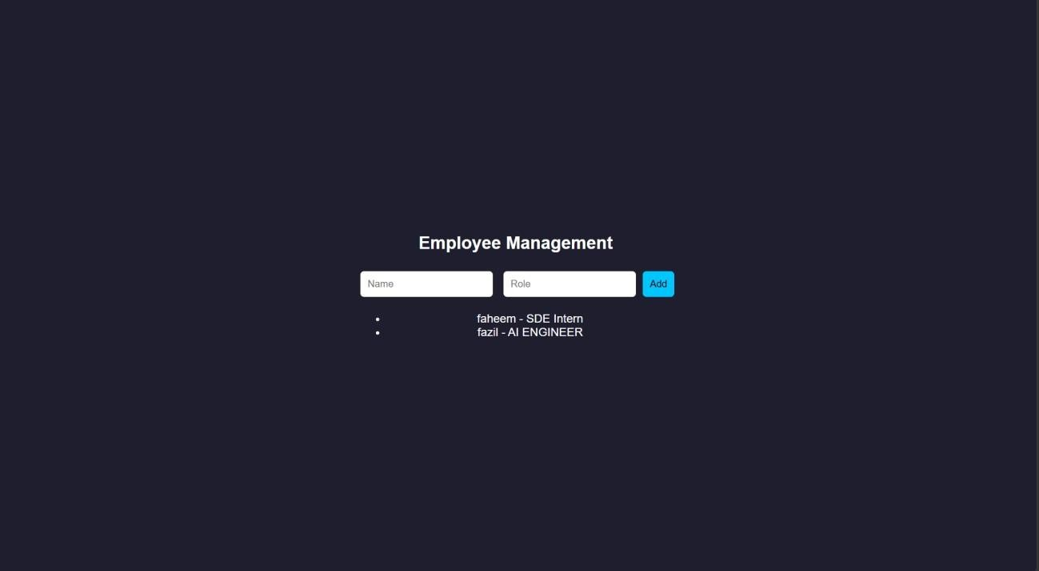
RESULT: The Employee Management system was successfully implemented with a userfriendly interface and dynamic data handling using Node.js backend.
TASK9: Employee MVC APP
AIM: To develop a basic MVC-based Employee application using HTML, CSS, JavaScript, and Node.js to handle user requests and display employee details.
ALGORITHM:
Start the program
Create project files (HTML, CSS, JS, server.js, db.js)
Design UI form to accept employee details
Apply CSS styling for better user interface
Capture user input using JavaScript
Send request to server using fetch API
Create controller logic in server.js

Slide 99
Define routes to handle requests (/add, /all)
Store employee data in memory using db.js
Retrieve employee data from database module
Send response back to frontend (view)
Display employee details dynamically and stop
PROGRAM:
INDEX.HTML:
<!DOCTYPE html>
<html>
<head>
<title>Employee MVC</title>
<link rel="stylesheet" href="style.css">
</head>
<body>
<div class="container">
<h2>Employee Details</h2>
<input id="name" placeholder="Name">
<input id="role" placeholder="Role">
<button onclick="addEmployee()">Add</button>
<ul id="list"></ul>
</div>
<script src="script.js"></script>
</body>
</html>
STYLE.CSS:

Slide 100
* { margin: 0;
padding: 0; box-sizing: border-box;
}
body { font-family: 'Segoe UI', sans-serif; linear-gradient(135deg, #1f1c2c, #928dab);
background:
height:
100vh;
display: flex; justify- content: center; align- items: center;
color: white;
}
.container {
background: rgba(255,
255, 255, 0.1); padding: 30px;
border-radius: 15px; backdrop-filter: blur(10px); width: 320px; text- align: center;
box-shadow: 0 10px 25px rgba(0,0,0,0.4);
}
h2 { margin-bottom: 15px;
}

Slide 101
input {
width:
100%;
padding: 10px; margin: 8px 0;
border: none; border- radius: 8px; outline: none;
transition: 0.3s;
}
input:hover,
input:focus { transform:
scale(1.05); box-shadow: 0 0 8px #00f7ff;
}
button { width:
100%; padding:
10px; margin-top:
10px;
background: #00c6ff;
border: none; border-radius: 10px;

Slide 102
color: white; font-
weight: bold; cursor:
pointer;
transition: 0.3s;
}
button:hover {
background: #0072ff; transform: scale(1.05);
} ul { list-style:
none; margin-top:
15px;
} li
{
background: rgba(255,255,255,0.15); padding: 8px; margin: 5px 0;
border-radius: 6px;
transition: 0.3s;
}
li:hover { background: rgba(255,255,255,0.3);
}
SCRIPT.JS:
function addEmployee() { const name = document.getElementById("name").value;
const role =

Slide 103
document.getElementById("role").value; fetch("/add", {
method: "POST", headers: { "Content-Type":
"application/json" }, body: JSON.stringify({ name, role
})
})
.then(() => loadEmployees());
}
function loadEmployees() { fetch("/all")
.then(res => res.json())
.then(data => { let list = document.getElementById("list");
list.innerHTML = ""; data.forEach(emp => { let li = document.createElement("li");
li.innerText = emp.name + " - " + emp.role; list.appendChild(li);
});
});
}
loadEmployees();
SERVER.JS:
const express = require("express"); const cors = require("cors"); const path
= require("path"); const db =
require("./db"); const app = express(); app.use(cors());

Slide 104
app.use(express.json());
app.use(express.static( dirname)); app.post("/add", (req, res) => { db.addEmployee(req.body); res.json({ msg: "Employee Added" });
});
app.get("/all", (req, res) => { res.json(db.getEmployees());
});
app.listen(3000, () => {
console.log("http://localhost:3000");
});
DB.JS:
let employees = []; function addEmployee(emp) { employees.push(emp);
}
function getEmployees() { return employees;
}
module.exports = { addEmployee, getEmployees }; OUTPUT:

Slide 105
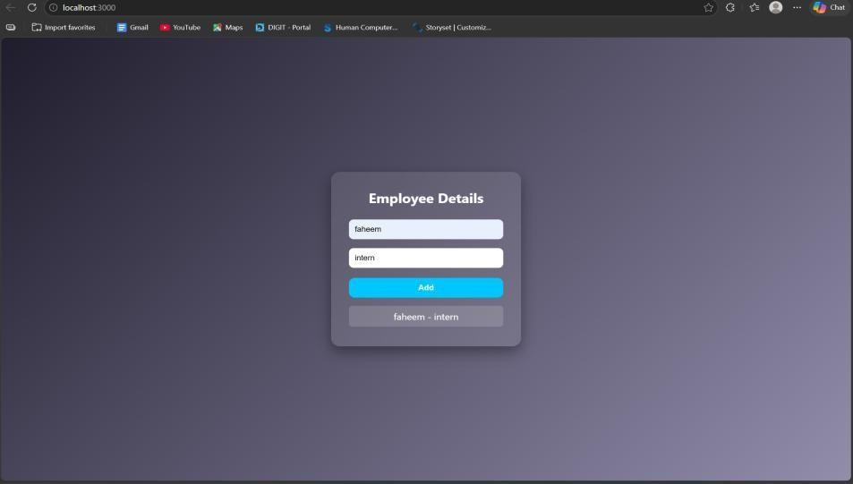
RESULT: The MVC-based Employee application was successfully implemented using Node.js, where user requests were processed and employee details were displayed dynamically.
TASK10: Student Crud App
AIM: To develop a Student CRUD application using HTML, CSS, JavaScript, and Node.js to perform create, read, update, and delete operations.
ALGORITHM:
Start the program
Create project files (HTML, CSS, JS, server.js, db.js)
Design UI for student input (id, name, course)
Apply CSS for styling and layout
Capture user input using JavaScript
Send data to server using fetch API
Create backend using Node.js and Express
Implement Create operation (POST request)
Implement Read operation (GET request)
Implement Update operation (PUT request)
Implement Delete operation (DELETE request)
Display updated student data dynamically and stop
PROGRAM:

Slide 106
INDEX.HTML:
<!DOCTYPE html>
<html>
<head>
<title>Student CRUD</title>
<link rel="stylesheet" href="style.css">
</head>
<body>
<div class="container">
<h2>Student CRUD</h2>
<input id="id" placeholder="ID">
<input id="name" placeholder="Name">
<input id="course" placeholder="Course">
<button onclick="addStudent()">Add</button>
<button onclick="updateStudent()">Update</button>
<ul id="list"></ul>
</div>
<script src="script.js"></script>
</body>
</html> STYLE.CSS: body { font-family: 'Segoe UI';
background: linear-gradient(135deg,#1f1c2c,#928dab); height: 100vh; display:flex; justify-content:center; align-items:center; color:white;
}
.container { background: rgba(255,255,255,0.1);

Slide 107
padding:20px;
border-radius:10px;
text-align:center;
} input { display:block;
margin:8px auto; padding:8px;
}
button { margin:5px; padding:8px;
background:#00c6ff; border:none;
color:white;
}
SCRIPT.JS:
function addStudent() {
let data = getInput();
fetch("/add", { method: "POST", headers:
{"Content-Type":"application/json"}, body: JSON.stringify(data)
}).then(loadStudents);
}
function loadStudents() { fetch("/all")
.then(res => res.json())
.then(data => {
let list = document.getElementById("list"); list.innerHTML = ""; data.forEach(s => {

Slide 108
let li = document.createElement("li");
li.innerHTML = `
${s.id} - ${s.name} (${s.course})
<button onclick="deleteStudent(${s.id})"> </button>
`;
list.appendChild(li);
});
});
}
function updateStudent() { let data = getInput(); fetch("/update", { method: "PUT",
headers: {"Content-Type":"application/json"}, body: JSON.stringify(data)
}).then(loadStudents);
}
function deleteStudent(id) {
fetch(`/delete/${id}`, { method: "DELETE" })
.then(loadStudents);
}
function getInput() { return
{
id: document.getElementById("id").value,
name: document.getElementById("name").value, course: document.getElementById("course").value
};
}

Slide 109
loadStudents();
SERVER.JS: const express = require("express"); const cors = require("cors"); const db = require("./db"); const app = express(); app.use(cors()); app.use(express.json());
app.use(express.static( dirname));
// CREATE app.post("/add", (req, res) => {
db.add(req.body); res.json({msg:"Added"});
});
// READ app.get("/all", (req, res) => { res.json(db.getAll());
});
// UPDATE app.put("/update", (req, res) => {
db.update(req.body); res.json({msg:"Updated"});
});
// DELETE app.delete("/delete/:id", (req, res) => {
db.remove(req.params.id); res.json({msg:"Deleted"});

Slide 110
});
app.listen(3000, () => console.log("http://localhost:3000"));
DB.JS:
let students = []; function add(s) {
students.push(s);
}
function getAll() { return students;
}
function update(updated) { students = students.map(s =>
s.id == updated.id ? updated : s
);
}
function remove(id) { students = students.filter(s => s.id != id);
}
module.exports = { add, getAll, update, remove };
OUTPUT:

Slide 111
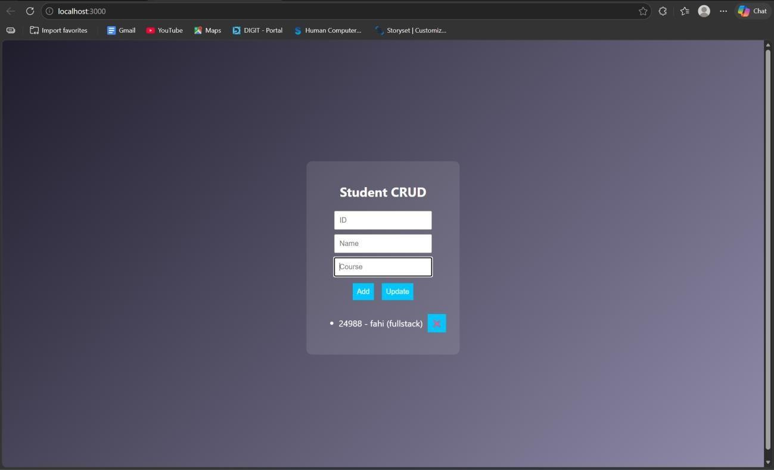
RESULT: The Student CRUD application was successfully implemented with full create, read, update, and delete operations using Node.js and a dynamic web interface.
TASK11: Student Data Layer
AIM: To implement a data access layer for managing student records with filtering, sorting, and pagination using HTML, CSS, JavaScript, and Node.js.
ALGORITHM:
Start the program
Create project files (HTML, CSS, JS, server.js, db.js)
Design UI for student details (id, name, age, department)
Apply CSS styling for layout and UI
Capture input using JavaScript
Send data to backend using fetch API
Create Node.js server using Express

Slide 112
Store student data in memory (db.js)
Implement filtering (by department/age)
Implement sorting (by name/age)
Implement pagination (limit & page number)
Display filtered, sorted, paginated data
PROGRAM:
INDEX.HTML:
<!DOCTYPE html>
<html>
<head>
<title>Student Data Layer</title>
<link rel="stylesheet" href="style.css">
</head>
<body>
<div class="container">
<h2>Student Data</h2>
<input id="name" placeholder="Name">
<input id="age" placeholder="Age">
<input id="dept" placeholder="Department">
<button onclick="addStudent()">Add</button>
<hr>
<input id="filterDept" placeholder="Filter Dept">
<input id="sortBy" placeholder="Sort (name/age)">
<input id="page" placeholder="Page No">
<button onclick="loadStudents()">Search</button>
<ul id="list"></ul>

Slide 113
</div>
<script src="script.js"></script>
</body>
</html> STYLE.CSS:
body { font-family: Arial; background:
#1e1e2f; color: white; display:flex; justify- content:center; align- items:center;
height:100vh;
}
.container { text- align:center;
}
input { display:block; margin:5px; padding:8px;
}
SCRIPT.JS: function addStudent() { const data = { name:
val("name"), age:
val("age"), dept: val("dept")

Slide 114
};
fetch("/add", { method: "POST",
headers: {"Content-Type":"application/json"}, body: JSON.stringify(data)
}).then(loadStudents);
}
function loadStudents() { const dept = val("filterDept"); const sort = val("sortBy"); const page = val("page"); fetch(`/students?dept=${dept}
&sort=${sort}&page=${page}`)
.then(res => res.json()) .then(data => { list = document.getElementById("list"); list.innerHTML = ""; data.forEach(s => { let li = document.createElement("li");
let
li.innerText = `${s.name} (${s.age}) - ${s.dept}`;
list.appendChild(li);
});
});
}
function val(id){ return
document.getElementById(id).value;
}
loadStudents();

Slide 115
SERVER.JS: const express =
require("express"); const cors = require("cors"); const db = require("./db"); const app = express(); app.use(cors()); app.use(express.json());
app.use(express.static( dirname))
;
// Add student app.post("/add", (req, res) => {
db.add(req.body); res.json({msg:"Added"});
});
// Filter + Sort + Pagination
app.get("/students", (req, res) => { let { dept, sort, page } = req.query; let data = db.getAll(); // FILTER if (dept) {
data = data.filter(s => s.dept === dept);
}
// SORT if (sort === "name") {
data.sort((a,b)=>a.name.localeCompare(b.name));
} else if (sort === "age") { data.sort((a,b)=>a.age - b.age);
}
// PAGINATION

Slide 116
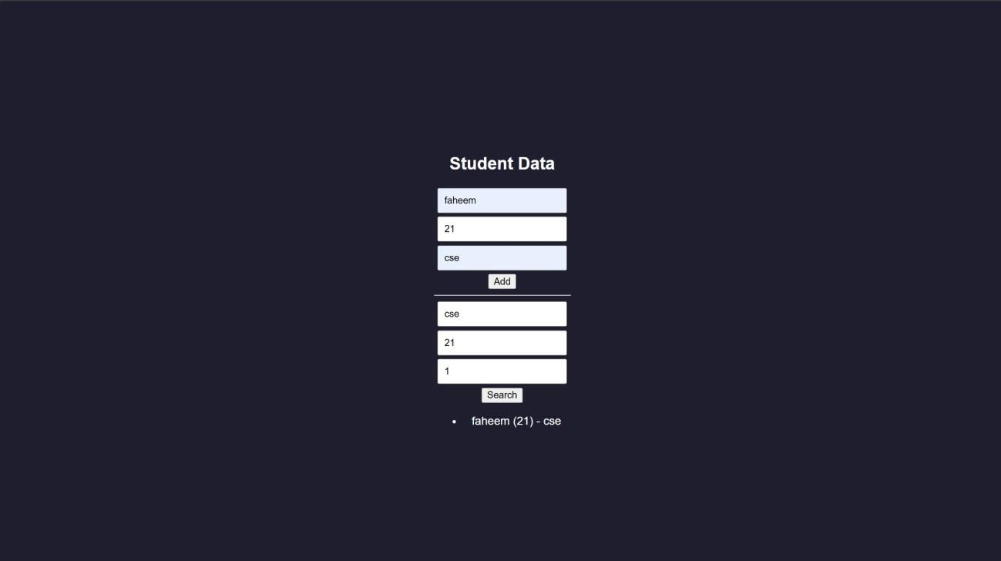
let limit = 3; page = parseInt(page) || 1;
let start = (page - 1) * limit; let paginated = data.slice(start, start + limit);
res.json(paginated);
});
app.listen(3000, () => console.log("http://localhost:3000")); DB.JS:
let students = []; function add(s) {
students.push(s);
}
function getAll() { return students;
}
module.exports = { add, getAll }; OUTPUT:

Slide 117
RESULT: The data access layer was successfully implemented with filtering, sorting, and pagination using Node.js and dynamic frontend interaction.
TASK12: Product Api
AIM: To design and develop a RESTful API for Product Management using Node.js that supports GET, POST, PUT, and DELETE operations with JSON responses.
ALGORITHM:
Start the program
Create project files (server.js, db.js, HTML, CSS, JS)
Design product structure (id, name, price)
Create Node.js server using Express
Enable JSON parsing using middleware
Implement POST method to add products
Implement GET method to fetch all products
Implement PUT method to update product details
Implement DELETE method to remove a product
Store product data in memory using db.js
Send JSON responses for all API requests
Test APIs using browser or REST client
PROGRAM: INDEX.HTML:
<!DOCTYPE html>
<html>
<head>
<title>Product API</title>
</head>

Slide 118
<body>
<h2>Product API Test</h2>
<input id="id" placeholder="ID">
<input id="name" placeholder="Name">
<input id="price" placeholder="Price">
<button onclick="add()">Add</button>
<button onclick="get()">Get All</button>
<ul id="list"></ul>
<script src="script.js"></script>
</body>
</html>
STYLE.CSS:
/* Reset */
* { margin: 0;
padding: 0; box-sizing:
border-box;
}
/* Background */ body { font-family: 'Segoe UI', sans- serif; background: linear-gradient(135deg, #141e30, #243b55); height: 100vh; display: flex; justify-
content: center; align-items: center; color: white;
}
/* Container */
.container {
background: rgba(255,
255, 255, 0.1); padding: 25px;

Slide 119
border-radius: 15px;
backdrop-filter:
blur(10px);
width: 350px; text-align: center;
shadow: 0 10px 25px rgba(0,0,0,0.4);
box-
}
/* Heading */ h2 {
margin-bottom: 15px;
}
/* Inputs */ input { width: 100%; padding: 10px;
margin: 8px 0; border: none;
border-radius: 8px; outline: none; transition: 0.3s;
}
/* Hover + focus effect */ input:hover,
input:focus { transform:
scale(1.05); box-shadow: 0 0 8px #00f7ff;
}
/* Buttons */ button { width: 100%; padding: 10px;

Slide 120
margin-top: 8px;
background: #00c6ff; border: none;
border-radius: 10px; color: white; font- weight: bold; cursor:
pointer; transition:
0.3s;
}
/* Button hover */ button:hover {
background: #0072ff; transform: scale(1.05);
}
/* Product List */ ul { list-style:
none; margin-top:
15px; }
/* List items */ li {
background: rgba(255,255,255,0.15); padding: 10px; margin: 6px 0;
border-radius: 8px; display: flex; justify-content: space-between;
align-items: center; transition: 0.3s;
}

Slide 121
/* Hover effect */ li:hover {
background: rgba(255,255,255,0.3);
}
/* Optional delete button inside list */ li button { width: auto; padding: 5px 8px; font-size: 12px;
background: #ff4b5c;
}
li button:hover {
background: #ff1e38;
}
SCRIPT.JS: function add() { fetch("/products", { method: "POST", headers: {"Content-
Type":"application/json"}, body: JSON.stringify(getData())
}).then(get);
}
function get() {
fetch("/products")
.then(res => res.json()) .then(data => {
= document.getElementById("list"); list.innerHTML = ""; data.forEach(p => {
let list
let
li = document.createElement("li"); li.innerText
= `${p.id} - ${p.name} - ₹${p.price}`; list.appendChild(li);
});

Slide 122
});
}
function getData() { return { id: document.getElementById("id").value,
name:
document.getElementById("name").value,
price:
document.getElementById("price").value
};
}
SERVER.JS:
const express = require("express"); const cors = require("cors"); const db = require("./db"); const app = express(); app.use(cors());
app.use(express.json()); // GET all products app.get("/products",
(req, res) => { res.json(db.getAll());
});
// POST add product
app.post("/products", (req, res) => { db.add(req.body); res.json({ message: "Product added" });
});
// PUT update product app.put("/products/:id", (req, res) => { db.update(req.params.id,

Slide 123
req.body); res.json({ message: "Product
updated" });
});
// DELETE product app.delete("/products/:id", (req, res) => { db.remove(req.params.id); res.json({ message: "Product deleted" });
});
// Server start app.listen(3000, () => {
console.log(" API running
at http://localhost:3000/products");
});
DB.JS:
let products = []; function getAll() { return products;
}
function add(p) { products.push(p);
}
function update(id, newData) { products = products.map(p =>
p.id == id ? { ...p, ...newData } : p
);
}
function remove(id) { products = products.filter(p => p.id != id);
}

Slide 124
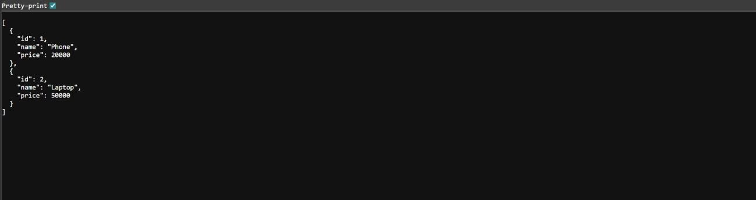
module.exports = { getAll, add, update, remove };
OUTPUT:
RESULT: The RESTful API for Product Management was successfully implemented with GET, POST, PUT, and DELETE methods returning JSON responses.

Slide 125
TASK13: PRODUCT-API
AIM: To design and develop a RESTful API for Product Management using Node.js that supports GET, POST, PUT, and DELETE operations with JSON responses.
ALGORITHM:
Start the program
Create project files (server.js, db.js, HTML, CSS, JS)
Design product structure (id, name, price)
Create Node.js server using Express
Enable JSON parsing using middleware
Implement POST method to add products
Implement GET method to fetch all products
Implement PUT method to update product details
Implement DELETE method to remove a product
Store product data in memory using db.js
Send JSON responses for all API requests
Test APIs using browser or REST client
PROGRAM: INDEX.HTML:
<!DOCTYPE html>
<html>
<head>
<title>Product API</title>
</head>
<body>
<h2>Product API Test</h2>
<input id="id" placeholder="ID">

Slide 126
<input id="name" placeholder="Name">
<input id="price" placeholder="Price">
<button onclick="add()">Add</button>
<button onclick="get()">Get All</button>
<ul id="list"></ul>
<script src="script.js"></script>
</body>
</html>
STYLE.CSS:
/* Reset */
* { margin: 0;
padding: 0; box-sizing:
border-box;
}
/* Background */ body { font-family: 'Segoe UI', sans- serif; background: linear-gradient(135deg, #141e30, #243b55); height: 100vh; display: flex; justify-
content: center; align-items: center; color: white;
}
/* Container */
.container {
background: rgba(255,
255, 255, 0.1); padding: 25px;
border-radius: 15px; backdrop-filter: blur(10px);

Slide 127
width: 350px; text-align: center;
shadow: 0 10px 25px rgba(0,0,0,0.4);
box-
}
/* Heading */ h2 {
margin-bottom: 15px;
}
/* Inputs */ input { width: 100%; padding: 10px;
margin: 8px 0; border: none;
border-radius: 8px; outline: none; transition: 0.3s;
}
/* Hover + focus effect */ input:hover,
input:focus { transform:
scale(1.05); box-shadow: 0 0 8px #00f7ff;
}
/* Buttons */ button { width: 100%; padding: 10px;
margin-top: 8px;
background: #00c6ff; border: none;

Slide 128
border-radius: 10px;
color: white; font- weight: bold; cursor:
pointer; transition:
0.3s;
}
/* Button hover */ button:hover {
background: #0072ff; transform: scale(1.05);
}
/* Product List */ ul { list-style:
none; margin-top:
15px; }
/* List items */ li {
background: rgba(255,255,255,0.15); padding: 10px; margin: 6px 0;
border-radius: 8px; display: flex; justify-content: space-between;
align-items: center; transition: 0.3s;
}
/* Hover effect */ li:hover {
background: rgba(255,255,255,0.3);
}

Slide 129
/* Optional delete button inside list */
li button { width: auto; padding: 5px 8px; font-size: 12px;
background: #ff4b5c;
}
li button:hover {
background: #ff1e38;
}
SCRIPT.JS: function add() { fetch("/products", { method: "POST", headers: {"Content-
Type":"application/json"}, body: JSON.stringify(getData())
}).then(get);
}
function get() {
fetch("/products")
.then(res => res.json()) .then(data => {
= document.getElementById("list"); list.innerHTML = ""; data.forEach(p => {
let list
let
li = document.createElement("li"); li.innerText
= `${p.id} - ${p.name} - ₹${p.price}`; list.appendChild(li);
});
});
}

Slide 130
function getData() { return { id:
document.getElementById("id").value,
name:
document.getElementById("name").value,
price:
document.getElementById("price").value
};
}
SERVER.JS:
const express = require("express"); const cors = require("cors"); const db = require("./db"); const app = express(); app.use(cors()); app.use(express.json()); // GET all products app.get("/products",
(req, res) => { res.json(db.getAll());
});
// POST add product
app.post("/products", (req, res) => { db.add(req.body); res.json({ message: "Product added" });
});
// PUT update product app.put("/products/:id", (req, res) => { db.update(req.params.id, req.body); res.json({ message: "Product updated" });

Slide 131
});
// DELETE product app.delete("/products/:id", (req, res) => { db.remove(req.params.id); res.json({ message: "Product deleted" });
});
// Server start app.listen(3000, () => {
console.log(" API running
at http://localhost:3000/products");
});
DB.JS:
let products = []; function getAll() { return products;
}
function add(p) { products.push(p);
}
function update(id, newData) { products = products.map(p =>
p.id == id ? { ...p, ...newData } : p
);
}
function remove(id) { products = products.filter(p => p.id != id);
}
module.exports = { getAll, add, update, remove };

Slide 132
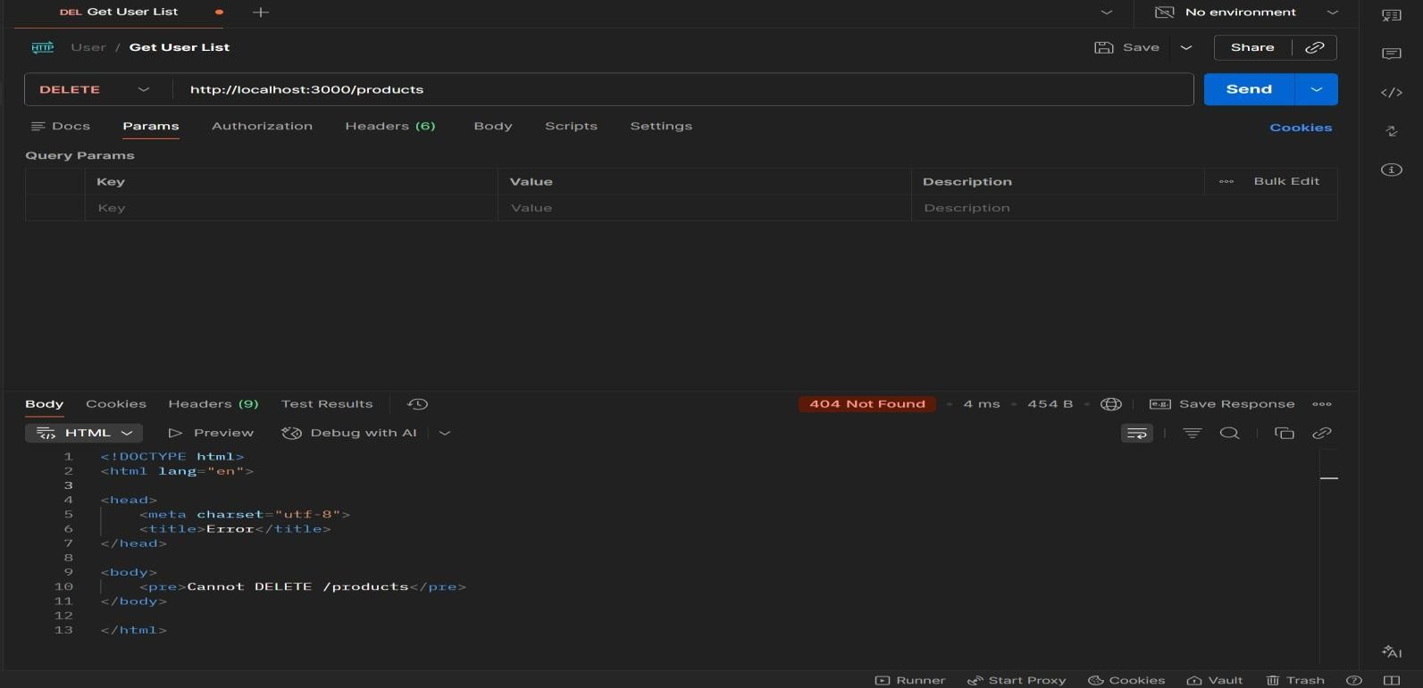
OUTPUT:
RESULT: The RESTful API for Product Management was successfully implemented with GET, POST, PUT, and DELETE methods returning JSON responses.
TASK14: MICROSERVICES APP
AIM: To design a simple microservices-based system by splitting a monolithic application into independent services with loose coupling and single responsibility.
ALGORITHM:
Start the program
Identify modules in monolithic system
Split system into independent services
Create separate folders for each service
Implement Service 1 (Product Service)
Implement Service 2 (Order Service)

Slide 133
Use separate databases (db.js) for each service
Assign different ports for each service
Enable communication via REST APIs
Keep services loosely coupled
Deploy and run services independently
Access services and verify functionality
PROGRAM:
INDEX.HTML:
<!DOCTYPE html>
<html>
<head>
<title>Microservices App</title>
<link rel="stylesheet" href="style.css">
</head>
<body>
<div class="container">
<h2>Microservices Demo</h2>
<input id="pname" placeholder="Product Name">
<button onclick="addProduct()">Add Product</button>
<input id="order" placeholder="Order Item">
<button onclick="addOrder()">Place Order</button>
</div>
<script src="script.js"></script>
</body>
</html> STYLE.CSS:
body { font-family:

Slide 134
Arial;
background:
#1e1e2f;
color: white;
display:flex; justify-
content:center; align- items:center;
height:100vh;
}
.container { text- align:center;
}
input {
margin: 5px; padding: 8px;
}
button { padding:
8px; margin: 5px; background: #00c6ff; border: none;
}
SCRIPT.JS:
function addProduct() {
fetch("http://localhost:3001/products", {
method: "POST", headers: { "Content-Type": "application/json" }, body: JSON.stringify({ name: val("pname") })
});

Slide 135
}
function addOrder() {
fetch("http://localhost:3002/orders", {
method: "POST", headers: { "Content-Type": "application/json" }, body: JSON.stringify({
item: val("order") })
});
}
function val(id) { return
document.getElementById(id).value;
}
SERVER.JS:
const express = require("express");
const cors = require("cors"); const db = require("./db"); const app = express(); app.use(cors());
app.use(express.json()); // GET products app.get("/products", (req, res) => { res.json(db.getAll());
});
// ADD product
app.post("/products", (req, res) => { db.add(req.body); res.json({ msg: "Product added" });
});

Slide 136
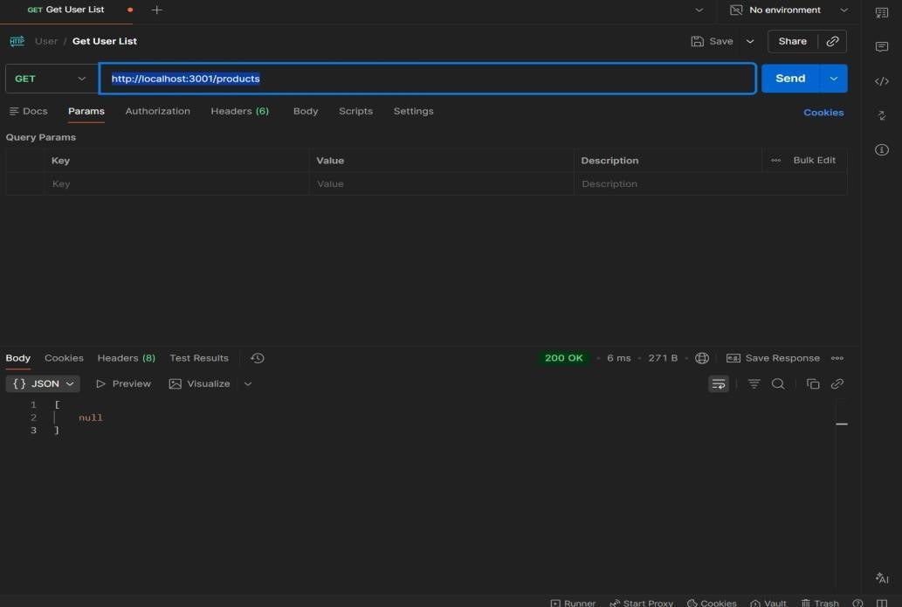
app.listen(3001, () => { console.log("Product Service running at
http://localhost:3001");
});
DB.JS:
let products = []; function add(p) { products.push(p);
}
function getAll() { return products;
}
module.exports = { add, getAll };
OUTPUT:
1. GET : http://localhost:3001/products
2. POST: http://localhost:3001/products

Slide 137
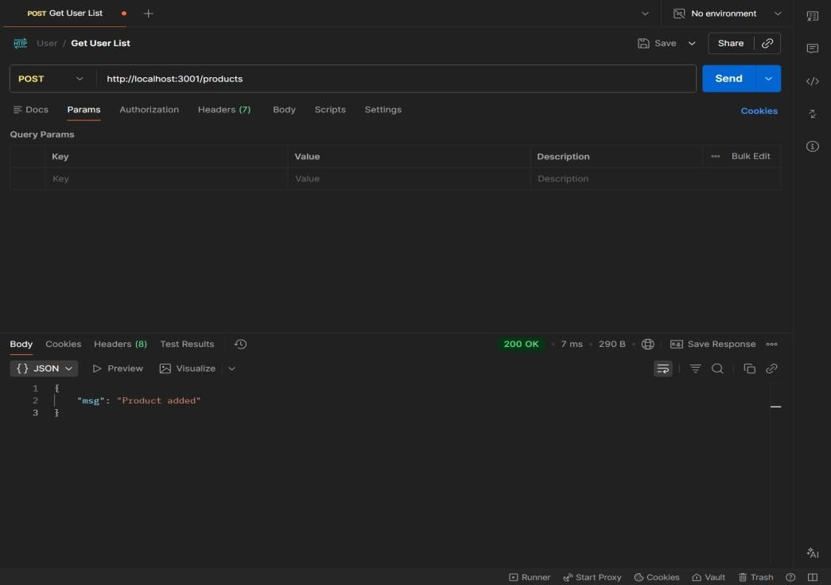
RESULTS: The application was successfully divided into independent microservices with separate responsibilities and communication via REST APIs
TASK15: Service Registry App
Aim: To implement service registry and discovery using Node.js by dynamically registering and discovering microservices without hard-coded URLs.
ALGORITHM:
Start the program
Create a registry server
Store service name and URL in memory
Start Product Service
Register Product Service to registry
Start Order Service
Register Order Service to registry
Maintain service list in registry
Client requests service from registry

Slide 138
Fetch service URL dynamically
Call the discovered service API
Stop the program
PROGRAM:
SERVER.JS: const express = require("express"); const app =
express(); app.use(express.json()); let services = {};
app.post("/register", (req, res) => { const { name, url } = req.body;
services[name] = url;
console.log(`${name} registered at
${url}`); res.json({ msg:
"Registered" });
});
app.get("/service/:name", (req, res) => { const service = services[req.params.name];
if (!service) { return res.status(404).json({ error: "Service not found" }) res.json({ url: service });
});
app.listen(4000, () => { console.log("Registry running at http://localhost:4000");
});
OUTPUT

Slide 139
RESULT: The microservices-based system was successfully implemented with service registry and discovery, enabling dynamic communication between independent services without
hardcoded URLs.
TASK16: API GATEWAY API
AIM: To configure an API Gateway that routes client requests to microservices and performs basic load balancing across multiple service instances.
ALGORITHM:
Start the program
Create API Gateway server
Define routes for microservices
Create multiple instances of a service
Store service URLs in an array
Implement round-robin load balancing
Receive client request at gateway
Select service instance dynamically
Forward request to selected instance

Slide 140
Get response from service
Send response back to client
Stop the program
PROGRAM:
SERVER.JS: const express = require("express"); const axios = require("axios"); const app = express(); const services = [
"http://localhost:3001", "http://localhost:3002"
];
let index = 0; app.get("/products", async (req, res) => {
try { const service = services[index]; index = (index + 1) % services.length; const response = await axios.get(service + "/products");
res.json(response.data);
} catch (err) {
res.status(500).json({ error: "Service
unavailable" });
}
});
app.listen(5000, () => { console.log("API Gateway → http://localhost:5000/products");
});
OUTPUT:

Slide 141
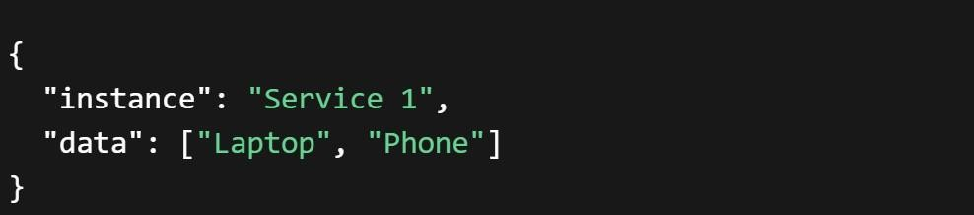
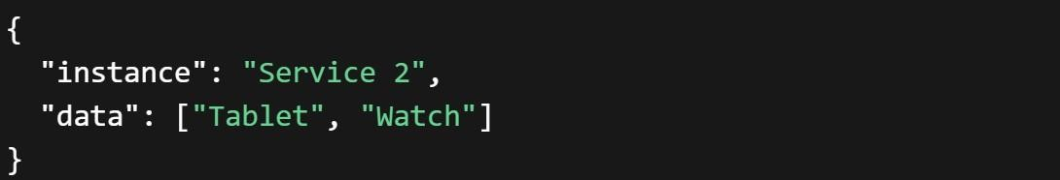
RESULT: The API Gateway was successfully implemented to route requests and distribute load across multiple service instances using round-robin load balancing.
TASK17: Inter Service App
AIM: To enable inter-service communication where one microservice consumes another service’s REST API and handles responses and failures gracefully.
ALGORITHM:
Start the program
Create Product Service (provider)
Create Order Service (consumer)
Implement REST API in Product Service
Store product data in memory
Implement Order Service API
Use axios/fetch to call Product Service
Receive response from Product Service
Process and store order data
Handle errors using try-catch
Send proper success/error response

Slide 142
12. Stop the program
FOLDER STRUCTURE:
inter-service-app/
│
├── product-service/
│ └── server.js
│
├── order-service/
│ └── server.js
PROGRAM:
PRODUCT-SERVICE:SERVER.JS:
const express =
require("express"); const app = express(); let products = [
{ id: 1, name: "Laptop" },
{ id: 2, name: "Phone" }
];
app.get("/products", (req, res) => { res.json(products);
});
app.listen(3001, () => { console.log("Product Service → http://localhost:3001/products");
});
ORDER-SERVICE:SERVER.JS:

Slide 143
const express = require("express");
const axios = require("axios"); const app = express();
app.use(express.json()); let orders = []; app.post("/orders", async (req, res) =>
{
try {
const response = await axios.get("http://localhost:3001/products"); const products = response.data; const order = { id: Date.now(),
products: products
};
orders.push(order); res.json({ message: "Order created successfully", order: order
});
} catch (error) { res.status(500).json({ "Failed to fetch products from Product Service"
error:
});
}
});
app.get("/orders", (req, res) => { res.json(orders);
});
app.listen(3002, () => { console.log("Order Service → http://localhost:3002/orders");

Slide 144
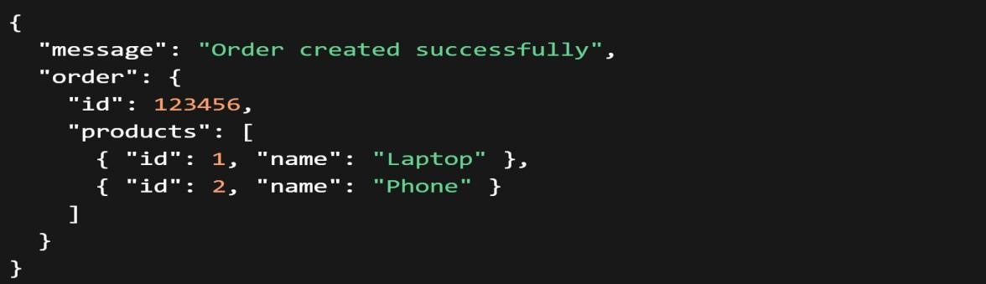
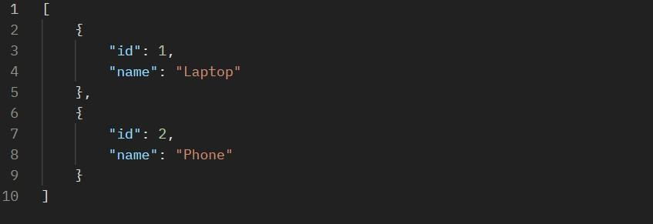
});
OUTPUT:
RESULT: Inter-service communication was successfully implemented using REST APIs, with proper handling of responses and failures between microservices.

Slide 145
TASK18: Microservice Test
AIM: To write unit test cases for microservices to validate service logic, REST APIs, and data handling using a testing framework.
ALGORITHM:
Start the program
Install testing framework (Jest, Supertest)
Configure test script in package.json
Create test folder/files
Import service modules
Write test cases for service logic
Write test cases for REST APIs
Mock external dependencies if needed
Execute test cases using Jest
Verify expected outputs
Handle edge cases and errors
Stop the program
PROGRAM:
app.js:
const express = require("express"); const app = express();
app.use(express.json()); let products = [];
// API app.get("/products", (req,
res) => { res.json(products);
});

Slide 146
app.post("/products", (req, res) => {
products.push(req.body); res.json({ msg: "Product added" });
});
module.exports = app;
SERVER.JS:
const app = require("./app"); app.listen(3001, () => {
console.log("Product Service running");
});
Product.Test.js: const request = require("supertest"); const app = require("../product-service/app"); describe("Product API Tests", () => { test("GET /products should return empty
array", async () => { const res = await request(app).get("/products");
expect(res.statusCode).toBe(200); expect(res.body).toEqual([]);
});
test("POST /products should add product", async () => { const res = await request(app) .post("/products")
.send({ name: "Laptop" });
expect(res.statusCode).toBe(200);
expect(res.body.msg).toBe("Product added");
});
test("GET /products should return data", async () => { const res = await request(app).get("/products");
expect(res.body.length).toBeGreaterThan(0);

Slide 147
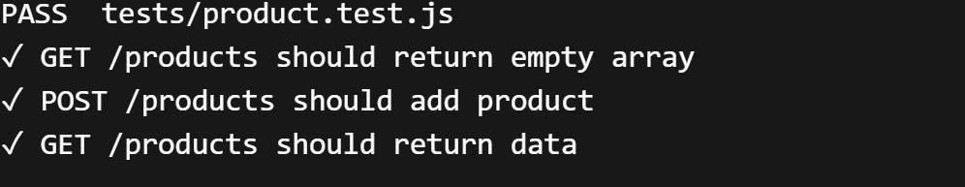
});
});
OUTPUT:
RESULT: Unit test cases were successfully implemented to validate microservice logic, REST APIs, and data handling, ensuring application reliability.

Slide 148
TASK19: Mini Git System
AIM: To design a simple Git-like web application that tracks file changes, stores versions, and displays commit history using HTML, CSS, JavaScript, and Node.js.
ALGORITHM:
Start the program
Create project files (HTML, CSS, JS, server.js, db.js)
Design UI for entering file content
Capture user input using JavaScript
Send data to server using fetch API
Store versions in database (array)
Assign version number to each commit
Save commit message and timestamp
Create API to fetch commit history
Display commit history in UI
Allow viewing previous versions
Stop the program
PROGRAM:
INDEX.HTML:
<!DOCTYPE html>
<html>
<head>
<title>Mini Git System</title>
<link rel="stylesheet" href="style.css">
</head>
<body>
<div class="container">

Slide 149
<h2>Mini Git System</h2>
<textarea id="content" placeholder="Write your code..."></textarea>
<input id="message" placeholder="Commit message">
<button onclick="commit()">Commit</button>
<h3>Commit History</h3>
<ul id="history"></ul>
</div>
<script src="script.js"></script>
</body>
</html> STYLE.CSS:
body { font-family: Arial; background:
#1e1e2f; color: white; display:flex; justify- content:center; align- items:center;
height:100vh;
}
.container { width: 400px; text-align: center;
}
textarea { width: 100%; height: 80px; margin: 5px;

Slide 150
}
input, button { margin: 5px; padding: 8px;
} li
{
background: #333;
margin: 5px; padding: 5px;
}
SCRIPT.JS:
function commit() { const content = document.getElementById("content").value;
const message =
document.getElementById("message").value;
fetch("/commit", { method: "POST", headers:
{"Content-Type":"application/json"}, body: JSON.stringify({ content, message })
}).then(loadHistory);
}
function loadHistory() { fetch("/history")
.then(res => res.json())
.then(data => {
let list = document.getElementById("history"); list.innerHTML = ""; data.forEach(c => {
let li = document.createElement("li");

Slide 151
li.innerText = `v${c.version}: ${c.message}`;
list.appendChild(li);
});
});
}
loadHistory();
SERVER.JS:
const express = require("express"); const db = require("./db"); const app = express();
app.use(express.json());
app.use(express.static( dirname)); app.post("/commit", (req, res) => { db.save(req.body); res.json({
msg: "Committed" });
});
app.get("/history", (req, res) => { res.json(db.getAll());
});
app.listen(3000, () => {
console.log("http://localhost:3000");
});
DB.JS:
let commits = []; let version
= 1; function save(data) {
commits.push({ version:

Slide 152
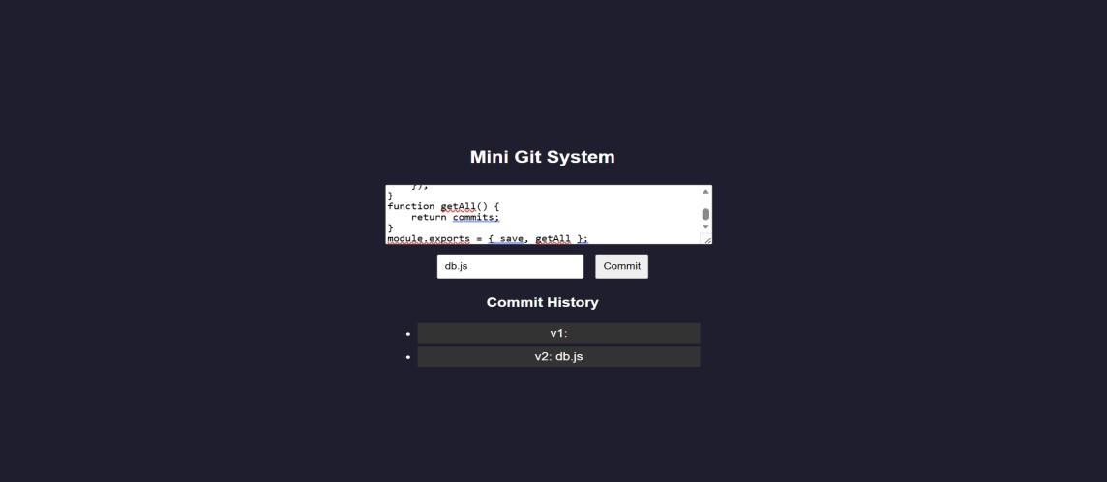
version++,
message:
data.message,
content:
data.content,
time: new
Date()
});
}
function getAll() { return commits;
}
module.exports = { save, getAll }; OUTPUT:
RESULT: A mini Git-like system was successfully developed to track versions, store commits, and display history through a web interface.
TASK20: Mini Git Branch App
Aim: To develop a Git-like application that supports branching, merging, rebasing, and conflict resolution using a web interface.
ALGORITHM:
Start the program
Create project files (HTML, CSS, JS, server.js, db.js)
Store branches and commits in memory

Slide 153
Create default branch (main)
Add feature to create new branch
Commit changes to selected branch
Implement merge logic
Detect conflicts (same file modified)
Show conflict message
Resolve conflicts manually
Implement rebase logic
Display branch history and stop
PROGRAM:
INDEX.HTML:
<!DOCTYPE html>
<html>
<head>
<title>Mini Git Branching</title>
<link rel="stylesheet" href="style.css">
</head>
<body>
<div class="container">
<h2>Mini Git Branching</h2>
<input id="branchName" placeholder="New Branch Name">
<button onclick="createBranch()">Create Branch</button>
<input id="message" placeholder="Commit Message">
<button onclick="commit()">Commit</button>
<button onclick="merge()">Merge</button>
<button onclick="rebase()">Rebase</button>

Slide 154
<h3>Branches</h3>
<ul id="branches"></ul>
<h3>History</h3>
<ul id="history"></ul>
</div>
<script src="script.js"></script>
</body>
</html> STYLE.CSS:
body { font-family: Arial; background:
#1e1e2f; color: white; display:flex; justify- content:center; align- items:center;
height:100vh;
}
.container {
text-align:center;
} input, button { margin: 5px; padding: 8px;
} li
{
background: #333;
margin: 5px; padding: 5px;

Slide 155
}
SCRIPT.JS:
function createBranch() { const name =
document.getElementById("branchName").value;
fetch("/branch", { method: "POST", headers: {"Content- Type":"application/json"}, body: JSON.stringify({ name })
}).then(load);
}
function commit() { const message = document.getElementById("message").value;
fetch("/commit", { method: "POST", headers:
{"Content-Type":"application/json"}, body: JSON.stringify({ message })
}).then(load);
}
function merge() { fetch("/merge", { method: "POST" })
.then(res => res.json())
.then(alert)
.then(load);
}
function rebase() {
fetch("/rebase", {
method: "POST" })
.then(load);
}

Slide 156
function load() {
fetch("/data")
.then(res => res.json()) .then(data => { b = document.getElementById("branches");
let
let
h = document.getElementById("history");
b.innerHTML = ""; h.innerHTML = "";
data.branches.forEach(br => {
let li =
document.createElement("li");
li.innerText = br;
b.appendChild(li);
});
data.history.forEach(c => {
let li = document.createElement("li"); li.innerText = c;
h.appendChild(li);
});
});
}
load(); SERVER.JS:
const express = require("express"); const db = require("./db"); const app
= express(); app.use(express.json()); app.use(express.static( dirname));
app.post("/branch", (req, res) => {

Slide 157
db.createBranch(req.body.name);
res.json({ msg: "Branch created" });
});
app.post("/commit", (req, res) => {
db.commit(req.body.message); res.json({ msg: "Committed" });
});
app.post("/merge", (req, res) => { const result = db.merge(); res.json({ msg: result });
});
app.post("/rebase", (req, res) => { db.rebase();
res.json({ msg: "Rebased" });
});
app.get("/data", (req, res) => {
res.json(db.getData());
});
app.listen(3000, () => console.log("http://localhost:3000"));
DB.JS:
let branches = ["main"]; let current = "main"; let commits = { main: []
};
function createBranch(name) { branches.push(name); commits[name]
= [...commits[current]];
}

Slide 158
function commit(msg) {
commits[current].push(msg);
}
function merge() { let mainCommits =
commits["main"]; let featureCommits =
commits[current]; if (mainCommits.length && featureCommits.length) { return "Merge Conflict Detected!";
}
commits["main"] = [...mainCommits, ...featureCommits]; return "Merged Successfully";
}
function rebase() {
commits[current] = [...commits["main"],
...commits[current]];
}
function getData() {
return {
branches, history:
commits[current]
};
}
module.exports = { createBranch, commit, merge, rebase, getData }; OUTPUT:

Slide 159
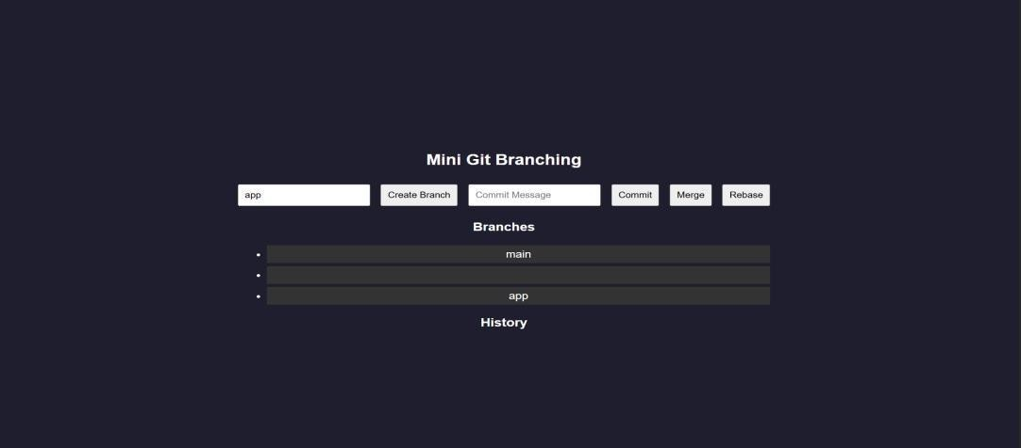
RESULT: A Git-like branching application was successfully developed to simulate branching, merging, rebasing, and conflict resolution through a web interface.
TASK21: Mini Cicd App
AIM: To develop a CI/CD pipeline simulation application that automates build, test, and deployment steps through a web interface.
ALGORITHM:
Start the program
Create project files (HTML, CSS, JS, server.js, db.js)
Design UI for pipeline trigger
Capture user action (Run Pipeline)
Send request to backend
Simulate code checkout step
Simulate build process
Simulate test execution
Simulate deployment step
Store pipeline logs
Display pipeline status in UI
Stop the program

Slide 160
PROGRAM:
INDEX.HTML:
<!DOCTYPE html>
<html>
<head>
<title>Mini CI/CD Pipeline</title>
<link rel="stylesheet" href="style.css">
</head>
<body>
<div class="container">
<h2>CI/CD Pipeline Simulator</h2>
<button onclick="runPipeline()">Run Pipeline</button>
<h3>Pipeline Logs</h3>
<ul id="logs"></ul>
</div>
<script src="script.js"></script>
</body>
</html> STYLE.CSS:
body { font-family: Arial; background:
#1e1e2f; color: white; display:flex; justify- content:center; align- items:center;
height:100vh;
}

Slide 161
.container { text-
align:center; width:
400px;
}
button { padding: 10px; margin: 10px;
background: #00c6ff; border: none; color:
white; cursor:
pointer;
}
li {
background: #333;
margin: 5px; padding:
5px;
}
SCRIPT.JS:
function runPipeline() {
fetch("/run", { method: "POST" })
.then(() => loadLogs());
}
function loadLogs() { fetch("/logs")
.then(res => res.json()) .then(data => { let list = document.getElementById("logs");
list.innerHTML = ""; data.forEach(log => {

Slide 162
let li = document.createElement("li");
li.innerText = log; list.appendChild(li);
});
});
}
loadLogs();
SERVER.JS:
const express = require("express"); const db = require("./db"); const app = express(); app.use(express.json()); app.use(express.static( dirname)); app.post("/run", async (req, res) => { await db.runPipeline(); res.json({
msg: "Pipeline executed" });
});
app.get("/logs", (req, res) => {
res.json(db.getLogs());
});
app.listen(3000, () => {
console.log("http://localhost:3000");
});
DB.JS: let logs = []; async function runPipeline() {
logs = [];

Slide 163

logs.push(" Code Checkout...");
await delay(); logs.push(" Build Started..."); await delay();
logs.push(" Running Tests..."); await delay(); logs.push(" Tests Passed"); await delay(); logs.push(" Deploying
Application..."); await delay(); logs.push(" Deployment Successful!");
}
function getLogs() { return logs;
}
function delay() { return new Promise(resolve => setTimeout(resolve, 1000));
}
module.exports = { runPipeline, getLogs }; OUTPUT:
RESULT: A CI/CD pipeline simulation application was successfully developed to automate and visualize build, test, and deployment processes.

Slide 164
TASK22: Cloud App
AIM: To develop a cloud comparison application that displays and compares services and pricing models of AWS, GCP, and Azure
ALGORITHM:
Start the program
Create project files (HTML, CSS, JS, server.js, db.js)
Design user interface with dropdown for cloud providers
Initialize cloud service data (AWS, GCP, Azure) in database module
Capture selected provider using JavaScript
Send request to server to fetch service details
Display compute, storage, database, and networking services
Accept user input for compute hours and storage usage
Send input data to server for cost calculation
Calculate cost based on pay-as-you-use pricing model
Display total cost dynamically on UI
Stop the program
PROGRAM:
INDEX.HTML:
<!DOCTYPE html>
<html>
<head>
<title>Cloud Comparison</title>
<link rel="stylesheet" href="style.css">
</head>
<body>
<div class="container">

Slide 165
<h2>Cloud Service Comparison</h2>
<select id="provider" onchange="loadData()">
<option value="aws">AWS</option>
<option value="gcp">GCP</option>
<option value="azure">Azure</option>
</select>
<h3>Services</h3>
<ul id="services"></ul>
<h3>Pricing Calculator</h3>
<input id="hours" placeholder="Compute Hours">
<input id="storage" placeholder="Storage (GB)">
<button onclick="calculate()">Calculate Cost</button>
<h3 id="result"></h3>
</div>
<script src="script.js"></script>
</body>
</html> STYLE.CSS:
body { font-family: Arial; background:
#1e1e2f; color: white;
display:flex; justify- content:center; align- items:center;
height:100vh;
}

Slide 166
.container { text-
align:center; width:
350px;
}
input, select, button {
margin: 5px; padding:
8px;
} li
{
background: #333;
margin: 5px; padding:
5px;
}
SCRIPT.JS:
function loadData() { const provider = document.getElementById("provider").value;
fetch(`/services/${provider}`)
.then(res => res.json()) .then(data => { list = document.getElementById("services");
let
list.innerHTML = "";
Object.entries(data).forEach(([key, value]) => { let li = document.createElement("li");
li.innerText = `${key}: ${value}`; list.appendChild(li);
});

Slide 167
}); } function calculate() { const provider =
document.getElementById("provider").value; const hours = document.getElementById("hours").value; const storage = document.getElementById("storage").value;
fetch("/cost", { method: "POST", headers: {"Content-Type":"application/json"},
body: JSON.stringify({ provider, hours, storage })
})
.then(res => res.json()) .then(data => {
document.getElementById("result").innerText = "Cost: $" + data.cost;
});
}
loadData(); SERVER.JS: const express =
require("express"); const db = require("./db"); const app = express(); app.use(express.json()); app.use(express.static( dirname));
app.get("/services/:provider", (req, res) => { res.json(db.getServices(req.params.provider));
});
app.post("/cost", (req, res) => {
const { provider,
hours, storage } = req.body; const cost =
db.calculate(provider, hours, storage); res.json({ cost });
});
app.listen(3000, () => {
console.log("http://localhost:3000");

Slide 168
});
DB.JS: const services = { aws: {
Compute: "EC2", Storage: "S3", Database: "RDS",
Network: "VPC"
},
gcp: {
Compute: "Compute Engine",
Storage: "Cloud Storage", Database: "Cloud SQL", Network: "VPC"
},
azure: {
Compute: "Virtual Machines", Storage: "Blob Storage",
Database: "SQL Database", Network: "VNet"
}
};
const pricing = {
aws: { compute: 0.1,
storage: 0.02 },
gcp: { compute: 0.09,
storage: 0.025 }, azure: { compute:
0.11, storage: 0.018 }

Slide 169
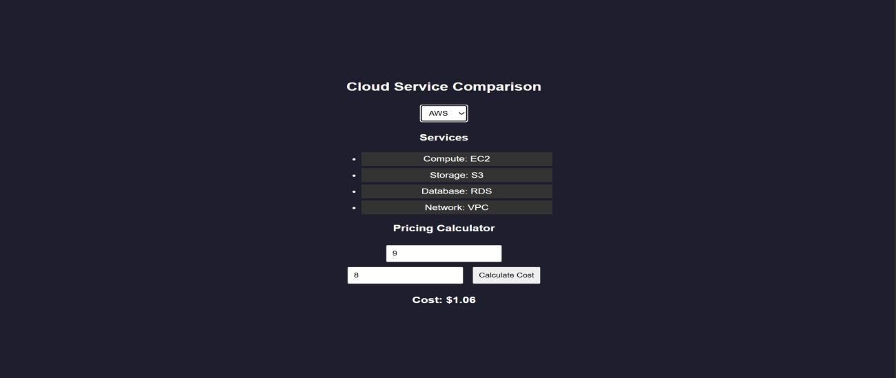
};
function getServices(provider) { return services[provider];
}
function calculate(provider, hours, storage) { const p = pricing[provider]; return (hours * p.compute + storage * p.storage).toFixed(2);
}
module.exports = { getServices, calculate }; OUTPUT:

Slide 170
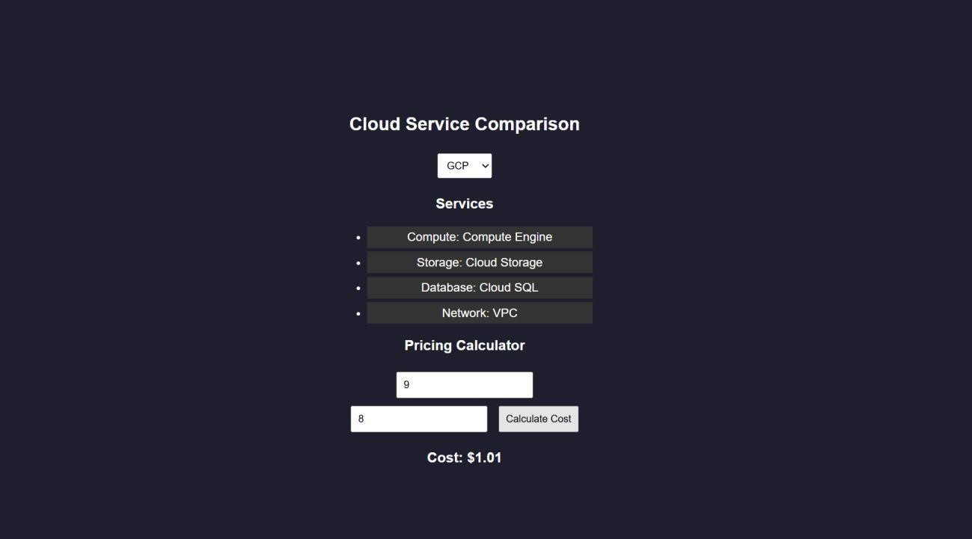
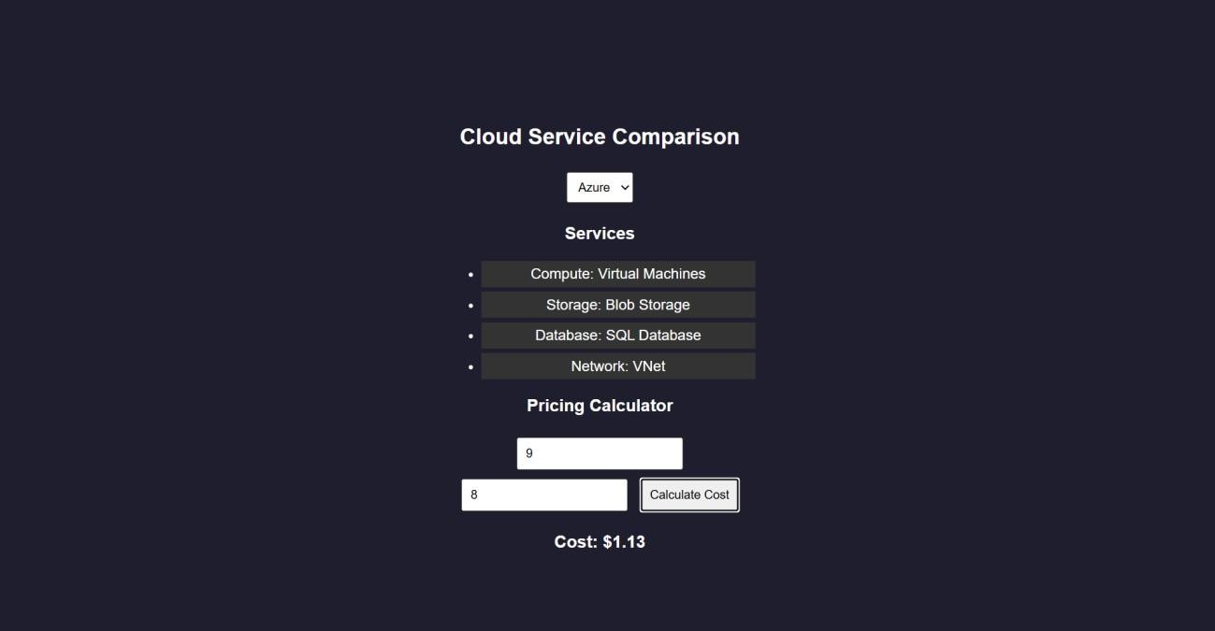
RESULTS: A cloud comparison application was successfully developed to display services and simulate pay-as-you-use pricing across AWS, GCP, and Azure.
TASK23: AI PROMPT APP

Slide 171
AIM: To develop an application that demonstrates prompt engineering by generating and evaluating code or cloud configurations based on user input.
ALGORITHM:
Start the program
Create project files (HTML, CSS, JS, server.js, db.js)
Design UI with input field for user prompt
Capture user prompt using JavaScript
Send prompt to server using fetch API
Receive prompt data in backend (server.js)
Process prompt using predefined logic (db.js)
Generate output (code / cloud config / response)
Evaluate output quality and assign score
Send generated output and score to frontend
Display output and score on UI
Stop the program
PROGRAM:
INDEX.HTML:
<!DOCTYPE html>
<html>
<head>
<title>AI Prompt App</title>
<link rel="stylesheet" href="style.css">
</head>
<body>
<div class="container">
<h2>Prompt Engineering Tool</h2>

Slide 172
<textarea id="prompt" placeholder="Enter your prompt..."></textarea>
<button onclick="generate()">Generate Output</button>
<h3>Generated Output</h3>
<pre id="output"></pre>
<h3>Quality Score</h3>
<p id="score"></p>
</div>
<script src="script.js"></script>
</body>
</html> STYLE.CSS:
body { font-family: Arial; background: #202038; color:
white; display:flex; justify-content:center; align-items:center; height:100vh;
}
.container { width: 400px; text-align: center;
}
textarea { width: 100%; height: 100px; margin: 5px;

Slide 173
}
button {
padding:
10px; margin: 10px;
background: #00c6ff; border: none; color: white;
}
pre { background: #333; padding:
10px;
}
SCRIPT.JS:
function generate() { const prompt = document.getElementById("prompt").value; fetch("/generate", { method: "POST",
headers:
{"Content-Type":"application/json"}, body:
JSON.stringify({ prompt })
})
.then(res => res.json())
.then(data => { document.getElementById("output").innerText = data.output; document.getElementById("score").innerText = data.score + "/10";
});
}
SERVER.JS: const express = require("express"); const db = require("./db");

Slide 174
const app = express();
// Middleware app.use(express.json());
app.use(express.static( dirname)); // serve HTML
// Home route (optional but useful) app.get("/", (req, res) => { res.sendFile( dirname + "/index.html");
});
// Generate output app.post("/generate", (req, res)
=> { const result =
db.processPrompt(req.body.prompt); res.json(result);
});
// START SERVER WITH LINK
app.listen(3000, () => { console.log(" Server running at:"); console.log(" http://localhost:3000");
});
DB.JS: function
processPrompt(prompt) {
let output = ""; let score = 5; if
(prompt.toLowerCase().includes("code")) { output = `function greet() {
console.log("Hello from AI!");

Slide 175
}`;
score
= 9;
}
else if (prompt.toLowerCase().includes("cloud")) { output = `AWS EC2 Config:
- Instance: t2.micro - Region: us-east-1`;
score = 8;
}
else {
output = "Basic AI response generated."; score = 5;
}
return { output, score };
}
module.exports = { processPrompt };
OUTPUT:

Slide 176
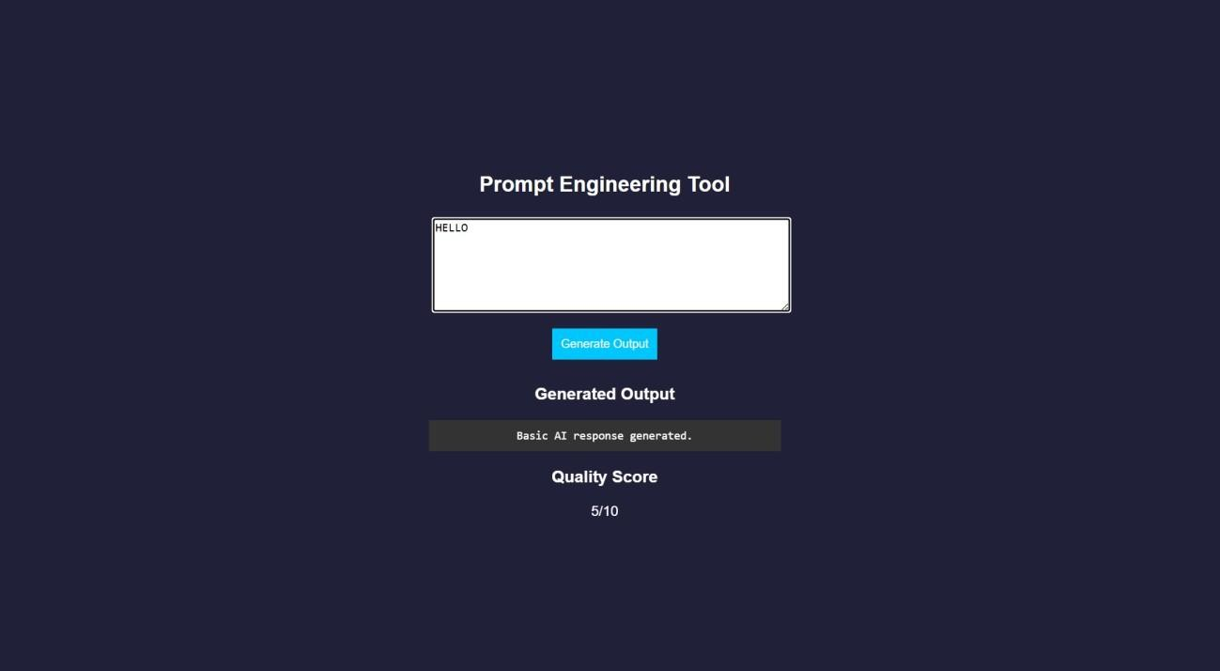
RESULT: A prompt engineering application was successfully developed to generate and evaluate AI-based outputs for code and cloud configurations.
TASK24: Vibe Cloud App
AIM: To develop an application that uses iterative prompt engineering to generate and evaluate REST APIs, cloud deployment steps, and security configurations.
ALGORITHM:
Start the program
Create project files (HTML, CSS, JS, server.js, db.js)
Design UI to accept user prompts
Capture prompt input using JavaScript
Send prompt to backend using fetch API
Receive prompt in server and forward to processing module
Store prompt in history for version tracking
Analyze prompt type (REST API / Cloud / Security)
Generate corresponding output based on prompt

Slide 177
Evaluate output quality and assign score
Return output and score to frontend and display results
Stop the program
PROGRAM:
INDEX.HTML:
<!DOCTYPE html>
<html>
<head>
<title>Vibe Coding App</title>
<link rel="stylesheet" href="style.css">
</head>
<body>
<div class="container">
<h2>Vibe Coding Cloud Generator</h2>
<textarea id="prompt" placeholder="Enter prompt..."></textarea>
<button onclick="generate()">Generate</button>
<h3>Output</h3>
<pre id="output"></pre>
<h3>Score</h3>
<p id="score"></p>
<h3>Prompt Versions</h3>
<ul id="history"></ul>
</div>
<script src="script.js"></script>
</body>

Slide 178
</html> STYLE.CSS: body
{ font-family: Arial; background: #b98bdb; color: white;
display:flex; justify- content:center; align- items:center;
height:100vh;
}
.container { width: 400px; text-align: center;
}
textarea { width: 100%; height: 100px;
}
button {
padding:
10px; margin: 10px;
background: #00c6ff; border: none;
}
pre { background: #333; padding:
10px;

Slide 179
} li
{
background: #444;
margin: 5px; padding: 5px;
}
SCRIPT.JS:
function generate() { const prompt = document.getElementById("prompt").value; fetch("/generate", { method: "POST",
{"Content-Type":"application/json"},
headers:
body: JSON.stringify({ prompt })
})
.then(res => res.json()) .then(data => {
document.getElementById("output").innerText = data.output; document.getElementById("score").innerText = data.score + "/10";
loadHistory();
});
}
function loadHistory() {
fetch("/history")
.then(res => res.json()) .then(data => { list = document.getElementById("history");
list.innerHTML = ""; data.forEach((p, i) => { let li = document.createElement("li");
let

Slide 180
li.innerText = `v${i+1}: ${p.prompt}`;
list.appendChild(li);
});
});
}
loadHistory();
SERVER.JS: const express = require("express"); const db = require("./db");
const app = express(); app.use(express.json()); app.use(express.static( dirname));
app.post("/generate", (req, res) => {
const
result = db.process(req.body.prompt);
res.json(result);
});
app.get("/history", (req, res) => { res.json(db.getHistory());
});
app.listen(3000, () => { console.log(" http://localhost:3000");
});
DB.JS:
let history = []; function process(prompt) { let output = ""; let score = 5; history.push({ prompt }); if
(prompt.includes("REST")) { output = `app.get('/api', (req,res)=>res.send('API running'));`; score = 7;

Slide 181
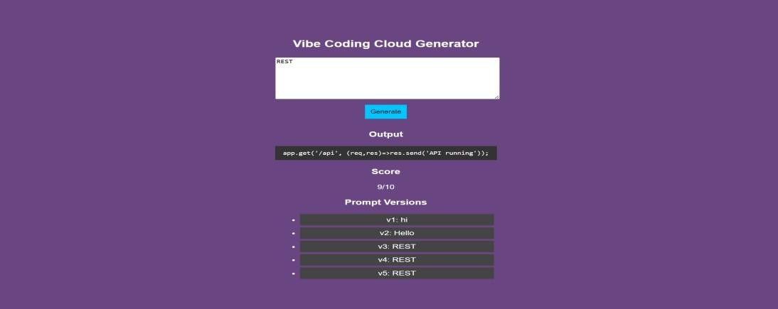
}
else if (prompt.includes("cloud")) { output = `Deploy using AWS EC2:
Launch instance
Install Node.js 3. Run app`;
score = 8;
}
else if (prompt.includes("security")) {
output = `Use HTTPS,
JWT authentication, and firewall rules`;
score = 9;
}
score += Math.min(history.length, 2); return { output, score };
}
function getHistory() { return history;
}
module.exports = { process, getHistory }; OUTPUT:
RESULT: A Vibe Coding application was successfully developed to generate and refine cloudbased features using iterative prompt engineering.

