Slide 1

Vel Tech Rangarajan Dr. Sagunthala R&D Institute of Science and Technology
School of Computing
Department of Computer Science and Engineering
10211CS224 / FULL STACK APPLICATION DEVELOPMENT (JAVA)
END SEMESTER PROJECT REVIEW
Date: 06-05-2026
Smart Campus Event Management System
SDG: SDG 4 – Quality Education
Presented By:
MINCHALA BHANU PRAKASH – VTU29722 – 23UECS2049.
Courses Handling Faculty:
Dr. C.M.Chidambaranathan

Slide 2
INTRODUCTION
-The Smart Campus Event Management System is designed to manage campus events and student registrations through a centralized digital platform.
It reduces manual work and minimizes errors in handling event-related data.
Students can easily view available events and register online without any hassle.
Event organizers can efficiently create, update, and manage events in real time.
The system improves communication between students and organizers.
It provides a complete solution for event planning, registration, and participation tracking.
Overall, it ensures a smooth, fast, and user-friendly campus event management process.
1
2
3
4
5
6
7
8
9

Slide 3
PROBLEM STATEMENT
1
Right now, most colleges handle event registrations manually. They use paper forms, put up notices on bulletin boards, or send out long, confusing emails. This old way of doing things causes many problems:
Wasted Time: Staff members spend hours collecting paper forms and typing data into Excel sheets.
Lost Information: Paper forms can get lost easily, and manual data entry often leads to mistakes like spelling a student's name wrong.
Poor Communication: Students might miss important announcements about date changes or venue updates because they didn't check the notice board.
Hard to Track: It is very difficult for organizers to know exactly how many people are coming to an event until the very last minute.
There is a strong need for a modern, digital solution that replaces paper with a fast, reliable online system.
2
3
4
5
6
7
8
9

Slide 4
OBJECTIVE(S)
The main goal of this project is to build a complete and secure website that solves all the problems of manual event management. Specifically, our objectives are:
Going Paperless: To completely remove the need for paper forms by allowing online registrations.
Easy Tools for Staff: To give college administrators a simple dashboard where they can add new events, update details, and manage student lists easily.
Quick Registration for Students: To let students register for any event with just one click, without filling out long forms every time.
Automatic Updates: To send automatic email confirmations and updates to students so they never miss out on important information.
Safe and Secure: To protect user passwords and personal data using modern security methods.
1
2
3
4
5
6
7
8
9

Slide 5
PROPOSED SYSTEM
We propose a complete web application divided into two main parts: the "frontend" (what the user sees on their screen) and the "backend" (the hidden engine that does the work).
The system recognizes two types of users: "Administrators" (like teachers or event heads) and "Students".
For Students: The system offers a beautiful and simple web page where they can securely log in, view a list of all upcoming college events, and book their spot instantly. If they forget their password, they can easily reset it using a secure code sent to their email.
For Administrators: The system provides a powerful control panel. They can log in to create new events, set a limit on how many students can join, and watch the registration numbers grow in real-time.
Everything is tied together with an automatic email system that sends welcome emails and booking confirmations in the background.
1
2
3
4
5
6
7
8
9

Slide 6
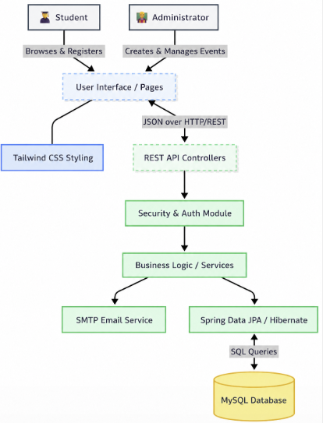
PROPOSED SYSTEM ARCHITECTURE
1
2
3
4
5
6
7
8
9
- The system is a web application with a frontend (user interface) and backend (processing system), supporting two user roles: Administrators and Students.
- Students can log in, view events, register, and reset passwords, while administrators can manage events and monitor registrations, with automated email notifications for users.

Slide 7
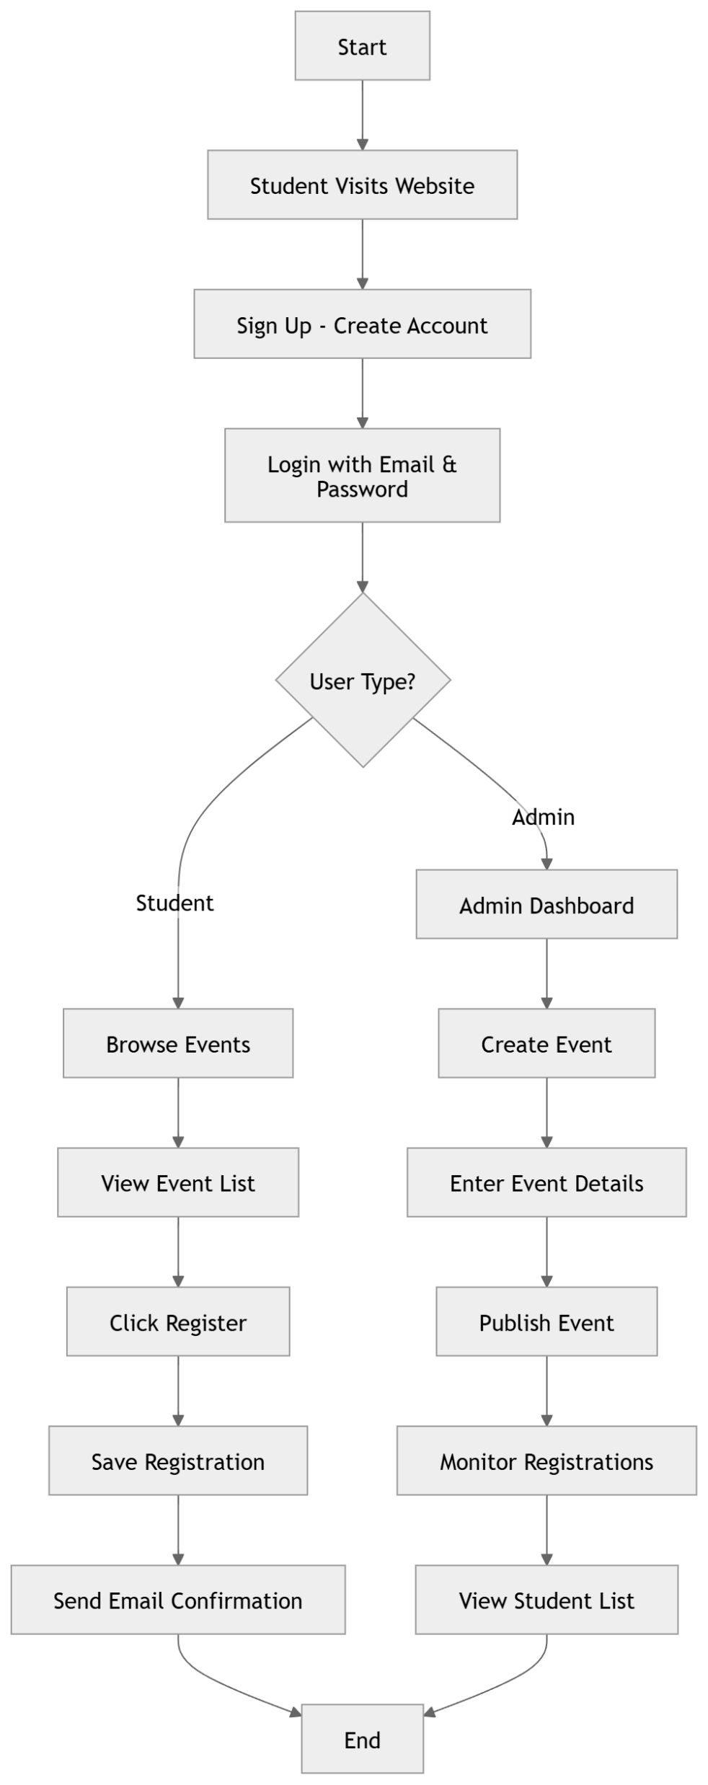
WORKFLOW
1
2
3
4
5
6
7
8
9

Slide 8
WORK FLOW
1. Account Creation (Sign Up): A new student visits the website, enters their details, and creates a secure account.
2. Logging In: The student logs into the platform using their email and password. The system checks their details to keep everything safe.
3. Creating an Event (Admin Only): A college administrator logs into their special dashboard. They click "Create Event" and fill in details like the event name, date, time, location, and the maximum number of seats available.
4. Browsing Events: The student goes to the home page and sees a colorful, easy-to-read list of all the events the admin just created.
5. One-Click Registration: The student finds an interesting event and simply clicks the "Register" button. The system immediately saves their spot.
6. Email Confirmation:Right after clicking register, the system's background email service sends a confirmation email to the student's inbox, thanking them for registering and providing the event details.
7. Monitoring Progress: The administrator can look at their dashboard to see a live count of how many students have registered for their event and view the complete list of names.
1
2
3
4
5
6
7
8
9

Slide 9
TECHNOLOGIES USED
1. Frontend:
The Frontend those are used are:
- React JS
- CSS
2. Backend:
The Backend those are used in these are:
- Java
- Spring Boot
3. Database:
- MySQL
4. Tools:
- Eclipse IDE
- VS Code
5. Other Technologies:
- REST API
- JSON
-Java Mail Sender
1
2
3
4
5
6
7
8
9

Slide 10
MODULE DESCRIPTION
Module 1: User Management
Handles user operations in the Smart Campus Event Management System:
* User registration (students admins)
* Secure login and authentication
* Role-based access control
* Profile management
Ensures secure access and proper user role management.
Module 2: Core Processing
Manages event-related operations:
Create, update, or cancel events
Event details: title, description, date, time, venue, participant limit
Users can view and search events
Ensures efficient event planning and scheduling within the campus.Manages data storage, retrieval, and ensures data integrity.
1
2
3
4
5
6
7
8
9

Slide 11
MODULE DESCRIPTION
Module 3: Registration and Participation Management
Handles event registration and participants:
* Users can register for events
* Stores participant details securely
* Organizers can view and manage registrations
* Tracks status (Registered, Approved, Cancelled, Attended)
Ensures smooth coordination between organizers and participants.
1
2
3
4
5
6
7
8
9

Slide 12
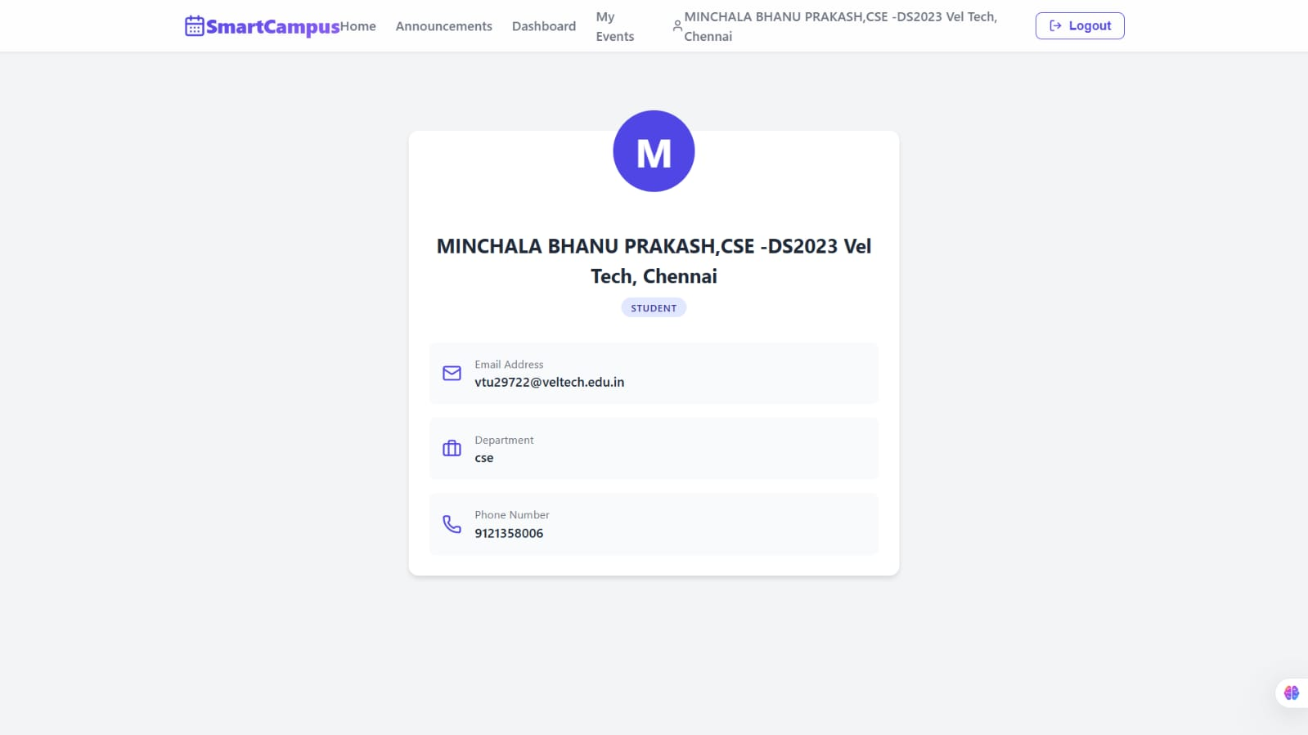
IMPLEMENTATION SCREENSHOTS
1
2
3
4
5
6
7
8(A)
9
The above diagram shows the details of a person and the details like name of the person/student and their Email, Branch and their Phone number.

Slide 13
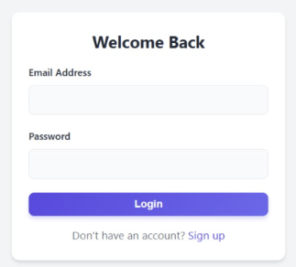
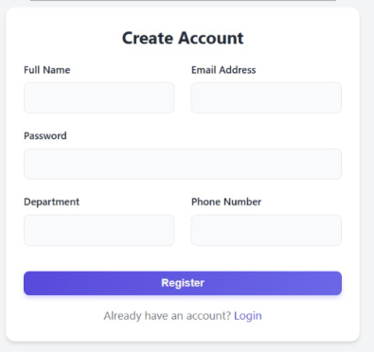
IMPLEMENTATION SCREENSHOTS
1
2
3
4
5
6
7
8(B)
9

Slide 14
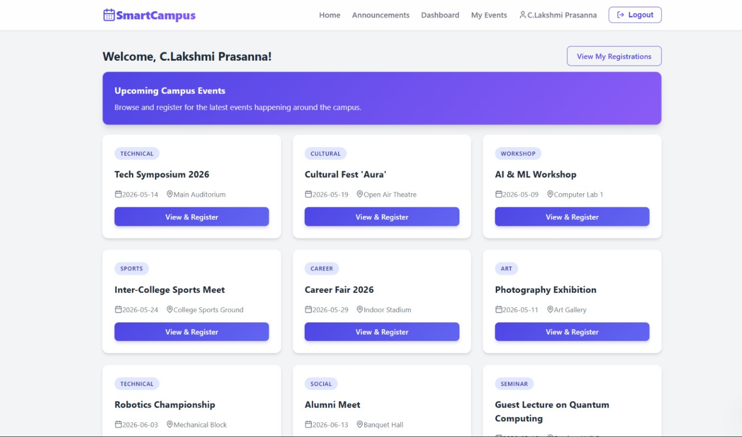
IMPLEMENTATION SCREENSHOTS
1
2
3
4
5
6
7
8(C)
9
The Above figure represents the Available Events page displays a list of all upcoming events with details such as date,time, venue, and description. It allows users to browse and select events based on their interests. Thispage helps users easily explore and choose events for registration.

Slide 15
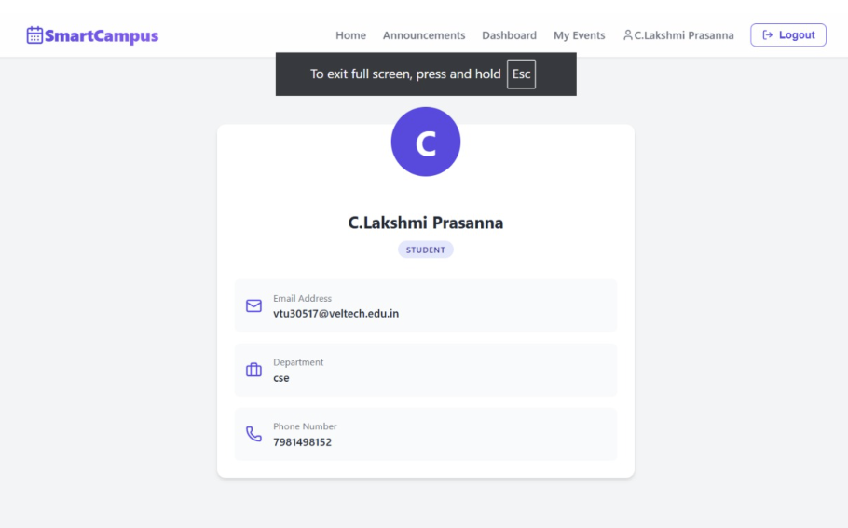
IMPLEMENTATION SCREENSHOTS
1
2
3
4
5
6
7
8(C)
9
This screen displays the user profile in the Smart Campus system, showing personal details like name, role, email, department, and phone number.It allows users to view and manage their information in a clear and organized interface.

Slide 16
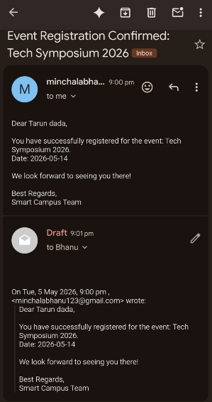
IMPLEMENTATION SCREENSHOTS
1
2
3
4
5
6
7
8(C)
9
An Email message will be sent to your mail if you have registered to any event and also gives you a remainder that you have to attend that particular Event.

Slide 17
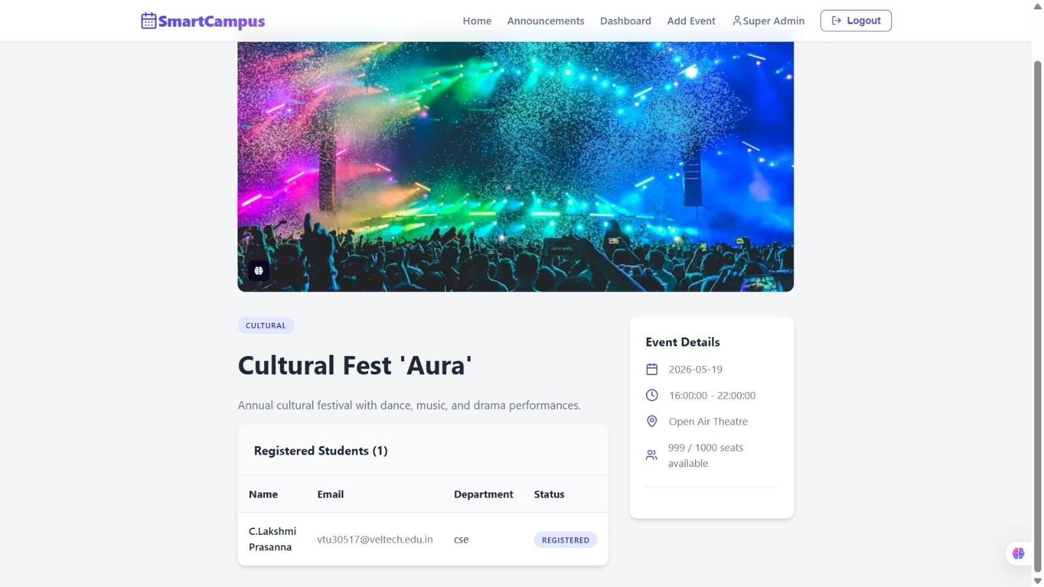
IMPLEMENTATION SCREENSHOTS
1
2
3
4
5
6
7
8(C)
9

Slide 18
ADVANTAGES & LIMITATIONS
ADVANTAGES:
Centralized system
Saves time
Easy event management
Real-time updates
Reduces paperwork
Improves accuracy
. User-friendly interface
LIMITATIONS:
- Requires internet connection
- Security risks if not properly handled
- Limited features in basic version
- Needs regular maintenance
- Scalability issues for large systems
- Users need basic technical knowledge
1
2
3
4
5
6
7
8
9

Slide 19
Thank you

