Slide 1

SCHOOL OF COMPUTING
DEPARTMENT OF COMPUTER SCIENCE & ENGINEERING
“Praja Sahayak”
PRESENTED BY
T. Arun kumar reddy
L. Akhil krishna
G. Vinay
PRESENTED AT
Vel Tech HACKATHON

Slide 2
AGENDA
OBJECTIVE
ABSTRACT
INTRODUCTION
DESIGN AND METHODOLOGIES
IMPLEMENTATION
CONCLUSION

Slide 3
OBJECTIVES
Aim of the Project:
To develop an Android Application for the people of Bihar state regarding COVID-19.
Scope of the Project:
The scope of the project is to facilitate the information and daily updates to the biharians regarding COVID-19.

Slide 4
ABSTRACT
Covid pandemic has infected many people in the World including India, most of our state Governments have developed an application for their states regarding Corona but Bihar Government doesn’t. So we are developing an Application called Praja Sahayak for Biharians.

Slide 5
INTRODUCTION
This app is built with 6 modules Self Test, Donations, e-Pass Request, Toll Free numbers, Services, Case Details.
Self Test is used to track the COVID from the people.
Interested people can donate using DONATIONS tab which will be directly forwarded to Government.
E-Pass request is used to generate e-Pass which will be provided by Government.
Service will be displaying the latest announcements by Government.
Case Details are the regular case details of COVID-19

Slide 6
DESIGN AND METHODOLOGIES
MODULE 1:
Creation of User Interface.
MODULE 2:
Connection of App with Firebase.

Slide 7
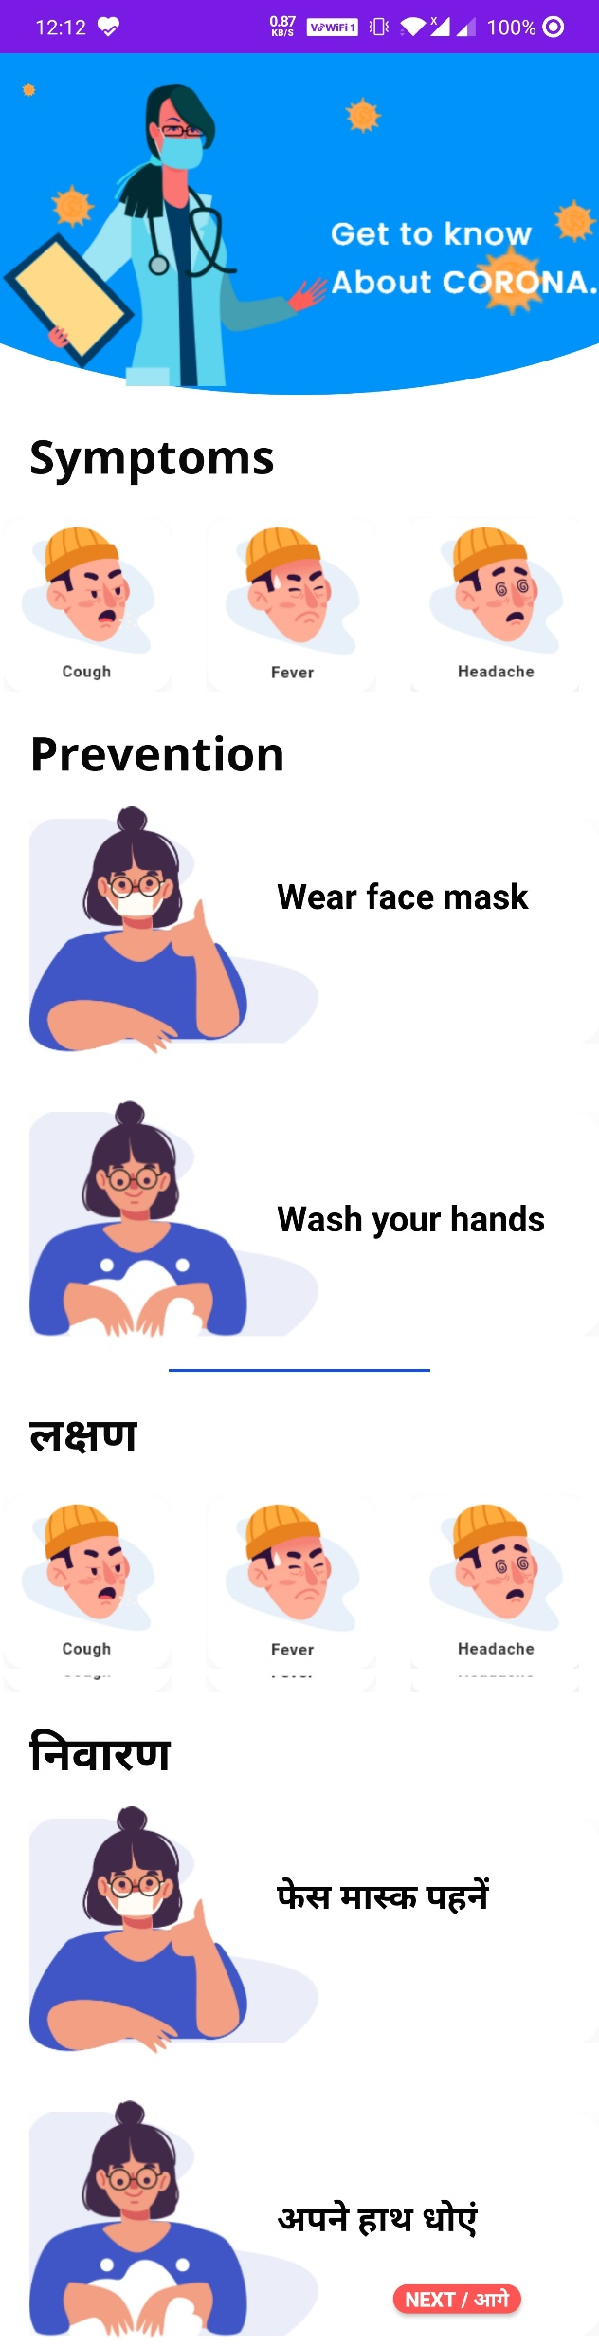
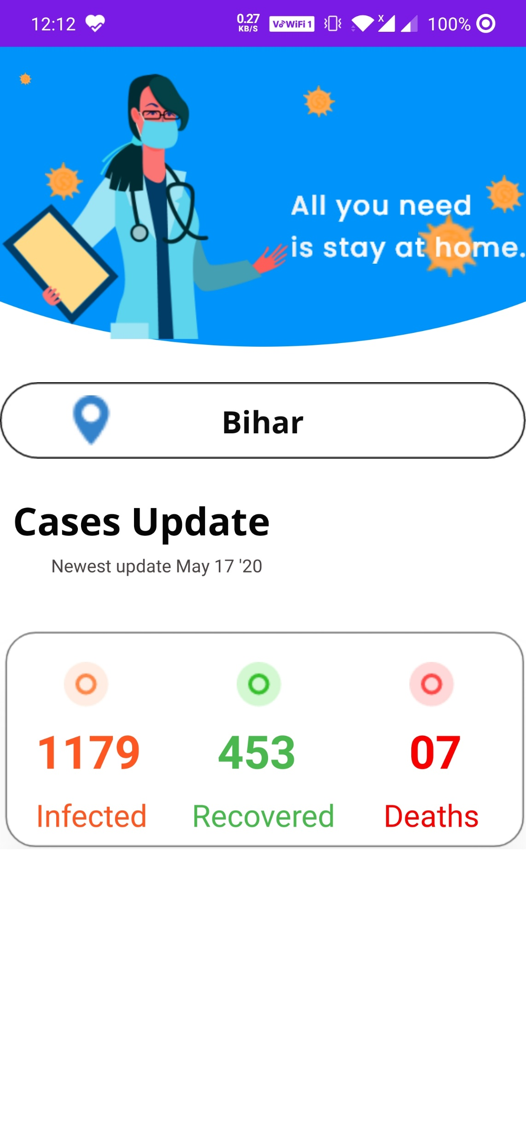
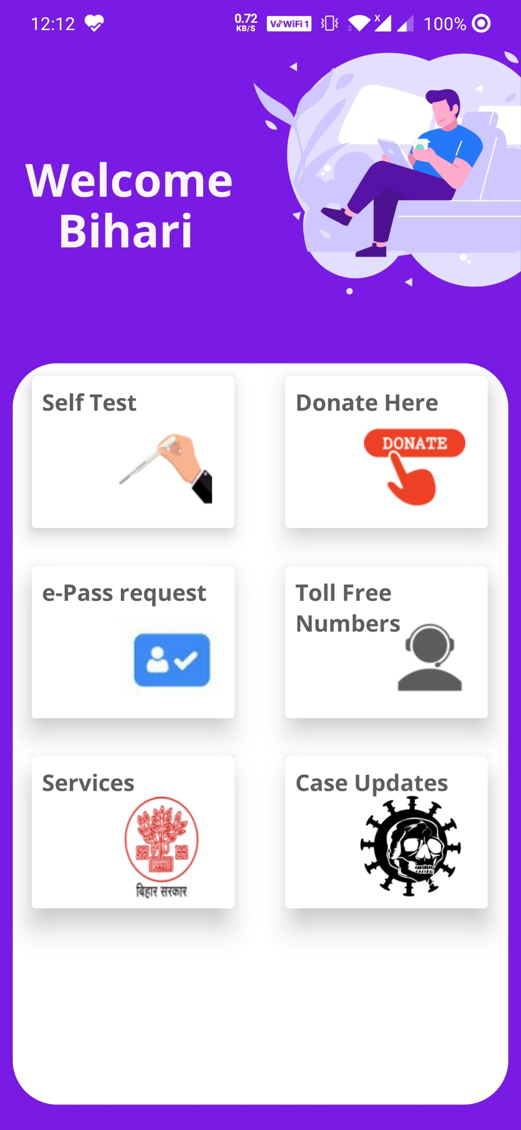
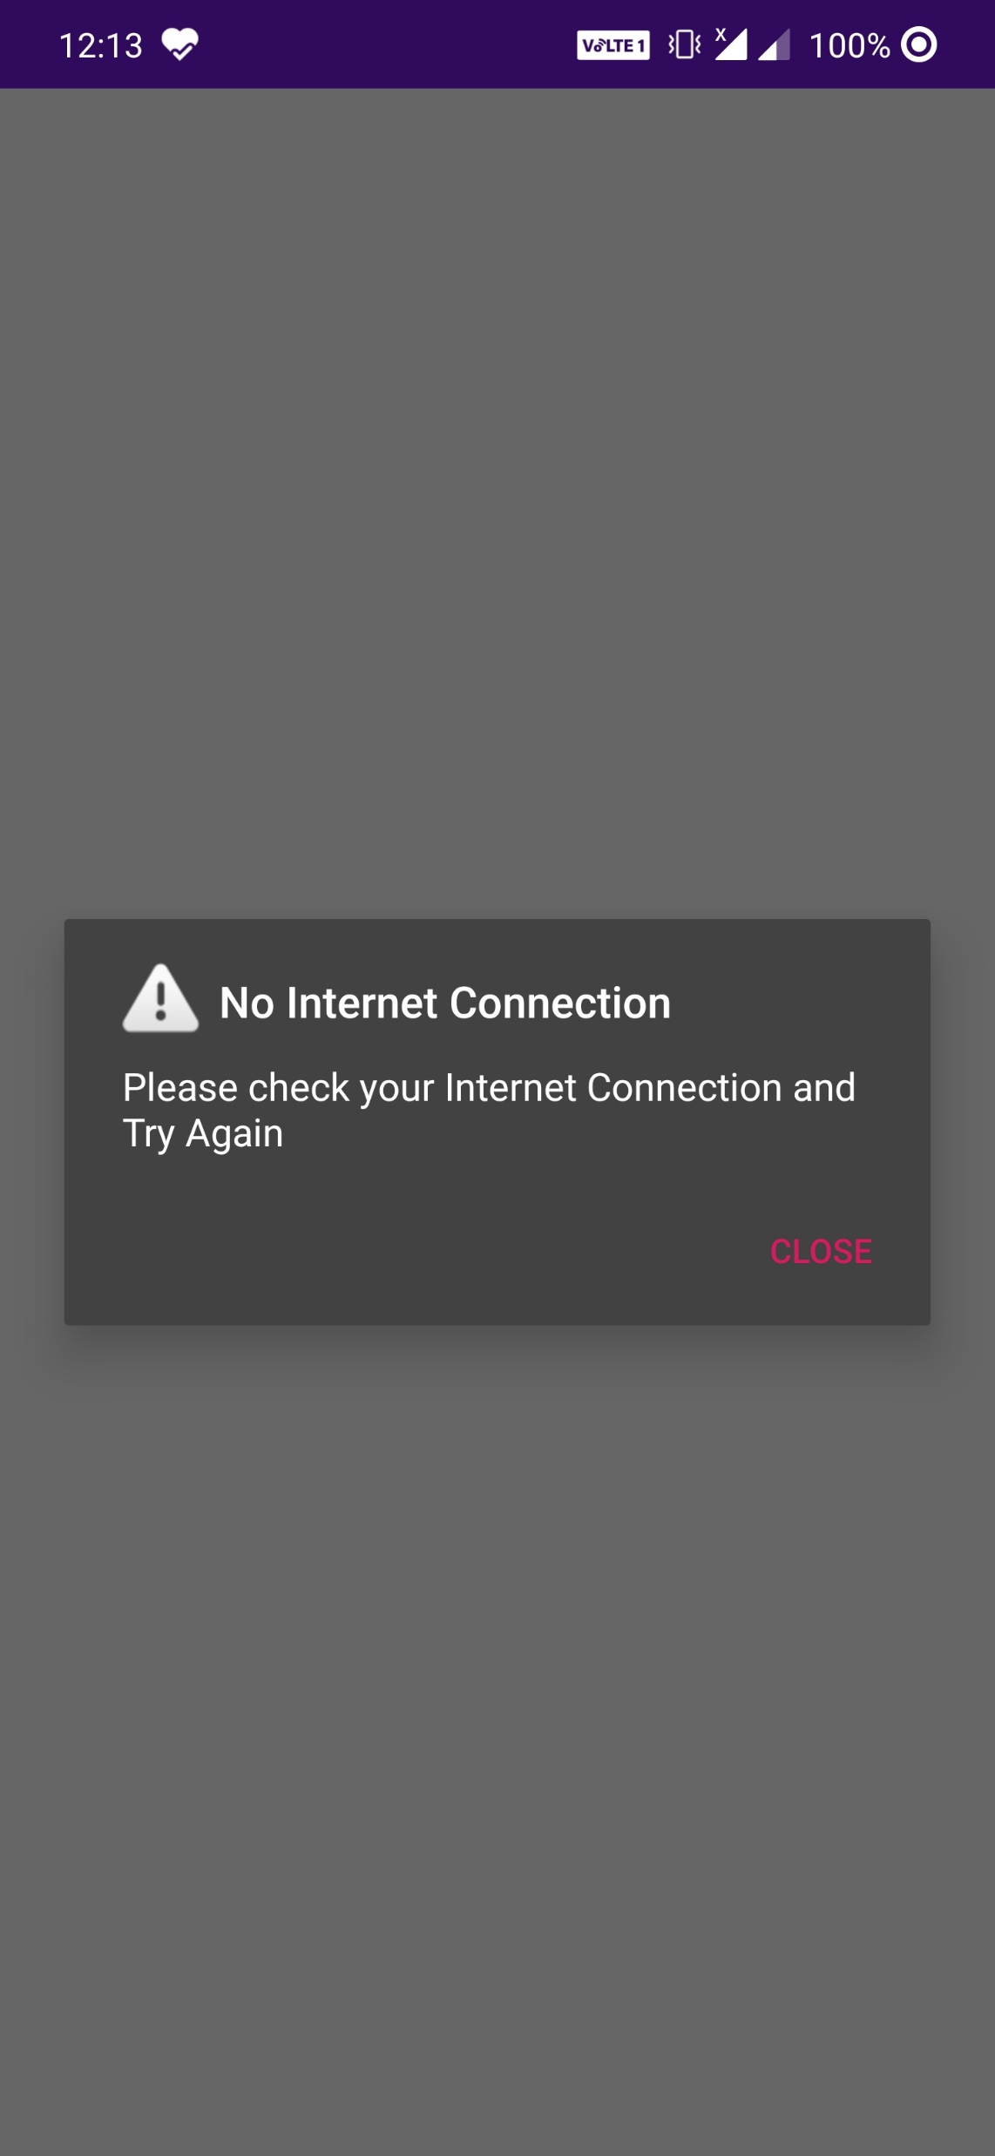
MODULE:1
User Interface

Slide 8
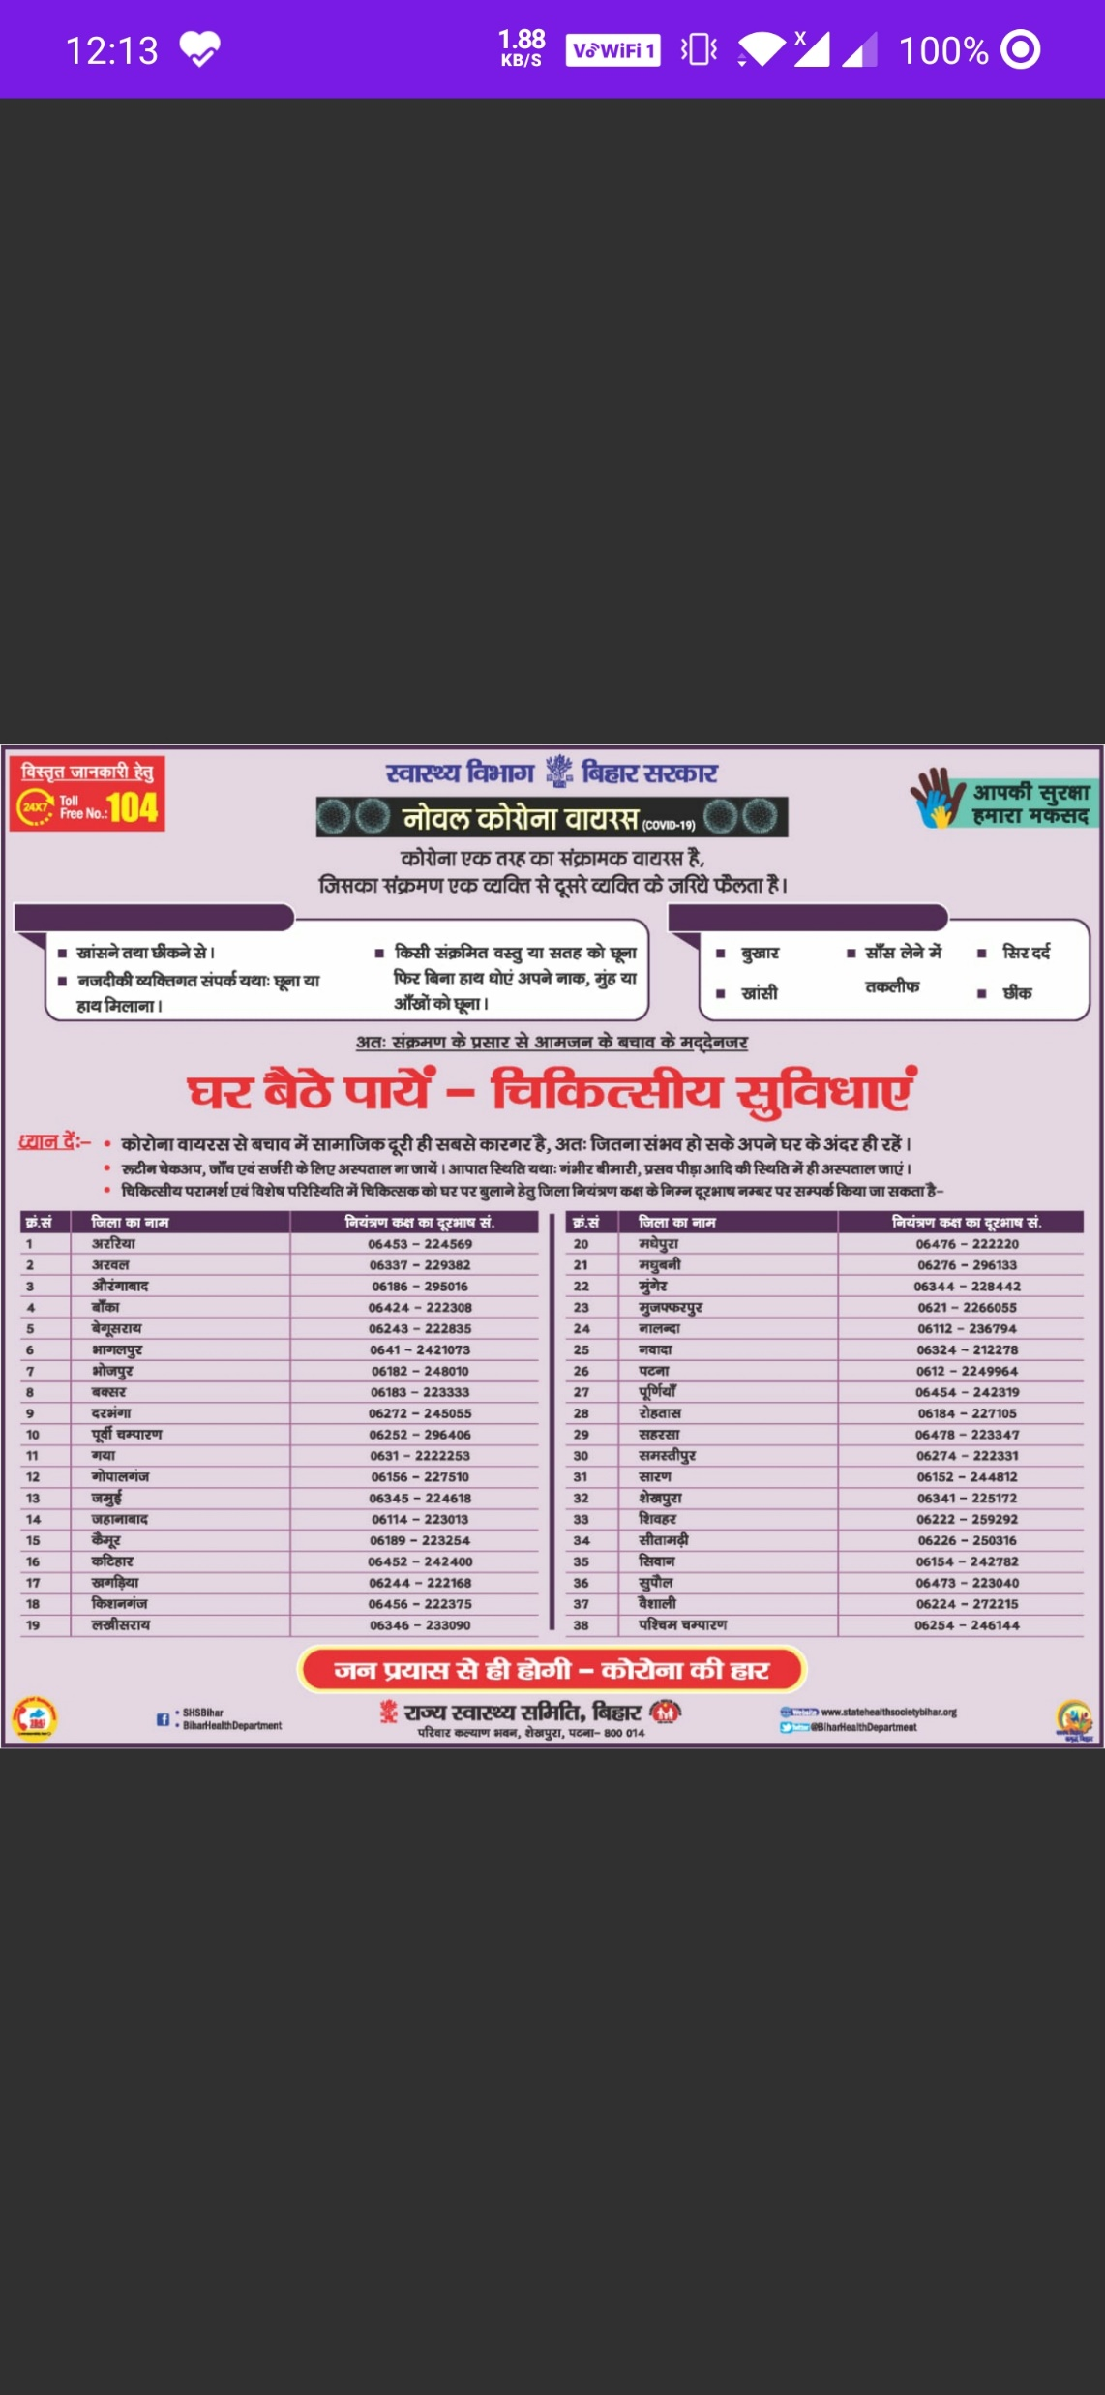
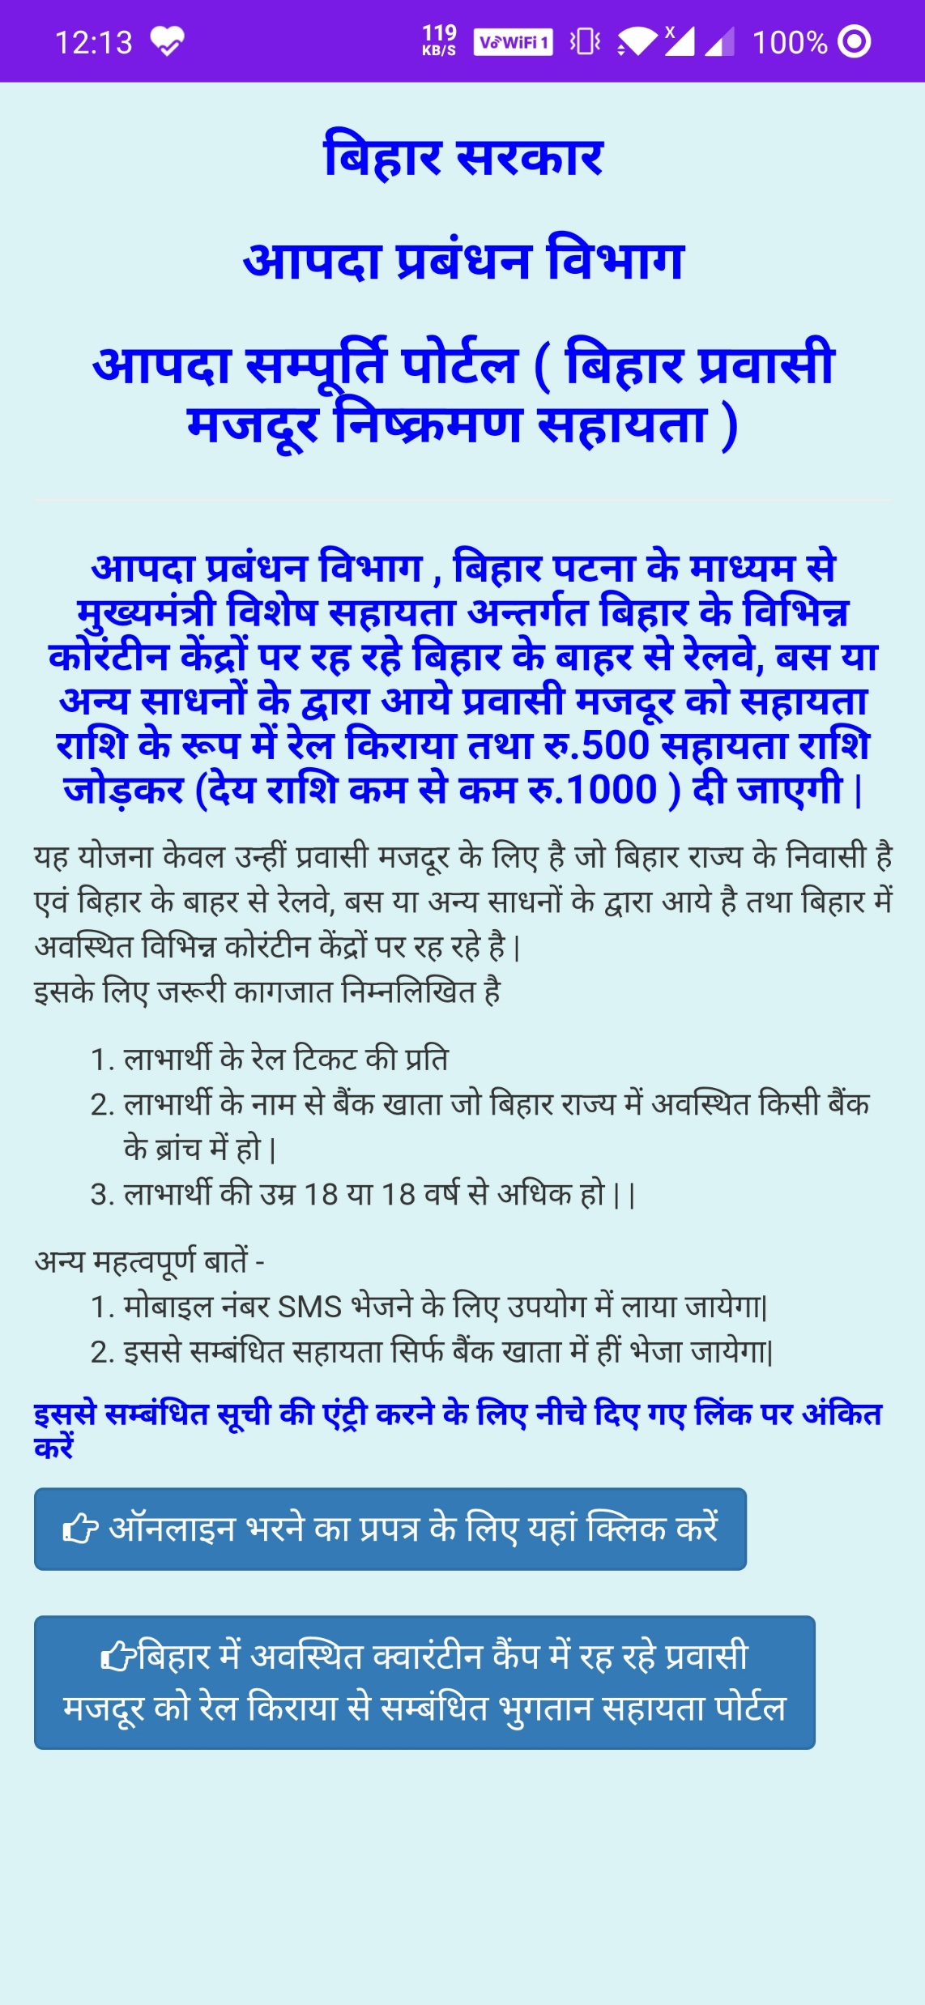
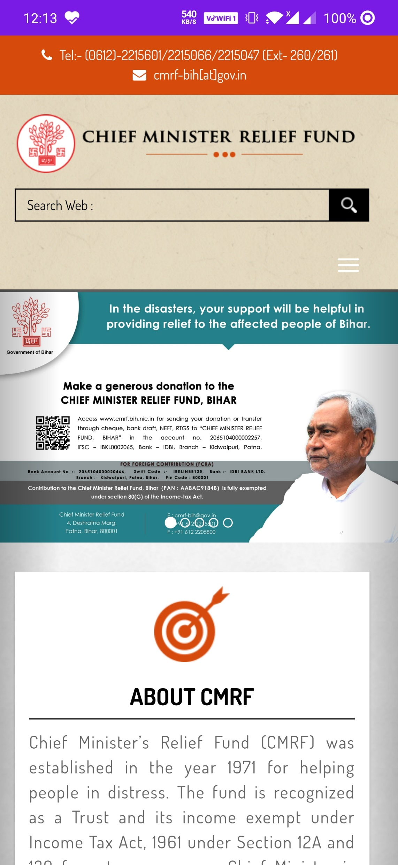
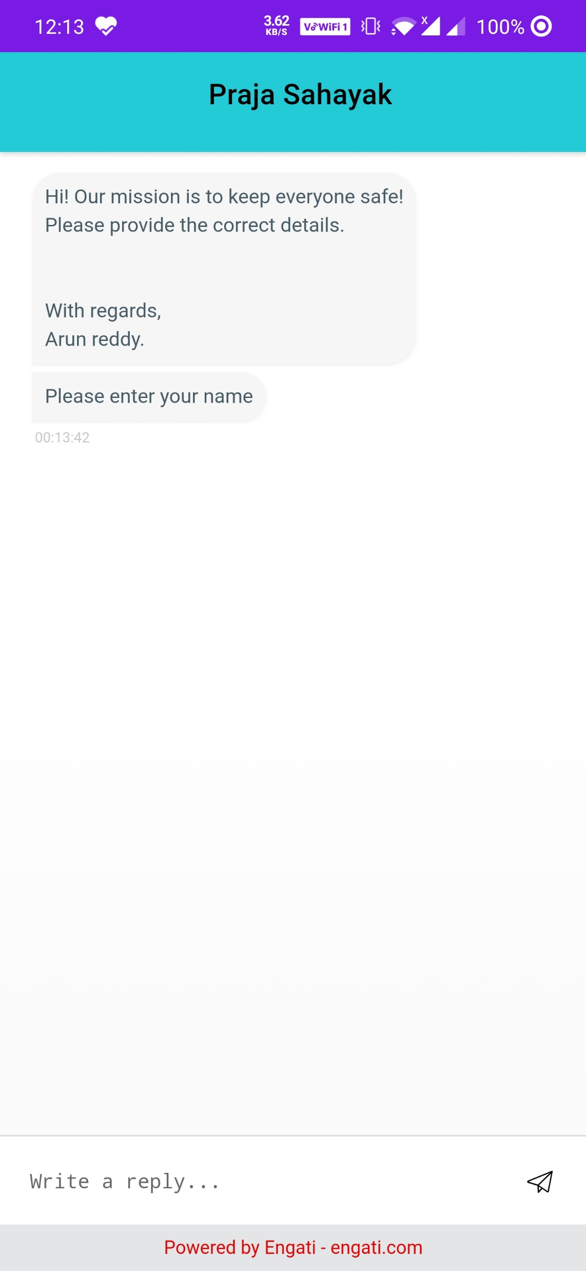
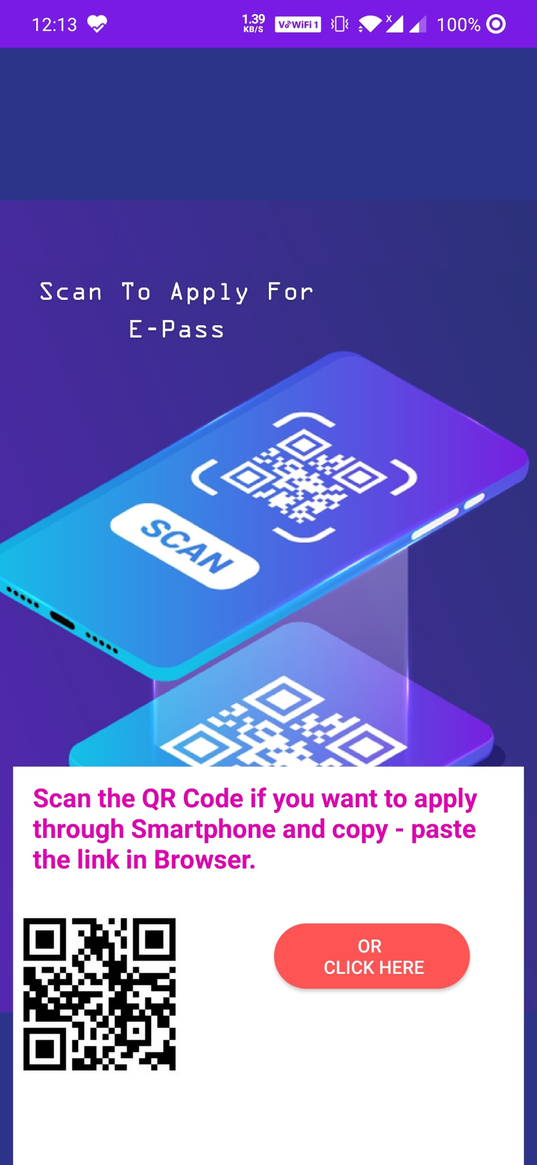

Slide 9
IMPLEMENTATION – Tools
Tools : Android Studio.
Languages : XML, Java.
Server : Firebase.

Slide 10
CONCLUSION
This project helps the people of bihar state with the live updates of COVID-19.

Slide 11
THANK YOU

