Slide 1
Java Threading: From Basics to Advanced

Slide 2
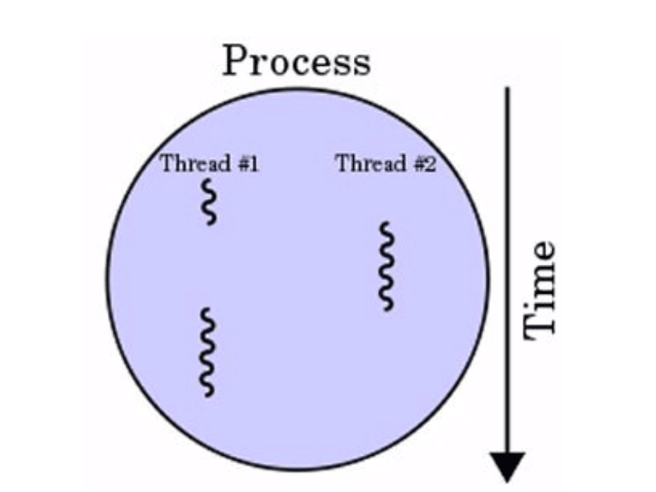
Introduction to Threads
What is a Process?
A process is an independent program in execution, with its own memory space, resources, and execution context.
What is a Thread?
A thread, on the other hand, is a smaller unit of execution within a process. Threads within the same process share the same memory space and resources, allowing for efficient communication and data sharing

Slide 3
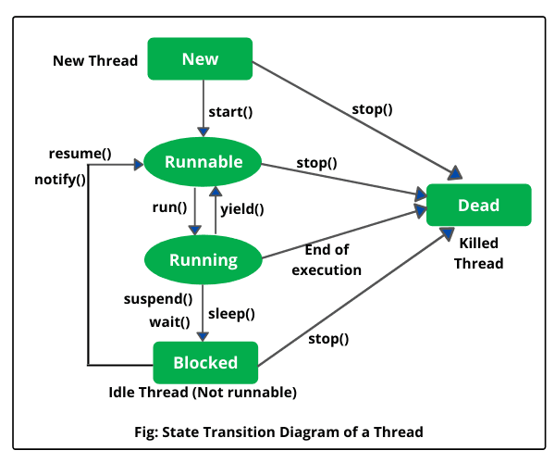
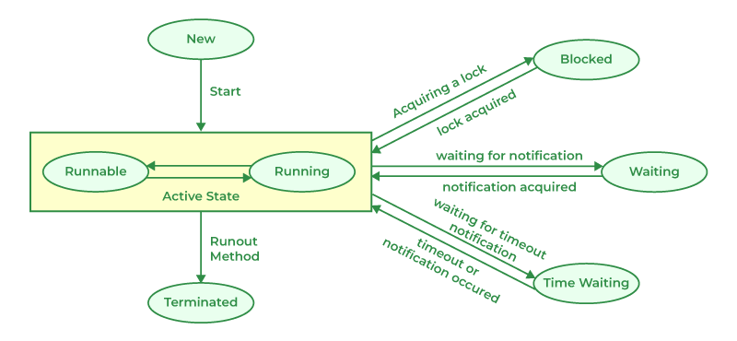
Thread Lifecycle

Slide 4
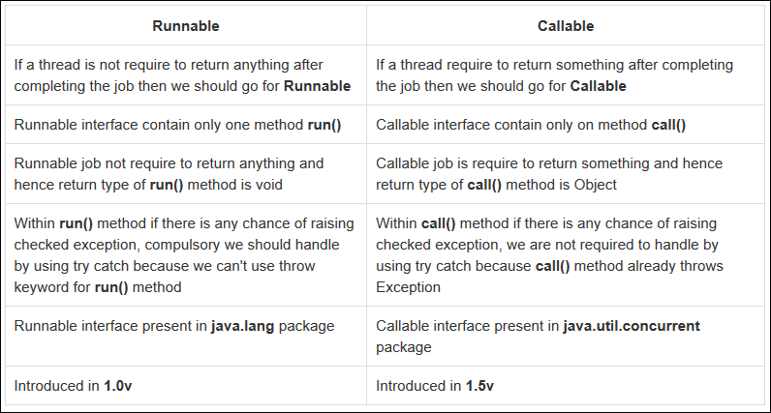
Runnable vs Callable

Slide 5




Thread Synchronization and Locks
Race Condition (Problem with shared resources)
synchronized keyword (Method-level & Block-level locking)
ReentrantLock (Advanced locking mechanism)
Deadlock & How to avoid it

Slide 6
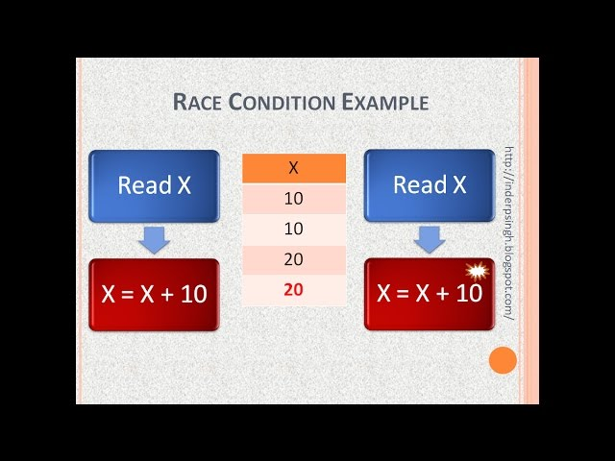
Race Condition
A race condition occurs when two or more threads access shared data concurrently, leading to unpredictable and often erroneous behavior

Slide 7
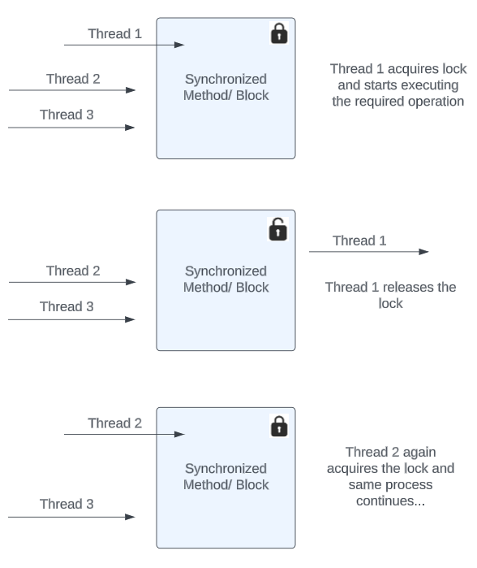
synchronized
The synchronized keyword is used to achieve thread synchronization, ensuring that only one thread can execute a specific block of code (either a whole method or a designated code block) at a time, preventing race conditions by acquiring a lock on an object

Slide 8
Lock
A Lock in Java is a more flexible and powerful synchronization mechanism introduced in Java 5 (java.util.concurrent.locks.Lock).
It provides explicit control over locking and unlocking, allowing for non-blocking and interruptible operations.
Key Features of Lock:
Explicit Locking & Unlocking (lock() & unlock())
Fairness Control (Fair vs. Non-Fair locks)
Try Locking Without Blocking (tryLock())
Interruptible Locking (lockInterruptibly())
Reentrant & Read-Write Lock Support (ReentrantLock, ReentrantReadWriteLock)

Slide 9
Lock vs synchronized
Feature | synchronized | Lock
Locking Mechanism | Implicit | Explicit (must call lock() and unlock())
Blocking Behavior | Always blocks | Can use tryLock() to avoid blocking
Interruptibility | Not interruptible | Supports interruptible locking
Fairness Control | No fairness guarantee | Can create fair locks (new ReentrantLock(true))
Condition Variables | Single implicit condition (wait(), notify()) | Multiple conditions using newCondition()
Performance | Simple, but less flexible | More flexible and can be optimized

Slide 10
Monitor Lock
Why synchronized Does Not Support Multiple Locking (Read & Write Locking)?
The synchronized keyword in Java provides intrinsic locking (monitor lock) but lacks the flexibility of ReentrantLock or ReentrantReadWriteLock because:
Single Lock Per Object/Method → No separate locks for reading and writing.
No Fine-Grained Control → Blocks all threads, even if they only need read access.
No Try-Lock or Interruptibility → Threads must wait indefinitely for the lock

Slide 11
Fair vs Non-Fair Lock
Scenario | Fair Lock (true) | Non-Fair Lock (false, Default)
Starvation Prevention? | ✅ Yes (FIFO order) | ❌ No (Threads may be skipped)
Performance | ❌ Slower | ✅ Faster
Best for | Critical applications needing fairness | High-performance apps where fairness is not critical
When to Use Fair vs Non-Fair Lock?
🔹 Use Fair Locks when fairness is required (e.g., banking, ticket booking).
🔹 Use Non-Fair Locks for better performance (e.g., logging, caching).

Slide 12
Interruptible Locks
When to Use Interruptible Locks?
Time-sensitive tasks, cancelable operations
Scenario | Use lockInterruptibly() | Use lock()
Thread needs to abort if waiting too long | ✅ Yes | ❌ No (Thread waits indefinitely)
Deadlock Prevention | ✅ Yes | ❌ No
Best for | Timeout-based operations, user-cancelable tasks | Simple lock management

Slide 13
ReentrantLock
A ReentrantLock is a Lock implementation that allows the same thread to acquire the lock multiple times without blocking itself. It is similar to the synchronized keyword but provides more features like fairness and interruptibility.
Key Features:
Supports reentrant locking (a thread can acquire the lock multiple times).
Can be fair or non-fair (default is non-fair for better performance).
Supports tryLock() to avoid blocking.
Allows lockInterruptibly(), which lets a thread be interrupted while waiting for the lock
Why Use ReentrantLock?
Allows interruptible locking (lockInterruptibly()).
Can check lock availability without blocking (tryLock()).
Supports fairness (FIFO locking order).

Slide 14
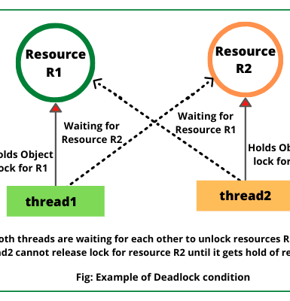
Deadlock
What is a Deadlock?
A deadlock occurs when two or more threads are waiting for each other's resources indefinitely, preventing further execution.
Example: Thread-1 holds Lock-A and waits for Lock-B, while Thread-2 holds Lock-B and waits for Lock-A → Neither can proceed

Slide 15
How to Avoid Deadlocks?
Strategy | How It Works
Lock Ordering | Always acquire locks in a fixed, consistent order.
Try-Lock Mechanism | Use tryLock() to avoid indefinite waiting.
Avoid Nested Locks | Minimize holding multiple locks at once.
Use Timeout for Locks | Set a time limit to acquire locks.
There are four major strategies to avoid deadlocks in Java:

Slide 16
Callable vs Future
What is Callable?
Callable<T> is a functional interface introduced in Java 5 that allows you to execute asynchronous tasks with return values.
Similar to Runnable, but returns a result and can throw checked exceptions.
Used with ExecutorService to execute tasks in a separate thread.
What is Future?
Future<T> represents the result of an asynchronous computation.
Can retrieve results, check task completion, or cancel execution.
Used along with ExecutorService.submit(Callable).

Slide 17
Callable vs Future: Key Differences
Feature | Callable<T> | Future<T>
Type | Functional interface | Interface for handling async results
Returns Value? | ✅ Yes | ✅ Yes (via get())
Exception Handling? | ✅ Yes (can throw checked exceptions) | ❌ No (but get() throws ExecutionException)
Cancel Task? | ❌ No | ✅ Yes (cancel())
Check Completion? | ❌ No | ✅ Yes (isDone())

Slide 18
ExecutorService
Feature | Thread | ExecutorService
Thread Management | Manual creation of threads | Manages thread pool automatically
Reusability | New thread for every task | Reuses threads (reduces overhead)
Task Execution | start() method | submit() or execute() methods
Task Handling | No automatic task management | Supports scheduling, shutdown, and futures
What is ExecutorService?
ExecutorService is an interface in Java’s java.util.concurrent package that manages a pool of threads to efficiently run asynchronous tasks
ExecutorService is better for multi-threading because it reuses threads and manages them efficiently.

Slide 19
CompletableFuture
Why Use CompletableFuture Instead of Future?
While Future requires blocking get(), CompletableFuture allows fully non-blocking, asynchronous execution with easy chaining and exception handling.
Key Benefits:
No blocking (get())
Easy chaining (thenApply(), thenAccept())
Automatic parallel execution

Slide 20
UseFul Link
https://thepracticaldeveloper.com/differences-between-completablefuture-future-and-streams/

