Slide 1
WEB PROGRAMMING
BK-MEC
A Website for Finding Medical Doctor

Slide 2
TABLE OF CONTENTS
01
02
03
04
05
Introduction
Requirements analysis
About the project and technologies.
Functional and non-functional
Design
Development
Database and system design
The finished product
Conclusion
Maintenance and future work

Slide 3

01
INTRODUCTION
→ The main objective of this project is to develop a simple but efficient website for finding medical doctor that can help patients immediately seek for medical health and book a doctor to their home.

Slide 4
01
TECHNOLOGIES
FRAMEWORK
APIs
LIBRARIES

Slide 5
02
Functional Requirements
REQUIREMENTS
• Display some advertisements or news banners.
• Support a simple, categorized and well-looked list of doctors.
• Search for a doctor by their name.
• Click on each doctor to see the details.
• Login or signup to start booking.
• Integrated with Google Maps.
• Momo will be the priority payment method.
• Display on IOS/Android phones.

Slide 6
02
Non-functional Requirements
REQUIREMENTS
• Nice UI and easy-to-access functions.
• Users should easily find the right doctor and start booking in a few steps.
• The web is responsive and load in less than 4 seconds.
• Only the system data administrator can assign roles and change access permissions.
• The back-end complexity is minimized for future maintenance.

Slide 7
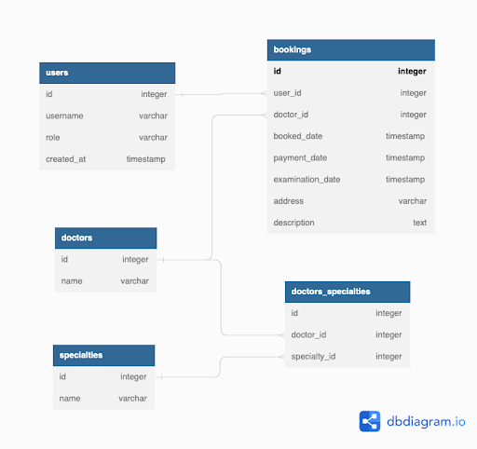
03
DESIGN

Slide 8

03
DESIGN

Slide 9
04
DEVELOPMENT
Description of doctors
Appointment
Payment method

Slide 10
Doctor Details
Describe a profile and experience and the hospitals where he/she has been doing and how he treats patients (victims) with carefulness and conscience
Show price for each different doctors
Describe majors which doctors are acknowledged and certificated

Slide 11
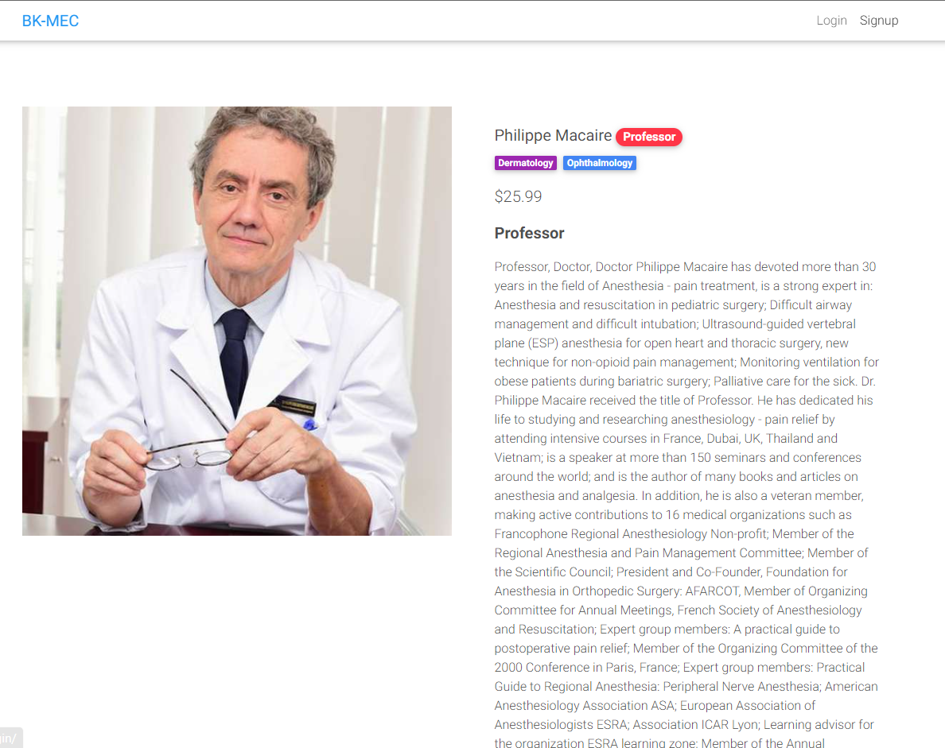
Doctor details
Doctor profile
Price
Status
Majors

Slide 12

Doctor details
Blue button is used to book doctors that users want
There is a recommendation which customers can base on to select affordable doctor service

Slide 13
Booking Process
The patient chooses a doctor with the specialties to be examined
Describe the problem
Confirm/ cancel the transaction
Choose Date and Location
Choose payment option

Slide 14
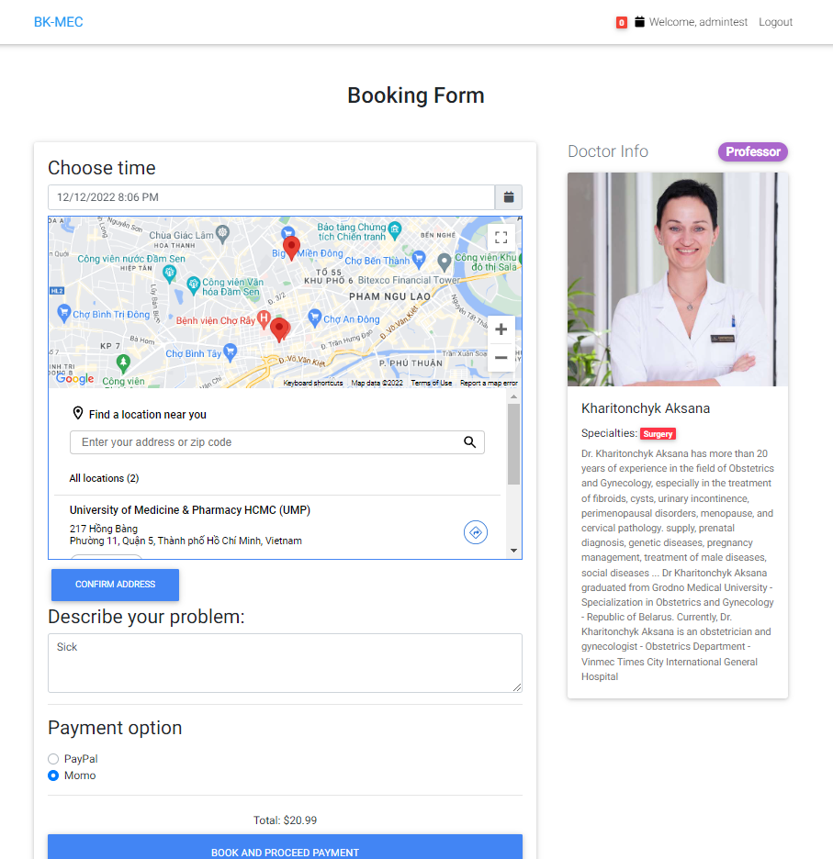
Booking Form
Doctor Info
Choose Time to have an appointment
Choose Time to have an appointment
Select Location
Describe the problem so that the doctor know your condition
Payment Method

Slide 15
Booking Process
The patient chooses a doctor with the specialties to be examined
Describe the problem
Confirm/ cancel the transaction
Choose payment option
Choose Date and Location

Slide 16
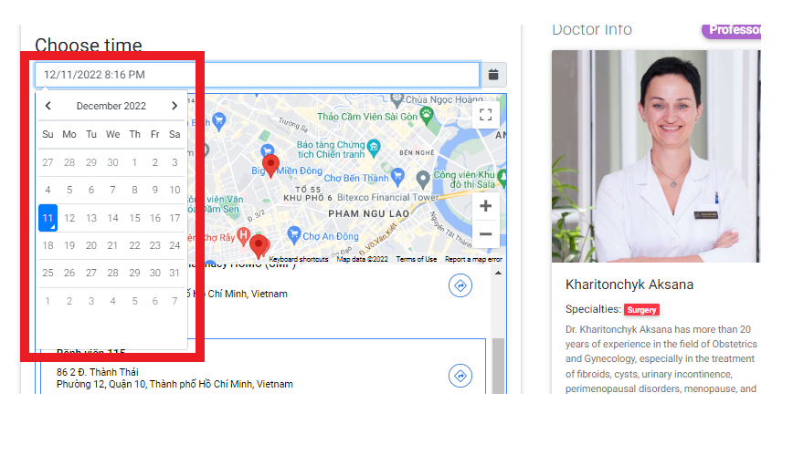
Time Select

Slide 17
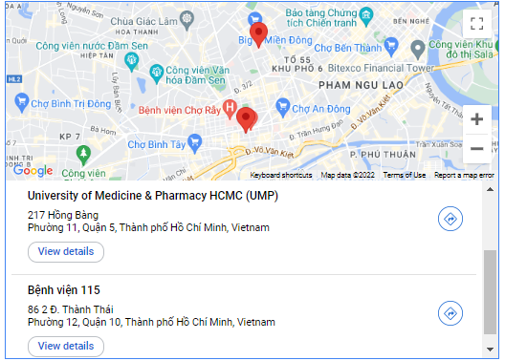
Location Select

Slide 18
Booking Process
The patient chooses a doctor with the specialties to be examined
Describe the problem
Confirm/ cancel the transaction
Choose payment option
Choose Date and Location

Slide 19
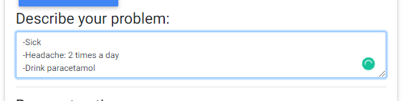
Tell me your problem, please?
Problem
- Sick
- Already have pill (paracetamol)
- Headache
- Hard to sleep
- Lose weight

Slide 20
Booking Process
The patient chooses a doctor with the specialties to be examined
Describe the problem
Confirm/ cancel the transaction
Choose payment option
Choose Date and Location

Slide 21
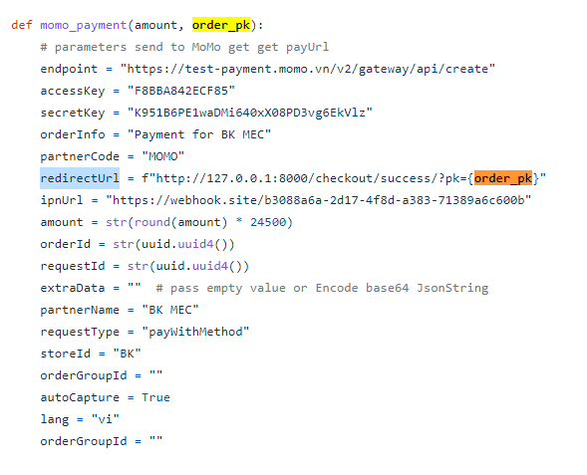

Slide 22
MOMO API
AccessKey
Redirect URL: After finish the transaction, return to this URL
Secret Key : for security purpose
Partner Name: Our website (“BK MEC”)
Amount : The money need to paid
Endpoint: The URL we send the Request ( Momo site)
RequestId: The unique identification of each transaction
ipnURL: The URL Momo sent back the result ( our webhook)

Slide 23
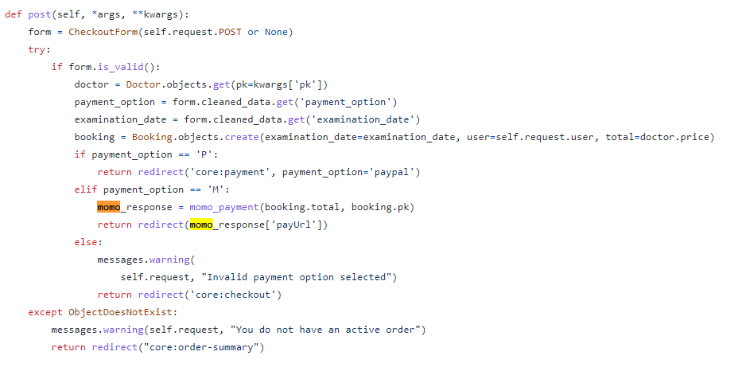

Slide 24
Booking Process
The patient chooses a doctor with the specialties to be examined
Describe the problem
Confirm/ cancel the transaction
Choose payment option
Choose Date and Location

Slide 25
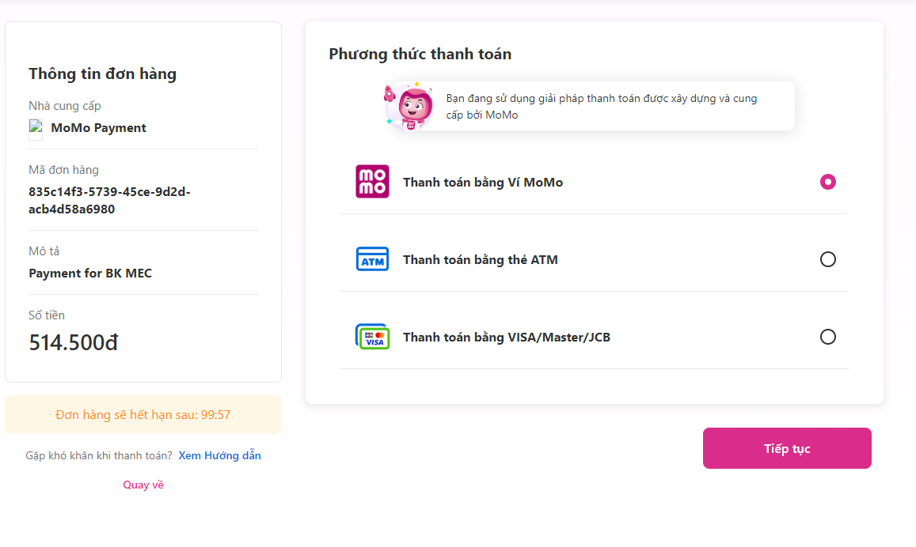
Momo Confirm

Slide 26
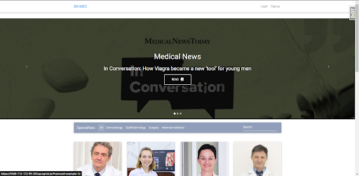
05
CONCLUSION

Slide 27
THANKS!

