Slide 1

NEEDFINDING
BY: Kristine Cay Cariaga
Vanessa Mae Verzosa

Slide 2
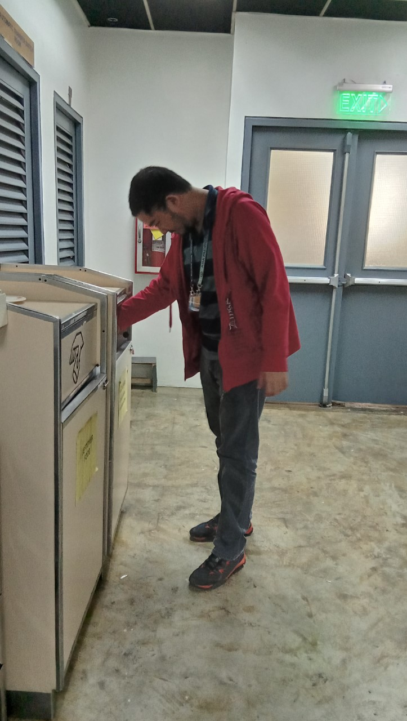
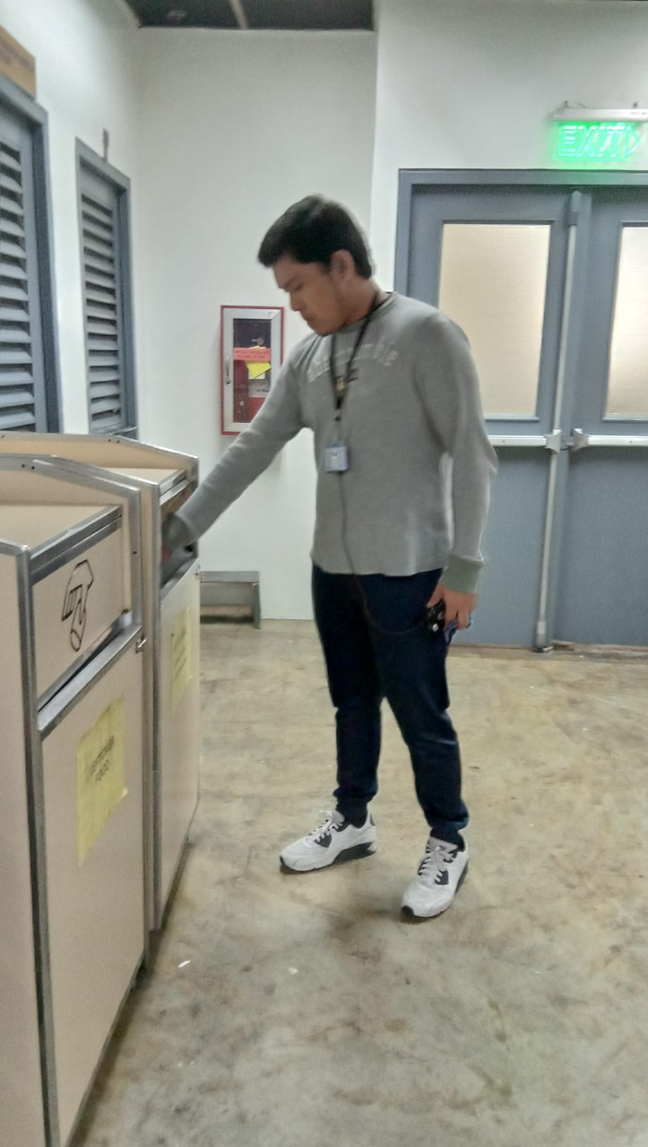
USERS
USER 1
Doesn’t care about the labels on the waste containers.
Doesn’t have an idea about the school’s waste management.
USER 2
Always makes sure to follow the labels everyday
Always segregate the garbage before throwing them out in the container

Slide 3
Interviewee # 1
What do you usually notice in our school’s waste management?
-Trashes are not thrown in a proper segregation because some waste containers do not have labels on it.
Do you know the difference between biodegradable and non-biodegradable materials?
-Yes, but sometimes I get confused
Do you think the labels in our waste containers are thoroughly followed?
-No, because some students might get confused to where they should throw their trash.

Slide 4
Interviewee # 2
What do you usually notice in our school’s waste management?
-Lack of label, some floor has the same label on the trash bin.
Do you know the difference between biodegradable and non-biodegradable materials?
-I learned about it back in elementary.
Do you think the labels in our waste containers are thoroughly followed?
-Some students might not care about the materials they throw in the trash bins.

Slide 5
OBSERVATIONS
Students throw recyclable materials or materials that can be sold per kilo
The label on the garbage bins are not followed by the students
Not all floors in APC have trash bins that have ‘BIODEGRADABLE’ and ‘NON-BIODEGRADABLE’ label on it

Slide 6
User Needs
The students should be enlightened about the proper way to segregate different kinds of trash.
Since some recyclable materials can be sold, the school should encourage the students to pile their papers and
The school should encourage the students to throw their trash properly on their designated bin
There should be a punishment if someone is caught not using the bin properly

Slide 7
Point of View

Slide 8
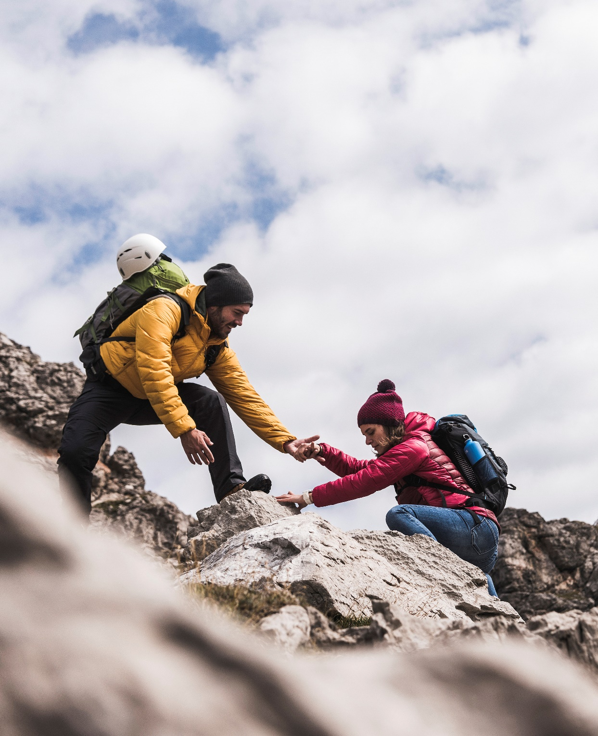
Thank You!!!

