Slide 1
LIBRARY MANAGEMENT SYSTEM

Slide 2
Introduction:
Libraries play a pivotal role in education and research by providing access to a wide range of resources, including books, journals, and multimedia materials. However, managing these resources efficiently can be a complex task, requiring meticulous organization and coordination. To address this challenge, the Library Management System (LMS) offers a solution that automates and streamlines various library operations.
The LMS is a software application designed to facilitate the management of library resources, transactions, and user interactions. By leveraging modern technologies such as Python, Tkinter, and database management systems like MySQL, the system provides librarians with tools to efficiently handle tasks such as cataloging books, issuing and returning materials, and maintaining user records.

Slide 3
Features:
Book Management:
Add Book Details
Delete Book
View Book List
Transaction Management:
Issue Book to Student
Return Book
QR Code Scanning:

Slide 4
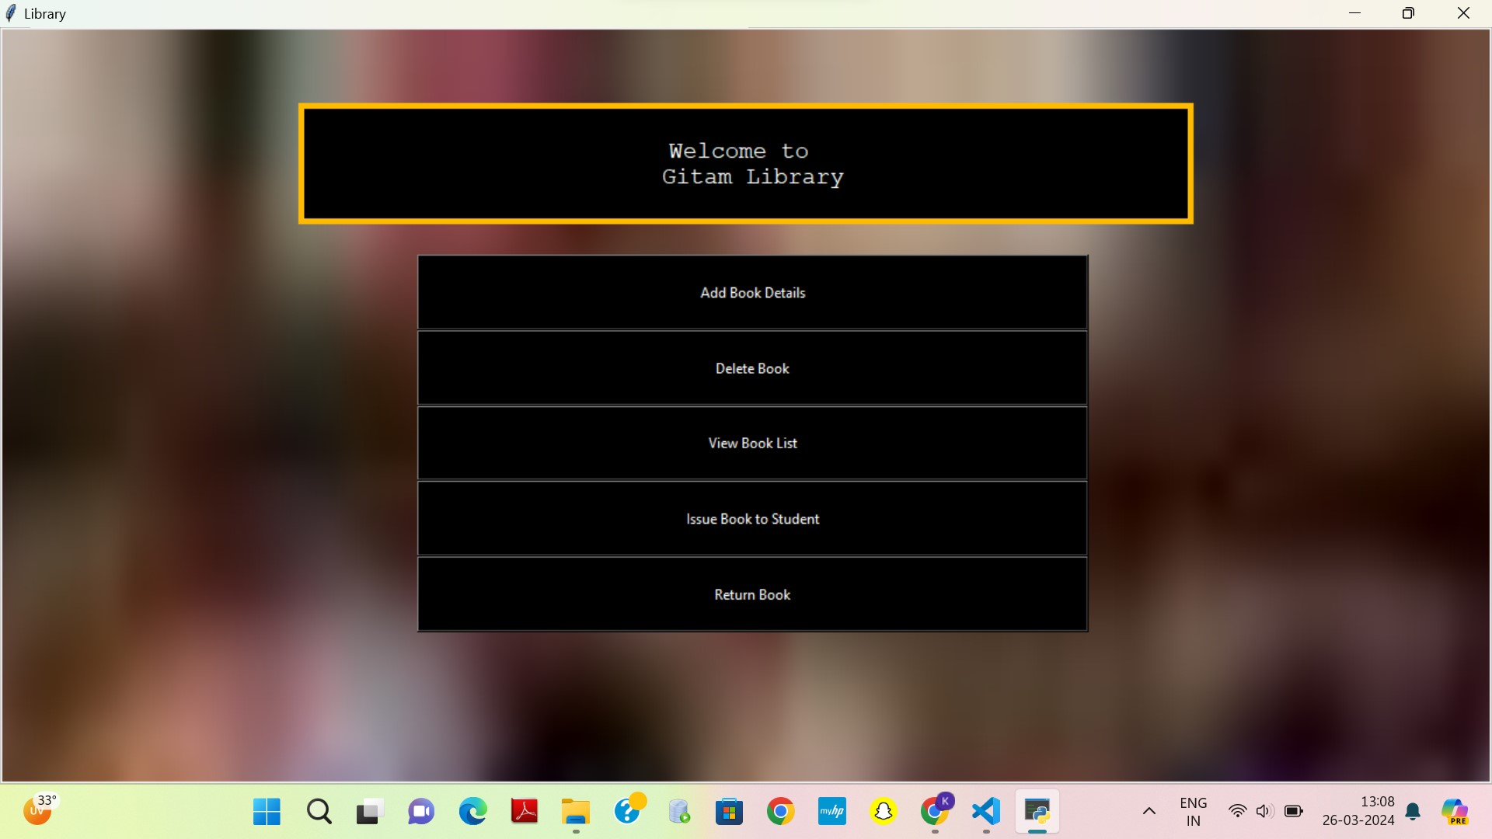

Slide 5
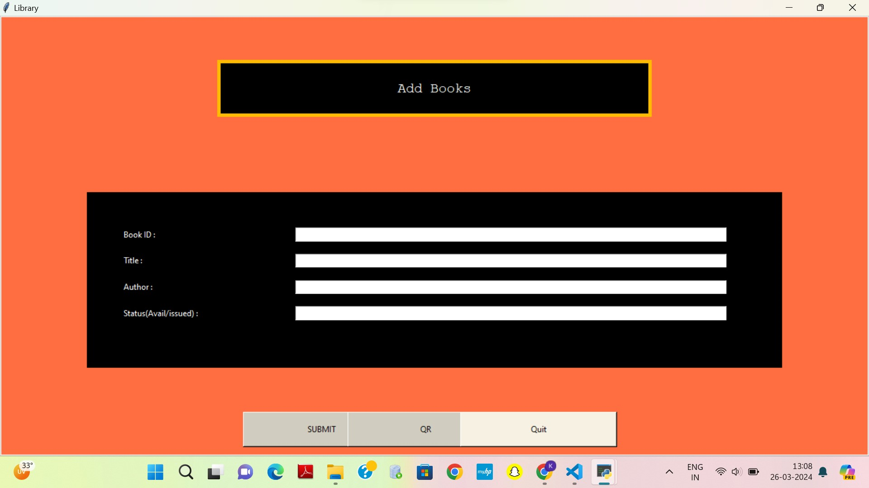

Slide 6
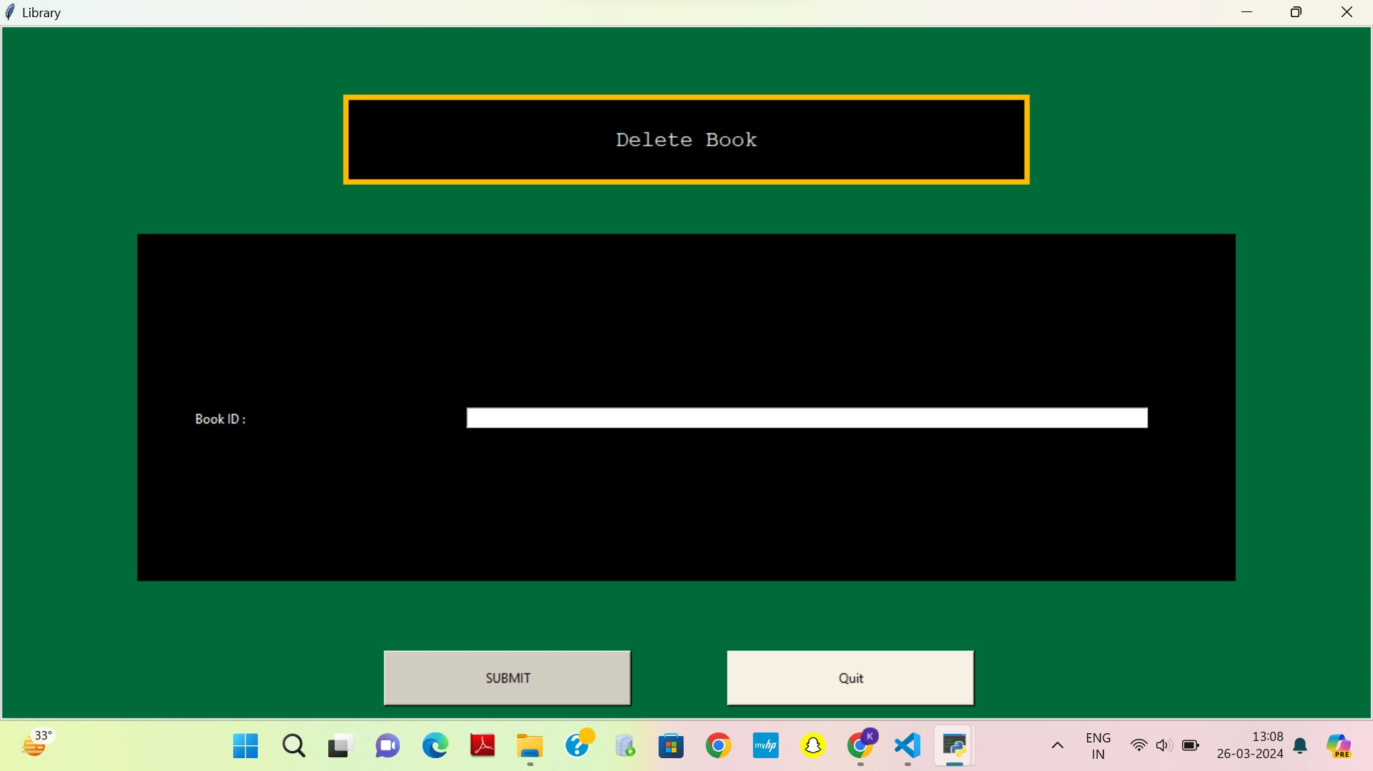

Slide 7
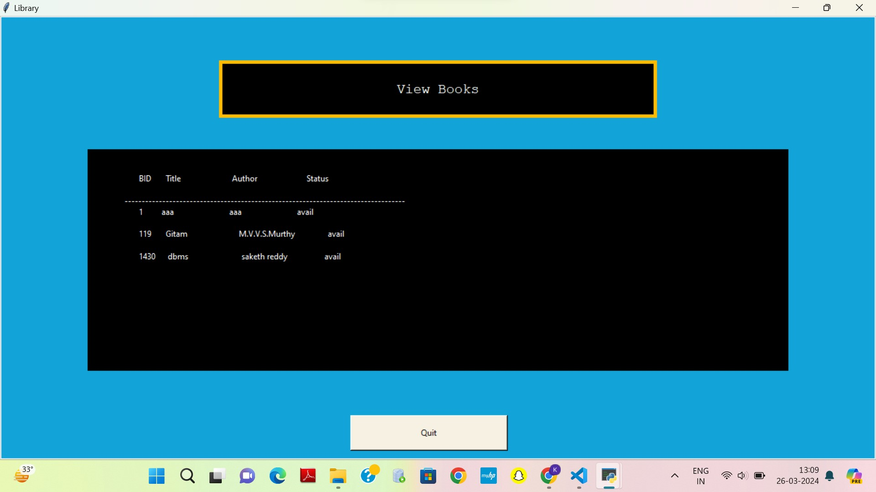

Slide 8
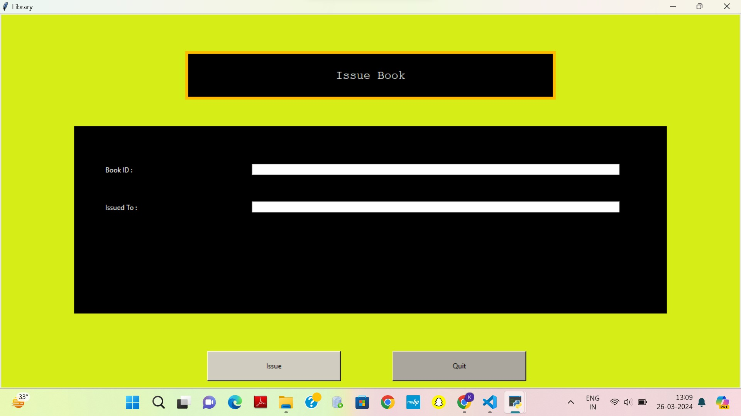

Slide 9
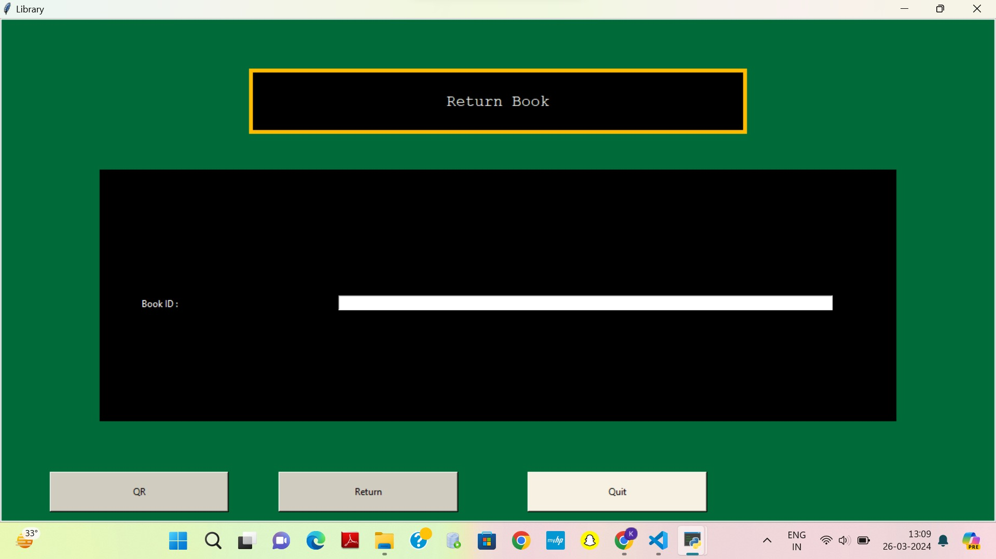

Slide 10
Technologies Used:
Python: The core programming language used for developing the application logic.
Tkinter: A Python library for creating graphical user interfaces (GUIs), utilized for building the application's frontend.
PIL (Python Imaging Library): Used for handling images, particularly for displaying background images and QR code scanning.
pymysql: A Python MySQL client library used for interacting with the MySQL database.
OpenCV: An open-source computer vision and machine learning software library, employed for QR code scanning functionality.
pyzbar: A Python library for decoding QR codes, integrated with OpenCV for scanning functionality.

Slide 11
Applications:
Academic Institutions: The Library Management System finds extensive use in academic institutions such as schools, colleges, and universities, where it facilitates the management of educational resources and supports the research needs of students and faculty.
Public Libraries: Public libraries leverage LMS solutions to efficiently manage their collections, offer diverse services to community members, and enhance the overall library experience for patrons.
Specialized Libraries: Libraries specializing in specific subject areas or industries, such as medical libraries, law libraries, and corporate libraries, benefit from tailored LMS solutions that cater to their unique requirements.
Digital Libraries: Digital libraries, which offer online access to digital collections and resources, utilize LMS platforms to organize and manage their digital assets effectively, providing users with seamless access to digital content.
Libraries in Healthcare Facilities: Hospitals and healthcare institutions often maintain libraries to support medical research, continuing education, and patient care. LMS solutions assist in managing medical literature, research publications, and patient education materials.
Government Libraries: Government agencies and public institutions utilize LMS platforms to manage government publications, legislative documents, and archival materials, ensuring efficient access to vital information for policymakers and the public.

Slide 12
Challenges and Limitations:
Implementation Complexity: Developing and implementing a robust Library Management System can be challenging, requiring expertise in software development, database management, and library operations.
Data Migration: Migrating existing library data to the new system can be complex and time-consuming, especially for libraries with extensive collections and legacy systems.
User Training: Training librarians and staff to use the new system effectively may pose challenges, particularly for those accustomed to manual processes or older software systems.
Integration with Existing Systems: Integrating the LMS with other institutional systems, such as student information systems or digital repositories, may present compatibility issues and require additional development efforts.

Slide 13
conclusion:
In conclusion, the development and implementation of the Library Management System (LMS) represent a significant milestone in improving library operations, enhancing user experience, and facilitating access to information resources. Through this project, we have successfully addressed various challenges, leveraged opportunities, and gained valuable insights into the complexities of developing and deploying software solutions for the library domain.
The LMS offers a range of benefits, including streamlined cataloging and circulation processes, improved resource discovery and access, enhanced user engagement and satisfaction, and better data management and analysis capabilities. By automating routine tasks, providing centralized management of library collections, and supporting online and mobile access, the system empowers librarians to focus on delivering high-quality services and resources to patrons.

