Slide 1
MERN STACK WEB DEVELOPMENT TRAINING
VoteSecure
Online Voting Management System
A secure, full-stack, enterprise-grade digital election management and secret balloting platform.
PROJECT TEAM DETAILS
Team Name: [Enter Unique Team Name]
• Team Member 1: [Enter Name] – Registration Number: [Registration Number]
• Team Member 2: [Enter Name] – Registration Number: [Registration Number]
• Team Member 3: [Enter Name] – Registration Number: [Registration Number]

Slide 2
CONTEXT & JUSTIFICATION
Introduction & Problem Statement
Challenges with Manual & Legacy Voting
The VoteSecure Modern Digital Solution
• Physical Ballot Manipulation & Vulnerabilities:
Manual paper ballots are vulnerable to ballot stuffing, damage, misplacement, and physical tampering.
• Turnout Inefficiency & High Overhead:
Requires significant manpower, paper printing expenditure, physical polling stations, and manual headcount verification.
• Slow & Error-Prone Tabulation:
Manual counting takes days, often leading to human counting errors, disputed ballots, and prolonged uncertainty.
• Open Registration Risks in Ad-hoc Software:
Generic systems allow public sign-ups, leading to unauthorized voter roll inflation and duplicate voting.
• Zero Public Self-Registration:
Only the institutional administrator can provision voter credentials, maintaining strict integrity over voter rolls.
• Decoupled Secret Balloting Protocol:
Voter identity is permanently decoupled from ballot selections, guaranteeing constitutional privacy from everyone including admins.
• Instant, Real-Time Cryptographic Audits:
Instant tallying through MongoDB aggregation with exportable CSV and visual turnout metrics.
• Concurrency & Anti-Tamper Protection:
Compound unique database constraints prevent duplicate voting even under rapid concurrent submissions.

Slide 3
SYSTEM GOALS
Project Objectives & Scope
🔐
1. Role-Governed Access & Strict Authentication
Implement separate admin and voter authentication layers using JSON Web Tokens (JWT) and salted bcrypt hashing, prohibiting voter self-registration.
👥
2. Admin-Controlled Voter Management
Provide authorized administrators complete CRUD authority to manually register, filter, edit, activate/deactivate, and reset credentials for voters.
🗳️
3. Dynamic Elections & Positions Management
Allow administrators to configure multi-post elections (e.g. President, Secretary), assign candidates with portraits and symbols, and manage lifecycle phases.
🛡️
4. Secret Balloting & Duplicate Vote Rejection
Guarantee voter privacy by separating participation tracking from secret ballots while enforcing database-level unique constraints to prevent double voting.
📊
5. Instant Results & Audit Generation
Deliver real-time analytics with Recharts data visualizations, automated winner computation, and downloadable official CSV audit reports.

Slide 4
ARCHITECTURAL FOUNDATIONS
Core Technology Stack (Genuine MERN Integration)
Database
Backend API
Frontend
MongoDB Atlas
Express.js
React.js
Cloud Database
Backend Framework
Frontend Client
Mongoose ODM, compound unique indexing for duplicate vote prevention, aggregation pipelines for real-time tallies.
RESTful API routing, rate limiting, Helmet security headers, Multer media parsing, and centralized error handling.
Vite bundling, React Router DOM, Context API for state management, Tailwind CSS design system, and Recharts analytics.
Runtime
Security
DevOps
Node.js
JWT & bcrypt.js
Git & Deployment
Runtime Environment
Security & Auth
DevOps & Hosting
High-concurrency asynchronous runtime, token cryptographic validation, and in-memory test database orchestration.
Signed stateless Bearer tokens, 10-round salted password hashing, and role-based middleware guards.
GitHub version control, Vercel frontend edge distribution, Render backend hosting, and MongoDB Atlas cloud.

Slide 5
END-TO-END DESIGN
System Architecture & Data Flow
CLIENT TIER (React.js)
API TIER (Node/Express)
DATA TIER (MongoDB)
• Admin Portal:
- Dashboard & Recharts
- Voter CRUD Management
- Election Lifecycles
- Positions & Candidates
- CSV Export & Audits
• Voter Portal:
- Authenticated Dashboard
- Contested Posts Browser
- Candidate Cards & Symbols
- Confirmation Modal Review
- Ballot Token Receipt
• Security Middleware:
- Helmet security headers
- CORS origin whitelist
- Express Rate Limiter
- JWT Auth & Role Guards
• REST API Endpoints:
- /api/auth/*
- /api/voters/*
- /api/elections/*
- /api/posts/*
- /api/candidates/*
- /api/votes/*
- /api/results/*
• Core Collections:
- Admin
- Voter
- Election
- Post
- Candidate
- Participation
- Vote (Anonymous)
• Compound Unique Index:
(voterId, electionId, postId)
Guarantees 1 vote per post.

Slide 6
FEATURE BREAKDOWN
Main Functional Modules
Administrator Control Dashboard
Voter Roll Provisioning & Management
• System statistics: Registered voters, active polls, turnouts, and total votes.
• Charts for election-wise voting distribution and status breakdowns.
• Quick shortcuts for voter registration and election creation.
• Strict manual provisioning — zero public self-registration.
• Instant voter search, department filtering, and status activation.
• One-click administrative password reset with bcrypt encryption.
Multi-Position Election Management
Secret Ballot & Verified Turnout
• Lifecycle states: Upcoming, Active, and Completed.
• Add customizable posts (President, Vice-President, etc.) to any election.
• Assign candidate profiles with official portrait photos and ballot symbols.
• Voter selection decoupled from identity to preserve privacy.
• 9-step voting booth with candidate manifesto review & confirm modal.
• Automated duplicate voting rejection at the database engine level.

Slide 7
BACKEND DESIGN
Database Schema & RESTful API Architecture
MongoDB Data Models
Core RESTful API Endpoints
• Admin: name, email (unique), password (hash), role
• Voter: fullName, userId (unique), password, registrationNumber (unique), email, mobile, department, year, status
• Election: electionName, description, startDate, endDate, startTime, endTime, status, resultsPublished
• Post: postName, description, electionId
• Candidate: candidateName, candidateId, photo, symbol, postId, electionId, status
• Participation: voterId, electionId, postId, submittedAt
└ Unique Index: { voterId: 1, electionId: 1, postId: 1 }
• Vote (Anonymous Secret Ballot):
└ electionId, postId, candidateId, ballotToken (NO voterId)
• Authentication API:
POST /api/auth/admin/login | POST /api/auth/voter/login
GET /api/auth/me (revalidates token)
• Voter CRUD API (Admin Only):
GET/POST /api/voters | PUT/DELETE /api/voters/:id
PATCH /api/voters/:id/status | POST /:id/reset-password
• Elections & Posts API:
GET/POST /api/elections | PATCH /api/elections/:id/status
GET/POST /api/posts | GET/POST /api/candidates
• Voting & Results API:
POST /api/votes/cast (atomic ballot transaction)
GET /api/results/:electionId (tallies & turnout)
GET /api/results/:electionId/export (CSV report)

Slide 8
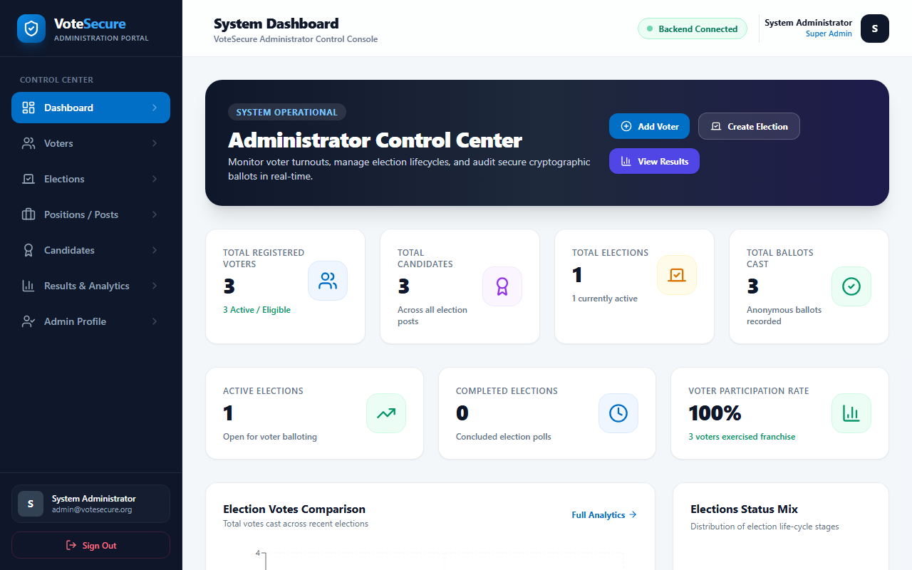
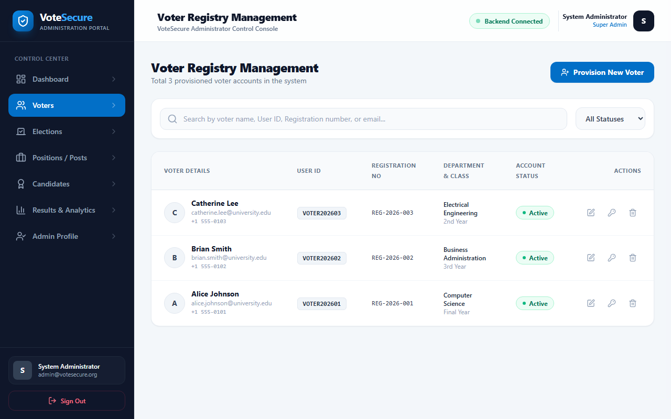
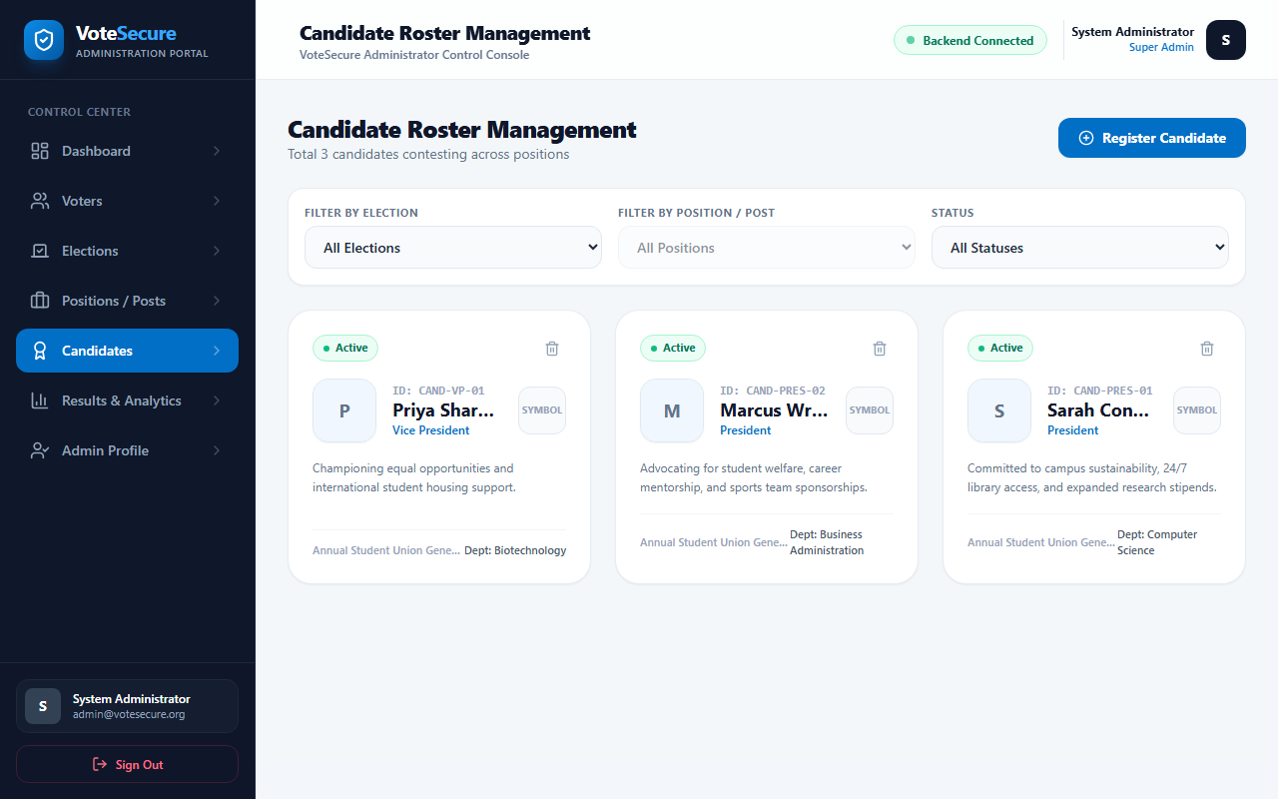
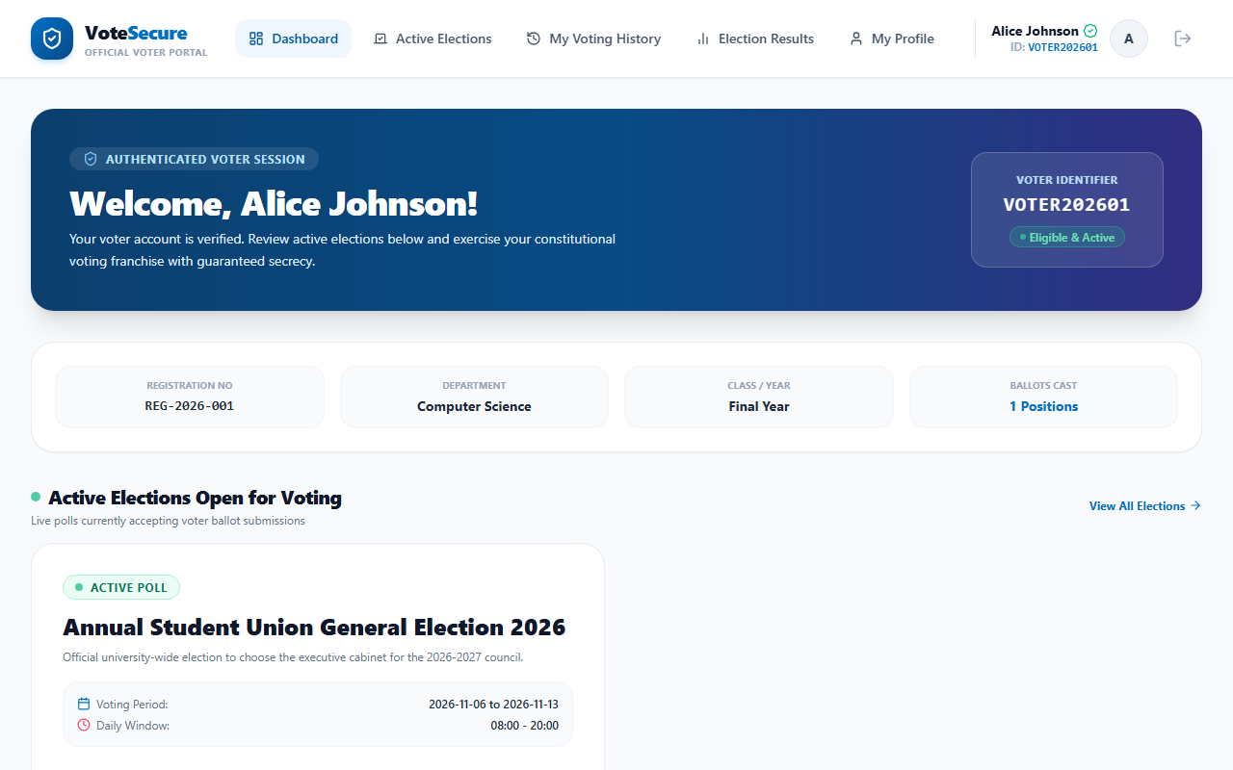
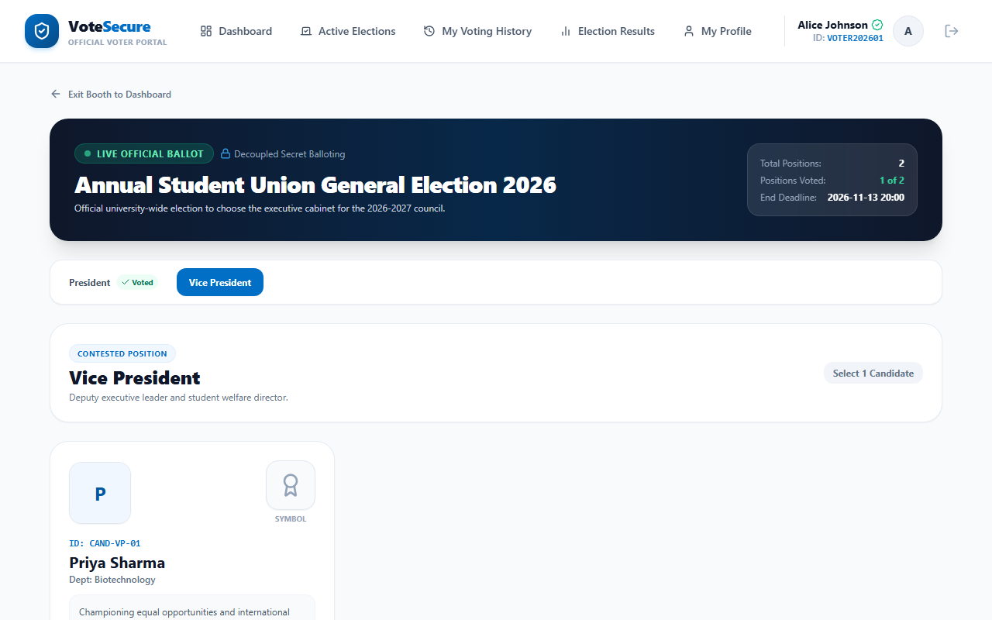
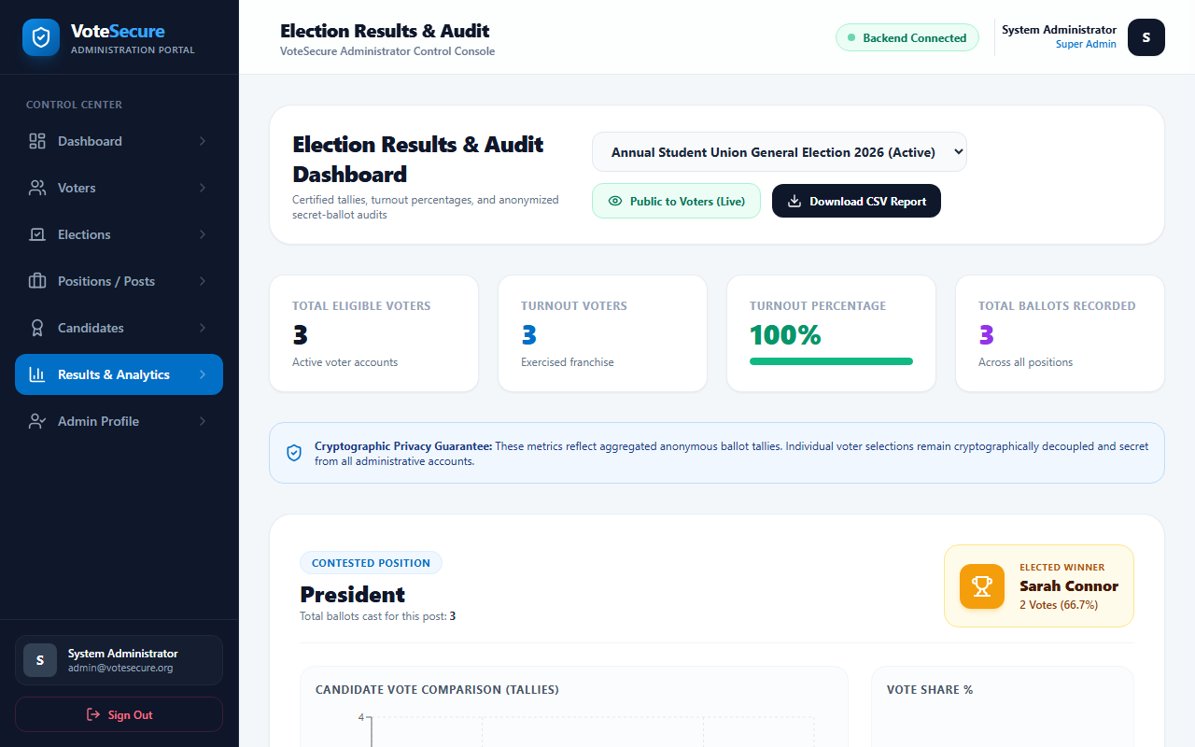
SYSTEM VISUALS
Actual Application Screenshots & UI Showcase
Admin Dashboard
Voter Registry Management
Candidate Roster & Symbols
Voter Portal Dashboard
Interactive Voting Booth
Certified Results & Audit

Slide 9
ENGINEERING LEARNINGS
Technical Challenges & Roadmap
Key Technical Challenges Solved
Future Scope & Planned Enhancements
• Concurrency & Race Conditions in Voting:
Challenge: Rapid double-clicks or parallel network requests could duplicate a vote before status updates.
Solution: Enforced compound unique index in MongoDB on { voterId, electionId, postId }, returning 400 on duplicate.
• Reconciling Voter Auditability with Secret Privacy:
Challenge: Admins need to know who voted, but must never know for whom.
Solution: Decoupled Participation record from Vote collection, storing only an anonymous ballotToken.
• Zero-Config In-Memory Database Fallback:
Challenge: Ensuring immediate local evaluation without external Atlas dependency.
Solution: Integrated mongodb-memory-server fallback when URI is unconfigured.
• Zero-Knowledge Proofs (ZKP) / Homomorphic Encryption:
Mathematically verifiable cryptographic proofs enabling voters to verify their vote was counted without revealing the selection.
• Multi-Factor Biometric Authentication (WebAuthn):
Hardware FIDO2 / TouchID authentication for high-security campus governance.
• Ranked-Choice & Preferential Voting Algorithms:
Instant-runoff voting (IRV) algorithms alongside simple majority plurality.
• Blockchain Ledger Integration:
Public immutability through decentralized hash anchor commitments.

Slide 10
PROJECT SUMMARY & CONCLUSION
VoteSecure Project Outcomes
• Complete End-to-End MERN Stack Architecture delivered with 100% genuine backend integration.
• 15 out of 15 automated security, voting, and authorization test cases passed with zero errors.
• Strict institutional voter roll integrity enforced via administrator-only provisioning.
• Secret ballot confidentiality guaranteed by decoupled database collections and anonymous tokens.
• Fully responsive, modern user experience built with React, Vite, Tailwind CSS, and Recharts.
Thank You! Questions & Discussion Welcome.

