Slide 1

ChalChitra
A Modern Movie & Trailer Platform
Technologies: HTML5, CSS3, Vanilla JS, JSON Server, Axios
Ranjna Ray
241FA04536
Dev Raj
241FA04624
Sumit Kumar
241FA04064

Slide 2
About the Project
Introduction: ChalChitra is a dynamic web application for browsing movies, trailers, and web series.
Problem Statement: Movie Management System.
Objective: To build a responsive, multi-lingual interface separating DOM logic from API services.
Key Features: Multi-lingual (EN, HI, TE), Watchlists, YouTube Trailer Embeds, Admin CRUD Panel.

Slide 3
Project Flow & Architecture
1. Frontend UI (HTML/CSS)
2. Service Layer (JS/Axios)
3. JSON Server (db.json)
Data Flow (DFD):
User actions trigger DOM events -> Services make REST API calls (GET/POST) -> JSON Server updates db.json -> UI re-renders synchronously.

Slide 4
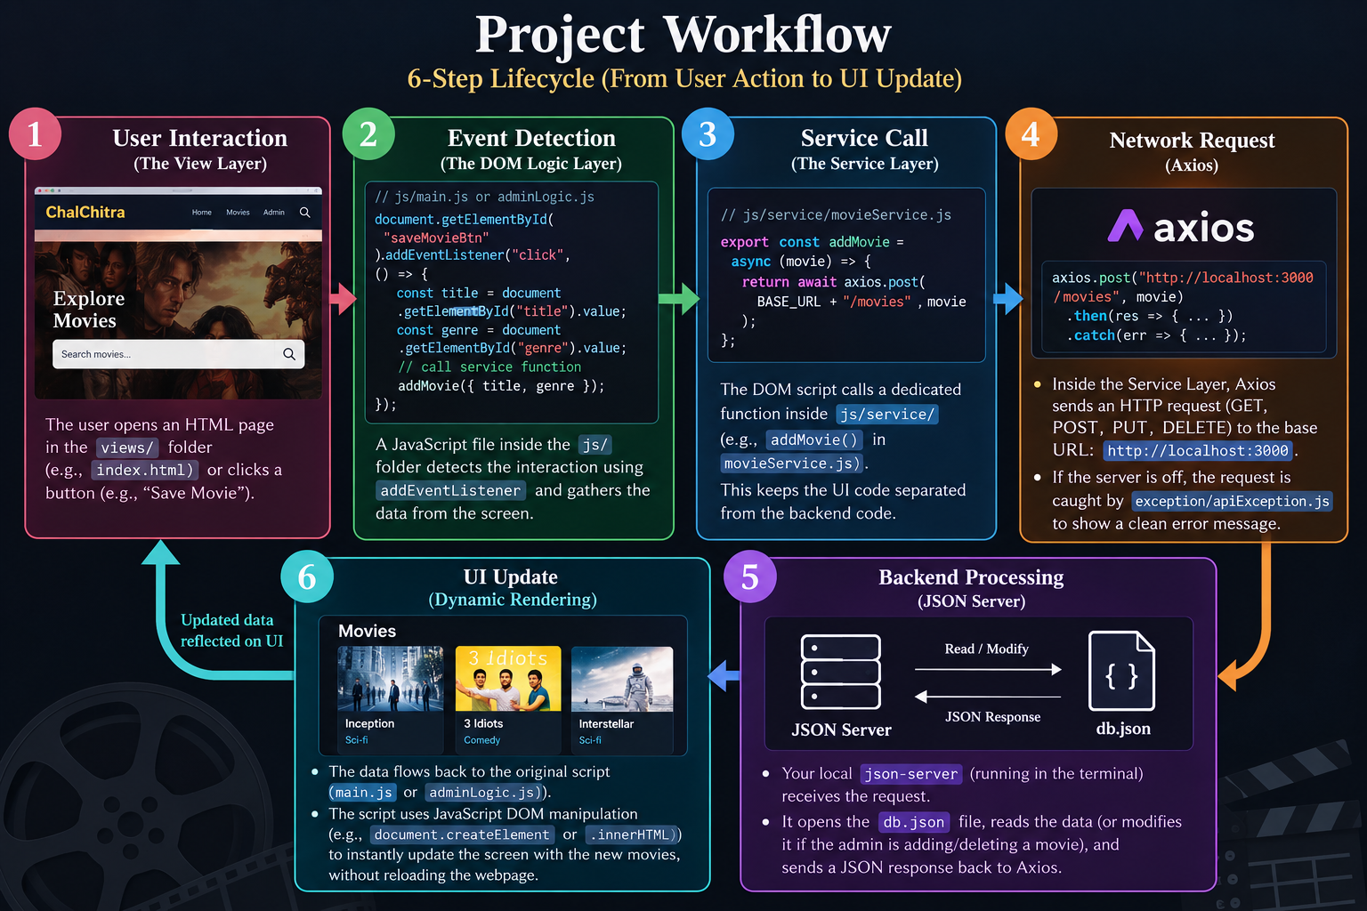
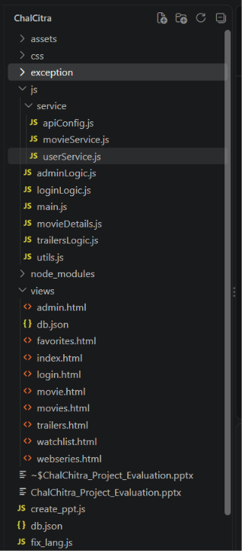
Folder Structure
Separation of Concerns

Slide 5
Modules & Features
User Module:
Browse movies, filter by genre, add to favorites/watchlist, toggle languages (EN/HI/TE).
Admin Module:
Secure login, add new movies, edit existing movie details, and delete records.
Services & Exception Module:
API calls isolated in movieService.js. Network errors gracefully caught in apiException.js.

Slide 6
Key Code Logic (Exception Handling)
// exception/apiException.js
function handleApiError(error, defaultMessage = "Error") {
let message = defaultMessage;
if (error.response && error.response.data && error.response.data.message) {
message = error.response.data.message;
} else if (error.message) {
message = error.message;
}
alert("Error: " + message);
throw new ApiException(message, error.response?.status, error);
}
API Call
↓
Error occurs?
↓
handleApiError(error)
↓
Kya server response mein message hai?
│
├── YES → server ka message use karo
│
└── NO
↓
Kya error.message hai?
│
├── YES → error.message use karo
│
└── NO → "Error" use karo
↓
Alert dikhao
↓
ApiException create karo
↓
Error throw karo
Highlights our custom error interception mechanism for robust API calls.

Slide 7
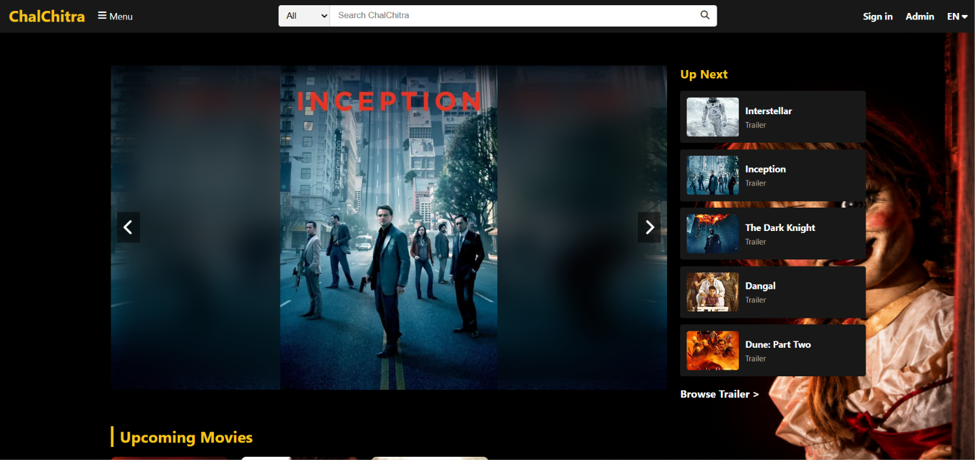
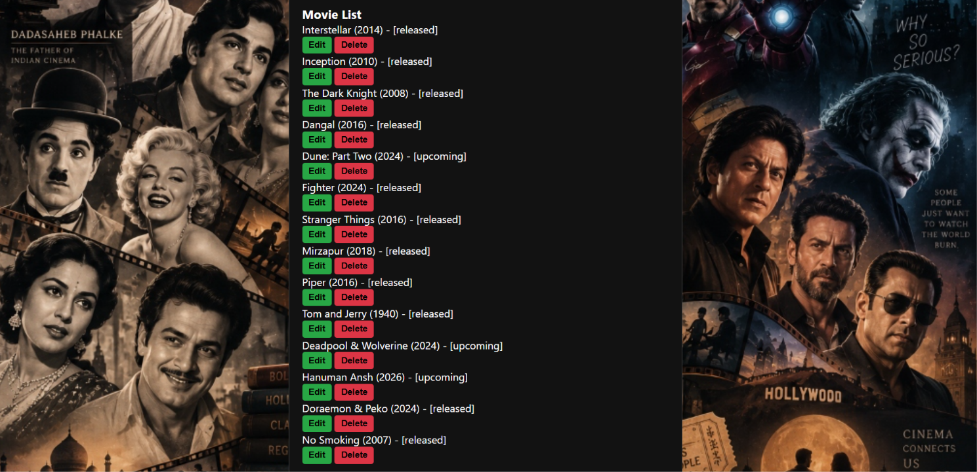
Application Output

Slide 8
Challenges & Learnings
Challenge: Cross-Origin Resource Sharing (CORS) blocked ES Modules natively over file:/// protocols.
Solution: Refactored to load decoupled scripts sequentially, keeping separation of concerns without module blocking.
Challenge: Managing global variables and state (like currentUser) without a framework.
Learning: Gained deep knowledge of DOM manipulation, asynchronous JS (async/await), and HTTP concepts.

Slide 9
Thank You!
We are ready to showcase the live project and codebase.

