Slide 1
Icinema
MERN Stack Project
Presented By:
M.Harika-241FA04212
R.Lalitha-241FA04B93
N.Bavitha-241FA04B96
B.Kayura Sai-241FA04C30

Slide 2

Introduction
.
iCinema is a web-based movie browsing and management platform.
It provides users with an interactive interface to explore available movies.
Users can search, filter and categorize movies based on their preferences.
It provides authentication features such as Sign Up, Sign In and Sign Out.
Administrators can add new movies to the platform.

Slide 3
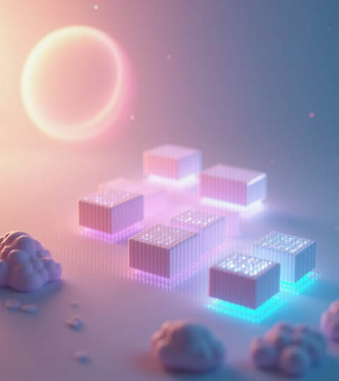
Project Statement
Managing movie information manually can be time-consuming.
Users need a convenient platform to explore movies and their details.
Finding movies based on genres and ratings can be difficult without filtering options.
Administrators require an organized system to manage movie listings.
Proposed Solution: Develop a centralized web application that simplifies movie browsing and provides efficient movie management functionalities.

Slide 4
Objectives
Develop a user-friendly movie browsing platform.
Implement secure user authentication.
Enable movie searching and filtering.
Organize movies based on genres and ratings.
Allow administrators to add new movies.
Provide a responsive and interactive user interface.

Slide 5
Technologies Used
Technology | Purpose
React.js | Frontend development
Redux | State management
HTML5 | Webpage structure
CSS3 | Styling and layout
Bootstrap | UI components
Node.js | Backend runtime
Express.js | REST API development
MongoDB | Database
Mongoose | Database modeling

Slide 6
System Architecture
Architecture: MERN Stack
The application follows a three-layer architecture:
1. Presentation Layer (Frontend)
Developed using React.js.
Displays movies and user interface components.
Uses Redux for state management.
2. Application Layer (Backend)
Developed using Node.js and Express.js.
Handles API requests, authentication and business logic.
3. Database Layer
Uses MongoDB to store users, movies and genres.
Mongoose manages database schemas and operations.

Slide 7

Key Features
User Registration and Login.
User Logout functionality.
Movie browsing and listing.
Movie search functionality.
Genre-based categorization.
Rating-based filtering.
Admin-based movie addition.
Welcome email notification after registration.
Movie details display.

Slide 8
Database Design
The application uses MongoDB as its database with three primary collections:
1. Users Collection
Stores user information.
Contains authentication-related details.
Maintains user roles and permissions.
2. Movies Collection
Stores movie information.
Maintains movie details, ratings and genre references.
3. Genres Collection
Stores available movie genres.
Helps categorize movies for filtering and browsing.

Slide 9
Backend and API Developmment
The backend is developed using Node.js and Express.js.
It provides RESTful APIs to enable communication between the frontend and database.
User APIs
POST /api/auth/signUp – Register a new user.
POST /api/auth/signIn – Authenticate a user.
PATCH /api/users/ – Update user information.
DELETE /api/users/ – Delete a user.
Movie APIs
GET /api/movies – Retrieve all movies.
GET /api/movies/ – Retrieve a specific movie.
POST /api/movies/addMovie – Add a new movie.
PATCH /api/movies/ – Update movie information.
Genre API
GET /api/genres – Retrieve available genres.

Slide 10

Security And Aunthentication
Password hashing using Bcrypt.
JWT-based user authentication.
Protected routes using authentication middleware.
Admin authorization using role-based middleware.
Input validation to improve data integrity.
Secure handling of user requests through backend APIs.

Slide 11
Application Workflow
User opens the iCinema website.
User registers or logs into the application.
Frontend communicates with the backend through REST APIs.
Backend retrieves movie and genre information from MongoDB.
Movies are displayed on the user interface.
Users search, browse and filter available movies.
Authorized administrators can add or update movie information.
Add database connectivity
Implement secure authentication
Add student registration
Create real mock test system
Add progress tracking
Deploy online for real users

Slide 12
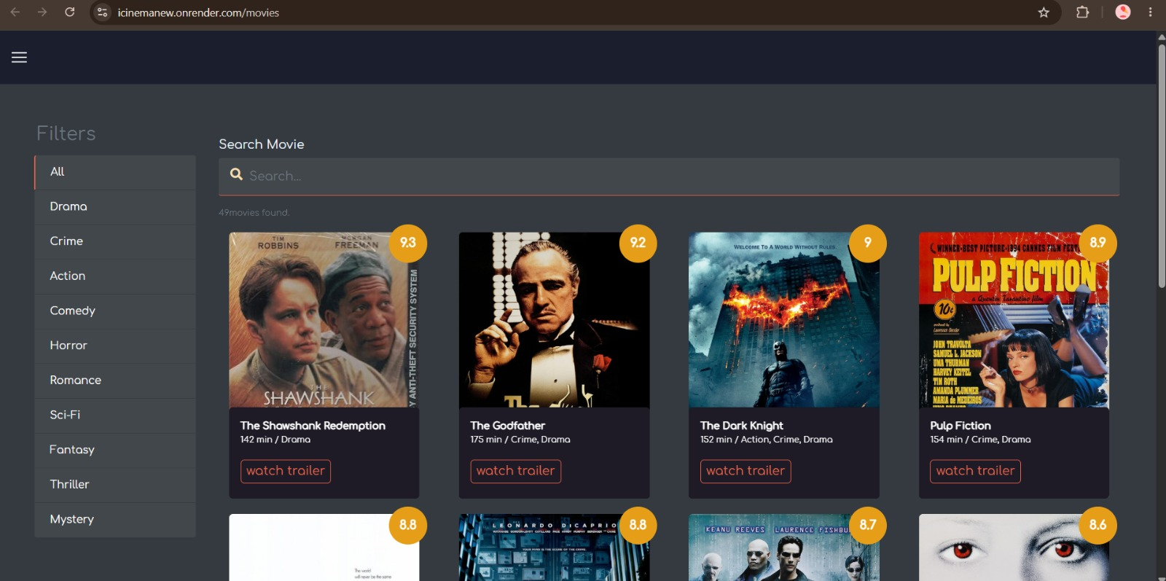
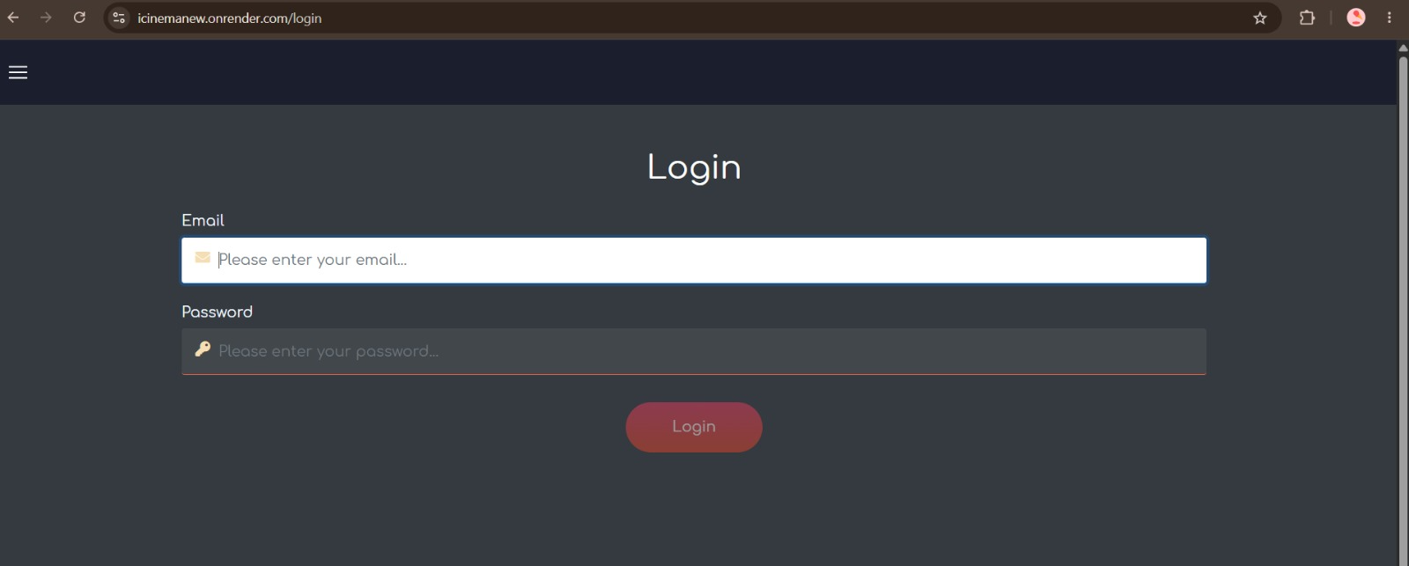
Final Result

Slide 13
Conclusion
iCinema provides an organized platform for movie browsing and management.
It combines modern frontend and backend technologies using the MERN stack.
It simplifies movie discovery through searching, categorization and rating-based filtering.
It provides secure user authentication and administrator functionalities.
The project demonstrates the practical implementation of full-stack web development concepts.

Slide 14
THANK YOU…

