Slide 1

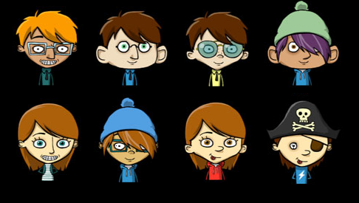
Hi! Welcome to the CHOCO-WORLD!
Here, small pieces of chocolates are given to experts for tasting.
You and your friends are the experts today.
Pick your avatar.
Write your name here.

Slide 2
Hi! Welcome to the CHOCO-WORLD!
Here, small pieces of chocolates are given to experts for tasting.
You and your friends are the experts today.
Pick your friend’s avatar.
JOHN
SUSAN
START

Slide 3


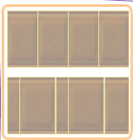
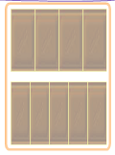
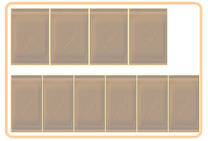
John wants to have 2/4 of a chocolate.
Susan wants to have 2/5 of an identical chocolate.
Which pair of chocolates will you choose for distribution? Click on it.
JOHN
SUSAN

Slide 4
John wants to have 2/4 of a chocolate.
Susan wants to have 2/5 of an identical chocolate.
Which pair of chocolates will you choose for distribution? Click on it.
JOHN
SUSAN

