Slide 1

Report on pothole detection using CNN
EAI6080: Advance Analytical Utilization
Professor Mimoza Dimodugno
Presented By: Vineet Upadhyay & Ujwal Kumar
15th May 2023

Slide 2
Introduction
Potholes pose a significant threat to road safety and cause substantial damage to vehicles.
Our project aims to address this issue by focusing on the accurate and efficient detection of potholes.
We will leverage deep learning techniques to develop a robust system that can identify potholes with high precision.
By utilizing deep learning, we can analyze road conditions and proactively detect potholes, minimizing the risk of accidents and reducing vehicle damage.
Our objective is to improve road safety by implementing an advanced pothole detection system based on deep learning algorithms.

Slide 3
Architecture Overview
The CNN architecture used for pothole detection consists of multiple layers, including convolutional layers, pooling layers, and fully connected layers.
The activation function used in the CNN architecture is the ReLU (Rectified Linear Unit), which introduces non-linearity and helps the network learn complex relationships between the input and output.
Dropout regularization is applied to reduce overfitting in the model. It randomly drops a fraction of the connections between layers during training, forcing the network to learn more robust features and preventing reliance on specific connections.
The final layer of the CNN architecture uses the softmax activation function for multi-class classification, producing probabilities for each class (positive and negative in this case) and selecting the class with the highest probability as the predicted label.

Slide 4
Data Information
Dataset: The dataset used for training and testing the pothole detection model consists of images of potholes and normal road surfaces.
Composition: The dataset includes positive samples (potholes) and negative samples (normal road surfaces).
Importance of a well-balanced dataset: A balanced dataset ensures equal representation of both classes during training, reducing bias and improving model performance. It helps the model learn meaningful patterns and generalize well to unseen data.

Slide 5
Data Preprocessing
Image resizing: The images in the dataset are resized to a fixed size of 128x128 pixels.
Normalization: The color images are loaded and processed using OpenCV's cv2 library. No specific normalization technique is used here
Class imbalance handling: The dataset contains positive samples (potholes) and negative samples (normal road surfaces). The code does not explicitly mention any techniques used to handle class imbalance.

Slide 6
Training overview
The training process includes 50 epochs and a batch size of 12.
The loss function used for training the CNN model is categorical cross-entropy when compiling the model.
The optimizer used is Adam, specified as optimizer='adam' when compiling the model.
The evaluation metric used is accuracy, specified as metrics=['accuracy'] when compiling the model.
The CNN model is trained with a dropout rate of 0.4, which helps in reducing overfitting.
The number of epochs is set to 50, indicating that the training process iterates over the entire training dataset 50 times.

Slide 7
Evaluation Metrices
The performance of the CNN model is assessed using the accuracy metric, which measures the overall accuracy of the model's predictions.
The code provided includes the implementation of other approaches, such as Random Forest Classifier, Support Vector Machines (SVM), and K-Nearest Neighbors (KNN).
The performance of these approaches is also evaluated using accuracy, precision, recall, F1-score, and classification reports.
A direct comparison of the model's performance with these approaches has beeen made based on the accuracy scores and other evaluation metrics obtained.

Slide 8
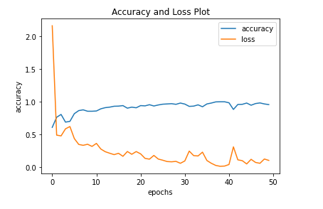
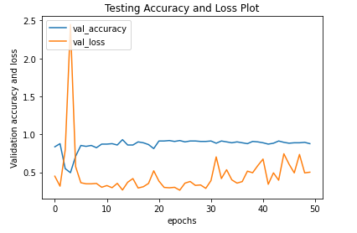
Model’s Performance
The test accuracy of the CNN model is 87.65 which is quite good.
Visual Representation of Accuracy and Loss Curves during Training:

Slide 9
CNN Vs Machine Learning Models
Models | Accuracy
CNN | 87.65%
SVM | 75.29%
Random Forest | 76.47%
KNN | 64.11%

Slide 10
Future Enhancements
Integration with real-time monitoring systems enables automatic and proactive pothole detection in video surveillance or vehicle-mounted cameras.
Development of a user-friendly application or API allows users to upload images or video streams for pothole detection using the trained model.
Continuous learning and improvement of the system can be achieved by incorporating a feedback loop that leverages newly detected potholes.
Further enhancements can include geolocation tagging, user feedback, and reporting mechanisms to enhance user engagement and community participation.

Slide 11
References
H., Asad, M. H., Khaliq, S., Yousaf, M. H., Ullah, M. O., & Ahmad, A. (2022, April 20). Pothole Detection Using Deep Learning: A Real-Time and AI-on-the-Edge Perspective. Pothole Detection Using Deep Learning: A Real-Time and AI-on-the-Edge Perspective. https://doi.org/10.1155/2022/9221211
Convolutional neural networks based potholes detection using thermal imaging. (2019, February 5). Convolutional Neural Networks Based Potholes Detection Using Thermal Imaging - ScienceDirect. https://doi.org/10.1016/j.jksuci.2019.02.004
H., & Hoang, N. D. (2018, June 6). An Artificial Intelligence Method for Asphalt Pavement Pothole Detection Using Least Squares Support Vector Machine and Neural Network with Steerable Filter-Based Feature Extraction. An Artificial Intelligence Method for Asphalt Pavement Pothole Detection Using Least Squares Support Vector Machine and Neural Network With Steerable Filter-Based Feature Extraction. https://doi.org/10.1155/2018/7419058
Sanad, M. (2020, February 18). Image Classification Using CNN (Convolutional Neural Networks). Analytics Vidhya. https://www.analyticsvidhya.com/blog/2020/02/learn-image-classification-cnn-convolutional-neural-networks-3-datasets/
Potholes caused over 5,000 deaths, shows 2018-2020 road accidents data. (2022, August 24). The Federal. https://thefederal.com/news/potholes-caused-over-5000-deaths-shows-2018-2020-road-accidents-data/
Self-Driving Technology Represented in Art. (n.d.). IEEE Potentials Magazine, January/February 2020Self-Driving Technology Represented in Art. https:////read.nxtbook.com/ieee/potentials/january_february_2020/self_driving_technology_repre.html
Ahmed, K. R. (2021, December 16). Smart Pothole Detection Using Deep Learning Based on Dilated Convolution. PubMed Central (PMC). https://doi.org/10.3390/s21248406
Mishra, M. (2020, September 2). Convolutional Neural Networks, Explained. Medium. https://towardsdatascience.com/convolutional-neural-networks-explained-9cc5188c4939
Sanad, M. (2020, February 18). Image Classification Using CNN (Convolutional Neural Networks). Analytics Vidhya. https://www.analyticsvidhya.com/blog/2020/02/learn-image-classification-cnn-convolutional-neural-networks-3-datasets/
Conditional probability - Wikipedia. (2020, September 11). Conditional Probability - Wikipedia. https://en.wikipedia.org/wiki/Conditional_probability

