Slide 1

A Project Review Meeting on Student Academic Records System
By
Akash K roll 2520090127
V Deepak roll 2520030503
Team Lead: Akash K
Under the guidance of
MS . D. Pavithra
Assistant Professor
Department of Computer Science and Engineering

Slide 2
Outline of the Presentation
Abstract
Introduction
Problem Statement
Project Flow Diagram
Objectives with Justification
Modules[Frontend web pages]
Expected Outcomes of the Proposed Work
Conclusion
References

Slide 3
Abstract
The Student Academic Records System is a web-based application developed to efficiently manage and maintain student academic information in educational institutions.
Traditional methods of handling academic records manually are time-consuming, error-prone, and difficult to manage as student data grows.
This system provides a centralized digital platform for managing academic records accurately and securely.
It allows administrators and faculty to store student details, enter subject-wise marks, and automatically calculate grades, GPA, and CGPA.
Additional features include backlog identification, semester-wise performance history, transcript generation, re-evaluation request management, and result tracking.
Developed using: HTML, CSS, JavaScript, React.js, Node.js, Express.js, and MySQL.
The system reduces manual paperwork, minimizes human errors, and improves the efficiency of academic data management.

Slide 4
Introduction
Background:
Educational institutions maintain vast amounts of academic data for each student across multiple semesters.
Managing this data manually leads to errors, delays, and inefficiencies in reporting and decision-making.
Purpose:
The Student Academic Records System (SARS) is designed to digitize, centralize, and automate student academic data management.
Technology Stack:
Frontend: HTML5, CSS3, JavaScript (ES6+), React.js
Backend: Node.js, Express.js | Database: MySQL | Tools: Axios, Postman, VS Code

Slide 5
Problem Statement
Existing Challenges:
1. Manual maintenance of student marks, grades, and academic history is tedious and error-prone.
2. No centralized platform to store and retrieve semester-wise academic records.
3. Difficulty in automatic calculation of GPA and CGPA across multiple semesters.
4. Lack of transparent communication between students and faculty for revaluation requests.
5. Time-consuming process of generating transcripts and academic reports.
6. No automated identification of backlogs or failed subjects.
Proposed Solution:
A centralized web-based system that automates all these tasks with a user-friendly interface.

Slide 6
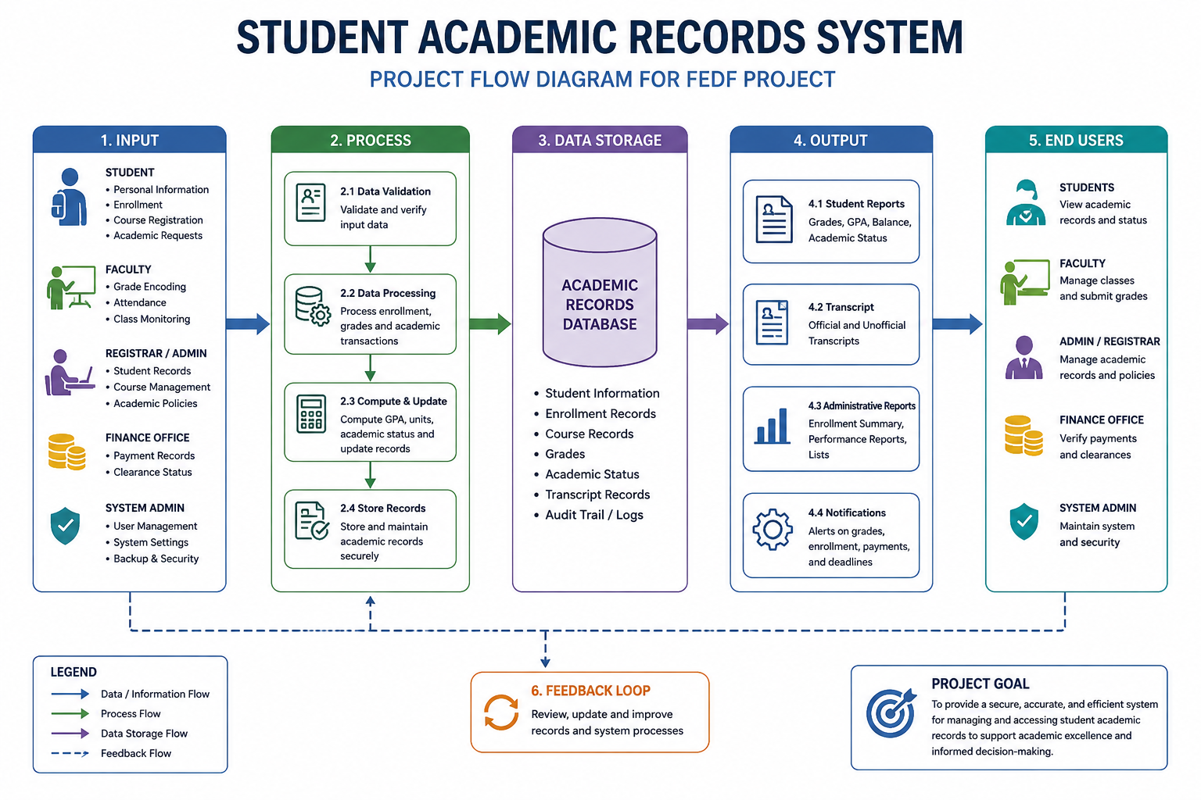
Project Flow Diagram

Slide 7
Objectives with Justification
1. Centralized Record Management
Store all student academic data in one secure, accessible system.
2. Automated Grade Calculation
Automatically compute grades, GPA, and CGPA based on entered marks.
3. Backlog Identification
Automatically flag failed subjects and track pending clearances.
4. Transcript Generation
Generate official semester-wise academic transcripts on demand.
5. Revaluation Management
Enable students to request revaluations and track their status.

Slide 8
Modules [Frontend web pages]
Module 1: Student Management (Roll: 2520090127 - Akash K)
Add, update, and maintain student personal details and database storage/retrieval.
Module 2: Marks & Grade Calculation (Roll: 2520030503 - V Deepak)
Enter semester-wise marks; automatically calculate grades, GPA, and CGPA.
Module 3: Transcript & Report Module (Roll: 2520090127 - Akash K)
Generate semester-wise academic reports, transcripts, and performance history.
Module 4: Admin & Revaluation Module (Roll: 2520030503 - V Deepak)
Manage admin activities, backlog identification, and revaluation request processing.

Slide 9
Expected Outcomes of the Proposed Work
Centralized Academic Record Management The system will provide a centralized platform for storing and managing student academic information, reducing the need for manual record keeping.
Improved Data Accuracy Automated data entry and validation processes will minimize human errors and ensure accurate maintenance of student records.
Efficient Access to Information Students, faculty, and administrators will be able to access academic records quickly and securely, improving overall operational efficiency.
Automated GPA and Performance Tracking The system will automatically calculate GPA, track academic progress, and generate performance reports, reducing administrative workload.
Enhanced Security and Privacy Role-based authentication and secure database management will protect sensitive academic information from unauthorized access.
Faster Report Generation Academic transcripts, grade reports, attendance summaries, and other documents can be generated instantly, saving time and effort.
Better Decision-Making Administrators can utilize academic data and performance analytics to make informed decisions regarding student progress and institutional planning.

Slide 10
Project Mapping To Course Outcomes (Co’s)
CO1 – Front-End Engineering & Framework Design React framework is used to build a component-based Student Academic Records System with reusable components and Virtual DOM for efficient UI rendering.
CO2 – JavaScript Engineering Modern JavaScript (ES6) features such as arrow functions, array methods, objects, and Fetch API are used for data processing and user interactions.
CO3 – React Component Model Functional components, Props, use State, and use Reducer hooks are used to create dynamic and interactive user interfaces.
CO4 – State Architecture & API Integration State management is implemented using use Reducer, and API integration is used in the AI Assistant module for handling asynchronous data.
CO5 – Forms, Accessibility & Performance The project includes Login, GPA Calculator, and Revaluation forms with validation, responsive design, and optimized performance.
CO6 – Build Systems & Deployment The application follows a structured React architecture and can be deployed using modern platforms such as Netlify or Vercel for scalability and maintenance.

Slide 11
Conclusion and Future Scope
Conclusion:
The Student Academic Records System addresses challenges of manual academic record management.
By automating grade calculations, transcript generation, and revaluation management, it improves accuracy and efficiency.
The system provides a reliable, user-friendly, and scalable solution for educational institutions.
Future Scope:
1. Mobile application (React Native) for student access on the go.
2. Integration with university ERP systems for seamless data exchange.
3. AI-based performance prediction and academic counseling features.
4. SMS/Email notifications for result publication and revaluation updates.

Slide 12
References
1. React.js Documentation - https://reactjs.org/docs/getting-started.html
2. Node.js Documentation - https://nodejs.org/en/docs/
3. Express.js Guide - https://expressjs.com/en/guide/routing.html
4. MySQL Reference Manual - https://dev.mysql.com/doc/
5. MDN Web Docs (HTML, CSS, JS) - https://developer.mozilla.org/
6. Axios Documentation - https://axios-http.com/docs/intro
7. Postman API Testing Guide - https://learning.postman.com/
8. Pressman, R. S. (2014). Software Engineering: A Practitioner's Approach. McGraw-Hill.

Slide 13
Thank you

