Slide 1
Skill-Based Career Analyzer
Presented by:
241FA04B93
241FA04B96
241FA04C30

Slide 2
ABSTRACT
This project presents a Skill-Based Career Analyzer that helps individuals evaluate their career potential based on their existing skills. By analyzing a user’s resume, the system identifies key skills, recommends suitable job roles, and highlights skill gaps that need improvement. It also detects outdated skills and suggests relevant, in-demand alternatives to keep users aligned with current industry trends. Also the system provides insights into companies hiring for recommended roles, along with relevant job and salary information. And using chatbot for personal queries. The goal is to offer personalized career guidance that enables users to make informed career decisions and enhance their employability in a rapidly evolving job market.

Slide 3
Proposed System
The proposed system, titled Skill-Based Career Analyzer, is designed to provide intelligent career guidance by analyzing a user’s resume and identifying relevant skills. Unlike traditional resume screening systems that focus mainly on recruitment, this system emphasizes skill awareness, job suitability, and career improvement guidance.
The system processes the uploaded resume, extracts meaningful skills, and compares them with a structured dataset of job roles and required skills. Based on this analysis, it recommends suitable job roles, identifies missing skills, detects outdated technologies, suggests suitable jobs and provides personalized solutions with chatbot.

Slide 4
Our approach(Architecture)
Limitations of Existing Systems
Most resume analysis systems focus mainly on matching resumes with job descriptions
Candidates are ranked using similarity scores
While efficient for recruitment, these systems:
Do not provide clear understanding of extracted skills
Lack detailed skill gap identification
Offer limited guidance for improvement
Skill awareness
Job suitability
Improvement guidance
Ease of job searching
Skill-Focused Resume Analysis
Resume is processed to extract text and identify skills
Skills are detected using:
A structured skills dataset (CSV)
Normalization techniques (lowercasing, cleaning)
Alias mapping (e.g., ML → Machine Learning)
Whereas Our approach focuses on:
Job Recommendation Using Skill Matching
Job roles are stored with required skills in a dataset
System compares:
User skills vs Job skills
Each job is ranked based on:
Percentage of matching skills

Slide 5
Skill Gap Analysis:
Compares:
Skills required for a selected job role
User’s extracted skills
Identifies missing skills
Use of a Unified Skills Dataset:
A single CSV dataset is used for:
Job roles
Required skills
Ensures: Consistency across modules
Skill Normalization and Noise Reduction:
Applies preprocessing techniques:
Lowercasing text
Removing special characters
Cleaning extra spaces
Uses:
Alias mapping (e.g., ML → Machine Learning)
Stopword removal
Handling Outdated Skills:
Detects outdated technologies in resume
Uses a predefined mapping of:
Old skills → Modern alternatives
Streamlined and Interactive Interface:
Provides a simple user interface for the entire workflow
Users can:
Upload resume
View extracted skills
See job recommendations
Analyze skill gaps

Slide 6
Hiring Companies Module:
Provides company recommendations based on the selected job role from the job matching module • Displays key hiring information including: • Company names • Available job titles • Job locations in India • Employment type (Full-time, Part-time, Contract, etc.) • Salary range (when available) • Direct application links (uses rapid Api (Jsearch)
Chatbot Module:
Provides personalized career guidance using resume and skill analysis.
Recommends suitable job roles and identifies skill gaps.
Suggests trending skills, learning paths, and career roadmaps.
Uses Streamlit and Groq LLM for an interactive AI career mentor.
Supports user authentication and saves chat history for future access.

Slide 7
Authentication & Chat History Module:
User Authentication: Secure signup and login functionality.
Session Management: Maintains user identity during usage.
Personalized Access: Users can view only their own data and chats.
Persistent Chat History: Saves and restores previous conversations.
Chat Management & Privacy: Supports new chats, chat retrieval, and organized user-specific storage.

Slide 8
Performance Evaluation of the Proposed Model
The performance of the proposed Skill-Based Career Analyzer is evaluated based on its accuracy, relevance, and efficiency in extracting skills, recommending jobs, and identifying skill gaps. Since the system is primarily rule-based and dataset-driven, evaluation focuses on practical metrics rather than complex machine learning measures.
1. Skill Extraction Accuracy The system evaluates how accurately it extracts relevant skills from the resume. This is measured by comparing extracted skills with expected skills from sample resumes.
Use of normalization and alias mapping improves accuracy.
Noise reduction techniques help eliminate irrelevant words. This ensures that the extracted skills closely represent the user’s actual profile.
2. Job Recommendation Relevance The effectiveness of job recommendations is evaluated using skill matching score (overlap count) between user skills and job requirements.
Jobs are ranked based on the number of matching skills.
Top-N (e.g., Top 5) jobs are displayed. Higher overlap indicates better relevance of recommendations.

Slide 9
3. Skill Gap Precision The system measures how correctly it identifies missing skills for a selected job role.
Only meaningful and filtered skills are considered.
Generic or non-skill phrases are removed. This ensures that the displayed skill gaps are accurate and actionable.
4. Consistency of Results Since the system uses a single CSV dataset as the source of truth, consistency is maintained across:
Skill extraction
Job recommendation
Skill gap analysis This avoids mismatches and improves reliability.
5. Processing Efficiency The system performance is also evaluated based on response time.
Use of caching (st.cache_data) reduces repeated computations.
Lightweight rule-based logic ensures fast processing. This makes the system suitable for real-time interaction.

Slide 10
6. Outdated Skill Detection Accuracy The system identifies outdated technologies by comparing resume skills with a predefined list.
Accuracy depends on the completeness of the outdated skills list.
Helps users recognize irrelevant skills effectively.
7. Hiring Companies Module
Fetches live job listings for the selected role.
Displays hiring companies in India.
Shows job title, location, salary, and job type.
Provides direct application links.
Updates results using real-time API data.
Integrates seamlessly with job recommendations.
Reduces job search effort for users.
Performance depends on API response time and data availability.

Slide 11
8. Chatbot Module
• Provides personalized career guidance • Uses resume and skill data for responses • Suggests suitable job roles and skills • Supports skill gap identification • Improves user engagement through interaction • Delivers quick and relevant career recommendations and saves the previous chats • Performance depends on the accuracy of extracted data and job matching results
9. User Interpretability The results are evaluated based on how easily users can understand them:
Clear display of extracted skills
Ranked job recommendations
Highlighted skill gaps This improves usability and decision-making.

Slide 12
Authentication Module:
Fast Login Verification for secure user access.
Maintains Active Sessions during usage.
Protects User Privacy with user-specific access.
Quick Chat Loading from saved history.
Lightweight Storage using JSON files.
Overall Technologies Used:
Frontend: Streamlit
Backend: Python
AI Model: Groq LLM
Storage: JSON Files
Data Processing: Pandas
External API: JSearch (RapidAPI)
Dataset: Skills & Job Roles CSV

Slide 13
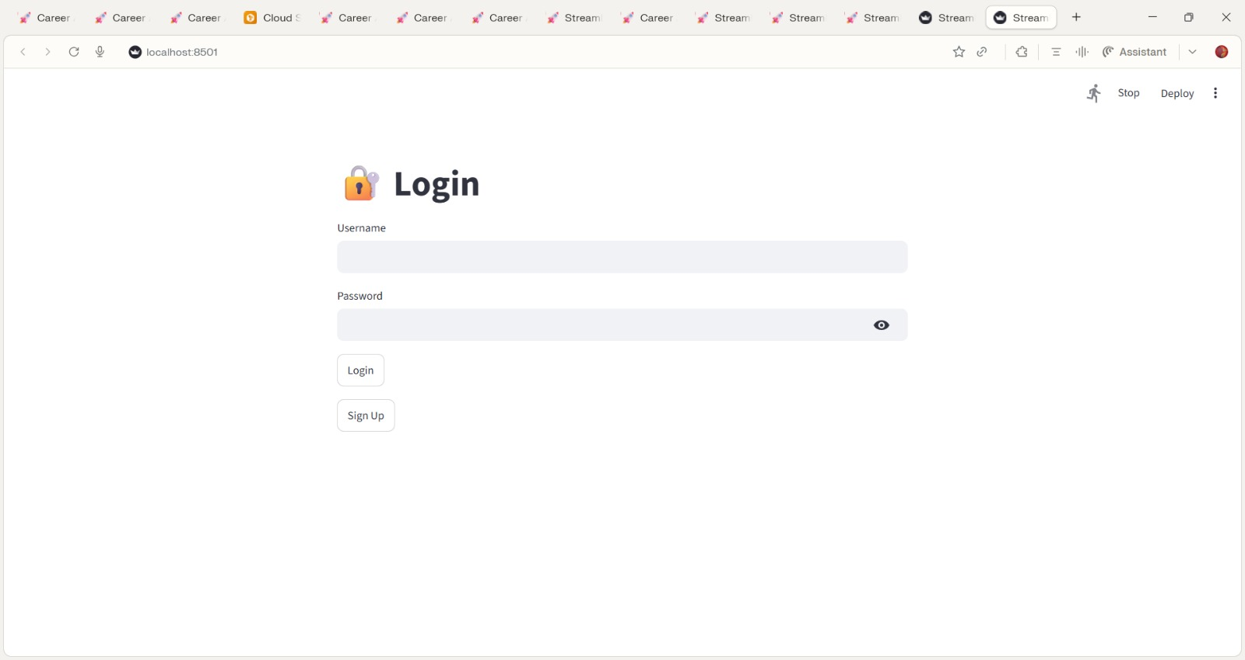
OUTPUT :
The Authentication Module enables secure user access, protects user data, and provides personalized chat history, improving both privacy and user experience.

Slide 14
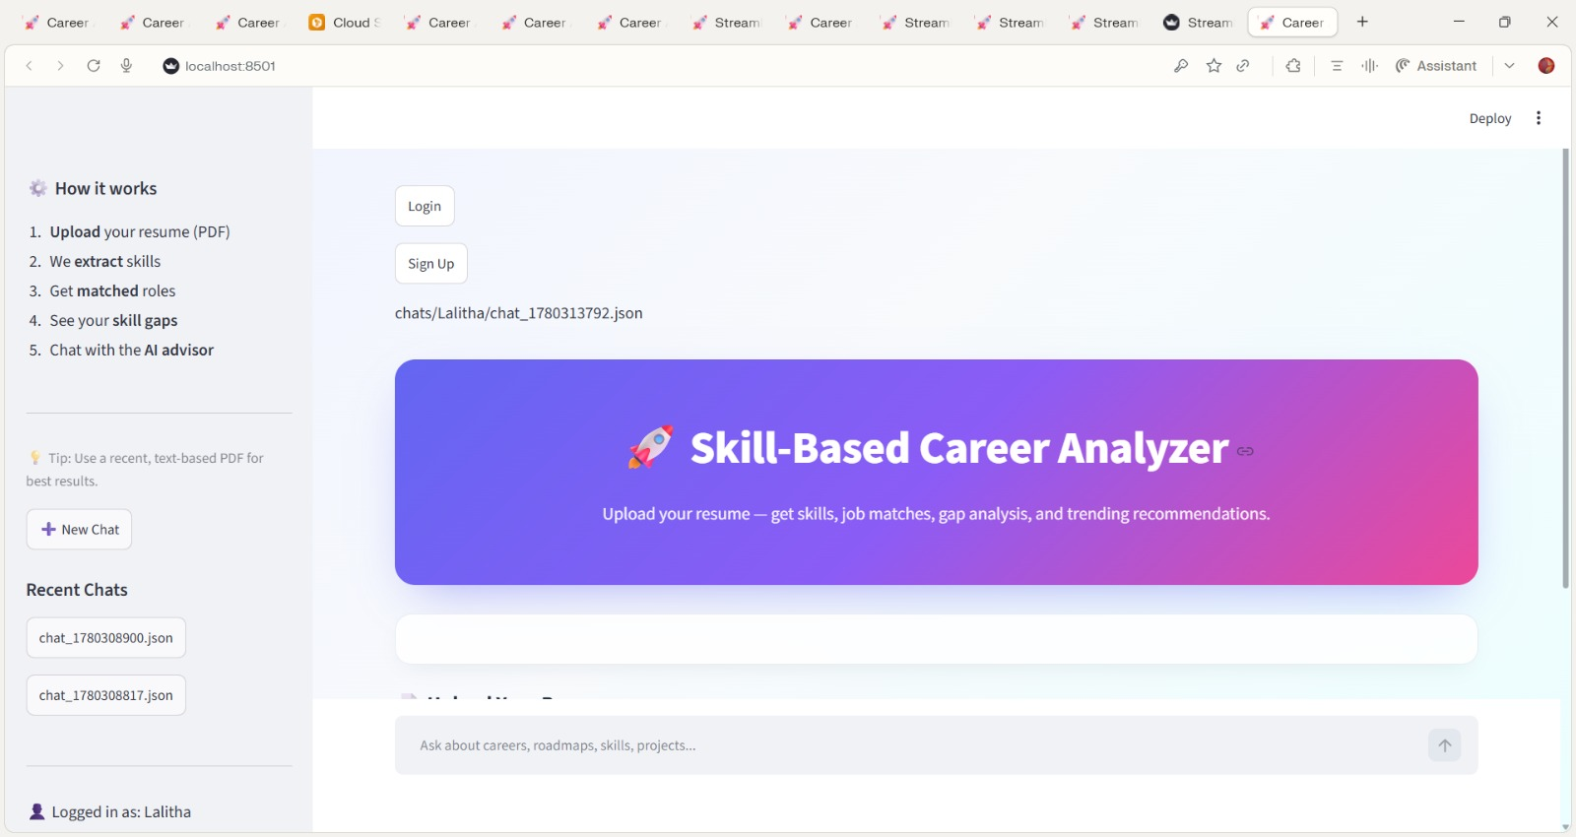
The proposed Skill-Based Career Analyzer was tested using sample resume inputs, and the results demonstrate the effective working of all system modules including skill extraction, job recommendation, outdated skill detection, and skill gap analysis.

Slide 15
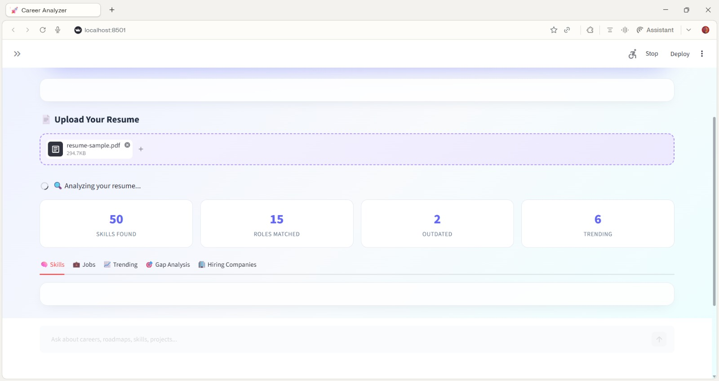
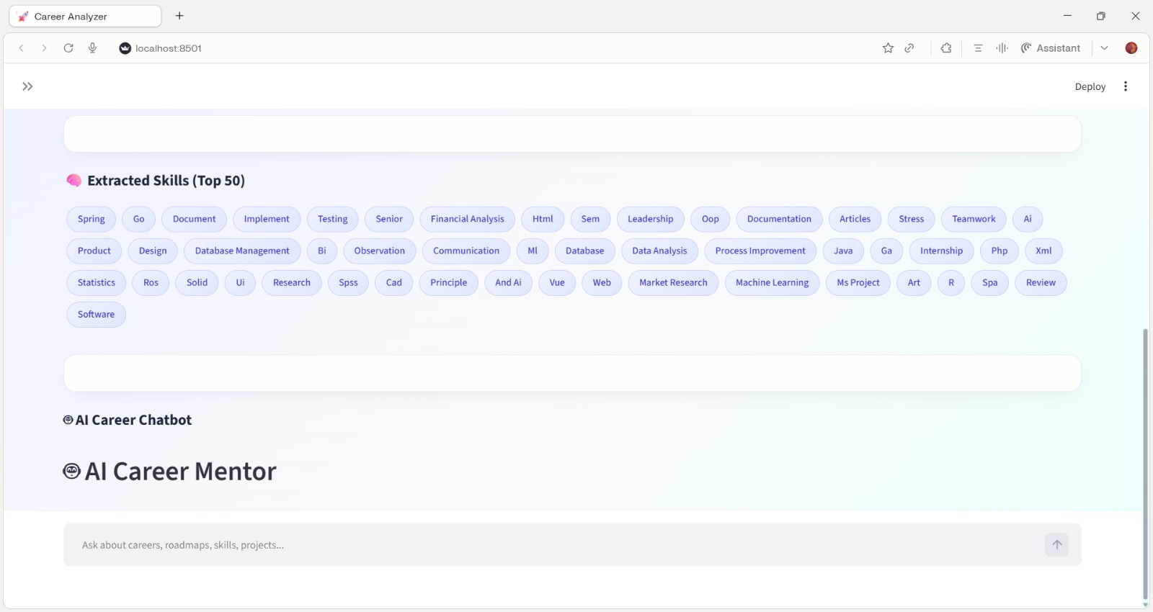
Resume Upload & Processing:
User uploads resume
Resume is processed
Skill Extraction
Automatic skill extraction
Structured display of skills
Multiple skills identified

Slide 16
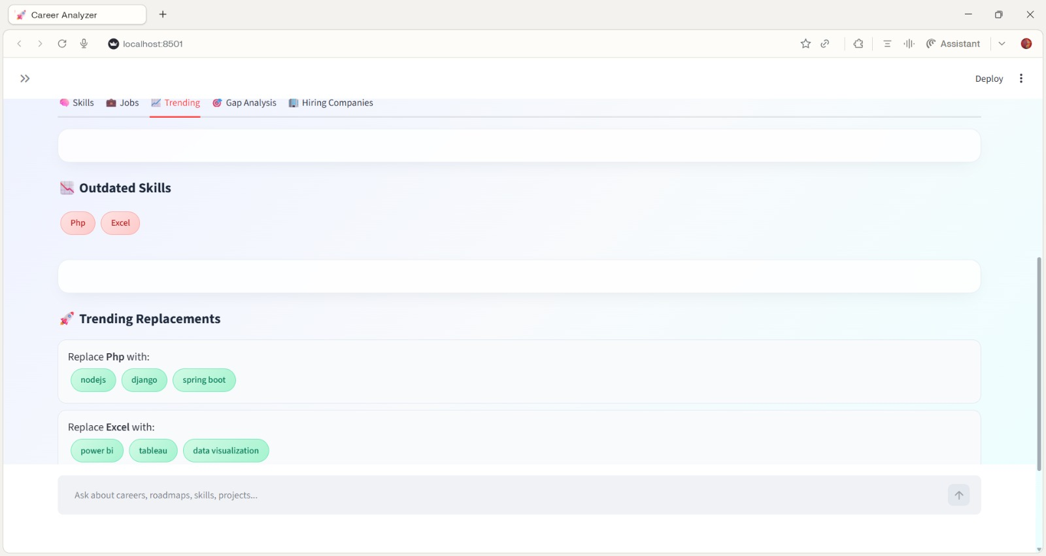
Outdated Skill Detection:
Detection of outdated skills The system checks which skills are no longer in demand
Examples of outdated skills → Skills like PHP and Excel are marked outdated

Slide 17
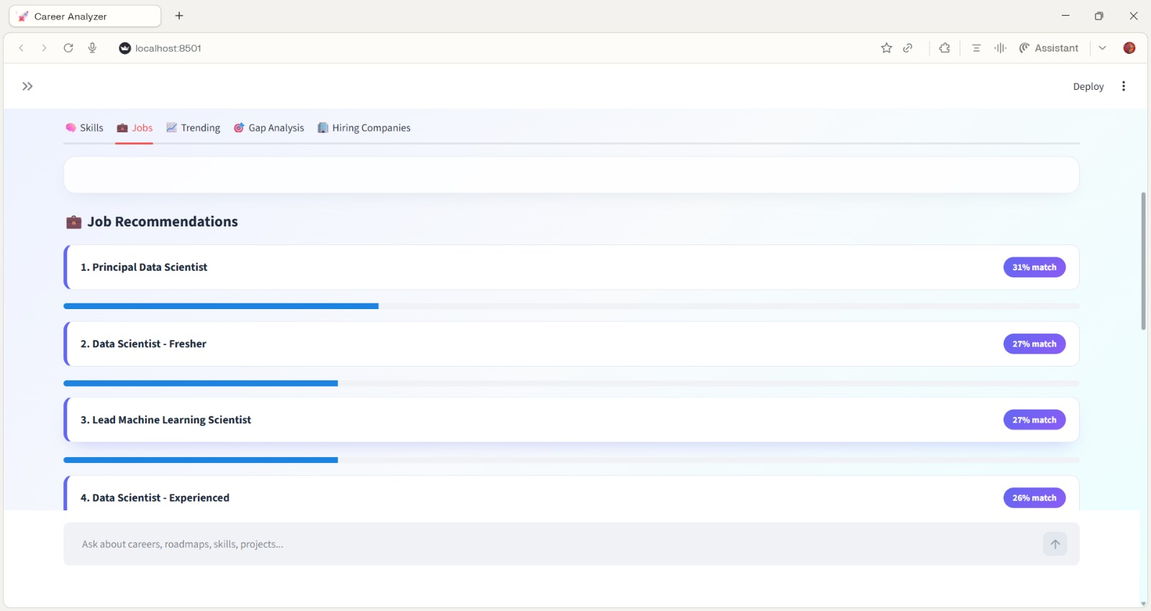
Job Recommendation Module:
Job roles are recommended
Ranking based on skill match
Match Percentage Concept
Example Job Roles:
Principal Data Scientist – 31%
Data Scientist (Fresher) – 27%
Machine Learning Scientist – 26%
Importance:
Provides practical recommendations
Helps in career planning

Slide 18
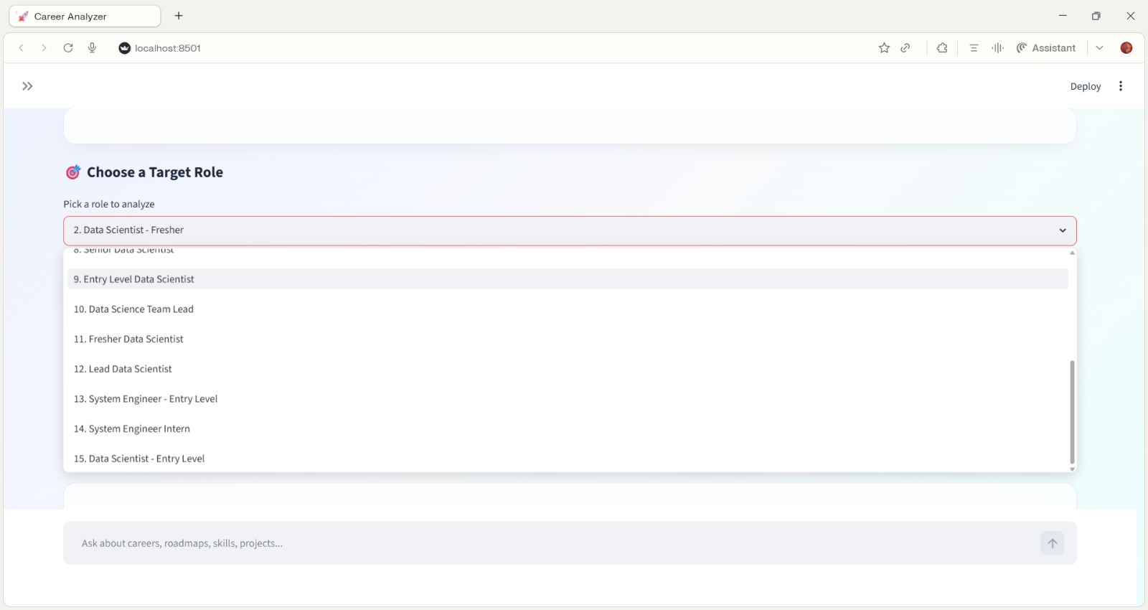
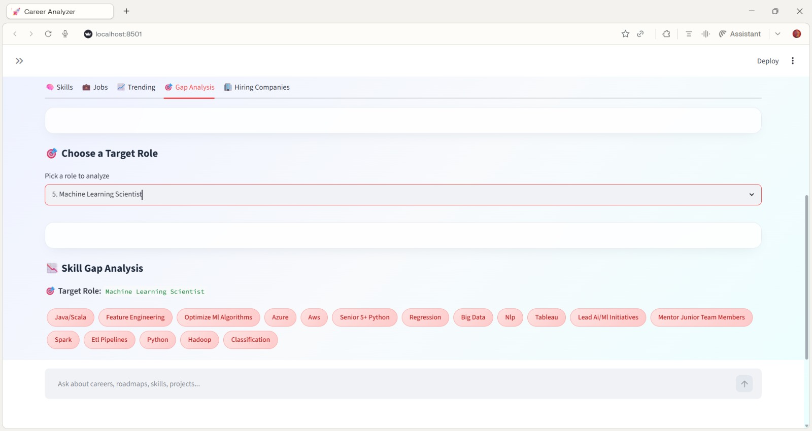
The job selection interface allows users to choose a preferred role from the recommended list. Based on the selected role the system performs skill gap analysis.
The output highlights missing skills such as Regression, Hadoop, Tableau, Spark, AWS, and Feature Engineering.
This clearly shows what additional skills are required for the selected role, making the system highly actionable.

Slide 19
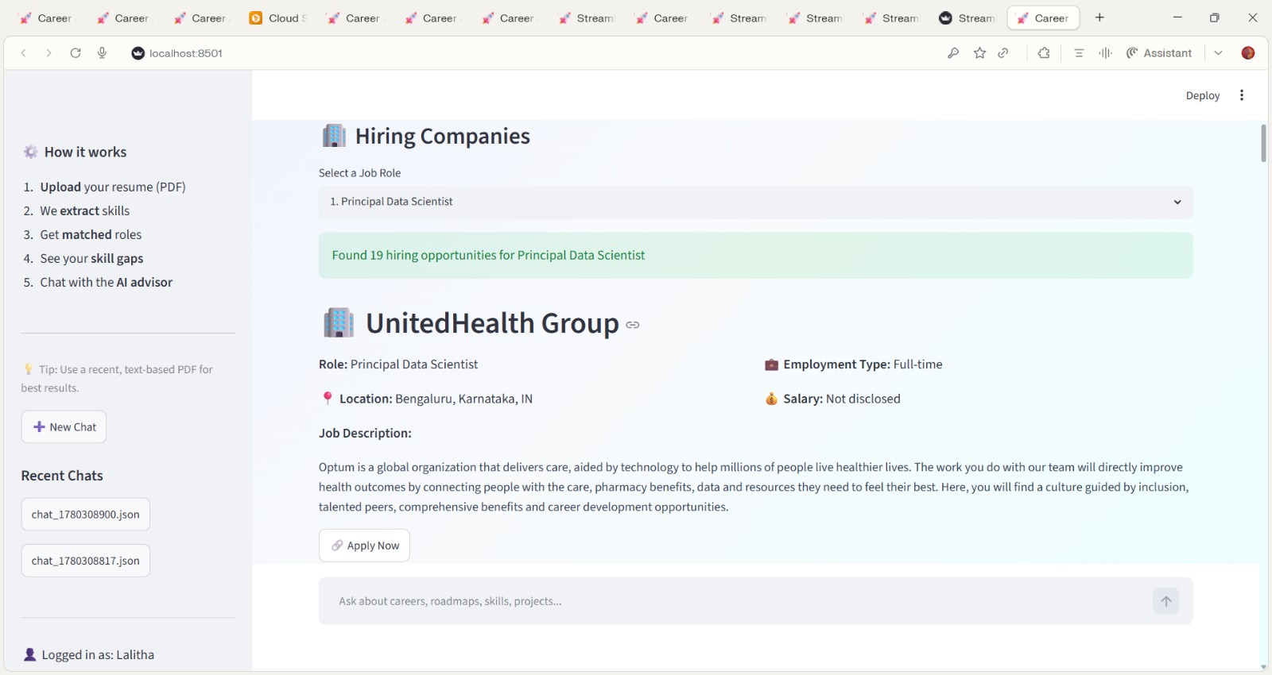
• The Hiring companies module connects recommended job roles with current hiring opportunities. • Provides company details, job locations, employment types, salary information, and application links. • Enhances the practical value of the system by helping users explore relevant job openings.

Slide 20
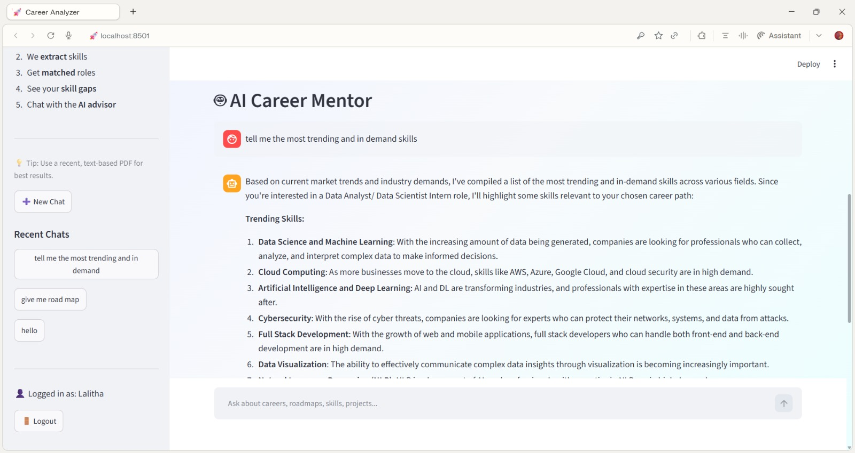
• The Chatbot module provides personalized career guidance based on resume analysis results. • Assists users in understanding skill gaps, job matches, and skill improvement strategies. • Improves user experience through interactive and instant career support.
Helps users to revisit their previous chats.

Slide 21
REFERENCES
Research papers on resume analysis and job recommendation systems - Research paper 1, Research paper 2.
Python Documentation (official Python libraries and modules)
Streamlit Documentation for user interface development
Online resources for skill datasets and career analysis – Kaggle dataset
GitHub Repository -https://github.com/vucse241fa04b96-lang/skill-match-project

Slide 22
CONCLUSION
The proposed Skill-Based Career Analyzer successfully achieves its objectives by providing an end-to-end career guidance solution. The system accurately extracts skills from resumes, recommends suitable job roles, identifies skill gaps, and suggests trending technologies to improve employability. The newly integrated Hiring Companies Module enhances the platform by displaying real-time hiring opportunities, job details, salary information, and direct application links for recommended roles.
Additionally, the AI Career Chatbot offers personalized career guidance, roadmap suggestions, and instant answers to user queries, improving overall user engagement and support.
Overall, the project delivers a practical, user-friendly, and effective career development platform that helps users understand their current skill profile, identify improvement areas, explore job opportunities, and make informed career decisions, with strong potential for future enhancements.

Slide 23
THANK YOU

