Slide 1


TMDB MOVIE DATA ANALYSIS
Customer Churn Analysis
Project by,
Date- 12/09/2023
Name-Vighnesh S Udaiyar
Course Name- Data Analysis
Batch –January 2023
Wave- DAS31
Mentor- Mr. Sagar Bhilare

Slide 2
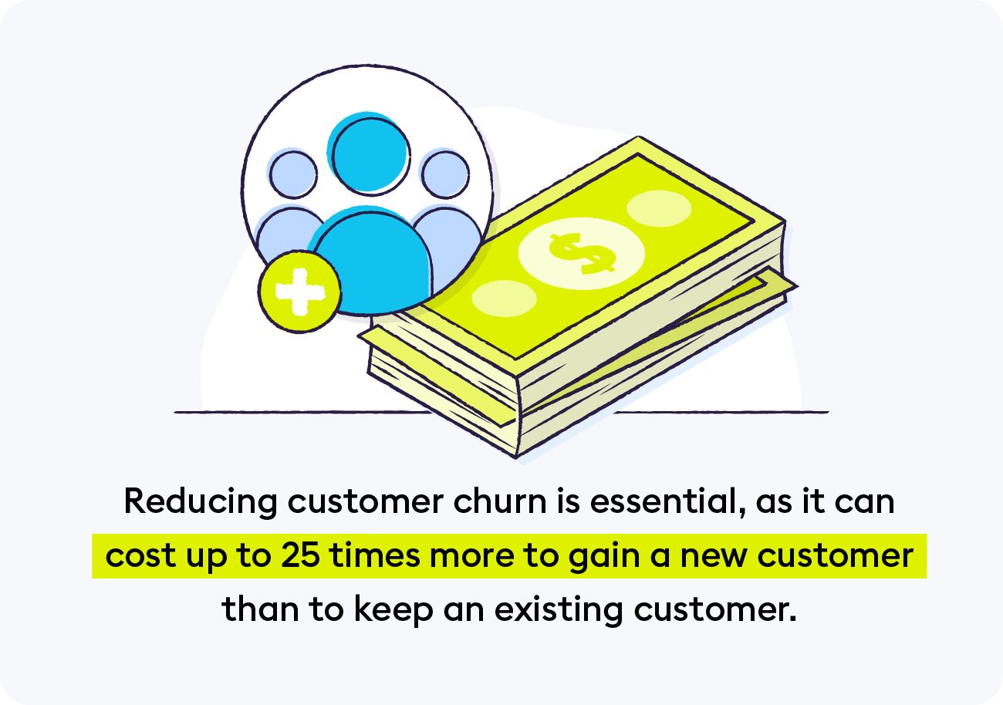
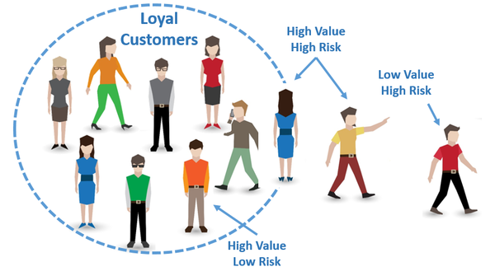

Customer Churn Analysis
PROJECT OBJECTIVE
The objective of the project is to use analyze the customer data of a North American bank and build an interactive dashboard .Building a dashboard will involve analyzing the data and presenting the result using a appropriate charts/graphs.

Slide 3
Customer Churn Analysis
Introduction
Customer Churn is one of the most important and challenging problems for businesses such as Credit Card companies, cable service providers, SASS and telecommunication companies worldwide.
Even though it is not the most fun to look at, customer churn metrics can help businesses improve customer retention.
Certain bank in North America wants to perform customer churn analysis, as the credit business of the bank is not performing very well .
Churn Analysis will help the bank evaluate the customers who have stopped purchasing the credit card of the bank and figure out measures to reduce the banks customer loss rate.

Slide 4
SYNTAX: df=pd.read_csv("DS1_C8_V3_ND_Sprint3_BankChurn_Data (1).csv") df df.isnull().sum()
Customer Churn Analysis
Data Preprocessing using Python
We have loaded the dataset in the jupyter notebook and there are 10127 rows and 20 columns.
Card_Category and credit_limit has a null values.
Card_Category null values are replaced with mode values.
Credit_Limit is replaced with median value.
Then Exported this cleaned dataFrame to CSV file and Exported to Tableau for analysis.

Slide 5
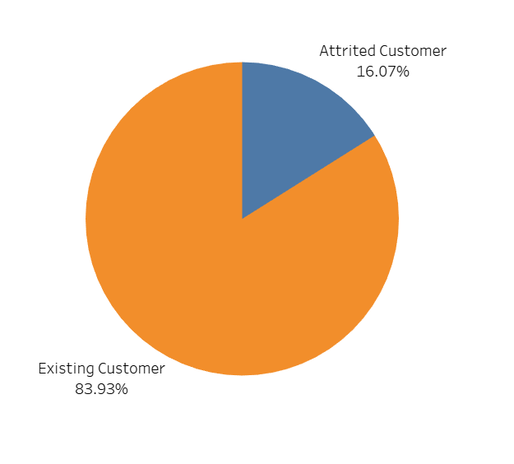

Output
Customer Churn Analysis
#Task 1 Display the percentage of the attrited and the existing customers from the data.
Interpretation
From the figure ,Percentage of at Attrited customer is 16.07% and the Percentage of at Existing customer is 83.93%.
The bank has a customer loss of 16.07% .Hence this needs to be addressed.

Slide 6
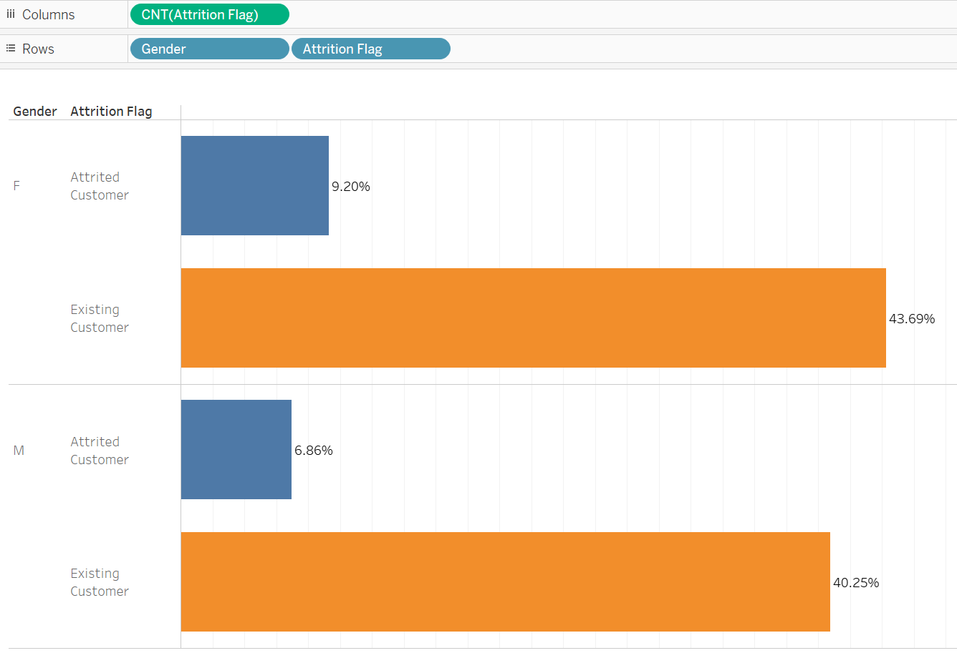
Output
Customer Churn Analysis
#Task 2 Display the Gender Wise attrited and the existing customers from the data.
Interpretation
From the figure ,Female customers(9.20%) are attrited more as compared to Males(6.86%)

Slide 7
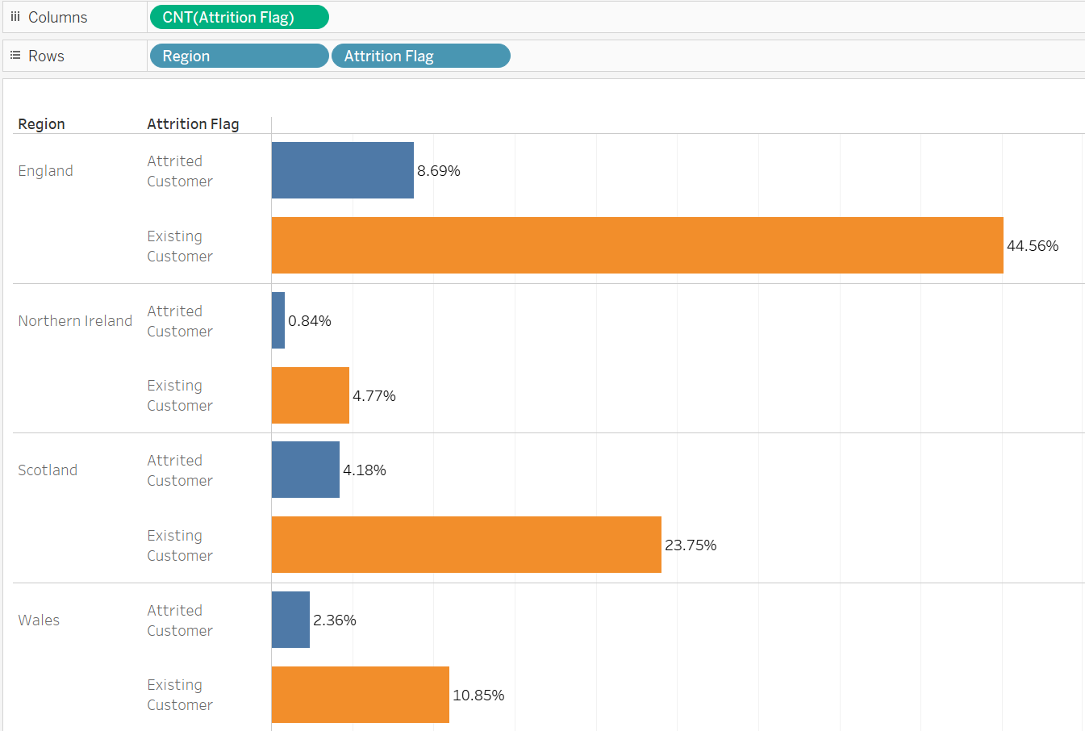
Output
Customer Churn Analysis
#Task 3 Display the Region Wise Attrited and the existing customers from the data.
Interpretation
From the figure ,England has the highest customers (8.69%) attrited as compared to other region.
North Ireland has the lowest customers (0.84%) attrited as compared to other region

Slide 8
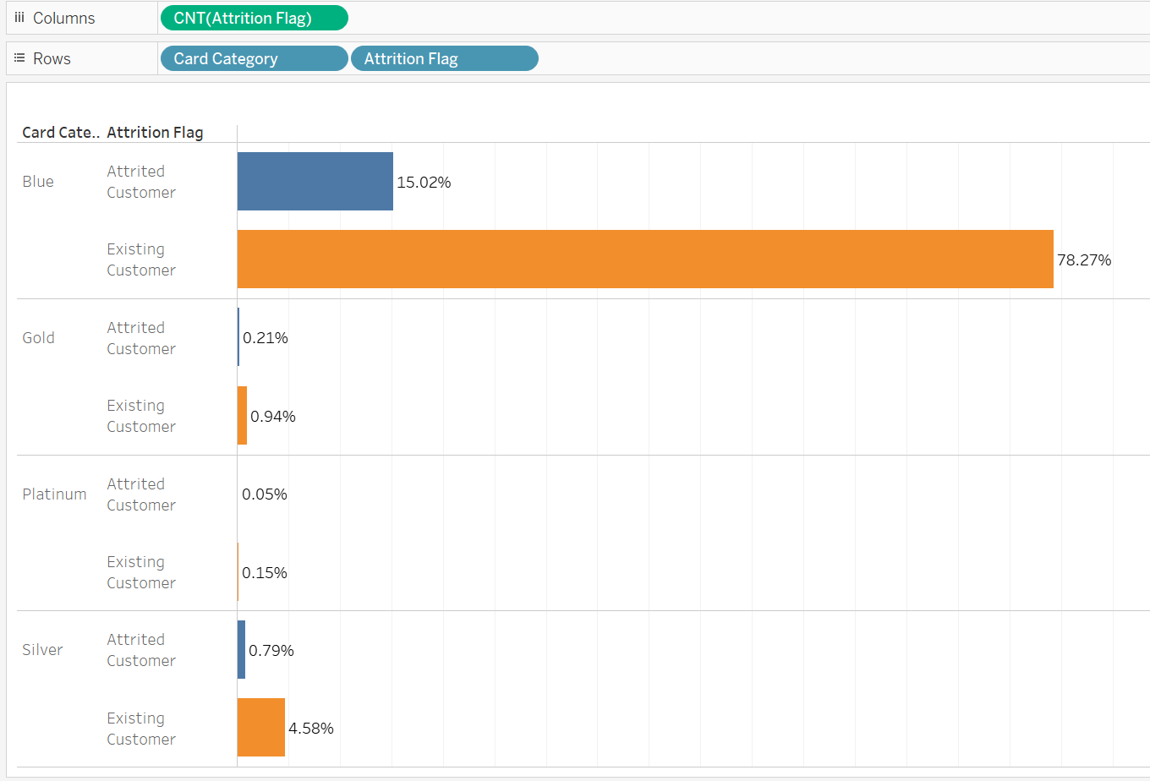
Output
Customer Churn Analysis
#Task 4 Display the Card Type Wise Attrited and the existing customers from the data.
Interpretation
Majority of the customers are churning from the blue card category. It is also to be noted that the maximum customers are also blue card holders.

Slide 9
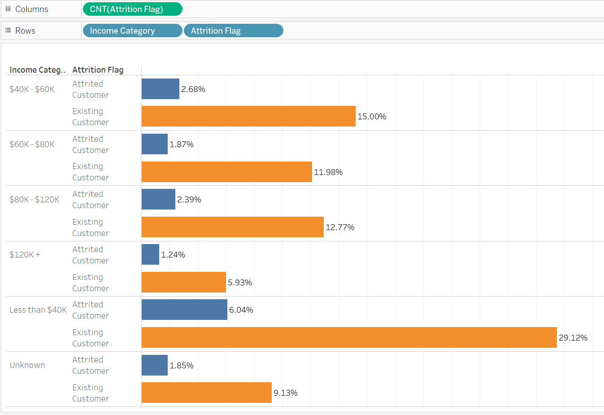
Output
Customer Churn Analysis
#Task 5 Display the Income Category Wise Attrited and the existing customers from the data.
Interpretation
Almost 20-30% of customers who attrited are earning less than $40,000

Slide 10
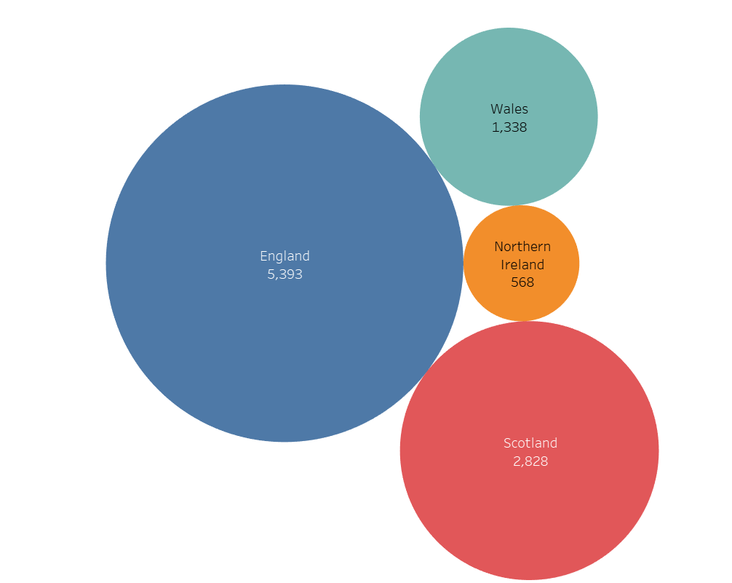
Output
Customer Churn Analysis
#Task 6 Display the region-wise count of customers and identify the region that has the highest number of customers.
Interpretation
England has a maximum count of customers 5393.

Slide 11
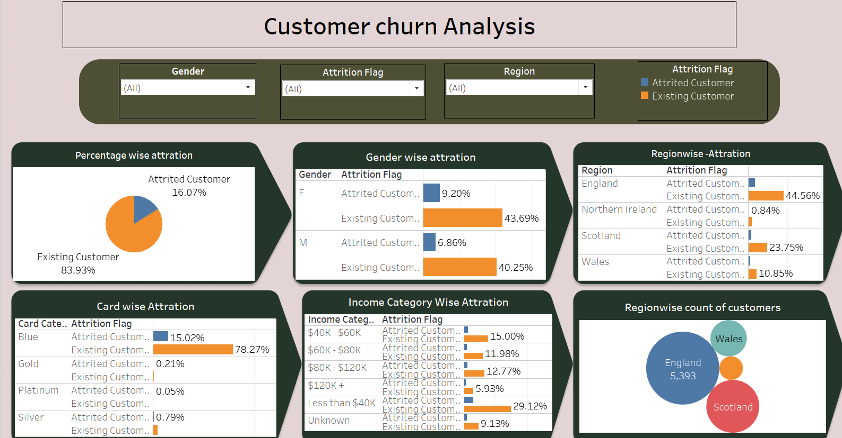
Customer Churn Analysis
#Task 7 Create an interactive dashboard by following the given instructions.
Create a Figma templates for the dashboard by following the given instructions:
Design the dashboard with the charts created in task 1-6.
Apply action filters on the charts created in task 1 and 6

Slide 12
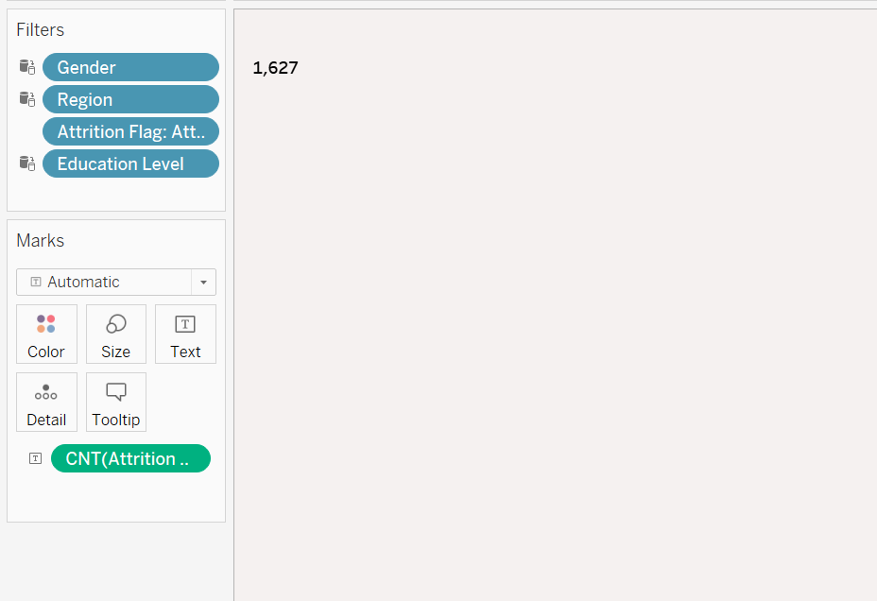
Output
Customer Churn Analysis
#Task 8 Display the count of attrited customer.
Interpretation
There are total 1627 attrited customer

Slide 13
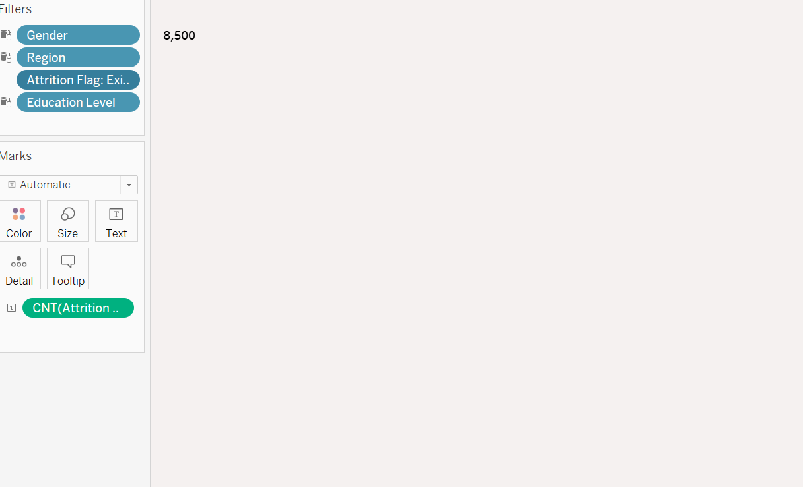
Output
Customer Churn Analysis
#Task 9 Display the count of Existing customer.
Interpretation
There are total 8500 Existing customer

Slide 14
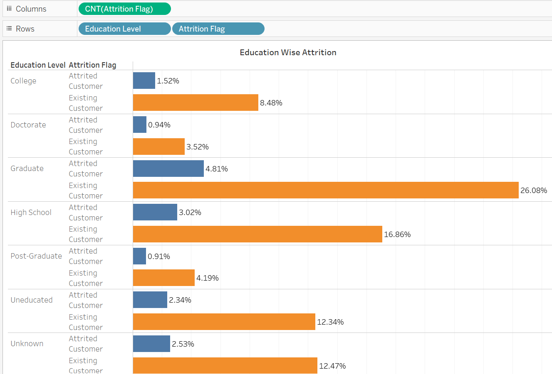
Output
Customer Churn Analysis
#Task 10 Display the Education wise Attrited and the existing customers from the data.
Interpretation
Graduate and High School customers have a higher Attrition rate compared to another education level.

Slide 15
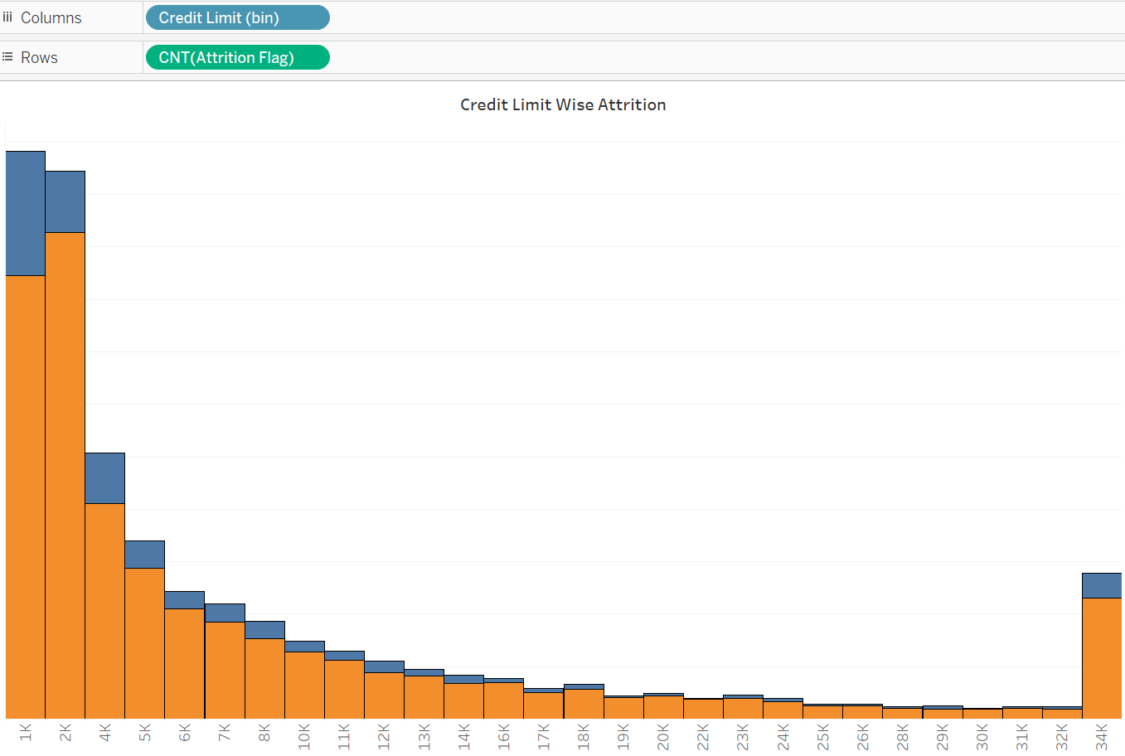
Output
Customer Churn Analysis
#Task 11 Display the Education wise Attrited and the existing customers from the data.
Interpretation
Customers with the credit limit of upto $1k have a higher Attrition rate compared to other credit limit.

Slide 16
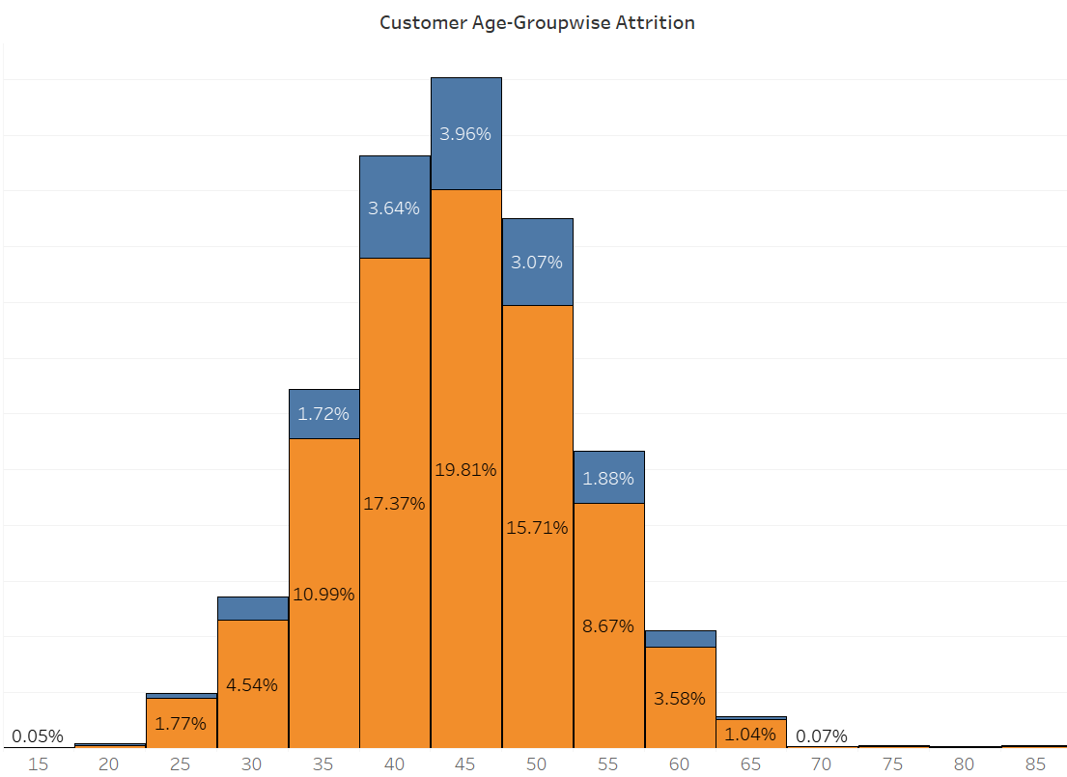
Output
Customer Churn Analysis
#Task 12 Display the Education wise Attrited and the existing customers from the data.
Interpretation
Customers Age group between 40 to 50 years has the highest attrition rate as compared to other age group.

Slide 17
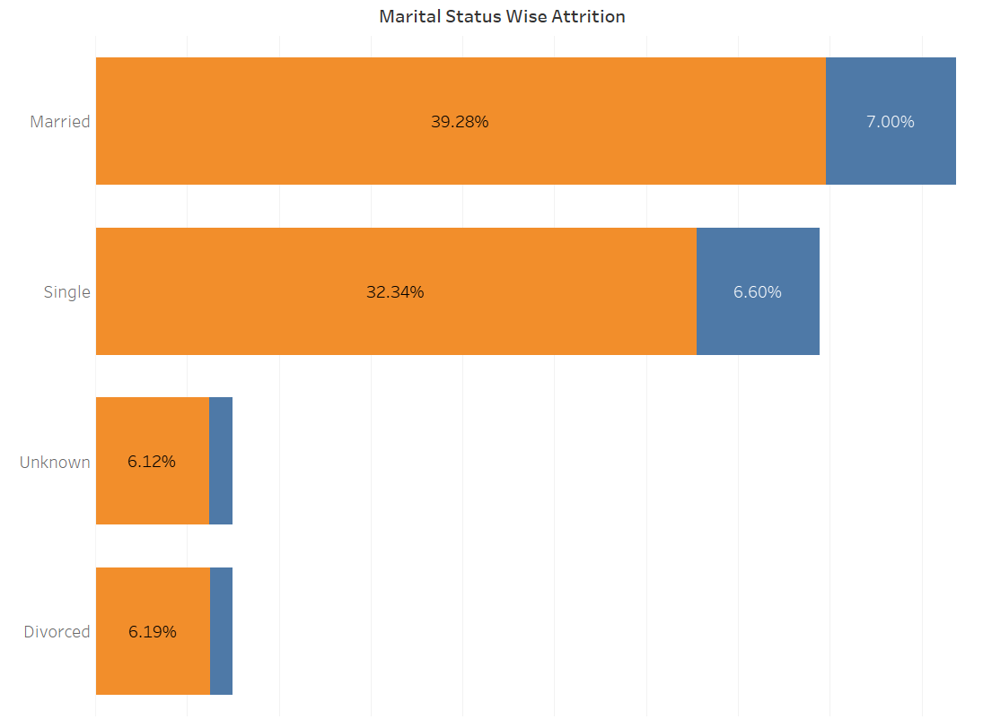
Output
Customer Churn Analysis
#Task 13 Display the Marital status wise Attrited and the existing customers from the data.
Interpretation
Married and single customers has highest attrition rate as compared to other Marital status

Slide 18
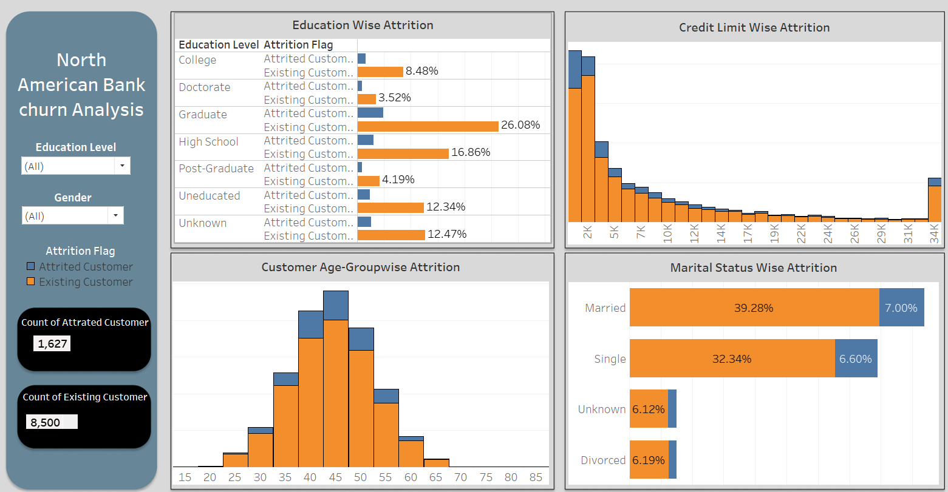
Customer Churn Analysis
#Task 14 Create an interactive dashboard by following the given instructions.
Create a Figma templates for the dashboard by following the given instructions:
Design the dashboard with the charts created in task 8-13.
Apply quick filters on the charts created

Slide 19
Executive Summary
The bank has a customer loss of 16.07% .Hence this needs to be addressed.
Female customers are more attired then male.
England has the highest number of attrition as compared to other region.
Majority of the customers are churning from the blue card category. It is also to be noted that the maximum customers are also blue card holders.
Almost 20-30% of customers who attrited are earning less than $40,000.
England has a maximum count of customers 5393
Graduate and High School customers have a higher Attrition rate compared to another education level.
Customers with the credit limit of upto $1k have a higher Attrition rate compared to other credit limit.
Customers Age group between 40 to 50 years has the highest attrition rate as compared to other age group.
Married and single customers has highest attrition rate as compared to other Marital status
19

Slide 20
Conclusion --
Female customers are easier to churn out then male customers.
Customers in England had the highest churn rate. This could be due to the low performance of the bank or rather the bank is facing tough competitors in England .
Churning rate of Customers who possess Blue card is high , it might be due to customers unsatisfaction for not upgrading his card to next high rank or might be because they no longer needed the credit.
Customers Age group between 40 to 50 years has the highest attrition rate as compared to other age group. This age category customers are the one who needs attention has the strength of them holding accounts is also high.
Banks' systems should be oriented towards providing better customer service and they should install suggestion/complaint box inside a bank and periodically read and take necessary actions to better its service and meet the customer demands , so that churning rate is reduced and increase its business.
20

Slide 21

THANK YOU …

