Slide 1


Slide 2


Slide 3

Contents:
What Is Java?
What Is The History Of Java.
What Can We Create?
What Are The Features?
What Happens Internally?
What Are Its Applications?

Slide 4
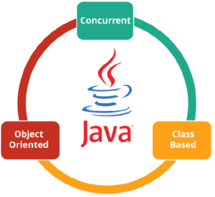
Java

Slide 5
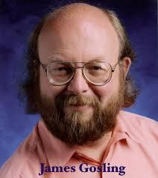
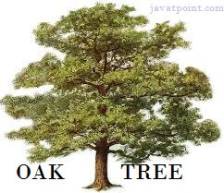
History

Slide 6
We Can Create:
StandAlone Application
Web Application
Enterprise Application
Mobile Application

Slide 7
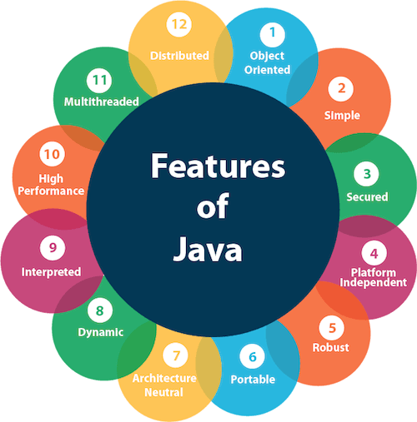

Slide 8
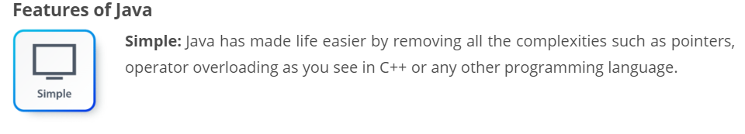
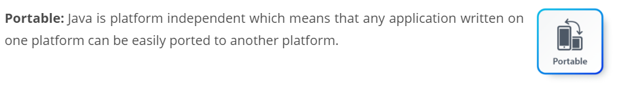
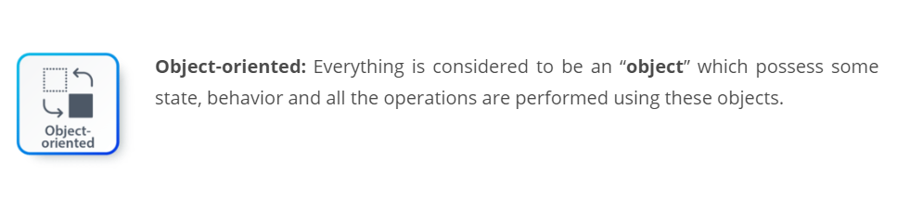

Slide 9
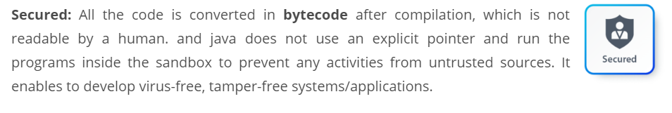
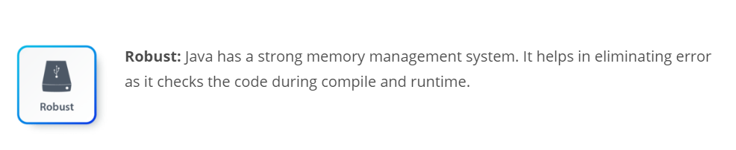

Slide 10
Internal View
At Compile Time:
Java Code
Compiler
Byte Code

Slide 11
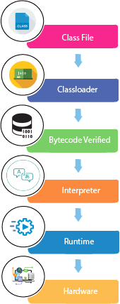
At Run Time:

Slide 12
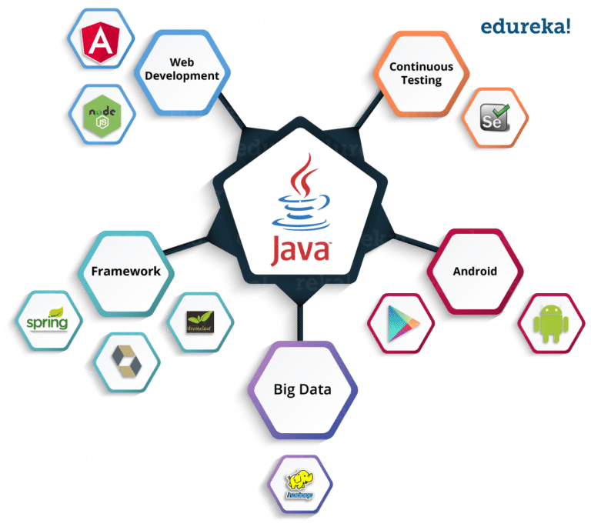
Applications:

Slide 13


