Slide 1
Fast Algorithms for Mining Association Rules
Brian Chase

Slide 2
Why?
Retailers now have massive databases full of transactional history
Simply transaction date and list of items
Is it possible to gain insights from this data?
How are items in a database associated
Association Rules predict members of a set given other members in the set

Slide 3
Why?
Example Rules:
98% of customers that purchase tires get automotive services done
Customers which buy mustard and ketchup also buy burgers
Goal: find these rules from just transactional data
Rules help with: store layout, buying patterns, add-on sales, etc

Slide 4
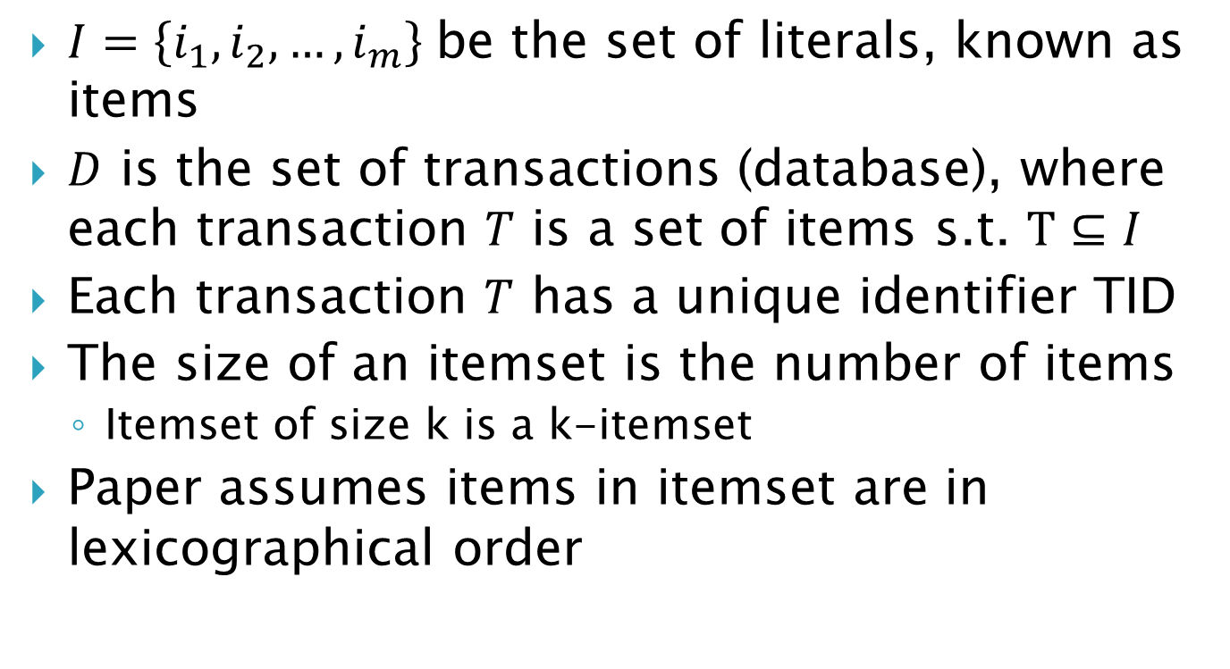
Basic Notation
$I=\left\{i_{1},i_{2},…,i_{m}\right\}$be the set of literals, known as items
$D$ is the set of transactions (database), where each transaction $T$ is a set of items s.t. $T⊆I$
Each transaction $T$ has a unique identifier TID
The size of an itemset is the number of items
Itemset of size k is a k-itemset
Paper assumes items in itemset are in lexicographical order

Slide 5
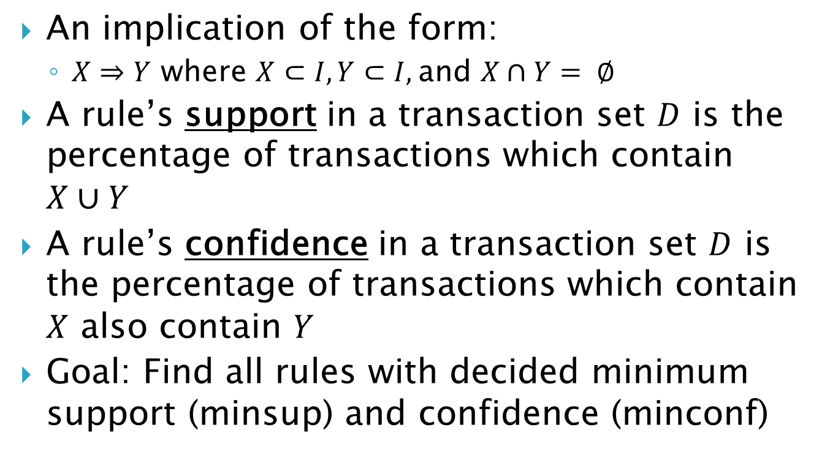
Association Rule
An implication of the form:
$X⇒Y$ where $X⊂I, Y⊂I,$and $X∩Y= ∅$
A rule’s support in a transaction set $D$ is the percentage of transactions which contain $X∪Y$
A rule’s confidence in a transaction set $D$ is the percentage of transactions which contain $X$ also contain $Y$
Goal: Find all rules with decided minimum support (minsup) and confidence (minconf)

Slide 6
Support Example
TID | Cereal | Beer | Bread | Bananas | Milk
1 | X |  | X |  | X
2 | X |  | X | X | X
3 |  | X |  |  | X
4 | X |  |  | X
5 |  |  | X |  | X
6 | X |  |  |  | X
7 |  | X |  | X
8 |  |  | X
Support(Cereal)
4/8 = .5
Support(Cereal => Milk)
3/8 = .375

Slide 7
Confidence Example
TID | Cereal | Beer | Bread | Bananas | Milk
1 | X |  | X |  | X
2 | X |  | X | X | X
3 |  | X |  |  | X
4 | X |  |  | X
5 |  |  | X |  | X
6 | X |  |  |  | X
7 |  | X |  | X
8 |  |  | X
Confidence(Cereal => Milk)
3/4 = .75
Confidence(Bananas => Bread)
1/3 = .33333…

Slide 8
Two Subproblems
Discovering rules can be broken into two subproblems:
1: Find all sets of items (itemsets) that have support above the minimum support (these are called large itemsets)
2: Use large item sets to find rules with at least minimum confidence
Paper focuses on subproblem 1

Slide 9
Determining Large Itemsets
Algorithms make multiple passes over the data (D) to determine which itemsets are large
First pass:
Count support of individual items
Subsequent Passes:
Use previous pass’s sets to determine new potential large item sets (candidate large itemsets sets)
Count support for candidates by passing over data (D) and remove ones not above minsup
Repeat

Slide 10
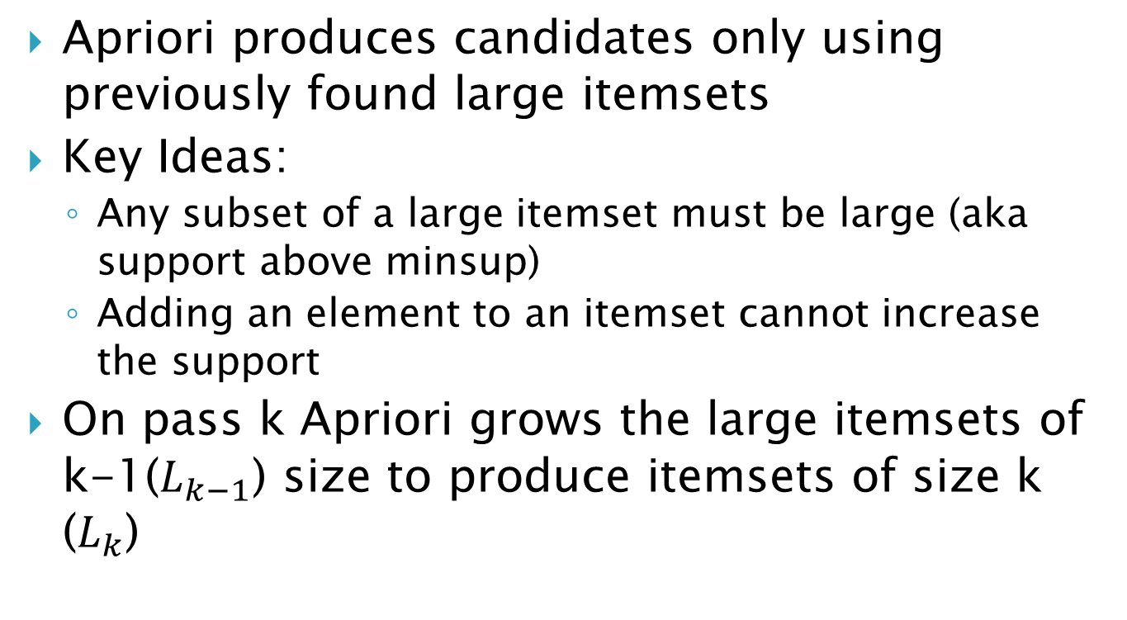
Determining Large Itemsets
Apriori produces candidates only using previously found large itemsets
Key Ideas:
Any subset of a large itemset must be large (aka support above minsup)
Adding an element to an itemset cannot increase the support
On pass k Apriori grows the large itemsets of k-1($L_{k−1}$) size to produce itemsets of size k ($L_{k}$)

Slide 11
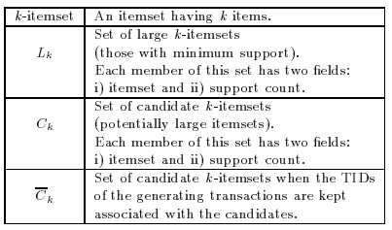
Additional Notation

Slide 12
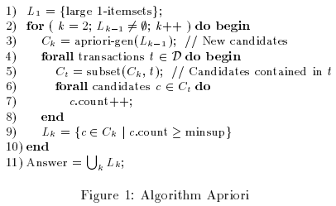
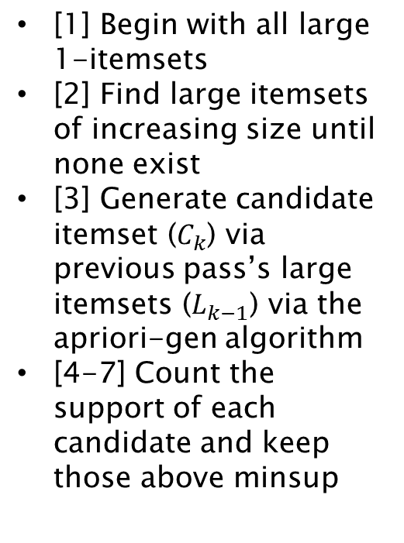
Apriori Algorithm High Level
[1] Begin with all large 1-itemsets
[2] Find large itemsets of increasing size until none exist
[3] Generate candidate itemset ($C_{k}$) via previous pass’s large itemsets ($L_{k−1}$) via the apriori-gen algorithm
[4-7] Count the support of each candidate and keep those above minsup

Slide 13

Apriori-Gen
Step 1: Join
Join the k-1itemsets that differ by only the last element
Ensure ordering (prevent duplicates)

Slide 14

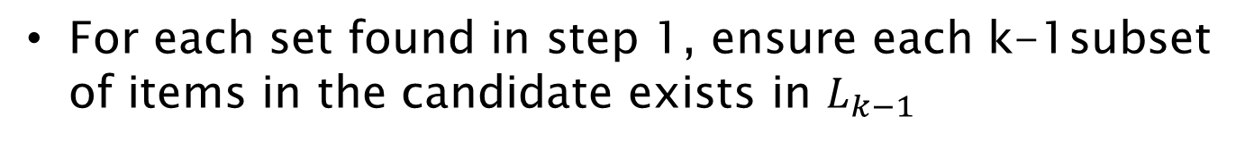
Apriori-Gen
Step 2: Prune
For each set found in step 1, ensure each k-1subset of items in the candidate exists in $L_{k−1}$

Slide 15


Apriori-Gen Example
Step 1: Join (k = 4)
$$L_{k−1}$$
*** Assume numbers 1-5 correspond to individual items
{1,2,3}
{1,2,4}
{1,2,5}
{1,3,5}
{2,3,4}
{2,3,5}
{3,4,5}
$$C_{k}$$
{1,2,3,4}

Slide 16
Apriori-Gen Example
Step 1: Join (k = 4)
$$L_{k−1}$$
{1,2,3}
{1,2,4}
{1,2,5}
{1,3,5}
{2,3,4}
{2,3,5}
{3,4,5}
$$C_{k}$$
{1,2,3,4}
{1,2,3,5}

Slide 17
Apriori-Gen Example
Step 1: Join (k = 4)
$$L_{k−1}$$
{1,2,3}
{1,2,4}
{1,2,5}
{1,3,5}
{2,3,4}
{2,3,5}
{3,4,5}
$$C_{k}$$
{1,2,3,4}
{1,2,3,5}
{1,2,4,5}

Slide 18
Apriori-Gen Example
Step 1: Join (k = 4)
$$L_{k−1}$$
{1,2,3}
{1,2,4}
{1,2,5}
{1,3,5}
{2,3,4}
{2,3,5}
{3,4,5}
$$C_{k}$$
{1,2,3,4}
{1,2,3,5}
{1,2,4,5}
{2,3,4,5}

Slide 19
Apriori-Gen Example
Step 1: Join (k = 4)
$$L_{k−1}$$
{1,2,3}
{1,2,4}
{1,2,5}
{1,3,5}
{2,3,4}
{2,3,5}
{3,4,5}
$$C_{k}$$
{1,2,3,4}
{1,2,3,5}
{1,2,4,5}
{2,3,4,5}

Slide 20

Apriori-Gen Example
Step 2: Prune (k = 4)
Remove itemsets that can’t possibly have the possible support because there is a subset in it which doesn’t have the level of support i.e. not in the previous pass (k-1)
$$L_{k−1}$$
{1,2,3}
{1,2,4}
{1,2,5}
{1,3,5}
{2,3,4}
{2,3,5}
{3,4,5}
$$C_{k}$$
{1,2,3,4}
{1,2,3,5}
{1,2,4,5}
{2,3,4,5}
No {1,3,4} itemset exists in $L_{k−1}$

Slide 21

Apriori-Gen Example
Step 2: Prune (k = 4)
$$L_{k−1}$$
{1,2,3}
{1,2,4}
{1,2,5}
{1,3,5}
{2,3,4}
{2,3,5}
{3,4,5}
$$C_{k}$$
{1,2,3,4}
{1,2,3,5}
{1,2,4,5}
{2,3,4,5}
No {1,4,5} itemset exists in $L_{k−1}$

Slide 22

Apriori-Gen Example
Step 2: Prune (k = 4)
$$L_{k−1}$$
{1,2,3}
{1,2,4}
{1,2,5}
{1,3,5}
{2,3,4}
{2,3,5}
{3,4,5}
$$C_{k}$$
{1,2,3,4}
{1,2,3,5}
{1,2,4,5}
{2,3,4,5}
No {2,4,5} itemset exists in $L_{k−1}$
Apriori-Gen returns only {1,2,3,5}

Slide 23
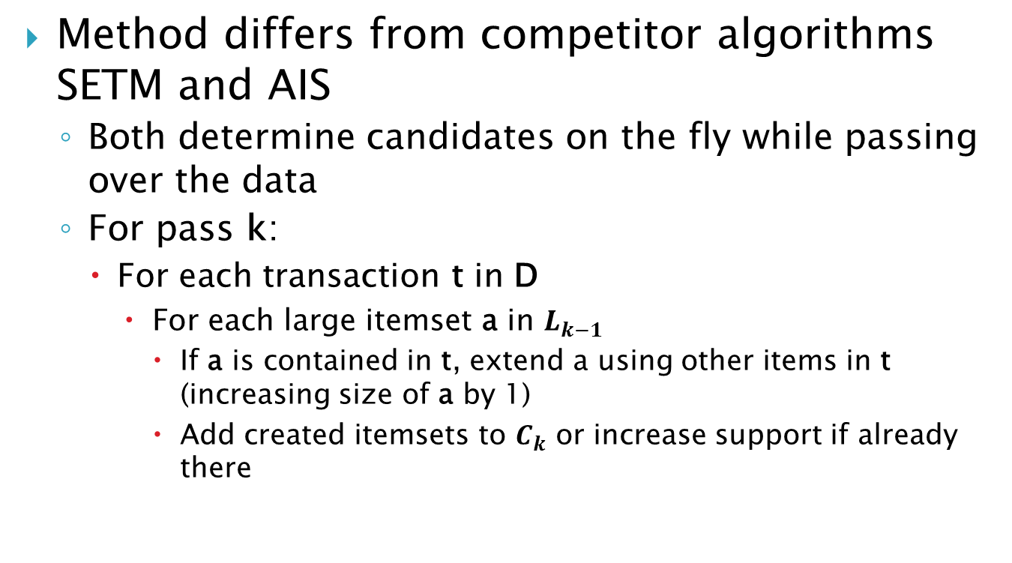
Determining Large Itemsets
Method differs from competitor algorithms SETM and AIS
Both determine candidates on the fly while passing over the data
For pass k:
For each transaction t in D
For each large itemset a in $L_{k−1}$
If a is contained in t, extend a using other items in t (increasing size of a by 1)
Add created itemsets to $C_{k}$ or increase support if already there

Slide 24
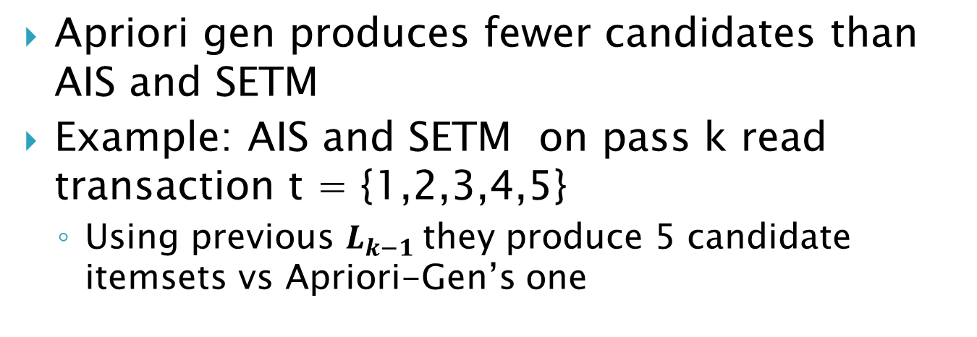
Cand-Gen AIS and SETM
Apriori gen produces fewer candidates than AIS and SETM
Example: AIS and SETM on pass k read transaction t = {1,2,3,4,5}
Using previous $L_{k−1}$they produce 5 candidate itemsets vs Apriori-Gen’s one
{1,2,3}
{1,2,4}
{1,2,5}
{1,3,5}
{2,3,4}
{2,3,5}
{3,4,5}
{1,2,3,4}
{1,2,3,5}
{1,2,4,5}
{1,3,4,5}
{2,3,4,5}

Slide 25
Apriori Problem
Database of transactions is massive
Can be millions of transactions added an hour
Passing through database is expensive
Later passes transactions don’t contain large itemsets
Don’t need to check those transactions

Slide 26
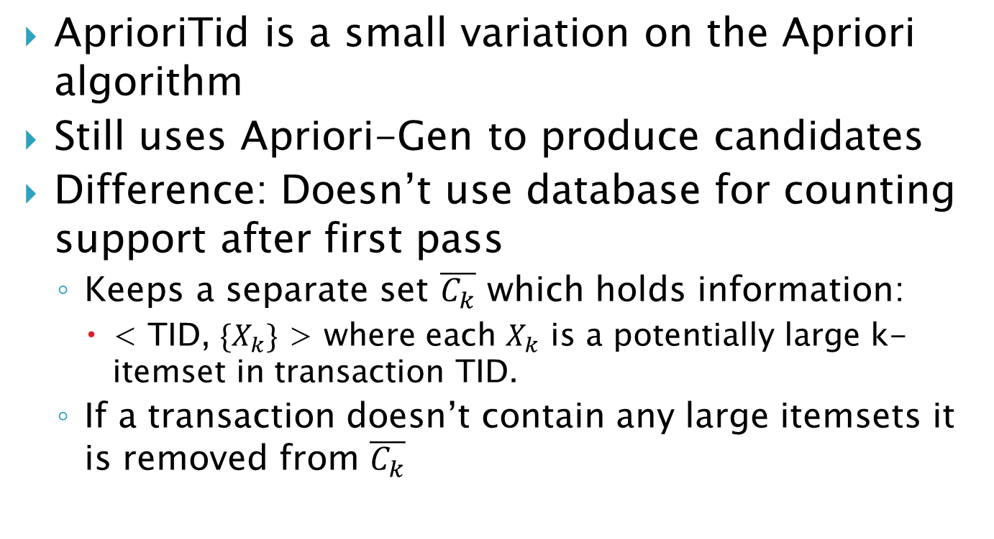
AprioriTid
AprioriTid is a small variation on the Apriori algorithm
Still uses Apriori-Gen to produce candidates
Difference: Doesn’t use database for counting support after first pass
Keeps a separate set $\overline{C_{k}}$ which holds information:
< TID, $\{X_{k}\}$ > where each $X_{k}$ is a potentially large k-itemset in transaction TID.
If a transaction doesn’t contain any large itemsets it is removed from $\overline{C_{k}}$

Slide 27

AprioriTid
Keeping $\overline{C_{k}}$ can reduces the support checks
Memory overhead
Each entry could be larger than individual transaction
Contains all candidate k-itemsets in transaction

Slide 28
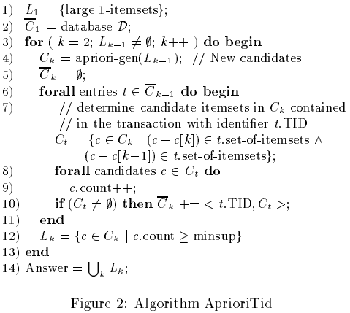
Notes:
Follows Apriori until check for support
For each transaction in $\overline{C_{k−1}}$ check if candidate c is in transaction, if it is increment support
If candidates found in transaction, add them into $\overline{C_{k}}$

Slide 29
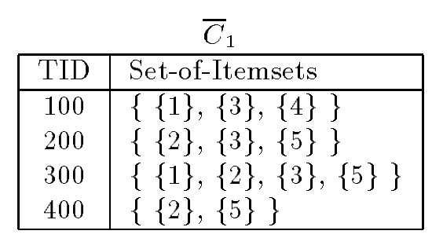
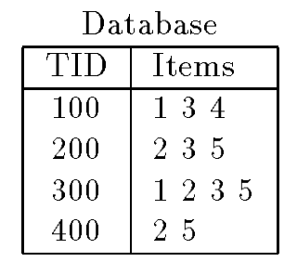
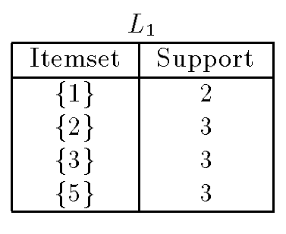
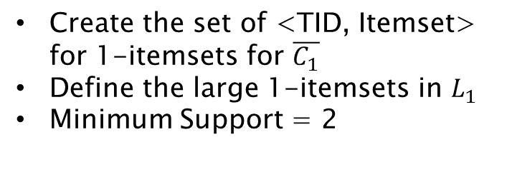
AprioriTid Example
Create the set of <TID, Itemset> for 1-itemsets for $\overline{C_{1}}$
Define the large 1-itemsets in $L_{1}$
Minimum Support = 2

Slide 30
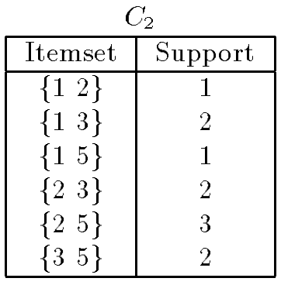
AprioriTid Example
Apriori-gen

Slide 31
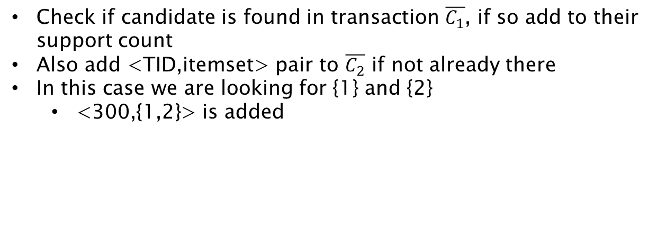
AprioriTid Example
Check if candidate is found in transaction $\overline{C_{1}}$, if so add to their support count
Also add <TID,itemset> pair to $\overline{C_{2}}$ if not already there
In this case we are looking for {1} and {2}
<300,{1,2}> is added

Slide 32

AprioriTid Example
<100, {1,3}> and <300, {1,3}> is added to $\overline{C_{2}}$

Slide 33
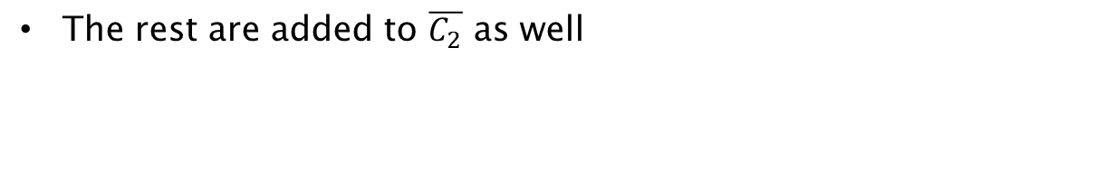
AprioriTid Example
The rest are added to $\overline{C_{2}}$ as well

Slide 34

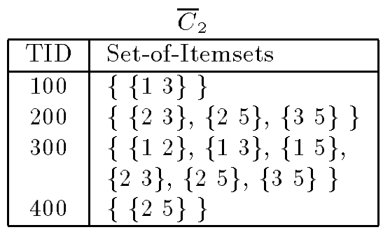
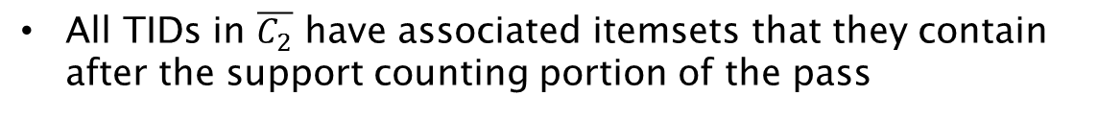
AprioriTid Example
All TIDs in $\overline{C_{2}}$ have associated itemsets that they contain after the support counting portion of the pass

Slide 35

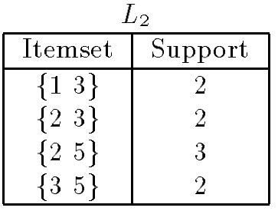
AprioriTid Example
Minimum Support = 2

Slide 36
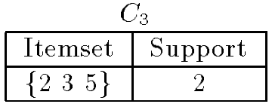
AprioriTid Example
Apriori-gen

Slide 37

AprioriTid Example
Looking for transactions containing {2,3} and {2,5}
<200, {2,3,5}> and <300, {2,3,5}> are added to $\overline{C_{3}}$

Slide 38
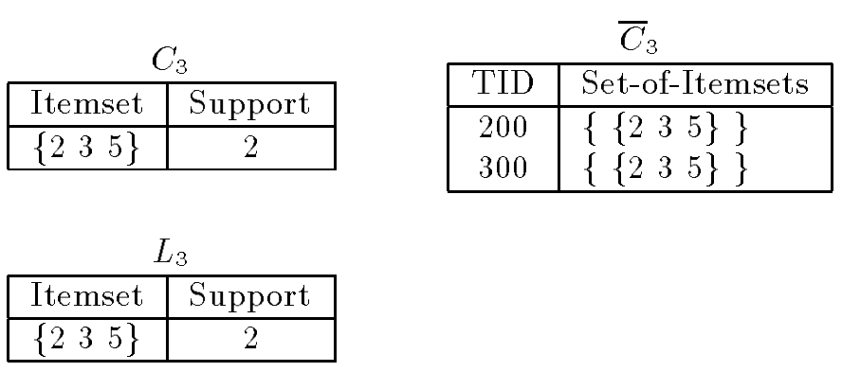
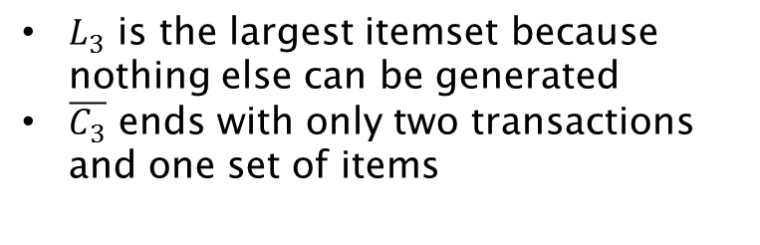
AprioriTid Example
$L_{3}$ is the largest itemset because nothing else can be generated
$\overline{C_{3}}$ ends with only two transactions and one set of items

Slide 39
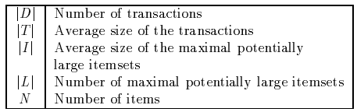
Performance
Synthetic data mimicking “real world”
People tend to buy things in sets
Used the following parameters:
Pick the size of the next transaction from a Poisson distribution with mean |T|
Randomly pick determined large itemset and put in transaction, if too big overflow into next transaction

Slide 40
Performance
With various parameters picked the data is graphed with time to minimum support
Obviously the lower the minimum support the longer it takes.

Slide 41
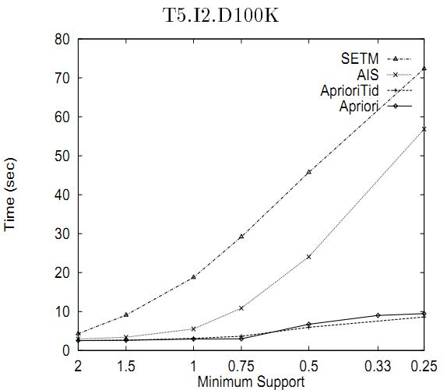
Performance
Notes:
SETM is only graphed once due to incredibly poor performance when average transaction size was large

Slide 42
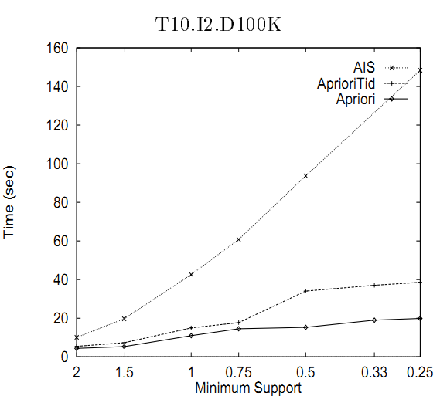
Performance

Slide 43
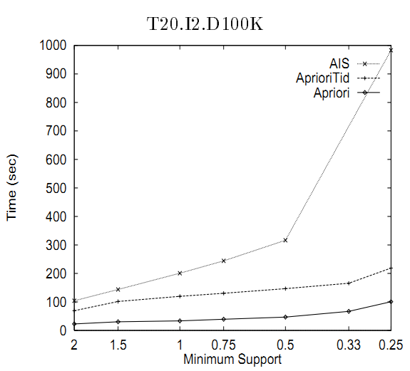
Performance

Slide 44
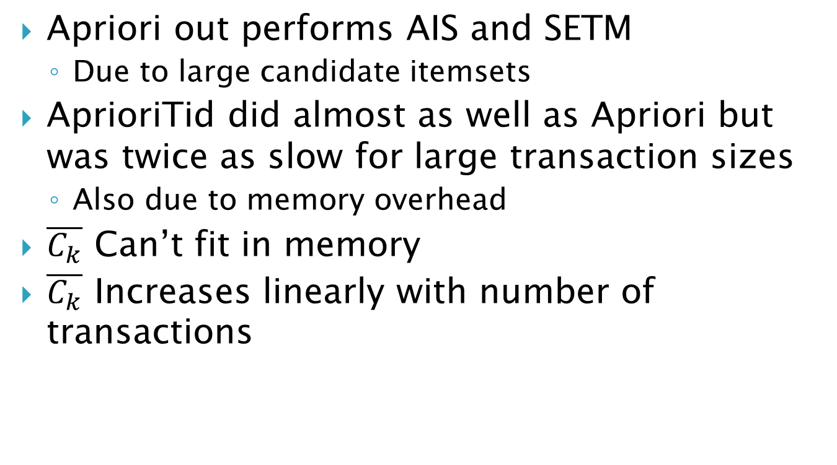
Performance
Apriori out performs AIS and SETM
Due to large candidate itemsets
AprioriTid did almost as well as Apriori but was twice as slow for large transaction sizes
Also due to memory overhead
$\overline{C_{k}}$ Can’t fit in memory
$\overline{C_{k}}$ Increases linearly with number of transactions

Slide 45
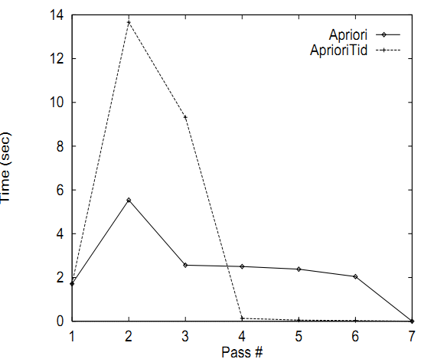
Performance
Notes:
What does this show us?

Slide 46
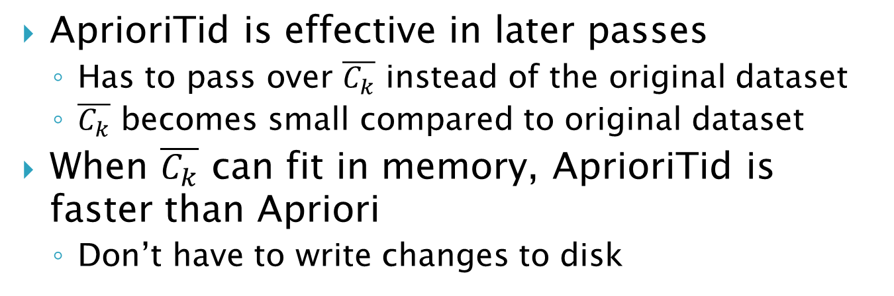
Performance
AprioriTid is effective in later passes
Has to pass over $\overline{C_{k}}$ instead of the original dataset
$\overline{C_{k}}$ becomes small compared to original dataset
When $\overline{C_{k}}$ can fit in memory, AprioriTid is faster than Apriori
Don’t have to write changes to disk

Slide 47
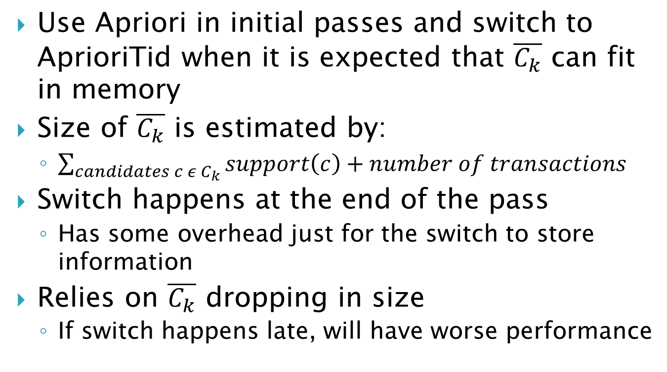
AprioriHybrid
Use Apriori in initial passes and switch to AprioriTid when it is expected that $\overline{C_{k}}$ can fit in memory
Size of $\overline{C_{k}}$ is estimated by:
$\sum_{candidates c ε C_{k}}{support\left(c\right)}+number of transactions$
Switch happens at the end of the pass
Has some overhead just for the switch to store information
Relies on $\overline{C_{k}}$ dropping in size
If switch happens late, will have worse performance

Slide 48
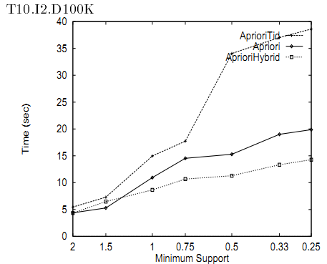
Hybrid Performance

Slide 49
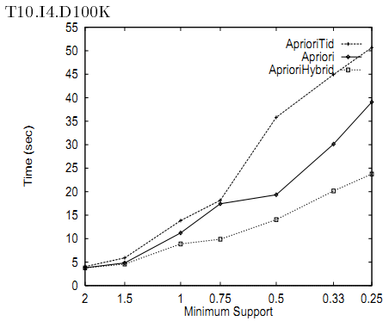
Hybrid Performance

Slide 50
Hybrid Performance
Additional tests showed that and increase in the number of items and transaction size still has the hybrid mostly being better or equal to apriori
When switch happens too late performance is slightly worse

