Slide 1
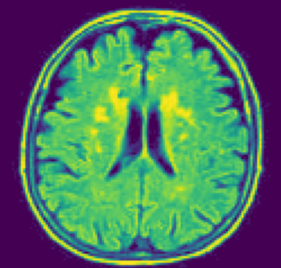
Picking the Brain with Ameya

Slide 2
Work So Far
Intro to Machine learning AI
How does MRI work
Why MRI is useful for analysis of brain tumors
Types of brain tumors
MRI Dataset
  Download
Software Download
  Python (Spyder IDE)
  CV2 and other libraries

Slide 3
Exploratory Data Analysis (EDA)
EDA is useful in all data modeling tasks
Explore data without any quantitative/modeling analysis
Focus on understanding data
  File structure
  What data do we have
  Use Figures and Charts
    Visual inspection
    Histograms

Slide 4
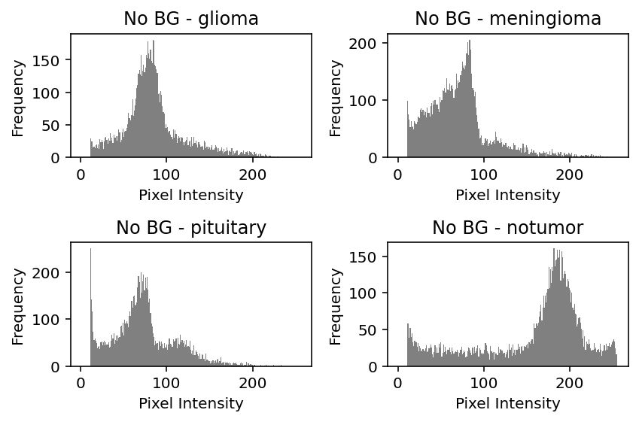
EDA
Thresholding
Global HIstogram Equalization
Local Equalization - CLAHE- Contrast Limited Adaptive Histogram Equalization

Slide 5
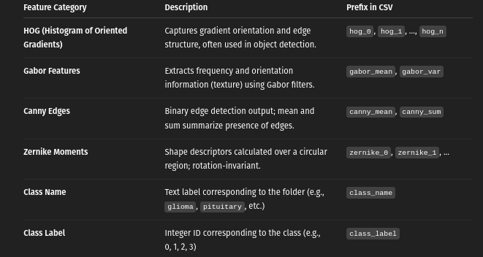
Features

Slide 6
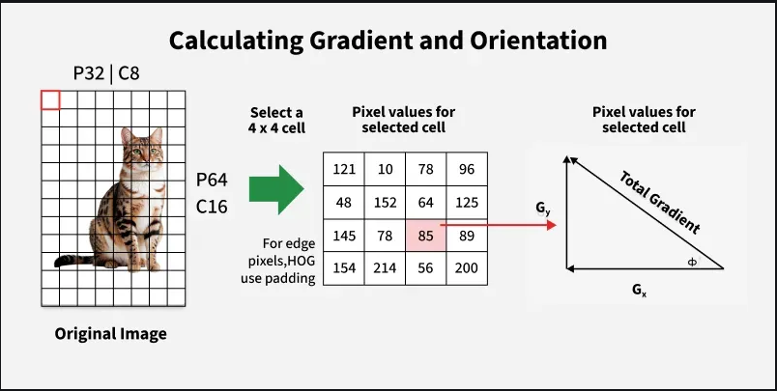
HOG – Histograms of Oriented Gradients
Preprocess
Compute gradient and orientation
Build histogram (9 bins when 0 -180 is dived into 20 degree bins)
Normalize for cross-comparison

Slide 7
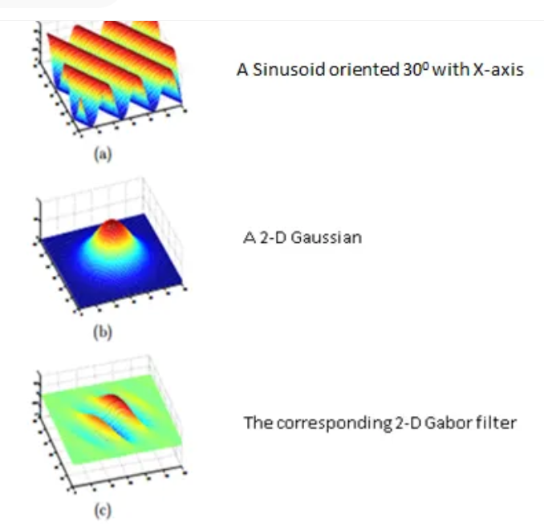
Gabor Fiters
Band pass filter
  Allows some frequencies but rejects others
Combining Sinusoid with Gaussian Filter
Useful for texture and edge detection
Use a bank of different orientation to extract all information

Slide 8
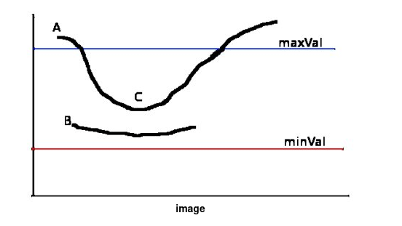
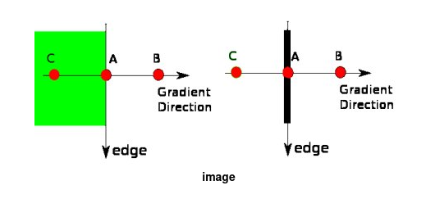
Canny Edges
Identification of edges
  Sharp discontinuities
  Local maxima or minima

Slide 9
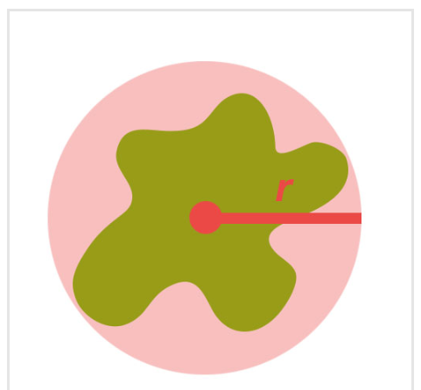
Zernikie Moments
Used to describe the shape
Essentially describes the data along multiple orthogonal directions
  Information is split without redundancy
  Directions are Orthogonal along as disk
  Two parameters – Radius (polar coordinates, polynomial degree) and

Slide 10
Lecture 2 – Feature reduction

Slide 11
Feature Selection
Our final feature extraction has led to a lot of variables
  HOG
  Zernkie moments
  Gabor Filters
  Entropy
  Summary Statistics
Not all of them are strongly correlated with tumor characteristics
Many of these are correlated
  Contain similar information to a large degree

Slide 12
High Dimensional Data
Working with high dimensional data is not advisible
  Redundancy makes the model difficult to explain
  Multicollinearity makes estimation of model coefficients tough
  Risk of over-fitting
    Memorize the data and not learn how to predict
We therefore want to reduce the data dimension

Slide 13
Dimension Reduction
There are two approaches
  Aggregate the data in higher dimension to lower dimensions
    Groupings of variables
  Eliminate those variables that are redundant
Keep those variables that correlate strongly with the output

Slide 14
mRMR
Minimum Redundancy Maximum Relevance
  Have high relevance to the target (tumor)
  Have low redundancy with other inputs
Balances redundancy and relevance to pick the inputs
Use the idea of Joint entropy
  Mutual Information Criteria

Slide 15

Entropy
Quantifies the uncertainty or randomness in a random variable X
For discrete variables with possible values x and probability p(x) we can write
Higher Entropy —> More uncertainty or disorder in the data
A Fair coin toss has more entropy than the biased coin toss

Slide 16
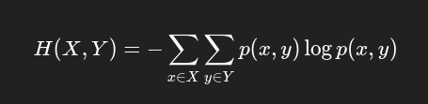
Joint Entropy
The uncertainty of information content associated with two random variables X and Y
Measure of uncertainty when both X and Y are considered
Based on joint probabilities between X and Y

Slide 17

Conditional Entropy
Amount of uncertainty remaining about random variable Y when another random variable X is known
  If uncorrelated then all uncertainty remains
Based on conditional probability

Slide 18


Relationships

Slide 19
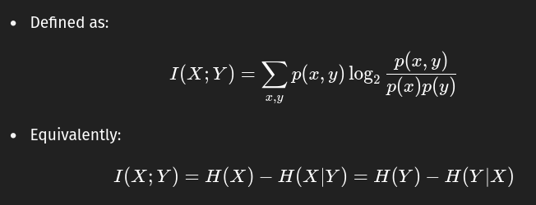
Mutual Information
Mutual information is a measure of amount of information shared between two random variables
  MI = 0 means X and Y are independent
  MI = 1 means X and Y are one and the same
  Higher MI —> Knowing X improves knowledge of Y

Slide 20
mRMR Strategy
Computes mutual information between the variables (X) and the output (Y)
  Retains those that have high mutual information
Computes mututal information between different X variables
  Eliminate those that have high MI
    Drop those that are correlated with multiple

Slide 21
mRMR
Pros
  Fast and efficient
  Handles high dimensional data
  Works well with discretized features
Cons
  Requires binning of data
  May not find globally optimal subset
  Feature interactions may be useful in modeling but not considered
    X1 and X2 are strongly correlated so X1 is removed but X1X2 (product) is very strongly correlated with Y (not considered)

Slide 22
Dimensionality Reduction
Transform high dimensional data to lower dimensional space
Preserve meaningful structure
Explain a vast majority of variance in this data
Many techniques
  PCA – Principle Component Analysis (Linear)
  PaCMAP - Nonlinear

Slide 23
PaCMAP
Pairwise controlled Manifold Approximation Projection
Nonlinear Dimensional Reduction Technique
Preserve both local and global data structure
Faster compared to similar algorithms

Slide 24
PacMAP principles
PACMAP works on 3 principles when reducing data dimension
  Data close to each other in high dimension must also be close in low dimensions
  Data with middle lengths must not become too close or too far
  Data which are far in high dimensions should stay far in low dimensions

Slide 25
PacMAP
Optimizes low-dimensional embedding using weighted pair-wise distances between points
Local/global balance controlled by several parameters
  KNN —> K nearest Neighbors (local structure)
  MN Ratio —> Mid nearest Ratio (global structure)
  FP Ratio —> Further Pairs Ratio (avoid redundancy and overlap)

Slide 26
mRMR + PaCMAP workflow
Start with all features ~350
Use mRMR to select top 50 - 80 (filtering step)
Apply PaCMAP to reduce dimensionality 7 - 8 dimensions (embedding step)
The embedders (7 or 8) act as input for Machine learning Models
  Reduced complexity
  Interpretable features

